Slide 1

₿
Chapter 2: How Bitcoin Works
Bitcoin-Qt 0.5.2, a wallet of 2012 - the Bitcoin developers, MIT licence, Wikimedia Commons
One payment, followed from the shop's invoice to the blockchain
Python 3.14.6; every result is computed by the chapter library; no Bitcoin Core node was run.
SEN0401 Special Topics in Software Engineering: Block Chain · Fall 2026 · Yusuf Altunel, PhD · İstanbul Kültür University
1 / 35
Notes:
Chapter 1 asked what Bitcoin is. Chapter 2 follows one payment, Alice paying Bob's Store, from the invoice to the blockchain. Every number in this deck was computed with the chapter's own Python library.

Slide 2
Today's route
₿
Six parts around one payment; every range is a slide you can jump to
1. Questions and the chapter map
(slides 3-4)
2. Buying from an Online Store
(slides 5-9)
3. Bitcoin Transactions
(slides 10-16)
35
slides, numbered bottom-right
4. Coin Selection
(slides 17-19)
5. Constructing a Transaction
(slides 20-22)
6. Adding the Transaction to the Blockchain
(slides 23-28)
3
true stories, each told by 5N1K
7. Spending the Transaction
(slides 29-32)
8. Summary, resources, closing
(slides 33-35)
14
code examples, each with a picture of its result
Six parts, three true stories, fourteen examples
2 / 35
Notes:
The route has six parts that follow one payment from the invoice to the spending. Three true stories and fourteen code examples are spread across them, and every example has a picture of its result.

Slide 3
The questions this chapter answers
₿
Each has an answer on a slide; we return to them in the summary
1
What do Alice's payment and Bob's invoice contain?
2
Why must inputs equal outputs plus a fee, and where does change come from?
3
How does a wallet choose coins and build the outputs?
4
How does a payment travel to a miner and into a block?
5
What makes a payment harder to reverse with each confirmation?
6
Which rules does every node check, and what if a block breaks one?
3 / 35
Notes:
The six questions are the chapter's own, rewritten so that each has an answer on a slide. We return to them in the summary. A reader who can answer all six has understood the chapter.

Slide 4
The chapter in one picture
₿
One payment, six steps; the parts of the deck follow them
1 Invoice
2 Transaction
3 Coins
4 Build
5 Block
6 Spend
Alice learns what to pay.
Inputs, outputs and a fee.
Pick them; change returns.
Price and sign the payment.
Miners add it; confirmations grow.
Every node checks the rules.
Fourteen code examples run along this path. Each prints its result under the listing and shows it as a picture beside it.
Six steps, one payment: from invoice to a spendable coin
4 / 35
Notes:
Six steps carry one payment. Alice reads an invoice, a transaction is formed, coins are chosen, the wallet builds and signs it, a miner puts it in a block, and Bob can spend it. The parts of this deck follow the same path.

Slide 5
Buying from an Online Store
Alice pays Bob's Store: one real payment, followed all the way
How Bitcoin Works
Bitcoin Overview
satoshi
One payment is followed from the shop's invoice to the blockchain.
Users, wallets, nodes and miners share one record that nobody owns.
The smallest unit: one hundred-millionth of a bitcoin.
Think of tracking a parcel from the shop to your door.
Think of a town where every shop keeps an identical ledger.
Think of the cent, only a million times smaller.
Store | Transactions | Coin selection | Construction | Blockchain | Spending
5 / 35
Notes:
Part 1 starts where Alice does: with an invoice from an online store. We meet the whole system first, then the smallest unit of money and the link that carries the invoice.

Slide 6

Four roles, one network
₿
Who does what when Alice pays Bob
Users and wallets
A wallet holds keys and signs payments for its user.
Nodes
Check every rule and pass valid transactions on.
Miners
Bundle waiting transactions into the next block.
The blockchain
The shared record of blocks that every node keeps.
Users, wallets, nodes and miners - from the course's 2025 deck
No single owner: wallets sign, nodes check, miners bundle
6 / 35
Notes:
Four roles share the work. Users hold wallets that sign payments, nodes check the rules and pass transactions on, and miners bundle waiting transactions into blocks that everyone copies. Nobody owns the record.

Slide 7

Five free bitcoins for every visitor
₿
11 June 2010 · how a first coin reached its owner
WHO Gavin Andresen, a software developer who later led the Bitcoin software after Satoshi Nakamoto left.
WHAT A website that gave five bitcoins to every visitor who solved a CAPTCHA.
WHEN 2010-06-11 (11 June 2010)
WHERE A website announced on the bitcointalk forum; Andresen worked from Massachusetts.
WHY Almost nowhere sold bitcoin in 2010, so he gave coins away to seed the first users.
Picture: Gavin Andresen, Web Summit 2014 - Stephen McCarthy, CC BY 2.0, Wikimedia Commons
HOW He stocked the site with 1,100 of his own bitcoins and paid five to each request.
READ Get 5 free bitcoins (bitcointalk thread) - bitcointalk.org
7 / 35
Notes:
Alice needs bitcoin before she can pay Bob. In 2010 there was almost nowhere to buy it, so Gavin Andresen gave five coins to every visitor of his website. Thousands of people got their first bitcoin this way.

Slide 8

Satoshis are whole numbers
₿
Converting the invoice amount without decimals
>>> btc = '0.01577764'
Result: one amount, written two ways
The invoice amount, written the way people write it.
Written as | Whole satoshis
1 bitcoin | 100,000,000
0.01577764 | 1,577,764
0.00075 | 75,000
>>> sats = T.to_sats(btc)
>>> back = T.to_btc(sats)
>>> (sats, back)
(1577764, '0.01577764')
Whole numbers in, whole satoshis out, and the same text comes back.
run under Python 3.14.6 - T is the chapter library of the page (sen0401_ch02_tx_lib_v1_0_0)
No decimals are needed inside Bitcoin; the amount is a whole number of satoshis.
The satoshi table of the course's 2025 deck: from one satoshi to one bitcoin
Inside the network every amount is a whole number of satoshis
8 / 35
Notes:
Bitcoin counts in satoshis, one hundred-millionth of a bitcoin. Decimals are only for people. Converting with whole numbers keeps every digit, which floating point would not.

Slide 9
Reading Bob's invoice
₿
A payment link is a small, readable address
>>> u = urllib.parse.urlsplit(T.INVOICE)
>>> q = urllib.parse.parse_qs(u.query)
Result: the parts of the invoice link
Part | Value
scheme | bitcoin
address | bc1qk2g6u8p4...
amount | 0.01577764 bitcoin
label | Bob's Store
Split the link into the part before the question mark and the query.
>>> [u.scheme, q['amount'][0], q['label'][0]]
['bitcoin', '0.01577764', "Bob's Store"]
The scheme tells a wallet to open; the query holds the amount and the label.
run under Python 3.14.6 - T is the chapter library of the page (sen0401_ch02_tx_lib_v1_0_0)
The wallet reads these four parts and fills in the payment for Alice.
One link carries the address, the amount and the label
9 / 35
Notes:
BIP 21 defines the bitcoin link that wallets and QR codes use. We split it into its parts with the standard library. The wallet then knows whom to pay, how much, and what to call the payee.

Slide 10
Bitcoin Transactions
Inputs, outputs, chains and change
Transaction Inputs and Outputs
Transaction Chains
Making Change
Inputs spend earlier outputs; outputs lock new amounts to new owners.
Each input points to an earlier output, back to where the coins began.
Part of a spent coin returns to you as a new output.
Think of handing over banknotes and receiving new ones.
Think of a trail of signed receipts, each naming the one before.
Think of paying with a 20 note for a 15 item and getting 5 back.
Store | Transactions | Coin selection | Construction | Blockchain | Spending
10 / 35
Notes:
Part 2 opens the payment itself. A transaction is a ledger entry: it spends earlier outputs and creates new ones, and the difference is the fee.

Slide 11
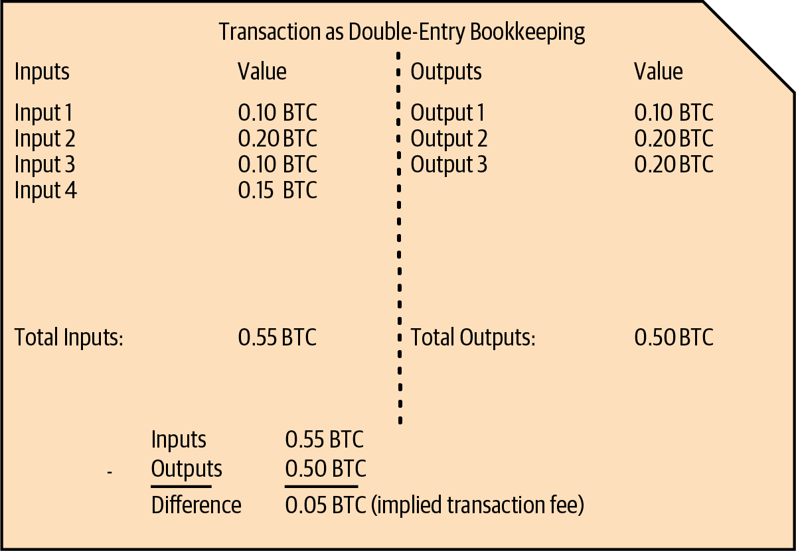
Inputs and outputs
₿
The ledger of figure 2-2, and the two words it is made of
input
A reference to an earlier output being spent, with a signature that proves ownership.
Think of a banknote you hand over to the cashier.
output
An amount of bitcoin locked to a new owner until it is spent.
Think of a banknote you receive in return.
Figure 2-2, Mastering Bitcoin 3rd edition, Antonopoulos and Harding, CC BY-SA 4.0
An input spends an earlier output; an output creates a new one
11 / 35
Notes:
A transaction is double-entry bookkeeping: the inputs on the left, the outputs on the right, and the difference is the fee. An input spends an earlier output; an output locks an amount to a new owner.

Slide 12
Inputs equal outputs plus the fee
₿
Alice's payment as double-entry bookkeeping
>>> ins, outs = T.ALICE_IN, T.ALICE_OUT
Result: where Alice's 100,000 satoshis go
Alice's one input and her two outputs, in satoshis.
>>> fee = sum(ins) - sum(outs)
>>> (sum(ins), sum(outs), fee)
(100000, 95000, 5000)
Inputs minus outputs is the fee; nobody writes it down anywhere.
run under Python 3.14.6 - T is the chapter library of the page (sen0401_ch02_tx_lib_v1_0_0)
100,000 in = 95,000 out + 5,000 fee: the ledger balances.
Whatever the outputs do not claim becomes the miner's fee
12 / 35
Notes:
A transaction balances like a ledger. The inputs add up to 100,000 satoshis and the outputs to 95,000. The difference of 5,000 is written nowhere; it is implied, and the miner collects it.

Slide 13
The txid is shown backwards
₿
The same 32 bytes in two orders
>>> raw = bytes.fromhex(T.PREV_RAW)
Result: the same identifier, two byte orders
The 32 bytes of the earlier transaction's identifier, as an input stores them.
Order | First 8 | Last 8
Stored | eb3ae38f | 8041c54a
Shown | 4ac54180 | 8fe33aeb
>>> shown = raw[::-1].hex()
>>> (raw.hex()[:8], shown[:8])
('eb3ae38f', '4ac54180')
The same 32 bytes, read in opposite directions.
Reverse the bytes to get the order in which block explorers display it.
run under Python 3.14.6 - T is the chapter library of the page (sen0401_ch02_tx_lib_v1_0_0)
Explorers show the identifier in reverse byte order
13 / 35
Notes:
The identifier of Alice's earlier transaction is a 32-byte hash. Inside a transaction it is stored one way, and block explorers print it the other way round. Reversing the bytes converts between them.

Slide 14
Size in virtual bytes and the fee rate
₿
How a miner compares transactions
>>> weight = 569
Result: weight, size, fee and rate
Alice's transaction weighs 569 weight units, as Bitcoin Core reports.
Measure | Value
Weight | 569 units
Size | 143 virtual bytes
Fee | 5,000 satoshis
Fee rate | 34.97 sat/vB
>>> vbytes = -(-weight // 4)
>>> rate = round(5000 / vbytes, 2)
>>> (vbytes, rate)
(143, 34.97)
Four units make a virtual byte, rounded up; fee divided by size is the rate.
run under Python 3.14.6 - T is the chapter library of the page (sen0401_ch02_tx_lib_v1_0_0)
569 / 4 = 142.25, rounded up to 143.
Miners rank transactions by fee per virtual byte
14 / 35
Notes:
Alice's transaction weighs 569 units, which is 143 virtual bytes. Her fee of 5,000 satoshis divided by 143 gives about 35 satoshis per virtual byte. Blocks have limited room, so miners pick the best rates first.

Slide 15
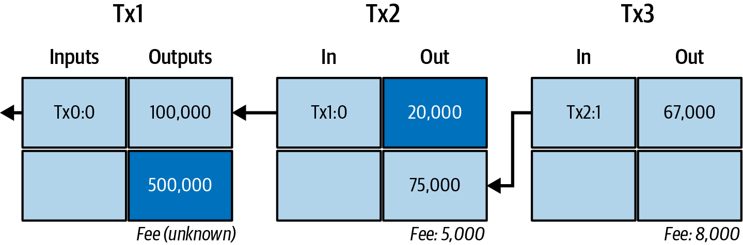
A chain of transactions
₿
Outputs become inputs, and the chain leads back in time
Figure 2-3, Mastering Bitcoin 3rd edition, Antonopoulos and Harding, CC BY-SA 4.0
Each input names an earlier output, such as Tx1:0.
A spent output can never be spent a second time.
Outputs nobody has spent are the coins in a wallet.
Follow the arrows backwards to find where a coin came from
15 / 35
Notes:
Figure 2-3 shows three linked transactions. Each input names an earlier output, so the coins can be traced back; an output that nobody has spent yet is a coin that still exists.

Slide 16
Which outputs are still unspent
₿
Walking the chain of figure 2-3
>>> C = T.CHAIN
>>> used = {i for a, b in C.values() for i in a}
Result: the five outputs of the chain
Output | Satoshis | State
Tx1:0 | 100,000 | spent
Tx1:1 | 500,000 | unspent
Tx2:0 | 20,000 | unspent
Tx2:1 | 75,000 | spent
Tx3:0 | 67,000 | unspent
The chain of figure 2-3, and the set of outputs that some input spends.
>>> val = {o: v for _, b in C.values() for o, v in b.items()}
Every output of the chain with its value in satoshis.
>>> free = [o for o in val if o not in used]
>>> free
['Tx1:1', 'Tx2:0', 'Tx3:0']
Fees: Tx2 paid 5,000, Tx3 paid 8,000 satoshis.
Outputs that nobody has spent are the coins that still exist.
run under Python 3.14.6 - T is the chapter library of the page (sen0401_ch02_tx_lib_v1_0_0)
Unspent outputs are the coins that exist right now
16 / 35
Notes:
Each transaction in the chain spends an earlier output and creates new ones. Collecting what was spent leaves the unspent outputs. Wallets and nodes keep exactly this set, because only these coins can be spent.

Slide 17
Coin Selection
Which coins to spend, and what shape the payment takes
Common Transaction Forms
consolidation transaction
change address
Payment, consolidation and batching are shapes of inputs and outputs.
Many small inputs are merged into one output.
A fresh address of your own that receives the change.
Think of a single cheque, a deposit of coins and a payroll run.
Think of swapping a jar of small coins for one banknote.
Think of a new envelope addressed to yourself.
Store | Transactions | Coin selection | Construction | Blockchain | Spending
17 / 35
Notes:
Part 3 asks how a wallet chooses what to spend. Coins are spent whole, so the choice decides the change, and the same rule produces payments, consolidations and batches.

Slide 18
Coin selection: pick, pay, change back
₿
A wallet chooses coins to cover a payment
>>> vals, need = [60000, 30000, 25000], 80000
Result: payment, coins picked, change
Three coins in the wallet, and a payment of 80,000 satoshis to make.
>>> pick, change = T.select(vals, need)
>>> (pick, change)
([60000, 30000], 10000)
Take whole coins in order until they cover the payment; the surplus is change.
run under Python 3.14.6 - T is the chapter library of the page (sen0401_ch02_tx_lib_v1_0_0)
Coins 60,000 + 30,000 are taken, 80,000 is paid, 10,000 goes back.
Coins are taken whole, so the surplus returns as change
18 / 35
Notes:
A wallet cannot cut a coin in two. It takes whole coins until the payment is covered, then sends the surplus back to itself as change. Real wallets use smarter rules, but this is the idea.

Slide 19
Three common shapes of a transaction
₿
Counting inputs, outputs and the fee
>>> F = T.FORMS
>>> shape = {k: (len(a), len(b)) for k, (a, b) in F.items()}
Result: inputs, outputs and fee of each shape
Form | In | Out | Fee
Payment | 1 | 2 | 5,000
Consolidation | 3 | 1 | 1,500
Batching | 1 | 4 | 3,000
Three forms, each a list of input values and a list of output values.
>>> fee = {k: sum(a) - sum(b) for k, (a, b) in F.items()}
>>> fee
{'payment': 5000, 'consolidation': 1500, 'batching': 3000}
The fee of each shape is again inputs minus outputs.
run under Python 3.14.6 - T is the chapter library of the page (sen0401_ch02_tx_lib_v1_0_0)
Consolidation merges coins; batching pays many people at once.
The same ledger rule fits every shape
19 / 35
Notes:
Three forms cover most transactions. A payment spends a coin and returns change. A consolidation merges many small coins into one, and batching pays many people at once. In every case inputs minus outputs is the fee.

Slide 20
Constructing a Transaction
The wallet assembles, prices and signs the payment
Getting the Right Inputs
Creating the Outputs
transaction fee
Find unspent outputs that together cover the payment and the fee.
Write down who receives how much, and where the change goes.
Inputs minus outputs: the difference that the miner keeps.
Think of counting coins onto the counter before paying.
Think of filling in the payee and the amount on a cheque.
Think of the postage stamp that pays the post office.
Store | Transactions | Coin selection | Construction | Blockchain | Spending
20 / 35
Notes:
Part 4 builds Alice's transaction step by step. The wallet finds inputs, writes the outputs, leaves a fee and signs, and the fee rate decides how much change comes back.

Slide 21
From coins to a signed transaction
₿
The five steps a wallet takes for Alice's payment
1 Inputs
2 Outputs
3 Fee
4 Sign
5 Send
Find unspent outputs that cover payment and fee.
One output for Bob's Store, one for the change.
Leave the difference for the miner.
Prove ownership of every input.
Pass the transaction to a node.
Tx1:0 = 100,000
75,000 and 20,000
100,000 - 95,000 = 5,000
one signature per input
the node relays it on
Steps 1 to 3 are the arithmetic of the ledger; step 4 is the signature, treated in chapter 8; step 5 hands the transaction to the network.
The wallet only decides inputs, outputs and fee; the rules do the rest
21 / 35
Notes:
The wallet builds Alice's transaction in five steps. It finds the inputs, writes the outputs, leaves the fee, signs every input and broadcasts the result to a node, which passes it on.

Slide 22
A higher fee rate leaves less change
₿
Pricing the payment before signing
>>> vb = 143
>>> rates = [10, 20, 35, 100]
Result: change left at four fee rates
The size of Alice's transaction, and four fee rates in satoshis per virtual byte.
>>> change = [100000 - 75000 - r * vb for r in rates]
>>> change
[23570, 22140, 19995, 10700]
Coin minus payment minus fee: what is left comes back as change.
run under Python 3.14.6 - T is the chapter library of the page (sen0401_ch02_tx_lib_v1_0_0)
At 100 sat/vB the fee takes 14,300; only 10,700 returns as change.
The wallet decides the fee; the change is what remains
22 / 35
Notes:
When the wallet builds the outputs it chooses a fee rate. The fee is the rate times the size. The change output is what is left after paying Bob and the fee, so a higher rate means smaller change.

Slide 23
Adding the Transaction to the Blockchain
From a node's inbox to a block that others build on
Bitcoin Mining
confirmation
genesis block
Miners search for a number that makes a block of transactions valid.
Every block built on top makes the payment harder to reverse.
The first block of the chain, fixed in the software of every node.
Think of rolling dice until a very rare number turns up.
Think of more witnesses signing a contract.
Think of page one of a ledger, printed into the binding.
Store | Transactions | Coin selection | Construction | Blockchain | Spending
23 / 35
Notes:
Part 5 follows the signed transaction to a block. Miners search for a lucky number, the block is added, and every block on top makes the payment harder to reverse.

Slide 24
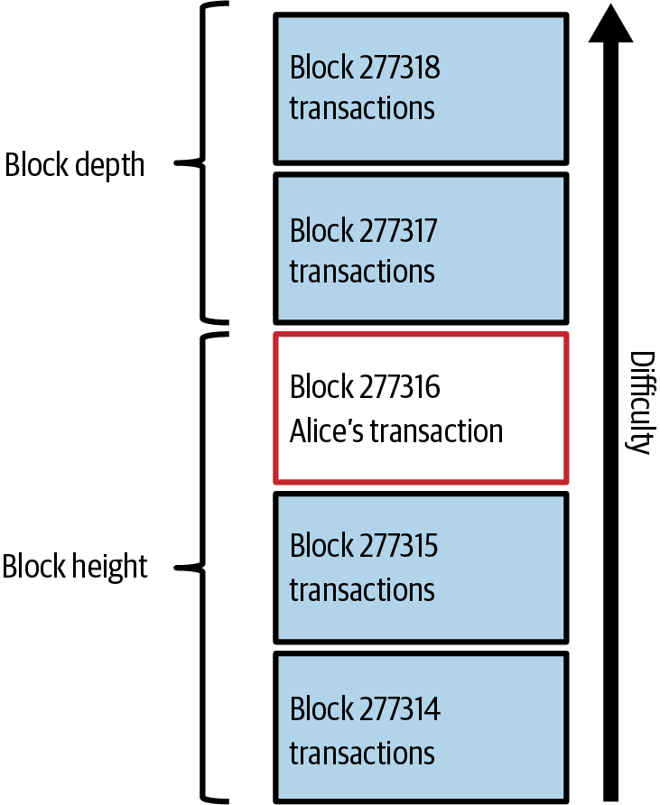
Height, depth and confirmations
₿
Where Alice's transaction sits in the chain
Block height
The position of a block, counted from the genesis block. Alice's block is 277,316.
Block depth
How many blocks lie on top of a block.
Confirmation
Alice's block is the first confirmation; each block on top adds one more.
Block explorer
Paste a transaction id into an explorer to see its block, depth and fee.
Figure 2-7, Mastering Bitcoin 3rd edition, CC BY-SA 4.0
More blocks on top means a payment that is harder to reverse
24 / 35
Notes:
Alice's transaction sits in block 277,316. A block's height counts from the genesis block, and its depth counts the blocks on top. Each block on top is one more confirmation, and a block explorer shows all of it.

Slide 25
One more zero, many more tries
₿
Mining as a search for a lucky number
>>> data = 'Hello, world! '
>>> ok = lambda n, z: T.sha(data + str(n)).startswith('0' * z)
Result: tries needed for 1 to 4 zeros (log scale)
A text, and a test: does the hash of text plus counter start with z zeros?
>>> find = lambda z: next(n for n in range(10**7) if ok(n, z))
>>> [find(z) for z in (1, 2, 3, 4)]
[33, 302, 10182, 32977]
Count up from zero until the test passes, for one to four zeros.
run under Python 3.14.6 - T is the chapter library of the page (sen0401_ch02_tx_lib_v1_0_0)
Each extra zero needs about 16 times more tries on average.
Mining is a search; more zeros means more work
25 / 35
Notes:
A miner changes a number, the nonce, and hashes again until the result starts with enough zeros. Nobody can shortcut the search, but anyone can check the answer with one hash. The network sets how many zeros are needed.

Slide 26
The first block header is 80 bytes
₿
Hashing the genesis block's header
>>> hdr = T.genesis_header()
Result: the six fields of the header
Pack the six fields of Bitcoin's first block header into 80 bytes.
Field | Bytes | Value
Version | 4 | 1
Previous block | 32 | all zeros
Merkle root | 32 | 4a5e1e4b...
Time | 4 | 1231006505
Bits | 4 | 1d00ffff
Nonce | 4 | 2083236893
>>> h = T.block_hash(hdr)
>>> (len(hdr), h[:20])
(80, '000000000019d6689c08')
Hash twice and reverse the bytes: the name of the first block starts with ten zeros.
run under Python 3.14.6 - T is the chapter library of the page (sen0401_ch02_tx_lib_v1_0_0)
Hashed twice: 000000000019d668...
A block's name is the hash of its 80-byte header
26 / 35
Notes:
The genesis block was mined on 3 January 2009. Its header packs a version, the previous block, a summary of the transactions, a time, a difficulty and a nonce. Hashing it twice gives the famous name that starts with ten zeros.

Slide 27

Nine pages, one table of probabilities
₿
31 October 2008 · section 11 of the white paper
WHO Satoshi Nakamoto, the pseudonymous author, writing to a cryptography mailing list.
WHAT A nine-page paper whose section 11 tabulates an attacker's chance of catching up.
WHEN 2008-10-31 (31 October 2008)
WHERE The metzdowd.com cryptography mailing list; the PDF now sits on bitcoin.org.
WHY To show with numbers that waiting for confirmations makes a double spend unlikely.
Picture: Satoshi bust, Budapest - Fekist, CC BY-SA 4.0, Wikimedia Commons
HOW A random walk models the race of an honest chain against a secret one; the next slide reruns it.
READ Bitcoin white paper (PDF) - bitcoin.org
27 / 35
Notes:
The white paper reached its readers on 31 October 2008. Its section 11 does something rare for a systems paper: it computes the attacker's odds. The next slide reruns that computation.

Slide 28
Nakamoto's catch-up table, recomputed
₿
Section 11 of the white paper, run again
>>> q10 = [round(T.catch_up(0.1, z), 7) for z in range(7)]
Result: the attacker's chance per block
The white paper's formula for an attacker with 10 percent of the hash power.
>>> q30 = [round(T.catch_up(0.3, z), 7) for z in range(7)]
>>> (q10[1], q10[6])
(0.2045873, 0.0002428)
The same for 30 percent; the printed pair is the chance at one and at six blocks.
run under Python 3.14.6 - T is the chapter library of the page (sen0401_ch02_tx_lib_v1_0_0)
A 30 percent attacker still has 13 percent after six blocks.
Every confirmation makes a reversal much less likely
28 / 35
Notes:
Section 11 of the white paper computes how likely an attacker is to catch up. We reran the formula and obtained the paper's table to seven places. The chance drops fast with every block, which is why six confirmations became a habit.

Slide 29
Spending the Transaction
When Bob may spend, and what every node checks first
consensus rules
block explorer
Rules that every node checks the same way; a block that breaks one is refused.
A website where anyone can look up blocks, transactions and addresses.
Think of the rules of chess that every player and referee enforce.
Think of a parcel tracker for money.
Store | Transactions | Coin selection | Construction | Blockchain | Spending
29 / 35
Notes:
Part 6 closes the loop. Bob can spend his new output, and every node checks the same rules, so that a block which breaks one is refused.

Slide 30
The reward halves every 210,000 blocks
₿
One of the consensus rules, in one line
>>> era = T.HALVING_INTERVAL
>>> reward = lambda h: 50 * T.COIN >> h // era
Result: the block reward of each era, in bitcoin
Fifty bitcoin, shifted right by one bit for every completed era of 210,000 blocks.
>>> [reward(h * era) / T.COIN for h in range(6)]
[50.0, 25.0, 12.5, 6.25, 3.125, 1.5625]
The reward at the first block of each of the first six eras, in bitcoin.
run under Python 3.14.6 - T is the chapter library of the page (sen0401_ch02_tx_lib_v1_0_0)
The reward halved in 2012, 2016, 2020 and 2024; 2028 is the next halving due.
Halving is a rule every node enforces, not a promise
30 / 35
Notes:
The block reward is a consensus rule. Every node computes it the same way and refuses a block that claims more. Halving every 210,000 blocks, about four years, is what limits the total number of bitcoin.

Slide 31

The day someone printed 184 billion bitcoin
₿
15 August 2010 · block 74,638
WHO An unknown attacker; Jeff Garzik, who spotted the block; Satoshi Nakamoto, who patched the software.
WHAT A block paid out about 184 billion bitcoin, thousands of times the 21 million limit.
WHEN 2010-08-15 (15 August 2010)
WHERE Block 74,638 of the Bitcoin chain, discussed live on the bitcointalk forum.
WHY Two outputs were so large that their sum overflowed and passed the checks; no rule limited the amounts.
Picture: Bitcoin logo - Grayliptrot, public domain, Wikimedia Commons - a stand-in, since no free picture of the event exists
HOW Garzik flagged the block within the hour; Satoshi shipped version 0.3.10 about five hours later and the honest chain overtook it.
READ Value overflow incident (Bitcoin Wiki) - en.bitcoin.it
31 / 35
Notes:
On 15 August 2010 block 74,638 created about 184 billion bitcoin out of an overflow. Every node checks every rule, and this one rule was missing. Within hours the software was fixed and the honest chain, without the forged coins, won.

Slide 32
Two outputs that wrapped around
₿
Block 74,638 and the value overflow of 2010
>>> big = 9223372036854277039
>>> total = big + big
Result: the overflow, number by number
Step | Satoshis
Each output | 9,223,372,036,854,277,039
True sum | 18,446,744,073,708,554,078
Stored in 64 bits | -997,538
Each of the two outputs of block 74,638 held this many satoshis.
>>> stored = T.wrap64(total)
>>> (stored, stored < 0)
(-997538, True)
A signed 64-bit number wraps around, so the sum turns negative.
run under Python 3.14.6 - T is the chapter library of the page (sen0401_ch02_tx_lib_v1_0_0)
The stored sum is negative, so it sits below any input and the old check passed.
One overflow created 184 billion bitcoin; one new rule ended it
32 / 35
Notes:
In August 2010 a block paid out two huge outputs. Their sum overflowed a 64-bit integer, so the software thought the outputs were small. A new rule was shipped within hours, and the honest chain, without the forged coins, won.

Slide 33
Summary: the six answers
₿
The questions of slide 3, answered
Question | Answer in one line
1 What does a payment contain? | Inputs that spend earlier outputs, outputs for Bob and the change, a fee.
2 Why inputs = outputs + fee? | The ledger must balance; the rest, 5,000 satoshis, is the miner's fee.
3 How is it built? | Pick coins, write the outputs, leave the fee, sign.
4 How does it reach a block? | A node relays it; a miner finds a valid nonce and adds a block.
5 Why confirmations? | A 10 percent attacker's chance falls from 20.5 to 0.02 percent.
6 Which rules? | Consensus rules, checked by every node; block 74,638 broke one.
Inputs, outputs, fee, mining, confirmations, rules
33 / 35
Notes:
Each row answers one of the six opening questions in a line. If you can say each answer in your own words, using the everyday pictures of this chapter, you have the chapter.

Slide 34
Resources: read, try, watch, ask
₿
Every link was opened on 25 October 2026; free to use
Read Mastering Bitcoin, chapter 2 (source text)
The chapter this deck follows.
Try mempool.space block explorer
Look up any transaction, block or fee.
Read Developer guide: transactions
Inputs, outputs and fees in detail.
Try Anders Brownworth's blockchain demo
Hash, block and mine in the browser.
Standards and papers Bitcoin white paper
Nine pages; section 11 holds the catch-up table.
Watch MIT 15.S12 Blockchain and Money
A full university course, free.
Standards and papers BIP 21: payment links
The standard behind Bob's invoice link.
Community Bitcoin Optech topics
Short explainers on how the technology works.
Standards and papers Bitcoin Core releases
The software that checks every rule.
Community Bitcoin Stack Exchange
Ask a question, read the answers.
Look up a real transaction in a block explorer today
34 / 35
Notes:
These links are all open and free. Start with the chapter source and the white paper, try the block explorer on a real payment, and use the MIT course for the wider story of blockchain and money.

Slide 35
Questions?
One payment, from the invoice to the blockchain
Next: chapter 3, Bitcoin Core, the reference implementation
Python 3.14.6; every result in this deck was computed by the chapter library, not typed
35 / 35
Notes:
That is the whole path of one payment. Chapter 3 opens the software that checks every rule, Bitcoin Core, and shows how to run it yourself. Bring your questions.

