Slide 1
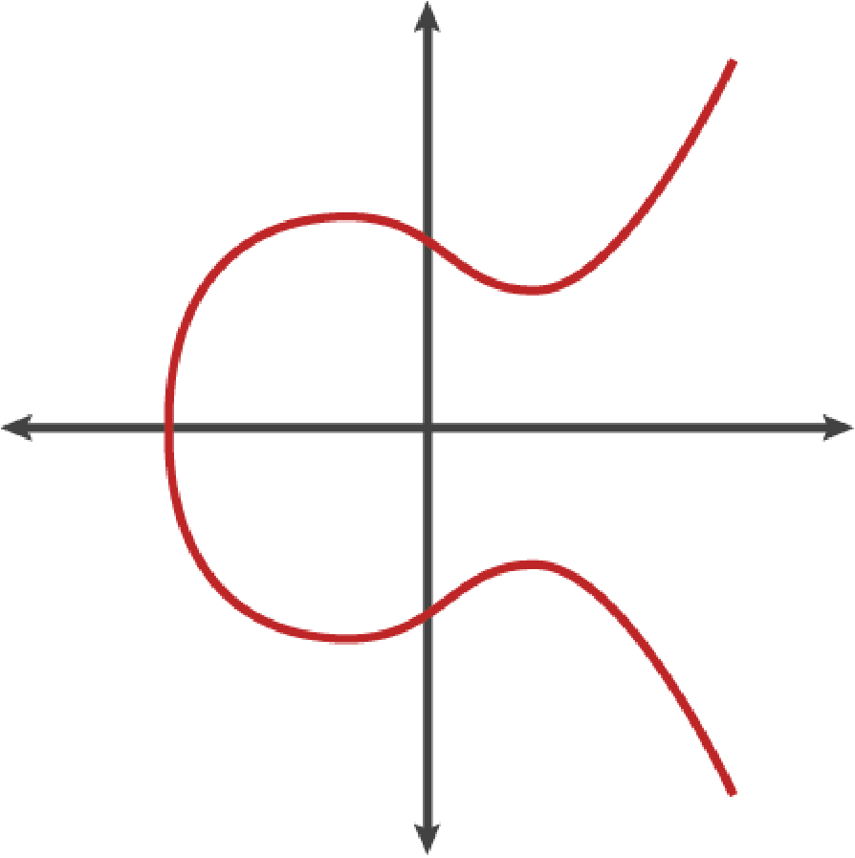
k
K
1J7m...
private key
public key
address
Chapter 4: Keys and Addresses
From a secret number to the string you can safely read out loud
Figure 4-2, Mastering Bitcoin 3rd edition, Antonopoulos and Harding, CC BY-SA 4.0
Python 3.14.6; every result is computed by the chapter library; no Bitcoin Core node was run.
SEN0401 Special Topics in Software Engineering: Block Chain · Fall 2026 · Yusuf Altunel, PhD · İstanbul Kültür University
1 / 47
Notes:
Chapter 3 showed the software that checks the rules. Chapter 4 opens the smallest secret it protects, a private key, and follows it to the address that people read aloud. Every number in this deck was computed with the chapter's own Python library.

Slide 2
Today's route
₿
Five parts around one key; every range is a slide you can jump to
1. Questions and the chapter map
(slides 3-4)
2. Public Key Cryptography
(slides 5-15)
3. Legacy Addresses
(slides 16-26)
47
slides, numbered bottom-right
4. Script Hashes and Bech32
(slides 27-30)
5. Private Key Formats
(slides 31-38)
6. Advanced Keys and Addresses
(slides 39-44)
3
true stories, each told by 5N1K
7. Summary, resources, closing
(slides 45-47)
21
code examples, each with a picture of its result
Five parts, three true stories, twenty-one examples
2 / 47
Notes:
The route has five parts that follow one secret from a number to an address. Three true stories and twenty-one code examples are spread across them, and every example has a picture of its result.

Slide 3
The questions this chapter answers
₿
Each has an answer on a slide; we return to them in the summary
1
What is a private key, and what makes one safe to use?
2
How does a private key become a public key, and why can it not be reversed?
3
How does a public key become a legacy address, and why does it carry a checksum?
4
What do P2SH, Bech32 and Bech32m change about addresses?
5
How is a private key written down so that a wallet can import it?
6
Why can an address be valid and still have no key behind it?
3 / 47
Notes:
The six questions are the chapter's own, rewritten so that each has an answer on a slide. We return to them in the summary. A reader who can answer all six has understood the chapter.

Slide 4
The chapter in one picture
₿
One secret, five steps; the parts of the deck follow them
1 Entropy
2 Private key k
3 Public key K
4 HASH160
5 Address
256 random bits, kept secret.
A number between 1 and n - 1.
The point k times G.
SHA256, then RIPEMD-160: 20 bytes.
Version, hash and checksum in text.
Every step runs forward easily and backwards never: you can always compute the next stage, but you cannot recover the one before it.
Random bits, a key, a point, a hash, an address
4 / 47
Notes:
One secret travels five steps. Random bits become a private key, the curve turns it into a public key, two hashes shorten it, and an encoding with a checksum makes the address. The parts of this deck follow the same path.

Slide 5
Public Key Cryptography
From one secret number to a point that nobody can run backwards
Private Keys
Public Keys
secp256k1
A secret 256-bit number; whoever knows it can spend the coins.
A point on the curve computed from the private key; safe to publish.
The curve y squared equals x cubed plus 7 that Bitcoin uses.
Think of the one key to your front door.
Think of the lock on your door: everyone can see it.
Think of the one game board that every player agrees on.
Keys | Legacy | Bech32 | Formats | Advanced
5 / 47
Notes:
Part 1 starts with the secret itself. A private key is only a number, a public key is a point computed from it, and the curve makes that computation a one-way street.

Slide 6
Keys: concepts, with everyday pictures (1 of 2)
₿
Each row: the idea in one line, then something you already know
Concept | In short | Think of
Keys and Addresses | The secret numbers that control coins, and the public names that receive them. | A house key and the street address on the door.
Public Key Cryptography | Two linked keys: one stays secret, the other can be shared with everyone. | A padlock anyone can snap shut but only you can open.
Private Keys | A secret 256-bit number; whoever knows it can spend the coins. | The one key to your front door.
Public Keys | A point on the curve computed from the private key; safe to publish. | The lock on your door: everyone can see it.
key pair | A private key together with the public key computed from it. | A key and the one lock it fits.
entropy | How unpredictable a secret is, counted in bits. | The dice rolls a thief would have to guess.
Think of each row as a flashcard: the concept, then a picture you know
6 / 47
Notes:
These rows pair each concept of the part Public Key Cryptography with something you already know. Say the meaning first, then the comparison, in your own words. The code slides that follow run the same ideas.

Slide 7
Keys: concepts, with everyday pictures (2 of 2)
₿
Each row: the idea in one line, then something you already know
Concept | In short | Think of
Elliptic Curve Cryptography Explained | Keys built from points on a curve and a multiplication that cannot be undone. | Stirring milk into coffee: easy to do, hopeless to undo.
secp256k1 | The curve y squared equals x cubed plus 7 that Bitcoin uses. | The one game board that every player agrees on.
generator point | The fixed point G from which every public key is counted. | The starting square of a board game.
point at infinity | The zero of the curve: adding it to a point changes nothing. | Zero on a number line.
elliptic curve multiplication | Adding a point to itself k times, done fast by doubling. | Folding paper: eight folds make 256 layers.
Think of each row as a flashcard: the concept, then a picture you know
7 / 47
Notes:
These rows pair each concept of the part Public Key Cryptography with something you already know. Say the meaning first, then the comparison, in your own words. The code slides that follow run the same ideas.

Slide 8
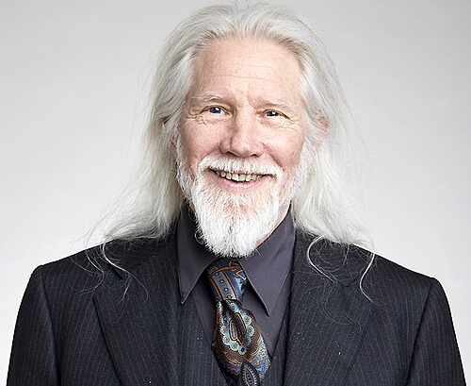
The 1976 paper that split the key in two
₿
3 June 1976 · public-key cryptography is born
WHO Whitfield Diffie and Martin Hellman, cryptographers at Stanford; both received the 2015 Turing Award.
WHAT The paper 'New Directions in Cryptography': a key split into a public half and a private half.
WHEN 1976-06-03 (manuscript received; printed in November 1976)
WHERE Stanford University, California; IEEE Transactions on Information Theory, volume IT-22.
WHY Secret keys had to be carried to every partner; the authors wanted to remove that need.
Picture: Whitfield Diffie, 2017 - Duncan Hull, CC BY-SA 4.0, Wikimedia Commons
HOW Each user publishes one half and keeps the other; a one-way computation links them, as in this chapter.
READ Diffie, Hellman: New Directions (PDF) - www-ee.stanford.edu
8 / 47
Notes:
In 1976 Whitfield Diffie and Martin Hellman asked whether two people could talk privately without first sharing a secret. Their answer was a key split in two. Bitcoin's elliptic-curve multiplication is a later form of the same idea.

Slide 9
A private key is a number below n
₿
The book's example key, and the edges of the range
>>> k = K.BOOK_K
Result: five numbers, valid or not
The private key of the book's example: one very large whole number.
Key | Bits | Valid?
0 | 0 | no
1 | 1 | yes
the book's key | 253 | yes
n - 1 | 256 | yes
n | 256 | no
>>> ok = lambda x: 0 < x < K.N
>>> [ok(x) for x in (0, 1, k, K.N - 1, K.N)]
[False, True, True, True, False]
A key is valid when it lies strictly between 0 and n; the list gives five verdicts.
run under Python 3.14.6 - K is the chapter library of the page (sen0401_ch04_lib_v1_0_0)
Valid keys fill the range from 1 to n - 1, about 2 to the power 256 of them.
Any whole number from 1 to n minus 1 is a key
9 / 47
Notes:
A private key is a very large number between 1 and n minus 1. Zero and n itself are not allowed. Every number inside the range is a valid key, which is why choosing one at random is safe.

Slide 10
Entropy: bits an attacker must guess
₿
Why a Bitcoin key needs 256 fair coin flips
>>> b = K.bits_of
Result: bits of entropy of five secrets
Entropy is the length times the base-2 logarithm of the size of the alphabet.
>>> [b(10, 4), b(26, 8), b(94, 12), b(2, 256)]
[13.3, 37.6, 78.7, 256.0]
A PIN, a lowercase word, a long password and 256 fair coin flips.
run under Python 3.14.6 - K is the chapter library of the page (sen0401_ch04_lib_v1_0_0)
A 12-symbol password has 78.7 bits; a key needs 256.
Only truly random choices reach the 256 bits of a key
10 / 47
Notes:
Entropy counts how many bits of guessing a secret withstands. A PIN has 13 bits and a long password 79. Only 256 fair coin flips match a Bitcoin key, so a key must come from a proper random source.

Slide 11
The curve secp256k1 and its generator
₿
Checking that G really lies on the curve
>>> x, y = K.G
Result: the generator point and the curve
The generator point G: the fixed starting point that every key multiplies.
Question | Answer
G on the curve? | yes
p has bits | 256
x of G begins | 0x79be667ef9
p = 2^256 - 2^32 - 977? | yes
>>> left, right = y * y % K.P, (x ** 3 + 7) % K.P
>>> left == right
True
Both sides of y squared equals x cubed plus 7 agree, counted modulo the prime p.
run under Python 3.14.6 - K is the chapter library of the page (sen0401_ch04_lib_v1_0_0)
One formula and one fixed point: nothing else is needed to start.
The curve is one short formula: y squared = x cubed + 7
11 / 47
Notes:
Bitcoin's curve is y squared equals x cubed plus 7, counted modulo a 256-bit prime. We test that the generator point G satisfies the formula. Every public key starts from this one fixed point.

Slide 12
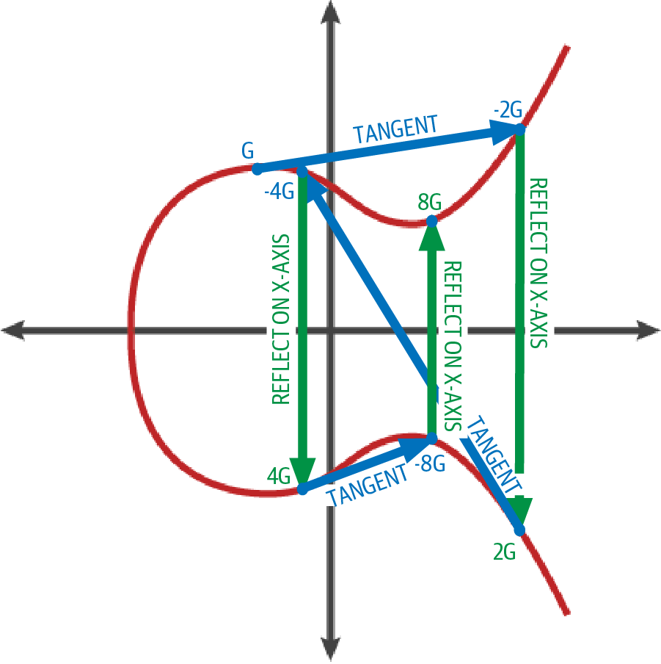
Points on a curve: doubling G
₿
How the curve turns one point into many
The red line is the curve; the blue and green arrows are the steps of one doubling.
1 Tangent
Draw the tangent to the curve at G.
2 Meeting point
It meets the curve once more.
G, 2G, 4G and 8G are labelled on the picture.
3 Mirror
Reflect that point on the x-axis: this is 2G.
Figure 4-4, Mastering Bitcoin 3rd edition, Antonopoulos and Harding, CC BY-SA 4.0
Tangent, meeting point, mirror image: that is one doubling
12 / 47
Notes:
Figure 4-4 shows one doubling on the curve of figure 4-2. Draw the tangent at G, find where it meets the curve again, and mirror that point across the x-axis. The result is 2G, and repeating the step gives 4G and 8G.

Slide 13
Doubling and adding: k times G
₿
How one multiplication reaches a huge number
>>> pts = [K.ec_mul(n) for n in (1, 2, 3, 4)]
Result: multiples of G and the work
Multiply G by one, two, three and four; every result is another point.
n | x of n times G (8 hex)
1G | 79be667e
2G | c6047f94
3G | f9308a01
4G | e493dbf1
>>> twice = K.ec_add(K.G, K.G)
>>> twice == pts[1]
True
Adding G to itself gives 2G, the same point that the multiplication found.
run under Python 3.14.6 - K is the chapter library of the page (sen0401_ch04_lib_v1_0_0)
The book's key needs 252 doublings and 123 additions.
Doubling reaches a 256-bit key in a few hundred steps
13 / 47
Notes:
Multiplying G by k means adding G to itself k times. Doubling makes this fast: a key of 253 bits needs a few hundred doublings and additions, not 10 to the 76 steps.

Slide 14
The point at infinity on a toy curve
₿
A curve over 17 numbers, small enough to list
>>> pts = K.multiples(10)
Result: the cycle of one point
Walk the multiples of one point on a toy curve over only 17 numbers.
n | n times P
1 | (1, 5)
2 | (2, 10)
3 | (5, 9)
4 | (12, 1)
5 | (12, 16)
6 | (5, 8)
7 | (2, 7)
8 | (1, 12)
9 | infinity
>>> pts.index(None) + 1
9
The ninth multiple is None, the point at infinity: the walk closes into a cycle.
run under Python 3.14.6 - K is the chapter library of the page (sen0401_ch04_lib_v1_0_0)
After 9 steps the walk reaches infinity and repeats.
Multiples of a point repeat; the cycle closes at infinity
14 / 47
Notes:
On a toy curve we can list every multiple of a point. The ninth multiple is the point at infinity, the zero of the curve, and then the list starts over. Bitcoin's curve works the same way with a vastly larger cycle.

Slide 15
One-way: the work to find a key
₿
Why the public key cannot be run backwards
>>> b = [20, 40, 80, 128, 256]
Result: tries as a power of ten
Key sizes in bits, from a toy key to the size Bitcoin uses.
>>> [round(math.log10(2 ** (n - 1))) for n in b]
[6, 12, 24, 38, 77]
Half the keys must be tried on average; the list gives that as a power of ten.
run under Python 3.14.6 - K is the chapter library of the page (sen0401_ch04_lib_v1_0_0)
A 20-bit key falls after about 524,288 tries; a 256-bit key needs 10 to the 77.
Each extra bit doubles the attacker's work
15 / 47
Notes:
Finding k from k times G means trying keys one by one, about half of them on average. A 20-bit key falls after half a million tries. A 256-bit key needs about 10 to the 77, which is out of reach.

Slide 16
Legacy Addresses
From a public key to the address that people read aloud
P2PKH
HASH160
Base58check Encoding
Pay to public key hash: the output script holds only a 20-byte hash.
SHA256 followed by RIPEMD-160: the 20-byte hash of a public key.
Version byte, payload and checksum written in base58.
Think of a locker that shows a number, never the shape of the key.
Think of two sieves in a row: the finer one decides.
Think of a parcel with a label, a content and a seal.
Keys | Legacy | Bech32 | Formats | Advanced
16 / 47
Notes:
Part 2 turns a public key into the first kind of Bitcoin address. Two hashes shorten the key to twenty bytes, and Base58Check adds a version and a checksum that catches typing mistakes.

Slide 17
Legacy: concepts, with everyday pictures (1 of 3)
₿
Each row: the idea in one line, then something you already know
Concept | In short | Think of
Output and Input Scripts | An output locks coins with a condition; an input supplies what unlocks it. | A locker and the code that opens it.
output script | The locking condition stored in a transaction output. | The lock fitted to a parcel locker.
input script | The data that satisfies the lock when the coins are spent. | The code you type to open the locker.
IP Addresses: The Original Address for Bitcoin (P2PK) | The first Bitcoin paid to an IP address; the output script held the full public key. | Mailing a parcel to a building's blueprint, not its street address.
P2PK | Pay to public key: the output script holds the public key itself. | A sealed box that shows its whole lock to everyone.
Legacy Addresses for P2PKH | Short text that names the hash of a public key; it starts with 1. | A bank account number instead of your ID card.
Think of each row as a flashcard: the concept, then a picture you know
17 / 47
Notes:
These rows pair each concept of the part Legacy Addresses with something you already know. Say the meaning first, then the comparison, in your own words. The code slides that follow run the same ideas.

Slide 18
Legacy: concepts, with everyday pictures (2 of 3)
₿
Each row: the idea in one line, then something you already know
Concept | In short | Think of
P2PKH | Pay to public key hash: the output script holds only a 20-byte hash. | A locker that shows a number, never the shape of the key.
commitment | A hash that fixes a value now and lets you reveal it later. | A sealed envelope holding your prediction.
SHA256 | A hash function: any input becomes a 32-byte fingerprint. | A fingerprint: small, unique and impossible to reverse.
RIPEMD-160 | A second hash function that gives a 20-byte fingerprint. | A photocopier that shrinks a page to a stamp.
HASH160 | SHA256 followed by RIPEMD-160: the 20-byte hash of a public key. | Two sieves in a row: the finer one decides.
Base58check Encoding | Version byte, payload and checksum written in base58. | A parcel with a label, a content and a seal.
Think of each row as a flashcard: the concept, then a picture you know
18 / 47
Notes:
These rows pair each concept of the part Legacy Addresses with something you already know. Say the meaning first, then the comparison, in your own words. The code slides that follow run the same ideas.

Slide 19
Legacy: concepts, with everyday pictures (3 of 3)
₿
Each row: the idea in one line, then something you already know
Concept | In short | Think of
base58 | An alphabet of 58 letters and digits without look-alike characters. | A font with no confusable letters.
checksum | Four bytes of a double SHA256 that catch typing mistakes. | The check digit at the end of a barcode.
version prefix | The first byte says what follows: 00 for a key hash, 05 for a script hash. | The country code at the start of a phone number.
Compressed Public Keys | 33 bytes: the x coordinate and one byte that says whether y is even or odd. | A map reference that says the column and up or down.
uncompressed public key | 65 bytes: a 04 byte, then both x and y in full. | Giving both map coordinates in full.
Think of each row as a flashcard: the concept, then a picture you know
19 / 47
Notes:
These rows pair each concept of the part Legacy Addresses with something you already know. Say the meaning first, then the comparison, in your own words. The code slides that follow run the same ideas.

Slide 20
A public key has two encodings
₿
Compressed keys keep x and the parity of y
>>> Kp = K.ec_mul(K.BOOK_K)
Result: the two encodings
Multiply G by the book's private key: the public key is a point (x, y).
Form | Prefix | Bytes | Holds
Compressed | 02 or 03 | 33 | x and parity
Uncompressed | 04 | 65 | x and y
>>> c, u = K.pub_bytes(Kp), K.pub_bytes(Kp, False)
>>> (len(c), len(u), c[0], u[0])
(33, 65, 3, 4)
Compressed keeps x and a parity byte; uncompressed writes x and y after 04.
Compressed is 49 percent shorter, and decompressing returns the same point: True.
run under Python 3.14.6 - K is the chapter library of the page (sen0401_ch04_lib_v1_0_0)
A compressed key is 33 bytes; the full one is 65
20 / 47
Notes:
A public key is a point with two coordinates. The uncompressed form writes both after a 04 byte. The compressed form writes x and one byte for the parity of y, and y is recovered from x.

Slide 21
P2PK holds the key, P2PKH only its hash
₿
Two output scripts for the same public key
>>> c = K.pub_bytes(K.ec_mul(K.BOOK_K))
Result: the two output scripts
The compressed public key of the book's example.
Output script | Bytes | Holds
P2PK | 35 | the public key
P2PKH | 25 | a 20-byte hash
>>> pk, pkh = K.p2pk_script(c), K.p2pkh_script(c)
>>> (len(pk), len(pkh))
(35, 25)
P2PK holds the key itself; P2PKH holds only a 20-byte hash of it, a commitment.
The hash inside P2PKH equals HASH160 of the key: True. Both end in opcode 0xac (CHECKSIG).
run under Python 3.14.6 - K is the chapter library of the page (sen0401_ch04_lib_v1_0_0)
P2PKH shows a commitment to the key, not the key
21 / 47
Notes:
The original output script, P2PK, contains the public key itself. P2PKH contains only a 20-byte hash of it. The hash is a commitment: the key is revealed only when the coins are spent.

Slide 22
HASH160 is SHA256 then RIPEMD-160
₿
Two hashes turn a 33-byte key into 20 bytes
>>> c = K.pub_bytes(K.ec_mul(K.BOOK_K))
>>> s = hashlib.sha256(c).digest()
Result: bytes after each hash
SHA256 turns the 33-byte key into a 32-byte fingerprint.
>>> r = K.ripemd160(s)
>>> (len(c), len(s), len(r), r == K.hash160(c))
(33, 32, 20, True)
RIPEMD-160 shortens it to 20 bytes; the pair of hashes is what HASH160 means.
run under Python 3.14.6 - K is the chapter library of the page (sen0401_ch04_lib_v1_0_0)
The 20 bytes are bbc1e42a... and match HASH160: True.
Two hashes in a row: 33 bytes in, 20 bytes out
22 / 47
Notes:
HASH160 first applies SHA256 and then RIPEMD-160. The 33-byte key becomes 32 bytes and then 20 bytes. The result is the number that a legacy address stands for.

Slide 23

Why 58? Satoshi left the reasons in the file
₿
8 January 2009 · a design memo inside base58.h
WHO Satoshi Nakamoto, the pseudonymous author of Bitcoin's first software; the file's copyright line names him.
WHAT A comment in base58.h that lists four reasons for dropping 0, O, I and l and all punctuation.
WHEN 2009-01-08 (version 0.1 announced; the memo's own date is not recorded)
WHERE The file src/base58.h in the bitcoin/bitcoin source tree on GitHub.
WHY People copy addresses by hand, in e-mail and by double-click, so the text must survive all three.
Picture: Satoshi bust, Budapest - Fekist, CC BY-SA 4.0, Wikimedia Commons - a stand-in, since the author's face is unknown
HOW Of 62 letters and digits the four look-alikes go, so 58 remain: the alphabet of every legacy address.
READ base58.h in bitcoin/bitcoin (source) - raw.githubusercontent.com
23 / 47
Notes:
The first lines of base58.h are a design memo. It gives four human reasons: look-alike characters, punctuation that breaks selection, line breaks in e-mail, and double-clicking. The alphabet of every legacy address is a usability decision.

Slide 24
Base58Check, step by step
₿
Version, hash and checksum become an address
>>> h = K.hash160(K.pub_bytes(K.ec_mul(K.BOOK_K)))
Result: the three parts of an address
The 20-byte key hash of the book's example.
Part | Bytes | Value
Version | 1 | 00
Key hash | 20 | bbc1e42a...
Checksum | 4 | 37fefcd0
Together | 25 | 34 characters
>>> body = b'\x00' + h
>>> chk = K.dsha(body)[:4]
Put the version byte 00 in front; the checksum is four bytes of a double SHA256.
>>> addr = K.b58check(body)
>>> (len(body + chk), len(addr), addr[0])
(25, 34, '1')
The address 1J7mdg5rbQyUHENYdx39WVWK7fsLpEoXZy starts with 1; the one-step library function gives the same text: True.
Twenty-five bytes in base58 become a 34-character address that starts with 1.
run under Python 3.14.6 - K is the chapter library of the page (sen0401_ch04_lib_v1_0_0)
An address is 25 bytes written in 34 characters
24 / 47
Notes:
A legacy address has three parts: a version byte, the 20-byte key hash and a four-byte checksum. Written in base58 they give a 34-character string. The leading 00 version byte becomes the first character, 1.

Slide 25
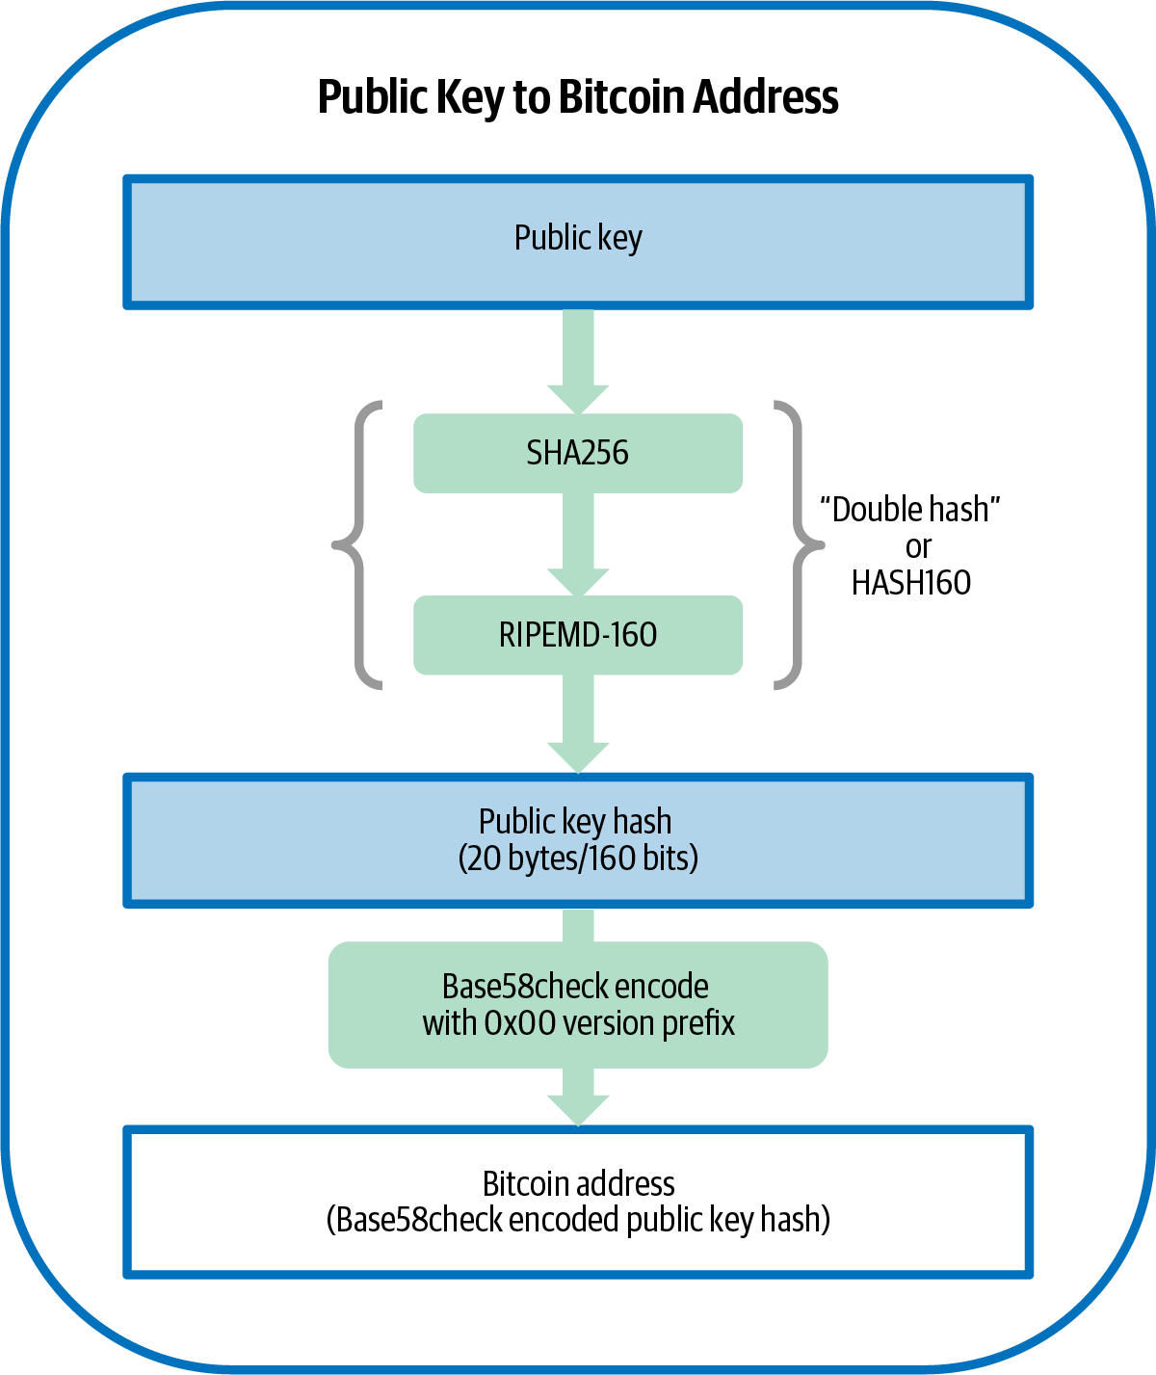
From public key to address
₿
The pipeline of figure 4-7, with the sizes that we measured
Public key 33 bytes
SHA256 32 bytes
RIPEMD-160 20 bytes: the key hash
Version and checksum added 25 bytes
Base58 text 34 characters
Figure 4-7, Mastering Bitcoin 3rd edition, Antonopoulos and Harding, CC BY-SA 4.0
Each arrow is a function that you have just run
25 / 47
Notes:
Figure 4-7 is the whole road from public key to address. SHA256 and RIPEMD-160 shrink the key to 20 bytes, a version byte and a checksum make 25, and base58 writes them as 34 characters. Each step is a function you have just run.

Slide 26
The checksum catches every single typo
₿
Every one-character mistake, tried one by one
>>> good = K.key_to_address(K.BOOK_K)
Result: every typo, tested
The example address; now change one character at a time.
Test | Count
Typos tried | 1,938
Typos accepted | 0
Original valid? | yes
>>> typos = K.single_typos(good)
>>> (len(typos), sum(map(K.is_valid_b58check, typos)))
(1938, 0)
Try every one-character substitution; the pair counts the typos and the accepted ones.
run under Python 3.14.6 - K is the chapter library of the page (sen0401_ch04_lib_v1_0_0)
A random typo passes the check about once in 4,294,967,296 tries.
A single typo is caught almost every time
26 / 47
Notes:
We change one character of the address in every possible way: 1,938 variants. A wallet that checks the four-byte checksum rejects every one of them. A random typo passes only about once in 4.3 billion.

Slide 27
Script Hashes and Bech32
Addresses that commit to a script, and the second alphabet
P2SH
Bech32 Addresses
Bech32m
Pay to script hash: spending reveals the script and then satisfies it.
SegWit addresses in lowercase letters and digits with a stronger checksum.
The same encoding with a new checksum constant, used from witness version 1.
Think of a locked briefcase opened in front of the cashier.
Think of a postcode that also detects a mistyped letter.
Think of a corrected second edition of the same form.
Keys | Legacy | Bech32 | Formats | Advanced
27 / 47
Notes:
Part 3 covers the addresses that came after the first kind. P2SH commits to a whole script, and SegWit's Bech32 and Bech32m add a version, a program and a stronger checksum.

Slide 28
Bech32: concepts, with everyday pictures (1 of 2)
₿
Each row: the idea in one line, then something you already know
Concept | In short | Think of
Legacy Pay to Script Hash (P2SH) | An address that commits to the hash of a whole script; it starts with 3. | A safe-deposit box whose contents you show only when you open it.
P2SH | Pay to script hash: spending reveals the script and then satisfies it. | A locked briefcase opened in front of the cashier.
redeem script | The script behind a P2SH hash; it is revealed and run when the coins are spent. | The instructions sealed inside the envelope.
collision attack | Finding any two different inputs that give the same hash. | Finding two strangers with the same fingerprint.
preimage attack | Finding an input that gives one particular hash. | Finding the person behind one given fingerprint.
Bech32 Addresses | SegWit addresses in lowercase letters and digits with a stronger checksum. | A postcode that also detects a mistyped letter.
Think of each row as a flashcard: the concept, then a picture you know
28 / 47
Notes:
These rows pair each concept of the part Script Hashes and Bech32 with something you already know. Say the meaning first, then the comparison, in your own words. The code slides that follow run the same ideas.

Slide 29
Bech32: concepts, with everyday pictures (2 of 2)
₿
Each row: the idea in one line, then something you already know
Concept | In short | Think of
Problems with Bech32 Addresses | Letters inserted before a final p slip past the old checksum. | Extra tick marks at the end of a ruler that nobody notices.
Bech32m | The same encoding with a new checksum constant, used from witness version 1. | A corrected second edition of the same form.
bech32 | The original encoding and checksum, still used for witness version 0. | The first edition of the form.
witness version | The first value in the address: 0 for the first SegWit, 1 for Taproot. | The version number printed on a form.
witness program | The data after the version: a key hash or a script hash. | The filled-in field of the form.
human-readable part | The letters before the 1 that name the network: bc, tb. | The country code on a number plate.
Think of each row as a flashcard: the concept, then a picture you know
29 / 47
Notes:
These rows pair each concept of the part Script Hashes and Bech32 with something you already know. Say the meaning first, then the comparison, in your own words. The code slides that follow run the same ideas.

Slide 30
P2SH commits to a whole script
₿
A two-of-three multisignature behind one address
>>> keys = [K.pub_bytes(K.ec_mul(n)) for n in (1, 2, 3)]
Result: script, hash and address
Three public keys for a two-of-three multisignature wallet.
Item | Value
Redeem script | 105 bytes
Its HASH160 | 15fc0754e73e...
Address starts | 3, 34 characters
>>> script = K.multisig_script(2, keys)
The redeem script lists the keys and asks for any two signatures.
>>> addr = K.p2sh(script)
>>> (len(script), addr[0], len(addr))
(105, '3', 34)
Address 33hG2q39jRi2... commits to the script; spending reveals all 105 bytes.
The address is HASH160 of that script with version 05, so it starts with 3.
run under Python 3.14.6 - K is the chapter library of the page (sen0401_ch04_lib_v1_0_0)
A P2SH address hides the script until spending
30 / 47
Notes:
P2SH lets an address stand for any script. We build a two-of-three multisignature script of 105 bytes and hash it with HASH160. The address starts with 3 and reveals the script only when the coins are spent.

Slide 31
Collision and preimage: bits of work
₿
Why a 160-bit hash is weaker for scripts
>>> col, pre = (lambda n: n // 2), (lambda n: n)
Result: bits of work, by attack
A hash of n bits falls to a collision after about 2 to the n over 2 tries.
>>> [col(160), pre(160), col(256), pre(256)]
[80, 160, 128, 256]
A preimage needs 2 to the n tries; the list gives the exponents for two hash sizes.
run under Python 3.14.6 - K is the chapter library of the page (sen0401_ch04_lib_v1_0_0)
A 160-bit hash gives 80 bits against collisions; SHA256 gives 128.
A collision costs only half the bits of a hash
31 / 47
Notes:
Finding any two inputs with one hash takes about 2 to the n over 2 tries; finding an input for a given hash takes 2 to the n. A 160-bit hash gives only 80 bits against collisions, which is why SegWit scripts use SHA256.

Slide 32
A Bech32 address, taken apart
₿
Network, version, program and checksum
>>> addr = K.segwit_address('bc', 0, K.PROG_WPKH)
Result: the parts of the address
A version 0 SegWit address for the book's key hash.
Part | Value
Network (HRP) | bc
Separator | 1
Version letter | q = 0
Program letters | 32 = 20 bytes
Checksum | c6aaee
>>> hrp, _, rest = addr.rpartition('1')
>>> [hrp, rest[0], len(rest[1:-6]), rest[-6:]]
['bc', 'q', 32, 'c6aaee']
Split at the last 1: network name, version letter, program letters, checksum.
run under Python 3.14.6 - K is the chapter library of the page (sen0401_ch04_lib_v1_0_0)
The whole address, 42 characters: bc1q9d3xa5gg45q2j39m9y32xzvygcgay4rgc6aaee
Split at the last 1: name, version, program, checksum
32 / 47
Notes:
A Bech32 address has four parts. The network name bc, a separator 1, the data and a six-letter checksum. The first data letter is the witness version, and the rest is the witness program.

Slide 33
Witness version and witness program
₿
Three addresses from the book, decoded
>>> p = [(0, K.PROG_WPKH), (0, K.PROG_WSH), (1, K.PROG_TR)]
>>> a = [K.segwit_address('bc', v, g) for v, g in p]
Result: three decoded addresses
Kind | Starts | Version | Bytes | Chars
P2WPKH | bc1q | 0 | 20 | 42
P2WSH | bc1q | 0 | 32 | 62
P2TR | bc1p | 1 | 32 | 62
Three programs from the book: a key hash, a script hash and a Taproot key.
>>> d = [K.segwit_decode('bc', x) for x in a]
>>> [(v, len(g)) for v, g in d]
[(0, 20), (0, 32), (1, 32)]
Decoding each address returns the witness version and the program length.
run under Python 3.14.6 - K is the chapter library of the page (sen0401_ch04_lib_v1_0_0)
Version 1 changes the letter after 1 from q to p.
Version 0 for older SegWit; version 1 for Taproot
33 / 47
Notes:
The decoder returns the witness version and the program. Version 0 holds a 20-byte key hash or a 32-byte script hash. Version 1 holds a 32-byte Taproot key and makes the address start with bc1p.

Slide 34
Bech32 accepts the extra q, Bech32m does not
₿
The weakness that Bech32m repaired
>>> ok = lambda a, c: K.bech_check(a) == c
Result: the same strings, two checksums
A string passes when its checksum equals the constant of the format.
Length | Bech32 | Bech32m
15 | accepted | rejected
18 | accepted | rejected
20 | accepted | rejected
22 | accepted | rejected
>>> old = [ok(a, K.BECH32) for a in K.EXT]
>>> new = [ok(a, K.BECH32M) for a in K.EXT]
>>> (old, new)
([True, True, True, True], [False, False, False, False])
The book's strings insert q before the last p; the old checksum cannot tell.
run under Python 3.14.6 - K is the chapter library of the page (sen0401_ch04_lib_v1_0_0)
Each string has more q letters before the last p.
Bech32m changed one constant and closed the gap
34 / 47
Notes:
In Bech32 a q inserted before a final p leaves the checksum valid, so a typo can go unnoticed. The strings from the book all pass the old check and fail the new one. Bech32m changes the constant to close the gap.

Slide 35
Private Key Formats
The same private key, written in the forms a wallet can import
WIF
WIF-compressed
Compressed Private Keys
Wallet import format: Base58Check of a version byte 80 and the key.
WIF with a final 01 byte that marks the key as compressed.
Not a smaller key: a flag that tells a wallet to use compressed public keys.
Think of a key packed in a labelled travel case.
Think of a luggage tag that says travel light.
Think of a note that says use the short form of my name.
Keys | Legacy | Bech32 | Formats | Advanced
35 / 47
Notes:
Part 4 is about writing a private key down. The same number can appear as hex or as WIF, and one extra byte tells the wallet whether to use compressed public keys.

Slide 36
Formats: concepts, with everyday pictures
₿
Each row: the idea in one line, then something you already know
Concept | In short | Think of
Private Key Formats | One key, several spellings: raw hex, WIF and WIF-compressed. | One amount written in figures, in words and as tally marks.
WIF | Wallet import format: Base58Check of a version byte 80 and the key. | A key packed in a labelled travel case.
WIF-compressed | WIF with a final 01 byte that marks the key as compressed. | A luggage tag that says travel light.
Compressed Private Keys | Not a smaller key: a flag that tells a wallet to use compressed public keys. | A note that says use the short form of my name.
Think of each row as a flashcard: the concept, then a picture you know
36 / 47
Notes:
These rows pair each concept of the part Private Key Formats with something you already know. Say the meaning first, then the comparison, in your own words. The code slides that follow run the same ideas.

Slide 37
WIF: a private key dressed for travel
₿
Base58Check of version 80, the key and a flag
>>> k = K.BOOK_K
>>> w, wc = K.wif(k, False), K.wif(k)
Result: the two WIF forms
Form | Starts | Chars | Bytes
WIF | 5 | 51 | 33
WIF-compressed | K | 52 | 34
The same key written twice: as WIF and as WIF-compressed.
>>> (w[0], len(w), wc[0], len(wc))
('5', 51, 'K', 52)
The first form starts with 5 and has 51 characters; the second starts with K or L and has 52.
The decoded bytes are 80, the 32-byte key and, when compressed, a final 01.
run under Python 3.14.6 - K is the chapter library of the page (sen0401_ch04_lib_v1_0_0)
The final 01 byte says: use compressed public keys
37 / 47
Notes:
Wallet import format wraps the private key in Base58Check. The version byte is 80. A trailing 01 byte, added only for compressed keys, makes the string one byte longer and changes its first letter to K or L.

Slide 38
One private key, two addresses
₿
Compressed and uncompressed keys hash differently
>>> k = K.BOOK_K
>>> a1 = K.key_to_address(k, False)
>>> a2 = K.key_to_address(k, True)
Result: two addresses, one key
Public key | Bytes | Address
Uncompressed | 65 | 1424C2F4bC9JidNjjTUZCbUxv6Sa1Mt62x
Compressed | 33 | 1J7mdg5rbQyUHENYdx39WVWK7fsLpEoXZy
Hash the 65-byte key and then the 33-byte key: two different addresses.
>>> (a1[:6], a2[:6], a1 != a2)
('1424C2', '1J7mdg', True)
The compressed flag in WIF tells a wallet which of the two addresses it must watch.
Two different addresses from one key: yes.
run under Python 3.14.6 - K is the chapter library of the page (sen0401_ch04_lib_v1_0_0)
The flag in WIF decides which address a wallet watches
38 / 47
Notes:
One private key gives two public key encodings, and each hashes to a different address. Coins sent to one address are not seen at the other. The compressed flag in the WIF tells a wallet which one to use.

Slide 39
Advanced Keys and Addresses
Chosen prefixes, printed keys and an address with no key
Vanity Addresses
Paper Wallets
commitment
A vanity address starts with chosen letters, found by trying many keys.
A key and its address printed on paper and kept offline.
A hash that fixes a value now and lets you reveal it later.
Think of a custom number plate you must keep applying for.
Think of a banknote locked in a drawer.
Think of a sealed envelope holding your prediction.
Keys | Legacy | Bech32 | Formats | Advanced
39 / 47
Notes:
Part 5 goes beyond a plain random key. A vanity address costs work in proportion to its letters, a paper wallet must be tested, and a valid address can still have no key.

Slide 40
Advanced: concepts, with everyday pictures
₿
Each row: the idea in one line, then something you already know
Concept | In short | Think of
Advanced Keys and Addresses | Beyond a plain random key: chosen address prefixes and printed keys. | A custom number plate and a spare key kept in a drawer.
Vanity Addresses | A vanity address starts with chosen letters, found by trying many keys. | A custom number plate you must keep applying for.
Paper Wallets | A key and its address printed on paper and kept offline. | A banknote locked in a drawer.
Think of each row as a flashcard: the concept, then a picture you know
40 / 47
Notes:
These rows pair each concept of the part Advanced Keys and Addresses with something you already know. Say the meaning first, then the comparison, in your own words. The code slides that follow run the same ideas.

Slide 41
Vanity search: 58 times harder per letter
₿
Trying keys until the address starts as chosen
>>> a = K.key_to_address
>>> n = next(i for i in range(1, 900) if a(i)[1] == 'A')
Result: expected tries per letter
Try keys 1, 2, 3 until the address has A as its first letter after the 1.
>>> [n, a(n)[:3]]
[19, '1Am']
One chosen letter took this many tries; each further letter costs 58 times more.
run under Python 3.14.6 - K is the chapter library of the page (sen0401_ch04_lib_v1_0_0)
Our one letter took 19 tries (address 1Am...); six letters take 38,068,692,544 on average.
Every extra letter costs about 58 times more work
41 / 47
Notes:
A vanity address is found by trying keys until the text fits. One chosen letter is quick. Each further letter divides the chance by 58, so six letters need about 38 billion tries, and the work cannot be shortcut.

Slide 42
A paper wallet must give back its address
₿
Print, scan and check before funding
>>> w, a = K.wif(K.BOOK_K), K.key_to_address(K.BOOK_K)
Result: the paper wallet round trip
A paper wallet prints two strings: the secret WIF key and the public address.
Step | Result
Print | WIF 52 characters, address 34
Scan | version 0x80, flag 0x01
Restore the key | from the WIF text
Same address? | yes
>>> raw = K.b58check_decode(w)
>>> back = int.from_bytes(raw[1:33], 'big')
Scanning the paper decodes the key from its WIF text.
>>> K.key_to_address(back) == a
True
Only when this reads yes should coins go to the address.
The restored key must reproduce the printed address; test it before you fund it.
run under Python 3.14.6 - K is the chapter library of the page (sen0401_ch04_lib_v1_0_0)
Test the paper before you put coins on it
42 / 47
Notes:
A paper wallet prints a WIF key and its address. Before any coins are sent, decode the WIF and confirm that the key reproduces the printed address. A smudged character is found while the paper is still empty.

Slide 43

The address that eats coins
₿
6 October 2026 · figures fetched from a block explorer
WHO Thousands of anonymous senders; Blockstream Explorer recorded their deposits. Nobody holds the key.
WHAT The valid address 1BitcoinEaterAddressDontSendf59kuE holds 13.41747849 bitcoin in 5,832 outputs, none ever spent.
WHEN 2026-10-06 (the day this balance was fetched)
WHERE The Bitcoin main chain; the address page of blockstream.info shows every deposit.
WHY A checksum catches typing mistakes, not a missing key, so wallets accept the address and the coins stay.
Picture: Bitcoin logo - Grayliptrot, public domain, Wikimedia Commons - a stand-in, since an address has no picture
HOW A message was written in base58 letters, and the last letters were chosen so that the checksum fits.
READ The eater address on blockstream.info - blockstream.info
43 / 47
Notes:
This address was made by spelling a message and then closing it with letters that satisfy the checksum. No private key exists for it. Thousands of senders still paid into it, and not one coin has ever left.

Slide 44
The eater address is valid but keyless
₿
A message spelled in base58, with a good checksum
>>> e = K.EATER
>>> msg, tail = e[1:28], e[28:]
Result: the parts of the eater address
Part | Value
Message | BitcoinEaterAddressDontSend
Closing letters | f59kuE
Checksum valid? | yes
Decoded bytes | 21 = 1 + 20
The address spells a message after the leading 1; six more letters close it.
>>> (msg, tail, K.is_valid_b58check(e))
('BitcoinEaterAddressDontSend', 'f59kuE', True)
The checksum is correct, so a wallet accepts the address without any warning.
run under Python 3.14.6 - K is the chapter library of the page (sen0401_ch04_lib_v1_0_0)
The 20-byte hash 759d6677... was never computed from a key.
A valid checksum is not proof that a key exists
44 / 47
Notes:
The address spells a message in base58 letters and then closes with letters that make the checksum right. Wallets accept it without a warning. Nobody holds a key for it, so coins sent there are gone for good.

Slide 45
Summary: the six answers
₿
The questions of slide 3, answered
Question | Answer in one line
1 What is a private key? | A random number between 1 and n - 1 with 256 bits of entropy.
2 How does it give a public key? | Multiply G by k with doubling and adding; nobody can run it backwards.
3 How does that give an address? | HASH160, a version byte and four checksum bytes, written in base58.
4 What do P2SH and Bech32 change? | P2SH hashes a script; Bech32 and Bech32m add a version, a program, a stronger checksum.
5 How is a key written down? | WIF: Base58Check of version 80, the key and a final 01 when compressed.
6 Valid address, no key? | A checksum catches typos, not a missing key: the eater address holds coins nobody can spend.
Entropy, a point, a hash, a checksum, a flag, no key
45 / 47
Notes:
Each row answers one of the six opening questions in a line. If you can say each answer in your own words, using the everyday pictures of this chapter, you have the chapter.

Slide 46
Resources: read, try, watch, ask
₿
Every link was opened on 25 October 2026; free to use
Read Mastering Bitcoin, chapter 4 (source text)
The chapter this deck follows.
Standards and papers BIP 350: Bech32m addresses
The fix used from witness version 1.
Read Elliptic curve cryptography: a gentle introduction
Pictures of the curve, step by step.
Try The eater address on blockstream.info
Open it and watch nothing move.
Read Bitcoin Wiki: technical background of addresses
From key to address, in steps.
Try base58.h in bitcoin/bitcoin (source)
Satoshi's four reasons, in the code.
Standards and papers Diffie and Hellman: New Directions (PDF)
The 1976 paper behind the key pair.
Watch Elliptic Curves - Computerphile (video)
The curve behind every public key.
Standards and papers BIP 173: Bech32 addresses
The format of native SegWit addresses.
Community Bitcoin Stack Exchange
Ask a question, read the answers.
Open the eater address tonight and watch nothing move
46 / 47
Notes:
These links are all open and free. Start with the chapter source, read the three standards or papers, open the eater address on an explorer, and watch the video for the curve behind every public key.

Slide 47
Questions?
From a secret number to an address you can read aloud
Next: chapter 5, Wallet Recovery: from a word list back to every key
Python 3.14.6; every result in this deck was computed by the chapter library, not typed
47 / 47
Notes:
That is the whole path from a secret number to an address. Chapter 5 asks what happens when the secret is lost, and how a word list can bring every key back. Bring your questions.

