Slide 1
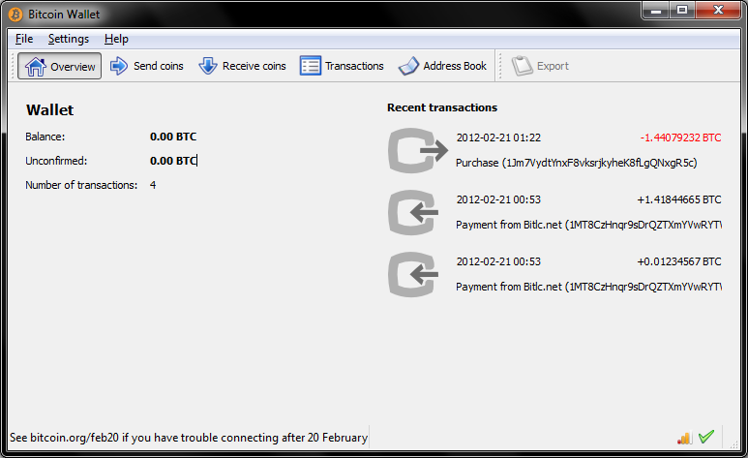
₿
Chapter 2: How Bitcoin Works
Bitcoin-Qt 0.5.2, a wallet of 2012 - the Bitcoin developers, MIT licence, Wikimedia Commons
One payment, followed from the shop's invoice to the blockchain
Python 3.14.6; every result is computed by the chapter library; no Bitcoin Core node was run.
SEN0401 Special Topics in Software Engineering: Block Chain · Fall 2026 · Yusuf Altunel, PhD · İstanbul Kültür University
1 / 59
Notes:
Chapter 1 asked what Bitcoin is; this chapter follows one payment, Alice paying Bob's Store, from invoice to blockchain. Point at the wallet picture on the right, a real wallet of 2012. Ask who has used a wallet app. Every number in the deck was computed by the chapter's own library.

Slide 2
Today's route
₿
Six parts around one payment; every range is a slide you can jump to
1. Questions and the chapter map
(slides 3-4)
2. Buying from an Online Store
(slides 5-10)
3. Bitcoin Transactions
(slides 11-21)
59
slides, 24 of them concept pictures
4. Coin Selection
(slides 22-26)
5. Constructing a Transaction
(slides 27-32)
6. Adding the Transaction to the Blockchain
(slides 33-47)
3
true stories, each told by 5N1K
7. Spending the Transaction
(slides 48-56)
8. Summary, resources, closing
(slides 57-59)
14
code examples, each with a picture of its result
Six parts, three true stories, fourteen examples
2 / 59
Notes:
Six parts follow one payment from the invoice to the spending. Point at the ranges: each is a block of slides you can jump to. Ask the class which part they expect to be hardest. Three true stories and fourteen code examples are spread across the parts.

Slide 3
The questions this chapter answers
₿
Each has an answer on a slide; we return to them in the summary
1
What do Alice's payment and Bob's invoice contain?
2
Why must inputs equal outputs plus a fee, and where does change come from?
3
How does a wallet choose coins and build the outputs?
4
How does a payment travel to a miner and into a block?
5
What makes a payment harder to reverse with each confirmation?
6
Which rules does every node check, and what if a block breaks one?
3 / 59
Notes:
These six questions are the chapter in miniature, and each has an answer on a slide. Read them aloud and ask students to guess the answer before the summary. A common mistake is to treat them as vocabulary; they are about how and why.

Slide 4
The chapter in one picture
₿
One payment, six steps; the parts of the deck follow them
1 Invoice
2 Transaction
3 Coins
4 Build
5 Block
6 Spend
Alice learns what to pay.
Inputs, outputs and a fee.
Pick them; change returns.
Price and sign the payment.
Miners add it; confirmations grow.
Every node checks the rules.
Fourteen code examples run along this path. Each prints its result under the listing and shows it as a picture beside it.
Six steps, one payment: from invoice to a spendable coin
4 / 59
Notes:
Six steps carry one payment: invoice, transaction, coins, build, block, spend. Trace Alice's payment along the row with a finger. Ask where the money is at each step. Students often think coins move; only records of ownership change.

Slide 5
Buying from an Online Store
Alice pays Bob's Store: one real payment, followed all the way
How Bitcoin Works
Bitcoin Overview
satoshi
One payment is followed from the shop's invoice to the blockchain.
Users, wallets, nodes and miners share one record that nobody owns.
The smallest unit: one hundred-millionth of a bitcoin.
Think of tracking a parcel from the shop to your door.
Think of a town where every shop keeps an identical ledger.
Think of the cent, only a million times smaller.
Store | Transactions | Coin selection | Construction | Blockchain | Spending
5 / 59
Notes:
Part 1 starts where Alice does, with an invoice from an online store. Point at the three cards: the whole system, the smallest unit and the link. Ask what the cent is to a dollar. Remind students that the cards are only a preview of the slides that follow.

Slide 6
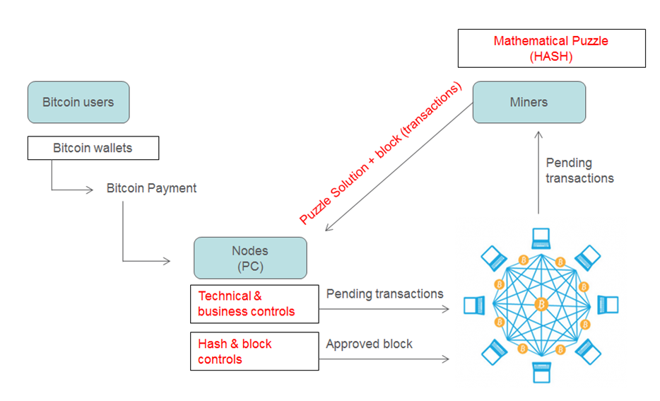
Four roles, one network
₿
Who does what when Alice pays Bob
Users and wallets
A wallet holds keys and signs payments for its user.
Nodes
Check every rule and pass valid transactions on.
Miners
Bundle waiting transactions into the next block.
The blockchain
The shared record of blocks that every node keeps.
Users, wallets, nodes and miners - from the course's 2025 deck
No single owner: wallets sign, nodes check, miners bundle
6 / 59
Notes:
Four roles share the work: wallets sign, nodes check, miners bundle, and the blockchain is the shared record. Point at each box on the right and match it to the picture. Ask who owns the record; the answer is nobody. Do not call a wallet a purse of coins.

Slide 7
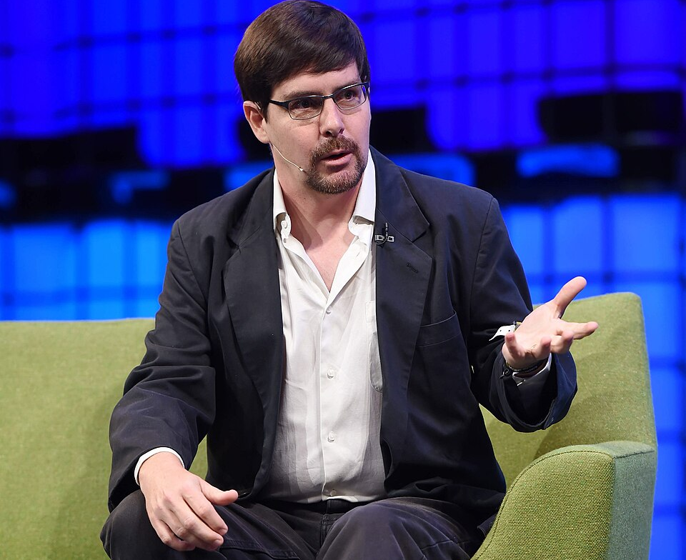
Five free bitcoins for every visitor
₿
11 June 2010 · how a first coin reached its owner
11 June 2010 · Massachusetts and the bitcointalk forum
In June 2010 almost nobody could buy bitcoin, because no exchange yet served ordinary people. Gavin Andresen, a software developer in Massachusetts, decided to put coins into people's hands.
On 11 June 2010 he announced on the bitcointalk forum a website giving five bitcoins to every visitor who solved a CAPTCHA, a puzzle that shows a human is asking.
He had stocked the site with 1,100 of his own bitcoins, enough for 220 visitors at five coins each, and requests were served first come, first served.
Thousands of people received their first bitcoin this way. When Satoshi Nakamoto withdrew in 2011, Andresen went on to lead the project.
Picture: Gavin Andresen, Web Summit 2014 - Stephen McCarthy, CC BY 2.0, Wikimedia Commons
Before bitcoin had a price, giving it away was how it reached its first users.
READ Get 5 free bitcoins (bitcointalk thread) - bitcointalk.org
7 / 59
Notes:
Alice needs bitcoin before she can pay, and in 2010 there was almost nowhere to buy it. Point at Andresen's photograph and at the link line. Ask why anyone would give coins away. Say that this is a true story with a source the students can open.

Slide 8
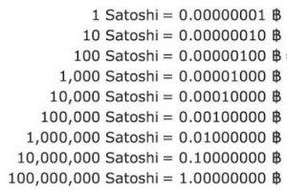
Satoshis are whole numbers
₿
Converting the invoice amount without decimals
btc = '0.01577764'
Result: one amount, written two ways
The invoice amount, written the way people write it.
Written as | Whole satoshis
1 bitcoin | 100,000,000
0.01577764 | 1,577,764
0.00075 | 75,000
sats = T.to_sats(btc)
back = T.to_btc(sats)
(sats, back)
(sats, back) → (1577764, '0.01577764')
Whole numbers in, whole satoshis out, and the same text comes back.
No decimals are needed inside Bitcoin; the amount is a whole number of satoshis.
run under Python 3.14.6 - T is the chapter library of the page (sen0401_ch02_tx_lib_v1_0_0)
The satoshi table of the course's 2025 deck: from one satoshi to one bitcoin
Inside the network every amount is a whole number of satoshis
8 / 59
Notes:
Bitcoin counts in satoshis, one hundred-millionth of a bitcoin. Point at the result card: whole numbers in, the same text back. Ask why decimals are risky for money. The common mistake is to compute with floating point, which loses digits.

Slide 9
Reading Bob's invoice
₿
A payment link is a small, readable address
u = urllib.parse.urlsplit(T.INVOICE)
q = urllib.parse.parse_qs(u.query)
Result: the parts of the invoice link
Part | Value
scheme | bitcoin
address | bc1qk2g6u8p4...
amount | 0.01577764 bitcoin
label | Bob's Store
Split the link into the part before the question mark and the query.
[u.scheme, q['amount'][0], q['label'][0]]
The scheme tells a wallet to open; the query holds the amount and the label.
run under Python 3.14.6 - T is the chapter library of the page (sen0401_ch02_tx_lib_v1_0_0)
The wallet reads these four parts and fills in the payment for Alice.
[u.scheme, q['amount'][0], q['label'][0]] → ['bitcoin', '0.01577764', "Bob's Store"]
One link carries the address, the amount and the label
9 / 59
Notes:
BIP 21 defines the link that wallets and QR codes use. Point at the code lines, then at the result card, now full width. Ask which three facts the wallet reads from the link. Remember that the query text is URL-encoded, so the apostrophe appears as %27.

Slide 10
What is inside Bob's payment link
₿
URI, BIP 21, QR code and BIP
Bob's invoice link, taken apart
bitcoin:
bc1qk2g6u8p4…u3e4
?
amount=0.01577764
&
label=Bob%27s%20Store
scheme
address of Bob's Store
how much
name the payer sees
A QR code on the checkout page holds this same text, so the camera replaces the typing.
Uniform resource identifier. A URI is a text string with a scheme, a path and a query. The scheme bitcoin: tells the phone which app should open.
BIP 21 link. A BIP 21 link carries the address, the amount and a label in one string. The wallet fills in the payment, so nobody types an address.
Think of a web address that opens the right app.
Think of a pre-filled payment slip.
QR code. A QR code is a square barcode that holds a short text such as that link. A phone camera reads it, so nothing is typed.
Bitcoin improvement proposal. A BIP is a numbered design document proposing a feature. Nobody owns Bitcoin, so changes start as public proposals.
Think of a barcode on a parcel.
Think of a numbered recipe card shared in public.
One string carries the address, the amount and the label
10 / 59
Notes:
Bob's link is one string with five parts. Point at the colour of each segment and read it aloud. Ask what the wallet does when it meets the word bitcoin followed by a colon. A common mistake is to think the QR code is encrypted; it only holds this text.

Slide 11
Bitcoin Transactions
Inputs, outputs, chains and change
Transaction Inputs and Outputs
Transaction Chains
Making Change
Inputs spend earlier outputs; outputs lock new amounts to new owners.
Each input points to an earlier output, back to where the coins began.
Part of a spent coin returns to you as a new output.
Think of handing over banknotes and receiving new ones.
Think of a trail of signed receipts, each naming the one before.
Think of paying with a 20 note for a 15 item and getting 5 back.
Store | Transactions | Coin selection | Construction | Blockchain | Spending
11 / 59
Notes:
Part 2 opens the payment itself. A transaction spends earlier outputs and creates new ones, and the difference is the fee. Point at the banknote analogy on the first card. Ask what happens to the part of a banknote you do not need.

Slide 12
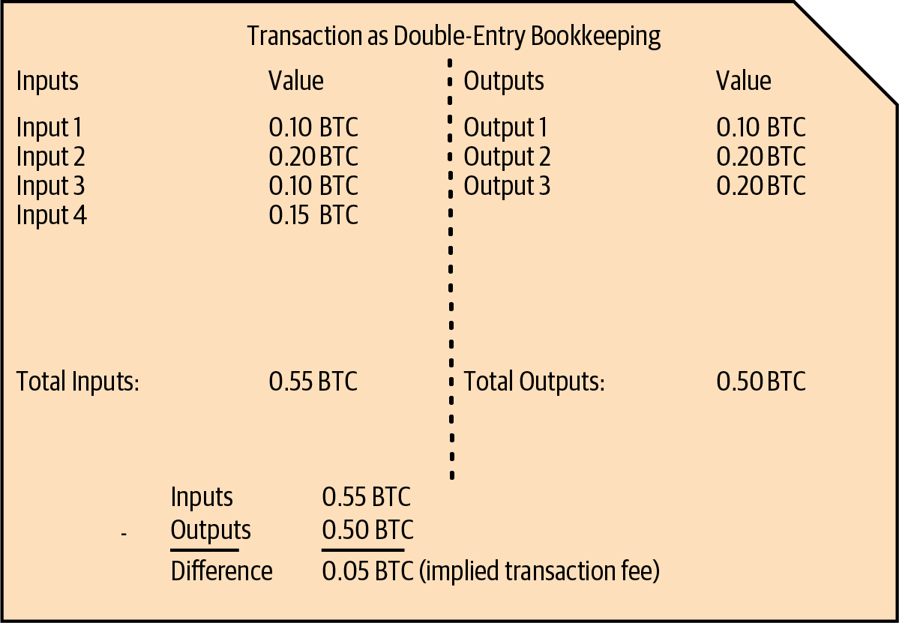
Inputs and outputs
₿
The ledger of figure 2-2, and the two words it is made of
input
A reference to an earlier output being spent, with a signature that proves ownership.
Think of a banknote you hand over to the cashier.
output
An amount of bitcoin locked to a new owner until it is spent.
Think of a banknote you receive in return.
Figure 2-2, Mastering Bitcoin 3rd edition, Antonopoulos and Harding, CC BY-SA 4.0
An input spends an earlier output; an output creates a new one
12 / 59
Notes:
A transaction is double-entry bookkeeping: inputs on the left, outputs on the right, and the difference is the fee. Point at the arrows of figure 2-2. Ask which side holds the coins. A common mistake is to think an input contains money; it only points.

Slide 13
Alice's transaction is a balanced ledger line
₿
Inputs, outputs and fee, in satoshis
Alice's one input and two outputs, drawn to scale (satoshis)
In
input Tx1:0 · 100,000
Out
output to Bob's Store · 75,000
change 20,000
fee 5,000 (implied)
100,000 in = 75,000 + 20,000 out + 5,000 fee
Double-entry ledger. A ledger writes each movement of value as two sides that balance; a transaction is one such line, inputs against outputs plus fee.
Input. An input points at an earlier output and carries the signature that proves you may spend it. That is how payments link into history.
Think of a till roll that must add up.
Think of a banknote you hand to the cashier.
Output. An output locks an amount of bitcoin to a new owner until that owner spends it. Outputs are where ownership is created.
Transaction fee. The fee is what the outputs leave unclaimed; the miner who includes the transaction keeps it, and it buys a place in the next block.
Think of the banknote you get back in return.
Think of the postage stamp on a parcel.
Every satoshi that goes in is either claimed by an output or left to the miner
13 / 59
Notes:
The picture is the ledger line of Alice's payment. Point at the two bars: they have the same length, so inputs equal outputs plus fee. Ask which part the miner collects. A common mistake is to look for the fee as a field; it is only what is left over.

Slide 14
Inputs equal outputs plus the fee
₿
Alice's payment as double-entry bookkeeping
ins, outs = T.ALICE_IN, T.ALICE_OUT
Result: where Alice's 100,000 satoshis go
Alice's one input and her two outputs, in satoshis.
fee = sum(ins) - sum(outs)
(sum(ins), sum(outs), fee)
(sum(ins), sum(outs), fee) → (100000, 95000, 5000)
Inputs minus outputs is the fee; nobody writes it down anywhere.
run under Python 3.14.6 - T is the chapter library of the page (sen0401_ch02_tx_lib_v1_0_0)
100,000 in = 95,000 out + 5,000 fee: the ledger balances.
Whatever the outputs do not claim becomes the miner's fee
14 / 59
Notes:
Inputs add up to 100,000 satoshis and outputs to 95,000, so 5,000 is implied and collected by the miner. Point at the chart: the three slices equal the input. Ask where the fee is written; the answer is nowhere. Students often hunt for a fee field that does not exist.

Slide 15
The txid is shown backwards
₿
The same 32 bytes in two orders
raw = bytes.fromhex(T.PREV_RAW)
Result: the same identifier, two byte orders
The 32 bytes of the earlier transaction's identifier, as an input stores them.
Order | First 8 | Last 8
Stored | eb3ae38f | 8041c54a
Shown | 4ac54180 | 8fe33aeb
shown = raw[::-1].hex()
(raw.hex()[:8], shown[:8])
(raw.hex()[:8], shown[:8]) → ('eb3ae38f', '4ac54180')
The same 32 bytes, read in opposite directions.
Reverse the bytes to get the order in which block explorers display it.
run under Python 3.14.6 - T is the chapter library of the page (sen0401_ch02_tx_lib_v1_0_0)
Explorers show the identifier in reverse byte order
15 / 59
Notes:
Inside a transaction the earlier identifier is stored in one byte order, and explorers print the reverse. Point at the first eight hex digits in the table, which differ. Ask why two tools disagree about the same value. A common mistake is to paste the stored form into an explorer.

Slide 16
How one output is named and found
₿
Unspent outputs, outpoints and the identifier
The coins: outputs no later input has spent
An outpoint names one of them: txid, colon, number
Tx1:1
500,000 sat
Tx2:0
20,000 sat
Tx3:0
67,000 sat
4ac54180…33aeb
:
1
transaction id, 32 bytes
output no.
Together they are the unspent output set that every full node keeps.
eb3ae38f…1c54a
stored form: the same bytes in reverse order
Unspent output. An unspent output is one that no later input has consumed. Nodes keep the set of them, and only these coins can be spent.
Outpoint. An outpoint is a transaction identifier plus an output number, such as Tx1:0. It names exactly one output, so an input can point at it.
Think of the banknotes still in your wallet.
Think of a street address with building and flat.
Transaction identifier. The txid is the 32-byte hash of a transaction's data. It is the transaction's name and the search key in every block explorer.
Byte order. Byte order is the direction bytes are written. A hash is stored one way and shown reversed, so one value looks like two.
Think of a parcel's tracking number.
Think of a date written day-month or month-day.
An input never holds coins; it names an earlier output by its identifier and number
16 / 59
Notes:
Here three names meet. Point at the outpoint on the right: a transaction identifier, a colon and an output number. Ask which outputs are still coins. Remind students that the bytes are stored in the opposite order to the one explorers display.

Slide 17
Size in virtual bytes and the fee rate
₿
How a miner compares transactions
weight = 569
Result: weight, size, fee and rate
Alice's transaction weighs 569 weight units, as Bitcoin Core reports.
Measure | Value
Weight | 569 units
Size | 143 virtual bytes
Fee | 5,000 satoshis
Fee rate | 34.97 sat/vB
vbytes = -(-weight // 4)
rate = round(5000 / vbytes, 2)
(vbytes, rate)
(vbytes, rate) → (143, 34.97)
Four units make a virtual byte, rounded up; fee divided by size is the rate.
run under Python 3.14.6 - T is the chapter library of the page (sen0401_ch02_tx_lib_v1_0_0)
569 / 4 = 142.25, rounded up to 143.
Miners rank transactions by fee per virtual byte
17 / 59
Notes:
The transaction weighs 569 units, which is 143 virtual bytes, and the 5,000 satoshi fee gives about 35 satoshis per byte. Point at the rounding up. Ask why miners care about the rate rather than the fee. Students often divide by the weight instead of the virtual size.

Slide 18
Size, weight and the fee rate
₿
How a miner compares transactions
Alice's transaction: 194 bytes on the wire
Transaction size. Size is the room a transaction takes in a block, counted in weight units; four units make one virtual byte. Blocks are limited, so space is scarce.
125 plain bytes
69 witness
125 × 4 + 69 × 1
weight 569
Think of luggage space on a plane.
Fee rate. The fee rate is the fee divided by the size, in satoshis per virtual byte. Miners fill a block with the best rates first.
569 ÷ 4, rounded up
143 virtual bytes
Think of the price per kilo on a freight bill.
5,000 ÷ 143
34.97 sat per vbyte
Witness. The witness holds the signatures, kept outside the part that names the transaction. Its bytes count only one unit each instead of four, so signing is cheaper.
Think of the signature page stapled behind a contract.
Signature bytes are discounted, and miners rank by fee per virtual byte
18 / 59
Notes:
Follow the numbers down the left: 125 plain bytes count four each, 69 witness bytes count once, giving 569 weight units. Ask why signatures are discounted. A common mistake is to divide the fee by bytes instead of virtual bytes.

Slide 19
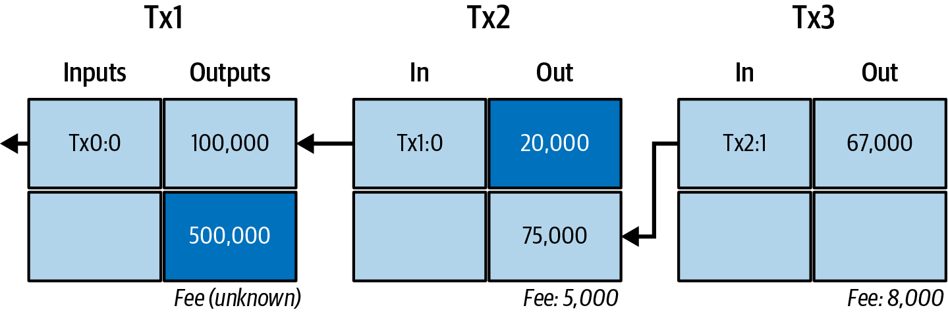
A chain of transactions
₿
Outputs become inputs, and the chain leads back in time
Figure 2-3, Mastering Bitcoin 3rd edition, Antonopoulos and Harding, CC BY-SA 4.0
Each input names an earlier output, such as Tx1:0.
A spent output can never be spent a second time.
Outputs nobody has spent are the coins in a wallet.
Follow the arrows backwards to find where a coin came from
19 / 59
Notes:
Figure 2-3 shows three linked transactions. Point at one arrow and read the output it names. Ask how to find where a coin began. A spent output can never be spent again, which is the whole defence against double spending.

Slide 20
Which outputs are still unspent
₿
Walking the chain of figure 2-3
C = T.CHAIN
used = {i for a, b in C.values() for i in a}
Result: the five outputs of the chain
Output | Satoshis | State
Tx1:0 | 100,000 | spent
Tx1:1 | 500,000 | unspent
Tx2:0 | 20,000 | unspent
Tx2:1 | 75,000 | spent
Tx3:0 | 67,000 | unspent
The chain of figure 2-3, and the set of outputs that some input spends.
val = {o: v for _, b in C.values() for o, v in b.items()}
Every output of the chain with its value in satoshis.
free = [o for o in val if o not in used]
free
free → ['Tx1:1', 'Tx2:0', 'Tx3:0']
Fees: Tx2 paid 5,000, Tx3 paid 8,000 satoshis.
Outputs that nobody has spent are the coins that still exist.
run under Python 3.14.6 - T is the chapter library of the page (sen0401_ch02_tx_lib_v1_0_0)
Unspent outputs are the coins that exist right now
20 / 59
Notes:
Collecting what was spent leaves the unspent outputs, and those are the coins that exist. Point at the three outputs in the result. Ask what a wallet balance is; the answer is the sum of unspent outputs it can sign for. Spent and unspent are not the same as old and new.

Slide 21
A lock, a key and a string of bytes
₿
Script and serialization
The output is a lock, the input brings the key
Script. A script is a tiny program in an output that states how it may be spent. The spender supplies data that makes the program end with TRUE.
Output of Tx2
75,000 satoshis
script: “needs Bob's signature”
Input of Bob's payment
points at Tx2:1
signature of Bob
Think of a padlock whose shape decides which key fits.
TRUE: spend
Serialization. Serialization writes a transaction as one flat run of bytes in a fixed order. That byte string is what is sent, hashed and stored.
The whole transaction written as one run of bytes
version
inputs
outputs
witness
lock time
Think of packing a letter flat for the post.
Sent, hashed and stored in exactly this order; the sizes here are only schematic.
A script locks the output, and serialization turns the whole transaction into bytes
21 / 59
Notes:
Point at the lock on the output and the key on the input, then at the byte fields below. Ask what a script can demand besides a signature. Students often think Bitcoin scripts are a general programming language; they are small on purpose.

Slide 22
Coin Selection
Which coins to spend, and what shape the payment takes
Common Transaction Forms
consolidation transaction
change address
Payment, consolidation and batching are shapes of inputs and outputs.
Many small inputs are merged into one output.
A fresh address of your own that receives the change.
Think of a single cheque, a deposit of coins and a payroll run.
Think of swapping a jar of small coins for one banknote.
Think of a new envelope addressed to yourself.
Store | Transactions | Coin selection | Construction | Blockchain | Spending
22 / 59
Notes:
Part 3 asks how a wallet chooses what to spend. Coins are spent whole, so the choice decides the change. Point at the three cards. Ask what you do when you only have a large banknote.

Slide 23
Coin selection: pick, pay, change back
₿
A wallet chooses coins to cover a payment
vals, need = [60000, 30000, 25000], 80000
Result: payment, coins picked, change
Three coins in the wallet, and a payment of 80,000 satoshis to make.
pick, change = T.select(vals, need)
(pick, change)
(pick, change) → ([60000, 30000], 10000)
Take whole coins in order until they cover the payment; the surplus is change.
run under Python 3.14.6 - T is the chapter library of the page (sen0401_ch02_tx_lib_v1_0_0)
Coins 60,000 + 30,000 are taken, 80,000 is paid, 10,000 goes back.
Coins are taken whole, so the surplus returns as change
23 / 59
Notes:
A wallet cannot cut a coin in half, so it takes whole coins until the payment is covered and sends the surplus back as change. Point at the chart: the picked coins and the change bar. Ask what would happen without change. Real wallets use smarter rules than this one.

Slide 24
Chains, change and the choice of coins
₿
How outputs lead to outputs
The chain of figure 2-3 (satoshis); grey is spent, teal is a coin
Transaction chain. Each input spends an earlier output, so transactions form a chain back to where the coins were created. Follow it to learn where a coin came from.
Tx1
Tx2
Tx3
Tx1:0
100,000
Tx2:0
20,000
Tx3:0
67,000
Think of signed receipts, each naming the one before.
Tx1:1
500,000
Tx2:1
75,000
Making change. An output cannot be spent in part, so the surplus comes back to the payer as a new output instead of going to the miner.
Tx2 pays 75,000 to Bob and returns 20,000 to Alice as change; its fee is 100,000 − 95,000 = 5,000.
Think of paying with a 20 note for a 15 item.
Coin selection chooses which unspent output feeds the next transaction.
Coin selection. Coin selection is the wallet's choice of which outputs to spend. It decides the change, the fee and how scattered the wallet's coins stay.
Think of choosing coins from a purse.
Spent outputs make the chain; unspent outputs are the coins
24 / 59
Notes:
Read the chain left to right: grey outputs are spent, teal ones are coins. Point at the 20,000 output, which is Alice's change. Ask why coin selection matters for privacy and fees. Change is an ordinary output to a new address of the payer.

Slide 25
Three common shapes of a transaction
₿
Counting inputs, outputs and the fee
F = T.FORMS
shape = {k: (len(a), len(b)) for k, (a, b) in F.items()}
Result: inputs, outputs and fee of each shape
Form | In | Out | Fee
Payment | 1 | 2 | 5,000
Consolidation | 3 | 1 | 1,500
Batching | 1 | 4 | 3,000
Three forms, each a list of input values and a list of output values.
fee = {k: sum(a) - sum(b) for k, (a, b) in F.items()}
fee
fee → {'payment': 5000, 'consolidation': 1500, 'batching': 3000}
The fee of each shape is again inputs minus outputs.
run under Python 3.14.6 - T is the chapter library of the page (sen0401_ch02_tx_lib_v1_0_0)
Consolidation merges coins; batching pays many people at once.
The same ledger rule fits every shape
25 / 59
Notes:
Payment, consolidation and batching are three shapes of the same ledger rule: inputs minus outputs is the fee. Point at the table rows. Ask which shape a business paying salaries would use. Do not confuse consolidation with mixing coins.

Slide 26
Three common shapes, counted in satoshis
₿
Payment, consolidation, batching
Payment
Consolidation
Batching
100,000
75,000
30,000
73,500
200,000
60,000
20,000
fee
5,000
25,000
fee
1,500
55,000
fee
3,000
20,000
50,000
32,000
Inputs left, outputs right, in satoshis; 100,000,000 satoshis make one bitcoin.
Simple payment. A simple payment has one input and two outputs: the payment and the change. It is the most common shape because outputs are spent whole.
Consolidation. A consolidation spends many small outputs into one. It tidies a wallet, and doing it when fees are low saves money later.
Think of paying with one note and taking change.
Think of swapping a jar of coins for one note.
Payment batching. Batching pays many people in one transaction with many outputs. One shared input and one overhead lower the fee for each payee.
Satoshi. A satoshi is one hundred-millionth of a bitcoin. The network counts only whole satoshis, so no decimal point is needed inside it.
Think of a payroll run.
Think of the cent, only a million times smaller.
The same ledger rule holds whether one coin or many are spent
26 / 59
Notes:
The same rule appears three times: inputs minus outputs is the fee. Point at the fees under each shape. Ask which shape saves the most per payee. Consolidation is best done when fees are low.

Slide 27
Constructing a Transaction
The wallet assembles, prices and signs the payment
Getting the Right Inputs
Creating the Outputs
transaction fee
Find unspent outputs that together cover the payment and the fee.
Write down who receives how much, and where the change goes.
Inputs minus outputs: the difference that the miner keeps.
Think of counting coins onto the counter before paying.
Think of filling in the payee and the amount on a cheque.
Think of the postage stamp that pays the post office.
Store | Transactions | Coin selection | Construction | Blockchain | Spending
27 / 59
Notes:
Part 4 builds Alice's transaction: find inputs, write outputs, leave a fee, sign. Point at the cheque analogy on the middle card. Ask who decides the fee; the wallet does. The fee rate decides how much change comes back.

Slide 28
From coins to a signed transaction
₿
The five steps a wallet takes for Alice's payment
1 Inputs
2 Outputs
3 Fee
4 Sign
5 Send
Find unspent outputs that cover payment and fee.
One output for Bob's Store, one for the change.
Leave the difference for the miner.
Prove ownership of every input.
Pass the transaction to a node.
Tx1:0 = 100,000
75,000 and 20,000
100,000 - 95,000 = 5,000
one signature per input
the node relays it on
Steps 1 to 3 are the arithmetic of the ledger; step 4 is the signature, treated in chapter 8; step 5 hands the transaction to the network.
The wallet only decides inputs, outputs and fee; the rules do the rest
28 / 59
Notes:
The wallet builds the transaction in five steps and only decides inputs, outputs and fee; the rules do the rest. Point at the sums under step 3. Ask which step needs the private key; it is step 4. Students often think the wallet sends coins, when it sends a signed record.

Slide 29
From a dollar price to a signed payment
₿
Address, exchange rate, wallet, construction
price in dollars
÷ exchange rate at checkout
0.01577764 bitcoin
× 100,000,000
1,577,764 satoshis
output locked to Bob's address
The amount in Bob's payment link is exactly the middle box; the wallet converts it to whole satoshis before it builds the output.
Bitcoin address. An address is a short string with a checksum that stands for the condition of an output. The payer is given it instead of a raw script.
Exchange rate. The exchange rate turns the shop's dollar price into bitcoin at checkout. The amount is valid only for a moment, because the rate keeps moving.
Think of an account number with a check digit.
Think of the board at a money-changer.
Transaction construction. Construction turns a decision to pay into a signed transaction: choose inputs, create outputs, leave the fee, sign. It can run offline.
Wallet. A wallet holds keys, not coins. It tracks which outputs you can spend, builds and signs transactions and shows your balance.
Think of filling in and signing a cheque.
Think of a key ring that opens your lockers.
The wallet turns the shop's price and address into an output you can sign
29 / 59
Notes:
Follow the six boxes from the dollar price to the output. Ask why the invoice must be paid soon. Point at the whole-number step: the wallet never works with decimals. Do not call the wallet a purse that holds coins; it holds keys.

Slide 30
A higher fee rate leaves less change
₿
Pricing the payment before signing
vb = 143
rates = [10, 20, 35, 100]
Result: change left at four fee rates
The size of Alice's transaction, and four fee rates in satoshis per virtual byte.
change = [100000 - 75000 - r * vb for r in rates]
change
change → [23570, 22140, 19995, 10700]
Coin minus payment minus fee: what is left comes back as change.
run under Python 3.14.6 - T is the chapter library of the page (sen0401_ch02_tx_lib_v1_0_0)
At 100 sat/vB the fee takes 14,300; only 10,700 returns as change.
The wallet decides the fee; the change is what remains
30 / 59
Notes:
A higher fee rate leaves less change, because the fee is rate times size. Point at the falling bars. Ask what rate Alice should pick when she is in no hurry. A common mistake is to treat the fee as a percentage of the payment; it depends on size.

Slide 31
Fingerprints and key pairs
₿
The tools a wallet signs with, part 1
One digit changes, the whole fingerprint changes
Easy one way, impossible the other
Alice pays Bob 75,000
fdbb0bf356f4d021…
private key
256-bit secret
multiply: easy
public key
a curve point
Alice pays Bob 75,001
efa7ad02e8f3b888…
undo: infeasible
address (a digest)
SHA-256 gives 64 hex digits for any input; 16 are shown.
Hash function. A hash function turns any data into a fixed-size fingerprint. The same input always gives the same result, and a change gives an unrelated one.
Key pair. A key pair is a secret private key and the public key computed from it. Share the public one, never the private one.
Think of the fingerprint of a document.
Think of a mailbox: anyone posts, only you open.
Public-key cryptography. Two linked keys and a one-way calculation let strangers check a signature without first sharing a secret.
Elliptic curve. Keys are points on the curve secp256k1. Multiplying a point by a number is easy, undoing it infeasible, which protects keys.
Think of a padlock you hand out open.
Think of stirring paint: easy to mix, impossible to unmix.
A hash fingerprints data; a key pair separates checking from signing
31 / 59
Notes:
The two hashes differ completely though the texts differ by one digit. Point at the one-way arrows on the right. Ask which direction is easy. A common mistake is to say the public key can be turned back into the private one; that is infeasible.

Slide 32
Signatures, checks and secrecy
₿
The tools a wallet signs with, part 2
Signing and checking
Digital signature. A signature is computed from a message and a private key. Anyone holding the public key can check it, so it proves approval and detects changes.
message
Signing is not hiding: every transaction is public
signature
private key
Think of a wax seal only you can press.
message + signature
valid, or not
Checksum. A checksum is a short value derived from the data and attached to it. If someone mistypes an address, the check fails before any money moves.
public key
Think of the check digit on a barcode.
A checksum is a short digest kept with the data (sha-256 twice, first 4 bytes):
pay Bob 75000
6f40f2c0
Encryption. Encryption hides data from anyone without the key. Bitcoin uses its keys for signing, not for hiding, so every transaction is public.
pay Bob 75001
681295b0
Think of a signed postcard, not a sealed letter.
A signature proves approval; a checksum catches slips; nothing is hidden
32 / 59
Notes:
Walk through signing on the top row and checking on the bottom. Point at the changed character that breaks the checksum. Ask whether anything is hidden in a transaction. Students confuse signing with encrypting; here nothing is hidden.

Slide 33
Adding the Transaction to the Blockchain
From a node's inbox to a block that others build on
Bitcoin Mining
confirmation
genesis block
Miners search for a number that makes a block of transactions valid.
Every block built on top makes the payment harder to reverse.
The first block of the chain, fixed in the software of every node.
Think of rolling dice until a very rare number turns up.
Think of more witnesses signing a contract.
Think of page one of a ledger, printed into the binding.
Store | Transactions | Coin selection | Construction | Blockchain | Spending
33 / 59
Notes:
Part 5 follows the signed transaction into a block. Point at the dice analogy for mining and the witness analogy for confirmations. Ask why page one of a ledger matters. Each block on top makes reversal harder.

Slide 34
Who takes part in the network
₿
Full nodes, lightweight clients and peers
full node: checks every rule, keeps every block
lightweight client: keeps keys, asks nodes for proofs
Lines are connections between peers. There is no server in the middle.
Full node. A full node downloads every block and checks every rule itself. It trusts nobody, but it needs storage and time.
Lightweight client. A lightweight client keeps your keys but fetches only headers and proofs. It is small and fast, and it trusts the nodes it asks.
Think of a cook who checks every ingredient himself.
Think of buying a ready meal.
Peer and connection. A peer is another node you keep a connection to. Peers swap transactions and blocks as equals; none of them is a server.
Peer-to-peer network. In a peer-to-peer network every participant gives and takes service, with no server or boss; Bitcoin is built so on purpose.
Think of neighbours passing news over the fence.
Think of a choir without a conductor.
Every participant is a peer; they differ in how much they check for themselves
34 / 59
Notes:
Point at the full nodes in the middle and the lightweight clients at the edge. Ask what a lightweight client has to trust. There is no server here; every line is a link between equals, and all participants are peers.

Slide 35
How a payment spreads
₿
Transmission, gossip and propagation
One signed transaction, hop by hop
Transmitting the transaction. Transmission is a wallet sending the signed transaction to any node. The route does not matter, because the transaction carries everything needed to check it.
Alice's wallet
Think of posting a sealed letter in any postbox.
node
node
node
Gossiping. Gossiping means a node that receives a valid new transaction forwards it to all its peers. No coordinator is needed to reach everybody.
node
node
node
node
node
node
Think of news passing from neighbour to neighbour.
miners pick it up
Transaction propagation. Propagation is the spread of the signed transaction by gossip until it reaches the miners. Each node checks it before relaying, so a bad one dies out.
Every node checks the transaction before it forwards it.
Think of a rumour that is fact-checked at every handover.
Each node checks a payment and passes it on, so it reaches the miners
35 / 59
Notes:
Trace the spread ring by ring: one wallet, a few nodes, then many. Point at the check each node makes before forwarding. Ask why the route does not matter. Gossip needs no coordinator, so the spread is fast and hard to stop.

Slide 36
The waiting room and the window
₿
Memory pool, recipient check and block explorer
A node's memory pool, best fee rate first (toy numbers)
Memory pool. The memory pool is a node's waiting room of checked but unconfirmed transactions. Miners build candidate blocks from it, and every node's pool differs a little.
tx a · 52 sat/vB
tx b · 35 sat/vB
fits the next block
Think of the waiting room before the doctor.
Alice's tx · 34.97 sat/vB
The recipient's own check. Bob's wallet recognises the payment because an output is locked to his keys. It checks what it can; a full check needs a full node.
tx d · 12 sat/vB
Think of checking a banknote you receive.
tx e · 4 sat/vB
waits for a later one
Block explorer. A block explorer is a website that searches the blockchain by address, transaction id, block number or block hash. Use it to check a payment without a node.
explorer: paste a txid → block, depth, fee
Think of a parcel tracker for money.
Transactions wait in the pool; an explorer lets anyone watch them reach a block
36 / 59
Notes:
Point at the pool sorted by fee rate and at the bracket that marks the next block. Ask where Bob sees the payment first. An explorer is only a window; the pool of one node can differ from another's.

Slide 37
What a miner builds
₿
Miner, candidate block, block and header
The header: 80 bytes
The body: the transactions
version · 4 bytes
coinbase transaction (pays the miner)
previous block · 32 bytes
summarised by the root
merkle root · 32 bytes
Alice's transaction
time · 4 bytes
other transactions…
target (bits) · 4 bytes
nonce · 4 bytes
Miner. A miner builds a candidate block and searches for a proof of work. The reward pays for ordering transactions, a job nobody is appointed to.
Candidate block. A candidate block is the block a miner is building from the memory pool. It is not valid until a proof of work is found for it.
Think of a lottery player who must show the winning ticket.
Think of a draft that is not yet signed.
Block. A block is a container of transactions with an 80-byte header. It gives the transactions an order and a time.
Block header. The header is 80 bytes: version, previous block, merkle root, time, target and nonce. Miners hash it, and the block's name is that hash.
Think of a page of the ledger.
Think of the cover sheet of a file.
A block is a header of 80 bytes plus a list of transactions
37 / 59
Notes:
Show a block as a header of six fields plus a list of transactions, the coinbase first. Point at the 80-byte total. Ask what the miner hashes; it is the header only. A candidate block becomes a block only with a proof of work.

Slide 38
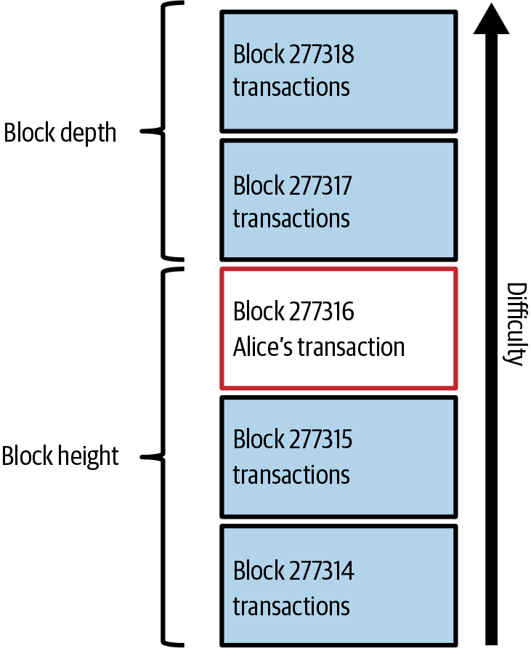
Height, depth and confirmations
₿
Where Alice's transaction sits in the chain
Block height
The position of a block, counted from the genesis block. Alice's block is 277,316.
Block depth
How many blocks lie on top of a block.
Confirmation
Alice's block is the first confirmation; each block on top adds one more.
Block explorer
Paste a transaction id into an explorer to see its block, depth and fee.
Figure 2-7, Mastering Bitcoin 3rd edition, CC BY-SA 4.0
More blocks on top means a payment that is harder to reverse
38 / 59
Notes:
Alice's transaction sits in block 277,316. Height counts up from the genesis block and depth counts the blocks on top. Point at figure 2-7 and ask how many confirmations Alice has after three more blocks. Height and depth are different numbers.

Slide 39
Confirmations counted on a ruler
₿
Where Alice's payment sits
Height counts blocks from the genesis block; confirmations count blocks from Alice's block upwards.
mempool
0 confirmations
height
0
height
…
height
277,316
height
277,317
height
277,318
genesis
Alice's block: 1
2
3
Confirmation. A transaction has one confirmation when its block is found and one more for each block on top. To reverse it, an attacker must redo them all.
Block height. Height is a block's distance from the first block, which has height 0. It tells a person or a program where in the chain a block sits.
Think of more witnesses signing a contract.
Think of the floor number in a tall building.
Genesis block. The genesis block is block 0, with no parent. It is written into the software, so every node starts from the same root.
Unconfirmed transaction. Checked and relayed, but in no block yet. Blocks arrive about every ten minutes on average, not on a timetable.
Think of page one of a ledger, printed into the binding.
Think of a cheque handed in but not yet cleared.
Each block on top of Alice's makes her payment harder to reverse
39 / 59
Notes:
The ruler runs from the genesis block to Alice's block and beyond. Point at the dashed box: before a block, the payment is unconfirmed. Ask how many confirmations after block 277,318. Height and confirmations are different counts.

Slide 40
One more zero, many more tries
₿
Mining as a search for a lucky number
data = 'Hello, world! '
def ok(n, z):
return T.sha(data + str(n)).startswith('0' * z)
Result: tries needed for 1 to 4 zeros (log scale)
A text, and a test: does the hash of text plus counter start with z zeros?
def find(z):
return next(n for n in range(10**7) if ok(n, z))
[find(z) for z in (1, 2, 3, 4)]
[find(z) for z in (1, 2, 3, 4)] → [33, 302, 10182, 32977]
Count up from zero until the test passes, for one to four zeros.
run under Python 3.14.6 - T is the chapter library of the page (sen0401_ch02_tx_lib_v1_0_0)
Each extra zero needs about 16 times more tries on average.
Mining is a search; more zeros means more work
40 / 59
Notes:
A miner changes the nonce and hashes again until the result starts with enough zeros. Point at the log-scale bars: each extra zero costs about sixteen times more tries. Ask how anyone can check the answer fast. The result is luck, not skill, and no shortcut exists.

Slide 41
Bytes, hex, entropy and nonce
₿
The small ideas under every hash
One byte, three ways: 0xEB
A nonce changes the hash of 'Hello, world! ' + n
bits
1110 1011
8 bits = 1 byte = 2 hex digits
n = 31
67714226e23b98ee4564…
starts with 0
hexadecimal
E B
n = 32
e403759cbc9dba939ca3…
decimal
235
n = 33
022fe9bf01b52d08c7fc…
Entropy: 256 bits are about 77 decimal digits of possibilities (2^256 is roughly 1.16 × 10^77).
Bit and byte. A bit is one binary digit; eight bits make a byte. A 256-bit hash is therefore 32 bytes.
Hexadecimal notation. Hexadecimal writes numbers in base sixteen, digits 0 to 9 and a to f. One byte is exactly two hex digits.
Think of letters and words.
Think of shorthand for long strings of zeros and ones.
Entropy. Entropy measures unpredictability in bits. A key drawn from 2^256 equally likely values cannot be guessed.
Nonce. A nonce is a number that is changed to get a different hash. Miners count it up until the hash is low enough.
Think of a die rolled too often to repeat.
Think of throwing the dice again and again.
A nonce changes the hash; entropy and bytes size the search
41 / 59
Notes:
Use the byte 0xEB to move between bits, hex and decimal. Point at the nonce table: one number changes the whole hash, and 33 is the first that starts with a zero. Ask how many digits 256 bits need in decimal. Do not mix up bits and bytes.

Slide 42
The first block header is 80 bytes
₿
Hashing the genesis block's header
hdr = T.genesis_header()
Result: the six fields of the header
Pack the six fields of Bitcoin's first block header into 80 bytes.
Field | Bytes | Value
Version | 4 | 1
Previous block | 32 | all zeros
Merkle root | 32 | 4a5e1e4b...
Time | 4 | 1231006505
Bits | 4 | 1d00ffff
Nonce | 4 | 2083236893
h = T.block_hash(hdr)
(len(hdr), h[:20])
(len(hdr), h[:20]) → (80, '000000000019d6689c08')
Hash twice and reverse the bytes: the name of the first block starts with ten zeros.
run under Python 3.14.6 - T is the chapter library of the page (sen0401_ch02_tx_lib_v1_0_0)
Hashed twice: 000000000019d668...
A block's name is the hash of its 80-byte header
42 / 59
Notes:
The genesis block was mined on 3 January 2009; its header packs six fields into 80 bytes. Point at the nonce row. Ask why the name starts with ten zeros. Hashing twice and reversing the bytes is the step students forget.

Slide 43
Trees, targets and the pace of mining
₿
Merkle tree, proof of work, difficulty, hash rate
Four transactions, one root
Proof of work: the hash must fall below the target
root 3d601750
target 00000000ffff…
da33c8c3
790f0d7e
genesis hash 000000000019…
Difficulty 1: about 4.3 billion hashes per block,
tx A b11cc6
tx B 3e06ec
tx C ea3d9d
tx D 042772
roughly 7 million hashes per second over 600 s.
Merkle tree. A merkle tree hashes transactions in pairs, up to one root. The header holds the root, so 80 bytes commit to every transaction.
Proof of work. Proof of work is data costly to produce and cheap to check. A hash below the target proves that many attempts were made.
Think of a tournament bracket that ends in one champion.
Think of a completed jigsaw puzzle.
Difficulty and target. The target is the ceiling a block hash must fall under; difficulty is its inverse, reset every 2,016 blocks to keep a ten-minute pace.
Hash rate. Hash rate is the number of hashes tried per second across the network. It measures how costly rewriting history would be.
Think of a thermostat for the pace of blocks.
Think of the number of dice thrown per second.
One root commits to all transactions, and one target sets the pace
43 / 59
Notes:
Build the tree from the bottom: pairs of hashes up to one root. Point at the target line on the right and the hash below it. Ask what changes when the difficulty rises. Difficulty moves every 2,016 blocks, not every block.

Slide 44
When two blocks compete
₿
Best chain, forks and the double spend
A fork resolved by the next block
Best blockchain. When several valid chains exist, each node follows the one with the most cumulative proof of work. That chain is the record.
A
next
block
block
block
Think of the road that took the most work to pave.
B
Fork and alternative block. Two valid blocks can appear at the same height by accident. The next block settles it, and the losing block's transactions return to the pool.
B is left behind; its transactions return to the pool.
Think of two forks in a road that rejoin.
Double spend: two transactions, one output
Tx1:0 → Bob's Store
enters block A, so the best chain keeps it
Double spend. A double spend tries to spend one output twice. Nodes refuse the second, and the blockchain's order decides which one came first.
Tx1:0 → Alice again
refused: the output is already spent
Think of paying two shops with the same banknote.
The chain with the most work wins, and the loser's transactions return to the pool
44 / 59
Notes:
Two blocks arrive at the same height, and the next block decides. Point at the longer branch. Ask what happens to the transactions in the loser. A double spend fails because only one of two conflicting transactions can be in the best chain.

Slide 45

Nine pages, one table of probabilities
₿
31 October 2008 · section 11 of the white paper
31 October 2008 · the metzdowd.com cryptography mailing list
On 31 October 2008 an author writing as Satoshi Nakamoto posted a nine-page paper to the readers of the metzdowd.com cryptography mailing list. The PDF now lives on bitcoin.org.
Section 11 does something unusual for a systems paper: it computes the attacker's odds. It models the race between the honest chain and a secret one as a random walk.
Its table gives the chance that an attacker holding a share q of the hash power catches up, showing that waiting for confirmations makes a double spend unlikely.
The next slide reruns the paper's own procedure and agrees with its table to seven decimal places.
Picture: Satoshi bust, Budapest - Fekist, CC BY-SA 4.0, Wikimedia Commons
A confirmation is a probability statement, and you can compute it.
READ Bitcoin white paper (PDF) - bitcoin.org
45 / 59
Notes:
The white paper reached readers on 31 October 2008, and its section 11 computes the attacker's odds. Point at the bust and at the source link. Ask what question a mathematician would ask about confirmations. Say that Satoshi Nakamoto is a pseudonym.

Slide 46
Nakamoto's catch-up table, recomputed
₿
Section 11 of the white paper, run again
q10 = [round(T.catch_up(0.1, z), 7) for z in range(7)]
Result: the attacker's chance per block
The white paper's formula for an attacker with 10 percent of the hash power.
q30 = [round(T.catch_up(0.3, z), 7) for z in range(7)]
(q10[1], q10[6])
(q10[1], q10[6]) → (0.2045873, 0.0002428)
The same for 30 percent; the printed pair is the chance at one and at six blocks.
run under Python 3.14.6 - T is the chapter library of the page (sen0401_ch02_tx_lib_v1_0_0)
A 30 percent attacker still has 13 percent after six blocks.
Every confirmation makes a reversal much less likely
46 / 59
Notes:
Rerunning the formula gives the paper's table to seven places. Point at the two lines: the attacker with 10 percent and with 30 percent of the power. Ask why six confirmations became a habit. A larger attacker never makes the odds vanish, only smaller.

Slide 47
How many confirmations are enough
₿
The odds, and a shop's choice
Chance that an attacker ever catches up (the white paper's formula, rerun)
Probability of reversal. The chance that an attacker catches up falls very fast with each confirmation. Nakamoto's table lets a shop choose how many to wait for.
confirmations | 10% of hash power | 30% of hash power
0 | 1.0000000 | 1.0000000
1 | 0.2045873 | 0.6277491
2 | 0.0509779 | 0.4457171
4 | 0.0034552 | 0.2391269
6 | 0.0002428 | 0.1321112
Think of the odds of a trailing runner catching the leader.
Accepting a small payment unconfirmed. A shop may accept a small payment with no confirmation because waiting costs more than the risk. How many to require is a business choice.
Think of a cafe taking coins without checking each one.
Example choices: a coffee 0, a laptop 3, a car 6 confirmations.
The more it costs to lose, the more confirmations a seller waits for
47 / 59
Notes:
Read the table downwards: each confirmation shrinks the attacker's chance. Point at the two columns. Ask what a shop selling a coffee should require. The number of confirmations is an economic choice, not a technical rule.

Slide 48
Spending the Transaction
When Bob may spend, and what every node checks first
consensus rules
block explorer
Rules that every node checks the same way; a block that breaks one is refused.
A website where anyone can look up blocks, transactions and addresses.
Think of the rules of chess that every player and referee enforce.
Think of a parcel tracker for money.
Store | Transactions | Coin selection | Construction | Blockchain | Spending
48 / 59
Notes:
Part 6 closes the loop: Bob spends his output, and every node checks the same rules. Point at the chess analogy. Ask what happens to a block that breaks a rule. It is refused by everyone, and its miner earns nothing.

Slide 49
The reward halves every 210,000 blocks
₿
One of the consensus rules, in one line
era = T.HALVING_INTERVAL
def reward(h):
return 50 * T.COIN >> h // era
Result: the block reward of each era, in bitcoin
Fifty bitcoin, shifted right by one bit for every completed era of 210,000 blocks.
[reward(h * era) / T.COIN for h in range(6)]
The reward at the first block of each of the first six eras, in bitcoin.
run under Python 3.14.6 - T is the chapter library of the page (sen0401_ch02_tx_lib_v1_0_0)
The reward halved in 2012, 2016, 2020 and 2024; 2028 is the next halving due.
[reward(h * era) / T.COIN for h in range(6)] → [50.0, 25.0, 12.5, 6.25, 3.125, 1.5625]
Halving is a rule every node enforces, not a promise
49 / 59
Notes:
The reward is a consensus rule: every node computes it the same way and refuses a block that claims more. Point at the halving steps and the full-width result. Ask why the total is capped. Halving is a rule, not a promise of price.

Slide 50
Where new coins come from
₿
Coinbase, reward, pools and the sudoku picture
The coinbase transaction
Hard to solve, instant to check
A mining pool
input: none
(coinbase text)
reward + fees
to the miner
1
3
4
Empty cells are found by trial; a full grid is checked at a glance.
miner 1
4
1
3
miner 2
pool
It is where new coins are created.
4
3
1
miner 3
3
1
4
The reward is shared by shares proved.
Coinbase transaction. The coinbase is the first transaction of each block. It spends no earlier output and pays the miner the new coins plus the fees.
Block reward. The reward is new coins plus fees. The subsidy began at 50 bitcoin and halves every 210,000 blocks, capping the total just under 21 million.
Think of the mint's wage slip.
Think of a prize that is halved at fixed intervals.
Mining pool. A mining pool joins many miners' hash power and shares the reward in proportion to the shares each one proves. Small miners get a steady income.
Sudoku analogy. Mining is like a huge sudoku: hard to solve, instant to check, adjustable in size, and restarted whenever someone finishes.
Think of a lottery syndicate.
Think of a sudoku handed in for checking.
The first transaction of each block creates the coins that pay for mining
50 / 59
Notes:
Point at the coinbase: no input, one output to the miner. Next to it, show the sudoku, hard to fill and quick to check. Ask who pays for mining. The pool diagram shows many small miners sharing one reward in proportion to their shares.

Slide 51

The day someone printed 184 billion bitcoin
₿
15 August 2010 · block 74,638
15 August 2010 · block 74,638 · the bitcointalk forum
On 15 August 2010 block 74,638 contained a transaction that paid out about 184 billion bitcoin, thousands of times the 21 million limit. Nobody knows who sent it.
Two of its outputs were so large that, added as 64-bit numbers, they wrapped around to a small number, and the check that outputs do not exceed inputs passed.
Jeff Garzik spotted the strange block and raised it on the forum within the hour. Satoshi Nakamoto shipped a corrected version, 0.3.10, about five hours after the block.
The honest chain, built without the forged coins, overtook the bad one by block 74,691, and the 184 billion bitcoin ceased to exist.
Picture: Bitcoin logo - Grayliptrot, public domain, Wikimedia Commons - a stand-in, since no free picture of the event exists
Every node checks every rule, so the missing rule was repaired within hours.
READ Value overflow incident (Bitcoin Wiki) - en.bitcoin.it
51 / 59
Notes:
On 15 August 2010 block 74,638 created about 184 billion bitcoin out of an overflow. Point at the date and at the source link. Ask which rule was missing. Say that the network fixed itself in hours because every node checks every rule.

Slide 52
Two outputs that wrapped around
₿
Block 74,638 and the value overflow of 2010
big = 9223372036854277039
total = big + big
Result: the overflow, number by number
Step | Satoshis
Each output | 9,223,372,036,854,277,039
True sum | 18,446,744,073,708,554,078
Stored in 64 bits | -997,538
Each of the two outputs of block 74,638 held this many satoshis.
stored = T.wrap64(total)
(stored, stored < 0)
(stored, stored < 0) → (-997538, True)
A signed 64-bit number wraps around, so the sum turns negative.
run under Python 3.14.6 - T is the chapter library of the page (sen0401_ch02_tx_lib_v1_0_0)
The stored sum is negative, so it sits below any input and the old check passed.
One overflow created 184 billion bitcoin; one new rule ended it
52 / 59
Notes:
Two huge outputs summed to a negative number in 64 bits, so the old check passed. Point at the table row 'Stored in 64 bits'. Ask what a range check would have done. The common mistake is to think the attacker broke cryptography; no key was broken.

Slide 53
The rules and how they change
₿
Consensus rules, soft forks and hard forks
What every full node checks
Consensus rules. Consensus rules are the checks every full node applies to blocks and transactions. A block that breaks one is refused by everyone and earns its miner nothing.
✓ proof of work below the target
✓ no output above its inputs
Think of the rules of chess that every referee enforces.
✓ coinbase not above the reward
✓ block within the size limit
Soft fork and hard fork. A soft fork narrows what is valid, so old nodes still agree. A hard fork widens it, and nodes that do not upgrade split away.
Soft and hard forks, as sets of valid blocks
Think of tightening a rule versus changing the game.
hard fork: wider set, old nodes split away
old rules
soft fork: narrower
A rule change is safe when old nodes still accept the new blocks
53 / 59
Notes:
Rules are checks every full node makes. Point at the nested boxes: a soft fork shrinks the valid set, a hard fork enlarges it. Ask which one old nodes survive. A hard fork is not just a big upgrade; it splits nodes that stay behind.

Slide 54
Spending onward, and checking with a short proof
₿
Chain extension and simplified verification
Spending onward: the chain grows by one link
Spending onward. Once recorded, Bob can spend the output in a new transaction, which extends the chain. His 67,000 satoshis out of 75,000 leave a fee of 8,000.
Joe
Alice
Bob
Gopesh
Bob pays Gopesh 67,000 of the 75,000 he received; the fee is 8,000.
Think of passing a banknote on to the next shop.
A short proof: 3 hashes for 8 transactions
root in header
Simplified payment verification. Simplified payment verification proves a transaction is in a block with a short merkle path of about log2 N hashes, instead of the whole block.
hash
hash
hash
hash
hash
hash
Think of checking one page's seal, not the book.
tx1
tx2
tx3
tx4
tx5
tx6
tx7
tx8
Orange: the payment. Teal: the hashes a lightweight client is sent.
Bob's wallet can prove a payment with a handful of hashes
54 / 59
Notes:
Spending onward extends the chain: Bob's output becomes the input to his payment. Point at the merkle path of three hashes. Ask how a phone checks a block of thousands without downloading it. The proof shows inclusion, not that the payment is wise.

Slide 55
The chain written as a graph of statements
₿
Ontology, triples and provenance
Each arrow is one triple: subject, predicate, object
Ontology. An ontology is an explicit, machine-readable description of a field's concepts and their relations. This course records every chapter as one so it can be queried and checked.
Entity
output Tx2:1
Agent
Alice's key holder
Think of a catalogue with a map of how things relate.
associated with
generated by
Triple and graph. A triple is a statement of subject, predicate and object. Many triples form a graph, and graphs from different sources combine without planning.
Activity
transaction Tx2
used
Entity
output Tx1:0
Think of a sentence cut down to three words.
Tx2:1 generated by Tx2; Tx2 used Tx1:0; Tx2 associated with Alice.
Provenance graph. Read as a provenance graph, outputs are entities, transactions are the activities that derive them and key holders are the agents responsible.
Think of a family tree of money.
Outputs, transactions and key holders are things, activities and agents
55 / 59
Notes:
The chain can be written as triples: subject, predicate, object. Point at the three kinds of node: entity, activity and agent. Ask what question a graph can answer that a list cannot. An ontology is a model of the field, not a database.

Slide 56
Five pages to try the mechanism yourself
₿
The interactive demonstration, step by step
Each page keeps everything of the one before and adds one idea
page 5
page 4
page 3
page 2
page 1
Hash page. The first page shows a data box and its SHA-256 digest, recomputed with every keystroke.
Block page. The second page adds a block number, a nonce and a Mine button: thousands of tries to find it, one instant check.
Blockchain page. The third page links five blocks by previous hash; edit an early block and every later one turns red until it is mined again.
Distributed page. The fourth page gives peers A, B and C a copy each; tamper with one and the others disagree with it.
Coinbase page. The last page adds a reward line and transactions to every block, so balances can be read off the chain.
Think of a fingerprint scanner.
Think of three notebooks kept by three friends.
Think of a ledger that includes the mint's entry.
Think of a combination lock opened by trying.
Think of a chain of sealed envelopes.
Each page adds one idea to the one before it
56 / 59
Notes:
Each demonstration page adds one idea: hash, block, chain, peers, coinbase. Point at the ladder and ask students to predict what breaks when an early block is edited. Say that trying each page for five minutes teaches more than rereading the slide.

Slide 57
Summary: the six answers
₿
The questions of slide 3, answered
Question | Answer in one line
1 What does a payment contain? | Inputs that spend earlier outputs, outputs for Bob and the change, a fee.
2 Why inputs = outputs + fee? | The ledger must balance; the rest, 5,000 satoshis, is the miner's fee.
3 How is it built? | Pick coins, write the outputs, leave the fee, sign.
4 How does it reach a block? | A node relays it; a miner finds a valid nonce and adds a block.
5 Why confirmations? | A 10 percent attacker's chance falls from 20.5 to 0.02 percent.
6 Which rules? | Consensus rules, checked by every node; block 74,638 broke one.
Inputs, outputs, fee, mining, confirmations, rules
57 / 59
Notes:
Each row answers one of the six opening questions in a line. Ask students to cover the right column and answer from memory. Point back to slide 3. A student who can use the everyday pictures to explain each answer has the chapter.

Slide 58
Resources: read, try, watch, ask
₿
Every link was opened on 25 October 2026; free to use
Read Mastering Bitcoin, chapter 2 (source text)
The chapter this deck follows.
Try mempool.space block explorer
Look up any transaction, block or fee.
Read Developer guide: transactions
Inputs, outputs and fees in detail.
Try Anders Brownworth's blockchain demo
Hash, block and mine in the browser.
Standards and papers Bitcoin white paper
Nine pages; section 11 holds the catch-up table.
Watch MIT 15.S12 Blockchain and Money
A full university course, free.
Standards and papers BIP 21: payment links
The standard behind Bob's invoice link.
Community Bitcoin Optech topics
Short explainers on how the technology works.
Standards and papers Bitcoin Core releases
The software that checks every rule.
Community Bitcoin Stack Exchange
Ask a question, read the answers.
Look up a real transaction in a block explorer today
58 / 59
Notes:
These links are open and free. Start with the chapter source and the white paper, then paste a real transaction into the block explorer. Ask which resource each student will try this week. Treat the explorer as a reading tool, never as a place to enter keys.

Slide 59
Questions?
One payment, from the invoice to the blockchain
Next: chapter 3, Bitcoin Core, the reference implementation
Python 3.14.6; every result in this deck was computed by the chapter library, not typed
59 / 59
Notes:
That is the whole path of one payment. Chapter 3 opens Bitcoin Core, the software that checks every rule. Ask for the one slide that was least clear. Invite questions on any of the six answers.

