Slide 1
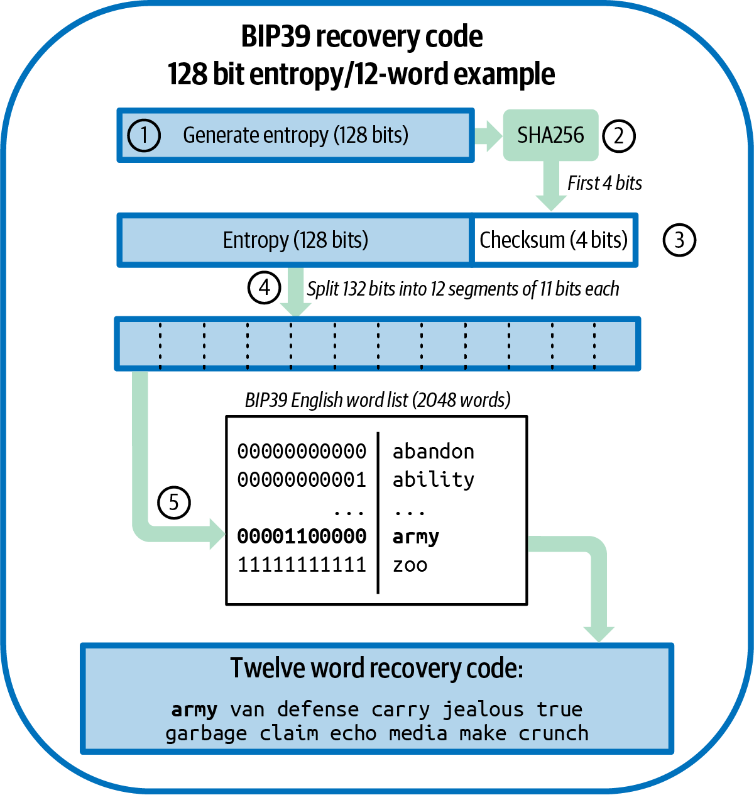
Chapter 5: Wallet Recovery
One seed, twelve words, and every key you will ever need back
SEN0401 Special Topics in Software Engineering: Block Chain - Fall 2026 - Yusuf Altunel, PhD - Istanbul Kultur University
Figure: Mastering Bitcoin 3e, CC BY-SA 4.0
Mastering Bitcoin 3e, chapter 5: Wallet Recovery
1 / 68
Notes:
Welcome to chapter five. A wallet is not a bag of coins but a bag of keys, and keys can be lost. Today we learn how one seed, written as twelve words, brings every key back.

Slide 2
Today's route
₿
Seven parts; every number is a slide you can jump to
1
Questions, map, story and tools (slides 3-6)
68
2
Part 1: Keys in wallets (slides 7-11)
slides, numbered bottom-right
3
Part 2: Recovery codes (slides 12-18)
4
Part 3: The BIP39 stack (slides 19-30)
27
5
Part 4: The HD wallet (slides 31-42)
code examples, each with its result
6
Part 5: Paths and descriptors (slides 43-52)
7
Part 6: Data that is not keys (slides 53-56)
3
8
Part 7: Deploying and testing (slides 57-65)
true stories, told as who, what, when, where, why, how
9
Summary, resources and questions (slides 66-68)
Seven parts, and at the end a backup you have actually tested.
Mastering Bitcoin 3e, chapter 5: Wallet Recovery
2 / 68
Notes:
Today has seven parts, and every part opens with a divider. The numbers are slide numbers, so you can jump back to any part. The code slides are numbered in order and match the course page.

Slide 3
The questions this chapter answers
₿
Seven questions; each one is answered by a part of the deck
1
What does a Bitcoin wallet actually contain?
2
How does a recovery code turn into a seed?
3
How does one seed make a whole tree of keys?
4
Which recovery code schemes are in use?
5
Which derivation paths does a wallet use?
6
Where does the book differ from the standards?
7
What must you back up, and how do you test it?
If you can answer these seven, chapter 5 is yours.
Mastering Bitcoin 3e, chapter 5: Wallet Recovery
3 / 68
Notes:
These seven questions are the chapter's own competency questions. If you can answer them at the end, you own the chapter. Keep them in mind as we move through the parts.

Slide 4
One chapter, eight branches
₿
How many concepts the course page explains in each branch
How to read the deck
Seven parts follow the branches.
Every part opens with a divider.
Code slides show the code, a note beside it, and the result.
Today's spine: keys, codes, the tree, paths, backups.
Mastering Bitcoin 3e, chapter 5: A Wallet Technology Stack in Detail
4 / 68
Notes:
The chapter is a tree of eight branches. The bars count the concepts in each branch of the course ontology. Today we walk the spine: keys, codes, the BIP39 stack, the HD tree, paths, non-key data and deployment.

Slide 5

Two guesses from 7,002 bitcoin
₿
A true story, told as who, what, when, where, why and how
WHO
Stefan Thomas, programmer and former Ripple technology chief; reporter Nathaniel Popper, New York Times.
WHAT
Locked out of an IronKey drive that holds the keys to 7,002 BTC; eight of ten password guesses used.
WHEN
2021-01-12 - the story ran; the 7,002 BTC was paid in 2011.
WHERE
An IronKey USB drive in a safe, and the front page of the New York Times.
WHY
The password was on a paper he lost; memory was his only backup.
HOW
The drive locks forever after ten wrong guesses. A tested recovery code is the alternative.
READ NYT via Business Standard (news) business-standard.com
Stefan Thomas, 2015 - Lift Conference, CC BY 2.0
Memory is not a backup; a recovery code you never test is barely one
5 / 68
Notes:
Stefan Thomas was paid 7,002 bitcoin in 2011 and locked the keys on an encrypted drive. He lost the password and has two guesses left. This chapter is the discipline that makes the story impossible to repeat.

Slide 6
The tools we run today
₿
One small Python library, written for reading
Function | What it does
entropy_to_mnemonic | random bits to recovery words
mnemonic_to_seed | words to a 512-bit seed
master, ckd_priv, ckd_pub | seed to master key, parent to child
keys_at | a key at a path below a code
p2wpkh_address | a public key to a bc1q address
descsum_create | a descriptor checksum
shamir_split, scan_with_gap | split a secret, scan addresses
Name | Sample data
ENT, WORDS | the book's 128 bits and its 12 words
TV | BIP32 test seed
B84 | BIP84 test recovery code
DESC | a descriptor Core made
BOOK_XPUB | the book's extended public key
Same library, same data, every code slide: only the idea changes.
Mastering Bitcoin 3e, chapter 5: Wallet Recovery
6 / 68
Notes:
Every code slide uses the same small chapter library, written for reading and checked against the standards' test vectors. It is not for real money. The sample data names on the right are reused on every slide.

Slide 7
Part 1: Keys in wallets
From a bag of keys to one recoverable seed
wallet database
the file where a wallet keeps its keys and notes
How they fit together
1. Seed
2. A rule
3. Key 0
4. Key 1
5. Key 2
independent key generation
every key made alone, so every key needs a backup
deterministic key generation
every key follows from one seed by a rule
seed
the one secret all the keys come from
key tweak
a number added to a key to make a related key
hardware signing device
a small computer that signs and never shows its keys
Mastering Bitcoin 3e, chapter 5: Independent Key Generation
7 / 68
Notes:
Part one asks what a wallet really holds and why one seed beats a bag of keys. Six concepts open the part. The picture shows the idea: one seed and a rule give every key.

Slide 8
What a wallet really holds
₿
A wallet application, its database, and who signs
Wallet application prepares a payment
Wallet database supplies the keys
Signing device signs
Network receives it
Wallet database
Wallet with public keys only
The file where a wallet application keeps its keys and its notes.
It can see funds sent to its keys and show them, but it cannot spend.
External signing
Hardware signing device
One program prepares the transaction; another program or device signs it.
A small computer that holds private keys and signs without revealing them.
Keys are the wallet; everything else can be rebuilt from them.
Mastering Bitcoin 3e, chapter 5: A Wallet Technology Stack in Detail
8 / 68
Notes:
A wallet database mostly holds keys. Some databases hold only public keys, so the application can watch funds but not spend them. Then an external signer, such as a hardware signing device, makes the signature.

Slide 9
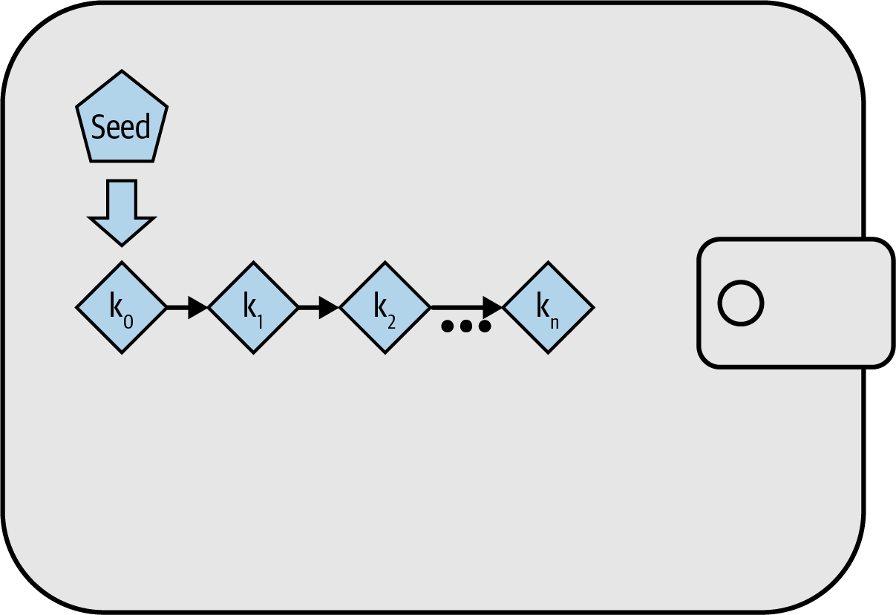
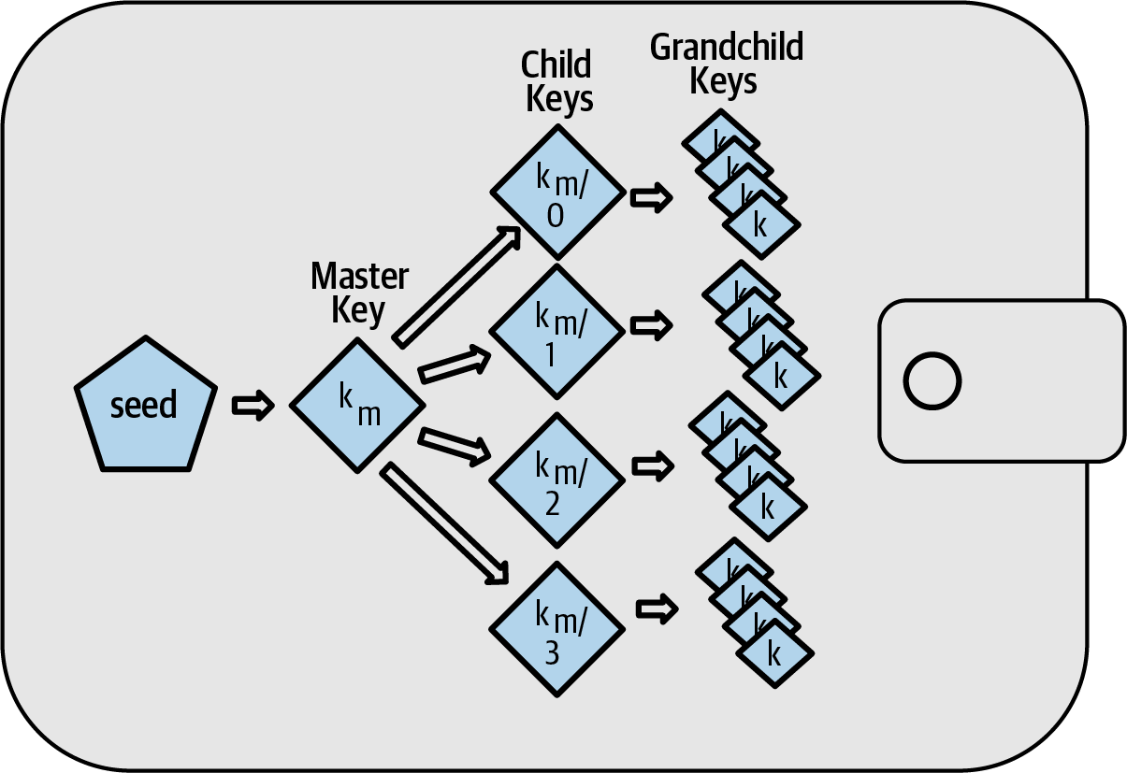
Three ways to make keys
₿
Loose, deterministic, hierarchical
Figure: Mastering Bitcoin 3e, CC BY-SA 4.0
Figure: Mastering Bitcoin 3e, CC BY-SA 4.0
Deterministic: one seed, keys k0 to kn
Hierarchical: a tree of keys below the seed
Independent keys: a backup for each. Seed-based keys: one backup.
Mastering Bitcoin 3e, chapter 5: Hierarchical Deterministic (HD) Key Generation (BIP32)
9 / 68
Notes:
Independent keys are made one by one and each needs its own backup. A deterministic wallet derives every key from one seed. A hierarchical wallet adds a tree, so one seed also gives organised branches. A key tweak is the small step between keys.

Slide 10
Everyday pictures for part 1
₿
A key ring, a recipe and a notary
Concept | In everyday life | In the wallet
wallet database | A key ring in a drawer, with a notebook beside it | The file that stores a wallet's keys and notes
independent key generation | Cutting a new, unrelated key for every door | Each key is made alone, so each needs its own backup
deterministic key generation | A recipe: the same ingredients give the same dish | One seed and a rule always give the same keys
seed | The master recipe card kept in a safe | The one secret every key comes from
key tweak | A copy of a key filed down by a fixed amount | A number added to a key to make a related key
hardware signing device | A notary who stamps letters and never hands over the stamp | A device that signs and never reveals its keys
Wallet Recovery | Getting back into a locked house with a spare key | Chapter 5: how a wallet is restored after a loss
A Wallet Technology Stack in Detail | A workshop manual showing every layer of a machine | The layers: keys, codes, paths, backups
A seed is a recipe: keep the card, and you can cook every key again.
Mastering Bitcoin 3e, chapter 5: A Wallet Technology Stack in Detail
10 / 68
Notes:
Each term gets one everyday picture. The recipe is the best one: ingredients are the seed, the recipe is the rule, and the dish is a key. Say the picture first, then the wallet meaning.

Slide 11
Code 1: Loose keys versus one seed
₿
Deterministic key generation, run
seed = b"my seed"
key = lambda i: sha256_hex(seed + bytes([i]))
One secret, and a rule that turns it into key number i.
keys = [key(i)[:8] for i in range(3)]
print(keys)
Ask the rule for keys 0, 1 and 2; show the first eight characters of each.
again = [key(i)[:8] for i in range(3)]
print(keys == again)
__import__("sys").version_info[:2]
Run it again. The same seed gives the same keys, so one backup is enough.
(3, 14)
What the run printed (python 3.14.6)
Key number | First 8 characters
0 | aa74b609
1 | 94af53de
2 | fc092c45
Same keys on a second run | True
1 seed to back up
all keys follow
One seed, one backup, every key.
Mastering Bitcoin 3e, chapter 5: Deterministic Key Generation
11 / 68
Notes:
Here is deterministic generation in four lines. One secret and a rule give key number i. Asking again gives the same keys, which is why one backup of the seed is enough.

Slide 12
Part 2: Recovery codes
Seeds written down so a human can keep them
recovery code
words or characters that stand for the seed
How they fit together
1. Entropy
2. Recovery code
3. Written on paper
4. Restored later
BIP39
words from a list of 2,048, with a checksum
Electrum v2, Aezeed, Muun
rival schemes with versions, dates or encryption
SLIP39 and codex32
one secret split into shares you can recombine
recovery code passphrase
an extra secret that changes the wallet
brainwallet
words you chose yourself: not a recovery code
Mastering Bitcoin 3e, chapter 5: Seeds and Recovery Codes
12 / 68
Notes:
Part two is about recovery codes. A code is the seed written for human hands. The book names several schemes and one important choice: the passphrase.

Slide 13
Six recovery code schemes
₿
What each one adds
Scheme | What it adds | Source
BIP39 recovery code | Words from a list of 2,048, a checksum, an optional passphrase | BIP39 standard
Electrum version 2 recovery code | No global word list; a version number inside the code | Electrum wallet 2.0+
Aezeed cipher seed | Two version numbers and a wallet birthday | lnd wallet
Muun recovery code | A non-word code that decrypts the keys in a separate document | Muun wallet
SLIP39 share set | One seed split into several codes, for example five made, three needed | SLIP-0039
codex32 recovery code | Shares made and checked by hand with paper and a pen | BIP93 (draft)
Same goal, different trade-offs: reliability, privacy, splitting.
Mastering Bitcoin 3e, chapter 5: Seeds and Recovery Codes
13 / 68
Notes:
BIP39 is the common scheme, and Electrum version two avoids a global word list. Aezeed adds versions and a wallet birthday, and Muun uses a non-word code. SLIP39 splits a seed into shares. Codex32 can be made by hand.

Slide 14
Why words, and what can go wrong
₿
Memory, imitation and coercion
Memorising a recovery code
Brainwallet
Words make a code easy to remember, yet the book strongly urges writing it down.
Words you chose yourself. A recovery code is random and made by the wallet.
Coercion and physical risk
Wallet birthday
Someone who thinks you remember a code may force you. The book cites over 100 attacks; the 2026 copy of the list has 364 rows.
A date stored in the code, so a restore need not scan the whole blockchain.
Write it down, make it random, and do not depend on memory.
Mastering Bitcoin 3e, chapter 5: Recovery Code Passphrases
14 / 68
Notes:
Words were chosen so a code is easy to remember, but the book urges writing it down. A brainwallet is a phrase you invented, which is not random. Coercion is real: the list of attacks has grown, so the book's count is a floor.

Slide 15
Everyday pictures for part 2, schemes
₿
Notes, dictionaries and torn maps
Concept | In everyday life | In the wallet
recovery code | A spare-key note you can write by hand | Words that stand for the seed
BIP39 | A shared dictionary of 2,048 numbered words | The most common recovery code scheme
Electrum v2 | A notebook that stamps its own version | No global list; a version inside the code
Aezeed | A sealed letter carrying its own date | Versions and a wallet birthday
Muun | A safe-deposit key opened with a paper from the bank | A code that decrypts a separate document
SLIP39 | A map torn in five: any three pieces show the treasure | Shares of one seed with a threshold
Codex32 | A crossword you can check by hand | Shares and checksums made with paper and a pen
Seven schemes, seven pictures; the torn map is the one to remember.
Mastering Bitcoin 3e, chapter 5: Seeds and Recovery Codes
15 / 68
Notes:
Seven schemes, seven pictures. The torn map is the key image for SLIP39: three of five pieces reveal the treasure and two reveal nothing.

Slide 16
Everyday pictures for part 2, choices
₿
A second lock, a decoy and a date
Concept | In everyday life | In the wallet
recovery code passphrase | A second lock on the safe | An extra secret mixed into the seed
plausible deniability | A decoy purse with a little cash | A wallet that looks genuine and holds little
duress wallet | The purse you hand over under threat | A decoy wallet opened by another passphrase
brainwallet | A password you invented, not a random one | Words you chose yourself: easy to guess
wallet birthday | The date the safe was bought | The creation date stored in the code
Seeds and Recovery Codes | A master recipe written on a card | Writing the seed as words a person can keep
Recovery Code Passphrases | A second lock on the recipe box | Adding a secret word to the recovery code
A passphrase is a second lock: lose it, and the words alone open nothing.
Mastering Bitcoin 3e, chapter 5: Recovery Code Passphrases
16 / 68
Notes:
The passphrase is a second lock: lose it and the first lock is not enough. A decoy purse is how plausible deniability works. A brainwallet is the weak opposite of a random code.

Slide 17
Code 2: Codes check themselves differently
₿
codex32 and Electrum, run
print(codex32_check(C32))
codex32 carries a long checksum that can be checked by hand.
n = next(i for i in range(99999)
if electrum_has_version("seed %d" % i, "100"))
Electrum marks a seed by the first digits of an HMAC. Search for one marked 100.
print(n, electrum_hash("seed %d" % n)[:3])
__import__("sys").version_info[:2]
The search stops at the first match and shows the marker.
(3, 14)
What the run printed (python 3.14.6)
Scheme | How it checks itself | What the run printed
codex32 | A checksum over the whole string | valid: True
Electrum v2 | Version = the first digits of an HMAC | seed number 5483 starts with 100
BIP39 | Checksum bits taken from SHA-256 | see the checksum slide
Every scheme has its own safety net.
Mastering Bitcoin 3e, chapter 5: Seeds and Recovery Codes
17 / 68
Notes:
Different schemes protect against typos in different ways. codex32 uses a long checksum that can be checked by hand. Electrum marks a seed with a version that is a prefix of an HMAC.

Slide 18
Code 3: Three of five shares recover the secret
₿
SLIP39's idea, run on a small model
secret = 0x1337c0de
shares = shamir_split(secret, 3, 5, [11, 22])
Split a secret into five shares; any three can rebuild it.
print(shamir_combine(shares[:3]) == secret)
print(shamir_combine(shares[1:4]) == secret)
Two different groups of three both recover the secret.
print(shamir_combine(shares[:2]) == secret)
__import__("sys").version_info[:2]
Two shares give a wrong answer and reveal nothing.
(3, 14)
What the run printed (python 3.14.6)
Shares used | Which ones | Secret recovered?
3 of 5 | shares 1, 2, 3 | True
3 of 5 | shares 2, 3, 4 | True
2 of 5 | shares 1, 2 | False
Any three recover; two learn nothing.
Mastering Bitcoin 3e, chapter 5: Seeds and Recovery Codes
18 / 68
Notes:
Secret sharing splits one secret into shares. Any three of five rebuild it; two reveal nothing. This is a small model, not SLIP39 itself, which works in a different field.

Slide 19
Part 3: The BIP39 stack
Entropy in, twelve words out, then a seed
entropy
the random bits the code is made from
How they fit together
1. Entropy
2. Checksum added
3. Eleven-bit pieces
4. Words
5. PBKDF2 stretch
6. 512-bit seed
checksum
a few bits that reveal a typo
word list
2,048 numbered words everyone shares
key-stretching function
repeated work that makes guessing slow
PBKDF2 and salt
the stretcher BIP39 uses, and its added string
root seed
the 512-bit result that starts the tree
Mastering Bitcoin 3e, chapter 5: BIP39 Recovery Codes
19 / 68
Notes:
Part three follows BIP39 from random bits to a seed. First the code is generated: entropy, checksum, eleven-bit pieces, words. Then the code is stretched into a seed.

Slide 20
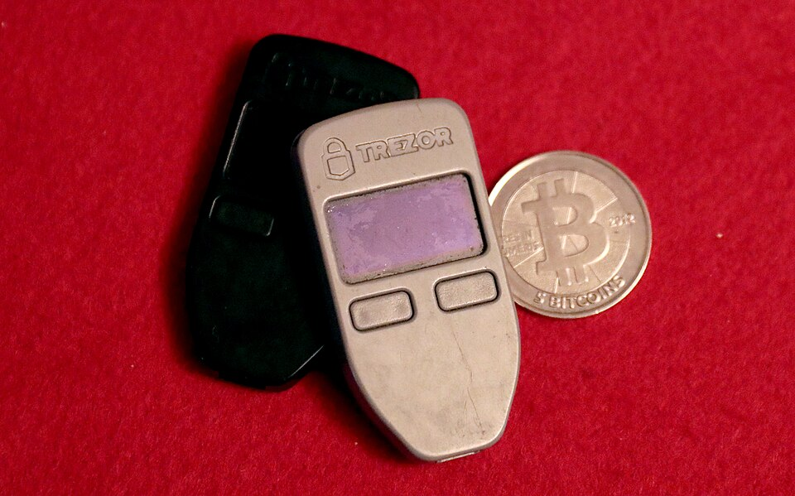
Twelve words between you and 128 bits
₿
A true story, told as who, what, when, where, why and how
WHO
Marek Palatinus and Pavol Rusnak (SatoshiLabs, makers of Trezor), with Aaron Voisine and Sean Bowe.
WHAT
BIP 39: a way to write entropy as ordinary words.
WHEN
2013-09-10 - BIP 39 was created.
WHERE
In the public bips repository on GitHub.
WHY
Nobody transcribes 128 raw bits correctly.
HOW
2,048 words of eleven bits each, a checksum folded in, and key stretching from words to seed.
READ BIP 39: Mnemonic code (spec) bips.dev
Trezor One devices - Gage Skidmore, CC BY-SA 3.0
The recovery code is an interface standard between humans and entropy
20 / 68
Notes:
The team behind the first hardware signing device faced a human problem: nobody copies 128 bits without errors. Their answer, BIP 39, is the standard we run on the next slides.

Slide 21
Generating a recovery code
₿
Five steps from random bits to words
Entropy: 128 bits
4
1 Generate entropy (128 bits for 12 words)
128 bits of entropy + a 4-bit checksum = 132 bits
2 Hash it with SHA-256
11 bits
word 1
11 bits
word 2
11 bits
word 3
11 bits
word 4
3 Append the first 4 bits as the checksum
11 bits
word 5
11 bits
word 6
11 bits
word 7
11 bits
word 8
4 Split the 132 bits into 12 pieces of 11 bits
11 bits
word 9
11 bits
word 10
11 bits
word 11
11 bits
word 12
5 Look each piece up in the word list of 2,048
Twelve pieces of eleven bits, one word each
12 words x 11 bits = 132 bits = 128 of entropy + 4 of checksum.
Mastering Bitcoin 3e, chapter 5: Generating a recovery code
21 / 68
Notes:
Step one, generate entropy, and step two, hash it with SHA-256. Step three, append the first bits as a checksum. Step four, cut the result into eleven-bit pieces. Step five, look each piece up in the word list.

Slide 22
Code 4: A hash function changes half its bits
₿
SHA-256, the tool inside BIP39
a = hashlib.sha256(b"seed A").digest()
b = hashlib.sha256(b"seed B").digest()
Hash two inputs that differ by one letter with SHA-256.
diff = int(a.hex(), 16) ^ int(b.hex(), 16)
print(len(a) * 8, bin(diff).count("1"))
__import__("sys").version_info[:2]
XOR the results and count the bits that differ: about half of the 256 change.
(3, 14)
What the run printed (python 3.14.6)
Two inputs differ by one letter; the outputs differ in 126 of 256 bits.
A tiny change makes a huge difference.
Mastering Bitcoin 3e, chapter 5: BIP39 Recovery Codes
22 / 68
Notes:
A hash function turns any input into a fixed-size fingerprint. SHA-256 is one. Change a single letter and about half of the 256 output bits flip, so no output hints at its input.

Slide 23
Code 5: How many words for how much entropy
₿
Code length and security strength
for bits in (128, 160, 192, 224, 256):
ent = bytes(bits // 8)
Five allowed entropy sizes, from 128 to 256 bits.
n = len(entropy_to_mnemonic(ent).split())
print(bits, n)
__import__("sys").version_info[:2]
Turn each into a recovery code and count its words: 12, 15, 18, 21 and 24.
(3, 14)
What the run printed (python 3.14.6)
128 bits is 12 words; each extra 32 bits adds 3 words.
More bits, more words, more security strength.
Mastering Bitcoin 3e, chapter 5: How Much Entropy Do You Need?
23 / 68
Notes:
BIP39 allows five entropy sizes. More entropy means more words and more security strength. The checksum grows with it: one bit per 32 bits of entropy.

Slide 24
Code 6: From entropy to twelve words
₿
Eleven-bit segments and the word list
words = entropy_to_mnemonic(bytes.fromhex(ENT))
print(words == WORDS)
The chapter's 128 bits of entropy become its twelve words.
idx = [wordlist().index(w) for w in words.split()]
print(idx)
Each word is a position, 0 to 2047, in the BIP39 list: eleven bits each.
print(format(idx[0], "011b"), words.split()[0])
__import__("sys").version_info[:2]
Position 96 is the eleven bits 00001100000, the word army.
(3, 14)
What the run printed (python 3.14.6)
word | army | van | defense | carry | jealous | true
position | 96 | 1929 | 459 | 279 | 956 | 1866
word | garbage | claim | echo | media | make | crunch
position | 764 | 333 | 559 | 1107 | 1076 | 423
Word number 1 is position 96: the eleven bits 00001100000.
Every word is just an eleven-bit number.
Mastering Bitcoin 3e, chapter 5: Generating a recovery code
24 / 68
Notes:
Each eleven-bit segment is a position in the BIP39 word list, 0 to 2047. The book's 128 bits of entropy become exactly the book's twelve words.

Slide 25
Code 7: The checksum catches a wrong word
₿
BIP39 checksum
ent, ok = mnemonic_to_entropy(WORDS)
print(ent.hex(), ok)
Decode the code back to entropy and check the last four bits.
bad = WORDS.replace("crunch", "army")
print(mnemonic_to_entropy(bad)[1])
__import__("sys").version_info[:2]
Change the last word. The recomputed checksum no longer matches.
(3, 14)
What the run printed (python 3.14.6)
Recovery code | Entropy decoded | Checksum ok?
army van ... media make crunch | 0c1e24e5917779d297e14d45f14e1a1a | True
army van ... media make army (last word changed) | not trusted | False
A checksum turns a silent typo into a loud error.
Mastering Bitcoin 3e, chapter 5: Generating a recovery code
25 / 68
Notes:
The last bits of a recovery code are a checksum of the entropy. Decoding recomputes it. Change one word and the check fails, so most typos are caught.

Slide 26
Code 8: Text is normalised before stretching
₿
Text normalisation
s = "caf\u00e9"
n = unicodedata.normalize("NFKD", s)
The same word can be one character or two: e-acute, or e plus an accent.
print(len(s), len(n))
print(mnemonic_to_seed(s) == mnemonic_to_seed(n))
__import__("sys").version_info[:2]
Normalising makes both spellings give the same seed on every device.
(3, 14)
What the run printed (python 3.14.6)
Spelling of the word | Characters | Same seed?
as typed: e-acute is one character | 4 | -
after normalising: e plus an accent | 5 | True
Normalise first, so one phrase gives one seed.
Mastering Bitcoin 3e, chapter 5: From recovery code to seed
26 / 68
Notes:
Computers can store the same letter in different ways. BIP39 first normalises the text, so a phrase gives one seed on every device and in every language setting.

Slide 27
Code 9: PBKDF2 stretches the words with a salt
₿
Key-stretching, salt and the root seed
def stretch(salt, rounds):
d = hashlib.pbkdf2_hmac(
"sha512", WORDS.encode(), salt, rounds)
return d.hex()[:12]
PBKDF2 with HMAC-SHA512 repeats the work many times on the words.
print(stretch(b"mnemonic", 1))
print(stretch(b"mnemonic", 2048))
print(stretch(b"mnemonic1", 2048))
__import__("sys").version_info[:2]
One round, 2048 rounds, and another salt: three unrelated results. BIP39 uses 2048 rounds.
(3, 14)
What the run printed (python 3.14.6)
Rounds | Salt | First 12 hex digits of the result
1 | mnemonic | d4a21305b044
2048 (BIP39) | mnemonic | 5b56c417303f
2048 | mnemonic1 | 6b63963292ef
Slow on purpose: 2048 rounds make every guess costly.
Mastering Bitcoin 3e, chapter 5: From recovery code to seed
27 / 68
Notes:
A key-stretching function repeats work so each guess is slow for an attacker. BIP39 uses PBKDF2 with 2048 rounds and the word mnemonic as the salt. A different salt or round count gives an unrelated result.

Slide 28
Code 10: A passphrase opens a different wallet
₿
Optional passphrase in BIP39
path = "m/84h/0h/0h/0/0"
def addr(pp):
Pick one key path and define a helper that returns its address.
k, c = keys_at(WORDS, path, pp)
return p2wpkh_address(ser_p(ec_mul(k)))
The helper derives the key from the words plus the passphrase.
print(addr(""))
print(addr(PASSPHRASE))
__import__("sys").version_info[:2]
Same twelve words, two passphrases, two different addresses.
(3, 14)
What the run printed (python 3.14.6)
Passphrase | First address of the wallet
(none) | bc1qg0azlj4w2lrq8jssrrz6eprt2fe7f7edm4vpd5
SuperDuperSecret | bc1qp2dvcxvj4y5p5mesfgspljzdvnyzmqy2724n04
A passphrase is a second secret to back up.
Mastering Bitcoin 3e, chapter 5: Optional passphrase in BIP39
28 / 68
Notes:
The passphrase is part of the salt. The same twelve words with another passphrase give a completely different wallet. That makes a decoy wallet possible, and it also means a forgotten passphrase loses the funds.

Slide 29
Everyday pictures for part 3
₿
Shuffling, check digits and kneading
Concept | In everyday life | In the wallet
entropy | A deck shuffled so well nobody can guess it | The random bits a code is made from
checksum | The check digit on a bank card number | Bits that reveal a typo
word list | A numbered dictionary everyone shares | 2,048 words for eleven bits each
key-stretching function | Kneading dough again and again | Repeated hashing that makes guessing slow
PBKDF2 | A kneading machine set to 2,048 turns | The stretcher BIP39 uses with HMAC-SHA512
salt | A pinch of spice that makes each dish unique | A string that separates equal inputs
root seed | The first seed from which the garden grows | The 512-bit seed that starts the tree
Shuffle, tag, name, knead: that is a recovery code.
Mastering Bitcoin 3e, chapter 5: From recovery code to seed
29 / 68
Notes:
Entropy is the shuffled deck, the checksum the check digit, the word list the dictionary. Stretching is kneading: it takes effort, and effort is what slows an attacker.

Slide 30
Everyday pictures for part 3, the book's sections
₿
Padlocks, cards and dough
Concept | In everyday life | In the wallet
BIP39 Recovery Codes | The shared dictionary and its spelling rules | The standard that turns bits into words
Generating a recovery code | Shuffle the deck, then write the card order down | Entropy, checksum, eleven-bit pieces, words
From recovery code to seed | Kneading the written card into dough | Stretching the words into a 512-bit seed
How Much Entropy Do You Need? | How long a padlock combination should be | 128 to 256 bits: 12 to 24 words
Optional passphrase in BIP39 | A second combination on the same padlock | The passphrase mixed into the salt
More entropy is a longer combination; a passphrase is a second lock.
Mastering Bitcoin 3e, chapter 5: BIP39 Recovery Codes
30 / 68
Notes:
Each section of the book gets a picture too. The padlock is the one to keep: more entropy is a longer combination, and a passphrase is a second combination on the same lock.

Slide 31
Part 4: The HD wallet
One seed, a tree of keys
master private key
the first private key of the tree
How they fit together
1. Root seed
2. HMAC-SHA512
3. Master key + chain code
4. Children by index
5. Extended keys
master chain code
the 32 bytes that let the tree keep growing
child key derivation
a new key from a parent, a chain code and an index
hardened derivation
a step only the private parent key can take
extended key
a key and its chain code written as one string
index number
which child: 0 to 2^31-1 normal, then hardened
Mastering Bitcoin 3e, chapter 5: Creating an HD Wallet from the Seed
31 / 68
Notes:
Part four builds the tree. One HMAC of the seed gives the master key and chain code. Every child comes from a parent, its chain code and an index. Extended keys write the pair as text.

Slide 32
One seed, a tree of keys
₿
Every node is a key and a chain code
m/0/0
Nodes are named by their paths
Master
m/0
One HMAC of the seed gives the master key and chain code.
m/0/1
m/1/0
seed
master
key m
Children
m/1
A parent, its chain code and an index make each child.
m/1/1
m/2/0
Every node
m/2
32 bytes of key and 32 bytes of chain code.
m/2/1
From one seed grows a tree that backs up as one secret.
Mastering Bitcoin 3e, chapter 5: Hierarchical Deterministic (HD) Key Generation (BIP32)
32 / 68
Notes:
The picture is the book's: a seed becomes a master key, the master key has children, and each child has grandchildren. Every node is two 32-byte values, the key and its chain code, so the tree never runs dry.

Slide 33
Code 11: HMAC-SHA512 makes the master key
₿
Master private key and master chain code
h = hmac.new(b"Bitcoin seed", TV, hashlib.sha512)
I = h.digest()
left, right = I[:32], I[32:]
One HMAC-SHA512 of the seed gives 64 bytes, split into two halves.
print(len(I), len(left), len(right))
k, c = master(TV)
The library function master() does the same in one call.
print(k == int.from_bytes(left, "big"), c == right)
print("%064x" % k)
__import__("sys").version_info[:2]
Left half is the master private key, right half the master chain code.
(3, 14)
What the run printed (python 3.14.6)
Seed, 16 bytes
Master private key 32 bytes e8f32e723d...
Master chain code 32 bytes
64 bytes in all = 32 + 32; both halves match the library: True True
Half of the HMAC is the key, half the chain code.
Mastering Bitcoin 3e, chapter 5: Creating an HD Wallet from the Seed
33 / 68
Notes:
HMAC-SHA512 mixes a secret key with data. Using the text Bitcoin seed as the key and the seed as data gives 64 bytes. The left half is the master private key, the right half the master chain code.

Slide 34
Code 12: Child keys from a parent and an index
₿
Child key derivation, chain code and index
k, c = master(TV)
for i in range(3):
Start at the master pair and ask for children 0, 1 and 2.
ki, ci = ckd_priv(k, c, i)
print(i, "%064x" % ki, ci.hex())
__import__("sys").version_info[:2]
Each child gets its own key and its own chain code, so the tree can keep growing.
(3, 14)
What the run printed (python 3.14.6)
Index | Child private key (first 12 hex digits) | Child chain code (first 12 hex)
0 | 4e2cdcf2f14e | d323f1be5af3
1 | 4df92b81d272 | 8dd96414ff4d
2 | 271614f2ca44 | 6da671c6fba4
Three indexes, three unrelated children.
Mastering Bitcoin 3e, chapter 5: Private child key derivation
34 / 68
Notes:
A child key needs the parent key, the parent chain code and an index number. The chain code is what makes children unpredictable. Each child gets its own new chain code, so the tree can keep growing.

Slide 35
Code 13: Hardened and normal children differ
₿
Hardened child key derivation
k, c = master(TV)
normal, _ = ckd_priv(k, c, 0)
Child number 0 is in the normal range, below 2 to the 31.
hard, _ = ckd_priv(k, c, HARD)
print(HARD, normal == hard)
Child number 2147483648 is the first hardened one: a different key.
print(path_indices("m/0h") == [HARD])
__import__("sys").version_info[:2]
In a path, the letter h adds 2 to the power 31 to the index.
(3, 14)
What the run printed (python 3.14.6)
Child index | Kind | Same key as child 0?
0 | normal | -
2147483648 | hardened (first one) | False
the path m/0h | hardened | its index is 2^31: True
The letter h in a path is a security decision.
Mastering Bitcoin 3e, chapter 5: Hardened child key derivation
35 / 68
Notes:
Indexes below 2 to the 31 are normal; from 2 to the 31 up they are hardened. A hardened child is derived from the private parent key, not its public key. In a path, the letter h means hardened.

Slide 36
Code 14: Why hardened steps protect the parent
₿
Using derived child keys
k, c = master(TV)
K = ec_mul(k)
Take a parent key and its public key K.
kid, _ = ckd_priv(k, c, 5)
back = leak_parent_private_key(K, c, 5, kid)
The extended public key plus ONE normal child private key.
print(back == k)
__import__("sys").version_info[:2]
The parent private key falls out. A hardened step cannot be undone this way.
(3, 14)
What the run printed (python 3.14.6)
Parent extended public key
+ one normal child private key
- the hash value
= parent private key
The run printed True: the parent private key was recovered.
Normal child plus xpub exposes the parent; hardening stops it.
Mastering Bitcoin 3e, chapter 5: Using derived child keys
36 / 68
Notes:
A normal child private key plus the parent's extended public key reveals the parent private key. Subtract the hash value and the parent falls out. A hardened step cannot be undone this way, so account levels are hardened.

Slide 37
Code 15: Public keys derived without private keys
₿
Public child key derivation
k, c = master(TV)
K = ec_mul(k)
The parent private key and its public key.
k5, _ = ckd_priv(k, c, 5)
K5, _ = ckd_pub(K, c, 5)
Route one: derive the private child, then its public key. Route two: use only K.
print(ec_mul(k5) == K5)
__import__("sys").version_info[:2]
Both routes give the same public key, so a shop can make addresses without any private key.
(3, 14)
What the run printed (python 3.14.6)
Parent private key
Child private key
Child public key
Parent public key
Same child public key: True
Public keys alone can make the shop's addresses.
Mastering Bitcoin 3e, chapter 5: Public Child Key Derivation
37 / 68
Notes:
Normal derivation works on public keys too. Route one derives the private child and then its public key. Route two never touches a private key. Both give the same public key.

Slide 38
Code 16: Extended keys, xprv and xpub
₿
Extended key encoding and key fingerprint
k, c = master(TV)
xprv = serialize_xprv(k, c)
A key plus its chain code, written in Base58Check.
xpub = serialize_xpub(ec_mul(k), c)
print(xprv[:4], len(xprv), xpub[:4], len(xpub))
The same for the public key: xprv and xpub, both 111 characters long.
print(fingerprint(ec_mul(k)).hex())
print(parse_extended(xpub)["depth"])
__import__("sys").version_info[:2]
Four bytes identify the key; the depth says how far down the tree we are.
(3, 14)
What the run printed (python 3.14.6)
Item | Starts with | Length / value
Extended private key | xprv | 111 characters
Extended public key | xpub | 111 characters
Fingerprint of the master key | - | 3442193e
Depth of the master key | - | 0
xprv can spend; xpub can only watch.
Mastering Bitcoin 3e, chapter 5: Extended keys
38 / 68
Notes:
An extended key is a key plus its chain code, written in Base58Check. It starts with xprv for private and xpub for public, and is 111 characters long. A four-byte fingerprint names the key.

Slide 39
Code 17: 2 to the 31 children, normal and hardened
₿
Index numbers for normal and hardened derivation
print(2**31, HARD, 2**31 - 1)
The book writes 2,147,483,647 for the count; BIP32 counts 2 to the 31 for each kind.
print(len(range(0, HARD)), len(range(HARD, 2 * HARD)))
__import__("sys").version_info[:2]
Indexes 0 to 2^31 - 1 are normal, 2^31 to 2^32 - 1 hardened: equal counts.
(3, 14)
What the run printed (python 3.14.6)
The largest normal index is 2147483647; the count is 2147483648.
The book's 2,147,483,647 is the last index, not the count.
Mastering Bitcoin 3e, chapter 5: Index numbers for normal and hardened derivation
39 / 68
Notes:
The book says each parent can have 2,147,483,647 children. BIP32 says 2 to the 31 normal children and as many hardened ones. The book's figure is the largest normal index, not the count.

Slide 40
Everyday pictures for part 4, the tree
₿
A family tree with secrets
Concept | In everyday life | In the wallet
master private key | The ancestor's key at the top of the tree | The first private key of the tree
master chain code | The ancestor's secret handshake | The 32 bytes that let children be made
child key derivation | A child born from a parent and a birth number | A new key from parent key, chain code and index
chain code | A family secret passed down each generation | 32 bytes that keep derivation unpredictable
index number | Birth order: first child, second child | 0 to 2^31-1 normal, then hardened
A parent plus a birth number makes a child; the chain code keeps it unpredictable.
Mastering Bitcoin 3e, chapter 5: Creating an HD Wallet from the Seed
40 / 68
Notes:
The family tree fits well. The ancestor holds the master key, each child is born from a parent and a birth number, and the chain code is the family secret that keeps children unpredictable.

Slide 41
Everyday pictures for part 4, extended keys
₿
Notes stapled to a key
Concept | In everyday life | In the wallet
extended key | A key with its family notes stapled on | A key plus its chain code in one string
extended private key | The archive where every door opens | xprv: it can spend and derive
extended public key | A guest list that greets visitors but opens no doors | xpub: it derives public keys only
hardened derivation | A firewall between parent and children | A step that needs the private parent key
Give out the guest list, never the archive.
Mastering Bitcoin 3e, chapter 5: Extended keys
41 / 68
Notes:
An xprv is the whole archive; an xpub is the guest list. The firewall picture for hardened derivation is the one to remember: a leaked child must not open the parent.

Slide 42
Everyday pictures for part 4, the book's sections
₿
Family trees, firewalls and shelves
Concept | In everyday life | In the wallet
Hierarchical Deterministic (HD) Key Generation (BIP32) | A family tree grown from one ancestor | One seed, a tree of keys
Creating an HD Wallet from the Seed | Planting the first tree from a seed | Seed to master key and chain code
Private child key derivation | A parent handing a child their own key | A child private key from the parent private key
Using derived child keys | Giving each room its own key, not the master | Hardened children never expose the parent
Extended keys | A key with its family notes stapled on | A key plus a chain code, as xprv or xpub
Public child key derivation | Numbering doors without holding any key | Public keys derived from a public key
Hardened child key derivation | A firewall between parent and child | A step that needs the private parent key
Index numbers for normal and hardened derivation | Two numbered shelves, one ordinary, one locked | 0 to 2^31-1 normal; 2^31 and up hardened
One family tree, with a firewall for hardened children.
Mastering Bitcoin 3e, chapter 5: Creating an HD Wallet from the Seed
42 / 68
Notes:
The family tree is the main picture, and the rest follow from it. A parent hands a child a key, a firewall protects the parent, and two shelves hold the normal and the hardened children.

Slide 43
Part 5: Paths and descriptors
Which key is which, and how to write it down
HD wallet path
numbers from the master key down to one key
How they fit together
1. Recovery code
2. Path m/84h/0h/0h
3. Descriptor text
4. Addresses
BIP43 and BIP44
the first number names the scheme; BIP44 fixes five levels
implicit paths
paths fixed by a standard, so not recorded
explicit paths
paths written down next to the recovery code
output script descriptors
text that names the script and the keys behind it
key origin
the bracket naming a key's parent fingerprint and path
Mastering Bitcoin 3e, chapter 5: Backing Up Key Derivation Paths
43 / 68
Notes:
Part five answers the question: given a recovery code, which keys does the wallet use? A path names a key. Standards fix common paths. A descriptor writes down both script and path.

Slide 44
Code 18: Reading a key path level by level
₿
HD wallet path, BIP43 and BIP44
path = "m/84h/0h/0h/1/7"
idx = path_indices(path)
A path is a list of child numbers below the master key m.
names = "purpose coin account change index".split()
for n, i in zip(names, idx):
Five levels, as BIP43 and BIP44 define them.
print(n, i, i >= HARD)
__import__("sys").version_info[:2]
Print each number and whether it is hardened: the first three are.
(3, 14)
What the run printed (python 3.14.6)
m
purpose
84h
coin
0h
account
0h
change
1
index
7
Orange levels are hardened: purpose, coin type and account. Change and index are normal.
Purpose, coin, account, change, index.
Mastering Bitcoin 3e, chapter 5: HD wallet key identifier (path)
44 / 68
Notes:
A path is a list of child numbers below the master key m. The first number, the purpose, names the scheme. BIP44 then fixes coin, account, change and address index. A trailing h marks a hardened step.

Slide 45
Code 19: Four standard paths, four address types
₿
Implicit paths and output scripts
pub = lambda p: ser_p(ec_mul(keys_at(B84, p)[0]))
a44 = p2pkh(pub("m/44h/0h/0h/0/0"))
Purpose 44 gives a legacy pay-to-public-key-hash address, and it starts with 1.
s = b"\x00\x14" + hash160(pub("m/49h/0h/0h/0/0"))
a49 = b58check(b"\x05" + hash160(s))
Purpose 49 wraps a segwit script inside a script hash.
a84 = p2wpkh_address(pub("m/84h/0h/0h/0/0"))
q = taproot_output_key(pub("m/86h/0h/0h/0/0"))
a86 = p2tr_address(q)
print(a44, a49, a84, a86, sep="\n")
__import__("sys").version_info[:2]
Purposes 84 and 86 give native segwit and taproot addresses. Print all four.
(3, 14)
What the run printed (python 3.14.6)
Purpose | Address type | First address of the BIP84 test code
44 (BIP44) | legacy | 1LqBGSKuX5yYUonjxT5qGfpUsXKYYWeabA
49 (BIP49) | nested segwit | 37VucYSaXLCAsxYyAPfbSi9eh4iEcbShgf
84 (BIP84) | native segwit | bc1qcr8te4kr609gcawutmrza0j4xv80jy8z306fyu
86 (BIP86) | taproot | bc1p5cyxnuxmeuwuvkwfem96lqzszd02n6xdcjrs20cac6yqjjwudpxqkedrcr
One recovery code, four kinds of address.
Mastering Bitcoin 3e, chapter 5: Backing Up Key Derivation Paths
45 / 68
Notes:
Standards fix the purpose number: 44, 49, 84 and 86. A wallet that follows one needs no written path, an implicit path. The same recovery code gives four different kinds of address.

Slide 46
Code 20: Our address equals the standard's own
₿
Explicit paths and the standard's test vector
k, c = keys_at(B84, "m/84h/0h/0h/0/0")
addr = p2wpkh_address(ser_p(ec_mul(k)))
Derive the first address of the BIP84 test recovery code.
published = "bc1qcr8te4kr609gcawutmrza0j4xv80jy8z306fyu"
print(addr == published)
__import__("sys").version_info[:2]
Compare it with the address printed in BIP84 and derived by Bitcoin Core.
(3, 14)
What the run printed (python 3.14.6)
Source | First address at m/84h/0h/0h/0/0
Our code, in this run | bc1qcr8te4kr609gcawutmrza0j4xv80jy8z306fyu
BIP84 and Bitcoin Core publish | bc1qcr8te4kr609gcawutmrza0j4xv80jy8z306fyu
Equal? | True
Check your code against the published vector.
Mastering Bitcoin 3e, chapter 5: Backing Up Key Derivation Paths
46 / 68
Notes:
To trust a library, compare it with a published answer. BIP84 prints the first address of its test recovery code, and Bitcoin Core derives the same one. If a path is not standard, write it down: an explicit path.

Slide 47
Code 21: A key tweak makes the taproot key
₿
Key tweak and BIP86
k, c = keys_at(B84, "m/86h/0h/0h/0/0")
P = ser_p(ec_mul(k))
This is the internal key of the BIP86 path, before the tweak.
Q = taproot_output_key(P)
print(P[1:].hex()[:12], Q.hex()[:12])
Add a hash-derived number times the generator point: a tweaked output key.
print(p2tr_address(Q))
__import__("sys").version_info[:2]
The address encodes the tweaked key, not the internal one.
(3, 14)
What the run printed (python 3.14.6)
Item | Value
Internal key (BIP86 path), first 12 hex | cc8a4bc64d89
Output key after the tweak, first 12 hex | a60869f0dbcf
Taproot address | bc1p5cyxnuxmeuwuvkwfem96lqzszd02n6xdcjrs20cac6yqjjwudpxqkedrcr
Add a number to a key and you get a related key.
Mastering Bitcoin 3e, chapter 5: Backing Up Key Derivation Paths
47 / 68
Notes:
A key tweak is a number added to a key to make a related key. Taproot adds a hash-derived tweak to the internal key. The address encodes the tweaked output key, not the internal one.

Slide 48
Implicit and explicit paths
₿
Which paths need writing down?
Implicit path
Explicit path
Fixed by a standard such as BIP44, so the wallet does not record it.
Written down with the recovery code, usually in descriptor notation.
Purpose | Standard | Path in the book | Note
44 | BIP44 | m/44'/0'/0' | legacy scripts
49 | BIP49 | m/49'/1'/0' | coin type 1 is testnet in SLIP-0044
84 | BIP84 | m/84'/0'/0' | native segwit
86 | BIP86 | m/86'/0'/0' | single-key taproot
Know which paths are implicit and write down the rest.
Mastering Bitcoin 3e, chapter 5: Backing Up Key Derivation Paths
48 / 68
Notes:
A standard path needs no record because everyone knows it: that is implicit. A custom path must be written with the code: that is explicit. The book's table uses coin type one for BIP49, which is the testnet type.

Slide 49
Code 22: A descriptor with its checksum and origin
₿
Output script descriptors, checksum and key origin
print(descsum_create(DESC)[-8:])
The eight-character checksum that BIP380 appends after the hash sign.
fp, steps = parse_origin(DESC)
print(fp, [s >= HARD for s in steps])
The bracket at the start names the parent fingerprint and the hardened path.
multi = "wsh(multi(2,A,B,C))"
print(descsum_create(multi))
__import__("sys").version_info[:2]
A two-of-three multisignature descriptor gets its own checksum.
(3, 14)
What the run printed (python 3.14.6)
Part | What the run printed
Checksum of the wpkh descriptor | afwvtk2s
Key origin: fingerprint, hardened steps | 73c5da0a [True, True, True]
A 2-of-3 multisignature descriptor with its checksum | wsh(multi(2,A,B,C))#uhe03042
One line of text can rebuild the wallet's structure.
Mastering Bitcoin 3e, chapter 5: Backing Up Key Derivation Paths
49 / 68
Notes:
A descriptor is text that names an output script and the keys behind it. BIP380 adds an eight-character checksum. The bracket at the start is the key origin: a fingerprint and the hardened path.

Slide 50
Multisignature, multipath and miniscript
₿
Three ways descriptors grow
Key A
wsh(multi(2,A,B,C))
Any two sign
Key B
Key C
Multisignature
Multipath descriptor
Miniscript
Spending needs signatures from at least a threshold of the listed keys.
One path step holds a tuple, such as receiving and change, in one descriptor.
A language for a subset of scripts that supports analysis and generic signing.
Descriptors keep the wallet's rules in one line of text.
Mastering Bitcoin 3e, chapter 5: Backing Up Key Derivation Paths
50 / 68
Notes:
Multisignature needs several keys: two of three is the usual example. A multipath descriptor writes the receiving and change branches once. Miniscript is a structured language for scripts that tools can analyse.

Slide 51
Everyday pictures for part 5
₿
Street addresses and recipe cards
Concept | In everyday life | In the wallet
HD wallet path | A street address: country, city, street, house | A list of numbers from the master key to one key
BIP43 | A postal rule: the first number picks the scheme | The purpose number below the master key
BIP44 | A house numbering scheme everyone adopted | Five levels: purpose, coin, account, change, index
implicit paths | A standard everyone knows without being told | A path fixed by a standard, not recorded
explicit paths | The address written on the envelope | A path written down with the backup
output script descriptors | A recipe card naming the dish and its ingredients | Text that names the script and the keys
A path is a street address; a descriptor is the whole recipe card.
Mastering Bitcoin 3e, chapter 5: Backing Up Key Derivation Paths
51 / 68
Notes:
A path is a street address down the tree. Implicit paths are the streets everyone knows; explicit paths are addresses you write on the envelope. A descriptor is the whole recipe card.

Slide 52
Everyday pictures for part 5, the book's sections
₿
Addresses inside a building
Concept | In everyday life | In the wallet
Backing Up Key Derivation Paths | Writing the street address down with the key | Paths or descriptors saved with the code
HD wallet key identifier (path) | The address of one room in a building | m/84h/0h/0h/0/0 names exactly one key
Navigating the HD wallet tree structure | Walking down a family tree by birth order | Levels: purpose, coin, account, change, index
Write the address down with the key, or the key never finds its room.
Mastering Bitcoin 3e, chapter 5: Backing Up Key Derivation Paths
52 / 68
Notes:
A path is the address of one room in a building, and navigating the tree is walking down the floors. Write the address down with the key, or the key may be found but never matched to its room.

Slide 53
Part 6: Data that is not keys
A recovery code is not the whole backup
label
a note that names an address or a transaction
How they fit together
1. Keys from the seed
2. Labels
3. Protocol data
4. Encrypted backup
BIP329
a standard file format for exporting labels
Lightning Network
payments off the blockchain, with their own state
static channel backups
a one-time backup that helps recover channel funds
encryption
readable data turned into data only a key holder reads
encrypted wallet backup
the whole database, encrypted by a key from the seed
Mastering Bitcoin 3e, chapter 5: Backing Up Nonkey Data
53 / 68
Notes:
Part six is about what a recovery code does not hold. Labels, protocol data such as Lightning channels, and the full database are not in the seed. They need their own backups.

Slide 54
Code 23: Labels exported in the BIP329 format
₿
Address label, transaction label, BIP329
a = "bc1qcr8te4kr609gcawutmrza0j4xv80jy8z306fyu"
rows = [dict(type="addr", ref=a, label="rent"),
A label names an address or a transaction.
dict(type="tx", ref="ab" * 32, label="pay")]
for r in rows: print(json.dumps(r))
__import__("sys").version_info[:2]
BIP329 writes one JSON object per line, so any program can read the backup.
(3, 14)
What the run printed (python 3.14.6)
type | reference (first 14 characters) | label
addr | bc1qcr8te4kr60... | rent
tx | ababababababab... | pay
Labels are data too: export them.
Mastering Bitcoin 3e, chapter 5: Backing Up Nonkey Data
54 / 68
Notes:
Labels are notes such as rent or salary. They are not derivable from the seed, so losing them loses your bookkeeping. BIP329 stores one JSON object per line, readable by any program.

Slide 55
Channels and encrypted backups
₿
Two answers to data that keys cannot rebuild
Channel opens
Static channel backup saved once
Data is lost
Backup helps close the channel
Wallet database: keys, labels, protocol data
Encrypted with a key from the seed
Stored copy
Restore: seed decrypts it
Static channel backups
Encrypted wallet backup
A one-time backup for the off-chain pool; it cannot guarantee results.
Complete backups made often and automatically, encrypted by a key derived from the seed.
Keys come back from the seed; the rest needs its own copy.
Mastering Bitcoin 3e, chapter 5: Backing Up Nonkey Data
55 / 68
Notes:
The Lightning Network keeps payment state off the blockchain. A static channel backup is saved once, when a channel opens, and helps recovery after data loss, but cannot guarantee results. An encrypted wallet backup stores everything, encrypted with a key from the seed.

Slide 56

The 200,000 BTC in a forgotten wallet file
₿
A true story, told as who, what, when, where, why and how
WHO
Mark Karpeles, chief executive of Mt. Gox; reporter Simon Sharwood, The Register.
WHAT
Found about 200,000 BTC in an old-format wallet file.
WHEN
2014-03-21 - three weeks after the bankruptcy filing.
WHERE
An old-format wallet file the exchange thought held nothing.
WHY
The company believed its old wallets were empty and had not checked them.
HOW
A file made by software two generations older still held spendable keys.
READ MtGox finds 200,000 Bitcoin (The Register)
Mt. Gox logo - author unknown, public domain
Wallet files hold keys forever - label, test, and never discard them blindly
56 / 68
Notes:
In March 2014, three weeks into its bankruptcy, Mt. Gox said it had found about 200,000 bitcoin in an old-format wallet it thought was empty. Backups do not expire, and an untested file is not an empty one.

Slide 57
Part 7: Deploying and testing
Keys at work, and a backup you have tested
extended public key deployment
an xpub placed where it makes addresses
How they fit together
1. Extended public key on the shop
2. Customer pays
3. Keys stay cold
4. Restore drill
payment processor
software that turns an xpub into a working shop
gap limit
how many unused addresses in a row a scan checks
cold storage
keys kept where no connected computer can read them
written backup
the recovery code written on a physical medium
testing a backup
a restore drill before you need it
Mastering Bitcoin 3e, chapter 5: Using an Extended Public Key on a Web Store
57 / 68
Notes:
Part seven puts keys to work. A shop holds only an extended public key. Cold storage keeps keys offline. And the chapter ends with the most important habit: test the backup before you need it.

Slide 58
Code 24: A web shop that holds no private key
₿
Extended public key on a web store
acct = parse_extended(BOOK_XPUB)
K = decompress(acct["key"])
The shop is given only an extended public key.
for i in range(3):
Ki, _ = ckd_pub(K, acct["chain"], i)
For each customer it derives the next public key.
print(i, p2wpkh_address(ser_p(Ki)))
__import__("sys").version_info[:2]
A fresh address per customer, and no private key anywhere on the server.
(3, 14)
What the run printed (python 3.14.6)
Customer | Fresh address made from the xpub
0 | bc1qv32edz2zpvhmmjkd7vq2wcnhacys0pku9vh5jw
1 | bc1qtqvqy3kyl5y6dmvk65p7e966k8ycyhwg9ypw3p
2 | bc1qw399x6vyt7jhurm7h3ylc0uldlqr7wj9clk5ng
Publish the xpub; the keys never touch the internet.
Mastering Bitcoin 3e, chapter 5: Using an Extended Public Key on a Web Store
58 / 68
Notes:
A shop can generate a fresh address per customer from an extended public key. The payment processor, such as BTCPay Server, does this. The shop never sees a private key, so a hacked server cannot spend.

Slide 59
Code 25: The gap limit decides how far a scan looks
₿
Mind the Gap
used = {0, 3, 25}
for gap in (5, 10, 20, 30):
A wallet received payments on keys 0, 3 and 25.
found = scan_with_gap(used, gap)
print(gap, len(found))
__import__("sys").version_info[:2]
Scan, stopping after gap unused keys in a row. Gaps below 22 miss key 25.
(3, 14)
What the run printed (python 3.14.6)
The wallet used keys 0, 3 and 25. Only gap 30 reaches key 25.
A scan that stops too early misses your money.
Mastering Bitcoin 3e, chapter 5: Mind the Gap
59 / 68
Notes:
A recovery scan stops after a number of unused addresses in a row: the gap limit. If you used key 25 but skipped many keys, a small gap misses it. A bigger gap finds it.

Slide 60
Code 26: A digital signature fails if the message changes
₿
Digital signature and the hardware signing device
d = 0x1337
pub = ec_mul(d)
A toy private key and its public key.
z = int(sha256_hex(b"pay 1"), 16)
sig = ecdsa_sign(d, z, 4242)
Sign the hash of a message (never choose the nonce yourself in real life).
z2 = int(sha256_hex(b"pay 2"), 16)
print(ecdsa_verify(pub, z, sig))
print(ecdsa_verify(pub, z2, sig))
__import__("sys").version_info[:2]
The signature verifies for the signed message and fails for any other.
(3, 14)
What the run printed (python 3.14.6)
Check | Verifies?
The message that was signed | True
Another message with the same signature | False
A signature binds one key to one message.
Mastering Bitcoin 3e, chapter 5: Using an Extended Public Key on a Web Store
60 / 68
Notes:
A signing device signs the hash of a transaction with a private key. Anyone can verify with the public key. The signature is valid only for the message that was signed. This is a toy version, not for real money.

Slide 61
Cold storage and the hardware signing device
₿
Keep keys where nothing connected can read them
Wallet on a connected computer: watch-only
Unsigned transaction
Signing device offline signs
Signed transaction returns
Cold storage
Hardware signing device
Written backup
Keys created and stored offline; the book advises it for any significant holding.
Signs transactions and never shows the private keys.
The recovery code on paper or metal, stored apart from the device.
Offline keys, a device that signs, and a code on paper.
Mastering Bitcoin 3e, chapter 5: Backing Up Key Derivation Paths
61 / 68
Notes:
Cold storage keeps a reserve offline. A hardware signing device holds keys and signs without revealing them. A written backup of the recovery code is the last line of defence, kept apart from the device.

Slide 62
Code 27: The restore drill, a typo opens another wallet
₿
Testing a backup
def first(words):
k, c = keys_at(words, "m/84h/0h/0h/0/0")
A helper that derives the first address from a recovery code.
return p2wpkh_address(ser_p(ec_mul(k)))
noted = first(B84)
Write down this address when the wallet is created.
print(first(B84) == noted)
print(first(B84.replace("about", "above")) == noted)
__import__("sys").version_info[:2]
Restore from the right code: match. One wrong word: a different, empty wallet.
(3, 14)
What the run printed (python 3.14.6)
Restore from | Same first address as noted?
the right recovery code | True
the code with one word changed | False
Test the restore, not your luck.
Mastering Bitcoin 3e, chapter 5: Wallet Recovery
62 / 68
Notes:
A backup counts only after a successful restore. Write down the first address when the wallet is created, then restore from your written code and compare. One wrong word does not give an error, it gives a different, empty wallet.

Slide 63
What a complete backup holds
₿
The chapter's closing list
Recovery code
Passphrase, if used
Paths or descriptors
Other signers' public keys
Labels and protocol data
Then restore from the backup alone, and check the first address.
Data loss is nobody's fault but cannot be reversed: the holder makes the backups and tests them.
A backup is complete when a restore drill succeeds.
Mastering Bitcoin 3e, chapter 5: Wallet Recovery
63 / 68
Notes:
Data loss is perhaps the leading cause of lost bitcoin. A complete backup is a list: the recovery code, the passphrase if used, the paths or descriptors, other signers' public keys, and data that is not keys. Then test it.

Slide 64
Everyday pictures for parts 6 and 7
₿
Sticky notes, photocopies and mailboxes
Concept | In everyday life | In the wallet
label | A sticky note on a drawer | Text naming an address or a transaction
BIP329 | A filing format so notes move between programs | One JSON line per label
static channel backups | A photocopy of a contract made once | Helps recover channel funds; no guarantee
gap limit | Checking mailboxes until a set number in a row are empty | How many unused addresses in a row a scan checks
Backing Up Nonkey Data | Photocopying your notes and contracts | Labels and protocol data kept apart from the seed
Mind the Gap | Looking down the street for the next used mailbox | The gap limit of a recovery scan
Using an Extended Public Key on a Web Store | Handing the shop a guest list, not the archive | The xpub makes a fresh address per customer
Notes, copies and mailboxes: each needs its own backup or setting.
Mastering Bitcoin 3e, chapter 5: Mind the Gap
64 / 68
Notes:
Labels are sticky notes, and they are not in the seed. A static channel backup is a photocopy: it helps but guarantees nothing. The gap limit is a patient postman who stops after a set number of empty mailboxes.

Slide 65
Check yourself
₿
Six questions, then the slides that answer them
Question | Look again at
Why is one seed better than many loose keys? | Code 1
How many words does 256 bits of entropy make? | Code 5
What does the checksum protect against? | Code 7
Why does a passphrase change the wallet? | Code 10
Why are account levels hardened? | Code 14
How do you know a backup works? | Code 27
Answer without looking, then check the code slide.
Mastering Bitcoin 3e, chapter 5: Wallet Recovery
65 / 68
Notes:
Try each question aloud before you look at the slide. If you hesitate, go back to the slide named on the right. These are the questions the exam will build on.

Slide 66
The chapter in five lines
₿
One line per part
1
Wallets stopped storing keys and started deriving them: one seed, backed up once.
2
A recovery code is entropy in words: 11 bits a word, checksum included.
3
Words become a 512-bit seed by deliberate slowness; a passphrase forks the wallet.
4
The HD tree gives every purpose a numbered key; hardened steps protect the parent.
5
Beyond keys: paths, labels, channels, and a backup counts only once it is restored.
If a line feels unproven, its part's code slides carry the receipt.
Mastering Bitcoin 3e, chapter 5: Wallet Recovery
66 / 68
Notes:
Five lines carry the chapter. Wallets derive keys from a seed, and a recovery code is entropy in words. A seed is stretched slowly, and the tree hands every purpose a numbered key. Last, a backup counts only once it has been restored.

Slide 67
Where to go from here
₿
Every entry is a live link; the course page holds the same code
Read
Mastering Bitcoin, ch. 5: Wallets
NYT via Business Standard (news)
MtGox finds 200,000 Bitcoin (The Register)
Standards
BIP 39: Mnemonic code
BIP 32: HD wallets
BIP 84: P2WPKH derivation
BIP 380: Output script descriptors
Seminal work
Bitcoin: A Peer-to-Peer Electronic Cash System
Community
Bitcoin Stack Exchange
Bitcoin Optech topics
Tools
Ian Coleman's BIP39 tool (use offline)
BTCPay Server (the book's web store)
Course corpus
SEN0401 course repository
Tutorial
Bitcoin Wiki: Deterministic wallet
Watch
BIP-39 mnemonic words (video, Mobilefish.com)
Twelve words on paper beat every password you have ever memorised.
Mastering Bitcoin 3e, chapter 5: Wallet Recovery
67 / 68
Notes:
These are the places to read, check and ask. Start with the book chapter and the three BIPs. Use the tool only offline. The same code examples are on the course page, in the same order as the slides.

Slide 68
What you should now be able to say
₿
And where each claim gets its proof
Why one seed replaced bags of keys
What twelve words carry and how they become a tree
Which path your wallet walks, and who else can walk it
What a tested backup is
Questions?
Mastering Bitcoin 3e, chapter 5: Wallet Recovery
68 / 68
Notes:
Thank you. You should now be able to say why one seed replaced bags of keys, what twelve words carry, which path your wallet walks, and what a tested backup is. Questions are welcome.

