Slide 1

₿
Chapter 1: Introduction
What Bitcoin is, what it is made of, and why every part of it exists
from the owner's 2025 deck
SEN0401 Special Topics in Software Engineering: Block Chain · Fall 2026 · Yusuf Altunel, PhD · İstanbul Kültür University
Notes:
Mastering Bitcoin, 3rd edition, chapter 1, Introduction (Antonopoulos and Harding, 2023), free under CC BY-SA 4.0. This deck follows the chapter's own concept taxonomy: 90 concepts in 6 branches, of which 42 carry a worked example. Every number, hash, address and output on these slides was executed under Python 3.14.4 by the chapter's own examples and checked against the figure the chapter corpus records; the deck is refused by its checker if any of them stops agreeing.

Slide 2
Today's route
₿
Six parts; every number is a slide you can jump to
1
Outcomes, questions, and the chapter map (slides 3-5)
46
2
Origins - three true stories (slides 6-9)
slides, numbered bottom-right
3
Money - history, units, supply, price (slides 10-24)
9
4
Network - peers, consensus, mining (slides 25-29)
true stories, each with WHO / WHERE / WHEN / READ
5
Wallets and first use - keys, custody, Alice (slides 30-36)
12
6
Foundations, nature, summary, and resources (slides 37-46)
code examples, run live - each shown with its result
Six parts, one route - and every claim arrives with its receipt
2 / 46
Notes:
SAY: Six parts. The stories carry the why, the programs carry the proof, and every slide number on this list is printed bottom-right as we pass it.
ASK: Which part do you expect to be hardest - mark it now, check again at the summary.
FULL TEXT: course page, chapter 1 - every section.

Slide 3
The outcomes this session serves
₿
One course outcome, in the chapter's own parts
LO-1
6
117
explain Bitcoin as money and as a system
subject branches in this chapter
concepts, every one on the course page
History, units and the supply schedule
The parts: keys, addresses, transactions, blocks, nodes, mining
The problems each part was designed to solve
One outcome, one chapter, every concept on the page
3 / 46
Notes:
The branches are the chapter's own: Money, Network, Wallet, Usage, Foundations, Nature. Say at the start that the order of the lecture is the order of the taxonomy, so that a student who opens the interactive page afterwards finds the same tree. Concepts are corpus-derived from the 3rd edition's chapter 1 through the Stage 1 research record; the explanations were rewritten for version 1.2.0 from the documents and files listed at the head of this module, each read for this version, with every quotation re-read from its saved copy and every number recomputed by a claim that the builder executes; the supporting concepts (the cryptographic primitives, the parts of the chain, the everyday computing terms, the two threats, the objects of a payment and the standards bodies) were added because an audit of the terms used in the explanations fo

Slide 4
The questions this chapter answers
₿
Its own competency questions - we return to each
1
What is the unit of Bitcoin's currency?
2
Who creates new bitcoin?
3
Which problem of earlier digital money does Bitcoin solve?
4
How can a wallet be classified by platform?
5
What happens?
6
Which technical terms does the chapter use without defining them?
7
Which figures of the chapter are rules of the protocol and which are values at a date?
If you can answer these, chapter 1 is yours
4 / 46
Notes:
Read the course outcome aloud and say which part of it this chapter reaches. The chapter's objectives are the page's own and are what the question bank and the mock exam are written against. Course outcome LO-1 is recorded as a draft that the course owner has not yet approved, so present it as the direction of the course rather than as a settled requirement.

Slide 5
One chapter, six branches
₿
The concept map the whole chapter hangs on
Each branch is a question the chapter answers; the grey lists are the concepts that answer it, every one explained on the course page.
Money
Unit · Supply · Price · Issuance
Network
Consensus · History · Standards
Wallet
Wallet Platform · Node Type · Key Control · Backup
Chapter 1
Usage
Address · Transfer · Semantic Bridge · Acquisition
Foundations
Cryptography · Chain · Computing · Threats
Nature
Characteristic · Architecture
Six branches - every slide today lives on this map
5 / 46
Notes:
SAY: Chapter 1 begins by saying that Bitcoin is a collection of concepts and technologies that form the basis of a digital money ecosystem, and that units of currency called bitcoin are used to store and transmit value among the participants of the Bitcoin network (Antonopoulos and Harding, 2023).
FULL TEXT: course page, chapter 1 - Money, Network, Wallet, Usage, Foundations, Nature.

Slide 6
Origins
Three stories that explain why Bitcoin looks the way it does
A headline in block 0
The first payment
Forty years of attempts
6 / 46
Notes:
STORY (3 January 2009): The first Bitcoin block ever mined carries a piece of that morning's newspaper: 'The Times 03/Jan/2009 Chancellor on brink of second bailout for banks'. It proves the block could not have been made earlier than that headline, and at the same time records why the system was built - in the middle of a banking crisis, by someone who wanted money that needs no bailout and no bank.
SOURCE: Bitcoin genesis block coinbase text, block 0, 2009-01-03; The Times front page of 3 January 2009; https://en.wikipedia.org/wiki/Bitcoin (genesis block).

Slide 7
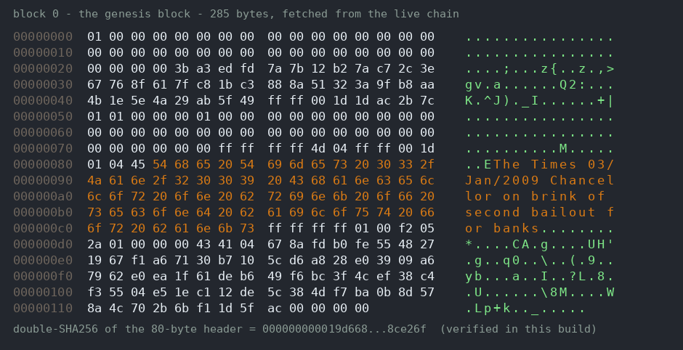
A newspaper headline carved into block zero
₿
3 January 2009
The Times
Saturday January 3 2009
Chancellor on brink of second bailout for banks
embedded in block 0
The orange bytes ARE the headline
WHO Satoshi Nakamoto
WHERE block 0 of the chain itself
WHEN 3 January 2009
READ blockstream.info
block 0's real 285 bytes, fetched from the live chain for this deck; its hash re-verified in the build
History is written into the chain itself
7 / 46
Notes:
STORY (3 January 2009): The first Bitcoin block ever mined carries a piece of that morning's newspaper: 'The Times 03/Jan/2009 Chancellor on brink of second bailout for banks'. It proves the block could not have been made earlier than that headline, and at the same time records why the system was built - in the middle of a banking crisis, by someone who wanted money that needs no bailout and no bank.
SOURCE: Bitcoin genesis block coinbase text, block 0, 2009-01-03; The Times front page of 3 January 2009; https://en.wikipedia.org/wiki/Bitcoin (genesis block).

Slide 8

The first person ever paid in bitcoin
₿
Satoshi Nakamoto, and the cryptographer who ran the code
Satoshi Nakamoto: still unidentified, by design
Hal Finney answered the whitepaper - and 'Running bitcoin'
Block 170, January 2009: Satoshi pays Finney 10 BTC
WHO Satoshi Nakamoto to …
WHERE block 170
WHEN Januar…
READ blockstrea…
anonymity, from the owner's 2025 deck
Peer to peer meant person to person from day one
8 / 46
Notes:
STORY (January 2009): Nine days after the genesis block, Satoshi Nakamoto sent 10 bitcoin to Hal Finney, a veteran cryptographer who had answered the whitepaper with curiosity instead of dismissal and famously tweeted 'Running bitcoin'. Finney had worked on PGP and had built the first reusable proof-of-work system years before Bitcoin existed - the first payment went to someone who had spent a career preparing for it.
SOURCE: Bitcoin block 170, 2009-01-12, the first bitcoin transaction (Satoshi Nakamoto to Hal Finney, 10 BTC); Hal Finney, 'Running bitcoin', twitter.com/halfin, 2009-01-10.

Slide 9
Forty years of failed digital money
₿
Every part existed before Bitcoin combined them
1982
1997
1998
2008
2009
Chaum: blind signatures, ecash
Back: Hashcash proof-of-work
Dai: b-money; Szabo: bit gold
Nakamoto: the whitepaper
The genesis block runs
DigiCash went bankrupt; b-money and bit gold were never built - agreement without a leader was missing
WHO Chaum, Back, Dai, Szabo - then Nakamoto
WHERE academic papers and mailing lists
WHEN 1982 - 2008
READ bitcoin.org
The pieces were old; the combination was new
9 / 46
Notes:
STORY (1982 - 2008): Bitcoin was not a first attempt. David Chaum designed blind-signature ecash in the 1980s and his company DigiCash went bankrupt; Adam Back built Hashcash's proof-of-work in 1997 to price email spam; Wei Dai sketched b-money and Nick Szabo bit gold in 1998, both unbuilt for want of a way to agree without a leader. Satoshi's 2008 whitepaper cites them and adds the missing piece - proof-of-work as the voting weight of an open network - turning four decades of near-misses into a running system.
SOURCE: S. Nakamoto, 'Bitcoin: A Peer-to-Peer Electronic Cash System' (2008), references; A. Back, Hashcash (1997); W. Dai, b-money (1998); N. Szabo, bit gold; D. Chaum, 'Blind signatures for untraceable payments' (1982).

Slide 10
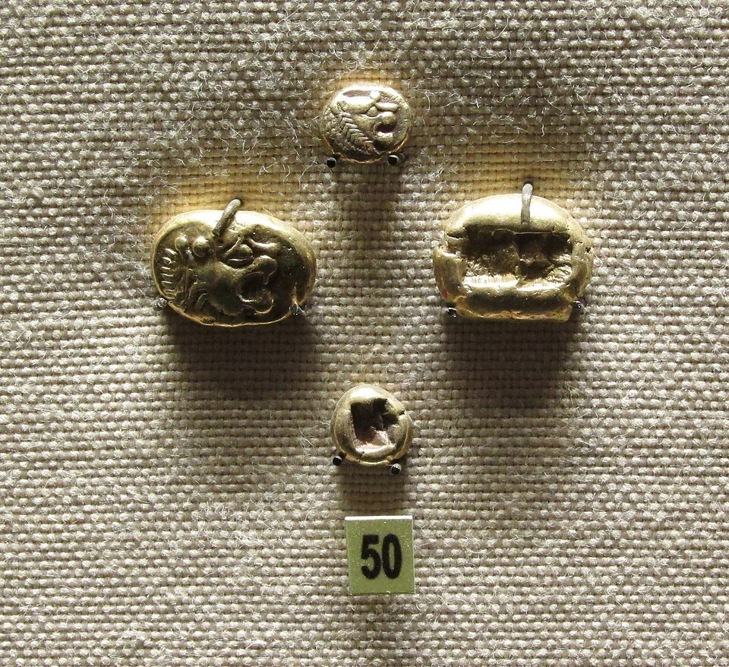
Money
What the currency is, who issues it, and on what schedule
Unit
Supply
Issuance
Price
Lydian electrum, the first coins - photo: brewbooks, CC BY-SA 2.0
10 / 46
Notes:
SAY: Chapter 1 begins by saying that Bitcoin is a collection of concepts and technologies that form the basis of a digital money ecosystem, and that units of currency called bitcoin are used to store and transmit value among the participants of the Bitcoin network (Antonopoulos and Harding, 2023).
FULL TEXT: course page, chapter 1 - Money.

Slide 11
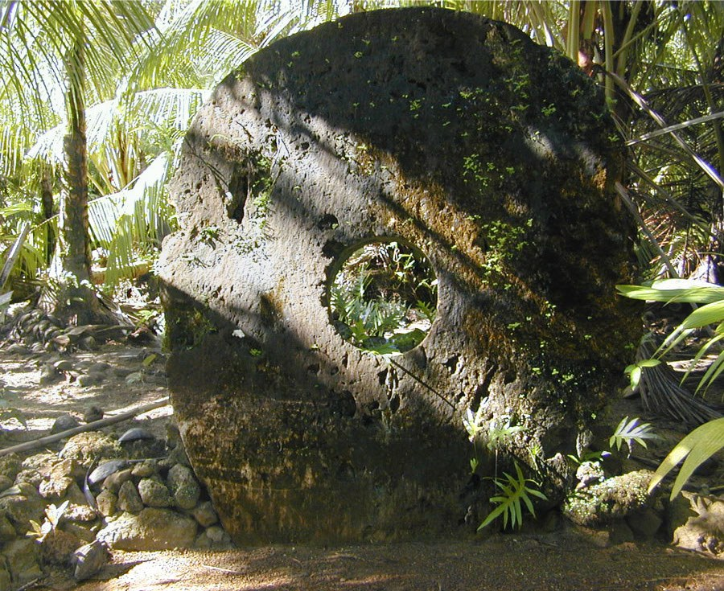
The island where money never moved
₿
Yap, documented 1903
Rai stones were money too heavy to move, so they never moved
A payment was the village agreeing the owner had changed
One stone sank at sea - and kept changing owners anyway
Fatu
Ngirmang
Teru
WHO the Yapese; documen…
WHERE Yap, Micronesia
WHEN Yap, …
READ en.wikipe…
a rai stone on Yap - photo: Eric Guinther, CC BY-SA 3.0, Wikimedia Commons
the stone stays; only the shared record moves
Money is a ledger; Bitcoin makes it digital
11 / 46
Notes:
STORY (Yap, documented 1903): On the island of Yap, wealth was held in rai - limestone discs up to four metres wide, far too heavy to move. When a stone changed owners, the stone stayed where it lay; what changed was the community's shared memory of who owned it. One famous stone sank to the sea floor in transit, and the islanders kept trading it anyway, because everyone agreed it existed and whose it was.
SOURCE: W. H. Furness III, The Island of Stone Money (1910); Milton Friedman, 'The Island of Stone Money', Hoover Institution Working Paper E-91-3 (1991).

Slide 12
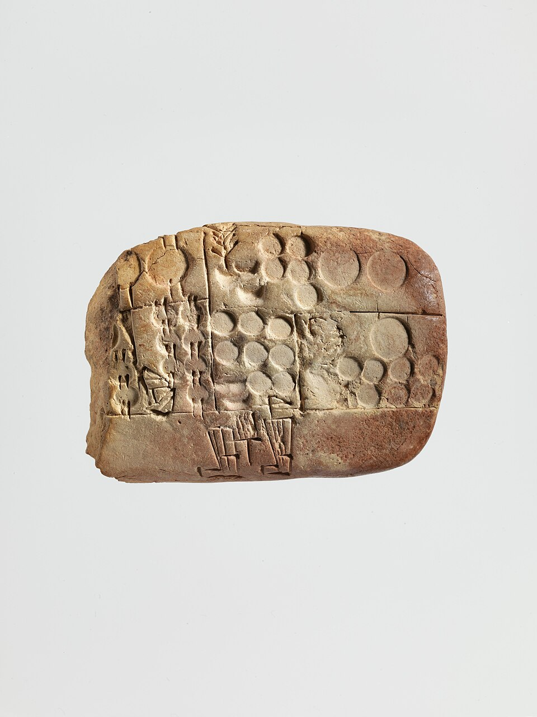
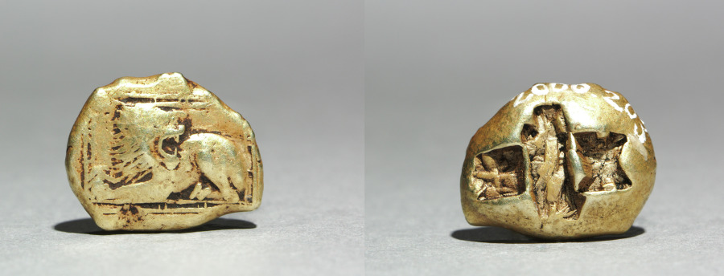
Five thousand years to digital cash
₿
c. 3000 BCE - 2009
Those Lydian coins were money once; so is your app balance - the difference is always the ledger.
The oldest money we can hold is already a ledger entry (left) and a standard token (right).
a barley account, Sumer - Met, CC0
electrum stater, 600-550 BCE - CMA, CC0
~3000 BCE
~600 BCE
~1000
1600s
1971
2009
grain ledgers, Mesopotamia
first coins, Lydia
paper money, Song China
goldsmiths' receipts, bank money
gold tie cut - pure fiat
cryptocurrency
WHO ledger-keepers, from temple scribes to…
WHERE Mesopotamia, Lydia, China, and onward
WHEN c. 3000 BCE - 20…
READ en.wikipedia.org
Each era changed the ledger-keeper; Bitcoin removed the position
12 / 46
Notes:
STORY (c. 3000 BCE - 2009): Money keeps changing form: grain-ledger entries in Mesopotamia, the first struck coins in Lydia around 600 BCE, paper notes in Song-dynasty China, goldsmiths' receipts becoming bank money, and in 1971 the dollar's last tie to gold cut, leaving pure fiat. Cards and online banking then made most money digital - but always as entries in some institution's private ledger. Cryptocurrency is the next step on the same road: money that is only a ledger, but a public one no single institution keeps.
SOURCE: Standard monetary history: Lydian electrum coinage (c. 7th-6th century BCE); Song-dynasty jiaozi paper money; the 1971 Nixon gold-convertibility suspension; Mastering Bitcoin 3e, ch. 1, on bitcoin as digital money.

Slide 13
Traditional, digital, crypto - side by side
₿
The chapter's one-table comparison
 | Traditional (cash) | Digital money (bank, card, e-money) | Cryptocurrency (bitcoin)
Issued by | A central bank | Commercial banks on a central bank base | No one - issuance is in the protocol
Exists as | Paper and coin in hand | Entries in banks' private ledgers | Entries in one public ledger
Who keeps the ledger | No ledger - possession is the record | Banks and processors | Every node, together
Supply is set by | Monetary policy | Monetary policy and credit | Fixed rules anyone can verify
Settles | Hand to hand, instantly | Through intermediaries, in days | Peer to peer, in about an hour
Same uses, different ledgers - and that difference is this course
13 / 46
Notes:
STORY (c. 3000 BCE - 2009): Money keeps changing form: grain-ledger entries in Mesopotamia, the first struck coins in Lydia around 600 BCE, paper notes in Song-dynasty China, goldsmiths' receipts becoming bank money, and in 1971 the dollar's last tie to gold cut, leaving pure fiat. Cards and online banking then made most money digital - but always as entries in some institution's private ledger. Cryptocurrency is the next step on the same road: money that is only a ledger, but a public one no single institution keeps.
SOURCE: Standard monetary history: Lydian electrum coinage (c. 7th-6th century BCE); Song-dynasty jiaozi paper money; the 1971 Nixon gold-convertibility suspension; Mastering Bitcoin 3e, ch. 1, on bitcoin as digital money.

Slide 14
Physical cash: superb in person, stuck there
₿
Why the oldest form still works - and where it stops
Before praising Bitcoin, be fair to cash: it settles instantly, anonymously, with no middleman - but it cannot reach the internet.
What cash does well
Where it fails
Settles hand to hand, instantly and finally
Needs no account, bank, identity, or permission
Cannot be frozen or censored remotely
Cannot travel a wire - no remote commerce
Theft and loss are final; carrying value is risky
Counterfeiting must be policed forever
Cash is a bearer instrument: perfect in person, useless on a network
14 / 46
Notes:
SAY: Chapter 1 begins by saying that Bitcoin is a collection of concepts and technologies that form the basis of a digital money ecosystem, and that units of currency called bitcoin are used to store and transmit value among the participants of the Bitcoin network (Antonopoulos and Harding, 2023).
ASK: Which of these failures did cards fix - and at what new price?
FULL TEXT: course page, chapter 1 - Money.

Slide 15

The internet got payments - and new gatekeepers
₿
The dot-com boom digitised paying, not cash
Before asking why Bitcoin exists, remember the dot-com race: the web needed money, companies built it as accounts - and the failures took their users' balances down with them.
1998
1999
2000
2001
2002
Confinity - Levchin and Thiel
X.com - Elon Musk
they merge; dot-com crash begins
Beenz and Flooz die with the crash
PayPal sold to eBay, $1.5B
What survived was account money on one company's ledger - convenient, reversible, and censorable
WHO Max Levchin and Peter Thiel (Confinity…
WHERE Palo Alto, in the dot-com boom
WHEN 1998 - 2002
READ en.wikipedia.org
Payments went online in 1998-2002; cash never did
15 / 46
Notes:
STORY (1998 - 2002): The web could sell before it could pay: cards were unsafe to type and banks had no internet rails. Confinity, founded 1998 by Max Levchin and Peter Thiel, and X.com, founded 1999 by Elon Musk, raced to fix it, merged in 2000, and became PayPal - sold to eBay for 1.5 billion dollars in 2002. The same boom's pure digital currencies, Beenz and Flooz, died in the 2001 crash, taking their customers' balances with them. Online payment was solved, but only as accounts on one company's private ledger - the internet still had no cash.
SOURCE: en.wikipedia.org/wiki/PayPal (Confinity 1998, X.com 1999, merger 2000, eBay acquisition 2002); en.wikipedia.org/wiki/Flooz.com and /wiki/Beenz.com (both closed 2001 in the dot-com crash).
IMAGE: the PayPal wordmark (public domain, via Wikimedia Commons) - the one survivor of the slide's timeline.

Slide 16
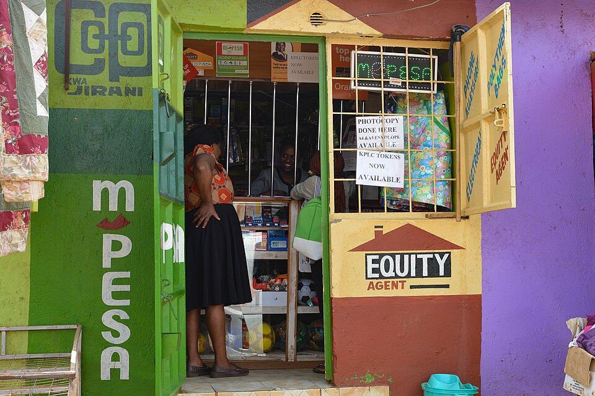
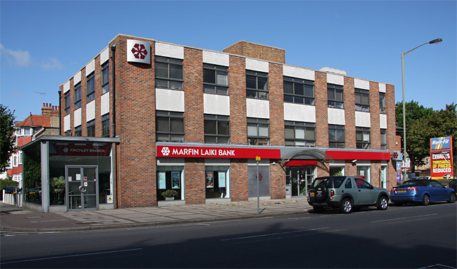
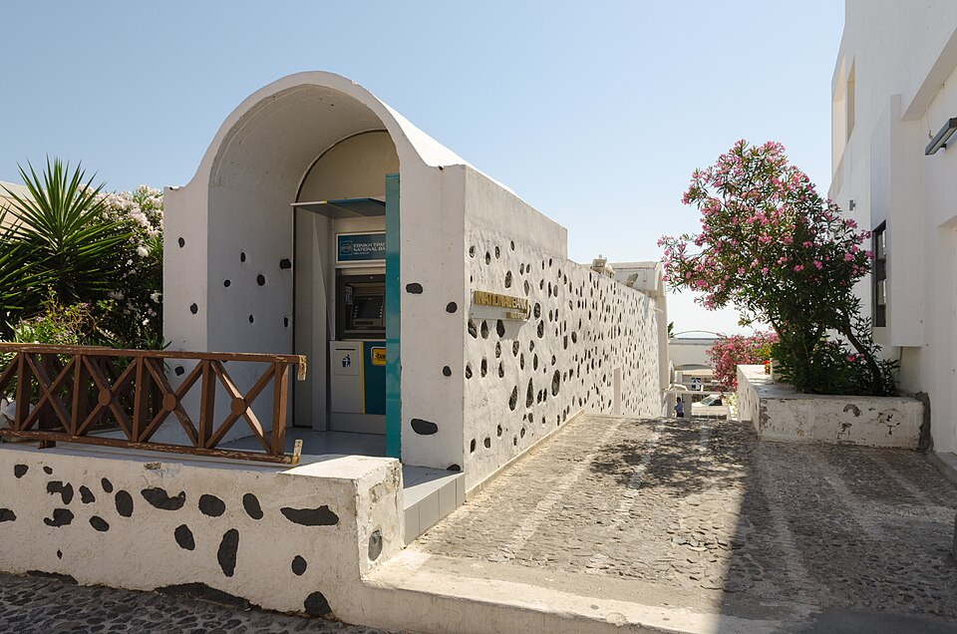
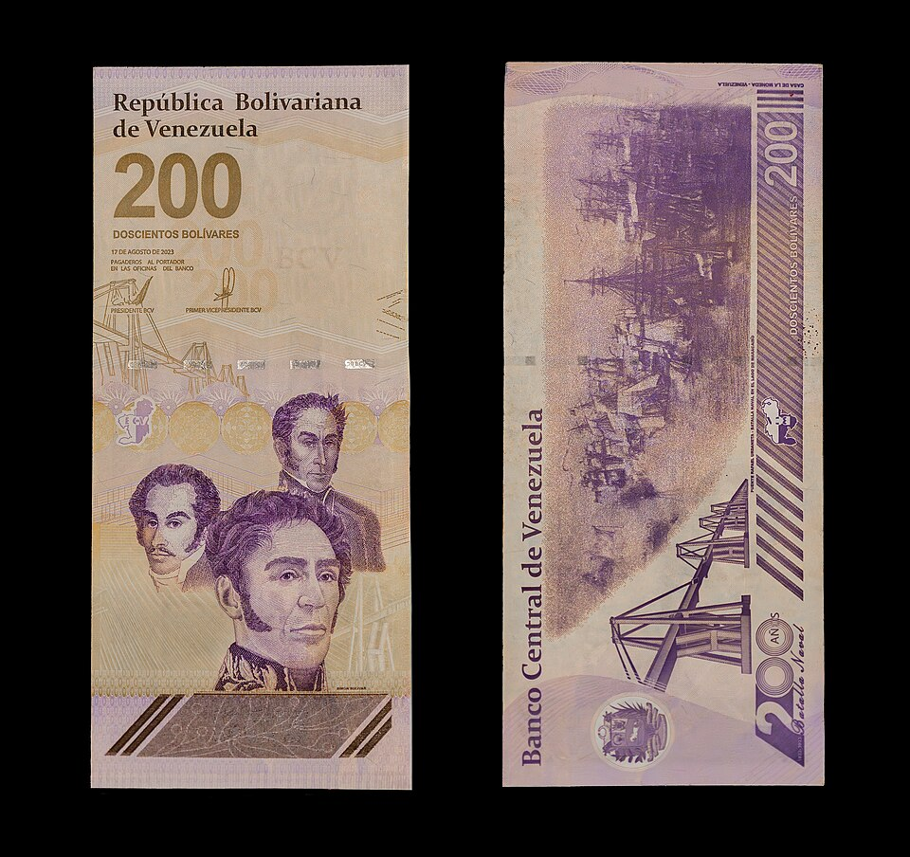

When the money in your hand stops working
₿
Five documented cases, five links - no hypotheticals
E-commerce without cards, aid without banks, savings under levies, wages under hyperinflation, a state under invasion: each card below is a real, dated case with its source.
Kenya 2007
Cyprus 2013
Greece 2015
Venezuela 2018
Ukraine 2022
No banks for most adults - M-Pesa made phones the payment rail
Banks shut for days; a levy took part of deposits overnight
Capital controls: ATM withdrawals capped at 60 euros a day
Hyperinflation beyond 1,000,000% - wages melted in hours
Under invasion, the state itself raised ~$35M in crypto in a week
READ →
READ →
READ →
READ →
READ →
photos via Wikimedia Commons: Fiona Graham/WorldRemit CC BY-SA 2.0 · Martin Addison CC BY-SA 2.0 · Norbert Nagel CC BY-SA 3.0 · Rjcastillo CC BY-SA 4.0 · U.S. Embassy Kyiv (PD)
WHO savers, the unbanked, and one governme…
WHERE Kenya, Cyprus, Greece, Venezuela, Ukra…
WHEN 2007 - 2022
READ cnbc.com
Crisis or war, banked or not - the need is documented, not theoretical
16 / 46
Notes:
STORY (2007 - 2022): Money fails people in documented ways. Kenya, 2007: most adults had no bank, so Safaricom's M-Pesa turned phone credit into the country's money rail. Cyprus, March 2013: banks closed for days and a levy took part of large deposits overnight. Greece, summer 2015: capital controls capped ATM withdrawals at 60 euros a day. Venezuela, 2018: hyperinflation passed one million percent and wages evaporated between morning and evening. Ukraine, February 2022: with war at the capital, the government itself posted donation addresses and raised tens of millions of dollars in crypto within days, run by Deputy Minister Alex Bornyakov, when ordinary rails were too slow.
SOURCE: en.wikipedia.org/wiki/M-Pesa (Safaricom, 2007); en.wikipedia.org/wiki/2012-2013_Cypriot_financial_crisis (deposit levy, March 2013); en.wikipedia.org/wiki/Greek_government-debt_crisis (2015 capital controls, 60-euro limit); en.wikipedia.org/wiki/Hyperinflation_in_Venezuela (over 1,000,000% in 2018); CNBC 2022-03-02 and Fortune 2022-03-26 on Ukraine's official crypto donations (Alex Bornyakov, 35 million dollars within the first week).

Slide 17
Why digital money had to wait
₿
The copy problem: a digital coin is a file
Digital money is older than you think - what was missing for forty years was a way to stop one coin being spent twice without a bank in the middle.
1
Make money digital and it becomes a file
perfect copy
copy 1
> Shop A
₿
2
Files copy perfectly - so coins would too
a coin,
as a file
₿
3
Both copies get spent: the double-spend
copy 2
> Shop B
₿
4
For decades only a trusted central ledger could stop it - so digital money meant bank money
both shops see valid money - the same money
Perfect copies made digital cash impossible without a referee
17 / 46
Notes:
SAY: The double-spend is the act of spending the same unit of digital money more than once. The chapter lists it as the second of three basic questions for anyone accepting digital money: can I trust that the digital money can only be spent once (Antonopoulos and Harding, 2023).
ASK: Why does the same problem not exist for paper cash?
FULL TEXT: course page, chapter 1 - DoubleSpend.

Slide 18
The double-spend, solved in public
₿
One shared ledger, one agreed order - no referee needed
Satoshi's whitepaper names the problem in its second sentence; the answer is not better files but a public ledger every node keeps and orders together.
1
Every payment is broadcast to every node
pay Bob - seen first
into the block ✓
2
Nodes agree on one order for all payments
Alice's
coin
₿
3
The first spend of a coin enters the block
pay Carol - same coin
refused by every node ✗
4
The second is refused by every node, everywhere
every node hears both; the shared ledger keeps only one order
The referee is everyone, and the whistle is arithmetic
18 / 46
Notes:
SAY: The double-spend is the act of spending the same unit of digital money more than once. The chapter lists it as the second of three basic questions for anyone accepting digital money: can I trust that the digital money can only be spent once (Antonopoulos and Harding, 2023).
ASK: What stops the network agreeing on the WRONG order? (chapter 12 answers)
FULL TEXT: course page, chapter 1 - DoubleSpend, Consensus.

Slide 19

One bitcoin divides into 100 million satoshis
₿
The unit and its divisions - run, not quoted
1 BTC
the currency unit
1,000 mBTC
millibitcoin
100,000,000 sat
the smallest unit
0.001 BTC, counted in satoshis
>>> int(decimal.Decimal('0.001') * 10**8)
100000
run under Python 3.14.4
the fraction table, from the owner's 2025 deck
Money here is counting, and the units are exact
19 / 46
Notes:
SAY: The Unit section answers the first question that any money raises, namely what the money is called and in what pieces it is counted. It contains the name of the currency, with its distinction between the unit and the system, and the smallest subdivision that can be recorded, the satoshi.
ASK: How many satoshis buy a coffee at today's price?
FULL TEXT: course page, chapter 1 - Unit.

Slide 20
21 million, by rule - not by promise
₿
Issuance halves every 210,000 blocks; the cap is the sum
210,000
blocks between halvings
20999999.9769
the sum of every era's issuance
~2140
the year issuance ends
dates = the chain's block timestamps; '~' = projected at the 10-minute target
Scarcity is enforced by arithmetic every node checks
20 / 46
Notes:
SAY: The Supply section is about how much bitcoin exists and how the amount grows. The chapter says that the protocol periodically decreases the number of new bitcoins that are created, limiting the total to a fixed number just below 21 million, so that the number in circulation follows a predictable curve (Antonopoulos and Harding, 2023).
ASK: Why does the sum stop just short of 21 million?
FULL TEXT: course page, chapter 1 - Supply, Issuance.
DATES: genesis 2009-01-03; halvings 2012-11-28 (block 210,000), 2016-07-09 (420,000), 2020-05-11 (630,000), 2024-04-20 (840,000) - the blocks' own timestamps; later dates are projections at the 10-minute target. Table: https://en.bitcoin.it/wiki/Controlled_supply

Slide 21
The schedule, executed
₿
The cap is an arithmetic fact - the slide computes it
1
Shift 50 BTC right once per era, times 210,000 blocks, summed over 33 eras: the 20,999,999.9769 cap
2
One shift for height 840,000 halves the subsidy to 3.125
3
Five heights at once show the whole staircase
1 - The cap, summed over 33 eras
>>> sum((50 * 10**8 >> era) * 210000 for era in range(33)) / 10**8
20999999.9769
2 - One halving = divide by two
run under Python 3.14.4
>>> (50 * 10**8 >> 840000 // 210000) / 10**8
3.125
3 - The subsidy at any block height
run under Python 3.14.4
>>> [(50 * 10**8 >> h // 210000) / 10**8 for h in (0, 210000, 420000, 630000, 840000)]
[50.0, 25.0, 12.5, 6.25, 3.125]
run under Python 3.14.4
Three one-liners reproduce the whole monetary policy
21 / 46
Notes:
SAY: The Supply section is about how much bitcoin exists and how the amount grows. The chapter says that the protocol periodically decreases the number of new bitcoins that are created, limiting the total to a fixed number just below 21 million, so that the number in circulation follows a predictable curve (Antonopoulos and Harding, 2023).
FULL TEXT: course page, chapter 1 - Supply, Issuance.

Slide 22
Price is discovered, not declared
₿
No authority sets an exchange rate
1
No authority quotes a rate: the first program just divides one trade's two amounts
2
The second weights every trade by its volume - one fair daily figure, as exchanges publish
1 - A price is a ratio of two quotes
>>> round(0.001 * 60000, 2)
60.0
run under Python 3.14.4
2 - A day summarised fairly, by volume
>>> sum(p * v for p, v in [(100, 3), (104, 1)]) / sum(v for p, v in [(100, 3), (104, 1)])
101.0
run under Python 3.14.4
No one sets the price; everyone does
22 / 46
Notes:
SAY: The Price section addresses a question that every newcomer asks, namely who sets the price of bitcoin. The chapter's short answer is that the price is set by markets (Antonopoulos and Harding, 2023).
FULL TEXT: course page, chapter 1 - Price.

Slide 23
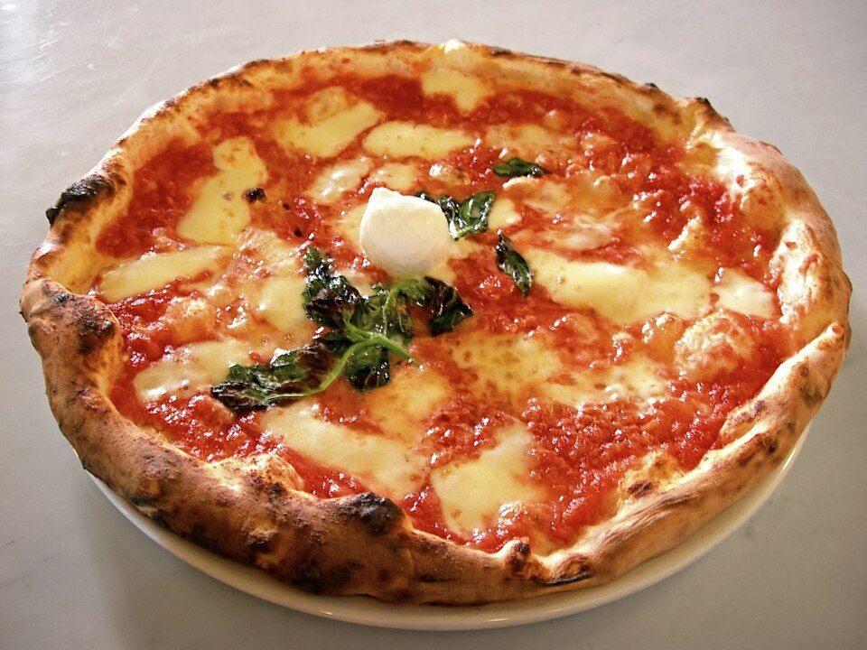
Two pizzas for ten thousand bitcoin
₿
22 May 2010
10,000 BTC
For 18 months bitcoin ran with no known price at all
Someone took the offer and ordered him two pizzas
offered on the bitcointalk forum by Laszlo Hanyecz
The first commercial purchase gave bitcoin its first real price
22 May is still celebrated as Bitcoin Pizza Day
WHO Laszlo Hanyecz
WHERE the bitcointalk for…
WHEN 22 Ma…
READ guinnessw…
photo: Valerio Capello, CC BY-SA 3.0, Wikimedia Commons
Price is discovered the first time someone pays
23 / 46
Notes:
STORY (22 May 2010): For Bitcoin's first year and a half, nobody knew what a bitcoin was worth, because nobody had ever bought anything with one. Then Laszlo Hanyecz, a Florida programmer, offered 10,000 BTC on a forum to anyone who would bring him two pizzas - and someone did. That order, the first known commercial purchase paid in bitcoin, is why 22 May is still celebrated as Bitcoin Pizza Day: it is the day a floating price began to exist.
SOURCE: Guinness World Records, 'First commercial Bitcoin transaction' (Laszlo Hanyecz, 2010-05-22, 10,000 BTC for two pizzas); bitcointalk.org thread 'Pizza for bitcoins?', May 2010.

Slide 24
The pizza, repriced every few years
₿
Documented milestones; the last point fetched live for this deck
$41
the pizzas' value in May 2010
$854M
the same 10,000 BTC on 2026-10-06, two APIs agreeing
each step x10
From 41 dollars to 854 million - price discovery never stopped
24 / 46
Notes:
SAY: Every point is a documented milestone - dollar parity in 2011, the first thousand in 2013, the 2017 and 2021 peaks - and the last one was fetched live from mempool.space and CoinGecko while this deck was built, agreeing within 0.1 percent.
ASK: Why does this chart need a log scale - what would it look like linear?
FULL TEXT: course page, chapter 1 - Price; story companion, PIZZA_VALUE.

Slide 25

Network
No bank in the middle - and what replaces it
Peer-to-peer
Consensus
Mining
History
25 / 46
Notes:
SAY: The Network branch is about the community of computers that runs Bitcoin and the way it agrees on a single history without a leader. The chapter describes Bitcoin as a distributed, peer-to-peer system in which there is no central server or point of control, and as a protocol, a peer-to-peer network, and a distributed computing innovation (Antonopoulos and Harding, 2023).
FULL TEXT: course page, chapter 1 - Network.

Slide 26
A bank in the middle vs. peers
₿
Decentralisation is an architecture, not a slogan
Centralised: one ledger-keeper
Bitcoin: every node checks every rule
Bank
Remove the hub and the rules must move to every node
26 / 46
Notes:
SAY: The Network branch is about the community of computers that runs Bitcoin and the way it agrees on a single history without a leader. The chapter describes Bitcoin as a distributed, peer-to-peer system in which there is no central server or point of control, and as a protocol, a peer-to-peer network, and a distributed computing innovation (Antonopoulos and Harding, 2023).
ASK: What breaks first in each picture if one machine lies?
FULL TEXT: course page, chapter 1 - Network, Consensus.

Slide 27

Peers find each other without a directory
₿
The chapter's own protocol sketch - run, not quoted
1
Four peers start, each knowing one neighbour
4
2
Each asks its neighbours for THEIR neighbours
links counted by the run - no server, no registry
3
Links are counted when the gossip settles: 4
what it builds: a flat mesh
the exact program - run it at home
links = {'A': ['B', 'C'], 'B': ['A', 'D'], 'C': ['A', 'E'], 'D': ['B', 'F'], 'E': ['C', 'F'], 'F': ['D', 'E', 'G'], 'G': ['F']}
seen, frontier, rounds = {'A'}, {'A'}, 0
while len(seen) < len(links):
frontier = {n for f in frontier for n in links[f]} - seen
seen |= frontier; rounds += 1
result = rounds
result 4
The network is just nodes agreeing to speak alike
27 / 46
program PeerToPeerProtocol, lines 1 to 6 of 6, run under Python 3.14.4
Notes:
SAY: The Network branch is about the community of computers that runs Bitcoin and the way it agrees on a single history without a leader. The chapter describes Bitcoin as a distributed, peer-to-peer system in which there is no central server or point of control, and as a protocol, a peer-to-peer network, and a distributed computing innovation (Antonopoulos and Harding, 2023).
FULL TEXT: course page, chapter 1 - Network.

Slide 28
Rules, not rulers, decide validity
₿
Each node applies the same consensus rules
The rule: at height h, a block may create subsidy plus fees, nothing more
✓
312,500,000 sat at height 840,000
1
2
Three blocks claim rewards at height 840,000
✗
312,500,001 sat - one too many
3
Verdicts: allowed, refused, allowed - right
✓
325,000,000 sat incl. 12,500,000 fees
the exact program - run it at home
def accept(claim, height, fees):
subsidy = (50 * 10**8) >> (height // 210000)
return claim <= subsidy + fees
result = [accept(312_500_000, 840000, 0), accept(312_500_001, 840000, 0), accept(325_000_000, 840000, 12_500_000)]
result [True, False, True]
Validity is computed, never decreed
28 / 46
program ConsensusRuleSet, lines 1 to 4 of 4, run under Python 3.14.4
Notes:
SAY: Consensus is the state in which the participants of the network agree on the same record of transactions.
FULL TEXT: course page, chapter 1 - Consensus.

Slide 29

Mining pays for honesty
₿
New coin and fees reward the work that secures the chain
Transactions
wait in the mempool
Miners
spend energy on proof-of-work
Block found
~every 10 minutes
Reward
subsidy + fees
The subsidy follows the halving chart
Cheating costs more than it could win
Chapter 12 opens the mechanism
from the owner's 2025 deck
Security is bought with energy and paid in bitcoin
29 / 46
Notes:
SAY: Consensus is the state in which the participants of the network agree on the same record of transactions.
FULL TEXT: course page, chapter 1 - Consensus, History.

Slide 30
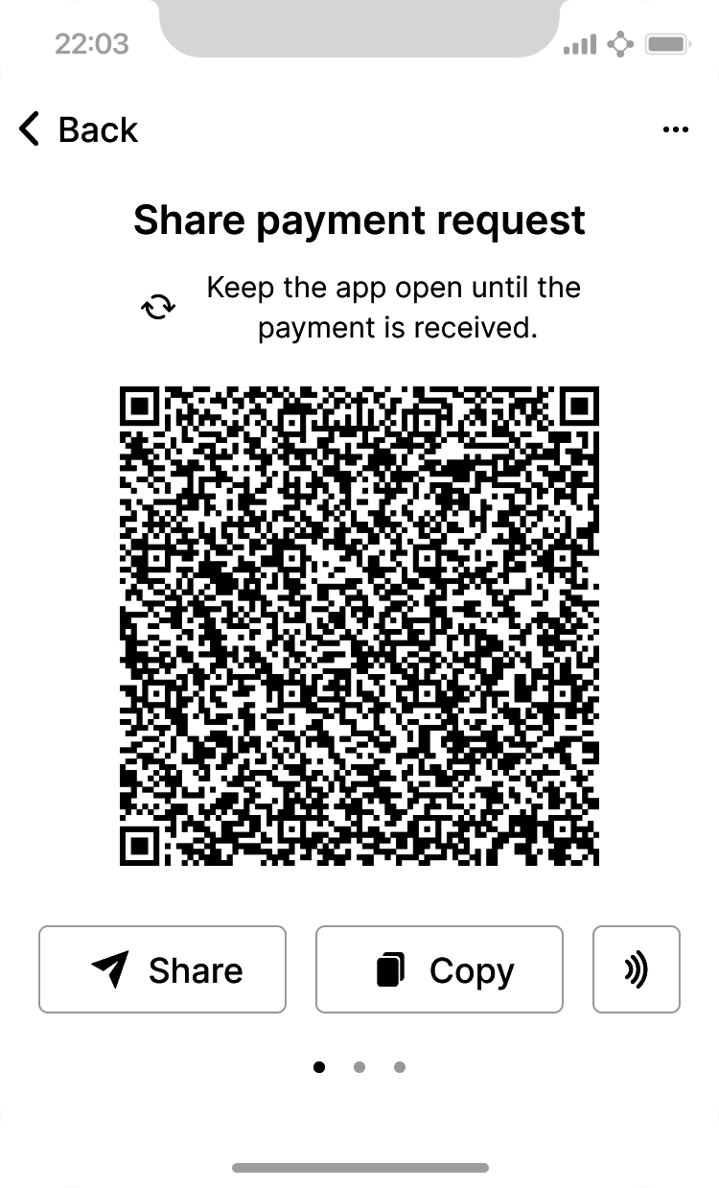
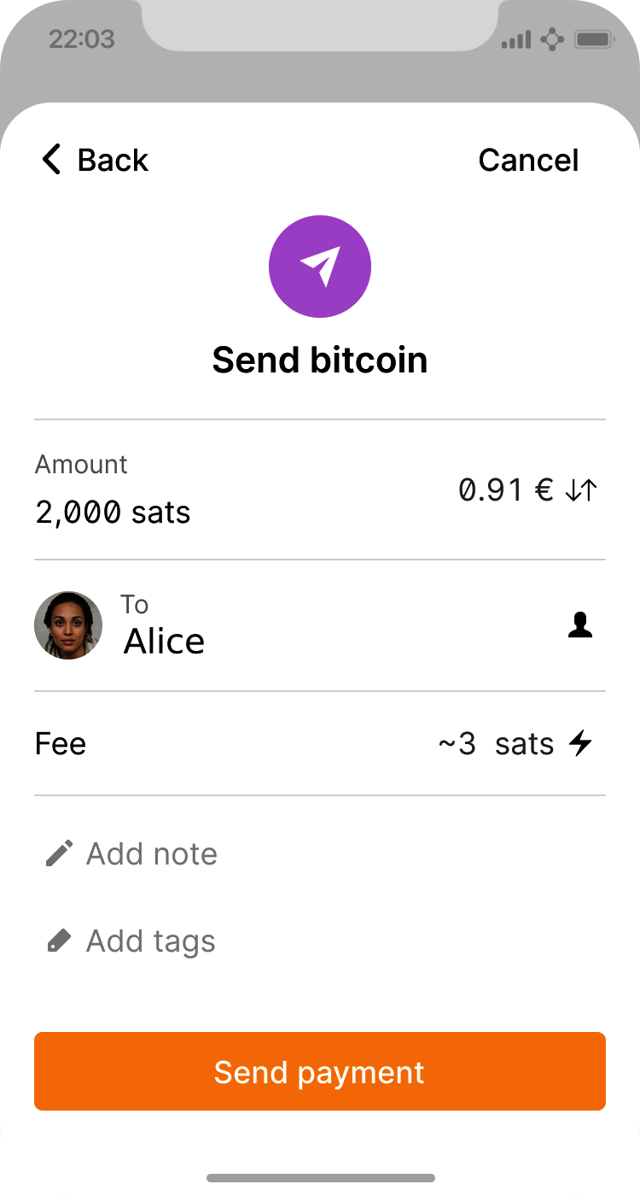
Wallets and first use
Choosing software, holding keys, and the first payment
Wallet platforms
Key control
Backup
First payment
Mastering Bitcoin 3e, CC BY-SA
30 / 46
Notes:
SAY: A wallet is the software through which a person uses Bitcoin. The chapter calls the Bitcoin wallet the most common user interface to the Bitcoin system, just as a web browser is the most common user interface for the protocol of the web, and the glossary of the book describes it as software that holds your Bitcoin addresses and secret keys and lets you send, receive and store your bitcoin (Antonopoulos and Harding, 2023).
FULL TEXT: course page, chapter 1 - Wallet, Usage.

Slide 31
The wallet branch, mapped
₿
Every leaf is explained on the course page
A wallet is the software that keeps keys and signs payments; these eight decisions - platform, node, custody, backup - define every wallet you will meet.
Wallet Platform
Desktop Wallet · Mobile Wallet · Web Wallet · Hardware Signing Device
Node Type
Full Node · Lightweight Client · Third Party API Client · Peer And Client
Wallet
Key Control
Noncustodial Wallet · Custodial Wallet
Backup
Recovery Code · Wallet Metadata
A wallet is software for keys, not a bag of coins
31 / 46
Notes:
SAY: A wallet is the software through which a person uses Bitcoin. The chapter calls the Bitcoin wallet the most common user interface to the Bitcoin system, just as a web browser is the most common user interface for the protocol of the web, and the glossary of the book describes it as software that holds your Bitcoin addresses and secret keys and lets you send, receive and store your bitcoin (Antonopoulos and Harding, 2023).
FULL TEXT: course page, chapter 1 - Wallet.

Slide 32
Your key is your deed - and you may never show it
₿
The house-key analogy, and where it breaks
With a car or a house, the key grants access but a registry proves ownership; in Bitcoin the key is both - so it must prove without being shown.
your house, your car
your bitcoin
One key opens it. Lose the key, lose access. But the deed, the registry, still names you.
The key IS the deed. Signing with it is the only proof of ownership there is.
Bitcoin's trick (ch. 4 and 8): a signature proves you hold the key while the key itself stays secret
Prove you hold the key; never reveal it
32 / 46
Notes:
SAY: Key control is the question of who holds the private keys that unlock a wallet's funds. The chapter calls this a very important additional consideration and says that access to bitcoins is controlled by private keys, which are like very long PINs.
ASK: Your house has a registry if the key is lost - what does bitcoin have?
FULL TEXT: course page, chapter 1 - KeyControl.

Slide 33
Who holds the keys, holds the coins
₿
The one wallet decision that matters most
Full control
Third-party control
You keep the keys
You sign; nobody can freeze
Backup is your job
A service keeps the keys
Convenient, custodial
You trust their honesty and uptime
desktop
mobile
web
hardware
paper
Custody is the first security decision you make
33 / 46
Notes:
SAY: Key control is the question of who holds the private keys that unlock a wallet's funds. The chapter calls this a very important additional consideration and says that access to bitcoins is controlled by private keys, which are like very long PINs.
ASK: Which side was the exchange that lost its customers' coins on?
FULL TEXT: course page, chapter 1 - KeyControl, WalletPlatform, Backup.

Slide 34
Mt. Gox: the exchange that lost everyone's coins
₿
Tokyo, February 2014 - CEO Mark Karpeles files for bankruptcy
Not a parable: a named company, a named CEO, a dated court filing - and the course's first security lesson.
850,000
#1
10+ yrs
bitcoins missing per the Tokyo court filing, Feb 2014
Mt. Gox had been the largest bitcoin exchange in the world
creditors still being repaid a decade later
Customers saw balances on a website; the keys - so the coins - sat in one company's safe
When the keys vanished, every balance on the screen meant nothing
WHO Mt. Gox, led by CEO Mark Karpeles
WHERE Tokyo; bankruptcy filed at the Tokyo D…
WHEN February 2014
READ en.wikipedia.org
Whoever holds the keys holds the coins - exchanges included
34 / 46
Notes:
STORY (February 2014): Mt. Gox of Tokyo, led by Mark Karpeles, was once the world's largest bitcoin exchange, handling the large majority of all trades. In February 2014 it halted withdrawals, filed for bankruptcy and admitted that around 850,000 bitcoins held on customers' behalf were gone - the customers had balances on a website, but the keys, and therefore the coins, had been in someone else's hands all along. Creditors were still being repaid more than a decade later.
SOURCE: Mt. Gox bankruptcy filing, Tokyo District Court, 2014-02-28, reporting approximately 850,000 BTC missing (about 750,000 of them customers'); widely reported, e.g. en.wikipedia.org/wiki/Mt._Gox.

Slide 35
From a phrase to a key, slowly on purpose
₿
Key stretching makes guessing expensive
Start from a human backup phrase and a salt
phrase 'abandon' + salt
1
HMAC-SHA512, round 1
2
Hash them with HMAC-SHA512 - that is one round
... 2,048 rounds ...
the wallet seed: 64 bytes
3
Feed each round into the next, 2,048 times
result: a 64-byte seed, digest d96147bf
the exact program - run it at home
4
Result: a 64-byte seed; a guesser pays the 2,048 rounds for every guess
import hmac
password, salt, iters = b'abandon', b'mnemonic', 2048
u = hmac.new(password, salt + bytes([0, 0, 0, 1]), 'sha512').digest()
seed = u
for _ in range(iters - 1):
u = hmac.new(password, u, 'sha512').digest()
seed = bytes(a ^ b for a, b in zip(seed, u))
result = (len(seed), seed.hex()[:8])
result (64, 'd96147bf')
Slowness here is a feature priced against attackers
35 / 46
program KeyStretching, lines 1 to 8 of 8, run under Python 3.14.4
Notes:
SAY: The Backup section is about getting a wallet back after something goes wrong. It begins with the chapter's account of Alice's first start-up, when her noncustodial wallet produces a recovery code that can be used to restore it, and it goes on to the additional data that a recovery code does not contain, and to the payments that some technologies keep outside the public blockchain (Antonopoulos and Harding, 2023).
FULL TEXT: course page, chapter 1 - Backup, KeyControl.

Slide 36
Alice's first bitcoin, step by step
₿
The chapter's running story begins
Install a wallet
keys made on her phone
First address
shared as text or QR
Acquire bitcoin
buy, earn, or exchange
Confirmations
the network accepts it
A channel opens on-chain: Alice 60,000, Bob 40,000
Alice, after
59,000
1
Bob, after
41,000
on-chain txs
2
2
100 payments of 10 sat hop inside the channel
the program
3
Only the final balances settle on-chain: 2 transactions total
onchain, a, b = 2, 60_000, 40_000
for _ in range(100):
a, b = a - 10, b + 10
result = (a, b, a + b, onchain)
result (59000, 41000, 100000, 2)
Five minutes of app taps hide all of this machinery
36 / 46
program PaymentChannel, lines 1 to 4 of 4, run under Python 3.14.4
Notes:
SAY: The Acquisition section lists the ways in which a newcomer obtains a first bitcoin, which is the practical problem a reader faces as soon as the wallet is installed.
FULL TEXT: course page, chapter 1 - Acquisition, Address, Transfer.

Slide 37
Foundations
The two old problems Bitcoin finally joined up
Hashcash
Byzantine Generals
Keys and signatures
The chain
37 / 46
Notes:
SAY: The Foundations branch collects the general technical ideas that the rest of the chapter takes for granted. Chapter 1 of the textbook introduces Bitcoin through a story about Alice and Joe, and in doing so it uses words such as digital signature, private key, blockchain, node, protocol and QR code as if every reader already knew them (Antonopoulos and Harding, 2023).
FULL TEXT: course page, chapter 1 - Foundations.

Slide 38
Two solved problems, one new system
₿
1997 and 1982 meet in 2008
Hashcash (1997)
Byzantine Generals (1982)
Proof-of-work: make sending cost a computation, so flooding costs real resources. Bitcoin turns the same cost into the price of writing history.
How do parties that cannot trust each other agree on one message? Proof-of-work plus the longest valid chain is Bitcoin's practical answer.
Bitcoin's novelty is the combination, not the parts
38 / 46
Notes:
SAY: The Foundations branch collects the general technical ideas that the rest of the chapter takes for granted. Chapter 1 of the textbook introduces Bitcoin through a story about Alice and Joe, and in doing so it uses words such as digital signature, private key, blockchain, node, protocol and QR code as if every reader already knew them (Antonopoulos and Harding, 2023).
FULL TEXT: course page, chapter 1 - Foundations, Cryptography.

Slide 39
From keys to the chain
₿
The pipeline the rest of the course walks
Keys
ch. 4
Addresses
ch. 4
Transactions
ch. 6
Blocks
ch. 11
Mining
ch. 12
Each stage only trusts what it can verify
Every later chapter opens one of these boxes
This pipeline is the course syllabus in one row
39 / 46
Notes:
SAY: The Chain section explains the data structure at the centre of Bitcoin and the computers that maintain it. The block is a group of transactions that the network accepts together, the blockchain is the list of blocks linked one to the next, the timestamp is the mark of time that orders them, and the node is a computer that takes part in the network.
FULL TEXT: course page, chapter 1 - Chain, Cryptography.

Slide 40
A chain that notices tampering
₿
Each block carries the digest of the one before
1
Each block stores the digest of the one before
block 0
block 1
block 2
Verify = recompute every digest: True
the genesis record
data changed!
digest of block 1
2
3
Change one byte - the next block refuses: False
verify: True, then False
the exact program, line by line
import hashlib
def link(prev, data): return hashlib.sha256((prev + data).encode()).hexdigest()
data = ['Joe pays Alice 1', 'Alice pays Eve 2', 'Eve pays Joe 3']
def build(items):
hs, prev = [], 'genesis'
for d in items:
prev = link(prev, d); hs.append(prev)
return hs
stored = build(data)
tampered = ['Joe pays Alice 100'] + data[1:]
result = (build(data) == stored, build(tampered) == stored)
result (True, False)
History becomes expensive to rewrite, cheap to verify
40 / 46
program Blockchain, lines 1 to 11 of 11, run under Python 3.14.4
Notes:
SAY: The Chain section explains the data structure at the centre of Bitcoin and the computers that maintain it. The block is a group of transactions that the network accepts together, the blockchain is the list of blocks linked one to the next, the timestamp is the mark of time that orders them, and the node is a computer that takes part in the network.
FULL TEXT: course page, chapter 1 - Chain.

Slide 41
The toolbox under the hood
₿
Four vocabularies the whole book leans on
Four vocabularies feed the chapters ahead: the cryptography that signs, the chain that remembers, the computing it all runs on, and the threats it must survive.
Cryptography
Hash Function · Digital Signature · Public Key Cryptography · Private Key · Entropy · Checksum · + 2 more
Chain
Block · Blockchain · Timestamp · Node
Foundations
Computing
Internet · Protocol · HTTP · Web Browser · Server · API · + 6 more
Threats
Malware · Phishing
Every term here gets its own page section
41 / 46
Notes:
SAY: The Computing section explains the ordinary technology on which Bitcoin software runs and by which people reach it. It covers the internet and the rules that computers follow on it, the way programs talk to each other through interfaces, the way data is named and stored, the operating systems and browsers in which wallets live, and the units in which computers count.
FULL TEXT: course page, chapter 1 - Computing, Threats.

Slide 42
What kind of thing is Bitcoin?
₿
Its stated characteristics, and the architecture behind them
The first row makes promises to users; the second names the machinery that keeps them.
Characteristics - each one a design choice
Virtual
Borderless
Decentralized
Robust
The architecture that delivers them
Peer To Peer Protocol
Public Journal
Consensus Rule Set
Each adjective is engineered, not advertised
42 / 46
Notes:
SAY: The Nature branch answers a question that precedes all the others: what kind of thing is Bitcoin? Chapter 1 gives two complementary answers.
FULL TEXT: course page, chapter 1 - Nature, Characteristic, Architecture.

Slide 43
Beyond the base layer
₿
Payment channels route through a network - chapter 14's subject
1
Channels: Alice-Bob, Bob-Carol, Carol-Dave
2
Alice pays Dave with no direct channel
A path is found: 3 hops, chain untouched
Alice
Bob
Carol
Dave
3
the exact program, line by line
3 hops; no direct channel
channels = {('Alice', 'Bob'), ('Bob', 'Carol'), ('Carol', 'Dave')}
nbr = {}
for x, y in channels: nbr.setdefault(x, []).append(y); nbr.setdefault(y, []).append(x)
path, frontier = {'Alice': ['Alice']}, ['Alice']
while 'Dave' not in path:
nxt = []
for x in frontier:
for y in nbr[x]:
if y not in path: path[y] = path[x] + [y]; nxt.append(y)
frontier = nxt
result = (path['Dave'], len(path['Dave']) - 1, ('Alice', 'Dave') in channels)
result (['Alice', 'Bob', 'Carol', 'Dave'], 3, False)
The chain settles; the edges scale
43 / 46
program LightningNetwork, lines 1 to 11 of 11, run under Python 3.14.4
Notes:
SAY: The Transfer section explains what happens when Joe sends bitcoin to Alice. It follows the payment from the moment he presses Send to the moment it is confirmed in a block, and it introduces the objects and ideas involved: the transaction, its inputs and outputs, the fee, the confirmation, the irreversibility, and the newer payments that never reach the public chain (Antonopoulos and Harding, 2023).
FULL TEXT: course page, chapter 1 - Transfer, SemanticBridge.

Slide 44
The chapter in six lines
₿
One line per part - each one provable from its slides
1
Origins: a dated newspaper headline sits in block 0, and the first payment went person to person
2
Money is a ledger: five thousand years of forms, three kinds today - what differs is who keeps it
3
Supply: 21 million by arithmetic - halvings on real, chain-stamped dates; a sum anyone can re-run
4
Price: discovered by trades, never declared - from two pizzas to $854M on one log chart
5
Network: no bank in the middle - every node checks every rule, and mining pays for honesty
6
Wallets: whoever holds the keys holds the coins - Mt. Gox is the named, dated proof
If a line feels unproven, its part's slides carry the receipt
44 / 46
Notes:
SAY: Six lines, one per part. If any of them still feels like a claim rather than a fact, the agenda slide names the slides that prove it - and the course page carries the full text.
ASK: Which line would you defend to a sceptic first, and with which slide?
FULL TEXT: course page, chapter 1 - every section.

Slide 45
Where to go from here
₿
Checked 2026-10-06; every entry is a live link in this file
Read
Community
The whitepaper (9 pages, 2008) bitcoin.org/bitcoin.pdf
Bitcoin Stack Exchange Q&A bitcoin.stackexchange.com
The textbook, free (CC BY-SA) github.com/bitcoinbook/bitcoinbook
bitcointalk - the forum of Pizza Day bitcointalk.org
Developer documentation developer.bitcoin.org
Seminal & watch
Explore & markets
Hashcash, the proof-of-work paper hashcash.org
Bitcoin Core, the reference client bitcoincore.org
b-money, Wei Dai (1998) weidai.com/bmoney.txt
mempool.space - watch blocks live mempool.space
But how does bitcoin work? (3Blue1Brown) youtube.com/watch?v=bBC-nXj3Ng4
blockstream.info - block 0 came from here blockstream.info
CoinGecko - market data coingecko.com
Nine free pages started all of this - read them this week
45 / 46
Notes:
SAY: Everything on this slide is free. The whitepaper is nine pages - read it this week; the textbook is the one this course follows, free under CC BY-SA in the same repository our materials pin.
ASK: Who can find today's newest block on mempool.space before the break ends?
FULL TEXT: course page, chapter 1 - Standards, History.

Slide 46
What you should now be able to say
And where each claim gets its proof
What a bitcoin is, and how far it divides
Why 21 million is arithmetic, not promise
What replaces the bank in the middle
Which chapter opens each box we drew
Questions?
46 / 46
Notes:
Mastering Bitcoin, 3rd edition, chapter 1, Introduction (Antonopoulos and Harding, 2023), free under CC BY-SA 4.0. This deck follows the chapter's own concept taxonomy: 90 concepts in 6 branches, of which 42 carry a worked example. Every number, hash, address and output on these slides was executed under Python 3.14.4 by the chapter's own examples and checked against the figure the chapter corpus records; the deck is refused by its checker if any of them stops agreeing.

