Slide 1

₿
Chapter 2: How Bitcoin Works
Transactions, the network, and the chain - one payment, followed all the way
users, wallets, nodes, miners - from the owner's 2025 deck
SEN0401 Special Topics in Software Engineering: Block Chain · Fall 2026 · Yusuf Altunel, PhD · İstanbul Kültür University
Notes:
Chapter 1 asked what Bitcoin is; chapter 2 follows one payment - Alice pays Bob - all the way from her wallet to a buried block, and meets every moving part on the way. The full explanation is on the course page, chapter 2.

Slide 2
Today's route
₿
Five parts; every number is a slide you can jump to
1
Questions and the chapter map (slides 3-4)
30
slides, numbered bottom-right
2
Transactions - inputs, outputs, change, fees (slides 5-10)
3
3
The network - gossip, nodes, explorers (slides 11-15)
true stories, each with WHO / WHERE / WHEN / READ
4
Blockchain and mining - blocks, proof, confirmations (slides 16-24)
18
5
Semantics, practice, summary, and resources (slides 25-30)
code examples, run live - each shown with its result
Five parts, one payment followed all the way through
2 / 30
Notes:
Five parts, one payment followed all the way. The stories carry the why, the consoles carry the proof, and every slide number here is printed bottom-right as we pass it. A question to think about is this: which part do you expect to be hardest? The full explanation is on the course page, chapter 2, in every section.

Slide 3
The questions this chapter answers
₿
Its own competency questions - we return to each
1
Which parts does a Bitcoin transaction consist of?
2
Which mathematical tools does a transaction rely on - hashing?
3
How does a payment begin: what does the invoice of the chapter contain?
4
How does a signed transaction reach the miners?
5
How is a transaction recorded: how is a block built?
6
What exactly does a confirmation buy?
7
How can the chapter's transaction chain be expressed as a provenance graph in the vocabulary of the W3C PROV Ontology?
8
Which terms do the explanations of this chapter rely on?
If you can answer these, chapter 2 is yours
3 / 30
Notes:
Each question on this slide is one the chapter answers, from the parts of a transaction to what a confirmation buys. We return to every one of them as the chapter proceeds. If you can answer them at the end, the chapter is yours.

Slide 4
One chapter, five branches
₿
The concept map the whole chapter hangs on
Each branch is a question the chapter answers; the grey lists are the concepts that answer it, every one explained on the course page.
Transaction
Transaction Part · Cryptography · Linkage · Form · Unit · Payment Request · Construction
Network
Participants · Propagation
Chapter 2
Blockchain
Mining · Security · Spending
Semantics
Provenance Model
Practice
Interactive Demo
Five branches - every slide today lives on this map
4 / 30
Notes:
A transaction is the unit of action in Bitcoin: a message telling the network that the owner of certain bitcoins has authorized the transfer of that value to another owner. The new owner can in turn spend the value by creating another transaction, and so on, which gives a chain of ownership. The full explanation is on the course page, chapter 2, in Transaction, Network and Blockchain.

Slide 5
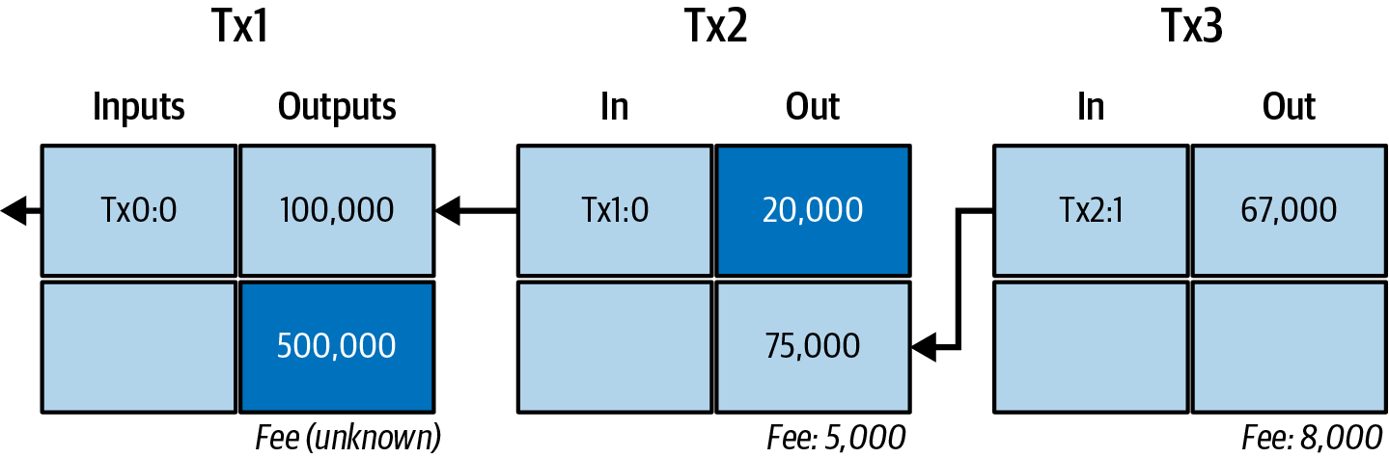
Transactions
Who pays whom, with what, and what it costs
Inputs and outputs
Change
outputs become inputs - Mastering Bitcoin 3e, CC BY-SA
Fees
The chain of spends
5 / 30
Notes:
A transaction is the unit of action in Bitcoin: a message telling the network that the owner of certain bitcoins has authorized the transfer of that value to another owner. The new owner can in turn spend the value by creating another transaction, and so on, which gives a chain of ownership. The full explanation is on the course page, chapter 2, in Transaction.

Slide 6
Nine pages, and a table of odds
₿
2008-10-31
The Cryptography List
"A purely peer-to-peer version of electronic cash would allow online payments to be sent directly from one party to another without going through a financial institution." - the abstract's first sentence
Friday October 31 2008
Bitcoin P2P e-cash paper
Section 11 computes the attacker's catch-up odds
nine pages at bitcoin.org
We rerun that computation live, later in this deck
WHO Satoshi …
WHERE bitcoin…
WHEN 2008-…
READ Bitcoin white paper (PDF)
bitcoin.org
The paper computes its promises - today we recompute them
6 / 30
Notes:
On 31 October 2008 a pseudonymous author posted nine pages to a cryptography mailing list. Section 11 does something unusual for a systems paper, because it computes the attacker's odds. For an attacker with ten percent of the power, the paper's table gives about 0.2046 at one confirmation and 0.0002428 at six, and the example group AttackerSuccess reruns both. The sources are Nakamoto's 2008 paper and the announcement on the metzdowd cryptography list.

Slide 7
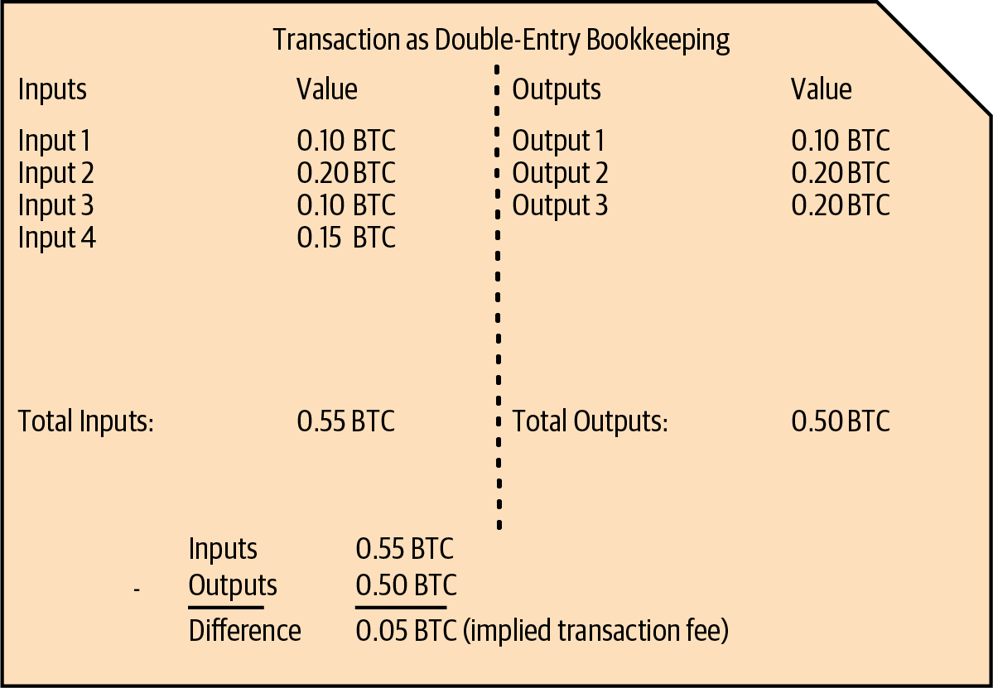
Alice pays Bob: one transaction, whole
₿
The chapter's running example, shown as the ledger sees it
1
One 100,000-sat output of Alice's is spent whole
2
Two new outputs: 75,000 to Bob, 20,000 back to Alice
3
What the sums leave over - 5,000 sat - is the fee
counted by the run: 1 input, 2 outputs, 5,000 fee
>>> ins, outs = [100000], [20000, 75000]
>>> (len(ins), len(outs), sum(ins) - sum(outs))
(1, 2, 5001)
double-entry view - Mastering Bitcoin 3e, CC BY-SA
run under Python 3.14.6
A transaction spends whole outputs and makes new ones
7 / 30
Notes:
A transaction is the unit of action in Bitcoin: a message telling the network that the owner of certain bitcoins has authorized the transfer of that value to another owner. The new owner can in turn spend the value by creating another transaction, and so on, which gives a chain of ownership. A question to think about is this: why must the 100,000 be spent whole rather than split? The full explanation is on the course page, chapter 2, in Transaction and Input.

Slide 8
Your balance is outputs, not an account
₿
The UTXO idea - what a wallet actually sums
1
Every payment leaves outputs - coins of exact sizes
Spending consumes outputs whole and mints new ones
Tx2:0 unspent
2
Your balance = the outputs your keys can unlock
Tx2:1 unspent
3
The run keeps only the unspent: Tx2:0 and Tx2:1
Tx1:0 spent
4
the ledger's view, filtered to the spendable
run under Python 3.14.6
>>> [o for o, spent in {'Tx1:0': True, 'Tx2:0': False, 'Tx2:1': False}.items() if not spent]
['Tx2:0', 'Tx2:1']
No accounts anywhere - only unspent outputs your keys can unlock
8 / 30
Notes:
An unspent transaction output, abbreviated UTXO, is a transaction output that has not yet been used as an input by any later transaction. The glossary defines it as an unspent transaction output that can be spent as an input in a new transaction (Antonopoulos and Harding, 2023). A question to think about is this: where does the idea of an 'account balance' live, if not on the chain? The full explanation is on the course page, chapter 2, in Unspent output and Output.

Slide 9

Change comes back to you
₿
Inputs are spent whole, like banknotes
A 100,000-satoshi output pays a 75,000 bill the way a banknote pays a coffee: spent whole, with change coming back - minus the tip to the miner.
to Bob
75,000
75,000 + 20,000 + 5,000 = 100,000
change, back to Alice
20,000
fee, to the miner
5,000
the fee is the remainder - computed, not quoted
>>> 100000 - sum([75000, 20000])
5000
run under Python 3.14.6
the fraction table, from the owner's 2025 deck
Inputs are spent whole; the difference returns as change
9 / 30
Notes:
Making change is the practice of adding to a transaction an output that returns the surplus to the person who is paying. The book explains the need with money in a shop: if you buy a five-dollar item with a twenty-dollar bill you expect fifteen dollars back, and in the same way a transaction input, like a currency note, cannot be partly spent (Antonopoulos and Harding, 2023). Think about this case: pay a 20-lira coffee with a 50-lira note: where is the change output? The full explanation is on the course page, chapter 2, in Making change and Transaction fee.

Slide 10
Fees price bytes, not value
₿
Block space is the scarce good
1 - weight to virtual bytes
run under Python 3.14.6
1
A block holds bytes, not value - space is what runs out
>>> (569 + 3) // 4
143
2
So fees are bid per virtual byte, not per coin moved
2 - the rate a wallet actually bids
run under Python 3.14.6
3
This transaction: 143 vbytes, 5,000 sat - about 35 sat/vB
>>> round(5000 / 143, 2)
34.97
34.97
143
sat/vB, from the run
virtual bytes here
You pay for block space - size, not amount
10 / 30
Notes:
The fee rate is the fee a transaction pays for each unit of the space it takes in a block. Miners do not compare transactions by their total fee alone; they divide the fee by the size of the transaction, as a shopper divides the price of a bag of rice by its weight to find the best deal. A question to think about is this: why does moving 1 BTC cost the same as moving 100? The full explanation is on the course page, chapter 2, in Fee rate and Transaction size.

Slide 11

The network
No postmaster - transactions travel by gossip
Propagation
Mempools
Full and light nodes
Explorers
11 / 30
Notes:
The Bitcoin network is the set of computers that run the Bitcoin protocol and exchange transactions and blocks with one another. This second branch of the chapter follows Alice's transaction out of her wallet and across that network. The full explanation is on the course page, chapter 2, in Network.

Slide 12

Five free bitcoins for every visitor
₿
Recorded: 2010-06-11, from the bitcointalk announcement
June 2010: almost nowhere to buy bitcoin existed
Andresen stocked a website with 1,100 BTC of his own
Five coins free per visitor; a CAPTCHA was the only price
Thousands got their first coins - then came the exchanges
WHO Gavin Andr…
WHERE freebitco…
WHEN 2010-06…
READ Get 5 free bitcoins (bitcointalk thread)
Gavin Andresen - photo: Stephen McCarthy / Web Summit, CC BY 2.0
Before exchanges, distribution itself had to be invented
12 / 30
Notes:
This is a true story, dated 2010-06-11. In June 2010 there was almost nowhere to buy bitcoin, so a developer in Massachusetts stocked a website with 1,100 of his own coins and gave five to anyone who asked - solving a CAPTCHA was the only price. Thousands of people got their first bitcoin from Gavin Andresen's faucet. The source is Andresen's own announcement thread, bitcointalk.org topic 141, 2010-06-11: 'Get 5 free bitcoins from freebitcoins.appspot.com', initially stocked with 1,100 BTC.

Slide 13

A transaction's journey to everyone
₿
Gossip, hop by hop, until every mempool holds it
Alice signs
her wallet builds the tx
One peer hears
any node will do
Gossip
each peer tells its peers
Every mempool
seconds later
hops counted by the run
run under Python 3.14.6
1
No central dispatcher - the whisper network is the mail
>>> sec, nodes = 5, 10000
>>> round(nodes / sec)
2000
2
Bob sees it unconfirmed within seconds
3
It waits in mempools until a miner picks it
Four seconds of gossip puts Alice's payment in every mempool
13 / 30
Notes:
Transaction propagation is the spread of a signed transaction across the network until it has reached, in practice, everyone who cares, including the miners who may record it. It is the composition of the two previous concepts: the wallet transmits the transaction to some node, and then the gossip rule carries it onward hop by hop. A question to think about is this: what happens if two conflicting spends gossip at once? The full explanation is on the course page, chapter 2, in Transaction propagation and Mempool.

Slide 14
Who checks? Everyone who wants to
₿
Full nodes verify history; light clients verify proofs
Full node
Lightweight client
Downloads and checks every block since 2009
Trusts nobody - recomputes all the rules
Serves the network; needs disk and patience
Keeps headers only - megabytes, not gigabytes
Verifies proofs that a tx sits in a block
Perfect for phones; trusts the strongest chain
the checklist a full node runs on every block
run under Python 3.14.6
>>> checks = {'syntax': True, 'inputs_nonempty': True, 'amounts_in_range': True, 'outputs_unspent': True, 'scripts_valid': True}
>>> all(checks.values()) and len(checks)
5
Full nodes verify; light clients trust proofs, not people
14 / 30
Notes:
A full node, which the chapter calls a full verification node, is a program that has both the software logic and the data necessary to fully verify the correctness of a new transaction (Antonopoulos and Harding, 2023). A question to think about is this: which one is Alice's phone wallet, and what exactly does it trust? The full explanation is on the course page, chapter 2, in Full node and Lightweight client.

Slide 15
Watch any transaction live
₿
The ledger is public - explorers are windows on it
what an explorer answers, computed by the run
1
Paste any txid into an explorer and watch it confirm
>>> q = '466200308696215bbc949d5141a49a4138ecdfdfaa2a8029c1f9bcecd1f96177'
>>> 'txid' if len(q) == 64 else 'address' if q.startswith('bc1') else 'height'
'txid'
2
Chapter 1's genesis bytes came from such an API
3
Same data, three windows: your node, a site, an API
run under Python 3.14.6
mempool.space
blockstream.info
your own node
The ledger is public - explorers are just viewers on it
15 / 30
Notes:
A block explorer is a web application that operates as a Bitcoin search engine: it allows you to search for addresses, transactions and blocks and to see the relationships and flows between them, in the chapter's own words (Antonopoulos and Harding, 2023). A question to think about is this: why does Bob check his OWN copy rather than trust Alice's screenshot? The full explanation is on the course page, chapter 2, in Block explorer and Recipient verification.

Slide 16
Blockchain and mining
How the next page of history gets written
Proof-of-work
Blocks and Merkle trees
The coinbase
Confirmations
16 / 30
Notes:
The blockchain is the record in which Bitcoin's transactions are finally written down. The chapter calls it the distributed journal of all transactions and, in its opening overview, the consensus blockchain which is the authoritative journal of all transactions (Antonopoulos and Harding, 2023). The full explanation is on the course page, chapter 2, in Blockchain.

Slide 17
Mining: hard to win, instant to verify
₿
A sudoku in reverse - and the run finds a real nonce
1
Guess a nonce, hash the block, hope the digest is small
try nonce 0, 1, 2, ...
hash each candidate
2
Like sudoku: hours to solve, seconds to check
most fail the target
6,630 clears it
3
The run really searches - and finds 6,630
nonce found: 6630 - anyone re-checks it in one hash
the search, exactly as the slide claims it
run under Python 3.14.6
>>> h = hashlib.sha256
>>> next(n for n in range(200000) if h(('1' + str(n) + 'Alice pays Bob 75000').encode()).hexdigest().startswith('0000'))
6630
Proof-of-work is a lottery whose ticket anyone can check
17 / 30
Notes:
Proof of work is a piece of data that takes a great deal of computation to find and almost none to check. A question to think about is this: who pays for all the losing tickets? The full explanation is on the course page, chapter 2, in Proof of work and Sudoku analogy.

Slide 18
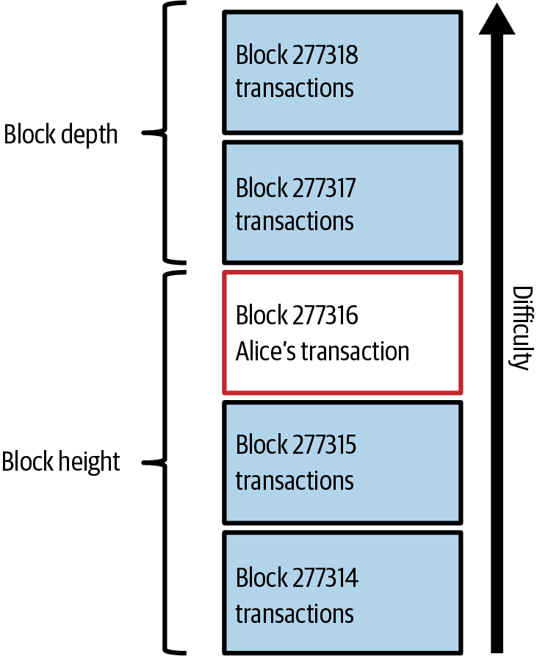
A block, anatomized
₿
80 bytes of header summarize everything beneath
1
Header: previous-block hash, Merkle root, time, target, nonce
2
Body: the transactions - Alice's among them
3
Chain the headers and you chain all history
prev hash
Merkle root
time
target
nonce
80 bytes carry a 4 MB body: 1 to 50,000
run under Python 3.14.6
>>> header, body = 80, 4000000
>>> (header, body // header)
(80, 50000)
Alice's tx inside a block - Mastering Bitcoin 3e, CC BY-SA
A header of 80 bytes summarizes everything beneath it
18 / 30
Notes:
A block is the unit in which transactions are added to the blockchain. The chapter says that transactions are bundled into blocks, and that blocks have a very small header that must be formed in a very specific way, requiring an enormous amount of computation to get right but only a small amount to verify as correct (Antonopoulos and Harding, 2023). A question to think about is this: why hash the header only, not the whole megabyte? The full explanation is on the course page, chapter 2, in Block and Block header.

Slide 19
One root for a thousand leaves
₿
The Merkle tree pins every transaction at once
1
Hash the transactions in pairs, then pairs of pairs
4 leaves: A B C D
2 pair-hashes
2
One root remains - 32 bytes for any number of leaves
1 root seals them all
3
Change any leaf and the root betrays it instantly
root of A,B,C,D: 59e82c45a3662f55...
four leaves to one root, computed
run under Python 3.14.6
>>> d = lambda b: hashlib.sha256(hashlib.sha256(b).digest()).digest()
>>> L = [d(x) for x in (b'A', b'B', b'C', b'D')]
>>> d(d(L[0] + L[1]) + d(L[2] + L[3])).hex()[:16]
'59e82c45a3662f55'
Change any leaf and the root betrays it
19 / 30
Notes:
A merkle tree, also called a binary hash tree, is a structure for summarizing and verifying the integrity of large sets of data. The book defines it as a tree constructed by hashing paired data, the leaves, then pairing and hashing the results until a single hash remains, the merkle root, and notes that in Bitcoin the leaves are almost always the transactions of a single block (Antonopoulos and Harding, 2023). Think about this case: a light client holds only the root. The full explanation is on the course page, chapter 2, in Merkle tree.

Slide 20
The coinbase: where new coin enters
₿
The one transaction with no inputs
Coinbase tx
first in every block
No inputs
value from the protocol
Subsidy + fees
chapter 1's chart
100 blocks
before it can be spent
the reward at this block, computed
run under Python 3.14.6
>>> inputs_spent, subsidy, fees = 0, 625000000, 183000
>>> (inputs_spent, subsidy + fees)
(0, 625183000)
0
inputs in a coinbase - the only transaction so allowed
Every coin in existence began life in a coinbase
20 / 30
Notes:
The coinbase transaction is the special first transaction of every block, by which the miner pays itself. The book's glossary calls it the first transaction in a block, always created by a miner, and the mining chapter adds the distinguishing property: unlike regular transactions the coinbase transaction does not consume unspent outputs as inputs, but has only one input, called the coinbase input, which implicitly contains the block reward (Antonopoulos and Harding, 2023). The full explanation is on the course page, chapter 2, in Coinbase transaction and Block reward.

Slide 21
The day someone printed 184 billion bitcoin
₿
Recorded: 2010-08-15, from the bitcointalk reports
184,467,440,737
74,638
~5 hours
BTC conjured by one transaction in block 74,638
the block that carried it, 2010-08-15
from forum report to Satoshi's 0.3.10 fix
✗
output of 92,233,720,368.54 BTC - overflow, summed as a small number
✗
its twin output, same trick
✓
0.3.10's corrected rule: outputs must sum in range - chain rebuilt without them
WHO An unknown attacker; spo…
WHERE block 74,638, discusse…
WHEN 2010-08-15
READ Value overflow incident (Bitcoin Wiki)
en.bitcoin.it
Validation by every node is the immune system - it worked
21 / 30
Notes:
This is a true story, dated 2010-08-15. On 15 August 2010 block 74,638 contained a transaction paying out about 184,467,440,737 BTC - thousands of times the 21 million cap. Two outputs were so large that, summed as 64-bit integers, they overflowed to a small number and slipped past the checks. The source is en.bitcoin.it/wiki/Value_overflow_incident: block 74,638 of 2010-08-15 (two outputs of 92,233,720,368.54 BTC each), Garzik's 'Strange block 74638' thread, Satoshi's 0.3.10 patch ~5 hours later, good chain ahead by block 74,691.

Slide 22
Confirmations: depth, not time
₿
Each block on top multiplies the attacker's bill
depth, counted
run under Python 3.14.6
block 0
block 1
block 2
>>> depth = 2
>>> depth + 1
3
the genesis record
digest of block 0
digest of block 1
Alice's block + 2 on top = 3 confirmations
1
A confirmation is a block on top of yours - depth, not minutes
2
To rewrite yours an attacker must redo every block above it, faster than everyone
3
How unlikely that is, the whitepaper computes - next slide
Each block on top multiplies the cost of rewriting yours
22 / 30
Notes:
A confirmation is a block that commits to a transaction, counted once for the block that contains it and once more for each block built on top. A question to think about is this: why does a reorg of depth 1 happen weekly, depth 6 almost never? The full explanation is on the course page, chapter 2, in Confirmation and Best blockchain.

Slide 23
The whitepaper's table, recomputed live
₿
Section 11's procedure, rerun for this deck - not quoted
0.2045873
catch-up odds after 1 block (q=0.1)
0.0002428
after 6 - the '6 confirmations' rule
the paper's own table
Six confirmations: the attacker's odds drop below 0.03%
23 / 30
Notes:
This chart is not an illustration: the build ran the whitepaper's section-11 procedure (examples group AttackerSuccess) and drew what it returned; the chapter research record matched the q=0.1 column against the paper to seven decimals. Think about this case: read the 30% line at six blocks. The full explanation is on the course page, chapter 2, in Probability and Confirmation.

Slide 24
Zero-conf espresso, six-block house
₿
Match the wait to the stake
Espresso: accept at zero
House: wait for six
Small sum, repeat customer, in person
Risk: someone races a double-spend for a coffee
Seconds matter more than certainty
Large, irreversible, worth attacking
Six blocks: odds near one in four thousand (q=0.1)
An hour of patience prices out the attack
same rule, different stakes
Match the wait to the stake - that is all 6 blocks means
24 / 30
Notes:
Accepting a small payment unconfirmed is the practice of treating a transaction as paid as soon as it has propagated, without waiting for a block. It is not a rule of Bitcoin but a judgement about risk. A question to think about is this: where would you put a used-car sale on this line? The full explanation is on the course page, chapter 2, in Small payment acceptance and Unconfirmed transaction.

Slide 25
Semantics and practice
The chapter as data, and the chapter on your laptop
Triples
Provenance
Run it at home
25 / 30
Notes:
This branch reads the chapter with the eyes of the course rather than of the book. A transaction chain, as the first branch described it, is a record of what came from what: each output exists because a transaction consumed earlier outputs, and each transaction happened because somebody who held a key authorized it. The full explanation is on the course page, chapter 2, in Semantics.

Slide 26
The chapter as data: triples and provenance
₿
How the course page itself stores what you just learned
1
Every fact on the course page is a triple: subject, predicate, object
2
Provenance says who asserted it and from where - the run builds one of each and reads it back
1 - one fact, as the page stores it
run under Python 3.14.6
>>> triples = [('Tx2', 'used', 'Tx1:0'), ('Tx2:1', 'wasGeneratedBy', 'Tx2'), ('Tx2', 'wasAttributedTo', 'Alice')]
>>> (len(triples), len({s for s, p, o in triples} | {o for s, p, o in triples}))
(3, 4)
2 - and who says so
run under Python 3.14.6
>>> chain = ['Tx1:0', 'Tx2:1', 'Tx3:0']
>>> [(b, 'wasDerivedFrom', a) for a, b in zip(chain, chain[1:])]
[('Tx2:1', 'wasDerivedFrom', 'Tx1:0'), ('Tx3:0', 'wasDerivedFrom', 'Tx2:1')]
The course page you use is built exactly this way
26 / 30
Notes:
A triple is the unit in which these descriptions are written: a subject, a predicate and an object, read as a single sentence. The statement that Alice's transaction used Joe's output is a triple whose subject is the transaction, whose predicate is the relation used and whose object is the output. A question to think about is this: what triple would record Alice's payment to Bob? The full explanation is on the course page, chapter 2, in Triple and Provenance graph.

Slide 27
Run the chapter at home
₿
Three consoles reproduce today's claims
1 - the fingerprint that seals everything
run under Python 3.14.6
>>> hashlib.sha256(b'Alice pays Bob 75000').hexdigest()[:16]
'320a22eeeb9c0391'
2 - a toy block, mined like the real ones
run under Python 3.14.6
>>> h = hashlib.sha256
>>> next(n for n in range(500000) if h(('1' + str(n) + 'Alice pays Bob 75000').encode()).hexdigest().startswith('0000'))
6630
3 - chain two and break one
run under Python 3.14.6
>>> chain, edited = ['b1', 'b2', 'b3', 'b4', 'b5'], 1
>>> [i for i in range(len(chain)) if i >= edited]
[1, 2, 3, 4]
Three consoles reproduce the chapter - tonight, on your laptop
27 / 30
Notes:
The last branch of this chapter is about trying things out. The concepts of the earlier branches are all mechanical, which means that a learner can operate them rather than only read about them, and a small number of interactive pages have become the standard way to do that in teaching. The full explanation is on the course page, chapter 2, in Practice.

Slide 28
The chapter in five lines
₿
One line per part - each one provable from its slides
1
A transaction spends outputs whole and mints new ones - balance is a sum, not an account
2
Fees buy bytes of block space; change is just an output back to yourself
3
Transactions travel by gossip; within seconds every mempool holds Alice's payment
4
Miners race a lottery that is instant to verify - and rules caught the 184-billion forgery
5
A confirmation is depth; the whitepaper computes what each block of depth buys you
If a line feels unproven, its part's slides carry the receipt
28 / 30
Notes:
Five lines, one per part. If any feels like a claim rather than a fact, the agenda names the slides that prove it; the course page carries the full text. A question to think about is this: which line would you defend to a sceptic first, and with which slide? The full explanation is on the course page, chapter 2, in every section.

Slide 29
Where to go from here
₿
Checked 2026-10-06; every entry is a live link in this file
Read
Community & history
Bitcoin white paper (PDF)
Section 11: the table of attacker odds this chapter charts
Bitcoin Stack Exchange (Q&A site)
Search or ask any technical question; answers are voted
Mastering Bitcoin, ch. 2: How Bitcoin Works
Chapter text as AsciiDoc source, plain text, free to read
Get 5 free bitcoins (bitcointalk thread)
Gavin Andresen's faucet announcement, 11 June 2010
Value overflow incident (Bitcoin Wiki)
What block 74,638 did and how it was fixed en.bitcoin.it
Watch
But how does bitcoin actually work? (video)
3Blue1Brown draws the ledger, signatures and proof of work
Explore & verify
mempool.space (block explorer)
Live blocks, transactions and fee rates; look up any txid
blockstream.info (block explorer)
Look up any block, transaction or address blockstream.info
learnmeabitcoin.com (illustrated guide)
Every Bitcoin structure drawn and explained, with code
One evening on an explorer replays this whole chapter for free
29 / 30
Notes:
Everything here is free. Watch one transaction confirm on mempool.space tonight - pick any txid from the latest block - and you will have SEEN this whole chapter happen once. A question to think about is this: who can find Alice-sized fees (about 35 sat/vB) in the current mempool? The full explanation is on the course page, chapter 2, in Practice.

Slide 30
What you should now be able to say
And where each claim gets its proof
What a transaction spends, creates, and pays
How a payment reaches every mempool with no postmaster
Why rewriting a buried block costs more than it wins
What six confirmations actually promises - a number
Questions?
30 / 30
Notes:
Four claims, each one carried by a computation you watched run. Next week: the wallet that holds Alice's keys. The full explanation is on the course page, chapter 2.

