Slide 1
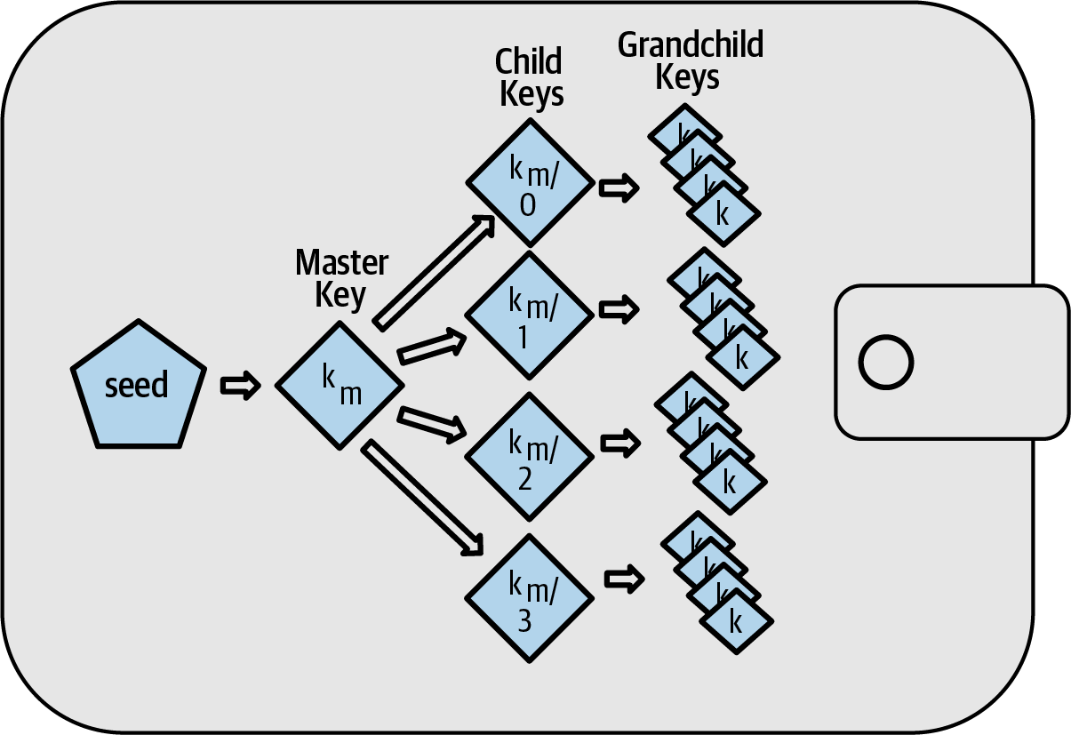
₿
Chapter 5: Wallet Recovery
One seed, twelve words, and every key you will ever need back
the HD tree - Mastering Bitcoin 3e, CC BY-SA
SEN0401 Special Topics in Software Engineering: Block Chain · Fall 2026 · Yusuf Altunel, PhD · İstanbul Kültür University
Notes:
SAY: Chapter 4 made one key; chapter 5 makes ALL of them recoverable from twelve words you can write on paper - and shows what happens to people who skip the writing.
FULL TEXT: course page, chapter 5.

Slide 2
Today's route
₿
Five parts; every number is a slide you can jump to
1
Questions and the chapter map (slides 3-4)
23
slides, numbered bottom-right
2
Keys in wallets - loose, deterministic, hierarchical (slides 5-7)
3
3
Recovery codes - BIP-39, measured and stretched (slides 8-11)
true stories, each with WHO / WHERE / WHEN / READ
4
The tree and its paths - to Core's own address (slides 12-15)
18
5
Beyond keys, summary, and resources (slides 16-23)
live-run consoles, each shown with its result
Five parts - and at the end, a backup you have actually tested
2 / 23
Notes:
SAY: Five parts, ending at a tested backup. One story costs 7,002 BTC, one finds 200,000, and one explains the twelve words in your pocket.
ASK: Which part do you expect to be hardest - mark it now, check at the summary.
FULL TEXT: course page, chapter 5 - every section.

Slide 3
The questions this chapter answers
₿
Its own competency questions - we return to each
1
What does a Bitcoin wallet actually contain?
2
How is a BIP39 recovery code generated from entropy and turned into a seed?
3
How does BIP32 make a tree of keys from one seed?
4
Which recovery code schemes are in use?
5
Which derivation paths does a wallet use?
6
Where do the chapter's statements differ from the standards and from Bitcoin Core 31.1?
7
Which terms do the explanations of this chapter rely on?
If you can answer these, chapter 5 is yours
3 / 23
Notes:
SAY: This first branch of the chapter asks what a Bitcoin wallet really contains and where its keys come from. The chapter begins by correcting a common belief.
FULL TEXT: course page, chapter 5 - WalletKeys.

Slide 4
One chapter, eight branches
₿
The concept map the whole chapter hangs on
Eight branches; the count under each is how many concepts the course page explains for it - today walks the spine.
Wallet Keys
10 concepts
Recovery Codes
14 concepts
BIP39 Stack
14 concepts
HD Wallet
25 concepts
Path Backup
15 concepts
Nonkey Backup
9 concepts
Wallet Deployment
8 concepts
Foundations
8 concepts
Eight branches - every slide today lives on this map
4 / 23
Notes:
SAY: This first branch of the chapter asks what a Bitcoin wallet really contains and where its keys come from. The chapter begins by correcting a common belief.
FULL TEXT: course page, chapter 5 - WalletKeys, RecoveryCodes.

Slide 5
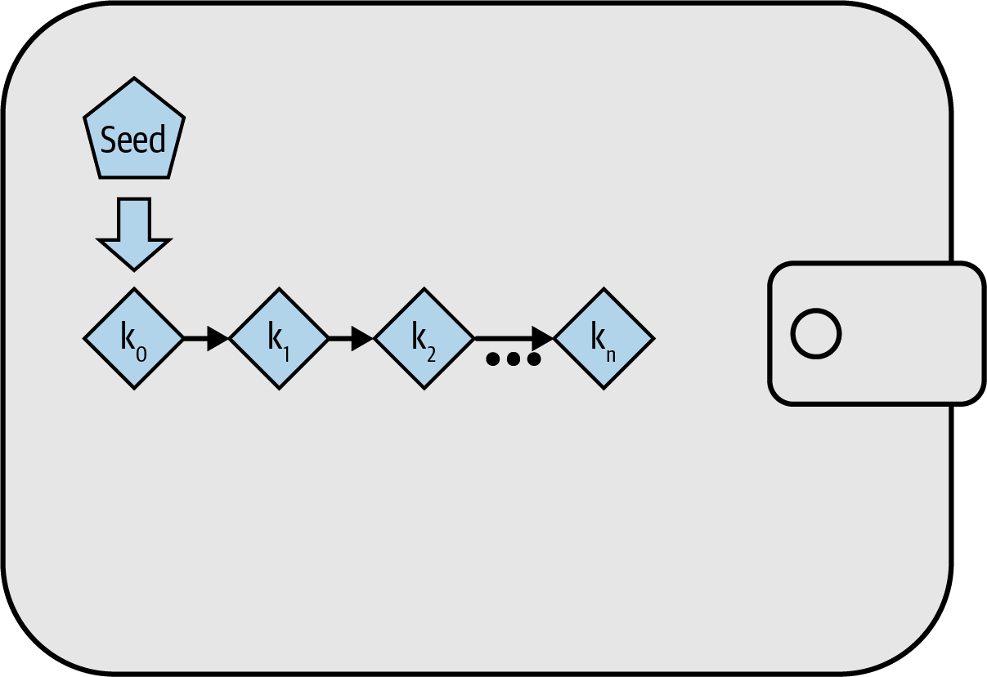
Keys in wallets
From a bag of keys to one recoverable seed
Wallet databases
Loose keys
Deterministic
Hierarchical
one seed, many keys - Mastering Bitcoin 3e, CC BY-SA
5 / 23
Notes:
SAY: This first branch of the chapter asks what a Bitcoin wallet really contains and where its keys come from. The chapter begins by correcting a common belief.
FULL TEXT: course page, chapter 5 - WalletKeys.

Slide 6
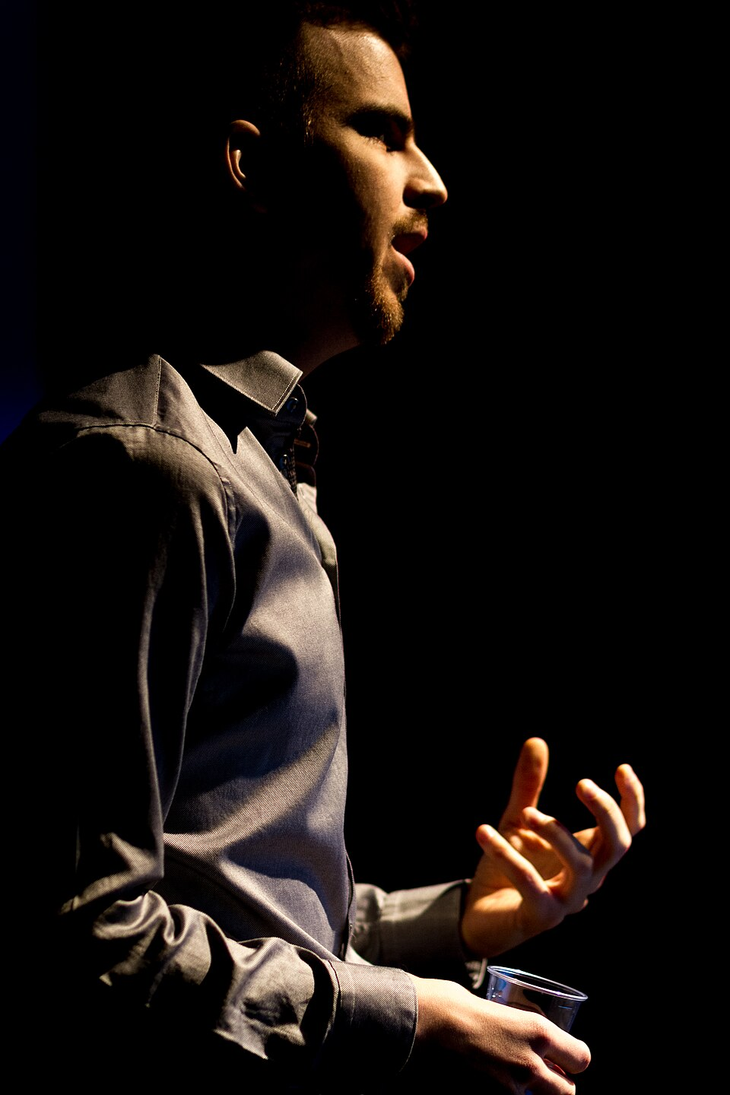
Two guesses from 7,002 bitcoin
₿
2021-01-12
2011: paid 7,002 BTC for an animated bitcoin explainer
Keys on an encrypted drive; password on a paper, lost
The drive allows ten guesses - by 2021, eight were gone
Front page of the New York Times, and of this chapter
WHO Stefan Thomas, program…
WHERE an IronKey USB drive i…
WHEN 2021-01…
READ nytimes.com
Stefan Thomas - Lift 2015, CC BY 2.0
Memory is not a backup - this chapter is the alternative
6 / 23
Notes:
STORY (2021-01-12): In 2011 Stefan Thomas was paid 7,002 BTC for making an animated explainer about bitcoin. He put the keys on an encrypted IronKey drive, wrote the password on a paper he later lost, and the drive allows ten guesses before locking forever. By January 2021, when the New York Times told the story, he had used eight. The chapter you are in - recovery codes, written backups, backup TESTING - is the discipline that makes this story impossible to repeat.
SOURCE: The New York Times, 2021-01-12, 'Lost Passwords Lock Millionaires Out of Their Bitcoin Fortunes': 7,002 BTC, ten guesses, eight used. Photo: Lift Conference 2015, CC BY 2.0 (the file page names Stefan Thomas).

Slide 7
From loose keys to one seed
₿
Three generations of wallet, one slide
Loose keys
back up every key, forever
Deterministic
one seed makes them all
Hierarchical
a tree with branches
loose keys: unrelated by design
same seed in, same keys out - always
>>> 32 * 1000
32000
>>> 32 * 1001 - 32 * 1000
32
>>> line = lambda i: (BOOK_SEED + ' + %d\n' % i).encode()
>>> [hashlib.sha256(line(i)).hexdigest()[:8] for i in range(3)]
['50b18e0b', 'a965dbcd', '19580c97']
>>> hashlib.sha256((BOOK_SEED + ' + 0\n').encode()).hexdigest()[:8]
'50b18e0b'
run under Python 3.14.4
run under Python 3.14.4
back up ONE secret, ONCE
Back up one secret once, instead of every key forever
7 / 23
Notes:
SAY: Independent key generation is the method in which a wallet application creates each of the keys that it plans to use independently of the others. Each is a fresh random number with no connection to the rest, and the wallet database is simply the collection of them.
ASK: What breaks if a deterministic wallet's RNG is biased? (chapter 4 answered)
FULL TEXT: course page, chapter 5 - IndependentKeyGeneration, DeterministicKeyGeneration.

Slide 8
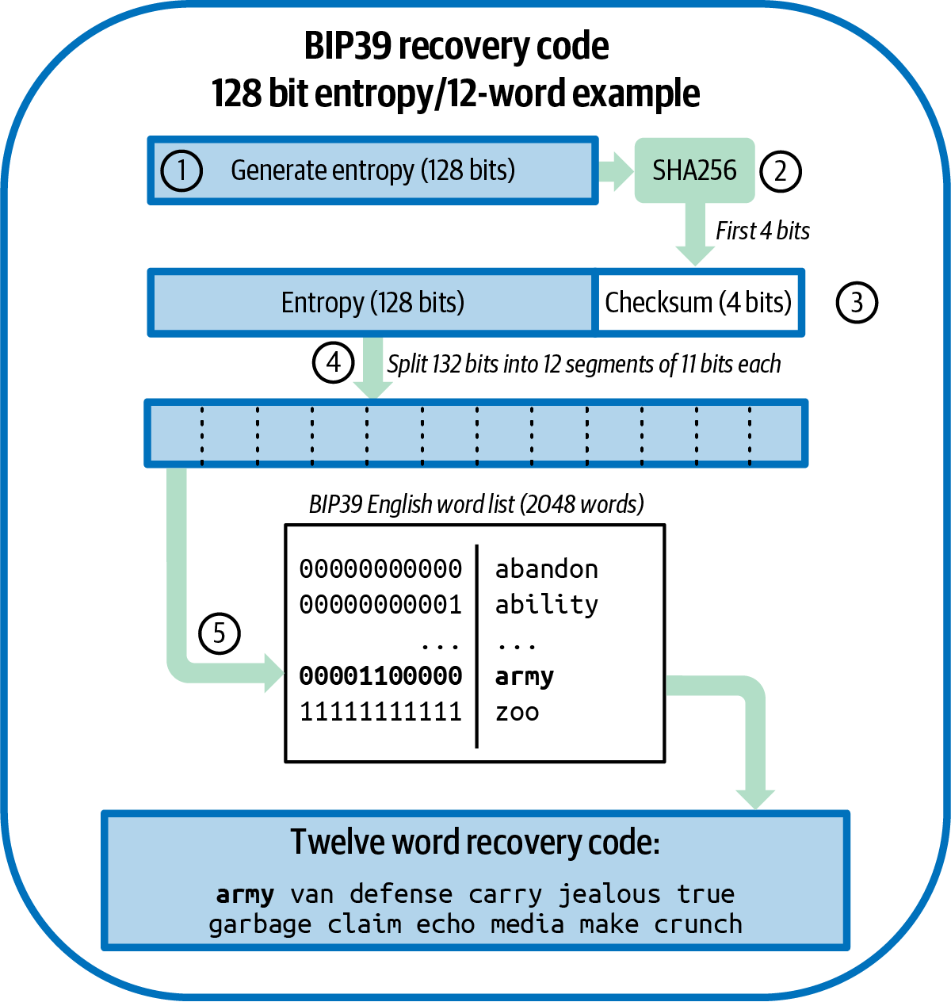
Recovery codes
Entropy, dressed for handwriting
BIP-39 words
Checksum
Passphrase
The rivals
entropy to code - Mastering Bitcoin 3e, CC BY-SA
8 / 23
Notes:
SAY: A recovery code is the short, written form of a wallet's seed: a sequence of words, or in one case a string of letters and digits, from which every key of a deterministic wallet can be computed again.
FULL TEXT: course page, chapter 5 - RecoveryCodes.

Slide 9
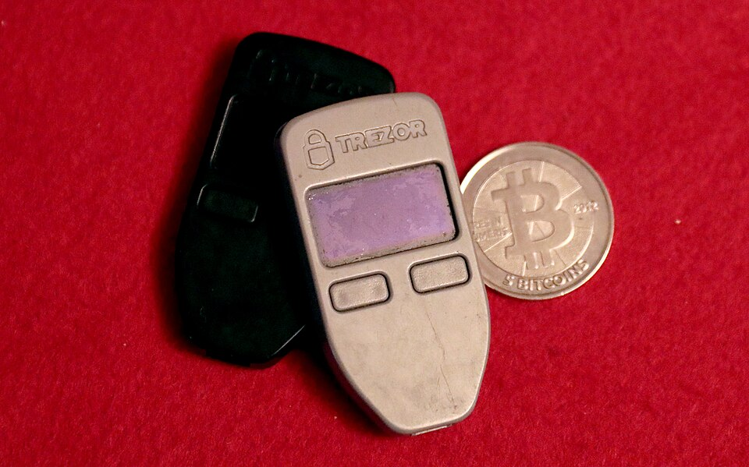
Twelve words between you and 128 bits
₿
2013-09-10
2013: the first hardware-wallet team hits a human problem
Nobody transcribes 128 raw bits correctly
BIP 39: 2,048 words, 11 bits each, checksum folded in
These slides run that standard against its own vectors
Trezor One devices - photo: Gage Skidmore, CC BY-SA 3.0
WHO Marek Palatinus and Pavol Rusnak (Sato…
WHERE BIP 39, in the public bips repository
WHEN 2013-09-10
READ github.com
The recovery code is an interface between humans and entropy
9 / 23
Notes:
STORY (2013-09-10): The team building the first hardware signing device faced a human problem: nobody transcribes 128 raw bits correctly. Their 2013 proposal, BIP 39, encodes entropy as ordinary words from a curated list of 2,048 - eleven bits a word, a checksum folded in, a key-stretching function from words to seed. The slides around this one do not describe that pipeline; they run it, word by word, against the standard's own test vectors.
SOURCE: BIP 39, 'Mnemonic code for generating deterministic keys', authors Palatinus, Rusnak, Voisine, Bowe, dated 2013-09-10, in bitcoin/bips. Photo: two Trezor One devices by Gage Skidmore, CC BY-SA 3.0.

Slide 10
Words to bits, measured
₿
The whole size table, computed - then checked word by word
The bars are computed, never quoted: CodeLength derived every pair, and the checker re-runs it off this file.
the list: 2,048 words, sorted
>>> 2 ** 11, len(wordlist())
(2048, 2048)
>>> [wordlist()[i] for i in (96, 1929, 459)]
['army', 'van', 'defense']
>>> sorted(wordlist()) == wordlist()
True
run under Python 3.14.4
the vector decodes and verifies
>>> mnemonic_to_entropy(WORDS)[0].hex()
'0c1e24e5917779d297e14d45f14e1a1a'
>>> mnemonic_to_entropy(WORDS)[1]
True
run under Python 3.14.4
Eleven bits a word; the checksum rides along
10 / 23
Notes:
SAY: The length of a recovery code is not a free choice: it is determined by the amount of entropy. The chapter prints the relation as a table with four columns, entropy in bits, checksum in bits, entropy plus checksum, and recovery code words, whose five rows run from 128 bits and 12 words to 256 bits and 24 words (Antonopoulos and Harding, 2023).
ASK: Why eleven bits a word - what is 2 to the 11?
FULL TEXT: course page, chapter 5 - CodeLength, WordList.

Slide 11
From words to seed, slowly on purpose
₿
PBKDF2, salt, and the passphrase that changes everything
words
the code you wrote
+ 'mnemonic' + passphrase
the salt
PBKDF2, 2048 rounds
HMAC-SHA512
512-bit seed
the tree's root
the seed is 512 bits, counted
same words, new passphrase - different wallet
>>> len(bytes.fromhex(BOOK_SEED)) * 8
256
>>> len(mnemonic_to_seed(WORDS)) * 8
512
>>> mnemonic_to_seed(WORDS).hex()[:16]
'5b56c417303faa3f'
>>> mnemonic_to_seed(WORDS, PASSPHRASE).hex()[:16]
'3b5df16df2157104'
the stretcher itself - and it refuses sloppy input
run under Python 3.14.4
run under Python 3.14.4
>>> mnemonic_to_seed(WORDS).hex()[:16]
'5b56c417303faa3f'
>>> len(mnemonic_to_seed(WORDS))
64
>>> hashlib.pbkdf2_hmac('sha512', 'words', b'mnemonic', 2048)
TypeError: a bytes-like object is required, not 'str'
run under Python 3.14.4
The passphrase changes everything - by design
11 / 23
Notes:
SAY: PBKDF2 is the second password-based key derivation function of the PKCS #5 standard, and it is the particular key-stretching function BIP39 names. Its specification defines it as applying a pseudorandom function to derive keys, with four inputs: a password, a salt, an iteration count and the intended length of the derived key in octets, and says it is recommended for new applications (Moriarty et al., 2017).
ASK: Where must the passphrase NOT be stored - and why is 'nowhere' a defensible answer?
FULL TEXT: course page, chapter 5 - Pbkdf2, RecoveryPassphrase.

Slide 12
The tree and its paths
One seed, a numbered key for every purpose
Master key
Child derivation
Hardened
Standard paths
12 / 23
Notes:
SAY: A hierarchical deterministic wallet, which the chapter and the standards abbreviate to HD wallet, is a wallet whose keys form a tree, every node of which is computed from the seed. The book's glossary calls the hierarchical deterministic protocol the key creation and transfer protocol of BIP32, which allows creating child keys from parent keys in a hierarchy, and an HD wallet a wallet using that protocol (Antonopoulos and Harding, 2023).
FULL TEXT: course page, chapter 5 - HdWallet.

Slide 13
One seed, a tree of keys
₿
HMAC-SHA512 splits every node in two
the master pair, derived and range-checked
1
The seed makes a master key and a chain code
>>> k, c = master(TV)
>>> '%064x' % k
'e8f32e723decf4051aefac8e2c93c9c5b214313817cdb01a1494b917c8436b35'
>>> 0 < k < N
True
2
Each child: HMAC of parent and an index
3
32 bytes of key, 32 of chain code - every node
run under Python 3.14.4
child zero, with its own chain code
>>> (512 // 2, 512 // 2 // 8)
(256, 32)
>>> k, c = master(TV)
>>> k1, c1 = ckd_priv(k, c, 0)
>>> (len(c1), k1 < N)
(32, True)
the tree never runs dry
run under Python 3.14.4
Two 32-byte halves at every node keep the tree alive
13 / 23
Notes:
SAY: Hierarchical deterministic key generation, usually shortened to HD, is the standard way to derive keys from a seed. It is defined in BIP32, a Bitcoin Improvement Proposal by Pieter Wuille that has the status Deployed (Wuille, 2012).
ASK: Why carry a chain code at all - what would leak without it?
FULL TEXT: course page, chapter 5 - HdKeyGeneration, ChildKeyDerivation.

Slide 14
Hardened or not: one question, two columns
₿
Can a thief with the xpub climb down?
Normal derivation (index < 2^31)
Hardened (index >= 2^31, the h)
Public keys derivable WITHOUT private keys
Perfect for watch-only shops
But: child private + xpub leaks the parent
Needs the private parent - no public shortcut
Standard for account levels
The run proves the two differ
same index, hardened and not - different keys, provably
>>> k, c = master(TV)
>>> kh, ch = ckd_priv(k, c, 2 ** 31)
>>> '%064x' % kh
'edb2e14f9ee77d26dd93b4ecede8d16ed408ce149b6cd80b0715a2d911a0afea'
>>> ckd_priv(k, c, 0)[0] == kh
False
run under Python 3.14.4
The h in a path is a security decision, not decoration
14 / 23
Notes:
SAY: Hardened derivation is the alternative derivation function that breaks the relationship between the parent public key and the child chain code.
ASK: Read m/84h/0h/0h/0/2: which hops could a watch-only server have taken itself?
FULL TEXT: course page, chapter 5 - HardenedDerivation, PrivateChildDerivation.

Slide 15
The paths everyone agreed on
₿
Five levels, and Core derives the same address we do
purpose / coin / account / change / index - hardened where it matters
>>> LEVELS = 'purpose / coin_type / account / change / address_index'.split(' / ')
>>> len(LEVELS)
5
>>> [i >= 2 ** 31 for i in path_indices('m/44h/0h/0h/0/2')]
[True, True, True, False, False]
BIP-84's own test vector: our math, then Core's answer - equal
run under Python 3.14.4
>>> k0, c0 = keys_at(B84, 'm/84h/0h/0h/0/0')
>>> p2wpkh_address(ser_p(ec_mul(k0)))
'bc1qcr8te4kr609gcawutmrza0j4xv80jy8z306fyu'
>>> CORE_BIP84['addresses'][0]
'bc1qcr8te4kr609gcawutmrza0j4xv80jy8z306fyu'
>>> p2wpkh_address(ser_p(ec_mul(k0))) == CORE_BIP84['addresses'][0]
True
run under Python 3.14.4
44h legacy
49h nested
84h segwit
86h taproot
m/84h/0h/0h/0/0 - and Core derives the same address
15 / 23
Notes:
SAY: BIP44 is the layout that gives a tree its familiar shape. The chapter says that, extending BIP43, BIP44 proposes a multi-account structure as purpose number 44 with a prime, that all wallets following the structure are identified by using only the branch m/44', and that the structure consists of five predefined tree levels: purpose, coin type, account, change and address index (Antonopoulos and Harding, 2023).
ASK: Your phone wallet says 'account 0' - write its path from memory.
FULL TEXT: course page, chapter 5 - Bip44Structure, StandardPath84.

Slide 16
Beyond keys
What else must survive, and how wallets ship
Watch-only xpubs
Labels and channels
Split secrets
Test the backup
16 / 23
Notes:
SAY: This branch is about everything in a wallet that a seed cannot reproduce.
FULL TEXT: course page, chapter 5 - NonkeyBackup.

Slide 17
Watch-only: the shop holds no keys
₿
An xpub derives addresses; it cannot spend
1
Deploy the xpub to the web shop, keep keys cold - it mints a fresh address per customer
2
The gap limit decides how far a recovery scan looks for used addresses
three addresses from the public key alone - cold keys, warm addresses
>>> ['M/84h/0h/0h/0/%d' % i for i in range(3)]
['M/84h/0h/0h/0/0', 'M/84h/0h/0h/0/1', 'M/84h/0h/0h/0/2']
>>> acct = parse_extended(BOOK_XPUB)
>>> K, ch = decompress(acct['key']), acct['chain']
>>> [p2wpkh_address(ser_p(pub_at(K, ch, '0/%d' % i)[0])) for i in range(2)]
['bc1qrx4d48k7etw6cvq8czlmd8j0c5rwswccl3vk06', 'bc1qt4qgamxv55gm0lksl0aay3pkjvt02zy4h8j3lv']
scan 20: index 25 is missed; scan 30 finds it
run under Python 3.14.4
>>> scan_with_gap({0, 3, 25}, 20)
[0, 3]
>>> scan_with_gap({0, 3, 25}, 30)
[0, 3, 25]
run under Python 3.14.4
Publish the xpub; the keys never feel the internet
17 / 23
Notes:
SAY: Deploying an extended public key means installing the public half of a branch on a machine that needs to receive but not to spend.
ASK: A donation page went viral and used 400 addresses - what must recovery change?
FULL TEXT: course page, chapter 5 - XpubDeployment, GapLimit.

Slide 18
The 200,000 BTC in a forgotten wallet file
₿
2014-03-21
200,000 BTC
2011
10+ yrs
reported found, three weeks into bankruptcy
when the old-format wallet file was last used
later, those coins began repaying creditors
A file written by software two generations older still held spendable keys
Backups do not expire - label them, test them, never discard them blindly
WHO Mt. Gox, weeks into its bankruptcy pro…
WHERE an old-format wallet file, unused sinc…
WHEN 2014-03-21
READ en.wikipedia.org
Backups do not expire - treat old wallet files as live keys
18 / 23
Notes:
STORY (2014-03-21): Chapter 1 told how Mt. Gox collapsed owing 850,000 BTC. Three weeks after the bankruptcy filing came a twist: the company reported finding about 200,000 BTC in an old-format wallet file that had sat unused since 2011. A file made by software two generations older still held spendable keys - backups do not expire. Those coins became the pool from which creditors, a decade later, began to be repaid.
SOURCE: Mt. Gox announcement of 2014-03-20/21 reporting approximately 200,000 BTC found in an old-format wallet; summarized with the bankruptcy chronology at en.wikipedia.org/wiki/Mt._Gox.

Slide 19
Split the secret, not the risk
₿
Shamir: three of five recovers; two learn nothing
split, recover, and fail honestly
1
Split the seed into five shares, threshold three
>>> SHARES = shamir_split(0x1337c0de, 3, 5, [11, 22])
>>> len(SHARES)
5
>>> shamir_combine([SHARES[0], SHARES[2], SHARES[4]]) == 0x1337c0de
True
>>> shamir_combine([SHARES[0], SHARES[2]]) == 0x1337c0de
False
2
Any three reconstruct it exactly
3
Any two: provably nothing - the run shows both
run under Python 3.14.4
SLIP-39 does this in words; Codex32 by hand on paper
>>> SHARES = shamir_split(0x1337c0de, 3, 5, [11, 22])
>>> [x for x, y in SHARES]
[1, 2, 3, 4, 5]
>>> shamir_combine(SHARES[:3]) == 0x1337c0de
True
>>> shamir_combine(SHARES[:2]) == 0x1337c0de
False
run under Python 3.14.4
Three of five recovers; two of five learns nothing
19 / 23
Notes:
SAY: Secret sharing is a way of splitting one secret into several parts with a threshold. SLIP39's description is the clearest: the scheme splits a secret into a number of unique parts, of which any threshold-many are required to reconstruct it, and knowledge of fewer than the required number does not leak information about the secret (Rusnak et al., 2017).
ASK: Where do five shares live so no burglary, flood, or sibling feud collects three?
FULL TEXT: course page, chapter 5 - SecretSharing, Slip39Code.

Slide 20
Test the backup, not your luck
₿
The chapter's closing discipline, executable
restore-drill: right words verify; one wrong word is caught
>>> mnemonic_to_seed(WORDS) == mnemonic_to_seed(WORDS)
True
>>> mnemonic_to_entropy(WORDS)[1]
True
>>> mnemonic_to_entropy(WORDS.replace('crunch', 'cruise'))[1]
False
Core's own tooling: backupwallet, and the keypool that guards gaps
run under Python 3.14.4
>>> 'Safely copies the current wallet file' in flat(CORE_BACKUP)
True
>>> '(default: 1000)' in flat(CORE_KEYPOOL)
True
run under Python 3.14.4
write it
split it if large
store it apart
TEST the restore
A backup counts only after a successful restore drill
20 / 23
Notes:
SAY: Testing a backup means performing the recovery while it is still optional. It is the action the chapter's last sentence asks for: it is up to the reader to actually use the systems available to make good backups and regularly test them (Antonopoulos and Harding, 2023).
ASK: When did you last restore a backup of anything - and how do you know it works?
FULL TEXT: course page, chapter 5 - BackupTesting, DataLoss.

Slide 21
The chapter in five lines
₿
One line per part - each one provable from its slides
1
Wallets stopped storing keys and started deriving them - one seed, backed up once
2
A recovery code is entropy in human clothing: 11 bits a word, checksum included
3
Words become a 512-bit seed through deliberate slowness - and a passphrase forks the wallet
4
The HD tree hands every purpose a numbered key; hardened hops keep the xpub harmless
5
Beyond keys: labels, channels, split secrets - and a backup only counts once restored
If a line feels unproven, its part's slides carry the receipt
21 / 23
Notes:
SAY: Five lines, one per part; the agenda names the slides that prove each.
ASK: Which line would you defend first, and with which slide?
FULL TEXT: course page, chapter 5 - every section.

Slide 22
Where to go from here
₿
Checked 2026-10-06; every entry is a live link in this file
Read
Tools
This chapter, free (CC BY-SA) github.com/bitcoinbook/bitcoinbook/blob/develop/ch05_wallets.adoc
Ian Coleman's BIP-39 tool (offline use!) iancoleman.io/bip39/
The IronKey story, as reported nytimes.com/2021/01/12/technology/bitcoin-passwords-wallets-fortunes.html
learnmeabitcoin - HD wallets, drawn learnmeabitcoin.com
Standards
Community
BIP 39 - the recovery code github.com/bitcoin/bips/blob/master/bip-0039.mediawiki
Bitcoin Stack Exchange Q&A bitcoin.stackexchange.com
BIP 32 - the HD tree github.com/bitcoin/bips/blob/master/bip-0032.mediawiki
BIP 84 - the path these slides derived github.com/bitcoin/bips/blob/master/bip-0084.mediawiki
Twelve words on paper beat every password you have ever memorized
22 / 23
Notes:
SAY: Everything here is free. Homework: generate a THROWAWAY twelve-word code, restore it in a second wallet, and bring the one surprise you hit to class. Never type a real code into any website.
ASK: Which of the four closing chips does your current phone wallet fail?
FULL TEXT: course page, chapter 5 - WalletDeployment.

Slide 23
What you should now be able to say
And where each claim gets its proof
Why one seed replaced bags of keys
What twelve words carry, and how they become a tree
Which path your wallet walks, and who else can walk it
What a tested backup is - and what Stefan Thomas teaches
Questions?
23 / 23
Notes:
SAY: Four claims, each carried by a computation you watched run against the standards' own vectors. First five chapters complete - the course page carries every word.
FULL TEXT: course page, chapter 5.

