Slide 1
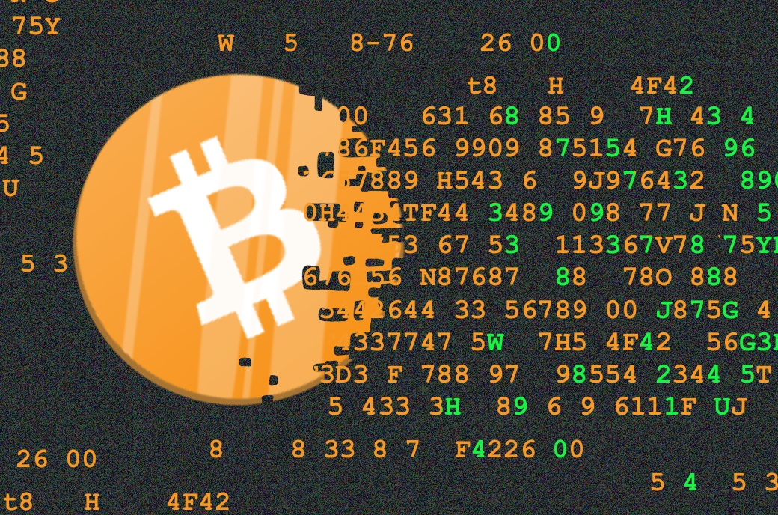
₿
Chapter 3: Bitcoin Core
The reference implementation: build it, run it, ask it questions
A coin that turns into code - from the course's 2025 deck
Python 3.14.6; every number is computed by the chapter library from saved data; no Bitcoin Core node was run.
SEN0401 Special Topics in Software Engineering: Block Chain · Fall 2026 · Yusuf Altunel, PhD · İstanbul Kültür University
1 / 42
Notes:
Chapter 2 followed one payment through the network. Chapter 3 opens the program that checks every rule, Bitcoin Core, and shows how to build it, run it and ask it questions. Every result in this deck was computed by the chapter library from saved data.

Slide 2
Today's route
₿
Seven parts around one program; every range is a slide you can jump to
1. Questions and the chapter map
(slides 3-4)
2. From Bitcoin to Bitcoin Core
(slides 5-8)
3. Bitcoin Development Environment
(slides 9-14)
42
slides, numbered bottom-right
4. Running a Bitcoin Core Node
(slides 15-22)
5. Bitcoin Core API
(slides 23-27)
6. Exploring and Decoding Transactions
(slides 28-31)
3
true stories, each told by 5N1K
7. Exploring Blocks
(slides 32-36)
8. Alternative Clients, Libraries, and Toolkits
(slides 37-39)
9. Summary, resources, closing
(slides 40-42)
19
code examples, each with a picture of its result
Seven parts, three true stories, nineteen examples
2 / 42
Notes:
The route has seven parts that follow the program from its source code to the toolkits around it. Three true stories and nineteen code examples are spread across them. Every example has a picture of its result.

Slide 3
The questions this chapter answers
₿
Each has an answer on a slide; we return to them in the summary
1
What makes Bitcoin Core the reference implementation of Bitcoin?
2
How do I choose a release, check it and build it from source?
3
Which settings decide what a node stores, remembers and trusts?
4
How do I ask a running node questions, and who may ask?
5
How do I decode a transaction and tell its txid from its weight?
6
How can I check a block myself, and what else can talk to a node?
3 / 42
Notes:
The six questions are the chapter's own, rewritten so that each has an answer on a slide. We return to them in the summary. A reader who can answer all six has understood the chapter.

Slide 4
The chapter in one picture
₿
One program, six steps; the parts of the deck follow them
1 Source
2 Build
3 Run
4 Ask
5 Read
6 Extend
Read the code; pick a release.
Compile it and check the files.
Start the node and set it up.
Call its interface with JSON-RPC.
Decode transactions and blocks.
Libraries and other clients.
Nineteen code examples run along this path. Each prints its result under the listing and shows it as a picture beside it.
Six steps from the source code to the data of the chain
4 / 42
Notes:
Six steps carry us from the source code to the data of the chain. We read the code and pick a release, build it, run it, ask it questions and read what it says. The last step looks at other programs that speak to a node.

Slide 5
From Bitcoin to Bitcoin Core
Bitcoin Core: The Reference Implementation
reference implementation
full verification node
Bitcoin Improvement Proposal
The program against which other programs are measured.
A node that downloads every block and checks every rule itself.
A numbered public document that proposes a change to Bitcoin.
Think of the standard metre bar that every ruler was checked against.
Think of an auditor who recounts every receipt instead of trusting a summary.
Think of a numbered bylaw proposed in a club's rulebook.
Core | Source | Node | API | Transactions | Blocks | Toolkits
5 / 42
Notes:
Part 1 asks what Bitcoin Core is. It began as the program Satoshi Nakamoto released in 2009, and it checks every rule itself as a full verification node. Changes reach it through numbered Bitcoin Improvement Proposals.

Slide 6

Version 0.1, set in stone
₿
8 January 2009 · the first release of Bitcoin
WHO Satoshi Nakamoto, the pseudonymous author of the white paper and of the first program.
WHAT Version 0.1 of Bitcoin, a Windows program that anyone could download and run.
WHEN 2009-01-08 (8 January 2009)
WHERE Announced on the metzdowd.com cryptography mailing list; the download sat on SourceForge.
WHY Only running software could start the network. Later he wrote that, once 0.1 was out, the core design was set in stone.
Picture: Satoshi bust, Budapest - Fekist, CC BY-SA 4.0, Wikimedia Commons
HOW A short post with the download link, five days after the first block had been mined.
READ Satoshi: Bitcoin v0.1 released (list post)
The program came first: the reference implementation defines the rules
6 / 42
Notes:
In January 2009 Satoshi Nakamoto published version 0.1 of the Bitcoin program. A year and a half later he wrote that its core design was set in stone. That is why Bitcoin Core is called the reference implementation: the software came first, and the rules are what it does.

Slide 7
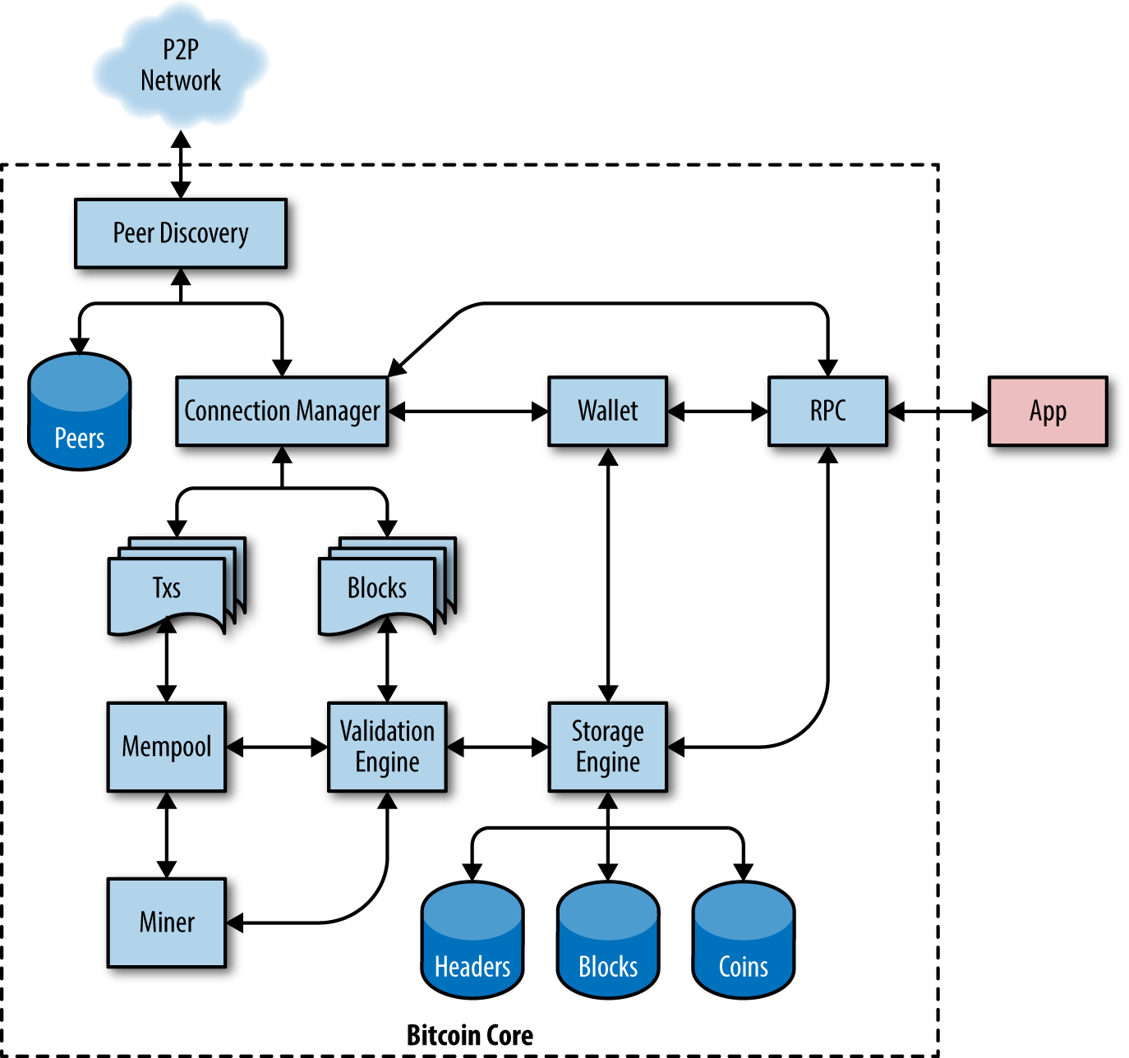
Inside the program
₿
The parts of Bitcoin Core, from the course textbook
Connection manager
Talks to the peers and passes on blocks and transactions.
Validation engine
Checks every block and every transaction against the rules.
Storage engine
Keeps the headers, the blocks and the set of coins.
RPC
Lets your own programs ask the node questions.
Antonopoulos and Harding, Mastering Bitcoin 3e, CC BY-SA 4.0
One program: it listens, checks, stores and answers
7 / 42
Notes:
Bitcoin Core is one program with several parts. Peers and the connection manager bring in blocks and transactions, the validation engine checks them, and the storage engine keeps headers, blocks and coins. The interface at the right lets your own programs ask questions.

Slide 8
A version number that carries a vote
₿
A Bitcoin Improvement Proposal signals through bit flags
>>> v = 0x20000002
Result: the 32 bits of the version
The version field of a block header that signals support for a new rule.
31-28 | 27-24 | 23-20 | 19-16 | 15-12 | 11-8 | 7-4 | 3-0
0010 | 0000 | 0000 | 0000 | 0000 | 0000 | 0000 | 0010
>>> top = v >> 29
>>> bits = [b for b in range(29) if v >> b & 1]
>>> (hex(v), top, bits)
('0x20000002', 1, [1])
Part | Value
Version | 0x20000002
Top three bits | 001 = BIP 9
Bits set below | 1
The top three bits mark a version-bits block (BIP 9); each lower bit that is set is one proposal's vote.
run under Python 3.14.6 - T is the chapter library of the page (sen0401_ch03_core_lib_v1_0_0)
Orange cell: the BIP 9 marker. Teal cell: bit 1, the vote.
Think of a ballot with 29 tick boxes, one for each proposal
8 / 42
Notes:
A block's version field is not a counter. Its top three bits mark the BIP 9 scheme, and every lower bit is a vote for one proposal. Here only bit 1 is set.

Slide 9
Bitcoin Development Environment
Compiling Bitcoin Core from the Source Code
release tag
release candidate
bitcoind
A name that fixes one exact version of the source, such as v31.1.
A tagged version offered for testing before it becomes final.
The node program, which runs in the background.
Think of a bookmark that always opens the same page.
Think of a dress rehearsal before the opening night.
Think of the engine of a car, working while you do other things.
Core | Source | Node | API | Transactions | Blocks | Toolkits
9 / 42
Notes:
Part 2 turns the source code into programs you can run. A release tag fixes which version you build, and release candidates are tried before a final tag exists. The build produces bitcoind, the node itself.

Slide 10
Three steps from source to executables
₿
The three headings of the book's building section
Selecting a Bitcoin Core Release
Configuring the Bitcoin Core Build
Building the Bitcoin Core Executables
Check out the tag of a final release, not of a candidate.
Choose options, such as whether to build the wallet or the window.
The compiler turns the source into the programs of the bin folder.
Think of choosing the printed edition, not the draft.
Think of ticking the options on a car order form.
Think of an oven that turns dough into bread.
Select, configure, build: three steps, one set of programs
10 / 42
Notes:
A build has three decisions. You select a release tag, you configure which features to build, and you build the executables. Each step has a single command, and a clean tag makes the result repeatable.

Slide 11
Release tags sort by number, not by letters
₿
A release tag names the version; a release candidate carries rc
>>> final = [t for t in T.TAGS if 'rc' not in t]
Result: the oldest tags, in two orders
Release candidates carry rc in their tag; the final releases do not.
Rank | As text | By number
1 | v0.10.0 | v0.9.5
2 | v0.21.2 | v0.10.0
3 | v0.9.5 | v0.21.2
4 | v22.0 | v22.0
>>> text = sorted(final)
>>> num = sorted(final, key=T.version_key)
>>> (text[0], num[0])
('v0.10.0', 'v0.9.5')
Sorted as text, v0.10.0 comes before v0.9.5; sorted by number, the oldest comes first.
run under Python 3.14.6 - Recorded data: git tags listed on 2026-10-04 - T is the chapter library
As text, v0.10.0 comes first; by number the oldest tag, v0.9.5, does.
Think of edition numbers: the tenth edition follows the ninth
11 / 42
Notes:
These are real tags of the Bitcoin repository. Sorted as text, v0.10.0 lands before v0.9.5, which is wrong. A release candidate is a tag with rc in it, so we leave those out first.

Slide 12
What a release folder holds
₿
bitcoind is the node; bitcoin-cli is the client that calls it
>>> bins = T.LAYOUT['bin']
>>> libs = T.LAYOUT['libexec']
Result: the programs of release 31.1
Program | What it does
bitcoin | starts the other programs
bitcoin-cli | calls the node by name
bitcoin-qt | node with a window
bitcoin-tx | builds and edits transactions
bitcoin-util | small helper commands
bitcoin-wallet | works on wallet files
bitcoind | the node, as a daemon
A release unpacks into a bin folder of programs and a libexec folder of parts they use.
>>> (len(bins), len(libs), 'bitcoind' in bins)
(7, 3, True)
Seven programs, among them the node bitcoind and its client bitcoin-cli.
run under Python 3.14.6 - Recorded data: file list of release 31.1 - T is the chapter library
Beside bin, libexec holds 3 parts: bitcoin-gui, bitcoin-node, test_bitcoin.
Think of bitcoind as the engine and bitcoin-cli as the steering wheel
12 / 42
Notes:
A release unpacks into seven programs and three helper parts. The one to know is bitcoind, the node. You steer it from the command line with bitcoin-cli.

Slide 13

Dozens of builders, one identical binary
₿
13 September 2021 · Bitcoin Core 22.0 moves to Guix
WHERE The guix.sigs repository, beside bitcoin/bitcoin on GitHub.
WHY A downloaded program asks for trust; here several builders compare hashes instead of taking one person's word.
Picture: GNU Guix logo - GNU Guix, public domain, Wikimedia Commons
WHO Carl Dong, who wrote the Guix build system, and the independent builders who sign its results.
HOW Each builder compiles the tagged source and signs the hashes. Release 31.1 shows 11 good signatures on its SHA256SUMS.
WHAT Release 22.0 was the first built with Guix, so anyone can rebuild the binary bit for bit.
WHEN 2021-09-13 (13 September 2021)
READ Builder attestation, Core 31.1 (hash list)
Verify, don't trust: the project applies its own rule to itself
13 / 42
Notes:
Anyone can ask whether a downloaded binary really matches the source. Since release 22.0 Bitcoin Core builds with Guix, so independent builders get identical files and sign their hashes. For release 31.1 the checksum file carries eleven good signatures.

Slide 14
A download must match its published hash
₿
Checking a release against SHA256SUMS
>>> listed = T.SUMS['bitcoin-31.1-x86_64-linux-gnu.tar.gz']
Result: the listed hash against the computed one
The release's SHA256SUMS file lists the expected hash of every archive.
SHA256SUMS lists
b80d9c3e04da...
>>> computed = T.RECOMPUTED
>>> (listed == computed, listed[:12])
(True, 'b80d9c3e04da')
Your download hashes to
b80d9c3e04da...
Hash the downloaded archive yourself; equal texts mean it is the file that was published.
run under Python 3.14.6 - Recorded data: SHA256SUMS of release 31.1 - T is the chapter library
Equal: True
all 64 characters
Only the first 12 of 64 characters are shown here.
Think of the safety seal on a medicine bottle: break it and you can tell
14 / 42
Notes:
Each release ships a list of hashes. You hash your download and compare. If the two texts match, the file is the one that the builders signed for.

Slide 15
Running a Bitcoin Core Node
Configuring the Bitcoin Core Node
configuration file
data directory
prune
A text file of settings that the node reads when it starts.
The folder in which the node keeps blocks, state, logs and settings.
An option that deletes old block files after the node has checked them.
Think of the settings card taped to a coffee machine.
Think of the node's filing cabinet.
Think of an accountant who audits old invoices, keeps the totals and shreds the paper.
Core | Source | Node | API | Transactions | Blocks | Toolkits
15 / 42
Notes:
Part 3 starts the node and sets it up. A configuration file and the command line decide what the node does, and the data directory is where it keeps everything. Pruning, the transaction index and the memory limits trade disk, memory and features.

Slide 16
The command line wins over the file
₿
The configuration file sets defaults; an option on the command line overrides them
>>> conf = T.parse_conf(T.CONF_TEXT)
>>> cli = {'dbcache': '2048'}
Result: which source wins for each option
Option | File | Command | Used
dbcache | 450 | 2048 | 2048
txindex | 1 | - | 1
The file sets the cache to 450 and turns the index on; the command line asks for 2048.
>>> used = {**conf, **cli}
>>> used
{'dbcache': '2048', 'txindex': '1'}
dbcache is set in both places, so the command line's 2048 is used; txindex comes from the file.
Merge the file first and the command line last, so the command line wins where both speak.
run under Python 3.14.6 - T is the chapter library of the page (sen0401_ch03_core_lib_v1_0_0)
Think of a recipe card that you may override with a note on the fridge
16 / 42
Notes:
A configuration file holds the settings of a node. When the same option is also given on the command line, the command line wins. A script can therefore change one value for one run.

Slide 17
Inside the data directory
₿
What the offline node of release 31.1 had written
Entry | What it holds
banlist.json | peers it refuses to talk to
bitcoin.conf | your configuration file
bitcoind.pid | the number of the running process
blocks | the block files and their index
chainstate | the set of unspent outputs
debug.log | the node's diary, line by line
demo | the folder of the demo wallet
fee_estimates.dat | what the node learned about fees
mempool.dat | waiting transactions, saved at shutdown
peers.dat | addresses of the peers it knows
settings.json | settings changed while running
Think of the data directory as the node's filing cabinet: long drawers for the blocks, a small box for the state of the chain, the diary on top.
The .cookie file with the node's temporary password is also written here while the node runs, and removed when it stops.
Recorded: the listing of the offline node of release 31.1.
The data directory is the whole memory of the node
17 / 42
Notes:
Everything the node knows lives in its data directory. Blocks and the chain state are the big parts, the log is the node's diary, and the configuration file holds your settings. The cookie file appears while the node runs.

Slide 18
How the database cache is shared out
₿
The dbcache setting is divided before it is used
>>> total = 1024
>>> parts = T.cache_split(total)
Result: MiB of cache for each use
The node is given 1024 MiB of cache; the library divides it the way Bitcoin Core does.
>>> (parts, sum(parts))
((2, 8, 1014), 1024)
A little goes to two small databases; nearly everything serves the coins cache.
run under Python 3.14.6 - T is the chapter library of the page (sen0401_ch03_core_lib_v1_0_0)
Of 1,024 MiB, 1,014 serve the coins cache; the block index gets 2 and the chain state 8.
Think of a desk: two small drawers and one very large tabletop
18 / 42
Notes:
The dbcache option sizes the cache for the unspent outputs. Bitcoin Core first gives two small databases their share. Everything else goes to the cache of coins.

Slide 19
Pruning and the transaction index do not mix
₿
prune deletes old blocks; txindex needs every block
>>> a, b = {'prune': 550}, {'txindex': 1}
>>> c = {'prune': 550, 'txindex': 1}
Result: the verdict for each option set
Options | Verdict | Why
prune 550 | ok | no conflict
txindex 1 | ok | no conflict
prune 550 + txindex 1 | refused | prune mode is incompatible with txindex
Three option sets: prune alone, index alone, and both together.
>>> [T.check_options(o)[0] for o in (a, b, c)]
['ok', 'ok', 'refused']
The index needs every block on disk, so a pruned node cannot also keep it.
run under Python 3.14.6 - Recorded data: refusal printed by release 31.1 - T is the chapter library
Recorded on release 31.1: the node refuses to start with both options.
Think of a library that shreds old books and so cannot catalogue them all
19 / 42
Notes:
Pruning keeps only recent blocks. The transaction index must find any block that holds a transaction. The node therefore refuses both at once, and release 31.1 printed exactly that.

Slide 20
Two ways to spend less memory
₿
The blocksonly and maxmempool options
Mempool limit in megabytes
blocksonly
The node takes blocks from its peers but no loose transactions.
Think of reading only the daily paper, not every rumour.
maxmempool
A cap, in megabytes, on the waiting room of unconfirmed transactions.
Think of a clinic's waiting room: it has only so many chairs.
300 MB are 286.1 MiB; blocks-only mode needs 60 times less.
A node can trade features for memory, and keep verifying everything
20 / 42
Notes:
Two settings reduce what a node asks of its machine. Blocks-only mode stops it from collecting loose transactions, and the mempool limit caps the waiting room. The default limit is 300 megabytes, and blocks-only mode needs only 5.

Slide 21
An alert text is cleaned before it runs
₿
The alertnotify option runs your command when the node raises an alert
>>> msg = "x'; reboot; '"
Result: the alert text, before and after
A hostile alert text tries to close the quote and run a second command.
Step | Text
Hostile alert | x'; reboot; '
After cleaning | x; reboot;
Command that runs | notify.sh "Alert: 'x; reboot; '"
>>> cmd = 'notify.sh "Alert: %s"'
>>> (T.clean(msg), len(msg) - len(T.clean(msg)))
('x; reboot; ', 2)
The node strips every character outside a short safe list, so both quotes vanish.
run under Python 3.14.6 - T is the chapter library of the page (sen0401_ch03_core_lib_v1_0_0)
2 characters were stripped, so no quote can end the word early.
Think of a mail room that removes anything dangerous before a letter reaches you
21 / 42
Notes:
The node can run a script of yours when something is wrong. The message goes into the command, so the node cleans it first. The hostile quotes vanish and the rest stays inside one word.

Slide 22

The project that outlives its keyholders
₿
7 April 2014 · Andresen hands over to van der Laan
WHO Gavin Andresen, who led the software after Satoshi Nakamoto, and Wladimir van der Laan, his successor.
WHAT Andresen passed the lead-maintainer role of Bitcoin Core to van der Laan.
WHEN 2014-04-07 (7 April 2014)
WHERE The public bitcoin/bitcoin repository on GitHub, where every change is reviewed in the open.
WHY Andresen wanted to focus on protocol work, and a reference cannot wait for one person.
Picture: Gavin Andresen, 2014 - Stephen McCarthy, CC BY 2.0, Wikimedia Commons
HOW He named van der Laan, who led until 2022; Satoshi had handed the project to Andresen in 2011.
READ Wladimir van der Laan (Bitcoin Wiki)
The reference implementation is an institution, not a person
22 / 42
Notes:
Bitcoin Core outlived its first author. Satoshi Nakamoto handed the project to Gavin Andresen in 2011, and on 7 April 2014 Andresen passed the lead to Wladimir van der Laan. A reference implementation needs a team and public review, not one keyholder.

Slide 23
Bitcoin Core API
Getting Information on Bitcoin Core's Status
bitcoin-cli
JSON-RPC
cookie authentication
rpcauth
A command-line tool that calls the node's interface.
A way to call a program's functions with small JSON messages.
A secret that the node writes to a file at every start.
A stored user name with a salted hash of the password.
Think of a remote control for the node.
Think of an order slip handed over a counter.
Think of a hotel key card coded anew for each guest.
Think of a bank that keeps a check value, not your PIN.
Core | Source | Node | API | Transactions | Blocks | Toolkits
23 / 42
Notes:
Part 4 talks to the running node. The command-line client bitcoin-cli sends JSON-RPC calls, and the node checks who is asking before it answers. The cookie is the default way in, and rpcauth is the fixed alternative.

Slide 24
One JSON-RPC call and its reply
₿
JSON-RPC is how every client talks to the node
>>> body = T.rpc_body('getblockchaininfo')
Result: the call and the reply
A call is a small JSON text that names the method and its parameters.
Client sends
method getblockchaininfo
>>> reply = json.loads(T.REPLY)
>>> r = reply['result']
>>> (json.loads(body)['method'], r['blocks'], reply['error'])
('getblockchaininfo', 799278, None)
bitcoind
checks the caller, runs the method
The node answers with a result, an error that is empty, and the id of the call.
run under Python 3.14.6 - Recorded data: the book's sample reply - T is the chapter library
Reply
blocks 799,278, error null, id curltest
An empty error means the call worked.
Think of an order slip: the same fields every time, and an answer on the same slip
24 / 42
Notes:
A call is a small JSON text with a method and parameters. The reply carries a result, an error and the id of the call. The sample reply is the one the book prints for the curl example.

Slide 25
The cookie is a fresh password
₿
Cookie authentication needs no password to invent or store
>>> cookie = '__cookie__:' + T.COOKIE
Result: the pieces of the cookie login
bitcoind writes a new random secret into the .cookie file every time it starts.
Piece | Value
User name | __cookie__
Secret, characters | 64
Secret, bytes | 32
Header sent | Basic X19jb29raWVf...
>>> token = base64.b64encode(cookie.encode()).decode()
>>> raw = bytes.fromhex(T.COOKIE)
>>> (len(T.COOKIE), len(raw), token[:12])
(64, 32, 'X19jb29raWVf')
The client sends user and secret in a header, Base64-encoded; the secret is 32 bytes.
The header holds user:secret in Base64, so it starts with X19jb29raWVf.
run under Python 3.14.6 - Recorded data: the book's example cookie - T is the chapter library
Think of a hotel key card that is recoded for every guest
25 / 42
Notes:
At every start bitcoind writes a new random secret to the .cookie file. A client that can read the file can call the node. The secret is 32 bytes, shown as 64 hexadecimal characters.

Slide 26
rpcauth stores a salted hash, not the password
₿
A fixed credential for programs that cannot read the cookie
>>> salt = T.SALT
>>> line = T.rpcauth('alice', 'correct horse', salt)
Result: the three parts of the rpcauth line
Part | Starts with | Length
user | alice | 5
salt | 001122334455... | 32
hash | 26b9b3d74500... | 64
A static credential keeps the user, a salt and a keyed hash instead of the password.
>>> [len(x) for x in line.replace('$', ':').split(':')]
[5, 32, 64]
The three parts have 5, 32 and 64 characters.
The same salt with a wrong password gives a different hash: equal is False.
run under Python 3.14.6 - T is the chapter library of the page (sen0401_ch03_core_lib_v1_0_0)
Think of a bank that keeps a check value and never your PIN
26 / 42
Notes:
The rpcauth line holds a user, a random salt and a keyed hash of the password. Even a leaked configuration file does not reveal the password. A wrong password gives a different hash.

Slide 27
Reading getblockchaininfo
₿
Getting Information on Bitcoin Core's Status
>>> i = json.loads(T.GETBLOCKCHAININFO)
Result: what the node reports
bitcoin-cli getblockchaininfo answers in JSON; this is the answer of an offline node of release 31.1.
Field | Value
chain | main
blocks | 0
bestblockhash | 000000000019d6...
difficulty | 1
chainwork | 4,295,032,833
still downloading | True
verification | 7.1e-10
>>> (i['chain'], i['blocks'], i['initialblockdownload'])
('main', 0, True)
A fresh node knows only the first block and says that it is still downloading.
run under Python 3.14.6 - Recorded data: getblockchaininfo of release 31.1 - T is the chapter library
The best block is the first one: its hash starts with 000000000019.
Think of a car dashboard: it reports, and you do not touch the engine
27 / 42
Notes:
This is the answer of a real node of release 31.1 that had only the first block. It says which chain it is on, how many blocks it has verified and how hard the work is.

Slide 28
Exploring and Decoding Transactions
Reading a transaction the way the node reports it
transaction ID
transaction malleability
weight units
The hash that names a transaction.
Changing a transaction's id without changing what it does.
The measure by which a block is filled.
Think of the tracking number on a parcel.
Think of a receipt whose number changes when the clerk re-signs it.
Think of postage by volume, where compact data costs less.
Core | Source | Node | API | Transactions | Blocks | Toolkits
28 / 42
Notes:
Part 5 reads a transaction the way the node reports it. Each transaction has an identifier, a weight and a witness. We decode Alice's payment from chapter 2 and look at each part.

Slide 29
Decoding Alice's transaction
₿
Exploring and Decoding Transactions
>>> tx = json.loads(T.ALICE_DECODED)
>>> sat = lambda v: round(v * 10**8)
Result: the outputs in satoshis
decoderawtransaction shows Alice's payment as JSON; the amounts are written in bitcoin.
>>> outs = [(o['n'], sat(o['value'])) for o in tx['vout']]
>>> outs
[(0, 20000), (1, 75000)]
In satoshis, 20,000 return to Alice and 75,000 pay the store.
run under Python 3.14.6 - Recorded data: decoderawtransaction of release 31.1 - T is the chapter library
Output 0 is a witness_v1_taproot output, output 1 a witness_v0_keyhash output; size 143 virtual bytes.
Think of an X-ray: the same body, shown layer by layer
29 / 42
Notes:
The node's own decoder turns Alice's bytes into readable fields. Every output has a number, a value and a type. Two outputs, 20,000 and 75,000 satoshis, plus the 5,000 fee make her 100,000.

Slide 30
The txid leaves the witness out
₿
The transaction ID and transaction malleability
>>> raw = bytes.fromhex(T.ALICE_HEX)
>>> txid, wtxid = T.txid(raw), T.wtxid(raw)
Result: two hashes of one transaction
Hash | Covers | Starts with
txid | no witness | 466200308696215b
second hash | everything | f7cdbc7cf8b910d3
Hash the transaction without its witness for the txid, and with it for the second hash.
>>> (txid[:16], wtxid[:16])
('466200308696215b', 'f7cdbc7cf8b910d3')
The two differ because the signature sits in the witness; the txid ignores it, so a changed signature cannot change the txid.
Same as Bitcoin Core says | Equal
txid | True
hash | True
run under Python 3.14.6 - Recorded data: decoderawtransaction of release 31.1 - T is the chapter library
The witness holds the signature, so only the second hash changes with it.
Think of a tracking number printed before anyone adds a signature
30 / 42
Notes:
The txid is a hash of the transaction without its witness. A third party can no longer change the txid by re-encoding a signature. That change is called transaction malleability, and segregated witness ended it.

Slide 31
Weight units and virtual bytes
₿
How much of a block a transaction fills
>>> raw = bytes.fromhex(T.ALICE_HEX)
>>> base, wit = T.split_witness(raw)
Result: weight units of the transaction
Split the transaction into the part every node counts in full and the witness part.
>>> weight = 4 * len(base) + len(wit)
>>> (weight, -(-weight // 4))
(569, 143)
Base bytes weigh four units, witness bytes one; a virtual byte is four units, rounded up.
run under Python 3.14.6 - Recorded data: decoderawtransaction of release 31.1 - T is the chapter library
194 bytes in all: 125 base and 69 witness. Core says 569 units; 569 / 4 rounded up is 143.
Think of postage by volume: compact, light data costs less
31 / 42
Notes:
Blocks are filled by weight units. Base bytes count four units each and witness bytes one. Alice's 194 bytes weigh 569 units, which is 143 virtual bytes.

Slide 32
Exploring Blocks
Height, hash, merkle root and time
block height
block hash
median time
A block's place in the chain, counted from zero.
The name of a block, made by hashing its header.
The middle timestamp of the last eleven blocks.
Think of a page number in a very long book.
Think of a fingerprint taken from the page's header.
Think of a median price that one odd sale cannot move.
Core | Source | Node | API | Transactions | Blocks | Toolkits
32 / 42
Notes:
Part 6 reads blocks. A block has a height, a hash made from its header, a merkle root of its transactions and a time. We rebuild each one ourselves with a few lines of Python.

Slide 33
Height, depth and confirmations
₿
Example numbers: block 123,456 with five blocks on top
123,456
123,457
123,458
123,459
123,460
123,461
6 confirmations
5 confirmations
4 confirmations
3 confirmations
2 confirmations
1 confirmation
Each block points back to the one before it. The tip, 123,461, has one confirmation: itself.
Block height
The place of a block in the chain, counted from zero at the first block.
Confirmations
The number of blocks from yours to the tip, yours included.
Think of a page number in a very long book.
Think of witnesses who sign a contract one after another.
A confirmation is one more block on top of yours
33 / 42
Notes:
A block's height counts the blocks before it, so the first block has height zero. Each block built on top adds a confirmation. The numbers in the picture are an example, not a live chain.

Slide 34
A block's name is the hash of its header
₿
The block hash and the block height of block 123,456
>>> b = T.BLOCK_123456
>>> h = T.header(b)
Result: the six fields of the header
Field | Bytes | Starts with
version | 4 | 01000000
previous block | 32 | 9500c43a
merkle root | 32 | 6cd86237
time | 4 | a6c8cb4d
bits | 4 | b3936a1a
nonce | 4 | e3143991
Block 123,456 as saved from a public API; its header packs into 80 bytes.
>>> name = T.hash256(h)[::-1].hex()
>>> (len(h), name == b['id'], name[:24])
(80, True, '0000000000002917ed80650c')
Hash the header twice and reverse the bytes: the block's own name, with its zeros in front.
run under Python 3.14.6 - Recorded data: block 123,456 saved from a public API - T is the chapter library
Hashed twice and reversed: 0000000000002917ed... equals the saved id: True.
Think of a fingerprint taken from the page's header line
34 / 42
Notes:
The header has six fields in 80 bytes. Hashing it twice and reversing the bytes gives the block hash, which starts with many zeros. The block's height, 123,456, counts the blocks before it.

Slide 35
Rebuilding the merkle root
₿
One hash that commits to every transaction of the block
>>> ids = T.TXIDS_123456
Result: hashes left on each level
The 13 transactions of block 123,456, as their ids.
>>> root, sizes = T.merkle(ids)
>>> (root[:16], sizes)
('0e60651a9934e8f0', [13, 7, 4, 2, 1])
Hash neighbours in pairs, level after level, until one hash is left: the merkle root.
run under Python 3.14.6 - Recorded data: block 123,456 saved from a public API - T is the chapter library
The single hash at the top equals the root saved in the block: True.
Think of a tournament bracket: pairs play, winners meet, one champion remains
35 / 42
Notes:
Block 123,456 holds 13 transactions. Hashing neighbours in pairs gives 7, 4, 2 and finally 1 hash. That last hash is the merkle root stored in the header, and one changed transaction would change it.

Slide 36
Median time of the last eleven blocks
₿
Block timestamps are guesses; the median time is not
>>> t = T.BLOCK_TIMES
>>> window = [t[h] for h in range(123446, 123457)]
Result: minutes since the first of the eleven blocks
The timestamps of the eleven blocks that end with block 123,456.
>>> median = sorted(window)[5]
>>> (median, median == T.BLOCK_123456['mediantime'])
(1305197900, True)
The sixth of eleven sorted times is the median time; the saved block says the same.
run under Python 3.14.6 - Recorded data: block times saved from a public API - T is the chapter library
Teal: the sixth value of the sorted times, 1,305,197,900, the same as the saved median time: True.
Think of a median price that one odd sale cannot move
36 / 42
Notes:
Miners write the time into every header, and it can be a little off. Bitcoin Core therefore uses the median of the last eleven times. We recompute the saved median of block 123,456.

Slide 37
Alternative Clients, Libraries, and Toolkits
Using Bitcoin Core's Programmatic Interface
python-bitcoinlib
alternative client
A Python library that calls the node and builds transactions.
Another program that follows Bitcoin's rules.
Think of a phrasebook that turns your Python into the node's language.
Think of another airline flying the same routes under the same safety rules.
Core | Source | Node | API | Transactions | Blocks | Toolkits
37 / 42
Notes:
Part 7 looks beyond Bitcoin Core. Libraries such as python-bitcoinlib call the node from your own programs, and other clients follow the same rules in other languages. We end with how fresh each toolkit is.

Slide 38
Using Bitcoin Core's Programmatic Interface
₿
python-bitcoinlib calls the node for you
Your Python script
asks for the block count
python-bitcoinlib
builds the JSON-RPC call
HTTP
carries it to the node
bitcoind
answers with the result
Think of a waiter who carries your order to the kitchen and brings the dish back to your table.
Recorded on the offline node of release 31.1: the call getblockcount returned 0, and python-bitcoinlib imported under Python 3.14.4.
Your code can ask the node anything the command line can
38 / 42
Notes:
A library can speak to the node for you. python-bitcoinlib builds the JSON-RPC call, sends it over HTTP and returns the result as a Python value. On the offline node of release 31.1 a call for the block count returned zero.

Slide 39
How fresh are the alternative toolkits
₿
python-bitcoinlib and its neighbours, by days since the latest release
>>> days = T.age_days(T.QUERIED)
Result: days since the latest release (log scale)
Nine toolkits, each with the date of its latest release; count the days back from the query.
>>> (days['python-bitcoinlib'], days['bitcoinjs-lib'])
(1217, 25)
python-bitcoinlib last released 1,217 days before the query; bitcoinjs-lib only 25.
run under Python 3.14.6 - Recorded data: package registries queried on 2026-10-02 - T is the chapter library
python-bitcoinlib is 1,217 days old, bitcoinjs-lib 25 days (log scale).
Think of the date on the newest delivery in a shop window
39 / 42
Notes:
Libraries for other languages and other clients exist, but they age. This is the number of days between each toolkit's latest release and the day we asked the registries. A library can be useful and still be old.

Slide 40
Summary: the six answers
₿
The questions of slide 3, answered
Question | Answer in one line
1 What makes Core the reference? | It came first, it defines the rules by running them, and it is built in the open.
2 How do I get a release I trust? | Check out a final tag, build it, and compare its hash with the published one.
3 What do the settings decide? | What is stored, how much memory is used, and which alerts run.
4 How do I ask a node, and who may? | JSON-RPC calls; the cookie or an rpcauth credential lets you in.
5 How do I read a transaction? | Decode it; the txid ignores the witness, and weight counts it.
6 How do I check a block? | Hash the 80-byte header and rebuild the merkle root yourself.
Reference, release, settings, interface, transaction, block
40 / 42
Notes:
Each row answers one of the six opening questions in a line. If you can say each answer in your own words, using the everyday pictures of this chapter, you have the chapter.

Slide 41
Resources: read, try, watch, ask
₿
Every link was opened on 25 October 2026; free to use
Read Mastering Bitcoin, chapter 3 (source text)
The chapter this deck follows.
Verify and build Build guide for Unix
Dependencies and commands for bitcoind.
Read Bitcoin Core releases
Every release, with notes and signatures.
Community Bitcoin Core PR Review Club
Weekly sessions that read one change together.
Read Bitcoin Core RPC reference
Every call with its arguments and results.
Community Delving Bitcoin
Developers discuss protocol and Core in the open.
Standards and papers BIP 1: what a BIP is
How a change to Bitcoin is proposed and numbered.
Community Bitcoin Stack Exchange
Ask a question, read the voted answers.
Standards and papers Bitcoin white paper
Nakamoto's nine pages of 31 October 2008.
Watch Tracing Bitcoin Core v23.0 (talk video)
A developer watches a running node with tracepoints.
Build a release, run it offline, and ask it getblockchaininfo
41 / 42
Notes:
These links are all open and free. Start with the chapter source and the release page, try the RPC reference against your own node, and watch the talk on tracing a running node. The community links are where questions get answered.

Slide 42
Questions?
From the source code to a node you can ask
Next: chapter 4, Keys and Addresses
Python 3.14.6; every result in this deck was computed by the chapter library, not typed
42 / 42
Notes:
That is Bitcoin Core from source to answers. Chapter 4 turns to keys and addresses, which the node's wallet depends on. Bring your questions.

