Slide 1
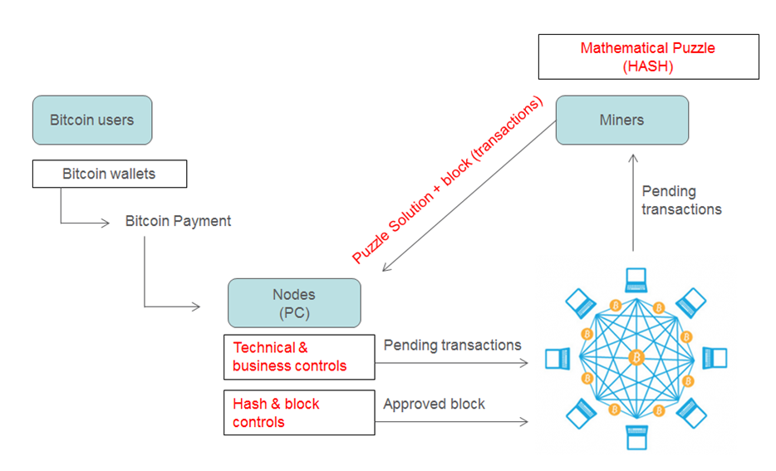
₿
Chapter 2: How Bitcoin Works
Transactions, the network, and the chain - one payment, followed all the way
users, wallets, nodes, miners - from the owner's 2025 deck
SEN0401 Special Topics in Software Engineering: Block Chain · Fall 2026 · Yusuf Altunel, PhD · İstanbul Kültür University
Notes:
SAY: Chapter 1 asked what Bitcoin is; chapter 2 follows one payment - Alice pays Bob - all the way from her wallet to a buried block, and meets every moving part on the way.
FULL TEXT: course page, chapter 2.

Slide 2
Today's route
₿
Five parts; every number is a slide you can jump to
1
Questions and the chapter map (slides 3-4)
30
slides, numbered bottom-right
2
Transactions - inputs, outputs, change, fees (slides 5-10)
3
3
The network - gossip, nodes, explorers (slides 11-15)
true stories, each with WHO / WHERE / WHEN / READ
4
Blockchain and mining - blocks, proof, confirmations (slides 16-24)
18
5
Semantics, practice, summary, and resources (slides 25-30)
code examples, run live - each shown with its result
Five parts, one payment followed all the way through
2 / 30
Notes:
SAY: Five parts, one payment followed all the way. The stories carry the why, the consoles carry the proof, and every slide number here is printed bottom-right as we pass it.
ASK: Which part do you expect to be hardest - mark it now, check at the summary.
FULL TEXT: course page, chapter 2 - every section.

Slide 3
The questions this chapter answers
₿
Its own competency questions - we return to each
1
Which parts does a Bitcoin transaction consist of?
2
Which mathematical tools does a transaction rely on - hashing?
3
How does a payment begin: what does the invoice of the chapter contain?
4
How does a signed transaction reach the miners?
5
How is a transaction recorded: how is a block built?
6
What exactly does a confirmation buy?
7
How can the chapter's transaction chain be expressed as a provenance graph in the vocabulary of the W3C PROV Ontology?
8
Which terms do the explanations of this chapter rely on?
If you can answer these, chapter 2 is yours
3 / 30
Notes:
SAY: A transaction is the unit of action in Bitcoin: a message telling the network that the owner of certain bitcoins has authorized the transfer of that value to another owner. The new owner can in turn spend the value by creating another transaction, and so on, which gives a chain of ownership.
FULL TEXT: course page, chapter 2 - Transaction.

Slide 4
One chapter, five branches
₿
The concept map the whole chapter hangs on
Each branch is a question the chapter answers; the grey lists are the concepts that answer it, every one explained on the course page.
Transaction
Transaction Part · Cryptography · Linkage · Form · Unit · Payment Request · Construction
Network
Participants · Propagation
Chapter 2
Blockchain
Mining · Security · Spending
Semantics
Provenance Model
Practice
Interactive Demo
Five branches - every slide today lives on this map
4 / 30
Notes:
SAY: A transaction is the unit of action in Bitcoin: a message telling the network that the owner of certain bitcoins has authorized the transfer of that value to another owner. The new owner can in turn spend the value by creating another transaction, and so on, which gives a chain of ownership.
FULL TEXT: course page, chapter 2 - Transaction, Network, Blockchain.

Slide 5
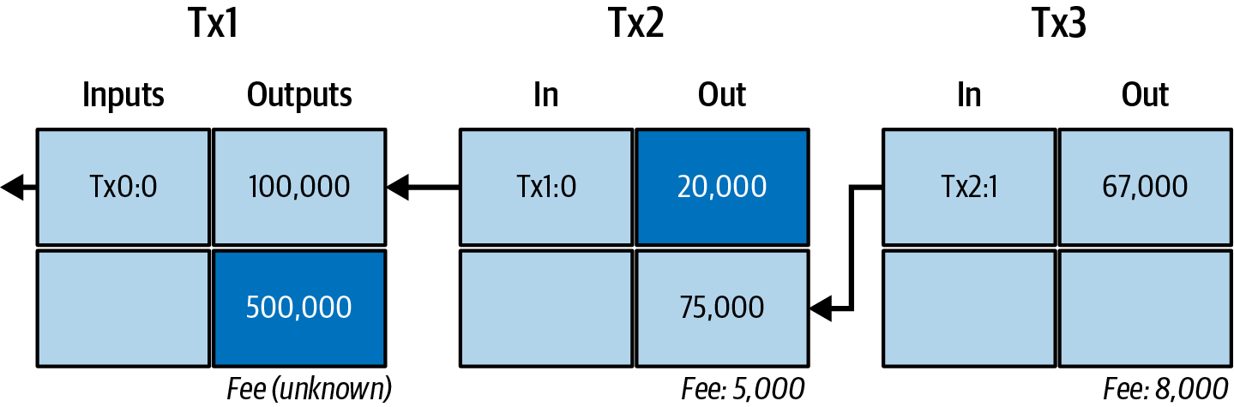
Transactions
Who pays whom, with what, and what it costs
Inputs and outputs
Change
outputs become inputs - Mastering Bitcoin 3e, CC BY-SA
Fees
The chain of spends
5 / 30
Notes:
SAY: A transaction is the unit of action in Bitcoin: a message telling the network that the owner of certain bitcoins has authorized the transfer of that value to another owner. The new owner can in turn spend the value by creating another transaction, and so on, which gives a chain of ownership.
FULL TEXT: course page, chapter 2 - Transaction.

Slide 6
Nine pages, and a table of odds
₿
2008-10-31
The Cryptography List
"A purely peer-to-peer version of electronic cash would allow online payments to be sent directly from one party to another without going through a financial institution." - the abstract's first sentence
Friday October 31 2008
Bitcoin P2P e-cash paper
Section 11 computes the attacker's catch-up odds
nine pages at bitcoin.org
We rerun that computation live, later in this deck
WHO Satoshi Nakamoto, a…
WHERE bitcoin.org - a nin…
WHEN 2008-…
READ bitcoin.o…
The paper computes its promises - today we recompute them
6 / 30
Notes:
STORY (2008-10-31): On 31 October 2008 a pseudonymous author posted nine pages to a cryptography mailing list. Section 11 does something unusual for a systems paper: it computes the attacker's odds. Modelling the race between an honest chain and a secret one as a binomial random walk, it tabulates the probability that an attacker with a share q of the hash power ever catches up from z blocks behind. This deck does not quote that table - it reruns the paper's own procedure and draws the result.
SOURCE: Nakamoto, 'Bitcoin: A Peer-to-Peer Electronic Cash System' (2008), section 11; announcement of 2008-10-31 on the metzdowd.com cryptography list. The chapter research record reproduced the paper's q=0.1 column - 0.2045873 at one confirmation, 0.0002428 at six - to seven decimal places (examples group AttackerSuccess reruns it for this deck).

Slide 7
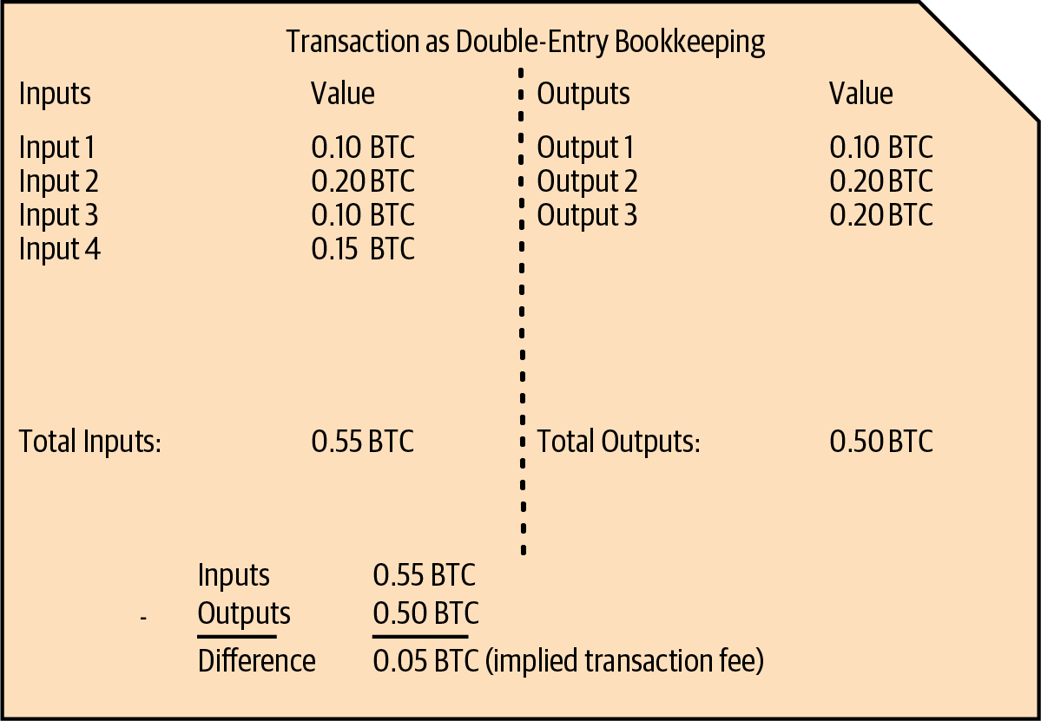
Alice pays Bob: one transaction, whole
₿
The chapter's running example, shown as the ledger sees it
1
One 100,000-sat output of Alice's is spent whole
2
Two new outputs: 75,000 to Bob, 20,000 back to Alice
3
What the sums leave over - 5,000 sat - is the fee
counted by the run: 1 input, 2 outputs, 5,000 fee
>>> ins, outs = [100000], [20000, 75000]
>>> (len(ins), len(outs), sum(ins) - sum(outs))
(1, 2, 5000)
double-entry view - Mastering Bitcoin 3e, CC BY-SA
run under Python 3.13.16
A transaction spends whole outputs and makes new ones
7 / 30
Notes:
SAY: A transaction is the unit of action in Bitcoin: a message telling the network that the owner of certain bitcoins has authorized the transfer of that value to another owner. The new owner can in turn spend the value by creating another transaction, and so on, which gives a chain of ownership.
ASK: Why must the 100,000 be spent whole rather than split?
FULL TEXT: course page, chapter 2 - Transaction, Input.

Slide 8
Your balance is outputs, not an account
₿
The UTXO idea - what a wallet actually sums
1
Every payment leaves outputs - coins of exact sizes
Tx2:0 unspent
2
Spending consumes outputs whole and mints new ones
3
Your balance = the outputs your keys can unlock
Tx2:1 unspent
4
The run keeps only the unspent: Tx2:0 and Tx2:1
Tx1:0 spent
the ledger's view, filtered to the spendable
>>> [o for o, spent in {'Tx1:0': True, 'Tx2:0': False, 'Tx2:1': False}.items() if not spent]
['Tx2:0', 'Tx2:1']
run under Python 3.13.16
No accounts anywhere - only unspent outputs your keys can unlock
8 / 30
Notes:
SAY: An unspent transaction output, abbreviated UTXO, is a transaction output that has not yet been used as an input by any later transaction. The glossary defines it as an unspent transaction output that can be spent as an input in a new transaction (Antonopoulos and Harding, 2023).
ASK: Where does the idea of an 'account balance' live, if not on the chain?
FULL TEXT: course page, chapter 2 - UnspentOutput, Output.

Slide 9

Change comes back to you
₿
Inputs are spent whole, like banknotes
A 100,000-satoshi output pays a 75,000 bill the way a banknote pays a coffee: spent whole, with change coming back - minus the tip to the miner.
to Bob
75,000
75,000 + 20,000 + 5,000 = 100,000
change, back to Alice
20,000
fee, to the miner
5,000
the fee is the remainder - computed, not quoted
>>> 100000 - sum([75000, 20000])
5000
run under Python 3.13.16
the fraction table, from the owner's 2025 deck
Inputs are spent whole; the difference returns as change
9 / 30
Notes:
SAY: Making change is the practice of adding to a transaction an output that returns the surplus to the person who is paying. The book explains the need with money in a shop: if you buy a five-dollar item with a twenty-dollar bill you expect fifteen dollars back, and in the same way a transaction input, like a currency note, cannot be partly spent (Antonopoulos and Harding, 2023).
ASK: Pay a 20-lira coffee with a 50-lira note: where is the change output?
FULL TEXT: course page, chapter 2 - MakingChange, TransactionFee.

Slide 10
Fees price bytes, not value
₿
Block space is the scarce good
1 - weight to virtual bytes
1
A block holds bytes, not value - space is what runs out
>>> (569 + 3) // 4
143
2
So fees are bid per virtual byte, not per coin moved
2 - the rate a wallet actually bids
run under Python 3.13.16
3
This transaction: 143 vbytes, 5,000 sat - about 35 sat/vB
>>> round(5000 / 143, 2)
34.97
run under Python 3.13.16
34.97
143
sat/vB, from the run
virtual bytes here
You pay for block space - size, not amount
10 / 30
Notes:
SAY: The fee rate is the fee a transaction pays for each unit of the space it takes in a block. Miners do not compare transactions by their total fee alone; they divide the fee by the size of the transaction, as a shopper divides the price of a bag of rice by its weight to find the best deal.
ASK: Why does moving 1 BTC cost the same as moving 100?
FULL TEXT: course page, chapter 2 - FeeRate, TransactionSize.

Slide 11

The network
No postmaster - transactions travel by gossip
Propagation
Mempools
Full and light nodes
Explorers
11 / 30
Notes:
SAY: The Bitcoin network is the set of computers that run the Bitcoin protocol and exchange transactions and blocks with one another. This second branch of the chapter follows Alice's transaction out of her wallet and across that network.
FULL TEXT: course page, chapter 2 - Network.

Slide 12
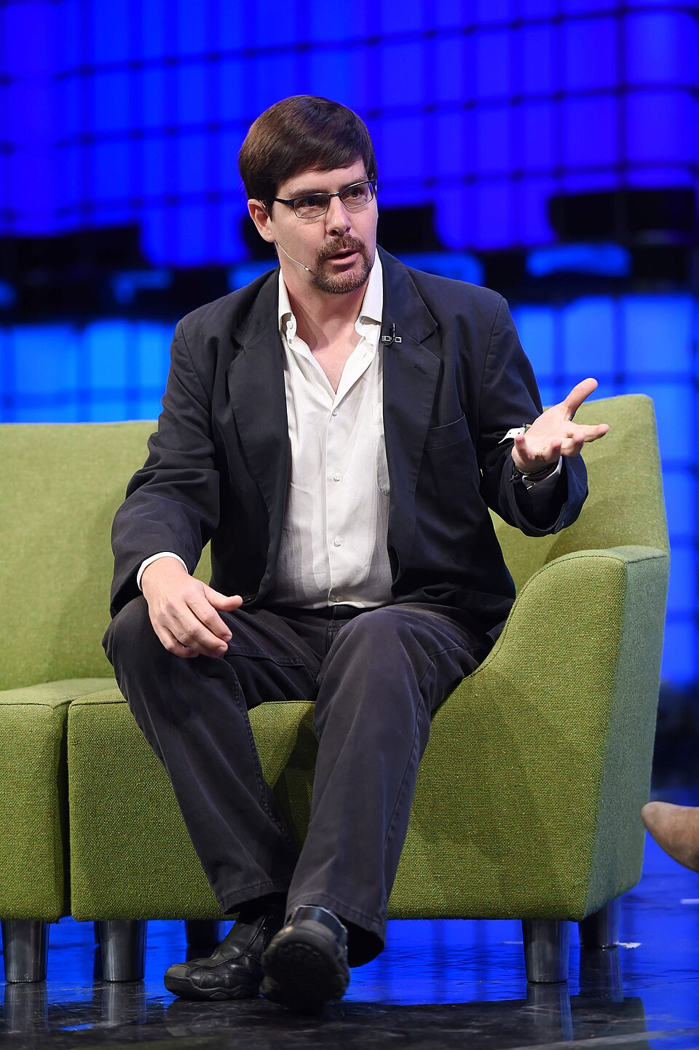
Five free bitcoins for every visitor
₿
2010-06-11
June 2010: almost nowhere to buy bitcoin existed
Andresen stocked a website with 1,100 BTC of his own
Five coins free per visitor; a CAPTCHA was the only price
Thousands got their first coins - then came the exchanges
WHO Gavin Andresen, the d…
WHERE freebitcoins.appspot.…
WHEN 2010-06…
READ bitcointalk…
Gavin Andresen - photo: Stephen McCarthy / Web Summit, CC BY 2.0
Before exchanges, distribution itself had to be invented
12 / 30
Notes:
STORY (2010-06-11): In June 2010 there was almost nowhere to buy bitcoin, so a developer in Massachusetts stocked a website with 1,100 of his own coins and gave five to anyone who asked - solving a CAPTCHA was the only price. Thousands of people got their first bitcoin from Gavin Andresen's faucet. The giveaway seeded the user base the first exchanges and the first payments then grew from, and Andresen went on to lead Bitcoin's development when Satoshi withdrew in 2011.
SOURCE: Andresen's own announcement thread, bitcointalk.org topic 141, 2010-06-11: 'Get 5 free bitcoins from freebitcoins.appspot.com', initially stocked with 1,100 BTC. Photo: Web Summit 2014, CC BY 2.0.

Slide 13
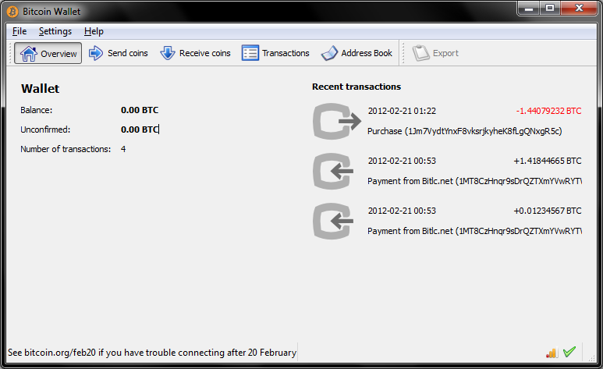
A transaction's journey to everyone
₿
Gossip, hop by hop, until every mempool holds it
Alice signs
her wallet builds the tx
One peer hears
any node will do
Gossip
each peer tells its peers
Every mempool
seconds later
hops counted by the run
1
No central dispatcher - the whisper network is the mail
>>> sec, nodes = 5, 10000
>>> round(nodes / sec)
2000
2
Bob sees it unconfirmed within seconds
3
It waits in mempools until a miner picks it
run under Python 3.13.16
Four seconds of gossip puts Alice's payment in every mempool
13 / 30
Notes:
SAY: Transaction propagation is the spread of a signed transaction across the network until it has reached, in practice, everyone who cares, including the miners who may record it. It is the composition of the two previous concepts: the wallet transmits the transaction to some node, and then the gossip rule carries it onward hop by hop.
ASK: What happens if two conflicting spends gossip at once? (next section answers)
FULL TEXT: course page, chapter 2 - TransactionPropagation, Mempool.

Slide 14
Who checks? Everyone who wants to
₿
Full nodes verify history; light clients verify proofs
Full node
Lightweight client
Downloads and checks every block since 2009
Trusts nobody - recomputes all the rules
Serves the network; needs disk and patience
Keeps headers only - megabytes, not gigabytes
Verifies proofs that a tx sits in a block
Perfect for phones; trusts the strongest chain
the checklist a full node runs on every block
>>> checks = {'syntax': True, 'inputs_nonempty': True, 'amounts_in_range': True, 'outputs_unspent': True, 'scripts_valid': True}
>>> all(checks.values()) and len(checks)
5
run under Python 3.13.16
Full nodes verify; light clients trust proofs, not people
14 / 30
Notes:
SAY: A full node, which the chapter calls a full verification node, is a program that has both the software logic and the data necessary to fully verify the correctness of a new transaction (Antonopoulos and Harding, 2023).
ASK: Which one is Alice's phone wallet, and what exactly does it trust?
FULL TEXT: course page, chapter 2 - FullNode, LightweightClient.

Slide 15
Watch any transaction live
₿
The ledger is public - explorers are windows on it
what an explorer answers, computed by the run
1
Paste any txid into an explorer and watch it confirm
>>> q = '466200308696215bbc949d5141a49a4138ecdfdfaa2a8029c1f9bcecd1f96177'
>>> 'txid' if len(q) == 64 else 'address' if q.startswith('bc1') else 'height'
'txid'
2
Chapter 1's genesis bytes came from such an API
3
Same data, three windows: your node, a site, an API
run under Python 3.13.16
mempool.space
blockstream.info
your own node
The ledger is public - explorers are just viewers on it
15 / 30
Notes:
SAY: A block explorer is a web application that operates as a Bitcoin search engine: it allows you to search for addresses, transactions and blocks and to see the relationships and flows between them, in the chapter's own words (Antonopoulos and Harding, 2023).
ASK: Why does Bob check his OWN copy rather than trust Alice's screenshot?
FULL TEXT: course page, chapter 2 - BlockExplorer, RecipientVerification.

Slide 16
Blockchain and mining
How the next page of history gets written
Proof-of-work
Blocks and Merkle trees
The coinbase
Confirmations
16 / 30
Notes:
SAY: The blockchain is the record in which Bitcoin's transactions are finally written down. The chapter calls it the distributed journal of all transactions and, in its opening overview, the consensus blockchain which is the authoritative journal of all transactions (Antonopoulos and Harding, 2023).
FULL TEXT: course page, chapter 2 - Blockchain.

Slide 17
Mining: hard to win, instant to verify
₿
A sudoku in reverse - and the run finds a real nonce
1
Guess a nonce, hash the block, hope the digest is small
try nonce 0, 1, 2, ...
hash each candidate
2
Like sudoku: hours to solve, seconds to check
most fail the target
6,630 clears it
3
The run really searches - and finds 6,630
nonce found: 6630 - anyone re-checks it in one hash
the search, exactly as the slide claims it
>>> h = hashlib.sha256
>>> next(n for n in range(200000) if h(('1' + str(n) + 'Alice pays Bob 75000').encode()).hexdigest().startswith('0000'))
6630
run under Python 3.13.16
Proof-of-work is a lottery whose ticket anyone can check
17 / 30
Notes:
SAY: Proof of work is a piece of data that takes a great deal of computation to find and almost none to check.
ASK: Who pays for all the losing tickets - and why is that the point?
FULL TEXT: course page, chapter 2 - ProofOfWork, SudokuAnalogy.

Slide 18
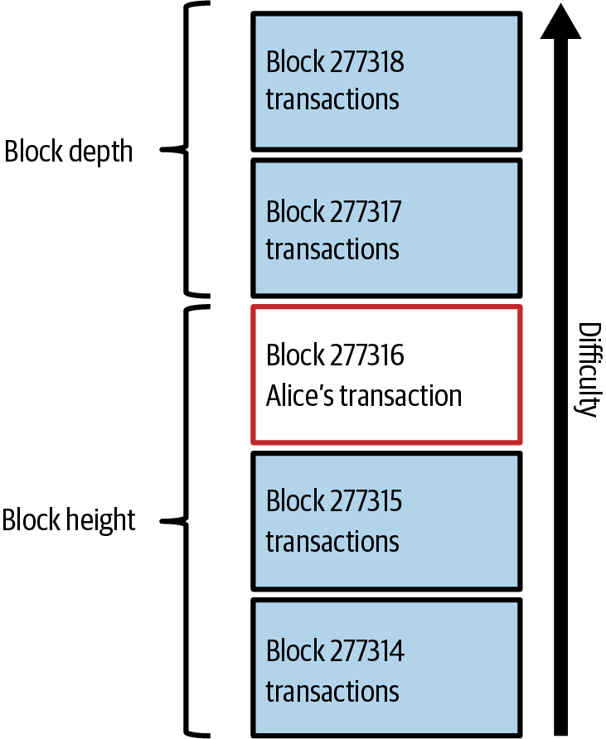
A block, anatomized
₿
80 bytes of header summarize everything beneath
1
Header: previous-block hash, Merkle root, time, target, nonce
2
Body: the transactions - Alice's among them
3
Chain the headers and you chain all history
prev hash
Merkle root
time
80 header bytes carry a 4,000,000-byte body: 1 to 50,000
target
nonce
>>> header, body = 80, 4000000
>>> (header, body // header)
(80, 50000)
Alice's tx inside a block - Mastering Bitcoin 3e, CC BY-SA
run under Python 3.13.16
A header of 80 bytes summarizes everything beneath it
18 / 30
Notes:
SAY: A block is the unit in which transactions are added to the blockchain. The chapter says that transactions are bundled into blocks, and that blocks have a very small header that must be formed in a very specific way, requiring an enormous amount of computation to get right but only a small amount to verify as correct (Antonopoulos and Harding, 2023).
ASK: Why hash the header only, not the whole megabyte?
FULL TEXT: course page, chapter 2 - Block, BlockHeader.

Slide 19
One root for a thousand leaves
₿
The Merkle tree pins every transaction at once
1
Hash the transactions in pairs, then pairs of pairs
4 leaves: A B C D
2 pair-hashes
2
One root remains - 32 bytes for any number of leaves
1 root seals them all
3
Change any leaf and the root betrays it instantly
root of A,B,C,D: 59e82c45a3662f55...
four leaves to one root, computed
>>> d = lambda b: hashlib.sha256(hashlib.sha256(b).digest()).digest()
>>> L = [d(x) for x in (b'A', b'B', b'C', b'D')]
>>> d(d(L[0] + L[1]) + d(L[2] + L[3])).hex()[:16]
'59e82c45a3662f55'
run under Python 3.13.16
Change any leaf and the root betrays it
19 / 30
Notes:
SAY: A merkle tree, also called a binary hash tree, is a structure for summarizing and verifying the integrity of large sets of data. The book defines it as a tree constructed by hashing paired data, the leaves, then pairing and hashing the results until a single hash remains, the merkle root, and notes that in Bitcoin the leaves are almost always the transactions of a single block (Antonopoulos and Harding, 2023).
ASK: A light client holds only the root - what must a proof hand it?
FULL TEXT: course page, chapter 2 - MerkleTree.

Slide 20
The coinbase: where new coin enters
₿
The one transaction with no inputs
Coinbase tx
first in every block
No inputs
value from the protocol
Subsidy + fees
chapter 1's chart
100 blocks
before it can be spent
the reward at this block, computed
>>> inputs_spent, subsidy, fees = 0, 625000000, 183000
>>> (inputs_spent, subsidy + fees)
(0, 625183000)
0
inputs in a coinbase - the only transaction so allowed
run under Python 3.13.16
Every coin in existence began life in a coinbase
20 / 30
Notes:
SAY: The coinbase transaction is the special first transaction of every block, by which the miner pays itself. The book's glossary calls it the first transaction in a block, always created by a miner, and the mining chapter adds the distinguishing property: unlike regular transactions the coinbase transaction does not consume unspent outputs as inputs, but has only one input, called the coinbase input, which implicitly contains the block reward (Antonopoulos and Harding, 2023).
ASK: Trace any coin backwards: where must the trail always end?
FULL TEXT: course page, chapter 2 - CoinbaseTransaction, BlockReward.

Slide 21
The day someone printed 184 billion bitcoin
₿
2010-08-15
184,467,440,737
74,638
~5 hours
BTC conjured by one transaction in block 74,638
the block that carried it, 2010-08-15
from forum report to Satoshi's 0.3.10 fix
✗
output of 92,233,720,368.54 BTC - overflow, summed as a small number
✗
its twin output, same trick
✓
0.3.10's corrected rule: outputs must sum in range - chain rebuilt without them
WHO An unknown attacker; spotted by develo…
WHERE block 74,638, discussed live on the bi…
WHEN 2010-08-15
READ en.bitcoin.it
Validation by every node is the immune system - it worked
21 / 30
Notes:
STORY (2010-08-15): On 15 August 2010 block 74,638 contained a transaction paying out about 184,467,440,737 BTC - thousands of times the 21 million cap. Two outputs were so large that, summed as 64-bit integers, they overflowed to a small number and slipped past the checks. Jeff Garzik flagged the 'strange block' on the forum within the hour; Satoshi shipped version 0.3.10 with a corrected rule about five hours after the block, and the honest chain, rebuilt without the forged coins, overtook the bad one. The 184 billion bitcoins ceased to exist.
SOURCE: en.bitcoin.it/wiki/Value_overflow_incident: block 74,638 of 2010-08-15 (two outputs of 92,233,720,368.54 BTC each), Garzik's 'Strange block 74638' thread, Satoshi's 0.3.10 patch ~5 hours later, good chain ahead by block 74,691.

Slide 22
Confirmations: depth, not time
₿
Each block on top multiplies the attacker's bill
depth, counted
block 0
block 1
block 2
>>> depth = 2
>>> depth + 1
3
the genesis record
digest of block 0
digest of block 1
Alice's block + 2 on top = 3 confirmations
run under Python 3.13.16
1
A confirmation is a block on top of yours - depth, not minutes
2
To rewrite yours an attacker must redo every block above it, faster than everyone
3
How unlikely that is, the whitepaper computes - next slide
Each block on top multiplies the cost of rewriting yours
22 / 30
Notes:
SAY: A confirmation is a block that commits to a transaction, counted once for the block that contains it and once more for each block built on top.
ASK: Why does a reorg of depth 1 happen weekly, depth 6 almost never?
FULL TEXT: course page, chapter 2 - Confirmation, BestBlockchain.

Slide 23
The whitepaper's table, recomputed live
₿
Section 11's procedure, rerun for this deck - not quoted
0.2045873
catch-up odds after 1 block (q=0.1)
0.0002428
after 6 - the '6 confirmations' rule
the paper's own table
Six confirmations: the attacker's odds drop below 0.03%
23 / 30
Notes:
SAY: This chart is not an illustration: the build ran the whitepaper's section-11 procedure (examples group AttackerSuccess) and drew what it returned; the chapter research record matched the q=0.1 column against the paper to seven decimals.
ASK: Read the 30% line at six blocks - why do exchanges wait longer for huge deposits?
FULL TEXT: course page, chapter 2 - Probability, Confirmation.

Slide 24
Zero-conf espresso, six-block house
₿
Match the wait to the stake
Espresso: accept at zero
House: wait for six
Small sum, repeat customer, in person
Risk: someone races a double-spend for a coffee
Seconds matter more than certainty
Large, irreversible, worth attacking
Six blocks: odds near one in four thousand (q=0.1)
An hour of patience prices out the attack
same rule, different stakes
Match the wait to the stake - that is all 6 blocks means
24 / 30
Notes:
SAY: Accepting a small payment unconfirmed is the practice of treating a transaction as paid as soon as it has propagated, without waiting for a block. It is not a rule of Bitcoin but a judgement about risk.
ASK: Where would you put a used-car sale on this line?
FULL TEXT: course page, chapter 2 - SmallPaymentAcceptance, UnconfirmedTransaction.

Slide 25
Semantics and practice
The chapter as data, and the chapter on your laptop
Triples
Provenance
Run it at home
25 / 30
Notes:
SAY: This branch reads the chapter with the eyes of the course rather than of the book. A transaction chain, as the first branch described it, is a record of what came from what: each output exists because a transaction consumed earlier outputs, and each transaction happened because somebody who held a key authorized it.
FULL TEXT: course page, chapter 2 - Semantics.

Slide 26
The chapter as data: triples and provenance
₿
How the course page itself stores what you just learned
1
Every fact on the course page is a triple: subject, predicate, object
2
Provenance says who asserted it and from where - the run builds one of each and reads it back
1 - one fact, as the page stores it
>>> triples = [('Tx2', 'used', 'Tx1:0'), ('Tx2:1', 'wasGeneratedBy', 'Tx2'), ('Tx2', 'wasAttributedTo', 'Alice')]
>>> (len(triples), len({s for s, p, o in triples} | {o for s, p, o in triples}))
(3, 4)
2 - and who says so
run under Python 3.13.16
>>> chain = ['Tx1:0', 'Tx2:1', 'Tx3:0']
>>> [(b, 'wasDerivedFrom', a) for a, b in zip(chain, chain[1:])]
[('Tx2:1', 'wasDerivedFrom', 'Tx1:0'), ('Tx3:0', 'wasDerivedFrom', 'Tx2:1')]
run under Python 3.13.16
The course page you use is built exactly this way
26 / 30
Notes:
SAY: A triple is the unit in which these descriptions are written: a subject, a predicate and an object, read as a single sentence. The statement that Alice's transaction used Joe's output is a triple whose subject is the transaction, whose predicate is the relation used and whose object is the output.
ASK: What triple would record Alice's payment to Bob?
FULL TEXT: course page, chapter 2 - Triple, ProvenanceGraph.

Slide 27
Run the chapter at home
₿
Three consoles reproduce today's claims
1 - the fingerprint that seals everything
>>> hashlib.sha256(b'Alice pays Bob 75000').hexdigest()[:16]
'320a22eeeb9c0391'
2 - a toy block, mined like the real ones
run under Python 3.13.16
>>> h = hashlib.sha256
>>> next(n for n in range(500000) if h(('1' + str(n) + 'Alice pays Bob 75000').encode()).hexdigest().startswith('0000'))
6630
3 - chain two and break one
run under Python 3.13.16
>>> chain, edited = ['b1', 'b2', 'b3', 'b4', 'b5'], 1
>>> [i for i in range(len(chain)) if i >= edited]
[1, 2, 3, 4]
run under Python 3.13.16
Three consoles reproduce the chapter - tonight, on your laptop
27 / 30
Notes:
SAY: The last branch of this chapter is about trying things out. The concepts of the earlier branches are all mechanical, which means that a learner can operate them rather than only read about them, and a small number of interactive pages have become the standard way to do that in teaching.
FULL TEXT: course page, chapter 2 - Practice.

Slide 28
The chapter in five lines
₿
One line per part - each one provable from its slides
1
A transaction spends outputs whole and mints new ones - balance is a sum, not an account
2
Fees buy bytes of block space; change is just an output back to yourself
3
Transactions travel by gossip; within seconds every mempool holds Alice's payment
4
Miners race a lottery that is instant to verify - and rules caught the 184-billion forgery
5
A confirmation is depth; the whitepaper computes what each block of depth buys you
If a line feels unproven, its part's slides carry the receipt
28 / 30
Notes:
SAY: Five lines, one per part. If any feels like a claim rather than a fact, the agenda names the slides that prove it; the course page carries the full text.
ASK: Which line would you defend to a sceptic first, and with which slide?
FULL TEXT: course page, chapter 2 - every section.

Slide 29
Where to go from here
₿
Checked 2026-10-06; every entry is a live link in this file
Read
Community & history
The whitepaper - section 11 is today's chart bitcoin.org/bitcoin.pdf
Bitcoin Stack Exchange Q&A bitcoin.stackexchange.com
This chapter, free (CC BY-SA) github.com/bitcoinbook/bitcoinbook/blob/develop/ch02_overview.adoc
The faucet announcement, as posted (2010) bitcointalk.org/index.php?topic=141.0
The value-overflow incident, documented en.bitcoin.it/wiki/Value_overflow_incident
Watch
Explore & verify
But how does bitcoin work? (3Blue1Brown) youtube.com/watch?v=bBC-nXj3Ng4
mempool.space - watch a tx confirm tonight mempool.space
blockstream.info - the API chapter 1 used blockstream.info
learnmeabitcoin - every structure, drawn learnmeabitcoin.com
One evening on an explorer replays this whole chapter for free
29 / 30
Notes:
SAY: Everything here is free. Watch one transaction confirm on mempool.space tonight - pick any txid from the latest block - and you will have SEEN this whole chapter happen once.
ASK: Who can find Alice-sized fees (about 35 sat/vB) in the current mempool?
FULL TEXT: course page, chapter 2 - Practice.

Slide 30
What you should now be able to say
And where each claim gets its proof
What a transaction spends, creates, and pays
How a payment reaches every mempool with no postmaster
Why rewriting a buried block costs more than it wins
What six confirmations actually promises - a number
Questions?
30 / 30
Notes:
SAY: Four claims, each one carried by a computation you watched run. Next week: the wallet that holds Alice's keys.
FULL TEXT: course page, chapter 2.

