Slide 1
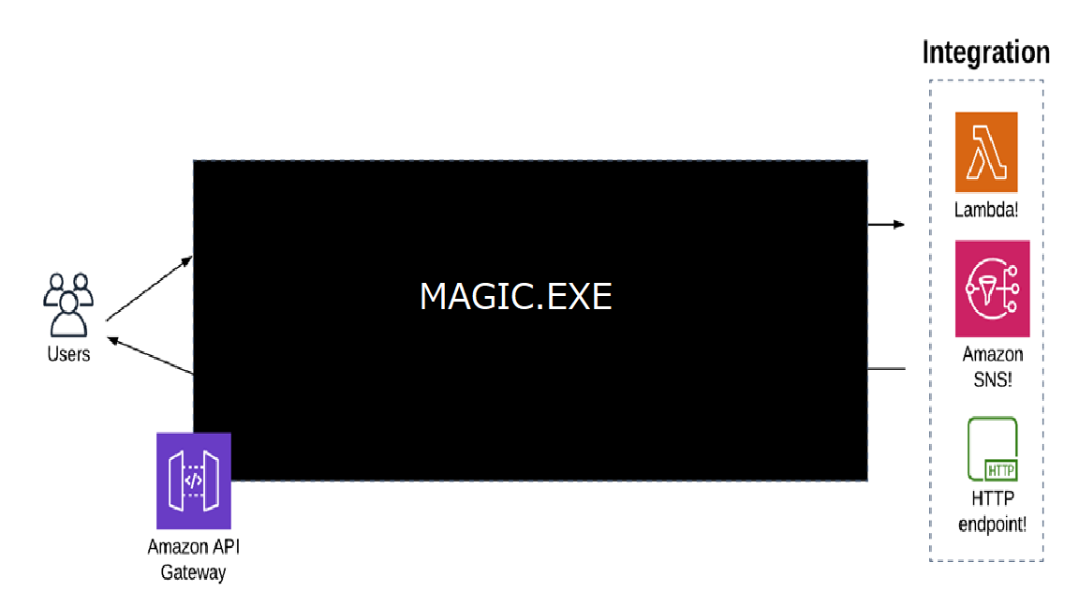
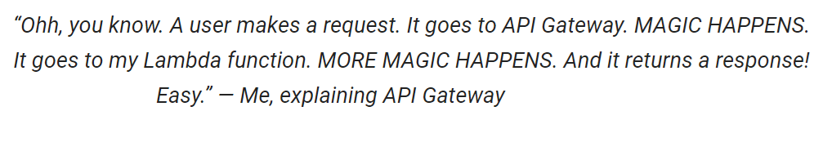
AWS API Gateway

Slide 2
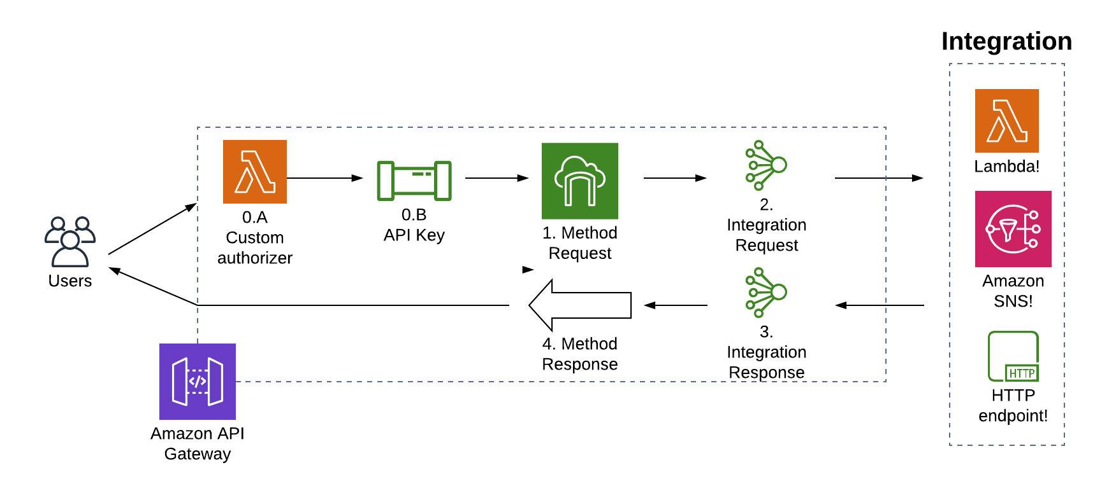
AWS API Gateway is a AWS-managed service - Creating, deploying, and managing a RESTful (API) to expose backend HTTP endpoints, AWS Lambda functions, or other AWS services (HTTP methods such as GET, POST, PUT, PATCH, and DELETE) - Creating, deploying, and managing a WebSocket API to expose AWS Lambda functions or other AWS services. - Provide Caching function for frequently used requests

Slide 3
AWS API Gateway Use cases - Protect your APIs from overuse and abuse, so you use an authentication service and rate limiting - Integrate with analytics and monitoring tools (evaluate performance of the system and users’ behaviors) - Protect your bank-end resources (a single request could require calls to dozens of distinct applications) Example: invoke a Lambda function with role to access DynamoDB (which users can not see) - Cache frequently requested information. Example: Cache product catalog information to improve the performance of your website - Transform requests into a format that your back end is using - Transform response from backend - Over time you’ll add some new API services and retire others, but your clients will still want to find all your services in the same place, API Gateway supports this

Slide 4
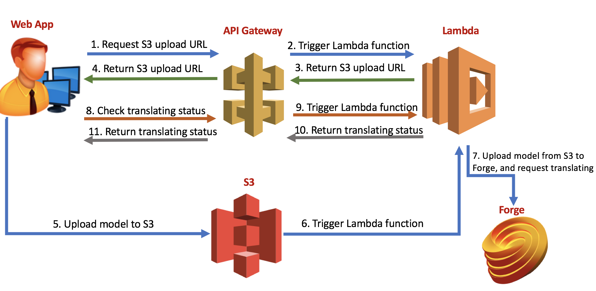
API Gateway use case
Y

Slide 5
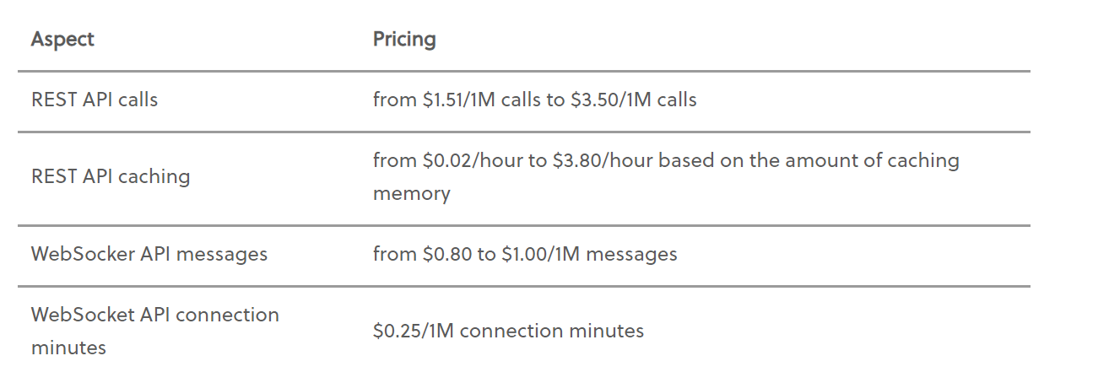
AWS API Gateway

Slide 6
API Gateway key concepts
Y
- Request Parameter-based Auth
- Token-based auth
- HTTP proxy/custom integration
- Lambda custom/proxy integration
- Stage variable
- Monitoring
- Cache hit/miss count
- cache-control
- Export/Import Import API definition
- Type of Endpoints: Edge-optimized, Regional, Private

Slide 7
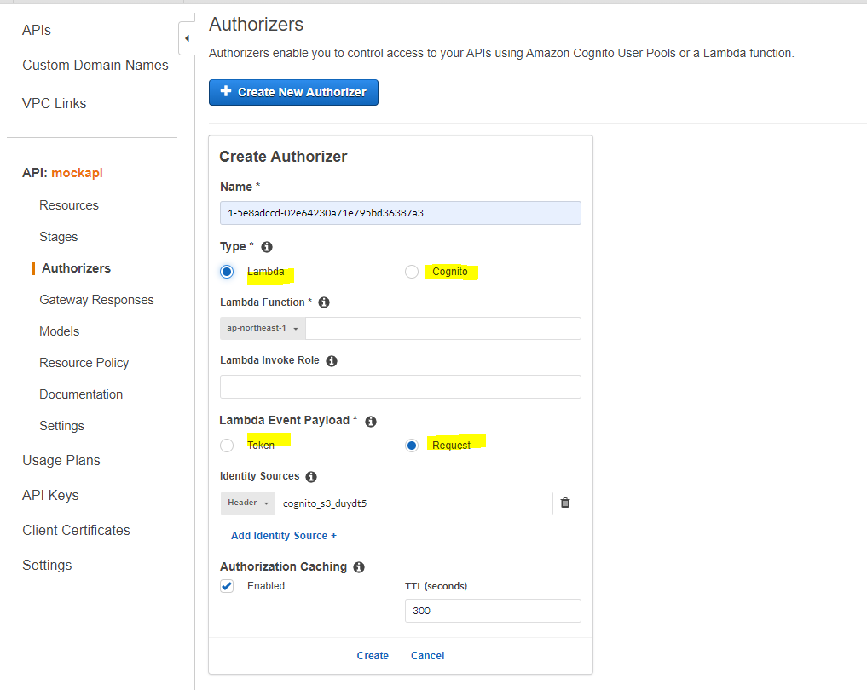
API Gateway key concepts - Authorization type - Cognito User Pools - Lambda custom authorizer: Token-based Request Parameter-base

Slide 8
API Gateway key concepts - Authorization type A developer is using API Gateway Lambda Authorizer to provide authentication for every API request and control access to your API. The requirement is to implement an authentication strategy which is similar to OAuth or SAML. Which of the following is the MOST suitable method that the developer should use in this scenario? ​ A. AWS STS-based Authentication ​ B. Token-based Authorization ​ C. Request Parameter-based Authorization ​ D. Cross-Account Lambda Authorizer Note: OAuth or SAML = token-based

Slide 9
API Gateway key concepts - Authorization type A developer is using API Gateway Lambda Authorizer to securely authenticate the API requests to their web application. The authentication process should be implemented using a custom authorization scheme which accepts header and query string parameters from the API caller. Which of the following methods should the developer use to properly implement the above requirement? ​ A. Token-based Authorization ​ B. Cross-Account Lambda Authorizer ​ C. Request Parameter-based Authorization ​D. Amazon Cognito User Pools Authorizer

Slide 10
API Gateway key concepts - Integration type - HTTP custom integration: (also called HTTP integration), you must configure both the integration request and integration response - HTTP proxy integration: API GW passes the request as-is to a HTTP back-end (Note: target of HTTP requests: application running on EC2, ECS, Beanstalk…) - Lambda integration: You must map any input data the client supplied as request parameters into the proper integration request body. You may also need to translate the client-supplied request body into a format recognized by the Lambda function. - Lambda proxy integration: API GW passes the request as-is to a Lambda function (Note: Using Lambda as endpoints is also called AWS integration)

Slide 11
API Gateway key concepts - Integration type UNDERSTANDING PROXY VS NON-PROXY PROXY = data is not modified NON PROXY = data is modified before being sent to back-end * example: translate an application/json payload from your client into an application/xml

Slide 12
API Gateway key concepts - Integration type Your customers require access to the REST APIs of your web application which is hosted on EC2 instances behind a load balancer in your VPC. To accommodate this request, your web services should be integrated with API Gateway that has a custom data mapping. You need to specify how the incoming request data is mapped to the integration request and how the resulting integration response data is mapped to the method response. Which of the following integration types is the MOST suitable one to use in API Gateway to meet this requirement? ​ A. HTTP_PROXY ​ B. HTTP ​ C. AWS ​ D. AWS_PROXY

Slide 13
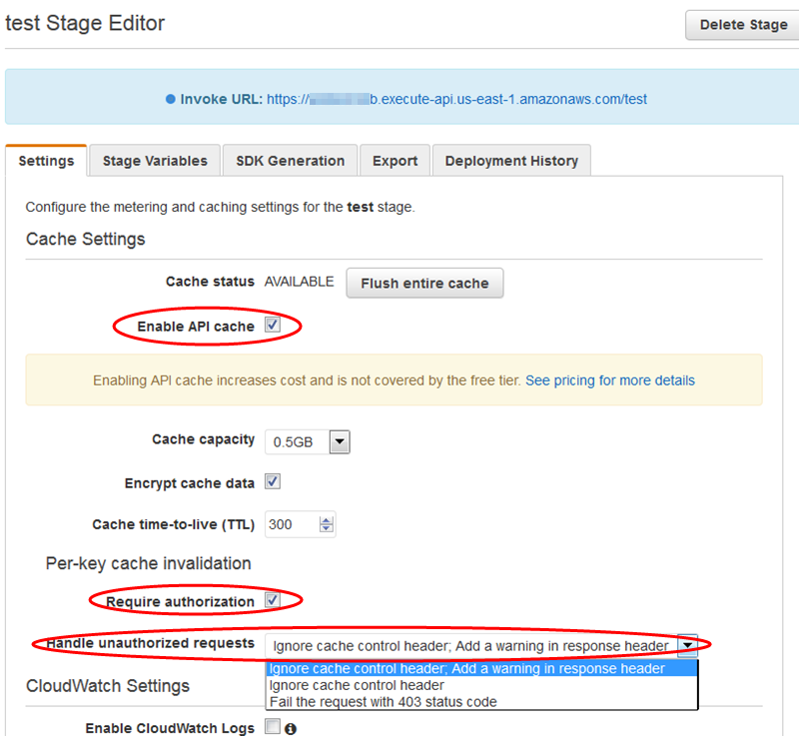
API Gateway key concepts - Cache invalidation Allow certain users to bypass Cache and connect to the newest data

Slide 14
API Gateway key concepts - Cache invalidation A web application is running in an ECS Cluster and updates data in DynamoDB several times a day. The clients retrieve data directly from the DynamoDB through APIs exposed by Amazon API Gateway. Although API caching is enabled, there are specific clients that want to retrieve the latest data from DynamoDB for every API request sent. What should be done to only allow authorized clients to invalidate an API Gateway cache entry when submitting API requests? (Select TWO) A. Provide your clients an authorization token from STS to query data directly from DynamoDB. B. Modify the cache settings to retrieve the latest data from DynamoDB if the request header's authorization signature matches your API's trusted clients list. C. Tick the Require Authorization checkbox in the Cache Settings of your API via the console. D. The client must send a request which contains the Cache-Control: max-age=0 header. E. The client must send a request which contains the Cache-Control: max-age=1 header.

Slide 15
API Gateway key concepts – Monitoring An API gateway with a Lambda proxy integration takes a long time to complete its processing. There were also occurrences where some requests timed out. You want to monitor the responsiveness of your API calls as well as the underlying Lambda function. Which of the following CloudWatch metrics should you use to troubleshoot this issue? (Select TWO) ​ A. CacheHitCount ​ B. CacheMissCount ​C. Latency ​ D. IntegrationLatency

Slide 16
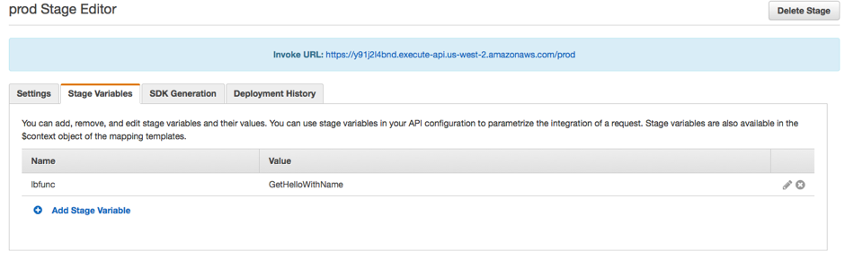
API Gateway key concepts – Stage variables

Slide 17
API Gateway key concepts – Stage variables You have several API Gateway APIs with Lambda Integration for each release life cycle of your application. There is a requirement to consolidate multiple releases into a single API Gateway for the ALPHA, BETA, RC (Release Candidate), and PROD releases. For example, their clients can connect to their ALPHA release by using the alpha.tutorialsdojo.com endpoint and beta release through the beta.tutorialsdojo.com endpoint. As the AWS developer, how can you satisfy this requirement? ​ A. Set up Stage Variables for each release. ​ B. Modify the Integration Response of the API Gateway to add different endpoints for each release. ​ C. Modify the Integration Request of the API Gateway to manage different endpoints for each release. ​ D. Use Layers to the underlying Lambda functions of the API Gateway.

Slide 18
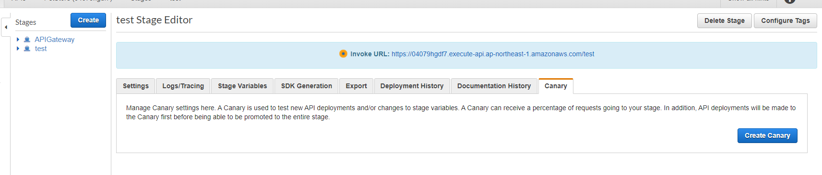
API Gateway key concepts – Deployment

Slide 19
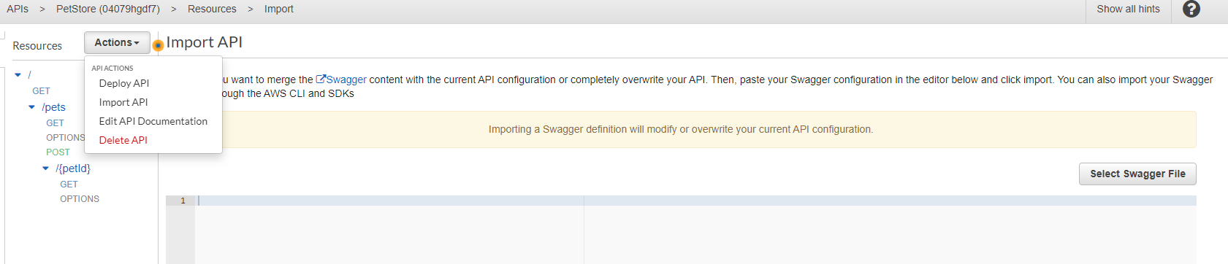
API Gateway key concepts – Import

Slide 20
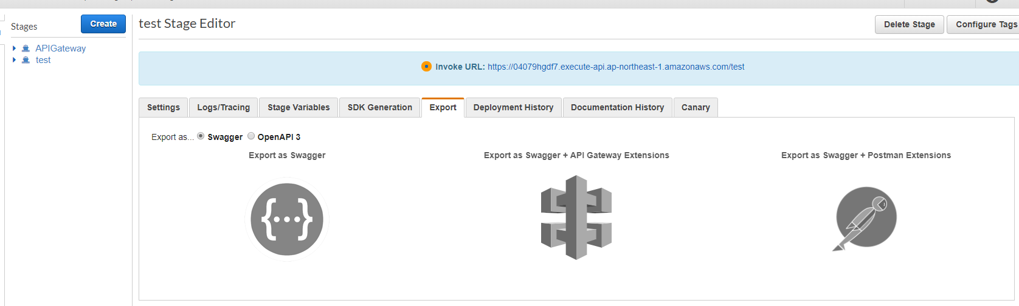
API Gateway key concepts – Export

Slide 21
API Gateway key concepts - Endpoints Edge-optimized API endpoint The default hostname of an API Gateway API that is deployed to the specified Region while using a CloudFront distribution to facilitate client access typically from across AWS Regions. API requests are routed to the nearest CloudFront Point of Presence (POP), which typically improves connection time for geographically diverse clients. => response time is slower , but can serve users from many parts of the world Regional API endpoint The host name of an API that is deployed to the specified Region and intended to serve clients, such as EC2 instances, in the same AWS Region. API requests are targeted directly to the Region-specific API Gateway API without going through any CloudFront distribution. For in-Region requests, a Regional endpoint bypasses the unnecessary round trip to a CloudFront distribution. => response time is faster, but your users have to be withint 1 region Private API endpoint An API endpoint that is exposed through interface VPC endpoints and allows a client to securely access private API resources inside a VPC. Private APIs are isolated from the public internet, and they can only be accessed using VPC endpoints for API Gateway that have been granted access. => for resources in Virtual Private Cloud (VPC)

