Slide 1
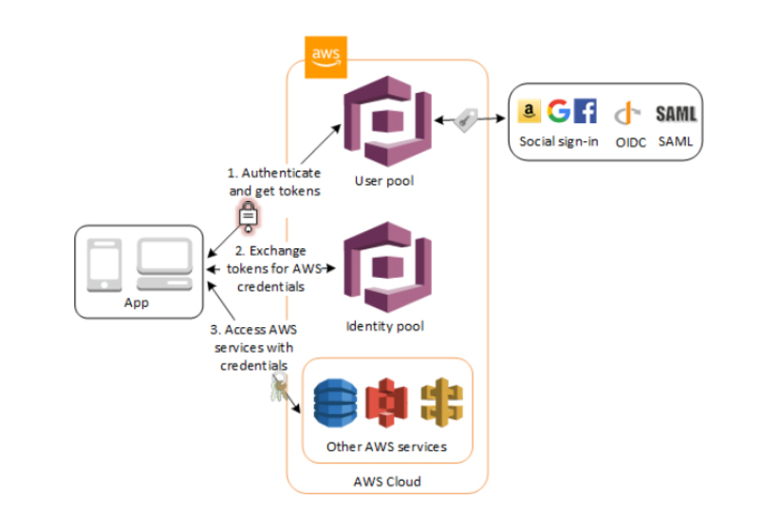
AWS Cognito Cognito helps you authenticate your user (registration/login….) Cognito is a AWS-managed service (which means AWS will manage the resources for you, you only have to worry about the functions of the services)

Slide 2
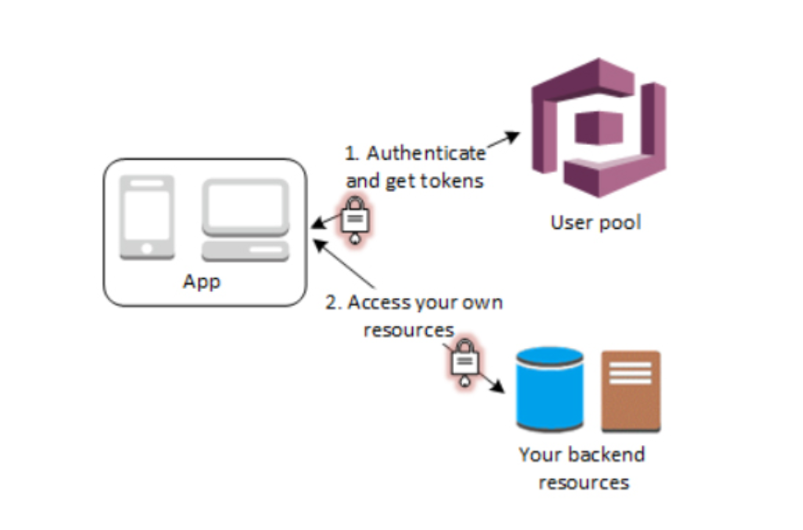
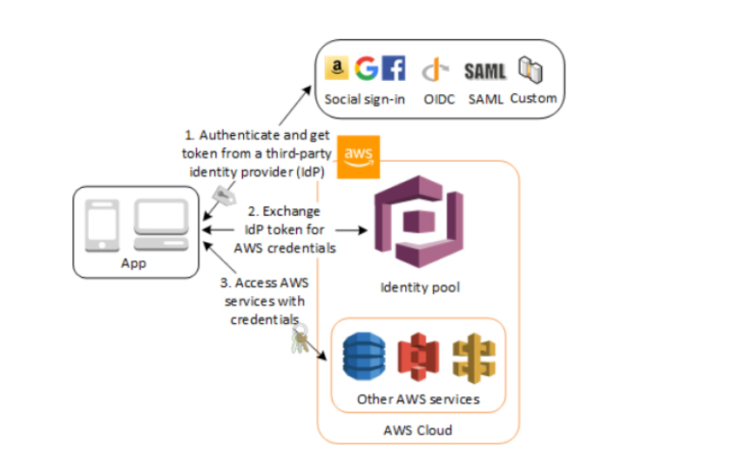
Cognito key concepts
Y
User pool: User pools are user directories that provide sign-up and sign-in options for users
*simple explanation: users have to create accounts
User identity: Identity pools provide AWS credentials to grant your users access to other AWS services
*simple explanation: users can use accounts from big Social networks: facebook, google, amazon…

Slide 3
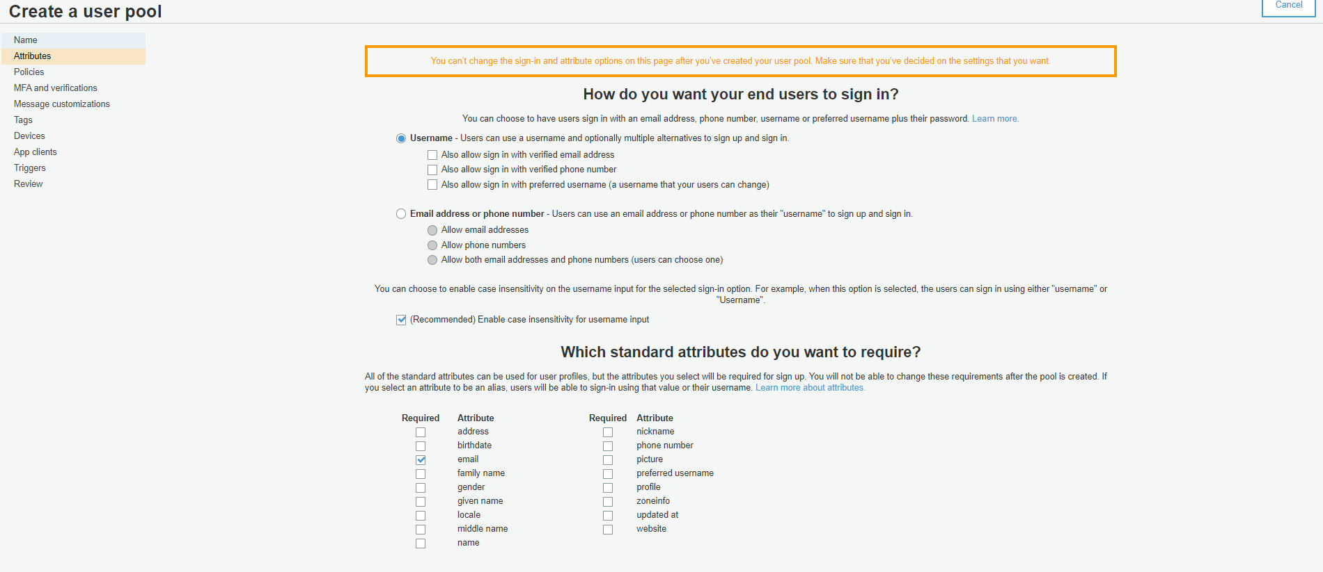
Cognito key concepts
Y
- User pool

Slide 4
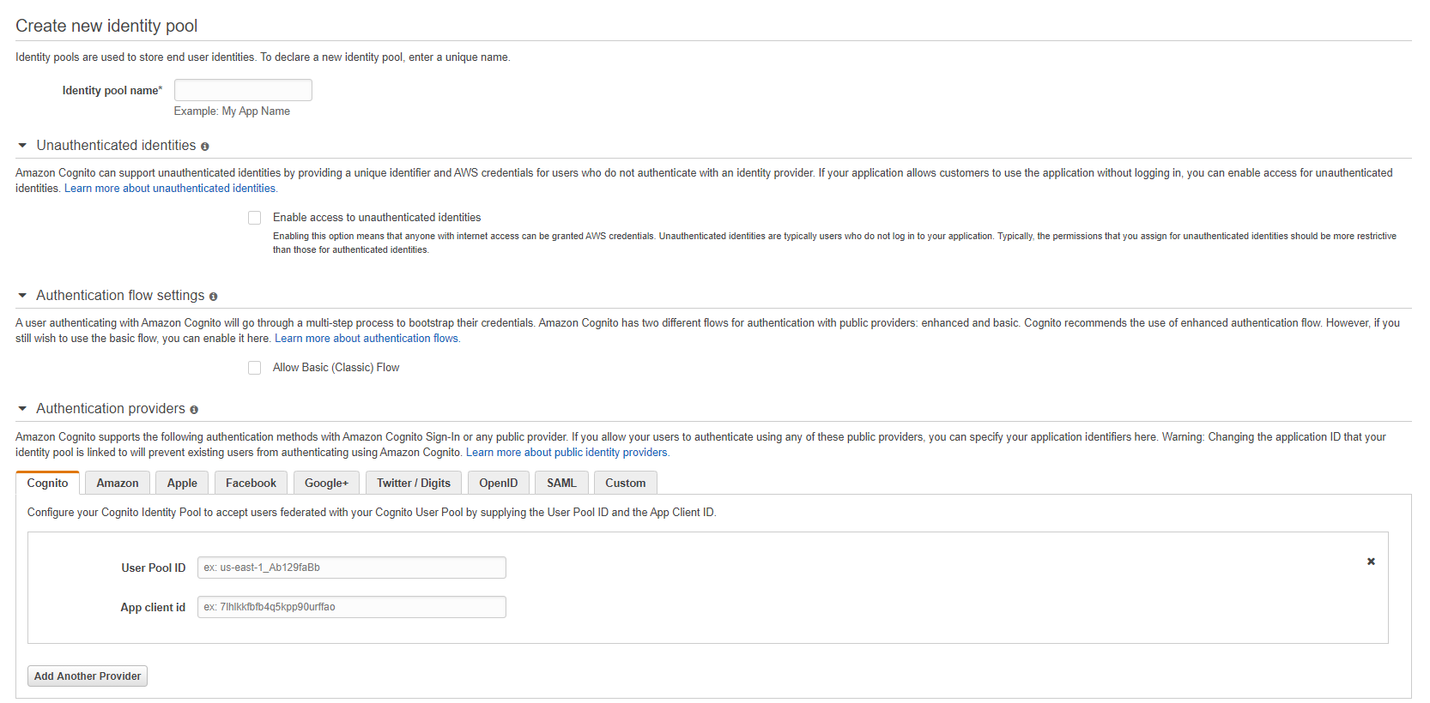
Cognito key concepts
Y
- Identity Pool

Slide 5
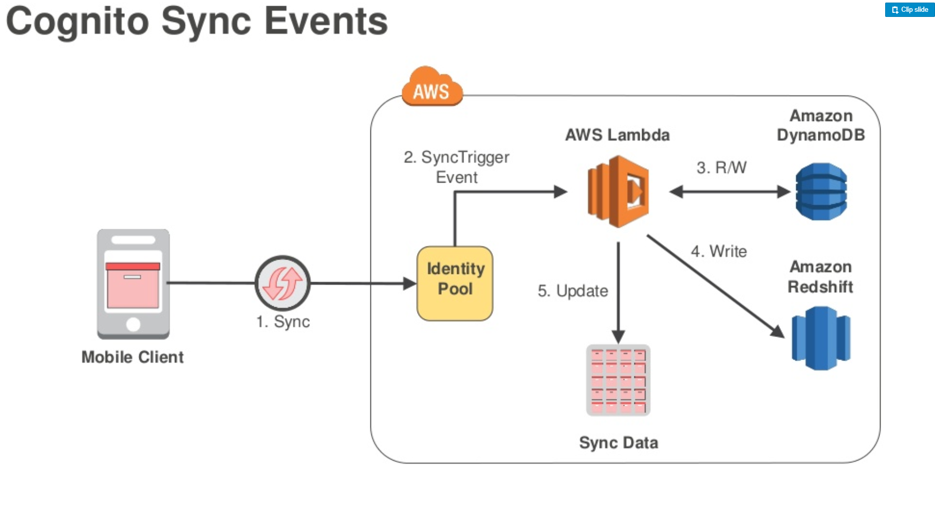
Cognito key concepts - cont
Y
Cognito Sync: allow you to sync data between devices of your users
Use case: sync timestamp of videos that user watched between devices

Slide 6
Cognito - question
Y
The users of a social media website must be authenticated using social identity providers such as Twitter, Facebook, and Google. Users can login to the site which will allow them to upload their selfies, memes, and other media files in an S3 bucket. As an additional feature, you should also enable guest user access to certain sections of the website.
Which of the following should you do to accomplish this task?
​
A. Create an Identity Pool in Amazon Cognito and enable access to unauthenticated identities.
B. Create a User Pool in Amazon Cognito and enable access to unauthenticated identities.
​
C. Create a custom identity broker which integrates with the AWS Security Token Service and supports unauthenticated access.
​
D. Integrate AWS Single Sign-On with your website.

