Slide 1
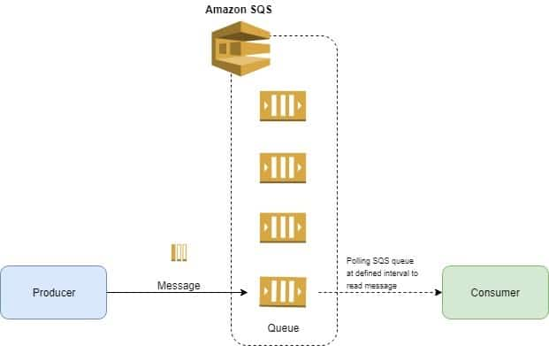
AWS SQS (Simple Queue Service) SQS allows you to receive and distribute messages to multiple resources SQS is a AWS-managed service

Slide 2
SQS key concepts
Y
- Visibility timeout
- Long/Short polling
- FIFO + Deduplication ID
Dead letter queue
Delivery Delay
-

Slide 3
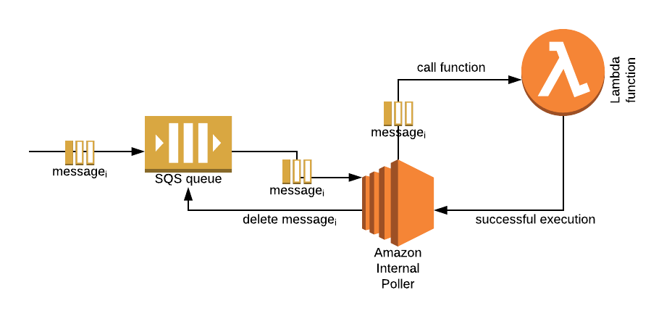
AWS SQS (Simple Queue Service) how does it work? Message > in SQS > polled by application > becomes invisible (within visibility timeout) case 1) SQS deletes message < notify SQS <application processes the message (success) case 2) send to Dead letter Queue < notify SQS <application processes the message (fail)

Slide 4
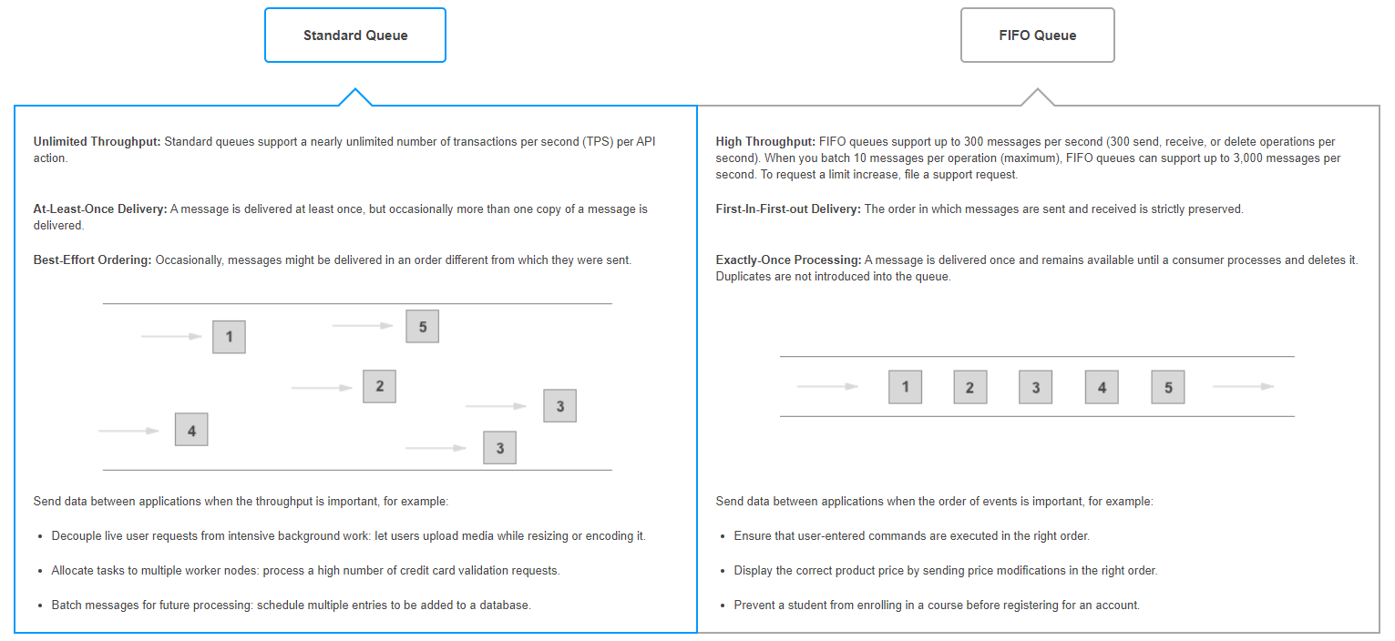
SQS – FIFO vs normal Queue
Y

Slide 5
SQS – FIFO vs normal Queue - normal Q: message order is not maintained (faster and cheaper) *at-least-once delivery - FIFO: (First in First out): message order is maintained (slower and more expensive) *exactly-once delivery FIFO is often used along with adding Deduplication ID to the message content to prevent message duplication
Y

Slide 6
SQS key concepts – cont - Visibility timeout: the time the message becomes invisible after being polled by a consumer - Long/Short polling: the time that the consumer wait between polling message - Dead letter queue: to store message the was not processed successfully - Delivery delay: Wait time before SQS allow a new message to be polled by consumer
Y

Slide 7
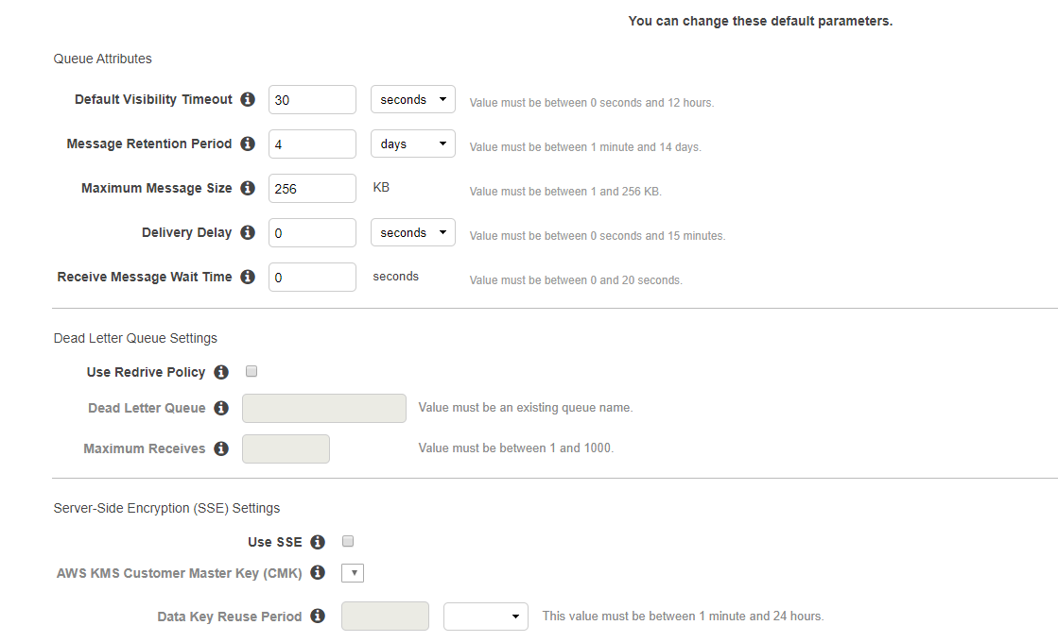
SQS key concepts – cont - Visibility timeout - Long/Short polling - Dead letter queue - Delivery delay
Y

Slide 8
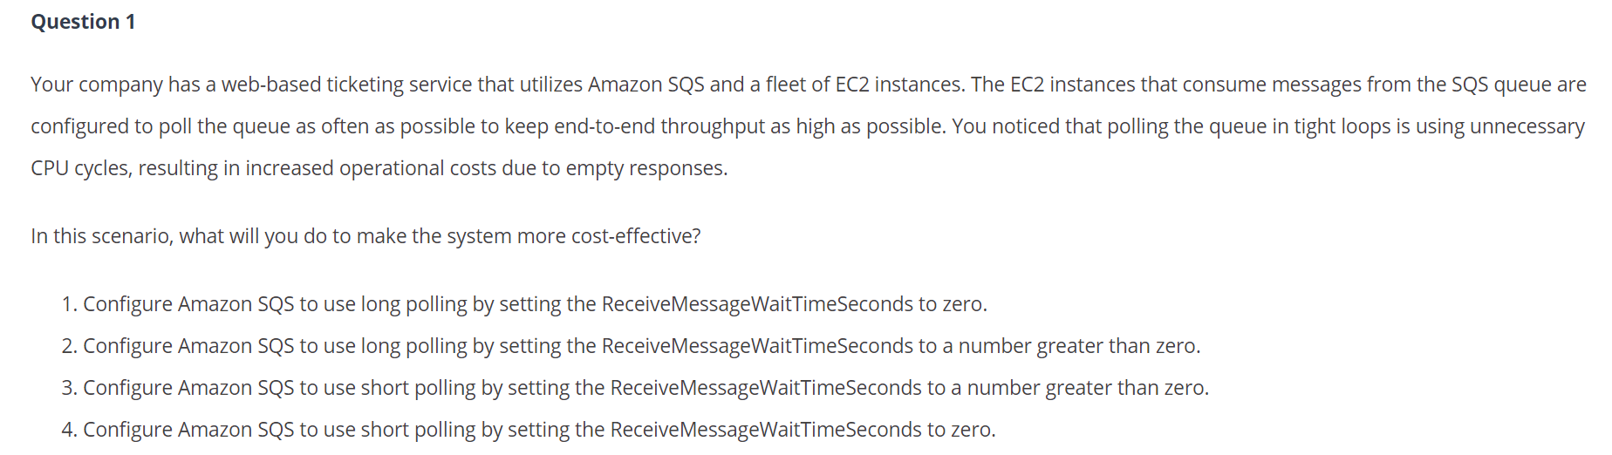
SQS key concepts – question
Y

Slide 9
SQS key concepts – question You are managing an application which is composed of an SQS queue and an Auto Scaling group of EC2 instances. Recently, your customers are complaining that there are a lot of incidents where their orders are being erroneously sent twice. What should you do to rectify this problem? ​ A. Use a Standard Queue and provide the Message Deduplication ID for each message. ​ B. Use a Standard Queue and provide the Message Group ID for each message. ​ C. Use a FIFO (First-In-First-Out) Queue and provide the Message Deduplication ID for each message. D. Use a FIFO (First-In-First-Out) Queue by disabling the content-based deduplication.
Y

Slide 10
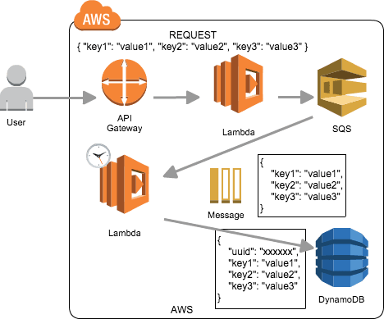
SQS Use case
Y

