Slide 1
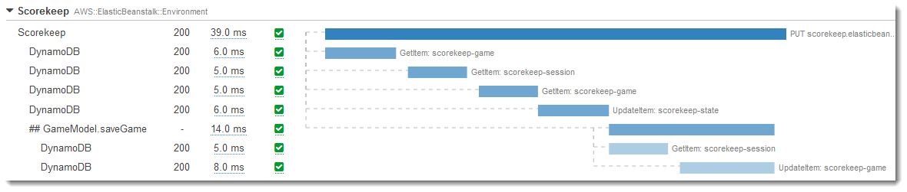
AWS X-ray
X-ray collects data about requests that your application serves, and provides tools you can use to view, filter, and gain insights into that data to identify issues and opportunities for optimization.
X-ray is a AWS-managed service (which means AWS will manage the resources for you, you only have to worry about the functions of the services)

Slide 2
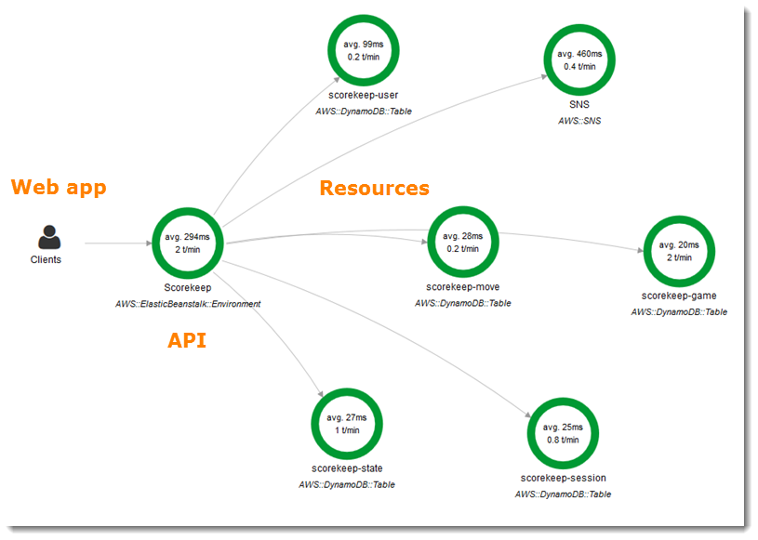
AWS X-ray example of a service graph

Slide 3
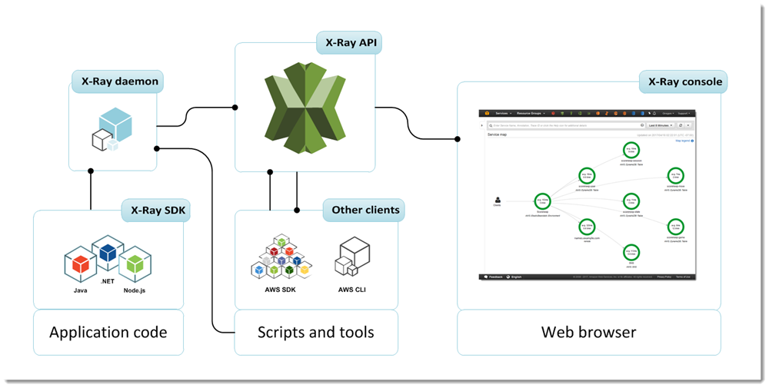
AWS X-ray
How does it work?
You can add X-ray deamon or use X-ray SDK to add X-ray into your application
*for Lambda, you can juse enable [Active X-ray tracing] option when creating the Lambda function

Slide 4
AWS X-ray – key concepts
Setup method for each service
Segments
Sub-segments
Service graph
Traces
Sampling
Filter expressions
Annotations

Slide 5
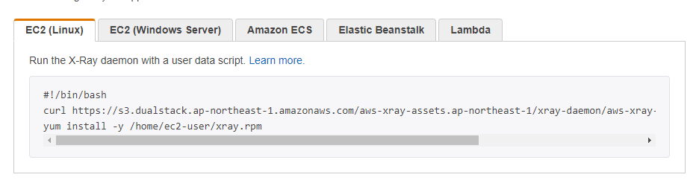
AWS X-ray – key concepts
Setup method for each service
Linux

Slide 6
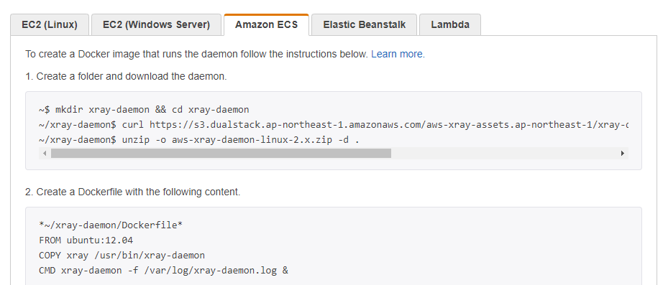
AWS X-ray – key concepts
Setup method for each service
ECS

Slide 7
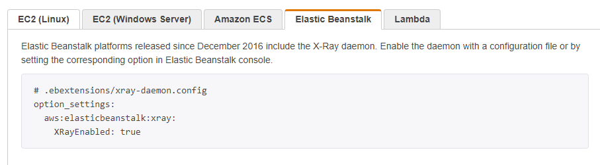
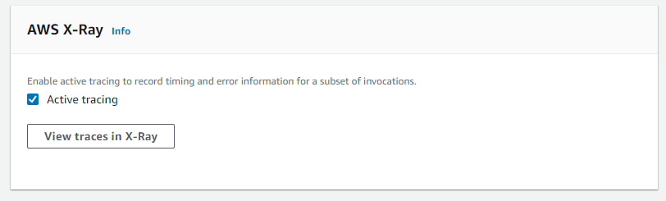
AWS X-ray – key concepts
Setup method for each service
Beanstalk
Lambda

Slide 8
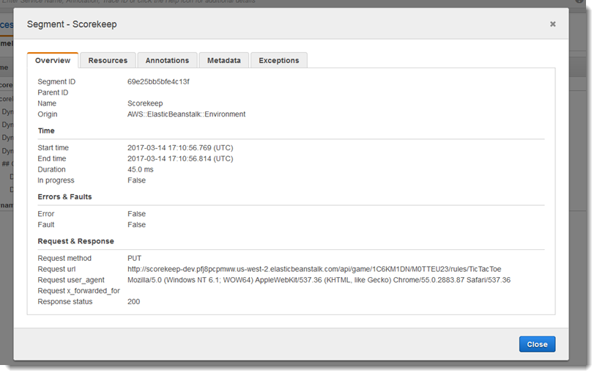
AWS X-ray – key concepts
Segments: the data about the work of a resource

Slide 9
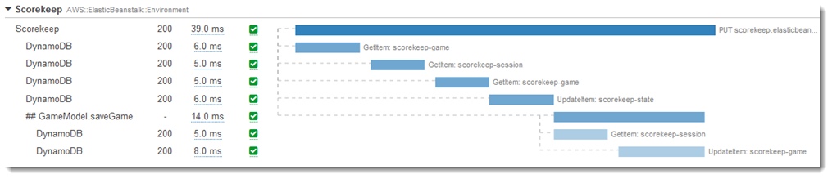
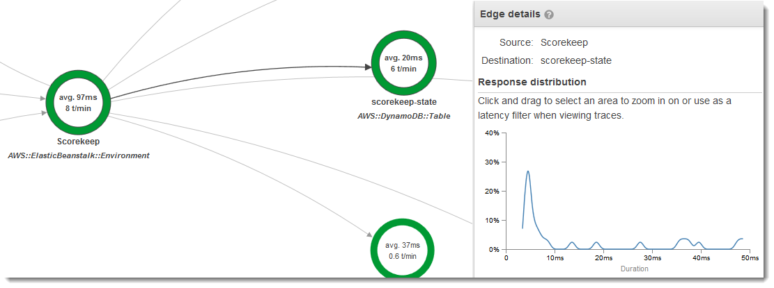
AWS X-ray – key concepts
Sub-segments: breakdown information of a segment

Slide 10
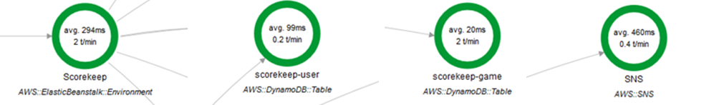
AWS X-ray – key concepts
Segments: the data about the work of a resource
Sub-segments: breakdown information of a segment

Slide 11
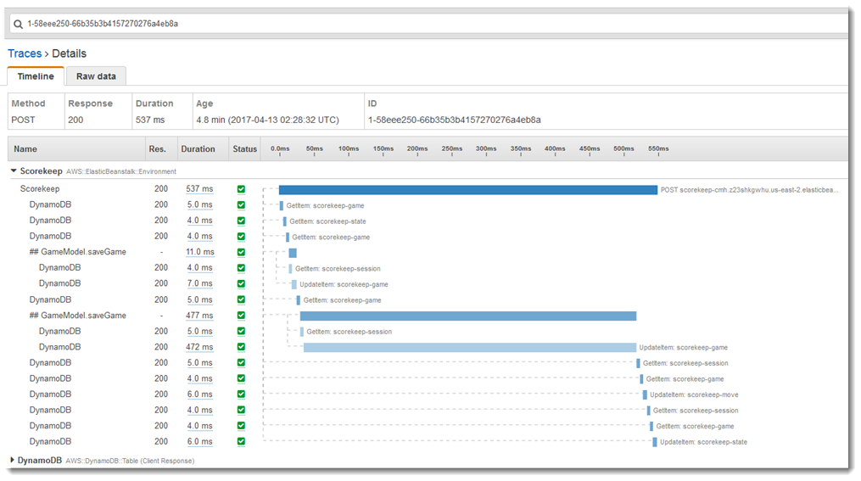
AWS X-ray – key concepts
Traces: A trace ID tracks the path of a request through your application. A trace collects all the segments generated by a single request.
(typically an HTTP GET or POST request that travels through a load balancer, hits your application code, and generates downstream calls to other AWS services or external web API)

Slide 12
AWS X-ray – key concepts
Sampling Rules: The default sampling rule is 1 request per second and 5 percent of additional requests. sample size = reservoir size + (fixed rate)*(total requests per second)
A financial company has a forex trading portal that is written in MERN stack and has been running on Elastic Beanstalk in AWS. The portal processes 200 requests per second and the results are stored in a DynamoDB database. For troubleshooting purposes, you were assigned to enable AWS X-Ray and sample a total of 160 requests per second. You should also ensure that you sample a percentage of matching requests after the reservoir is exhausted.
How should you configure the sampling rules in X-Ray to meet the above requirement?
​
A. Directly set the reservoir size to 160.
​
B. Set the reservoir size to 150 and the fixed rate to 20%.
​C. Set the reservoir size to 150 and the fixed rate to 5%.
​
D. Set the reservoir size to 20 and the fixed rate to 150%.

Slide 13
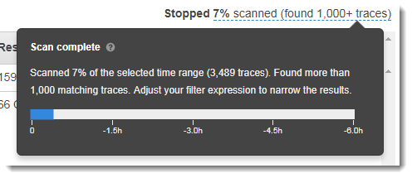
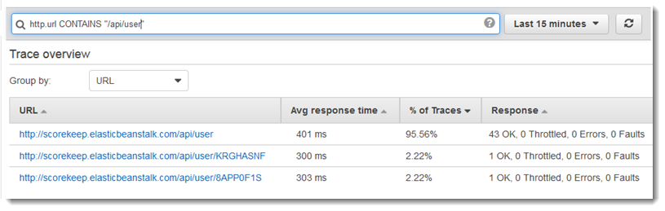
AWS X-ray – key concepts
Because there will be a lot of data
Filter expressions helps you filter out specific traces that you want to investigate
Example:
Requests where response time was more than 5 seconds responsetime > 5
Requests where the total duration was 5 to 8 seconds duration >= 5 AND duration <= 8 or as the image below: http contains “/api/user”

Slide 14
AWS X-ray – key concepts
Annotation: custom data that you add to the request so you can filter it later using [Filter expression] syntax: “key” : “value” ex: document.putAnnotation("mykey", "my value"); example: annotation.gameid = "817DL6VO“ annotation.age > 29 use case:
An application, which already uses X-Ray, generates thousands of trace data every hour. The developer wants to use a filter expression which will limit the results based on custom attributes or keys that he specifies.
How should the developer refactor the application in order to filter the results in the X-Ray console?
​
A. Create a new sampling rule based on the custom attributes.
​
B. Include the custom attributes as new segment fields in the segment document.
​
C. Add the custom attributes as metadata in your segment document.
​
D. Add the custom attributes as annotations in your segment document.

Slide 15
LAB
https://docs.aws.amazon.com/xray/latest/devguide/xray-gettingstarted.html

