Slide 1


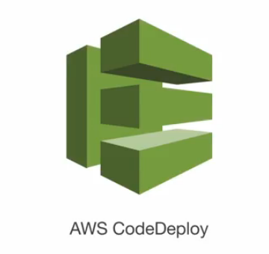

AWS Deployment services and strategy
Elastic Container Service
(ECS)
Elastic Beanstalk
CloudFormation
CodeDeploy

Slide 2
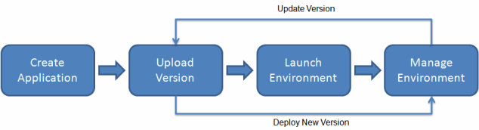
1. Elastic Beanstalk
Y
quickly deploy and manage applications in the AWS Cloud without having to learn about the infrastructure that runs those applications, simply upload your application, and Elastic Beanstalk automatically handles the details of capacity provisioning, load balancing, scaling, and application health monitoring.
**EB can also run Docker environment

Slide 3
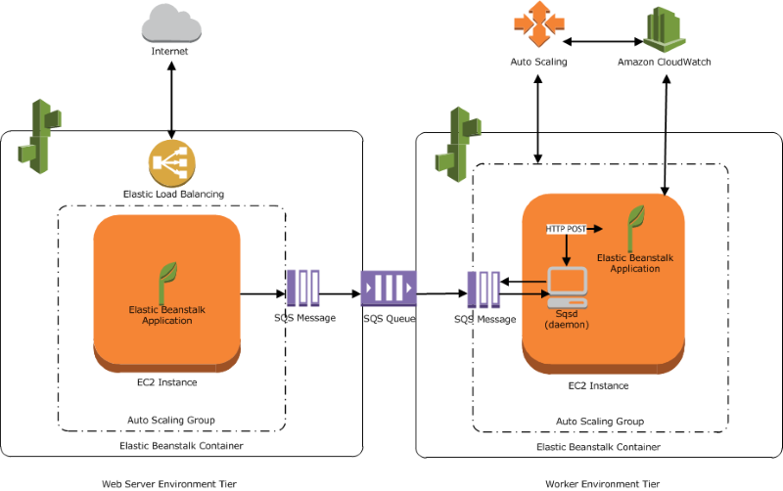
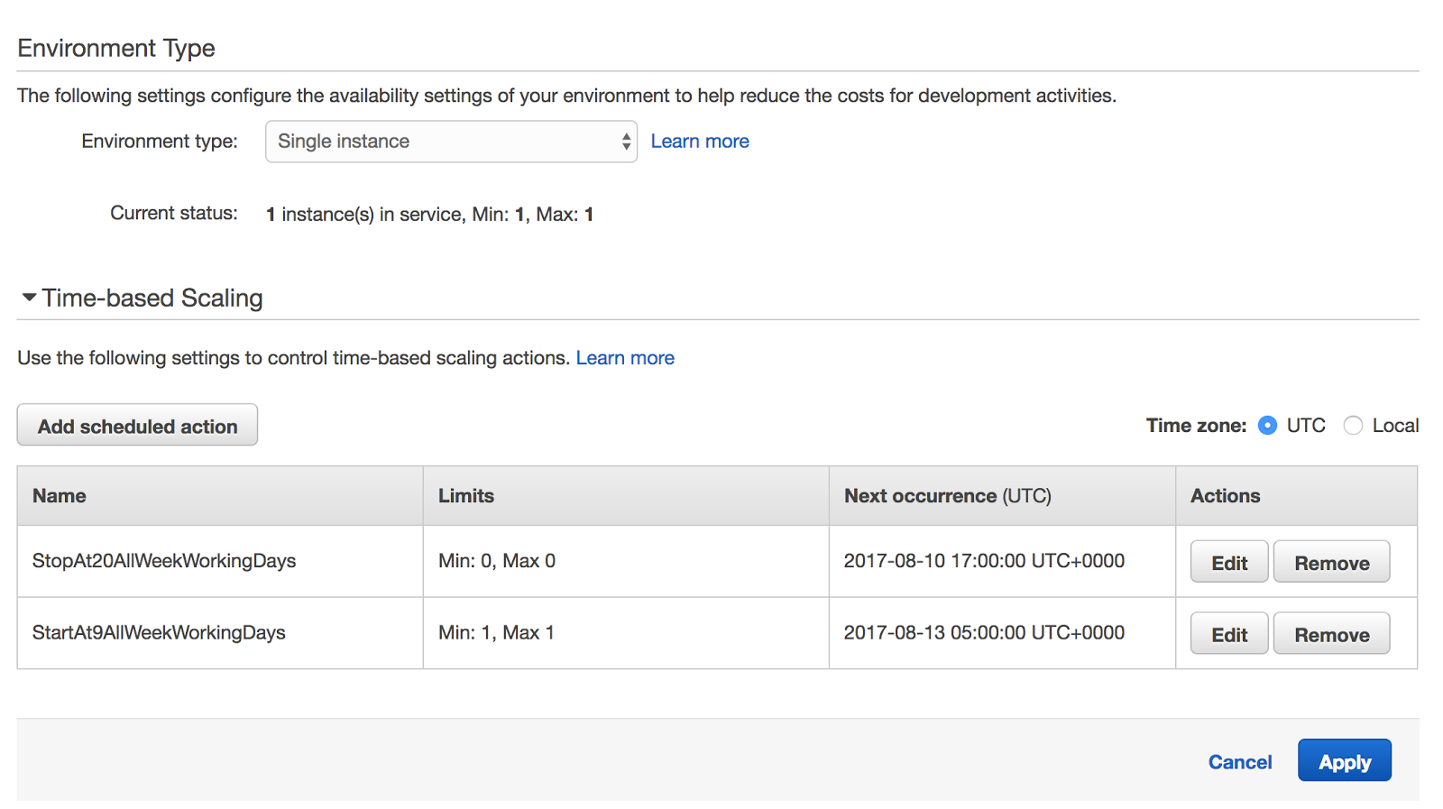
Elastic Beanstalk
Y

Slide 4
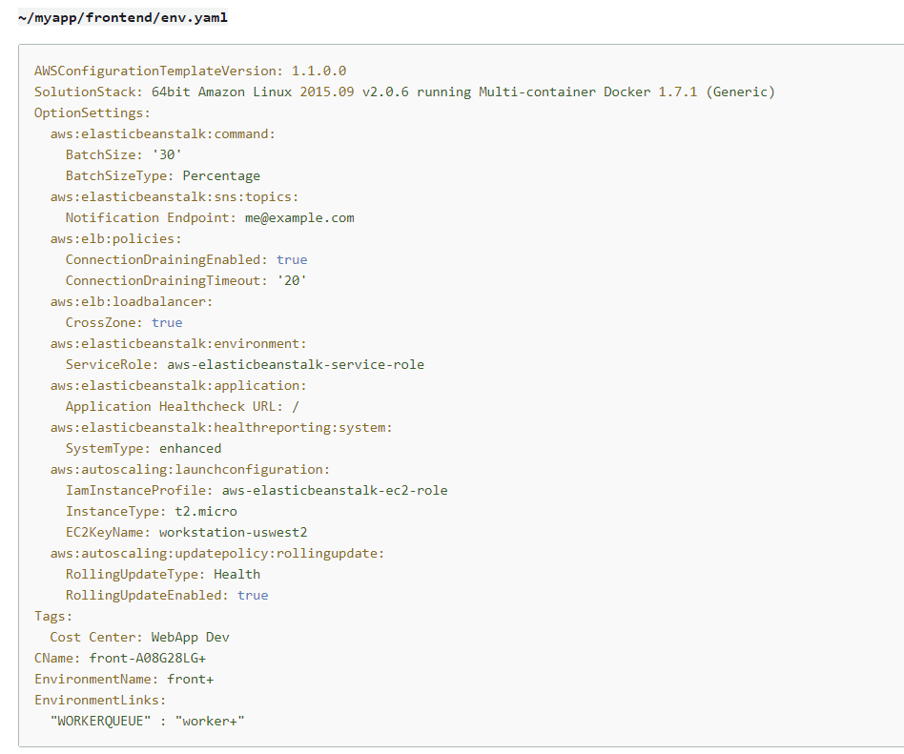
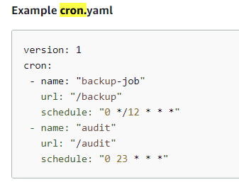
Elastic Beanstalk key concepts You can include a YAML formatted environment manifest in the root of your application source bundle env.yaml: configure the environment name, solution stack and environment links to use when creating your environment. cron.yaml: add jobs to your worker environment's queue automatically at a regular interval
Y

Slide 5
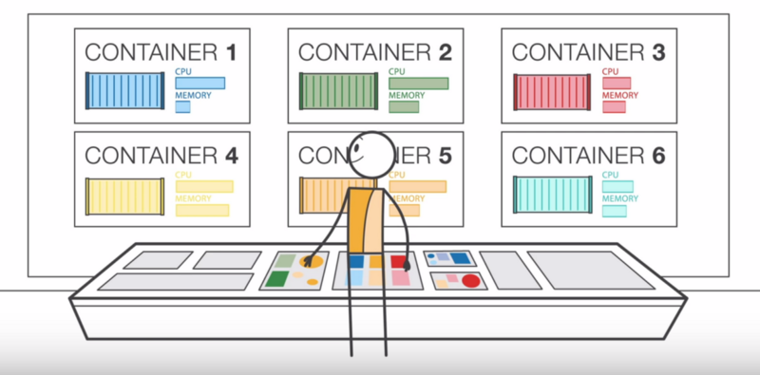
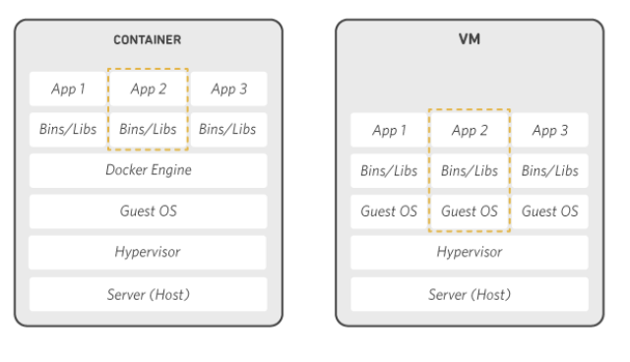
2. Elastic Container Service
Y
Docker is an operating system for containers.
Containers virtualize the operating system of a server. Docker is installed on each server and provides simple commands you can use to build, start, or stop containers.
(Amazon ECS) allows you to run, stop, and manage Docker containers on a cluster.

Slide 6
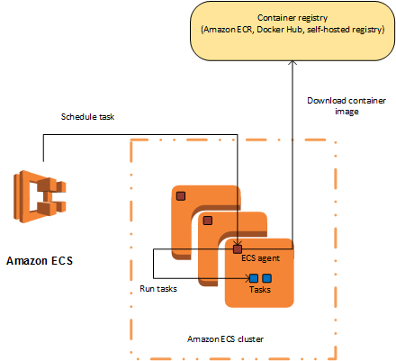
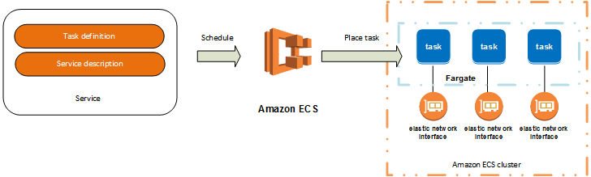
Elastic Container Service
Y
EC2 launch type : allow you to control how to host your tasks on a cluster of EC2
Fargate launch type: You can host your cluster on a serverless infrastructure that is managed by Amazon ECS by launching your services or tasks

Slide 7
Elastic Container Service – key concepts
Y
task definition
task placement strategies
- binpack
- random
- spread
Cluster Query Language

Slide 8
Elastic Container Service – key concepts
Y
A task definition is required to run Docker containers in Amazon ECS. Some of the parameters you can specify in a task definition include:
The Docker image to use with each container in your task
How much CPU and memory to use with each task or each container within a task
The launch type to use, which determines the infrastructure on which your tasks are hosted
The Docker networking mode to use for the containers in your task
The logging configuration to use for your tasks
Whether the task should continue to run if the container finishes or fails
The command the container should run when it is started
Any data volumes that should be used with the containers in the task
The IAM role that your tasks should use
https://docs.aws.amazon.com/AmazonECS/latest/developerguide/task_definition_parameters.html

Slide 9
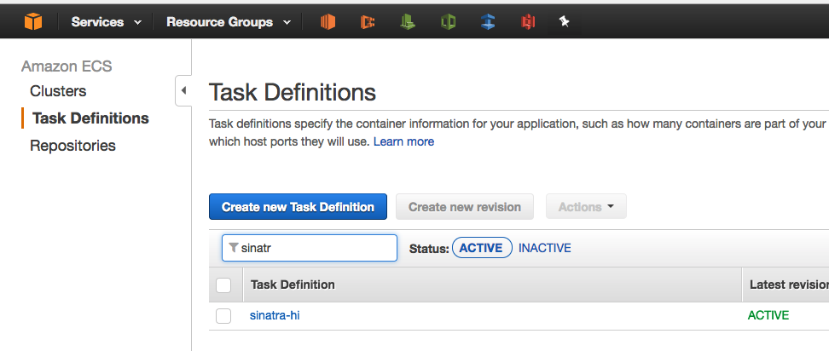
Elastic Container Service – key concepts
Y
task definition
{
"family": "sinatra-hi",
"containerDefinitions": [
{
"name": "web",
"image": "tongueroo/sinatra:latest",
"cpu": 128,
"memoryReservation": 128,
"portMappings": [
{
"containerPort": 4567,
"protocol": "tcp"
}
],
"command": [
"ruby", "hi.rb"
],
"essential": true
}
]

Slide 10
Elastic Container Service – key concepts
Y
Task placement strategies
Binpack: Place tasks based on the least available amount of CPU or memory (ie: BEING USED THE MOST). This minimizes the number of instances in use.
Random: Place tasks randomly.
Spread: Place tasks evenly based on the specified value. (ex: instanceId, attribute:ecs.availability-zone
** You can combine the above strategies:
"placementStrategy": [
{
"field": "attribute:ecs.availability-zone",
"type": "spread"
},
{
"field": "memory",
"type": "binpack"
}
]

Slide 11
Elastic Container Service – key concepts
Y
Task placement strategies
Binpack: Place tasks based on the least available amount of CPU or memory (ie: BEING USED THE MOST). This minimizes the number of instances in use.
Random: Place tasks randomly.
Spread: Place tasks evenly based on the specified value. (ex: instanceId, attribute:ecs.availability-zone
** You can combine the above strategies:
"placementStrategy": [
{
"field": "attribute:ecs.availability-zone",
"type": "spread"
},
{
"field": "memory",
"type": "binpack"
}
]

Slide 12
Elastic Container Service – key concepts
Y
Cluster Query Language
can group container instances by attributes such as Availability Zone, instance type, or custom metadata
subject operator [argument]
Example:
attribute:ecs.instance-type == t2.small
attribute:ecs.availability-zone in [us-east-1a, us-east-1b]
attribute:ecs.instance-type =~ g2.* and attribute:ecs.availability-zone != us-east-1d
not(task:group == database)

Slide 13
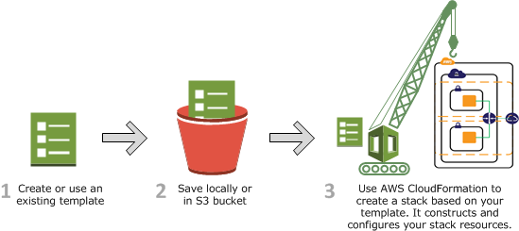
3. Cloudformation
Y
A blueprints for building your AWS resources, with format in JSON or YAML.
If a deployment fails, it will roll back ALL the resources of that deployment.

Slide 14
Cloudformation
Y
{
"AWSTemplateFormatVersion" : "2010-09-09",
"Description" : "A sample template",
"Resources" : {
"MyEC2Instance" : {
"Type" : "AWS::EC2::Instance",
"Properties" : {
"ImageId" : "ami-0ff8a91507f77f867",
"InstanceType" : "t2.micro",
"KeyName" : "testkey",
"BlockDeviceMappings" : [
{
"DeviceName" : "/dev/sdm",
"Ebs" : {
"VolumeType" : "io1",
"Iops" : "200",
"DeleteOnTermination" : "false",
"VolumeSize" : "20“ } } ] } } } }
AWSTemplateFormatVersion: "2010-09-09"
Description: A sample template
Resources:
MyEC2Instance:
Type: "AWS::EC2::Instance"
Properties:
ImageId: "ami-0ff8a91507f77f867"
InstanceType: t2.micro
KeyName: testkey
BlockDeviceMappings:
-
DeviceName: /dev/sdm
Ebs:
VolumeType: io1
Iops: 200
DeleteOnTermination: false
VolumeSize: 20

Slide 15
Cloudformation Anatomy of a template: AWSTemplateFormatVersion: "version date" Description: String Metadata: template metadata Parameters: set of parameters Mappings: set of mappings Conditions: set of conditions Transform: set of transforms Resources: set of resources Outputs: set of outputs
Y

Slide 16
Cloudformation Amazon’s Serverless Application Model (SAM) - SAM is an open-source framework that you can use to build serverless applications on AWS (also referred to as Lambda-based applications) - Use the [AWS::Serverless transform] section specifies the version of the SAM to use. When you specify a transform, you can use AWS SAM syntax to declare resources in your template. THe macro hosted by AWS CloudFormation will take an entire template written in the AWS Serverless Application Model (AWS SAM) syntax and transform and expand it into a compliant AWS CloudFormation template. Example: https://github.com/aws-samples/serverless-app-examples/tree/master/python/s3-get-object-python3
Y

Slide 17
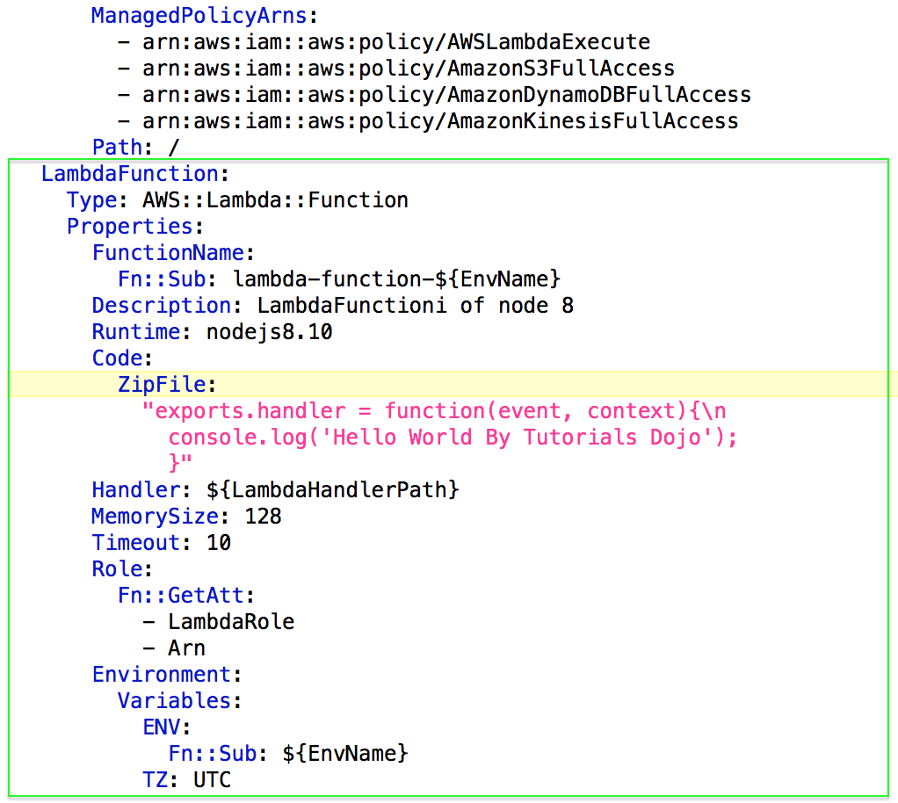
Cloudformation Amazon’s Serverless Application Model (SAM) -cont You can Include your function source inline in the ZipFile parameter of the AWS::Lambda::Function resource in the CloudFormation template.
Y

Slide 18
Cloudformation Question You are using AWS Serverless Application Model (AWS SAM) to build and deploy applications in your serverless infrastructure. Your manager instructed you to create a CloudFormation template that includes your SAM script and other service configurations. This template will be used to launch a similar infrastructure in another region. What should you do in order to accomplish this task? ​ A .Add a Parameters section in the template to specify the version of the AWS Serverless Application Model (AWS SAM) to use. ​ B. Add a Resources section in the template to specify the version of the AWS Serverless Application Model (AWS SAM) to use. ​ C. Add a Mappings section in the template to specify the version of the AWS Serverless Application Model (AWS SAM) to use. ​ D. Add a Transform section in the template to specify the version of the AWS Serverless Application Model (AWS SAM) to use.
Y

Slide 19
4. CodeDeploy CodeDeploy is a deployment service that automates application deployments to Amazon EC2 instances, on-premises instances, serverless Lambda functions, or Amazon ECS services. You can deploy a nearly unlimited variety of application content, including: code serverless AWS Lambda functions web and configuration files executables packages scripts multimedia files
Y

Slide 20
4. CodeDeploy CodeDeploy is a deployment service that automates application deployments to Amazon EC2 instances, on-premises instances, serverless Lambda functions, or Amazon ECS services. You can deploy a nearly unlimited variety of application content, including: code serverless AWS Lambda functions web and configuration files executables packages scripts multimedia files
Y

Slide 21
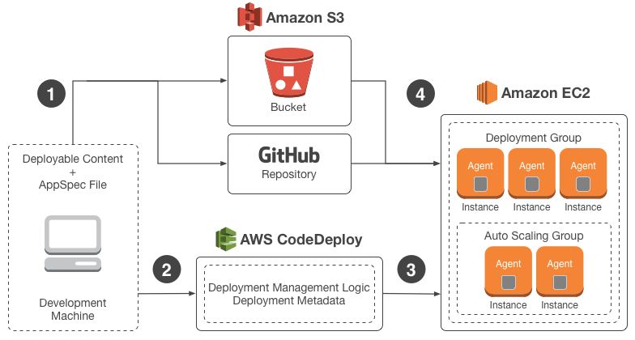
CodeDeploy
Y

Slide 22
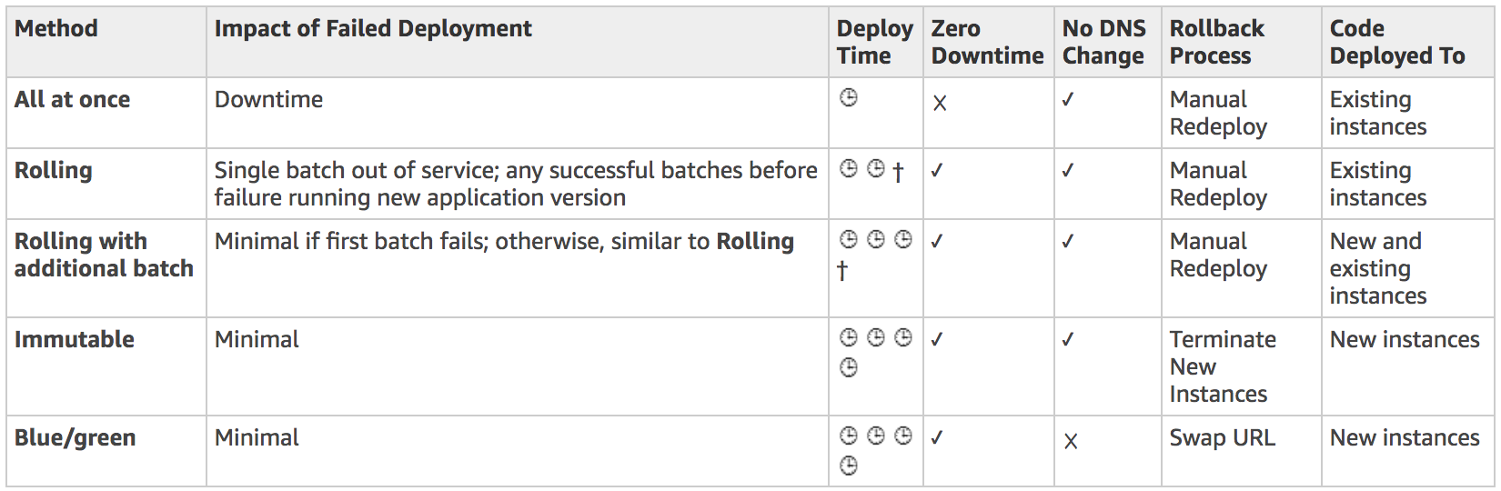
Deployment Strategy:

Slide 23
Deployment (question) A Lambda function has been integrated with DynamoDB Streams as its event source. There has been a new version of the function that needs to be deployed using CodeDeploy where the traffic must be shifted in two increments. It should shift 10 percent of the incoming traffic to the new version in the first increment and then the remaining 90 percent should be deployed five minutes later. Which of the following deployment configurations is the MOST suitable to satisfy this requirement? ​ A. All-at-once ​ B. Linear ​ C. Canary ​D. Rolling with additional batch
Y

Slide 24
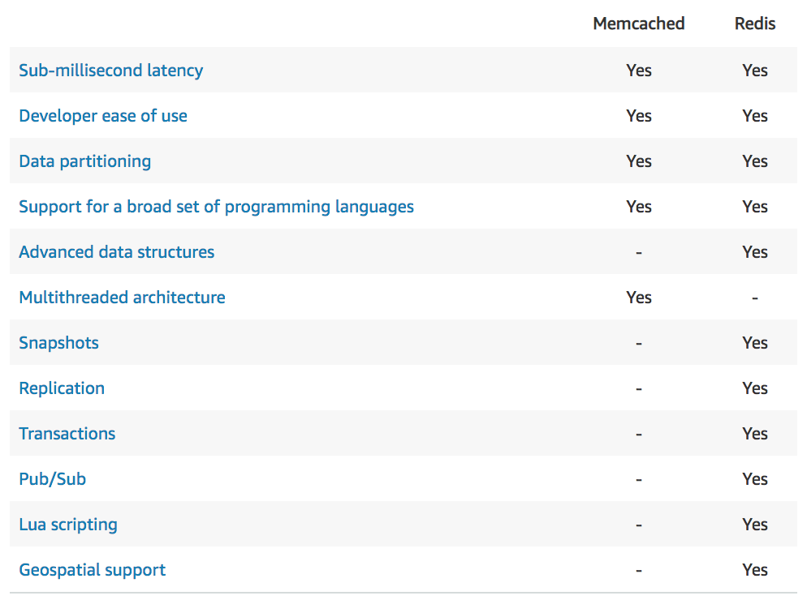
ElastiCache:
Brief: Save frequently accessed data in RAM for much faster access.
There are 2 types:
Memcached: keyword: simple data structure, multithread
Redis: keyword: complexe data structure, high-availability (cluter mode)

