Slide 1
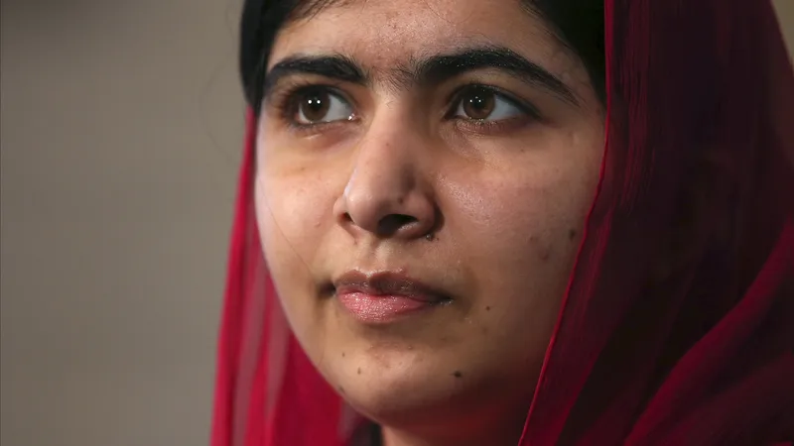
A renowned Pakistani activist, fighting for freedom and education. This slide will explain how literacy can be improved throughout OMERA from Year 7 to Year 11.

Slide 2




2
1
3
4
4 Ideas
The 1st idea that could improve literacy in OMERA, is oracy clubs, which can have a team behind it and allow students to go and train their oracy.
Another idea is the creation of a debate club, which could allow students of all years to attend where pupils can have a mature debate on a certain topic. Not only could this benefit other people by trying it, but it can also allow other students to use more formal language.
Annual Literacy competitions would be a great way to improve literacy as it can excite pupils and with a reward like 1000 house points could excite them even more.
More practical ways of learning aswell could help literacy ‘stick’ in pupil's mind, an example of this could be playing literacy-themed games.

Slide 3
1
2
3
4
The 1st idea that could improve literacy in OMERA, is oracy clubs, which can have a team behind it and allow students to go and train their oracy.
Another idea is the creation of a debate club, which could allow students of all years to attend where pupils can have a mature debate on a certain topic. Not only could this benefit other people by trying it, but it can also allow other students to use more formal language.
Annual Literacy competitions would be a great way to improve literacy as it can excite pupils and with a reward like 1000 house points could excite them even more.
More practical ways of learning aswell could help literacy ‘stick’ in pupil's mind, an example of this could be playing literacy-themed games.

Slide 4
Conclusion
These ideas/pitches can benefit students, and make OMERA stand out in terms of literacy.
We hope you enjoyed!

