Slide 1


WindowBuilder
Guillermo Esquivel González
Nicolas Hernandez González
Programacion de Aplicaciones Interactivas

Slide 2
WindowBuilder
What will we talk about?
· What is WindowBuilder?
· How to install WindowBuilder
· Short introduction for a quick start
· Distribution of the window
· Wizards
· LayoutManagers

Slide 3
What is WindowBuilder?
WindowBuilder is a powerful and easy to use bi-directional Java GUI designer that makes it very easy to create Java GUI applications without spending a lot of time writing code to display simple forms. With WindowBuilder you can create complicated windows in minutes. Use the visual designer and Java code will be generated for you. You can easily add controls using drag-and-drop, add event handlers to your controls, change various properties of controls using a property editor, internationalize your app and much more.

Slide 4
Installation
In Eclipse, click Help > Install New Software…
Get the proper link from http://www.eclipse.org/windowbuilder/download.php
In the Available Software dialog, enter the product's update site location and select all the items to install. Click Next to continue.
Click Next to confirm installation.
Accept the license agreement. Click Finish.
Restart Eclipse.

Slide 5
Short introduction for a quick start
Create a new project using the appropriate project wizard.
Use class wizard to create your GUI window or edit an existing window.
Choose an appropriate layour manager for your window.
Add various components from the Palette and edit their properties using the Property Pane.
Visually create and edit your window's menubar.
Add event handler to various widgets to provide behavior
If you create a new Composite or Jpanel, you can embed it in another window using the Choose Component command.
You cant test launch your window by right-clicking on it and selecting Run As > Java Application

Slide 6
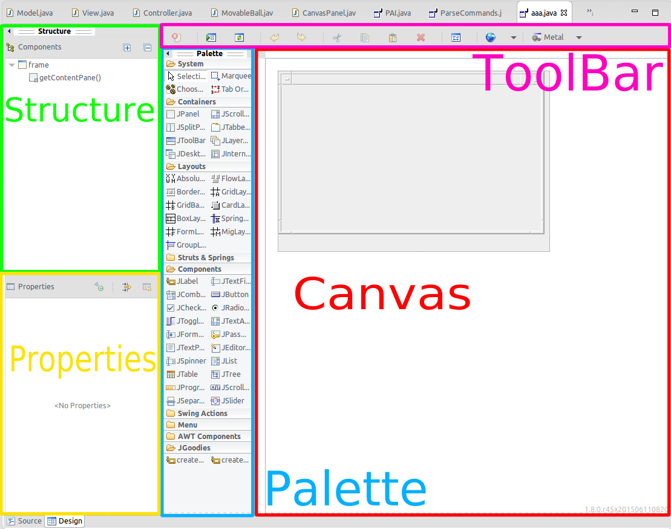
Distribution of the window
Design View
Source View
Structure View
  Component Tree
  Property Pane
Palette
Toolbar
Context Menu

Slide 7
Features
WYSIWYG visual designer and editing
Flexibility and consistency across frameworks
Bi-directional code generation (round-trip editing)
Drag-and-drop
Wizards and templates
Reverse engineering capabilities
Localization and Internationalization
Minimal code changes
Morphing tools
Factories
Data Binding
Auto-discovery of Uisupported frameworks

Slide 8
Wizards
Swing
  JFrame
  Jpanel
  JDialog
  JApplet
  JInternalFrame
  Application Window
  Automatic Data Binding

Slide 9
Bibliography
Help eclipse
Eclipse windowBuilder
Eclipse proposals windowBuilder

Slide 10

END
THANKS!
You can find as alu0100881677 & alu0100898293
Slides and code at Github repo
Any Question?

