Slide 1
NAAN MUDHALVAN FUNDAMENTALS DATA LITRACY WITH TABLEAU PROJECT TITLE: Measuring Success In Talent Management Team ID: NM2023TMID13578
Team Lead ID: 3B6F364BF524440B0E949174B87C17E8

Slide 2
Team Members ID: 55B844002EA509AAB8B407B32A000271 B83D18299859AB889FC4A7AF96D159FF 28896037C10D1989797411E465A5A1E6

Slide 3
INTRODUCTION: Talent management stands as a cornerstone in the modern business landscape, with organizations recognizing that their people are the most valuble assets. A robust talent management strategy not only attracts and retains top_tier employees but also fuels innovation ,growth,and sustained success . However, devising and executing a talent management strategy is just the beginning; measuring its effectiveness is the true litmus test of its impact.

Slide 4
Empathy and Brainstorming

Slide 5
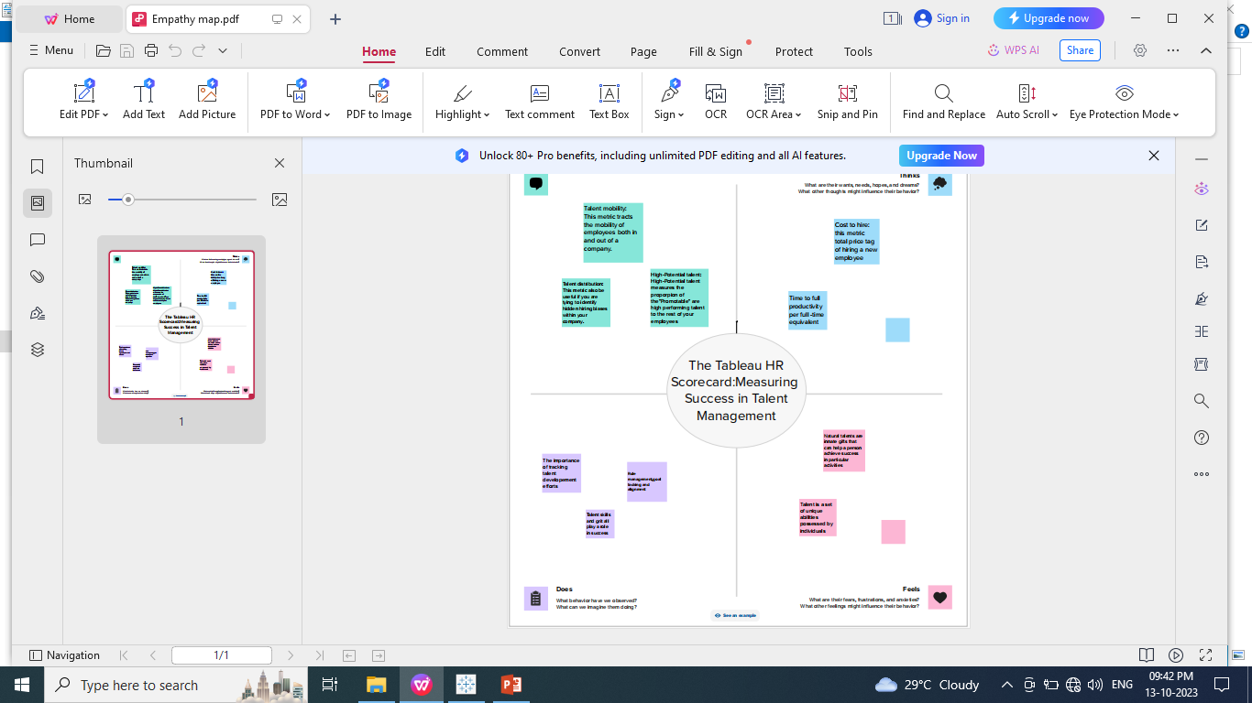

Slide 6
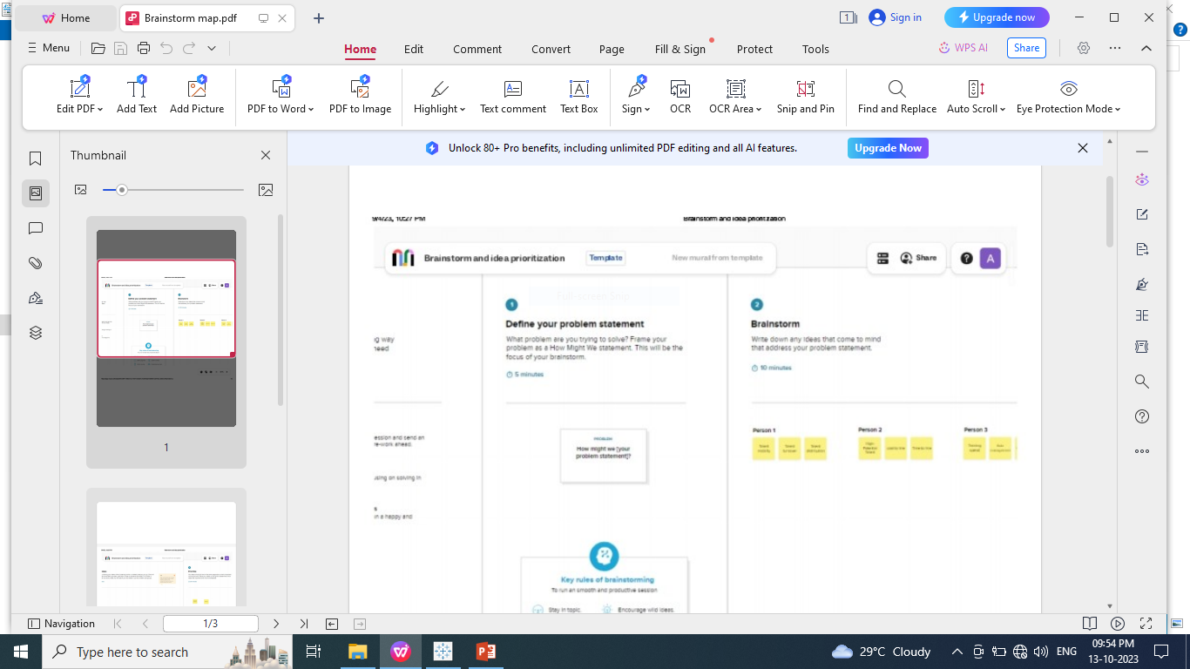

Slide 7
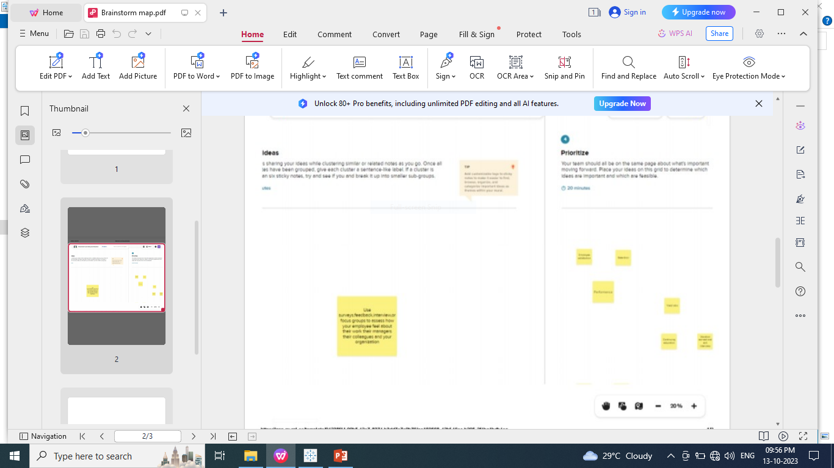

Slide 8
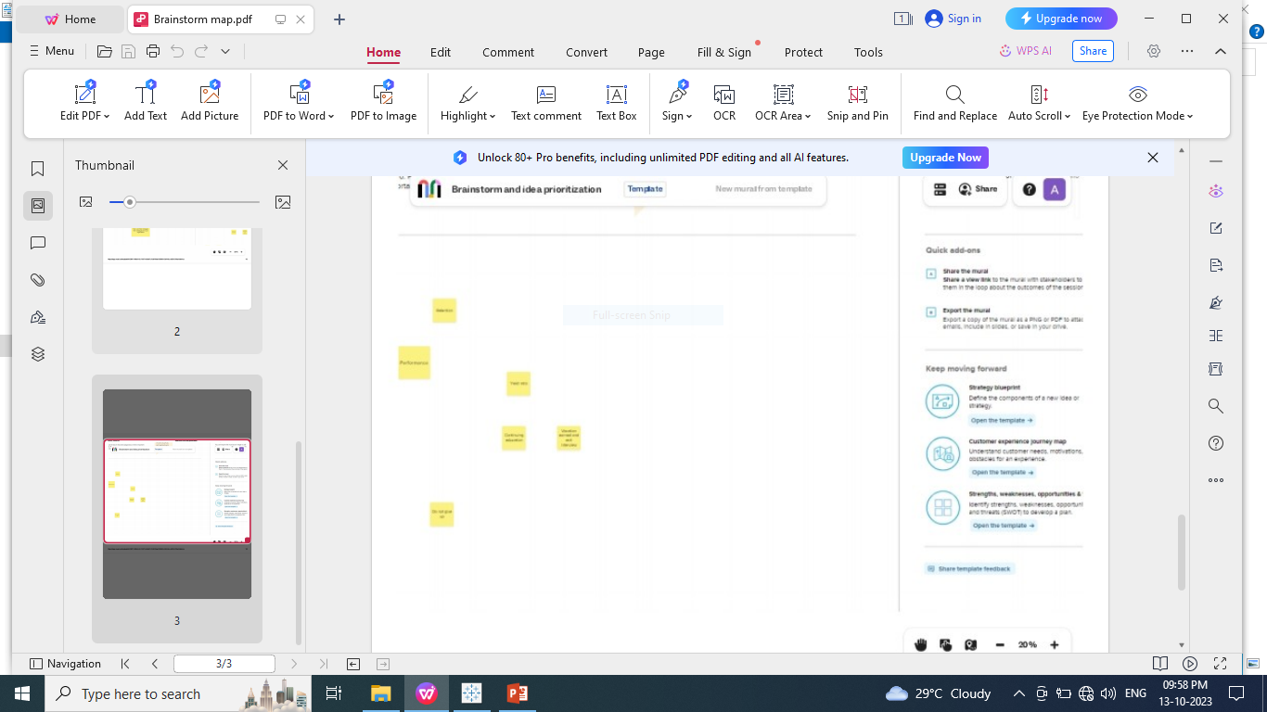

Slide 9
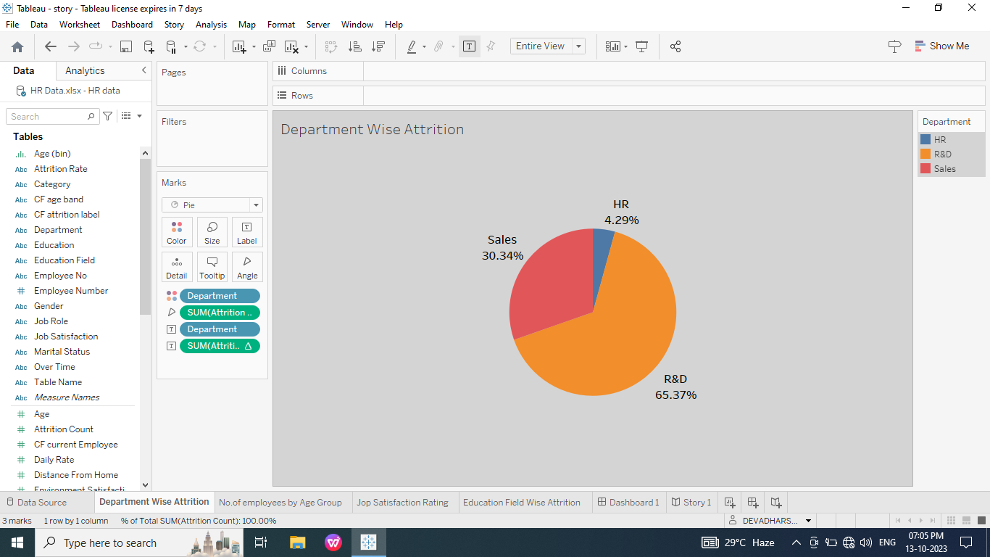
Department Wise Attrition

Slide 10
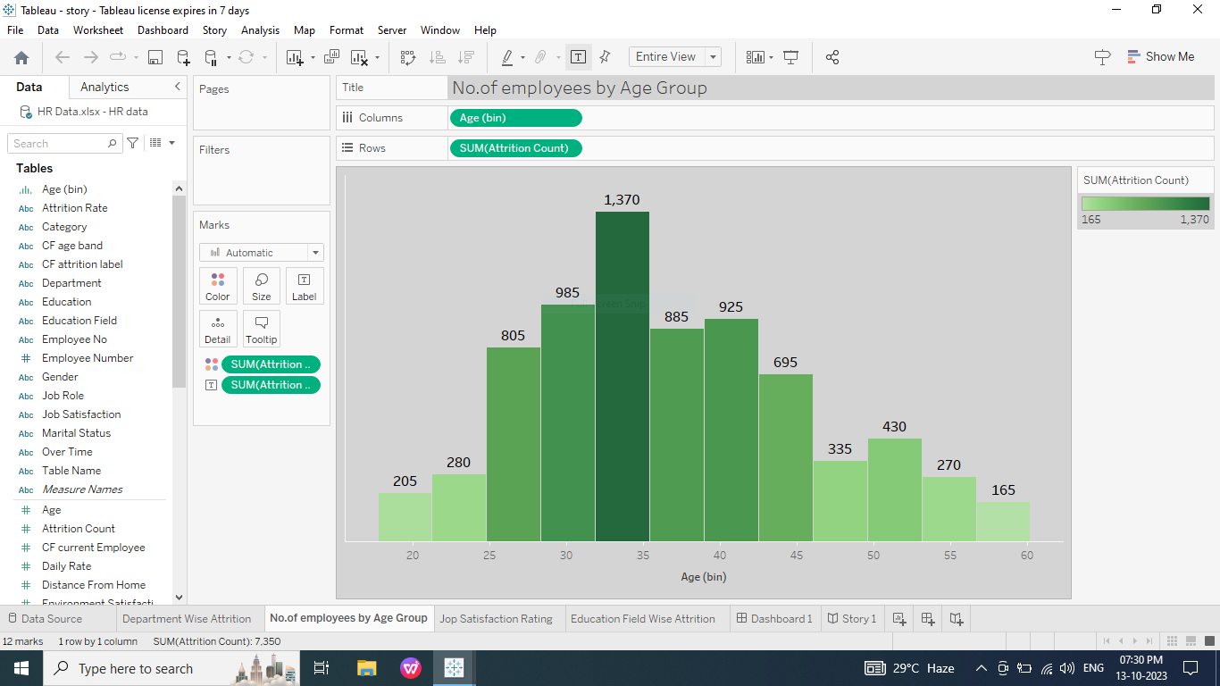
No.of employees by Age Group

Slide 11
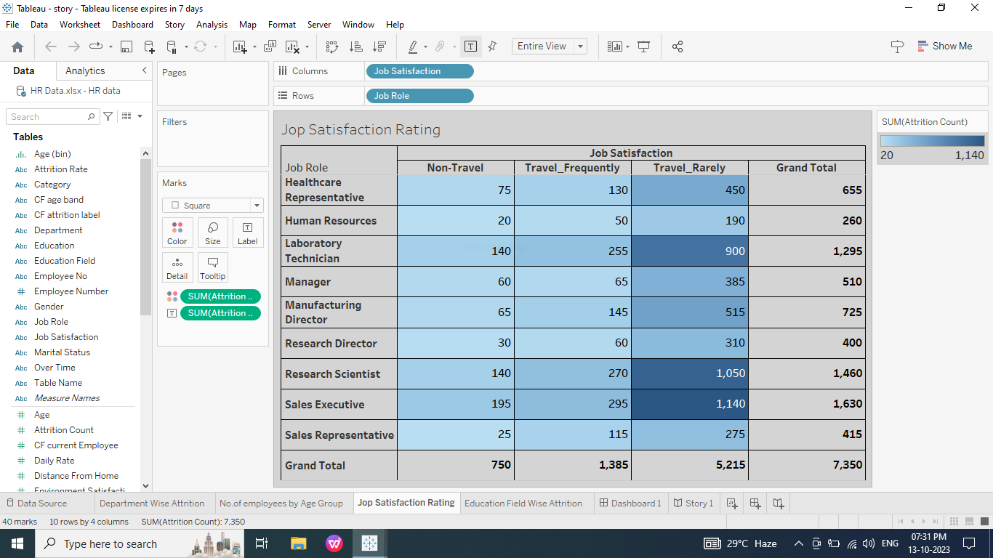
Job Satisfaction Rating

Slide 12
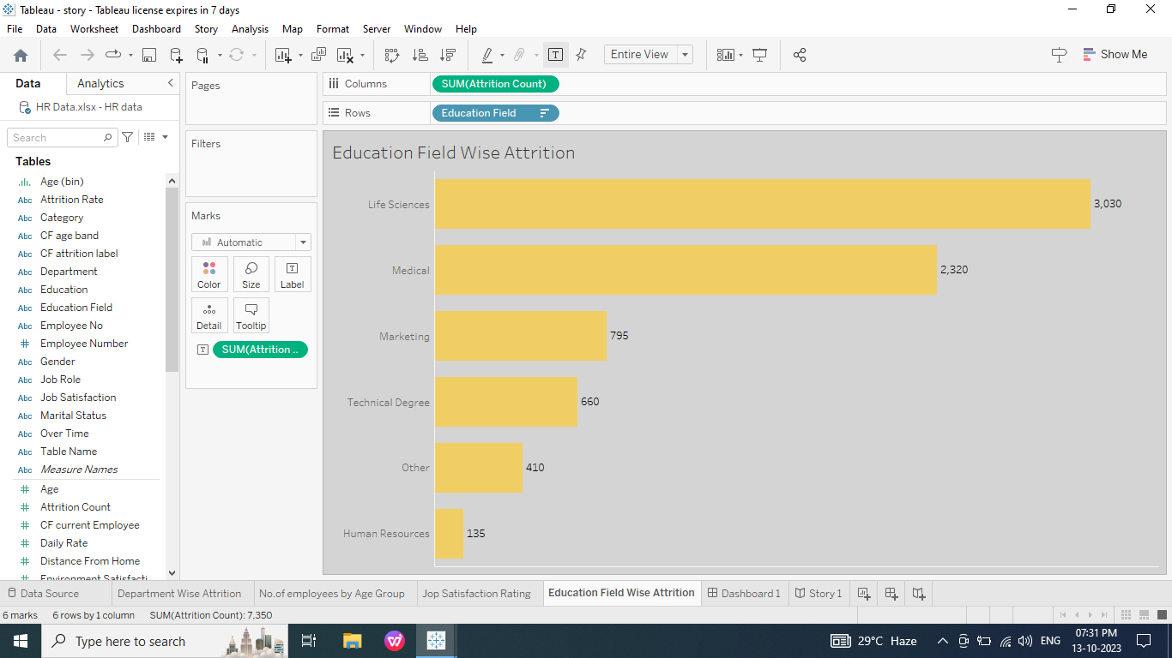
Education Field Wise Attrition

Slide 13
Dashboard

Slide 14
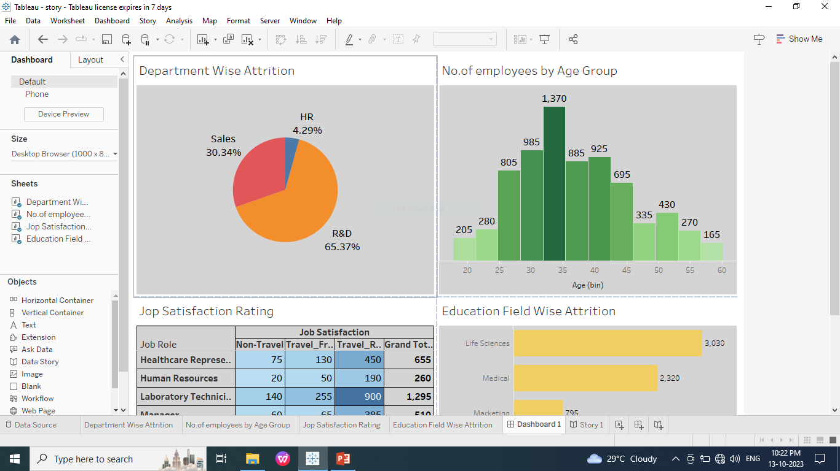

Slide 15
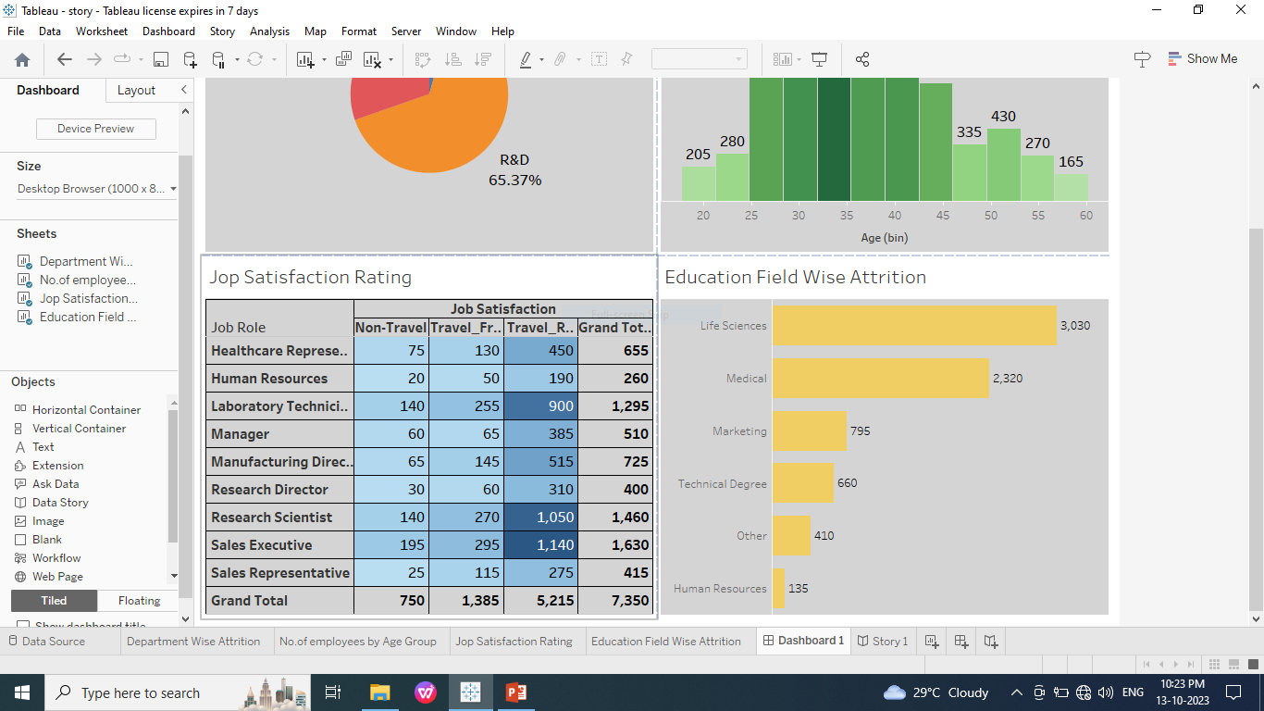

Slide 16
Story

Slide 17
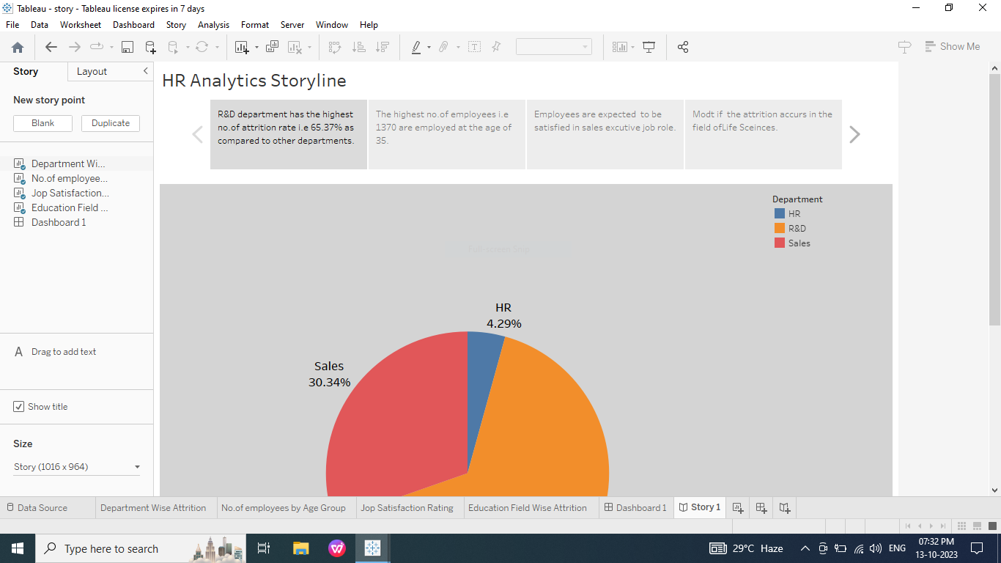

Slide 18
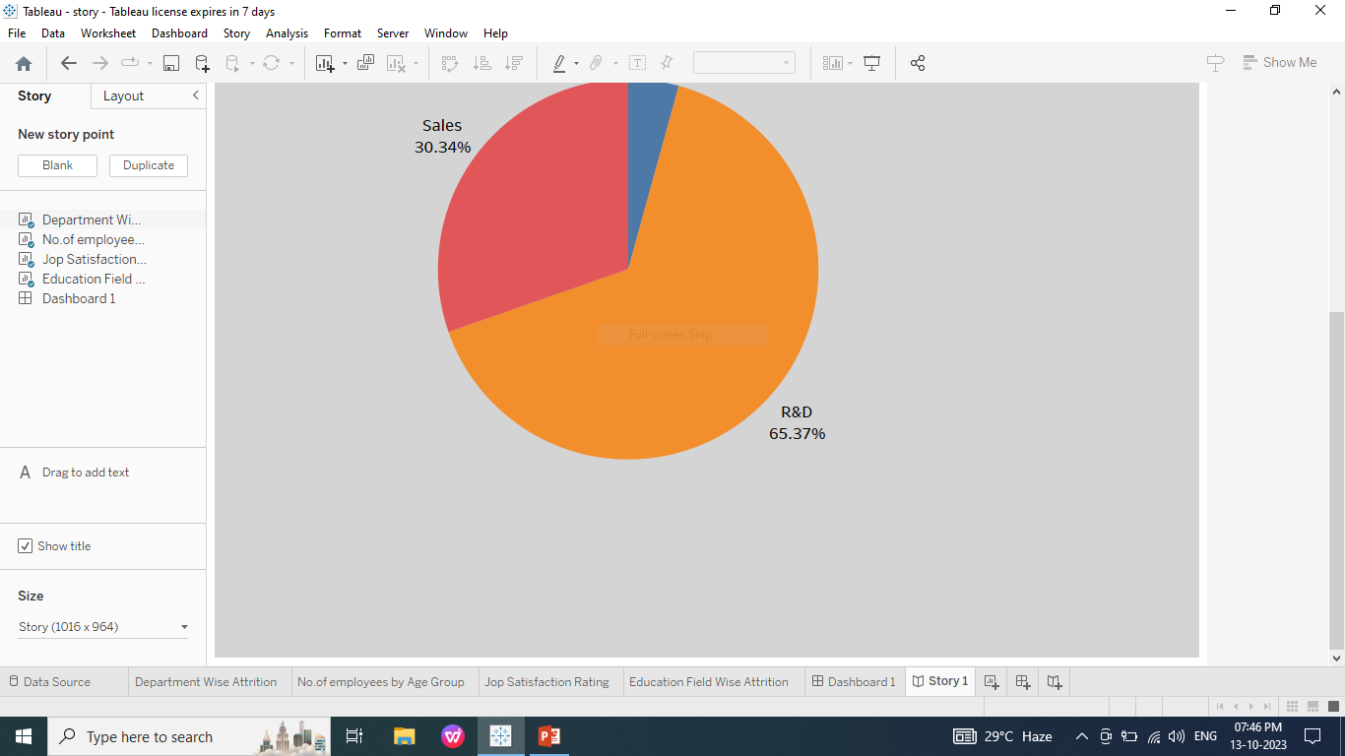

Slide 19
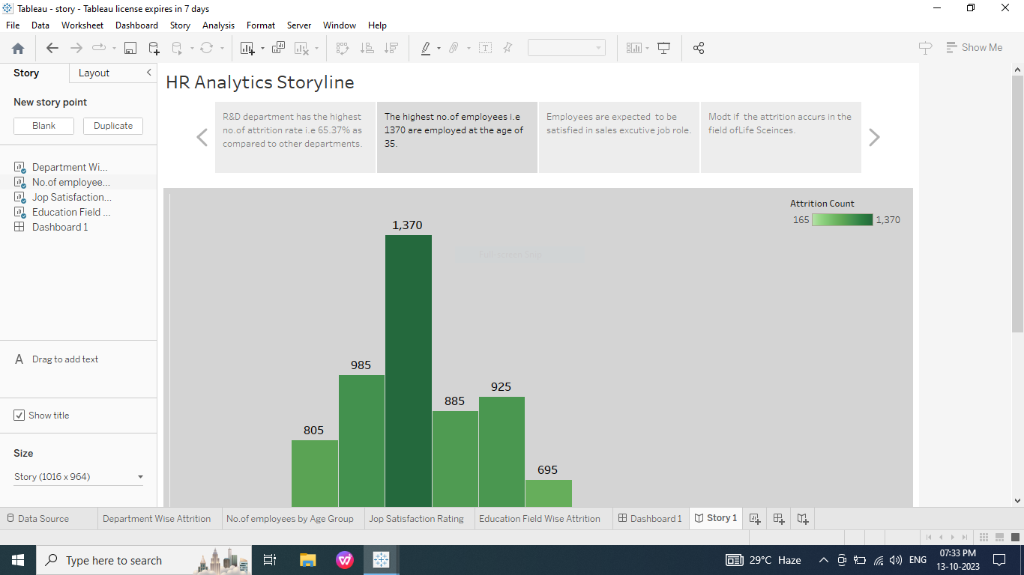

Slide 20
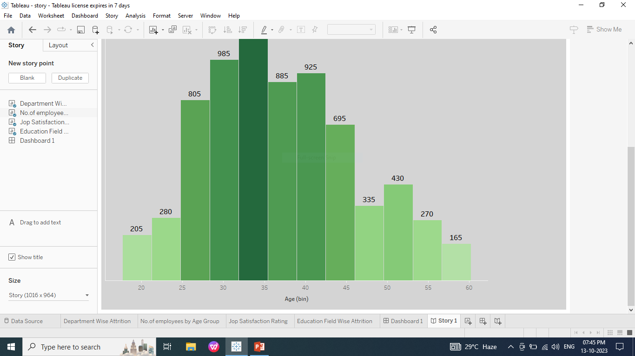

Slide 21
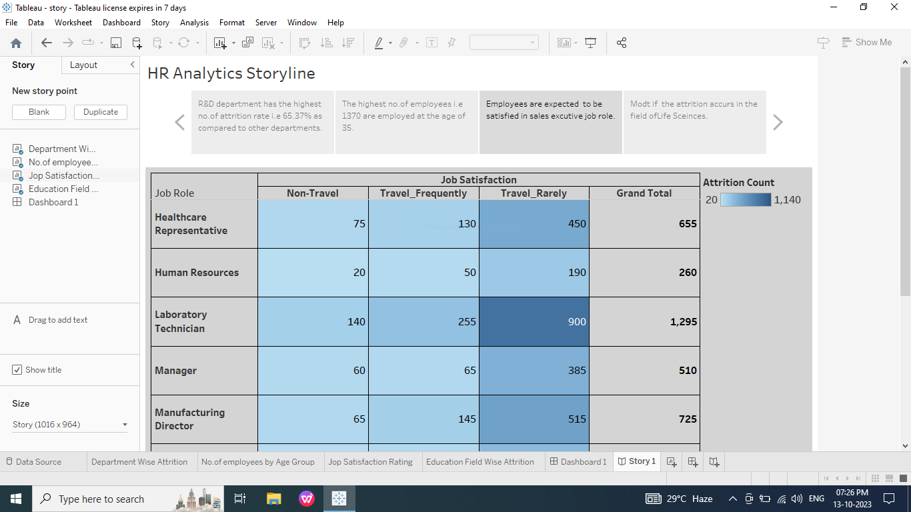

Slide 22
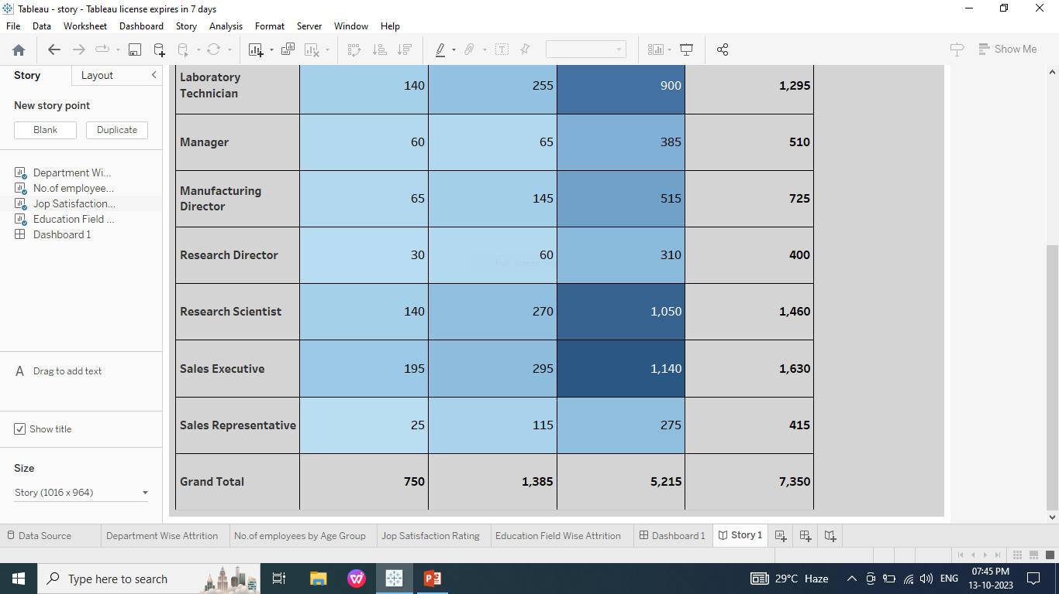

Slide 23
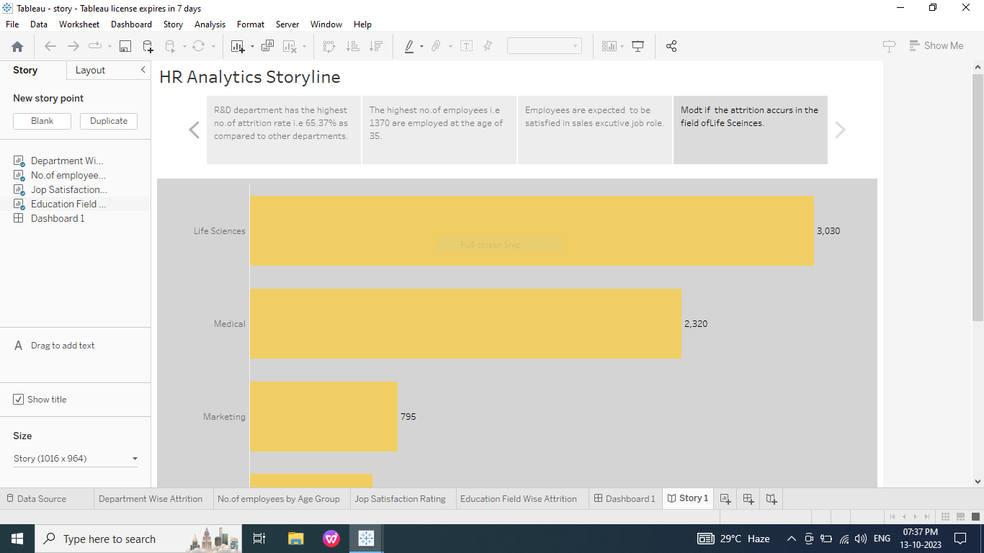

Slide 24
Publishing

Slide 25
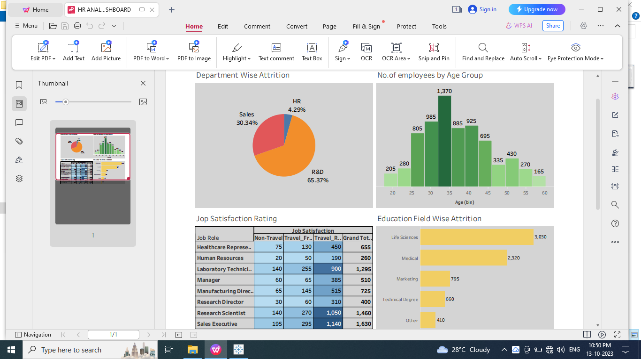

Slide 26
Thank You

