Slide 1
Analyzing HCI Principles in Secure Systems Practice 1 of HCI
Created by Alua & Ruslan

Slide 2

Select Case

Slide 3
Evaluate HCI Principles
Usability, Learnability, Memorability, Errors, Efficiency

Slide 4
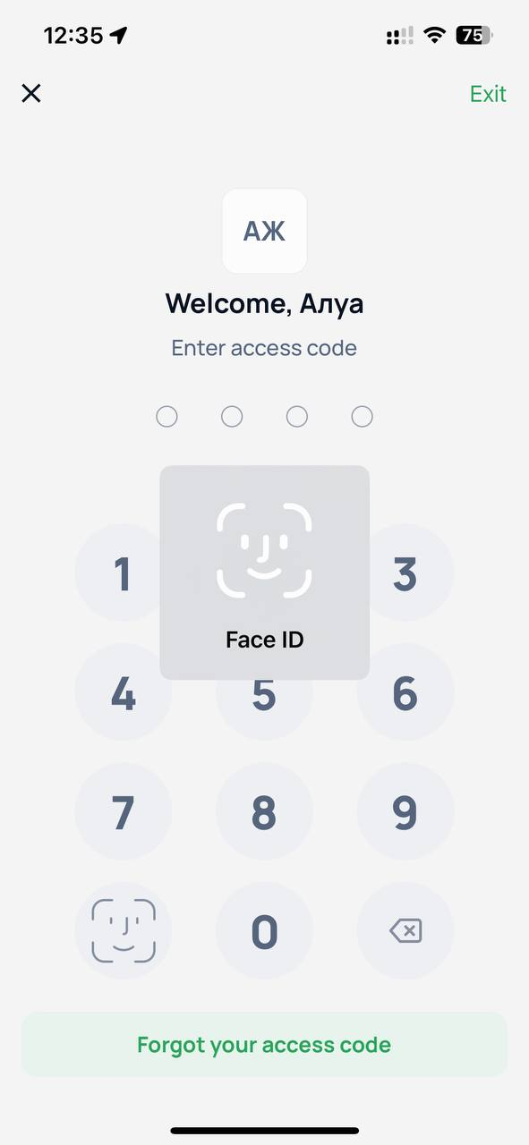
Usability of HCI Principles

Slide 5
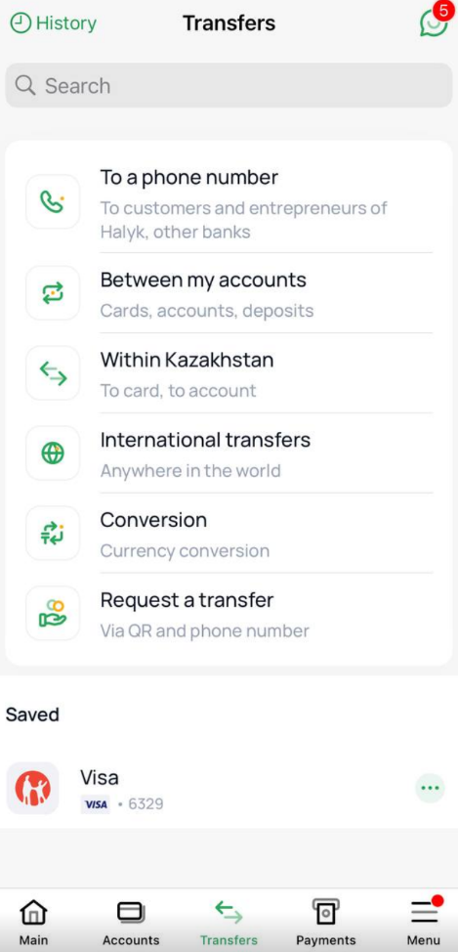
Learnability of HCI Principles

Slide 6
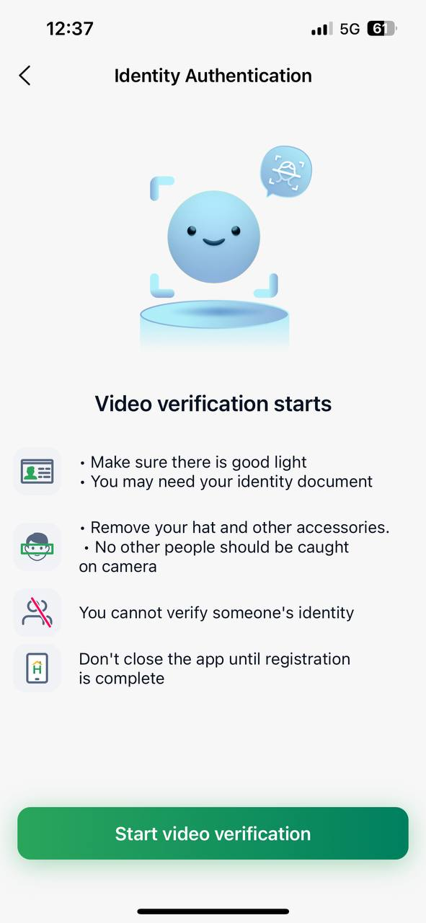
Memorability of HCI Principles

Slide 7
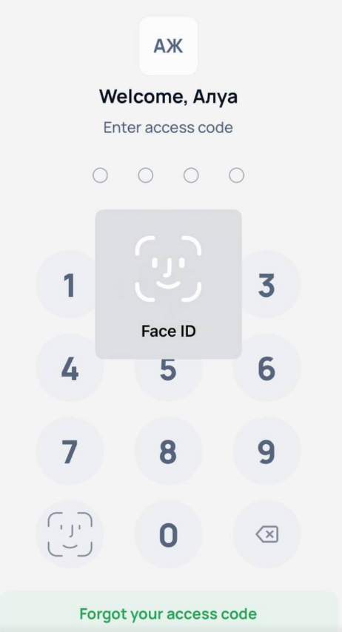
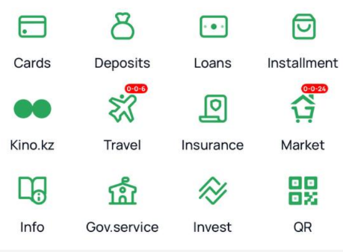
Errors of HCI Principles If person wants to use QR code or perform other operations, he should verificate himself

Slide 8
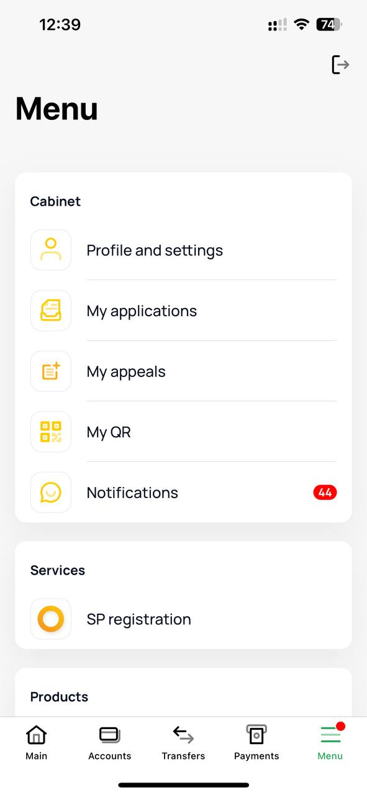
Efficiency of HCI Principles When you want to check your card’s number, Halyk sends code on your phone number

Slide 9
Design Improvement

Slide 10
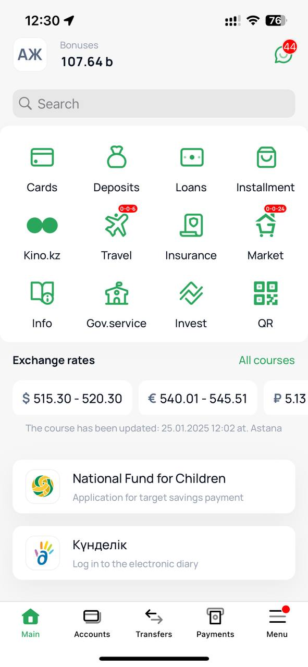
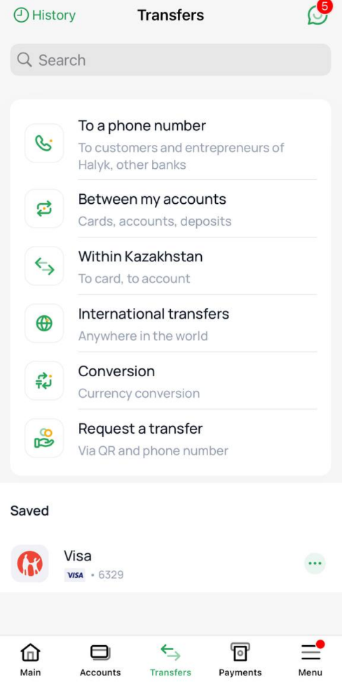
Identify Issues & The proposed Enhancement Usability issues: The QR code placed inconveniently. It should be in transfers or instead them

