Slide 1

Business Analytics 2020 Fall
To the Top of League of Legend
--- LOL Match Prediction and Champion Clustering
Annan Chen ac4619
Jiepeng Lian jl5521
Jing Xiao jx2422
Qingyuan Ren qr2130
Zezuan Zhang zz2705

Slide 2
Contents
01
Introduction
02
Data Description and Preprocessing
03
Champions Clustering
04
Game Result Prediction
05
Recommendation and Insight

Slide 3

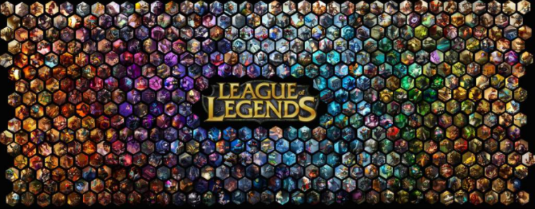
Introduction
About League of Legend
League of Legends is a PC-side MOBA game popular all over the world. Players can accumulate levels and money by killing monsters, minions and opponent heroes in the game, and finally winning the game by destroying the enemy base.
About LOL Business Market
There are mass user base and rich business chains, including worldwide professional competitions and regional leagues (LCS, LEC, LCK, LPL, etc ). The winners of the competition could receive up to millions of dollar award. Various betting companies or live stream activities closely following the detailed results of each competition. The outstanding team and players could attract various advertisement endorsement and commercial activities.
About our research plan
Originally all 152 champions are in 6 categories: Tank, Mage, Marksman, Assassin, Fighter and Support. In this project, we want to dig deeper into clustering champions based on their performance in a professional match, and provide valuable insights by suggesting champions selection and predicting games results at an early stage.

Slide 4
Data Description and Preprocessing
The datasets (https://oracleselixir.com/tools/downloads) we used include in-game features for all professional games during 2014 to 2020. More specifically, we pick all professional match data in 2020 because of timeliness - the game and champions might change after updates and new versions.
This dataset contains 77424 rows with 105 columns. Each 12 rows indicates 1 match (10 player-level data & 2 team-level data). We also do several data preprocessing steps to make the data more structural as desired (separating team level and champions level data, removing collinear and non-numerical features, combining each two team-level observations to one row . After data preprocessing we come to 6369 rows with 102 columns. We would use team-level dataset for predicting results, and use champion-level dataset for clustering.
Observations N = 77,424 |  | Features (k=105)
6,452 games in 2020 professional matches | Individual level: Blue sides players (5 in each game, N = 32,260) | Champion selected, game result kills/deaths/assists, gold difference, experience, creep score, vision score, etc. ……
 | Individual level: Red sides players (5 in each game, N = 32,260)
 | Team level integrated performance (2 in each game, N = 12,904) | 5 banned champions, game result team kills/deaths/assist, gold, experience, etc. ……

Slide 5
Data Description and Preprocessing
Figure: Champion pick rate (Who is popular?)
Figure: Champion ban rate (Who is threatening?)

Slide 6
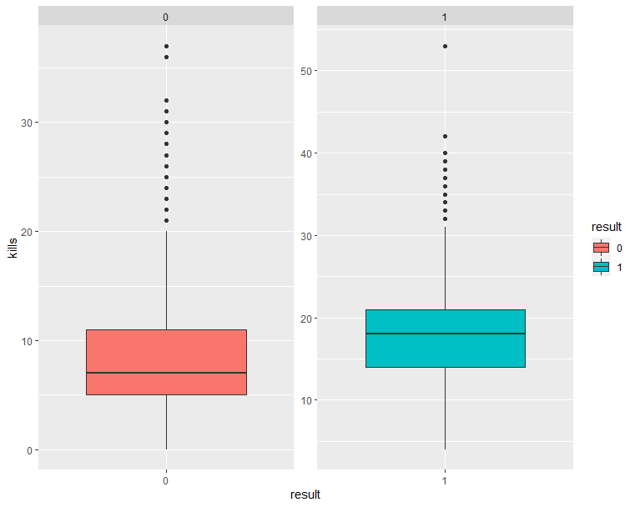
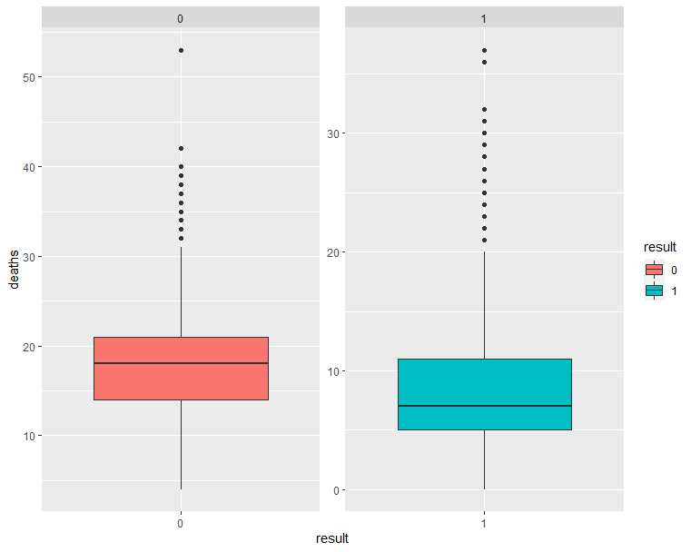
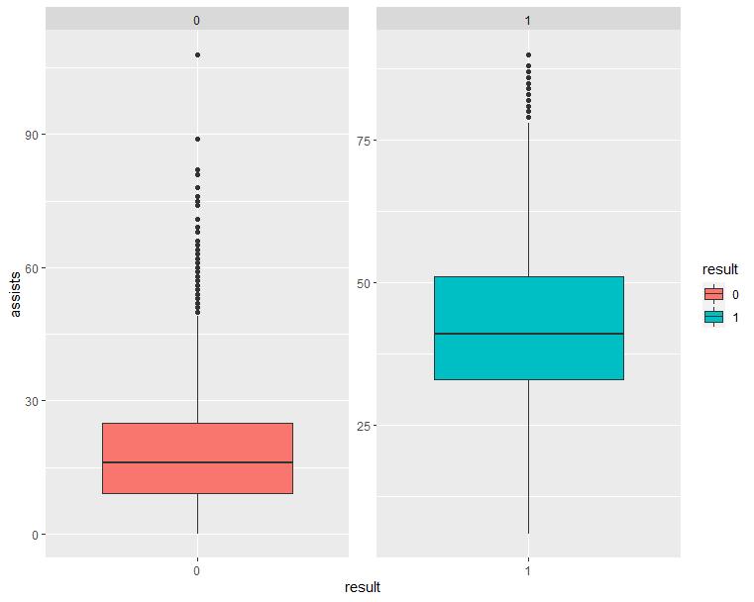
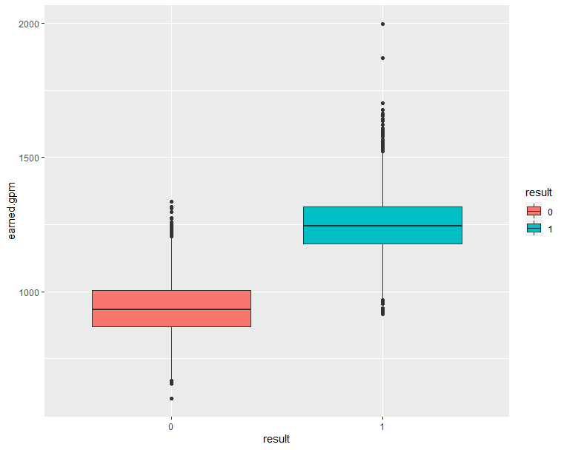
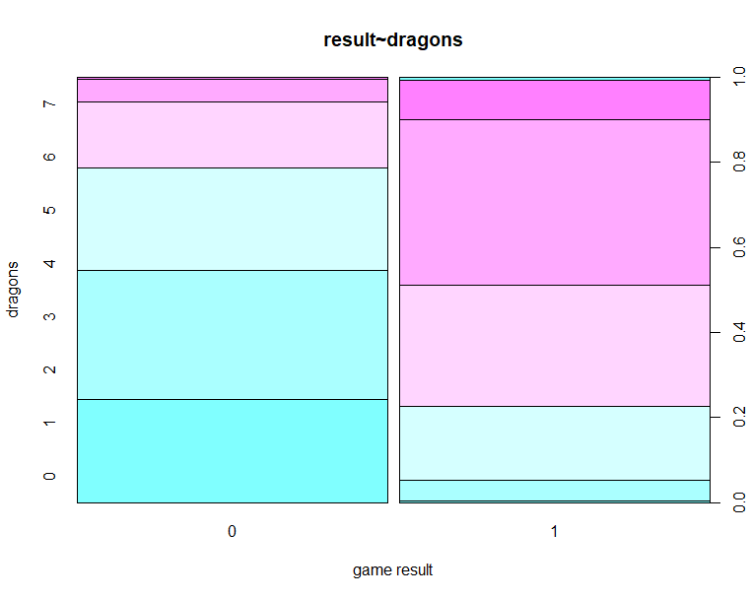
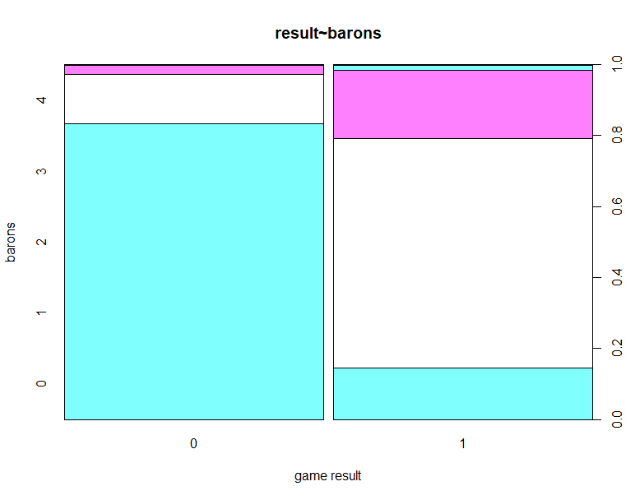
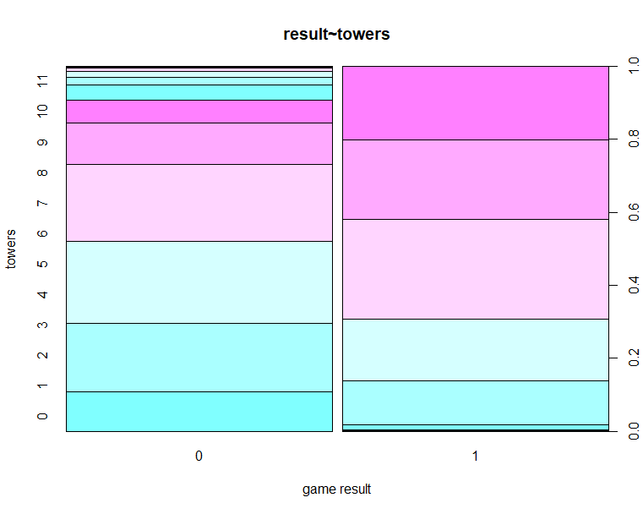
Data Description and Preprocessing
Figure: The overall performance difference between win and loss team
Kills deaths assists golds per minute
dragons barons towers

Slide 7
Champions Clustering
Purpose: Using player level data, clustering the champions for further prediction.
Step 1
Aggregate mean performance of players for each champion
Grouping by champion and getting the mean of every feature, we got the 54 features for each champion.
Split the whole data into the “win” and “loss” part to see how these champions performed in win or loss games. Thus, we got total 108(54 x 2) features for each champion and did PCA based on this dataset.
Letting the cumulative proportion of variance explained go over 90%, we chose 4 principle components, and the final cumulative var explained is 94.05%. We have loadings of the four factors as shown in next page.
Step 2
Calculating mean “win” and “loss” performance for each champion
Step 3
Decomposing the features using the PCA method
Notes:
With the data of each person, including the champions they chose and their performance, we tried to clustering the champions for further prediction. We firstly decomposed the features using the PCA method. Grouping by champion and getting the mean of every feature, we got the 54 features for each champion. Further, we split the whole data into the “win” and “loss” part to see how these champions performed in win or loss games. Thus, we got total 108(54 x 2) features for each champion and did PCA based on this dataset.
Letting the cumulative proportion of variance explained go over 90%, we chose 4 principle components, and the final cumulative var explained is 94.05%. We have loadings of the four factors as below:

Slide 8
Champions Clustering
Result: Four feature factors Results: Clustering result when k = 20
damage
Economy-experience
Win-loss difference
enemy
F1 |  | F2 |  | F3 |  | F4
damagetochampions | 0.653 | damagetochampions_ | 0.506 | damagetochampions | 0.532 | earnedgold_ | 0.527
damagetochampions_ | 0.521 | earnedgold | 0.325 | damagetochampions_ | 0.465 | earnedgold | 0.486
totalgold | 0.188 | totalgold | 0.295 | totalgold_ | 0.311 | xpat15 | 0.227
goldspent | 0.146 | opp_xpat15 | 0.258 | goldspent_ | 0.300 | xpat15_ | 0.227
totalgold_ | 0.142 | xpat15_ | 0.256 | earnedgold_ | 0.295 | opp_goldat15 | 0.224
opp_goldat15_ | 0.142 | xpat15 | 0.255 | opp_xpat15 | 0.202 | opp_goldat15_ | 0.213
opp_xpat15_ | 0.141 | opp_xpat15_ | 0.243 | opp_xpat15_ | 0.185 | opp_goldat10 | 0.178
opp_goldat15 | 0.130 | damagetochampions | 0.238 | xpat15 | 0.145 | opp_xpat15 | 0.170
opp_xpat15 | 0.130 | goldspent | 0.233 | opp_xpat10 | 0.133 | opp_xpat15_ | 0.159
goldspent_ | 0.129 | opp_xpat10 | 0.191 | xpat15_ | 0.133 | opp_goldat10_ | 0.148
Cluster 0 | Cluster 1 | Cluster 2 | Cluster 3 | Cluster 4 | Cluster 5 | Cluster 6
'Senna' 'Twitch' 'Jinx' 'Taliyah' 'Vayne' | 'Karma' 'Lux' 'Nunu & Willump' 'Volibear' 'Xin Zhao' 'Bard' 'Blitzcrank' 'Morgana' 'Soraka' | 'Fiora' 'Irelia' 'Twisted Fate' 'Jax' 'Riven' 'Tristana' 'Tryndamere' 'Camille' 'Aatrox' | 'Jayce' 'Quinn' 'Corki' 'Zoe' 'Vladimir' 'Syndra' 'Rumble' 'LeBlanc' "Vel'Koz" 'Viktor' 'Swain' | 'Thresh' 'Trundle' 'Skarner' 'Lulu' 'Jarvan IV' 'Taric' 'Leona' 'Tahm Kench' | 'Sejuani' 'Pyke' 'Lee Sin' "Rek'Sai" | 'Lucian' 'Dr. Mundo' 'Talon' 'Akali' 'Ekko' 'Aurelion Sol' 'Diana' 'Yorick' 'Cassiopeia' 'Sylas' 'Ahri' 'Ryze' 'Qiyana' 'Orianna' "Cho'Gath"
Cluster 7 | Cluster 8 | Cluster 9 | Cluster 10 | Cluster 11 | Cluster 12 | Cluster 13
'Sivir' 'Varus' 'Caitlyn' 'Aphelios' | 'Malphite' 'Mordekaiser' 'Gnar' 'Neeko' 'Yuumi' 'Singed' 'Lissandra' 'Fiddlesticks' 'Zilean' 'Kennen' 'Maokai' 'Malzahar' | 'Zyra' 'Karthus' 'Xerath' 'Heimerdinger' 'Ziggs' 'Illaoi' | 'Sion' 'Urgot' 'Kled' 'Shen' 'Ornn' 'Renekton' 'Galio' 'Poppy' 'Wukong' 'Darius' 'Sett' | 'Draven' 'Miss Fortune' 'Ashe' 'Jhin' "Kai'Sa" 'Kalista' 'Xayah' | 'Janna' 'Vi' 'Anivia' 'Sona' | 'Garen'
Cluster 14 | Cluster 15 | Cluster 16 | Cluster 17 | Cluster 18 | Cluster 19 | Cluster 20
'Gangplank' 'Evelynn' 'Azir' 'Lillia' 'Zed' 'Kayle' | 'Nocturne' 'Olaf' 'Fizz' 'Zac' 'Yasuo' 'Hecarim' 'Pantheon' | 'Veigar' 'Kassadin' | "Kha'Zix" 'Graves' 'Nidalee' 'Gragas' 'Kayn' 'Elise' 'Kindred' | "Kog'Maw" 'Shyvana' 'Ezreal' | 'Alistar' 'Rakan' 'Ivern' 'Braum' 'Nami' 'Nautilus' | 'Master Yi' 'Rengar' 'Amumu' 'Brand' 'Katarina' 'Shaco' 'Teemo' 'Warwick' 'Rammus' 'Annie'
Notes:
We see that the four factors all have similar weights on the win or loss dataset. Some might have the opposite effect on the two dataset. To give a definition for the four factors, we checked the top 20 largest coefficients for each factor. The first principal component F1 has relatively higher weight on “damage to champions”, which can be defined as a “damage” factor. F2 shows great impact from xpat15(average experience difference at 15 minutes), total gold and earner gold. So it can be defined as a “economy-experience” factor. For F3, we see that it also has high weight on damage to champions, but the impact is converse on win or loss set. F3 can then be seen as a “win-loss diff” factor. Compared with the other 3 factors, F4 has more weight on opp’s features, like opp_gold and opp_xpat. Thus F4 denotes the enemy factor. We should be specific that these definitions are just based on the relative difference between all four factors, but they all have some common characters. Like, all of the factors show great importance of damage-related features.
Based on the elbow method (see Appendix B) we could roughly determine the best number of clusters is equal to 10. However, as League of Legend owns about 150 champions in total, there will be too many champions in one cluster if we just divide them into 10 groups and thus losing parts of strategic insights - LOL has 5 different positions (TOP, JNG, MID, ADC, SUP) separated already. For our model later, we choose the best k (the number of clusters) to be 20 (See Appendix A)

Slide 9
Game Result Prediction
Game Result Prediction Based on In-game Features
Methods: logistic regression with LASSO, decision tree, KNN, random forest, SVM, neural network
Train : Validation : Test Set = 0.6 : 0.2 : 0.2
 | Logistic with Lasso penalty | Decision Trees | SVM | KNN | Random Forest | Neural Network
Accuracy in Test set | 98.81% | 98.18% | 99.13% | 96.86% | 99.06% | 98.74%
The overall accuracy based on in-game features is very high! Why?
It is not surprising to see such a high prediction accuracy since some features are collected at the end of the game, which have already indicated which team would win.
“snowballing” effect: For example, one feature that shows up huge in both logistic regression and tree-based models is the earned gold per minute. During a game, a team with advantage would try to keep the enemy team away from minions and objects, preventing them from obtaining money and buffs. The team that falls behind is typically getting more and more difficult to come back behind.
Notes:
We use several supervised classification models including logistic regression, random forest, SVM and neural network to predict which team would win.
We notice that the overall accuracy is very high. It is not surprising to see such a high prediction accuracy since some features are collected at the end of the game, which have already indicated which team would win. One feature that shows up huge in both logistic regression and tree-based models is the earned gold per minute. During a game, a team with advantage would try to keep the enemy team away from minions and objects, preventing them from obtaining money and buffs. As a result, the team that falls behind is typically getting more and more difficult to come back behind. This is called “snowballing” in League of Legends. Therefore, winning teams, in most cases, are earning gold faster than the teams behind. There are some other features that also have a very strong predicting power of the result, but can only be measured in late game, including the number of Barons, Elder Dragons and inhibitors that a team takes. Teams that obtain more powerful objects are always more likely to find their path towards winning.

Slide 10
Game Result Prediction
Game Result Prediction Based on Champions Clustering
Methods: logistic regression with LASSO, KNN, random forest, SVM, neural network
Train : Validation : Test Set = 0.6 : 0.2 : 0.2
 | Logistic with Lasso penalty | SVM | KNN | Random Forest | Neural Network
Accuracy in Test set | 53.74% | 51.85% | 52.79% | 54.17% | 56.17%
The overall accuracy based on champions clustering is better than random guessing (50%)
Apply the clusters we found using PCA to form features and create new predicting models. Using the results of the clustering algorithm, we create a one-hot 21 length vector for every champion. For each team we sum its vectors, then we concatenate two vectors of the matching teams. Using the 42-length vectors as input, we get the following result.
Further improvement: finding better cluster numbers and applying weights to the features in clustering, etc.

Slide 11
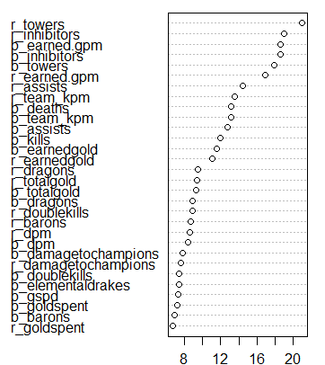
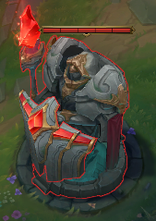
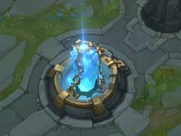
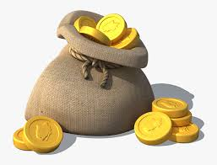
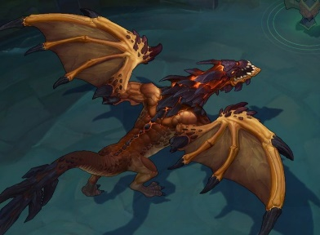

Recommendation and Insight
Topic 1: Recommendation on Resource Allocation
Tower and Inhibitor is always the focus, don’t forget the goal is to destroy the opposed base.
Figure: Feature importance obtained from the Random Forest model
Tower
Inhibitor
Gold Per Minute
The importance of dragon is larger than baron
Dragon
Baron
Notes:
Given the in-game data such as kills, deaths, gold and other resources, we get a significantly high accuracy in predicting the win-loss result. As stated before, it is because these features are mostly collected after the game, and some indicators, such as dragon, towels and barons are the ones that can largely influence the game result. Therefore, the accuracy might not be our key focus in the prediction model, especially using the data collected after the match ended. Nevertheless, we can still get the important information from the feature importance obtained from the Random Forest model. The resources, such as towers, inhibitors, golds, KDA, dragons, are the most significant ones that could affect the game result. But still, for E-sport, just like the traditional sport events such as basketball and football, though we might know which resources are the important ones, it is hard to predict players’ in-game status and performance, and that’s one of the reasons why sport is so charming - uncertainty.

Slide 12
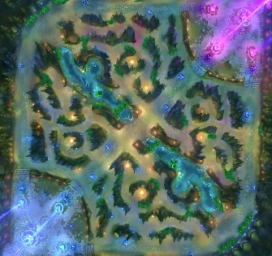
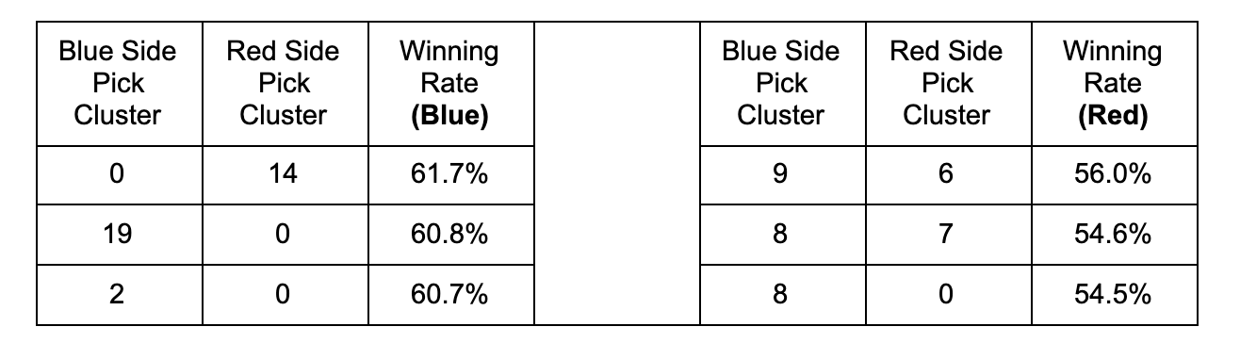











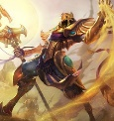









Recommendation and Insight
Topic 2: Recommendation on Pick Strategy
For the blue side and red side, if the opponent chooses a champion from one cluster, how can the team maximize the chance of winning by picking the natural enemy from another (or same) cluster?
Figure: Combination of the top 5 winning rates for each side (441 possibilities in total)
Cluster 0: 'Senna' 'Twitch' 'Jinx' 'Vayne' 'Taliyah'
Cluster 14: 'Kayle' 'Gangplank' 'Lillia' 'Evelynn' 'Zed' 'Azir'
ADC (Attack Damage Carry)
JNG
TOP
JNG
MID
Cluster 2: ‘Fiora’ ‘Irelia ‘Jax’ ‘Riven’ ‘Tryndamere’ ‘Camille’ ‘Aatrox‘ 'Tristana’ ‘Twisted Fate’
TOP (Fighters)
ADC/MID (Marksman/Mage)
Notes:
For the 21 clusters separated by principal component analysis, we would like to find out the restraint relationship between each cluster. In other words, for the blue side and red side, if the opponent chooses a champion from one cluster, how can the team maximize the chance of winning by picking the natural enemy from another (or same) cluster. As we have 21 clusters and two teams, the number of total combinations is 21^2 = 441 possibilities. And for each side, we demonstrate the combination of the top 3 winning rates.
Take a deeper look into the clusters, it makes more sense from the perspective of champions characteristic and positioning. For example, for the blue side if the opponent picks one champion from cluster 14 ('Gangplank' 'Evelynn' 'Azir' 'Lillia' 'Zed' 'Kayle'), it is better we have one champion from cluster 0 ('Senna' 'Twitch' 'Jinx' 'Taliyah' 'Vayne'). As the cluster 14 contains the champions who have high Damage Per Second (DPS) that can eliminate other’s ADC (Attack Damage Carry) champion instantly. However, the champions in cluster 0 are most of the ADC with self-protected skills.
The clustering result could also provide more insights in the ban & pick process. When the teams choose their champions, there might be the possibility of the desired ones being banned or picked by other teams. The clustering demonstrates several interesting characteristics of certain champions. For example, Tristana, which is tagged as a Marksman according to Riot, is performing more similar to many Fighters in cluster 2, rather than other Marksman in cluster 0,7 and 11. Tristana’s skill sets can deal a huge amount of damage to towers in a very short time, and at the same time she has skills to quickly escape. Thus, she can perform like a solo-lane champion like the others in cluster 2 who keeps pushing the lane, and destroying towers, while other Marksman would prefer to stay with support and farm safely.

Slide 13
Thanks for your time
Annan Chen ac4619
Jiepeng Lian jl5521
Jing Xiao jx2422
Qingyuan Ren qr2130
Zezuan Zhang zz2705

