Slide 1
AppLink BaaS平台
让移动开发更简单
致力于构建互联网创业生态圈 帮助创业者成功
Notes:
NNG award
+ MRC Certification on first slide

Slide 2
目录
什么是BaaS
AppLink
SWOT
市场分析
竞争性分析
现状
展望未来
联系方式
Notes:
Eyeblaster Analytics is not a product – it is what marketers call a Component Brand ‘- i.e. it is a self-branded subset of a product

Slide 3

BaaS Introduce
云计算的衍生
技术分工的产物
天下武功为快不破

Slide 4


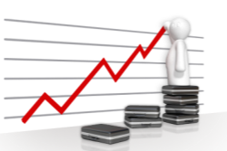



BaaS 的餐厅比喻
餐厅老板
=甲方
场地
=IssS（设施及服务）
餐厅
=PaaS（平台及服务）
决定餐厅菜色，服务，风格
决定应用功能，业务，类型
房地产商、商场
机房中心或阿里云
租赁场地
操作系统、虚拟服务器
菜单
=SaaS（软件及服务）
=APP或网站
工作团队
=服务团队
厨房
=数据服务
选择菜品，服务的媒介
应用提供服务，功能的界面
下单给厨房，端菜上桌子
数据管理，客户服务
订单变成菜品
用户数据加工
Notes:
Complimentary tools for different use cases
Campaign Monitor
One-click reporting (POWERPOINT GENERATOR)
Report Generator (ONLINE REPORTING)
Custom Report Builder- custom reports or service
Advanced Analytics (Plug-in for Excel)

Slide 5
BaaS 的餐厅比喻
装修
=应用开发
装修餐厅前场和后厨
开发APP的前端和后端
装修过程
=开发过程
木工、水工、电工、漆工干活
开发，设计，架构研发
厨房器件供应商
=BaaS（后端及服务）
水槽、炉灶、冰箱
数据处理服务
Notes:
Complimentary tools for different use cases
Campaign Monitor
One-click reporting (POWERPOINT GENERATOR)
Report Generator (ONLINE REPORTING)
Custom Report Builder- custom reports or service
Advanced Analytics (Plug-in for Excel)

Slide 6



BaaS(后端即服务)
应用后端技术整合
数据存储
统计
无服务器
移动技术集成（直播，通知，存储等）
优点
效率加快60%
成本降低60%
技术门槛减少
敏捷迭代
目标群体
互联网企业
创业团队
个人开发工程师
Notes:
Before the first thumbnail is scribbled on a napkin, you must define the goals of your campaign: What do you want to achieve, how much of it do you want to achieve, and what measurement best communicates the two? Once your goal is defined in terms of collectable data, ask how the creative execution drives towards that goal. And, when the campaign is finished, an in-depth data analysis is crucial to leverage your past experience to better optimise future campaigns. Increase your success metrics by basing your creative plan on sound analytical strategy.

Slide 7

BaaS的用户痛点——流于mBaaS
流程缺陷
仅支持移动，不支持整个解决方案
技术缺陷
不支持后台管理系统开发
不支持面向对象
无法解决实际业务问题
支持缺陷
价格缺陷
Notes:
Digital Advertising provides Agencies with something traditional channels have never been able to deliver—The ability to track and measure consumers interactions and engagement with your Brand Message.
However, as Digital advertising has evolved, with multi-channel campaigns, being tracked by disparate reporting systems, the amount and variety of metrics have increased to the point where Agencies are now drowning in a sea of information.
How do you stay afloat in, let alone take advantage of, the overwhelming amount of data that digital campaigns create?
Eyeblaster Analytics

Slide 8

AppLink BaaS
完全自主研发
创新的开发模式
不一样的BaaS
Notes:
Its a busy world and so much is fighting for our attention...
Times have changed. We are in the instant digital world. Its fast-paced learning. Time is now even more precious.
Now in this fragmented world it is about grabbing a few moments of my time.
We have to learn to build brand moments
We need a new way to measure those brand moments, we need to measure time!!
Reveals difference between interest and intent

Slide 9
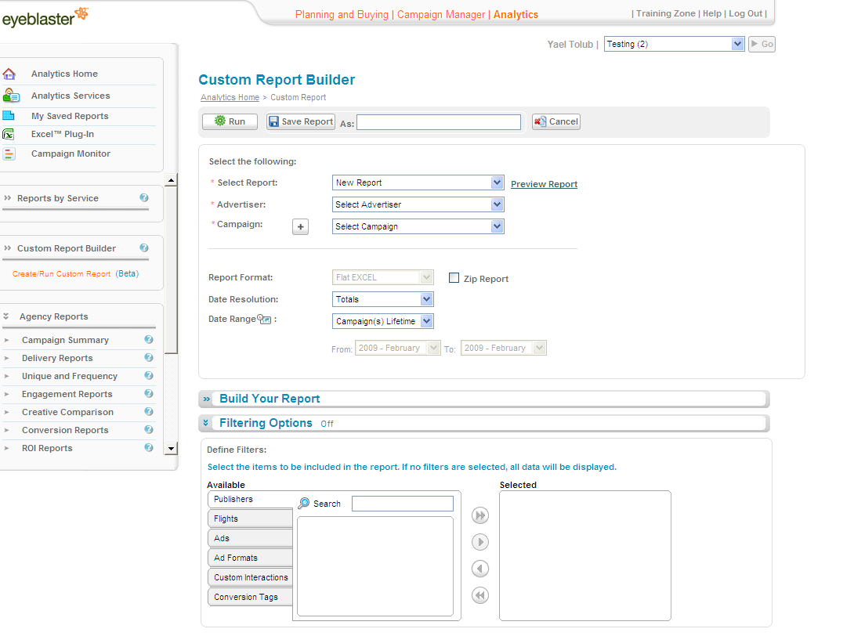
4大技术特性
基于数据模型驱动的敏捷开发模式
自动构建数据管理系统
可管理的数据接口访问控制权限
跨平台、跨技术、跨语言自动生成应用端接入代码

Slide 10




4大项目化特性
开源的独立化部署
自由接入第三方服务
面向开发者的免费云开发模式
开放性的云应用商店
© 2008 Eyeblaster. All rights reserved

Slide 11
五大市场
云开发平台
自动化构建数据管理系统
移动互联网敏捷开发框架
BaaS（Backend-as-a-Service，后端即服务）
知识共享的应用商店

Slide 12

Strength优势
自主研发
著作权、专利、Apache基金会
技术优势
提高效率、减少成本、降低门槛
竞争优势
专注早期、知识付费、免费
创始人
十年草根、优秀企业、技术广、行业广
Notes:
Digital Advertising provides Agencies with something traditional channels have never been able to deliver—The ability to track and measure consumers interactions and engagement with your Brand Message.
However, as Digital advertising has evolved, with multi-channel campaigns, being tracked by disparate reporting systems, the amount and variety of metrics have increased to the point where Agencies are now drowning in a sea of information.
How do you stay afloat in, let alone take advantage of, the overwhelming amount of data that digital campaigns create?
Eyeblaster Analytics

Slide 13

Weakness劣势 && Threat威胁
市场能力
缺少完成团队
缺少证明
经营企业经验
被抄袭的威胁
Notes:
Digital Advertising provides Agencies with something traditional channels have never been able to deliver—The ability to track and measure consumers interactions and engagement with your Brand Message.
However, as Digital advertising has evolved, with multi-channel campaigns, being tracked by disparate reporting systems, the amount and variety of metrics have increased to the point where Agencies are now drowning in a sea of information.
How do you stay afloat in, let alone take advantage of, the overwhelming amount of data that digital campaigns create?
Eyeblaster Analytics

Slide 14

Opportunity机会
政策与市场
互联网+下的中国互联网市场
技术趋势
软件开发的必然
需求在改变
企业IT服务化改革、创业者浪潮
BaaS市场不成熟
技术、方向的痛点
Notes:
Digital Advertising provides Agencies with something traditional channels have never been able to deliver—The ability to track and measure consumers interactions and engagement with your Brand Message.
However, as Digital advertising has evolved, with multi-channel campaigns, being tracked by disparate reporting systems, the amount and variety of metrics have increased to the point where Agencies are now drowning in a sea of information.
How do you stay afloat in, let alone take advantage of, the overwhelming amount of data that digital campaigns create?
Eyeblaster Analytics

Slide 15
Strength优势 Dwell Time?
average number of seconds the user engaged with the ad
including mouse-on-ad, user initiated expansion, user initiated video & timed custom interaction
Notes:
If I usually do something, and as a result I spent twice as long than the average on the page, it’s telling me something - Brand moment is being built.
If they are doing something as a result, it is telling me something. That that brand impact has not caused me to invest more of my time.
So how do we measure time? How do we give it a value? “Dwell Time” is the latest answer from Eyeblaster to try an answer online where TV currently fails – whether the user was in front of the TV or not. It is a solution to justifying the audience is actually taking in the message.
Not just what they did but for “how long” – it is “brand time” – a point of measurement that can show the impact on the audience where they are.
It goes much deeper then reach and frequency. It goes deeper than page open – all they do is show me exposure, not that I have a connected relationship.
The metrics advertisers should look at, for brand campaign, is reach (how many were consumers were affected) frequency (how many times) and dwell time (how long).

Slide 16
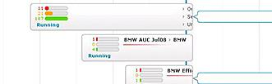
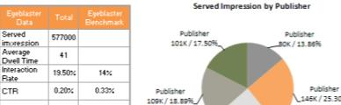
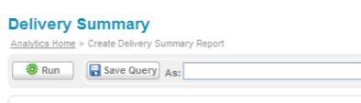
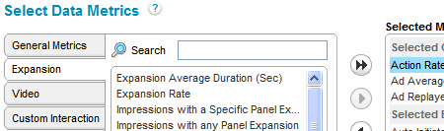
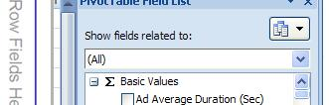

Making Data Actionable
Campaign Monitor
Report
Generator
One-click Reporting
Custom Report
Builder & Service
Plug-in for Excel
Data Feeds Service
Notes:
Complimentary tools for different use cases
Campaign Monitor
One-click reporting (POWERPOINT GENERATOR)
Report Generator (ONLINE REPORTING)
Custom Report Builder- custom reports or service
Advanced Analytics (Plug-in for Excel)

Slide 17
Metrics for Business Objectives
Delivery
Impressions
Clicks
Unique
Site/Publisher overlap
Engagement
Dwell
Interaction
Expansion
Video playback
ROI
Cost
Conversion tags
Notes:
Before the first thumbnail is scribbled on a napkin, you must define the goals of your campaign: What do you want to achieve, how much of it do you want to achieve, and what measurement best communicates the two? Once your goal is defined in terms of collectable data, ask how the creative execution drives towards that goal. And, when the campaign is finished, an in-depth data analysis is crucial to leverage your past experience to better optimise future campaigns. Increase your success metrics by basing your creative plan on sound analytical strategy.

Slide 18

Site Overlap
Back to Metrics slide
Accurately measure unique users by each publisher
When do publishers overlap to deliver multiple impressions to same user
Check your media buy: which publisher is overlapping with which
Notes:
Site Overlap. Accurately measure unique users contributed by each publisher. Identify when publishers overlap to deliver multiple impressions to the same user. Site Overlap provides clarity about the effect of each element of your media plan.

Slide 19
Dwell Time
Go beyond interaction
Build brand moments
Measure brand engagement
Notes:
Its a busy world and so much is fighting for our attention...
Times have changed. We are in the instant digital world. Its fast-paced learning. Time is now even more precious.
Now in this fragmented world it is about grabbing a few moments of my time.
We have to learn to build brand moments
We need a new way to measure those brand moments, we need to measure time!!
Reveals difference between interest and intent

Slide 20
What is Dwell Time?
average number of seconds the user engaged with the ad
including mouse-on-ad, user initiated expansion, user initiated video & timed custom interaction
Notes:
If I usually do something, and as a result I spent twice as long than the average on the page, it’s telling me something - Brand moment is being built.
If they are doing something as a result, it is telling me something. That that brand impact has not caused me to invest more of my time.
So how do we measure time? How do we give it a value? “Dwell Time” is the latest answer from Eyeblaster to try an answer online where TV currently fails – whether the user was in front of the TV or not. It is a solution to justifying the audience is actually taking in the message.
Not just what they did but for “how long” – it is “brand time” – a point of measurement that can show the impact on the audience where they are.
It goes much deeper then reach and frequency. It goes deeper than page open – all they do is show me exposure, not that I have a connected relationship.
The metrics advertisers should look at, for brand campaign, is reach (how many were consumers were affected) frequency (how many times) and dwell time (how long).

Slide 21
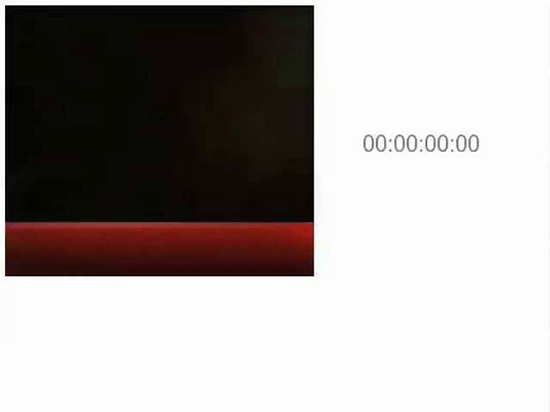
How it Works
Back to Metrics slide
Notes:
Accurately measures brand engagement in a way that is consistent with television and other media.
Our complex algorithm goes beyond interaction time
Considers user behavior and creative function to track how long the user truly engaged with the brand.
An effective analytic tool throughout the rich media spectrum – allow comparison across expandable, polite, with or without video.

Slide 22
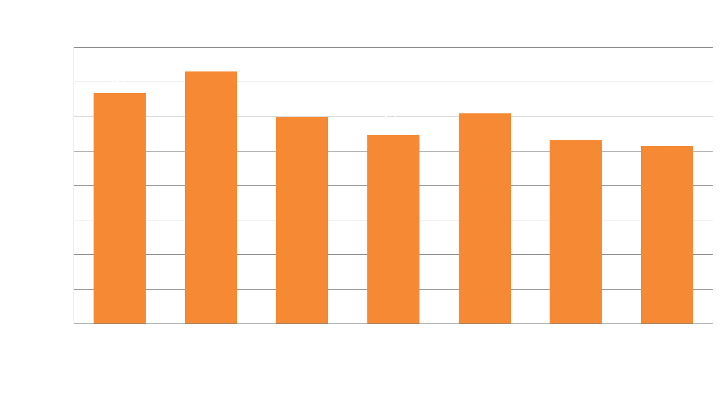
Day of the week
1 min
On average, weekday Dwell Time is 10 seconds longer than weekends*
* Weekdays (Mon – Fri): 62 Sec. Weekends: (Sat – Sun): 52 Sec.
Notes:
Dwell Time reveals a positive impact in favour of the brand and a new benchmark for brand building. Why? Because it addresses measuring those brand moments.
Dwell Time will help brand marketers bring more confidence back into digital and a step closer in to showing how to measure a brand online – and set new parameters which we will be able to move across to Digital TV.
And people are engaging with adverts – that is ACTIVELY INTERACTING with adverts for 1 minute!!
Twice as long as TV commercial, and guaranteed emotional involvement. This is absolutely key turning point for advertising…

Slide 23
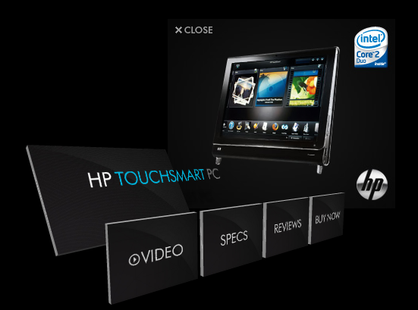
Hewlett Packard: 2008
“
Amazing execution. Clear calls to action and love the 3D effects. Have not seen an ad unit like this before. Hats off Eyeblaster and kudos to Goodby,. Is there anything you can not do?
Digital Design Professional
”
2 min
Notes:
So where are we now? Well following on from what we have learned in 2004, this is ad for 2008. Similar concept in terms of content on site, but in a way which is interesting for user to be involved with.
What is amazing is the average Dwell time was 2 minutes!!! 4x that of a TV advert!!!
Am amazing achievement to get users to stop what they were doing and immerse themselves in a brand experience for 2 minutes… If ever there was evidence for online effectiveness, this should be at the top of all the award tables!!!

Slide 24
Making Data Actionable
Campaign Monitor
Report
Generator
One-click Reporting
Custom Report
Builder & Service
Plug-in for Excel
Data Feeds Service
Notes:
Complimentary tools for different use cases
Campaign Monitor
One-click reporting (POWERPOINT GENERATOR)
Report Generator (ONLINE REPORTING)
Custom Report Builder- custom reports or service
Advanced Analytics (Plug-in for Excel)

Slide 25


Campaign Monitor
Campaign insights in real time
At-a-glance monitoring of key campaign data
Back to Solutions slide

Slide 26






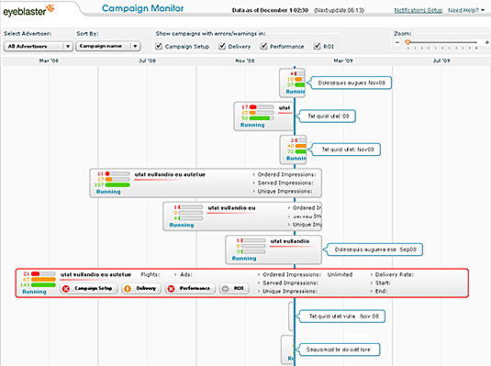
Campaign Ready, Set, Go
CM
1-Click
Report Generator
CRB
Plug-in for Excel
Data Feed
Back
Predefined
Custom
Instant access to Key Performance Indicators
View all campaigns at a glance
Detect problems quickly and easily
Gain control with real-time data
Campaign Monitor your window to the campaign
Notes:
Media plan in place
All systems ready
Check setup and delivery: if it started on time, delivery rate in line with planned,
Notify publisher immediately of any problems identified at outset
Continue monitoring during the course of the day throughout the campaign
What is the status – approved, pending? Has the Eyeblaster IO been signed? Has the flight started running? Monitor under- and over-delivery rates, Monitor served impressions, total clicks, CTR, interaction rate. Analyze behavior throughout campaign in real-time, Optimize on-the-fly. This feature is unique to Eyeblaster
Features:
Auto-refresh every 15 min
Setup status
Delivery status
Performance status
Status alerts
Manipulate fields to only monitor relevant info
Manipulate variables so reporting is set to your personal settings
Export to excel – show publishers what you need doing

Slide 27

One-click Reporting
Actionable insights at your fingertips
Prepare to impress
Back to Solutions slide

Slide 28
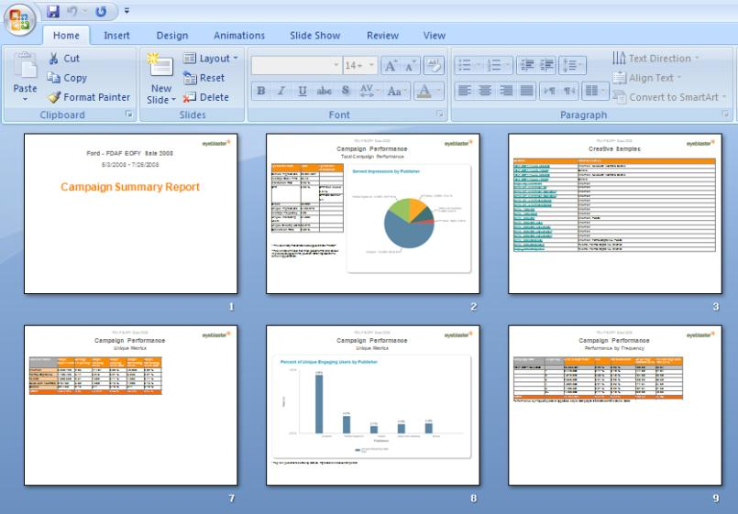
At the click of a button
CM
1-Click
Report Generator
CRB
Plug-in for Excel
Data Feed
Back
Predefined
Custom
Full Campaign Summary slide deck in standard PPT format
Visual representation of campaign performance data
“
We've taken the one-click PowerPoint summary and Excel data and made it our own for the client’s main campaigns this holiday season. We've received great feedback on these results, and it takes us far less time to pull everything together.
Alexia Paterson, MediaCom, Media Executive
”

Slide 29
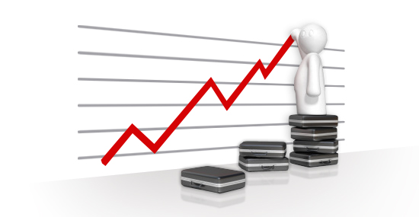
Report Generator
A complete campaign analysis package
Witness your data come to life
Back to Solutions slide

Slide 30
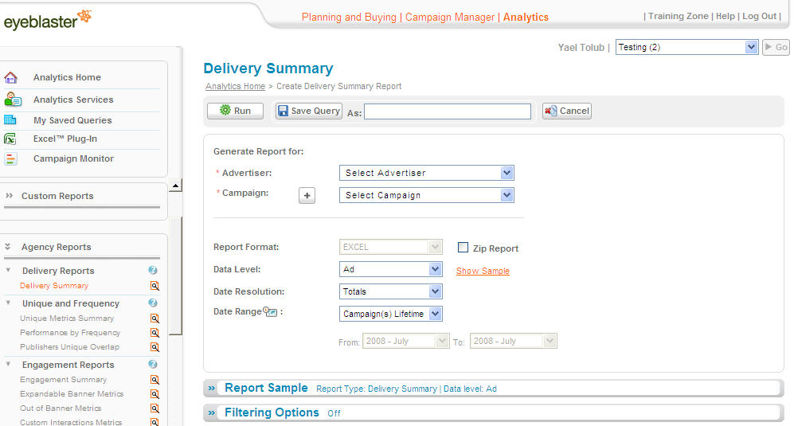
Made to measure
CM
1-Click
Report Generator
CRB
Plug-in for Excel
Data Feed
Back
Predefined
Custom
23 predefined reports, grouped into 8 simple categories
For agencies, publishers and creative shops
+ Embedded Benchmarks
+ Graphs
Notes:
On-Line Reports Benefits:
Quick and easy to generate with an intuitive UI
Saves time
Allows for advance analysis by guiding the user
Analytics V2 new items:
Campaign Summary: ppt and excel file that sums your entire campaign
Embedded Benchmark: puts your number into perspective
Graphs added to key reports, to allow for a faster understanding of your data.

Slide 31
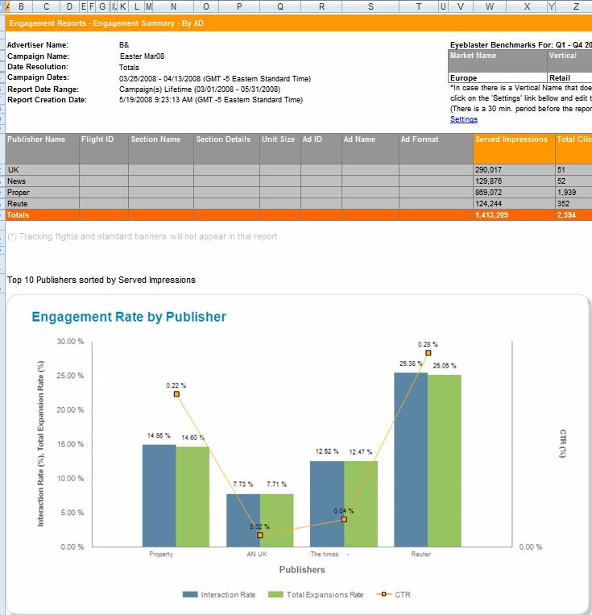
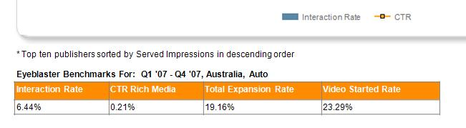
Made visual
CM
1-Click
Report Generator
CRB
Plug-in for Excel
Data Feed
Back
Predefined
Custom
Visual assistance of graphs embedded in reports
Selected Eyeblaster benchmarks embedded for comparison
Eyeblaster benchmark sample
Notes:
Time Saver
Gain better understanding of your campaign metrics

Slide 32

Custom Report Builder (CRB)
Freedom to create any report you want, instantly
The real solution to flexibility
A superb new user experience
Back to Solutions slide

Slide 33
Mix & Match
CM
1-Click
Report Generator
CRB
Plug-in for Excel
Data Feed
Back
Predefined
Custom
Select the metrics you need
Mix delivery, engagement and conversion data in one report
All delivered in flat Excel
Copy and paste the data to other sources

Slide 34
Stands out in the crowd
Ease of use complements innovation
Get it ad hoc or scheduled
Significant time saved
Use metrics available only in the CRB
Analysis made easy!
© 2008 Eyeblaster. All rights reserved

Slide 35
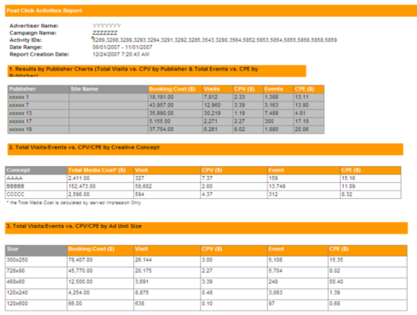
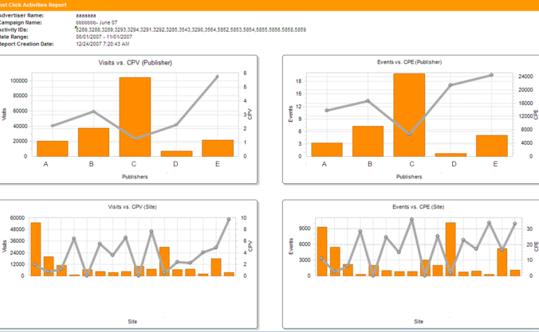
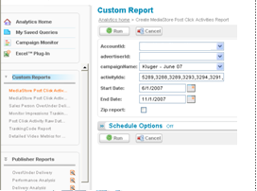
Custom Reporting Service
Back to Solutions slide
Define data structure
Tailored reports built for unique needs
Define required format
Define filtering options
Your list of custom reports available on-line
Notes:
Custom Report:
Is a tailored report built by professional service team for your unique needs. Once built, the report is available in the online reporting interface

Slide 36
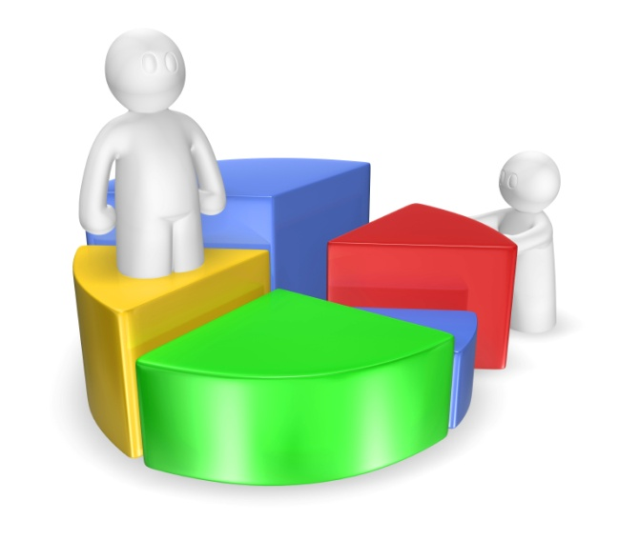
Plug-in for Excel
Advanced analytics for experienced users
Back to Solutions slide

Slide 37
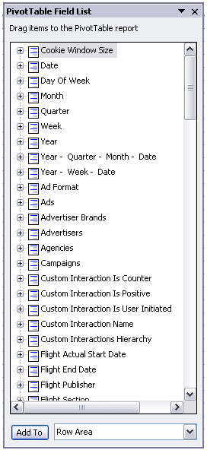
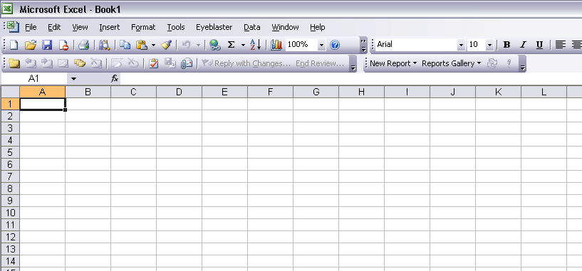
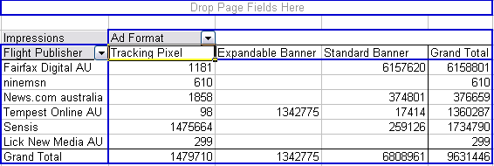
Slice and Dice
CM
1-Click
Report Generator
CRB
Plug-in for Excel
Data Feed
Back
Predefined
Custom
Perform exploratory, advanced analysis
Play around with the data
Pivot tables with all the account’s data
Actionable results are immediate
Notes:
available online and offline
change analysis criteria on the fly
flexible manipulation for advanced analysis
time saver: up-to-date with one click on “refresh”

Slide 38

Data Feeds Service
PPT模板下载：www.1ppt.com/moban/
Bespoke custom projects
All the data available in one place
Back to Solutions slide

Slide 39

Data Feeds Service
Transfer Eyeblaster data directly to your database
Integrate data automatically into any analytics systems
Data is transported in a secured way, and monitored 24/7
See the full picture in one place
© 2009 Eyeblaster. All rights reserved
Notes:
No need to manually combine data – get your Eyeblaster data automatically consolidated into any system you desire
See the full integrated picture in your favorite place (i.e. your internal analysis tools or database).

Slide 40
Eyeblaster Analytics
Accountability & measurability across media to ensure ad expenditure is giving results
Deeper, actionable analysis in less time
More effective campaigns, increased ROI

Slide 41
Thank you
Rumor has it that competitors consider Eyeblaster Analytics as the golden standard in the industry. www.1ppt.com
Contact us to find out more.

Slide 42



可以在下列情况使用
不限次数的用于您个人/公司、企业的商业演示。
修改模板中的内容包括，图片，数据，文本的替换。
拷贝模板中的内容用于其它幻灯片母版中使用。
不可以在以下情况使用
用于任何形式的在线付费下载。
收集整理我们发布的免费资源后，打包上传并
用于各种形式的付费下载。
收集整理我们发布的免费资源后，刻录光碟销售。
PPT模板下载：www.1ppt.com/moban/ 行业PPT模板：www.1ppt.com/hangye/
节日PPT模板：www.1ppt.com/jieri/ PPT素材下载：www.1ppt.com/sucai/
PPT背景图片：www.1ppt.com/beijing/ PPT图表下载：www.1ppt.com/tubiao/
优秀PPT下载：www.1ppt.com/xiazai/ PPT教程：www.1ppt.com/powerpoint/
Word教程：www.1ppt.com/word/ Excel教程：www.1ppt.com/excel/

