Slide 1
HOSPITALS IN LIMA DISTRICT
Coursera Capstone Project

Slide 2
INTRODUCTION
The coronavirus COVID-19 pandemic is the defining global health crisis of our time and one of the greatest challenges we have ever faced. Since its beginnings in Asia, it has spread to most countries in the world.
Peru is one of the most affected nations by COVID-19, being in the top 10 countries with most cases as of June 2, 2020.

Slide 3
INTRODUCTION
BUSINESS PROBLEM:
The government of Peru has organized a group of data scientists to analyze the COVID-19 positive cases in the city of Lima and select a district to open a new hospital. Lima is the capital city of Peru, and it holds 60% of the total positive cases in the country.
Analyzing the data, which districts would the team recommend opening a new hospital?

Slide 4
DATA
To solve this problem, the team has set up to find the following data:
List of districts in Lima, Peru. This encompass the whole project.
Latitude and Longitude of the districts in Lima, Peru. We need this information to plot the map and get the hospitals nearby.
COVID-19 positive cases in Lima per district.
Hospitals in Lima per district.

Slide 5
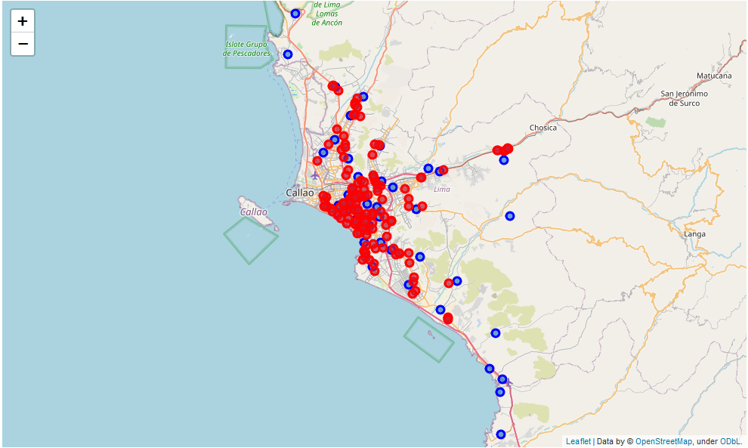
DATA ANALYSIS

Slide 6
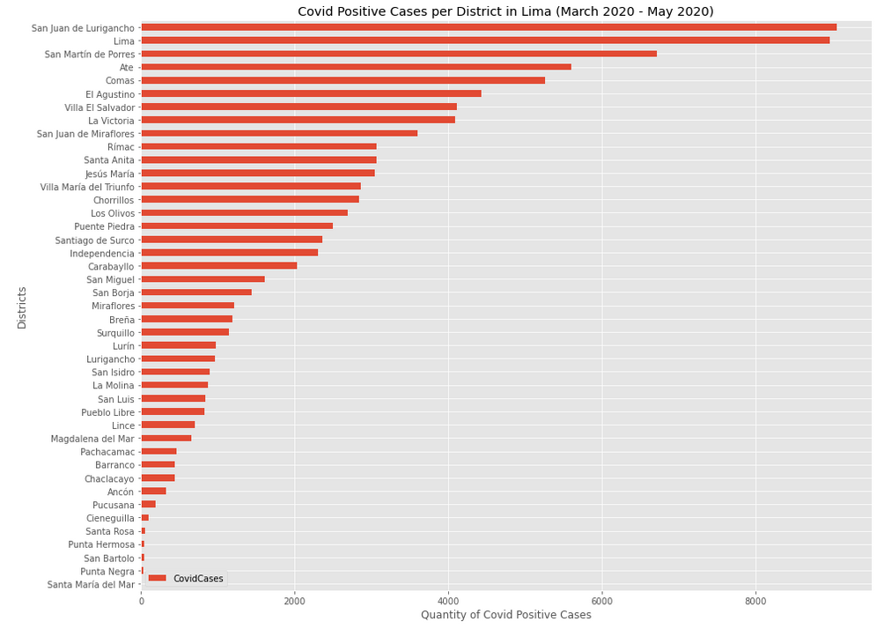
DATA ANALYSIS

Slide 7
DATA ANALYSIS

Slide 8

MACHINE LEARNING

Slide 9
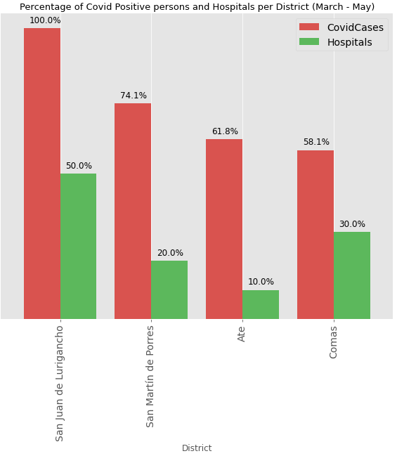
RESULTS
Q: Analyzing the data, which districts would the team recommend opening a new hospital?
A: The district that need new hospitals amidst this pandemic are San Juan de Lurigancho, San Martin de Porres, Ate and Comas.

Slide 10
DISCUSSION
ON FOURSQUARE API:
Very messy data
Outdated data
App not really used in Lima
Multiple locations with same name
ON COVID-19:
Data is updated daily
Project needs updated data to be relevant.
Data from the government might be unreliable

Slide 11
CONCLUSION
The government of Peru now has the answer to their problem.
The 4 districts of Lima, Peru have been set as a priority to build new hospitals and fight the pandemic.
This project has a lot of room for improvement. We can aggregate a lot more factors to do our decision like Pharmacies, population, transit of people, and much more.

Slide 12


