Slide 1
PRICE TRACKER / FALL 2026
Know when your game hits your price
A shared watchlist for Steam games,
with target-price alerts.
REAL PRICES / PRIVATE WATCHLIST / WEB + ANDROID
Status · 09 Nov 2026
Local integration verified; hosted demo pending.
PRICE TRACKER / COP 4331C
01 · Alex · 35s
Notes:
Alex — 35 seconds. Open with the problem: players repeatedly check prices or miss a target. Price Tracker tracks a supported Steam base game and alerts when its selected Steam offer meets the user’s target. State that hosted demonstration is pending as of November 9.

Slide 2
TEAM & OWNERSHIP
Five people, one shared product
Alex
Lead, integration & Flutter · @aluciencozy
Martin
React, TypeScript & Tailwind · @Martaino
Ibrahim
MongoDB, infrastructure & tests · @IbrahimShaqqou
James
Express authentication & API · @MageOfLight
Nick
CheapShark matching & email adapters · @NickTheBrick04
PRICE TRACKER / COP 4331C
02 · Alex · 40s
Notes:
Alex — 40 seconds. Introduce the five meaningful areas of work, not a claim of equal commit counts. GitHub issues and pull requests organize work. Each person explains their own area in this presentation.

Slide 3
PROBLEM & SCOPE
One specific offer, not any low price
01 IDENTIFY
02 COMPARE
03 ALERT
Parse a supported Steam app URL locally.
Use the exact Steam offer in USD, not the all-store low.
Notify when the user’s target is met; avoid repeats.
No DLC, bundles, guessed editions, or physical retailers in the MVP.
PRICE TRACKER / COP 4331C
03 · Nick · 40s
Notes:
Nick — 40 seconds. The MVP is US/USD individual base games, starting with Steam URLs and CheapShark. We match a Steam app to a CheapShark game and select the Steam store offer. A missing match or offer is unsupported, not another store’s price.

Slide 4
SYSTEM ARCHITECTURE
Two clients, one source of truth
CLIENTS
SHARED API
PERSISTENCE
React + Tailwind
Flutter / Android
→
Express + Node.js
TypeScript
→
MongoDB / Mongoose
owned data
PRICE SOURCE
DELIVERY
CheapShark · Steam
Email + Android push
PRICE TRACKER / COP 4331C
04 · James · 35s
Notes:
James — 35 seconds. React and Flutter call the same Express/Node TypeScript API. MongoDB holds accounts, trackers and durable delivery state. The API alone talks to CheapShark and notification adapters. GitHub supports project collaboration; the scheduler must run independently of clients in deployment.

Slide 5
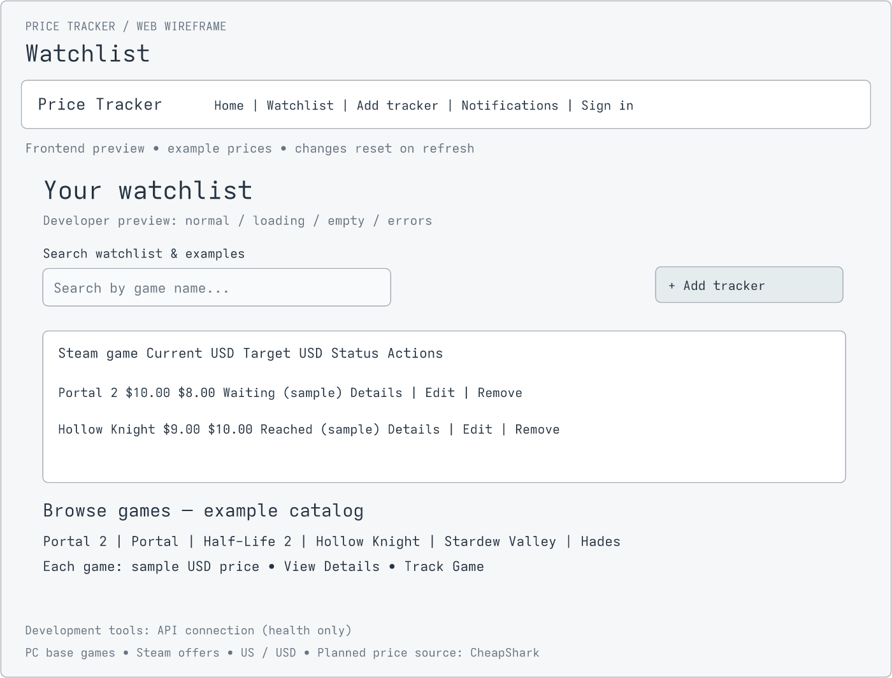
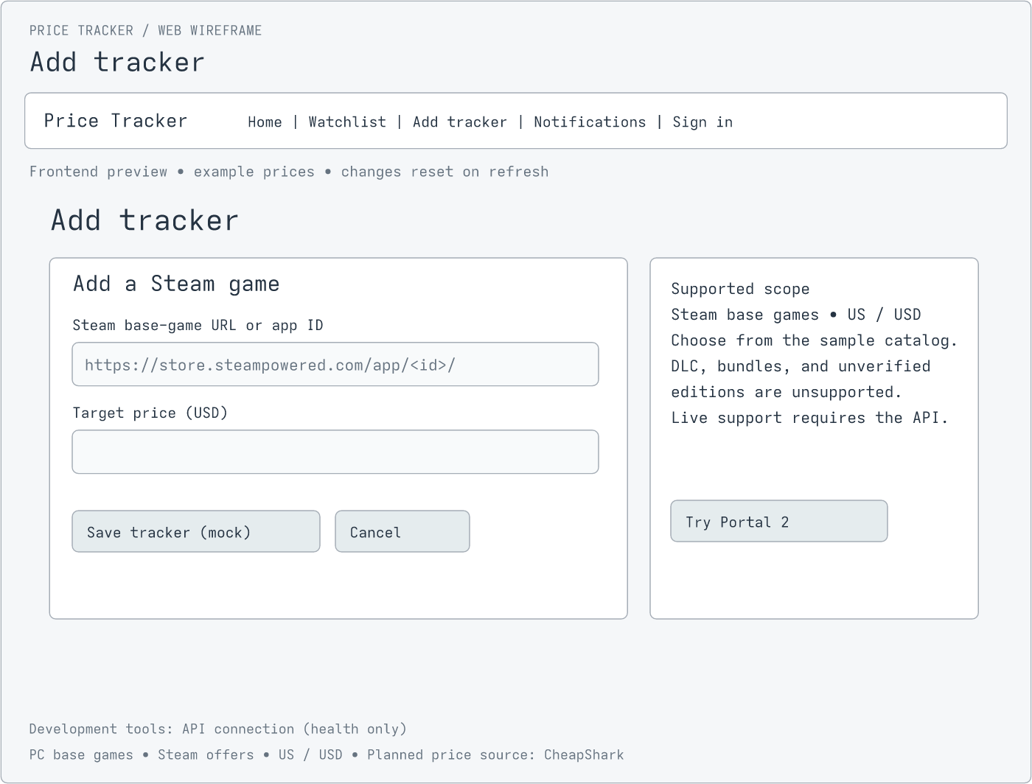
PROTOTYPE EVIDENCE
From early wireframes to the product
EARLY WIREFRAME / WATCHLIST
EARLY WIREFRAME / ADD
Sketch prices are illustrative, not live quotes.
PRICE TRACKER / COP 4331C
05 · Martin · 25s
Notes:
Martin — 25 seconds. These are existing early web wireframes, not screenshots of the current app. They show the watchlist and add flow. The live web and Android walkthrough follows later; no fictional mobile prototype is represented here.

Slide 6
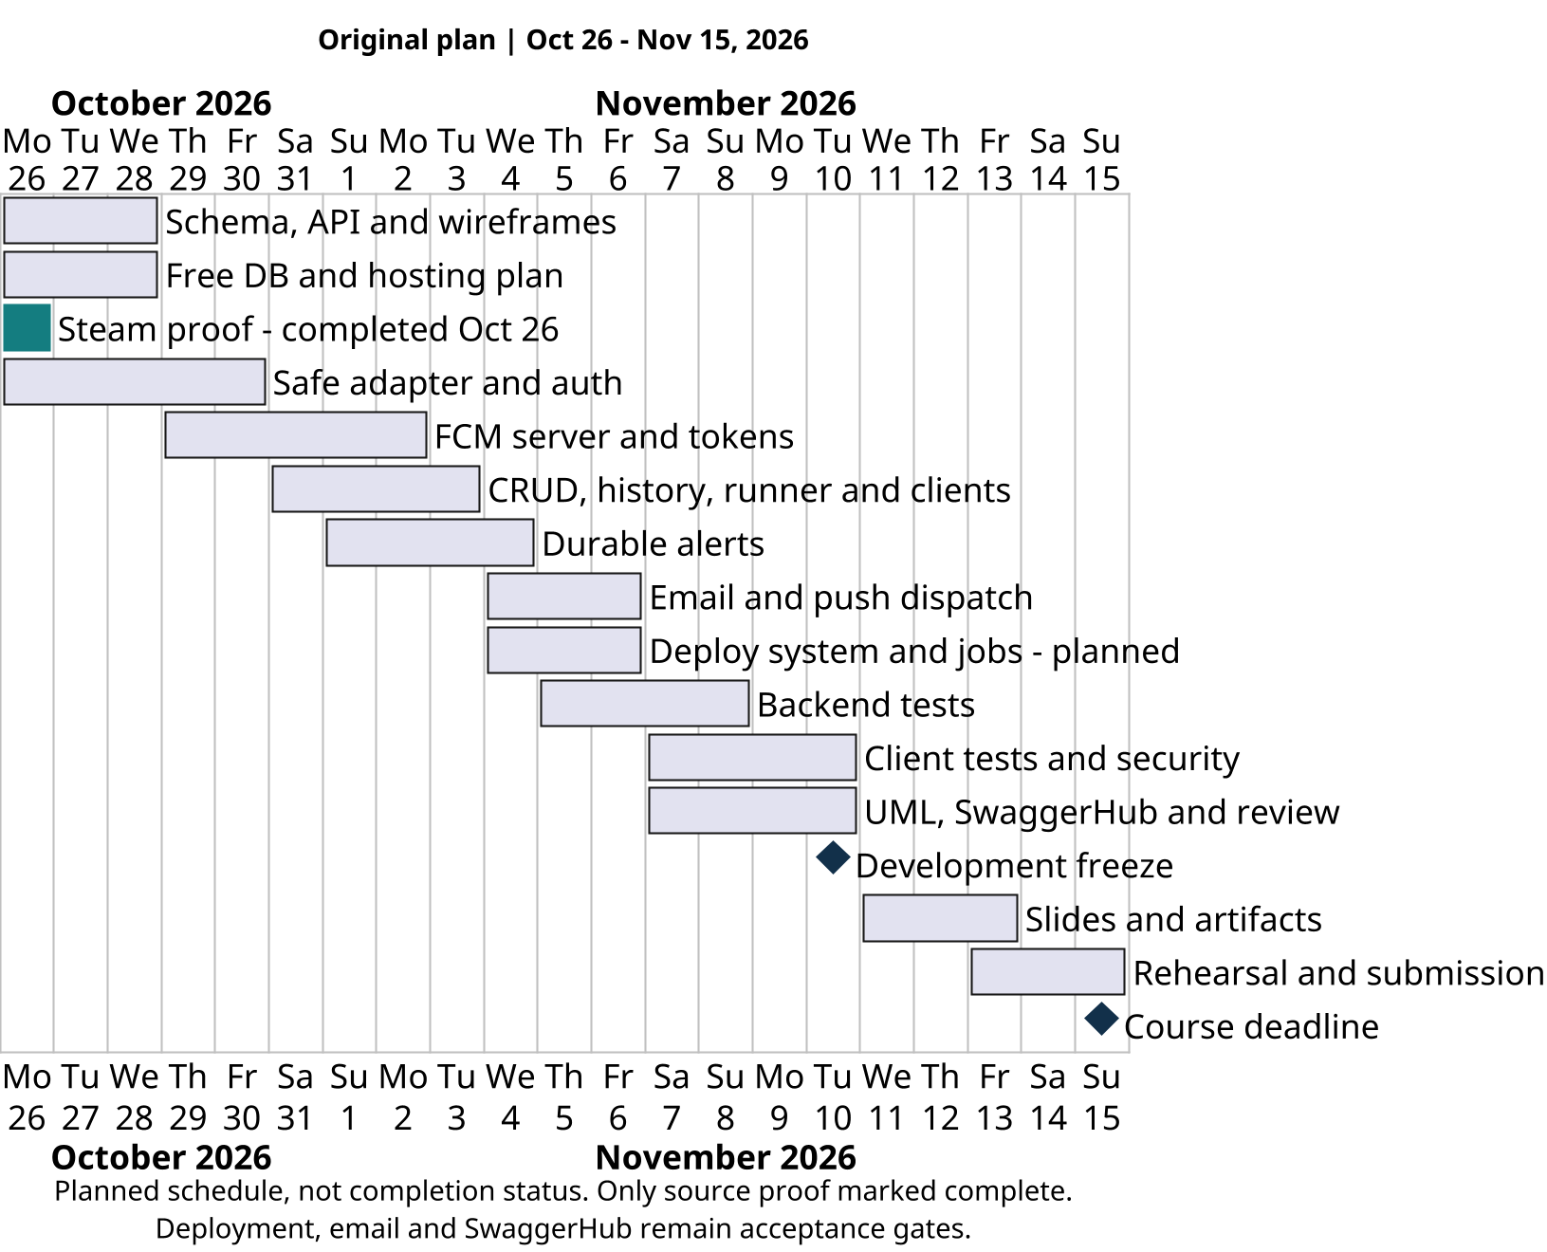
SCHEDULE · PLANNED, NOT ACTUAL
The planned path to delivery
Planned schedule · Oct 26–Nov 15, 2026
PRICE TRACKER / COP 4331C
06 · Ibrahim · 25s
Notes:
Ibrahim — 25 seconds. This is the October 26 to November 15 plan from the project schedule, not a claim that all milestones completed. Foundations, tracking, test/freeze and presentation preparation overlap. Hosted acceptance remains open.

Slide 7
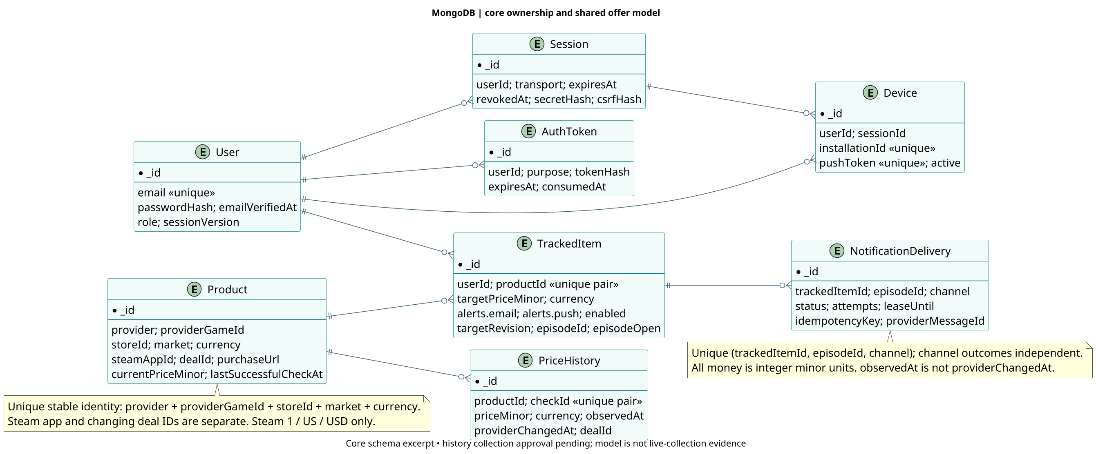
DATA MODEL · ERD
Shared offers, private tracking
Shared products; user-owned targets and delivery state
PRICE TRACKER / COP 4331C
07 · Ibrahim · 40s
Notes:
Ibrahim — 40 seconds. Explain that a shared game/store offer can be tracked by multiple users, but each tracked item belongs to one user. History records successful observations and notification deliveries are keyed per episode and channel.

Slide 8
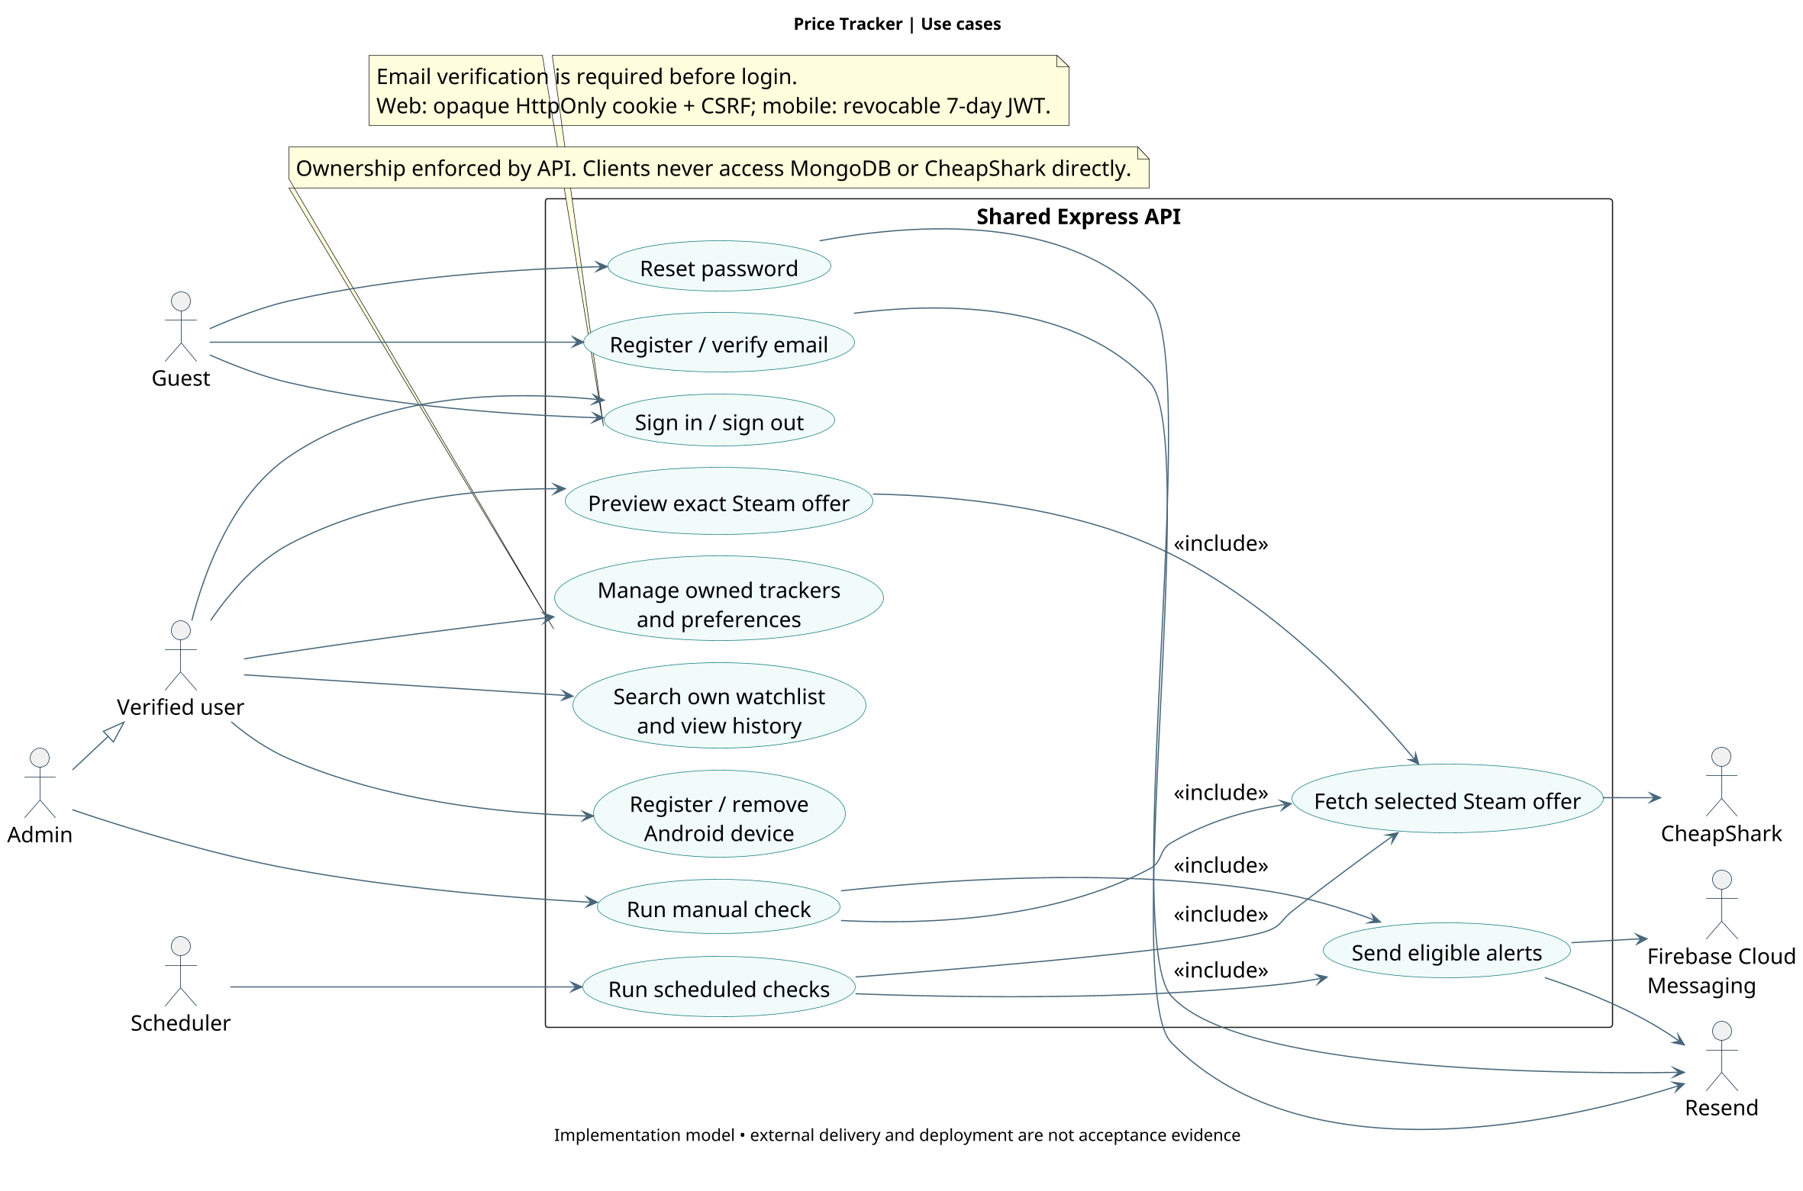
USE-CASE DIAGRAM
What users and administrators can do
The administrator’s manual check is separate from ordinary user actions
PRICE TRACKER / COP 4331C
08 · Martin · 25s
Notes:
Martin — 25 seconds. The user manages a private watchlist and notification preferences. The administrator runs a manual check; ordinary users cannot trigger unrestricted upstream checks.

Slide 9
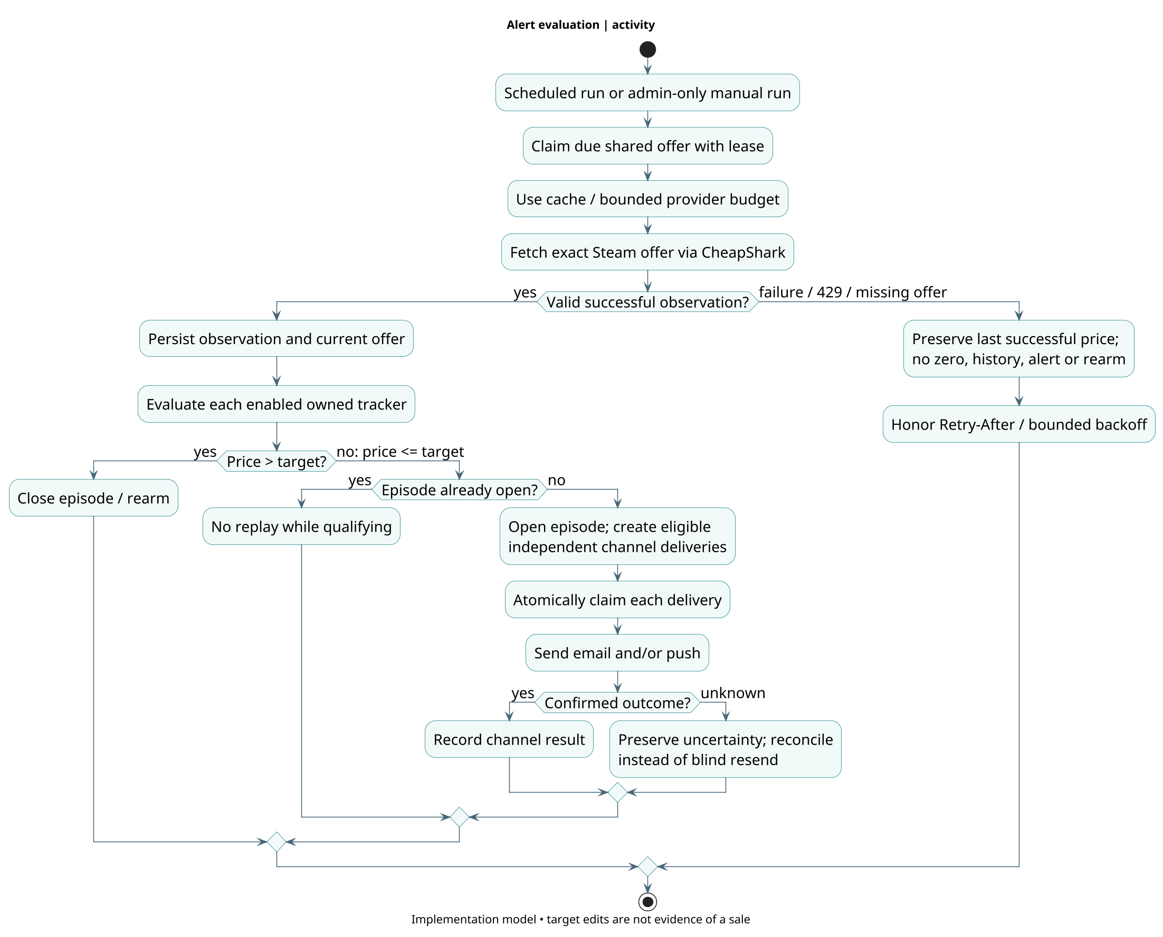
ACTIVITY DIAGRAM
A successful check is not a repeat alert
A failed fetch is not a zero price
PRICE TRACKER / COP 4331C
09 · Nick · 25s
Notes:
Nick — 25 seconds. Walk through the decision, not every box: fetch the selected Steam offer, preserve the last valid observation if the request fails, and evaluate the target only after a successful observation.

Slide 10
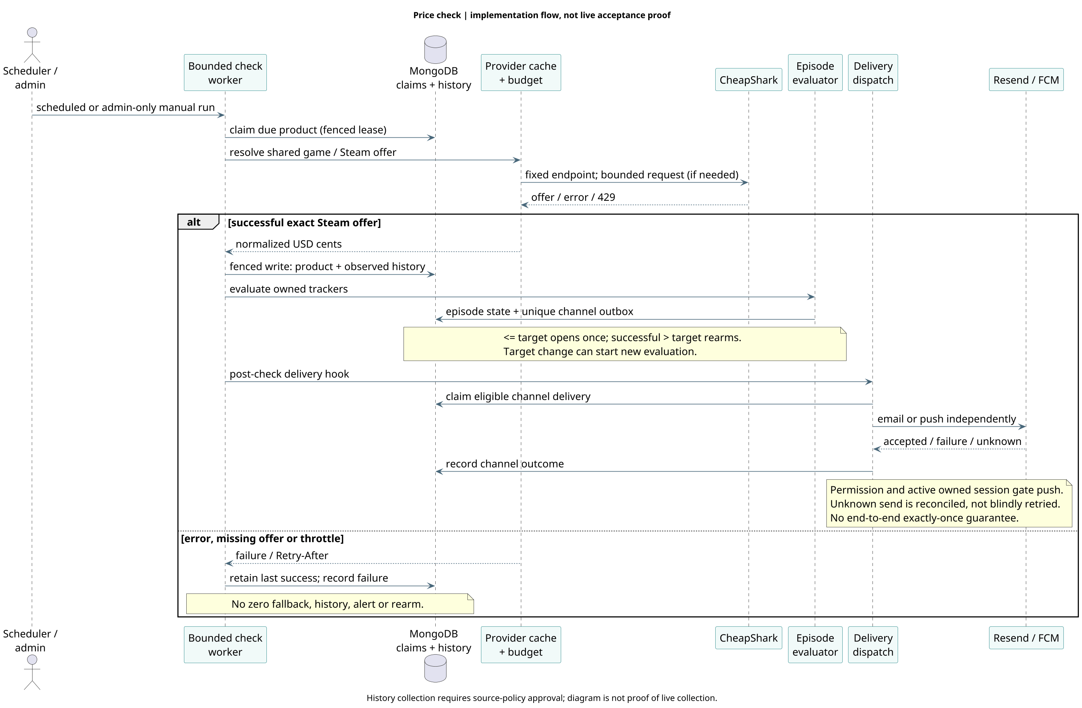
SEQUENCE DIAGRAM
From price check to delivery
Episode and per-channel records survive retries and restarts
PRICE TRACKER / COP 4331C
10 · Nick · 30s
Notes:
Nick — 30 seconds. The check service updates an observation, evaluates the qualifying episode and records channel deliveries before sending. Email and push are independent. Uncertain external outcomes need reconciliation, not a claim of exactly-once delivery.

Slide 11
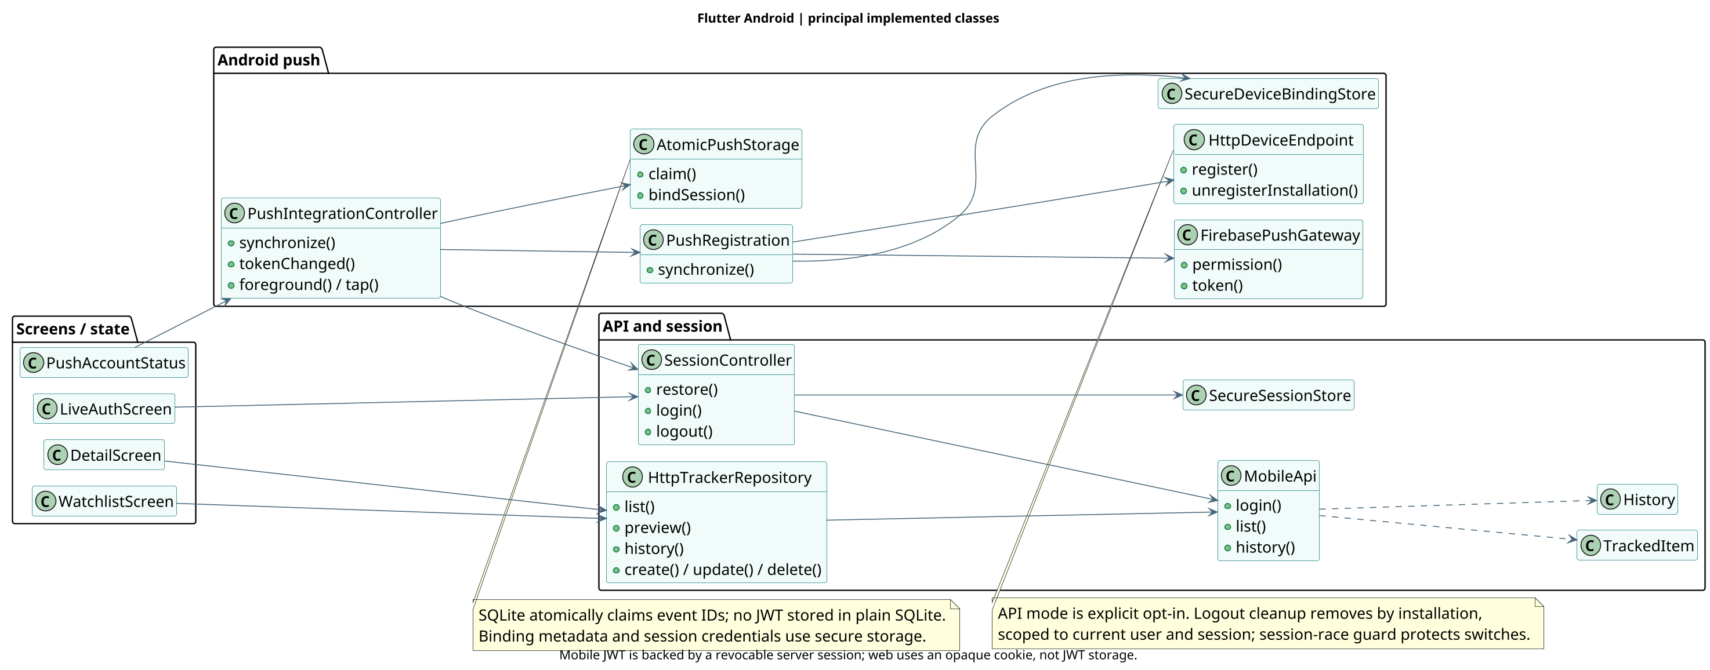
FLUTTER CLASS DIAGRAM
Mobile separates screens from data
Flutter uses the same API and ownership rules as web
PRICE TRACKER / COP 4331C
11 · Alex · 25s
Notes:
Alex — 25 seconds. The mobile app uses a repository/API boundary rather than connecting to MongoDB or CheapShark directly. Explain the relationship between presentation, repository, session and device notification responsibilities.

Slide 12
AUTHENTICATION & PRIVACY
Security at the boundaries
IDENTITY
SESSIONS
OWNERSHIP
Verified email before login; hashed passwords and single-use reset tokens.
Web: HttpOnly cookie + CSRF. Mobile: revocable JWT.
Server scopes private resources to the signed-in user.
PRICE TRACKER / COP 4331C
12 · James · 35s
Notes:
James — 35 seconds. An unverified user cannot log in. Passwords are strongly hashed; verification and reset tokens are hashed and single-use. Web uses an opaque HttpOnly cookie and CSRF protection. Mobile uses a seven-day JWT backed by a revocable server session. Every private query enforces ownership.

Slide 13
UNIT & INTEGRATION RESULTS
Tests are evidence, not deployment
700 / NODE
237 / FLUTTER
LOCAL QA
17 contract · 409 API
274 web
Format, analysis and tests passed
Cross-client ownership and Android lifecycle
Not a hosted end-to-end or real email acceptance claim.
Recorded validation: Nov 2026 · PR #61 open against Staging
PRICE TRACKER / COP 4331C
13 · Ibrahim · 40s
Notes:
Ibrahim — 40 seconds. At the recorded local validation, npm run check passed 700 tests: 17 contract, 409 API, 274 web, plus lint, typechecks and builds. Flutter had 237 passing tests, format and analyze. Local cross-client and Android device checks add integration evidence, not hosted acceptance. Eight FCM sends were accepted, seven receiver arrivals verified; the last post-permission duplicate arrival remains unverified.

Slide 14
SWAGGERHUB DEMO / CONFIGURE URL BEFORE PRESENTING
Live API: authenticate, then search
01 POST /api/auth/mobile/login
02 GET /api/tracked-items
Verified account → accessToken
Password entered live
?q=por&limit=20
Bearer token → owned search
CONFIGURE: published SwaggerHub URL + HTTPS API domain
PRICE TRACKER / COP 4331C
14 · James · 60s
Notes:
James — 60 seconds. CONFIGURE the published SwaggerHub URL and HTTPS API base before rehearsal. Demonstrate exactly two endpoints: POST /api/auth/mobile/login using a verified test account; enter the password live, never in slides or notes. Copy the returned accessToken into a temporary SwaggerHub Bearer authorization, then GET /api/tracked-items?q=por&limit=20. Show that search is server-side, partial and ownership-scoped. Clear temporary authorization afterward. Verify both endpoints live before rehearsal. If unavailable, state the demo is blocked; a recording or local endpoint does not fulfill the requirement.

Slide 15
HOSTED APP DEMO / CONFIGURE DOMAIN BEFORE PRESENTING
Live web: the watchlist workflow
ACCOUNT
WATCHLIST
Register / verify / reset
Sign in with verified account
Search · add · edit target
Preferences · remove
CONFIGURE: verified live application domain
PRICE TRACKER / COP 4331C
15 · Martin · 65s
Notes:
Martin — 65 seconds. On the approved HTTPS domain, briefly show the landing and login or registration entry, explain verification and reset, and sign in with an already verified test account. Show owned watchlist, server partial search, add or edit a supported game target and preferences, then removal if time permits. Never reveal credentials. Change a target without calling it a price drop. No localhost or fixture demo substitutes for the required hosted application.

Slide 16
HOSTED APP DEMO / DEVICE READY
Live Android: the same account and data
SHARED STATE
NOTIFICATIONS
Refresh on Android
See the same owned tracker
Per-game email / push
Real delivery only when verified
CONFIGURE: Android build + approved live API
PRICE TRACKER / COP 4331C
16 · Alex · 60s
Notes:
Alex — 60 seconds. On Android connected to the approved HTTPS API, show the same verified account and watchlist, refresh and show the web change, and explain notification preferences. Show real alert delivery only after sender, history, scheduler and push gates have been approved and verified. A changed target is not a price drop. Local Android QA is supplemental evidence, not a substitute for hosted demonstration.

Slide 17
RETROSPECTIVE
What we learned & what remains
WENT WELL
WAS DIFFICULT
STILL OPEN
Shared API + fixtures enabled integration and privacy checks.
Scope pivot, provider throttling and Android lifecycle races.
Hosted acceptance, SwaggerHub and real alert gates.
Questions / 50 seconds
PRICE TRACKER / COP 4331C
17 · Ibrahim · 65s
Notes:
Ibrahim — 65 seconds. What went well: a shared API and offline fixtures let clients and server integrate and privacy issues were found during cross-client QA. What was difficult: the pivot from physical retailers to games, provider 429 limits, and Android session/permission lifecycle races. Fixes were tested locally. The remaining gates are approved HTTPS deployment, remote database and independent job, SwaggerHub publication, verified sender and real history/alert approval. Ask for questions for 50 seconds after this slide.

