Slide 1
Unemployed archaeologists of the future
Engaugeus

Slide 2
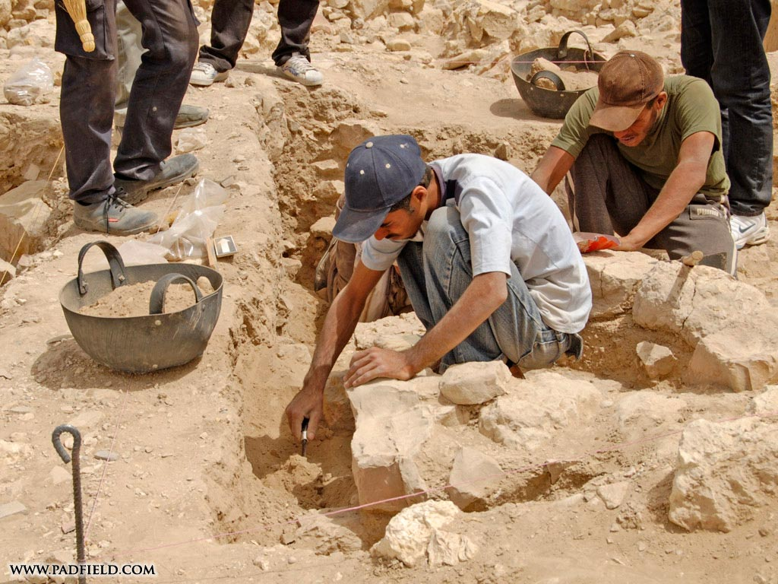
Artifacts of the future

Slide 3
The Facts of Today
Average weekday circulation fell 7%, the most since 2010, the most since Great Recession!
Advertising revenue experienced its greatest drop since 2009, falling nearly 8% from 2014 to 2015
In 2014, the Newspaper Association of America (NAA) stopped releasing industry-wide revenue data.

Slide 4

The Possibility of the Future
Modernise the traditional news format with a traditional modern format.
Communitize the news space, make it engaging wanting people to return.

Slide 5

Engaugeus
Getting us engaged

Slide 6
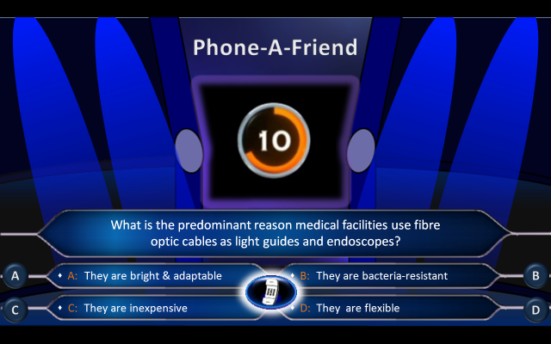
Ideation and Design
Research
Brainstorm

Slide 7
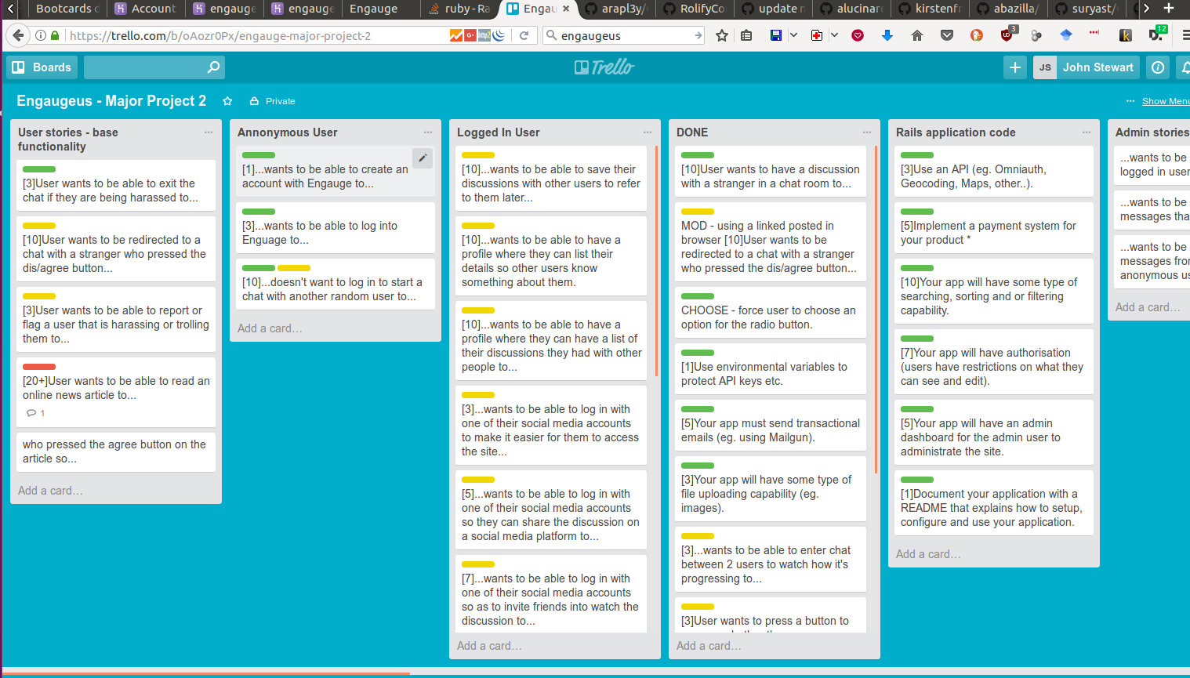
User stories & Agile Metho

Slide 8
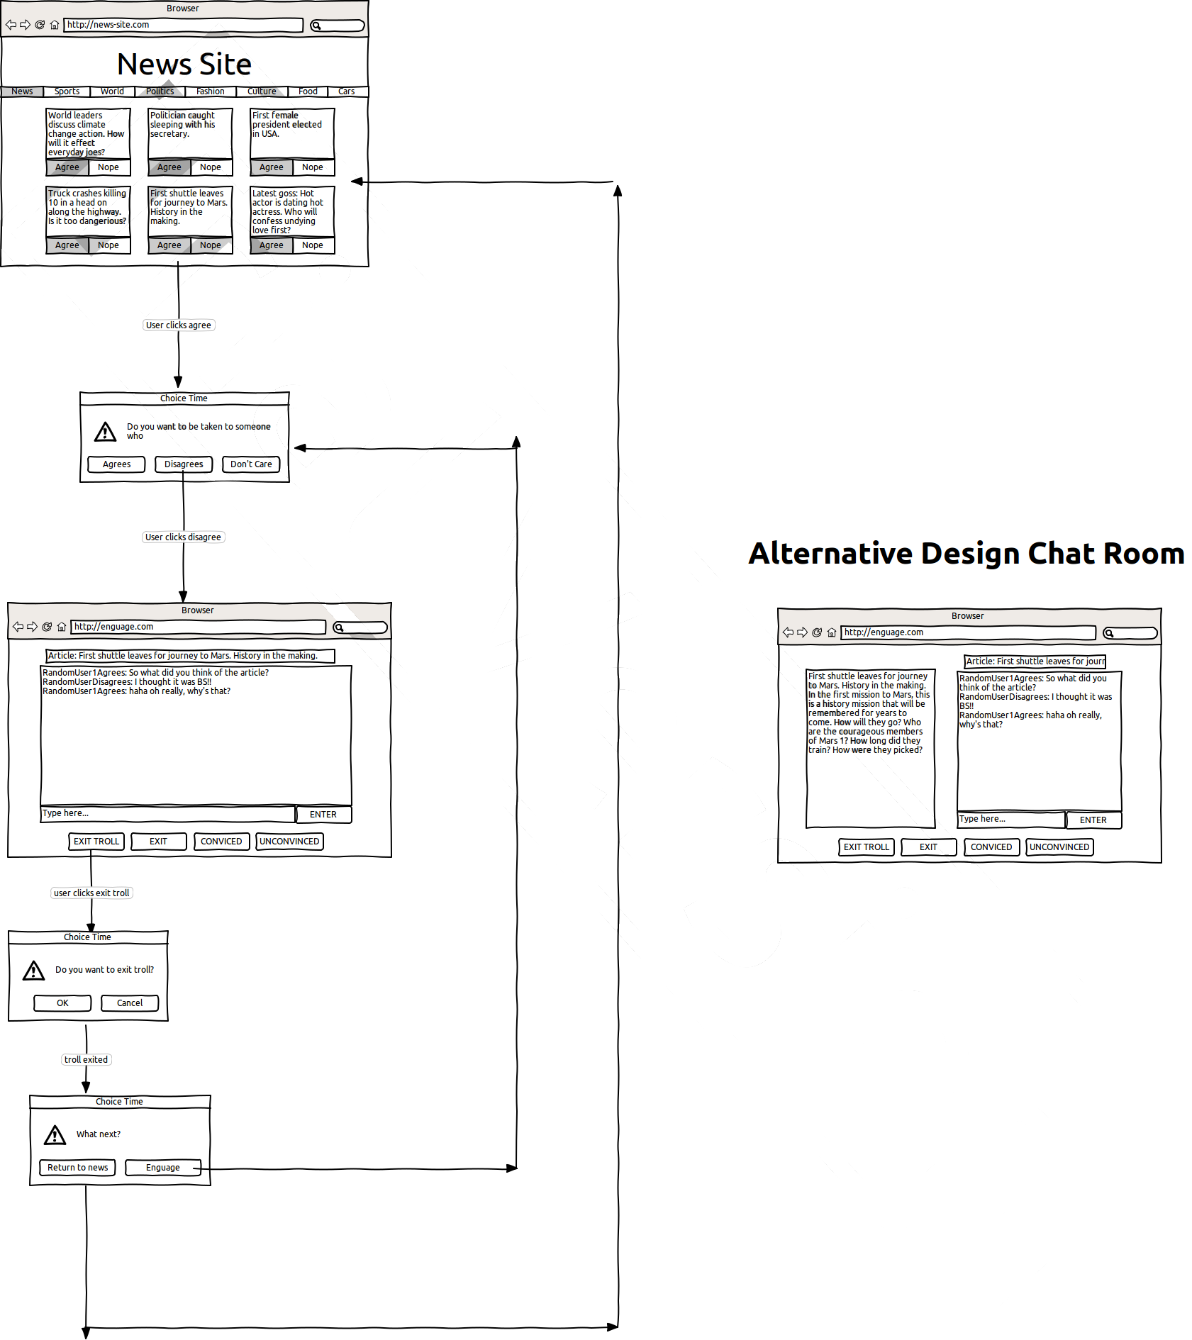
User flow

Slide 9
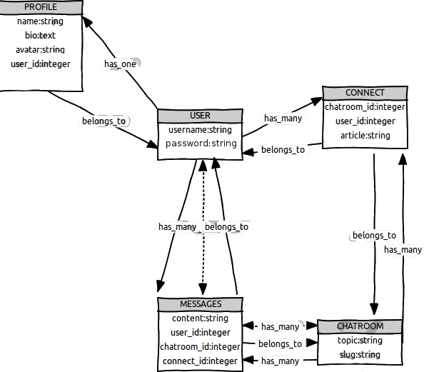
ERD

Slide 10
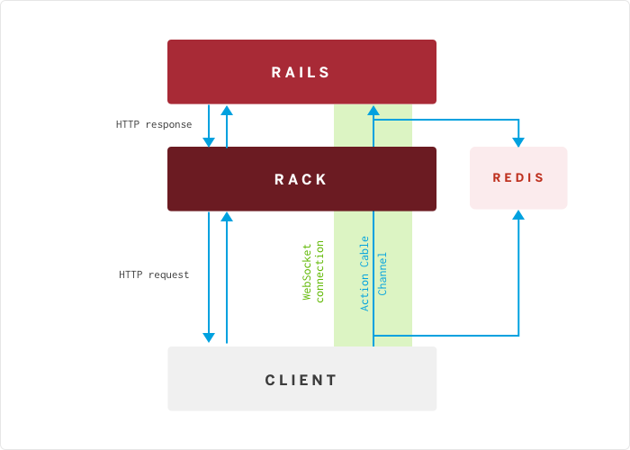
Websockets

Slide 11

Time to play!

Slide 12
Implementation Challenges
Agree and disagree tag for users in chat.
User login creation.
ERD modelling – the connects model was unclear.

Slide 13
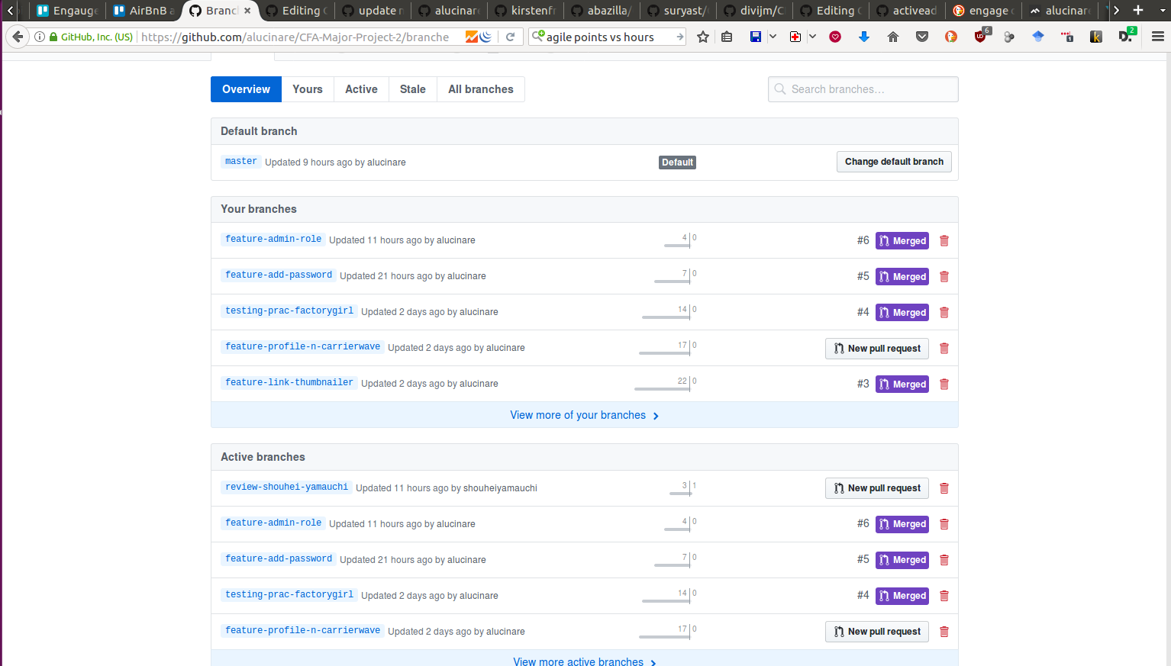
Git Hub

Slide 14
To infinity and beyond!!
Gamify: A engauger will get more points/badges depending on how often they discuss, how many votes they have gotten for their comments, etc.
Convince button: This is a button that an engauger presses to show that another engauger has convinced them of their point of view.
Natural Language Processing: This can be a way for the news site to better understand their audience by processing the public engaugements.

Slide 15

No more archaeologists

Slide 16
