Slide 1
UltraSonic Sensor
Architecture, Functionality, and software control

Slide 2
Architecture
Working Voltage− 5V DC
Quiescent Current − <2mA
Working Current − 15mA
Working Frequency − 40Hz
Effectual Angle − <15°
Ranging Distance − 2cm – 400 cm/1″ – 13ft
Resolution − 0.3 cm
Measuring Angle − 15 degree

Slide 3
Functionality
Uses travel time and speed of the sound to calculate distance
Uses IO trigger for at least 10us high level signal
The Module automatically sends eight 40 kHz and detect whether there is a pulse signal back
IF the signal back, through high level , time of high output IO duration is the time from sending ultrasonic to returning
Test distance = (high level time×velocity of sound (340M/S) / 2

Slide 4
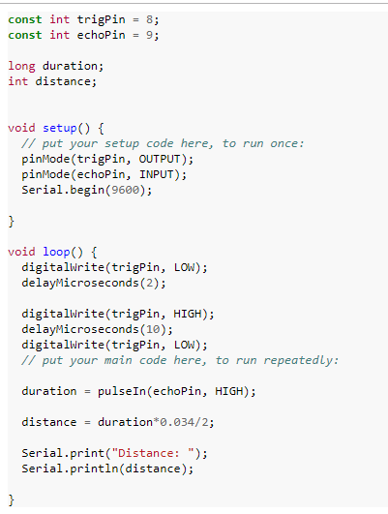
Software control

