Slide 1
Request Tracker (RT)
Abhishek Gupta

Slide 2
Overview/Benefits
System is used to report problems to, or request services from, various groups within DWIT, and some other departments/faculties.
Tracks and keeps record of the request (centralized)
Manage the entire workflow
Adds transparency
Efficient and Effective request-response cycle, since requester is along the process

Slide 3
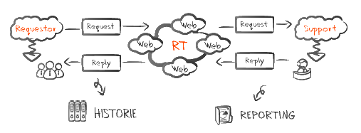
Workflow

Slide 4
Users
Students
Faculty
Departments/ Groups/ Staff - Moderators
Administrators

Slide 5
DEMO

Slide 6
Features

Slide 7
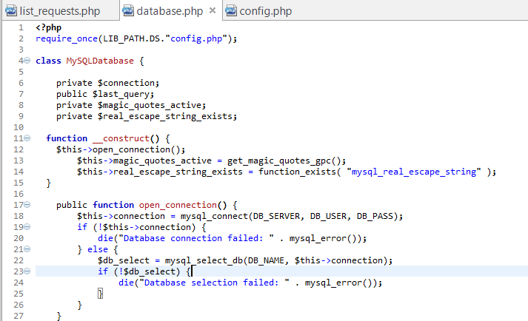
Configure the system
USER - Admin

Slide 8
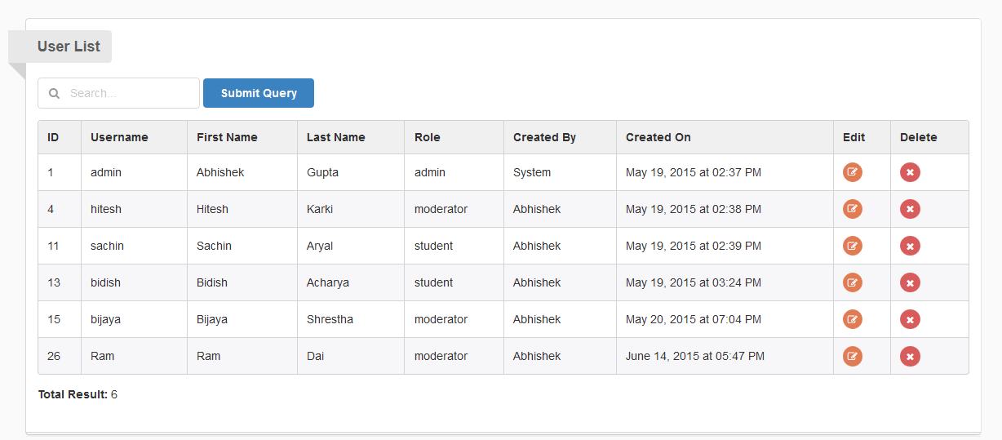
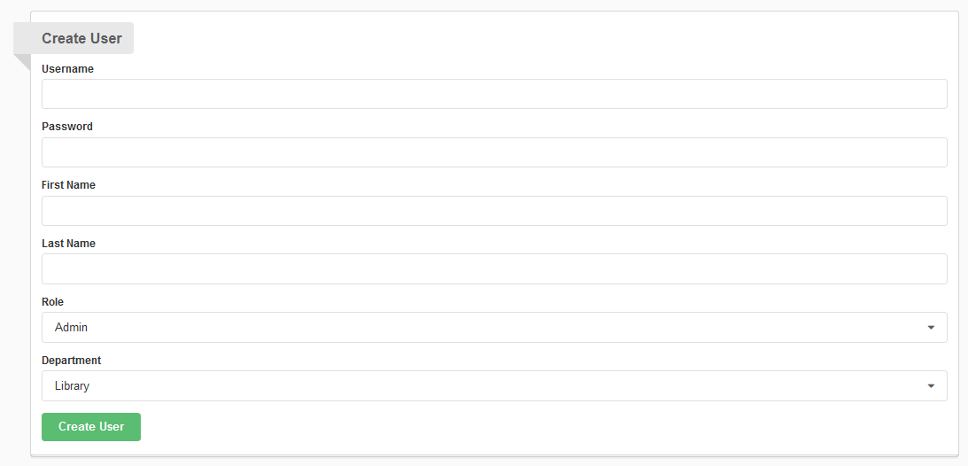
User Credentials Management
USER – Admin

Slide 9
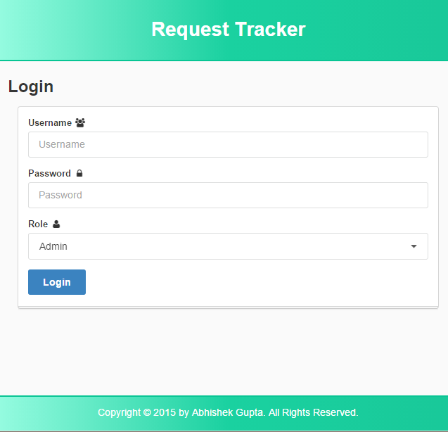
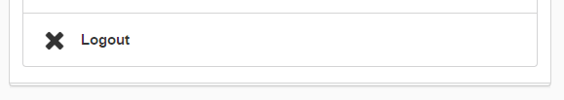
Login/Logout
USERS – Admin, Moderator, Students

Slide 10
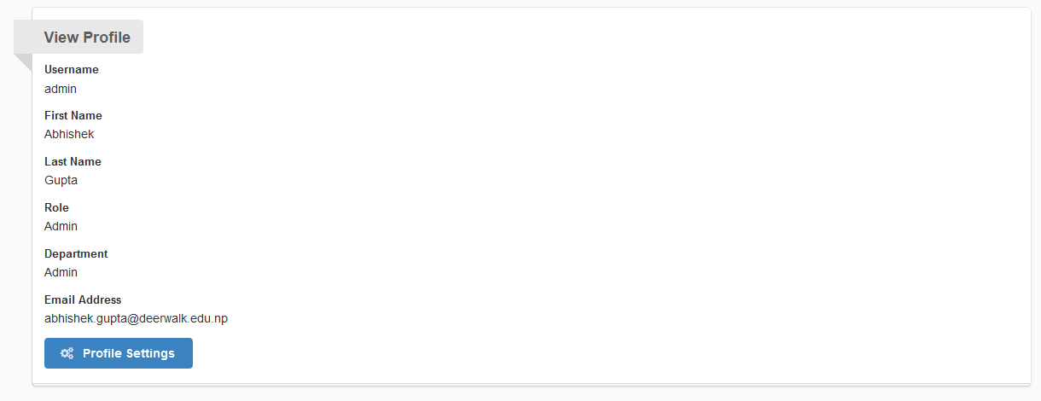
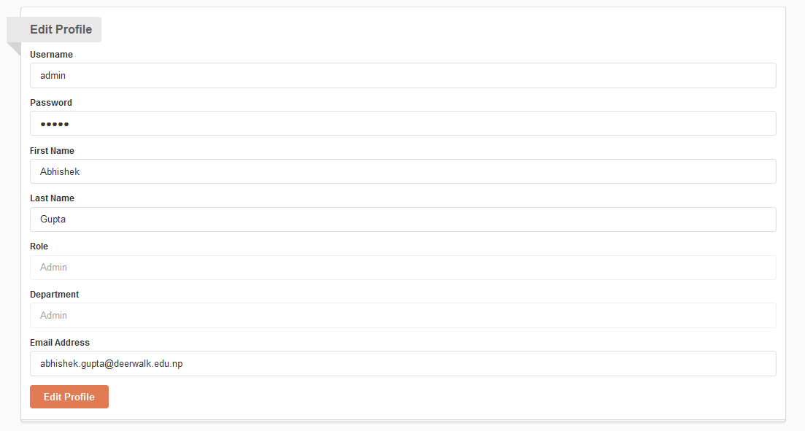
Profile
USERS – Admin,
Moderators,
Students

Slide 11
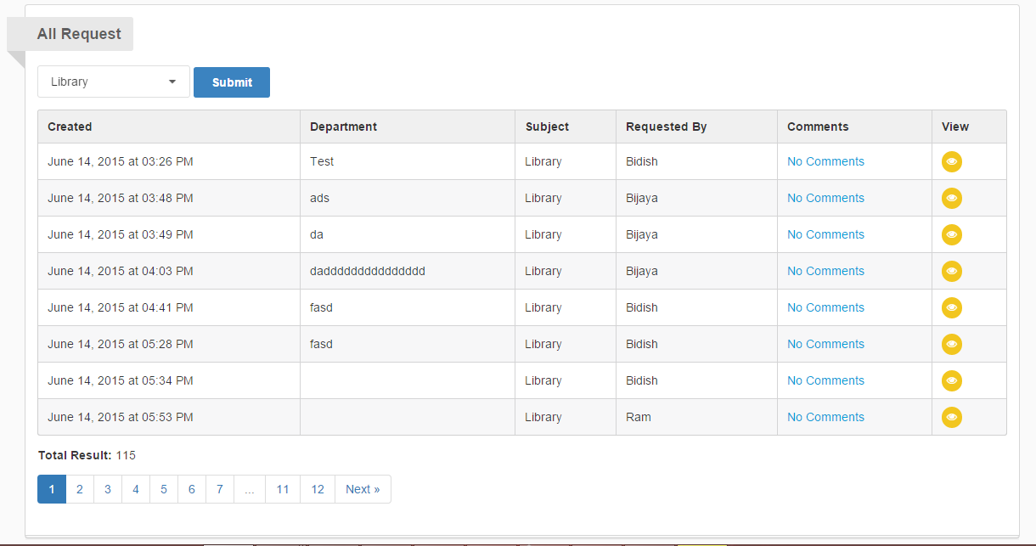
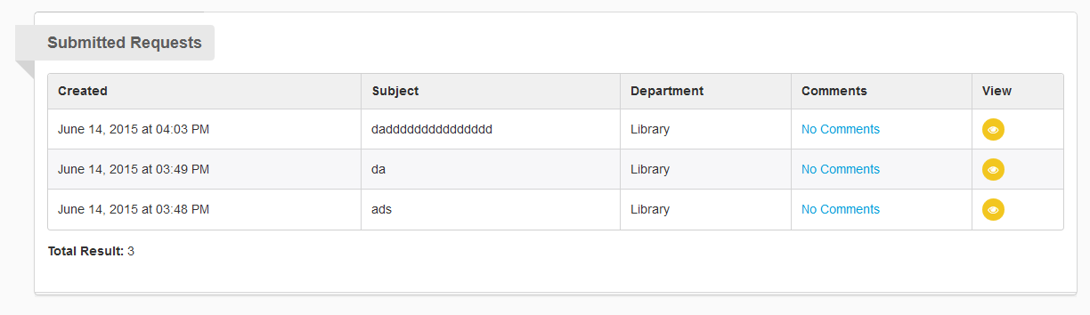
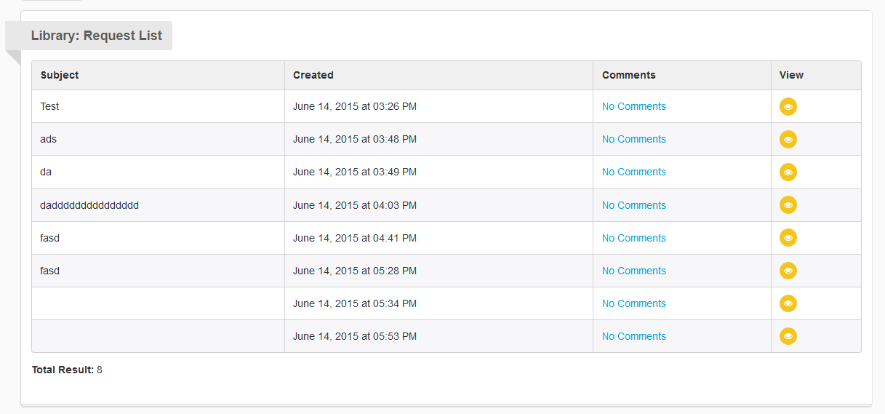
Request
USERS – Admin,
Moderators,
Students

Slide 12
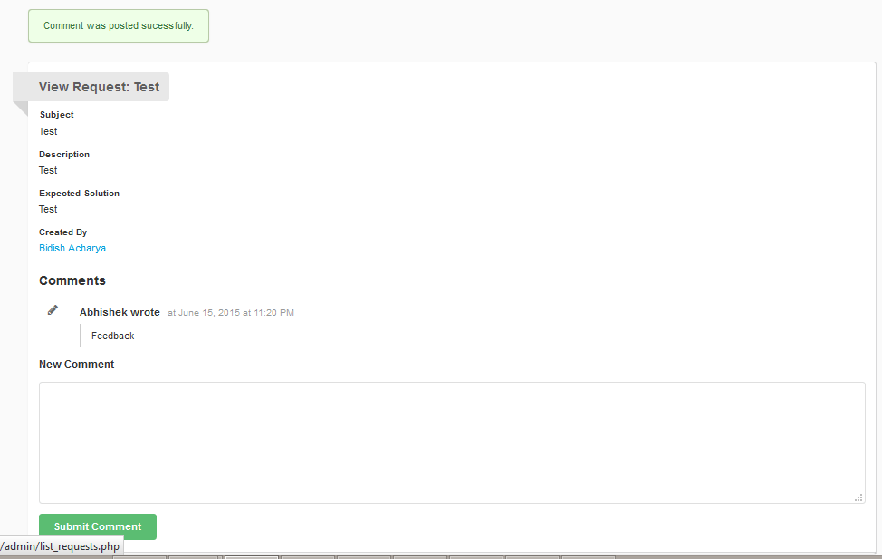
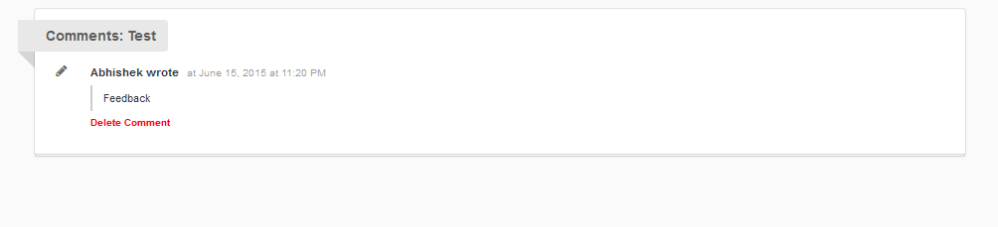
Comment
USERS – Admin,
Moderators,
Students

Slide 13
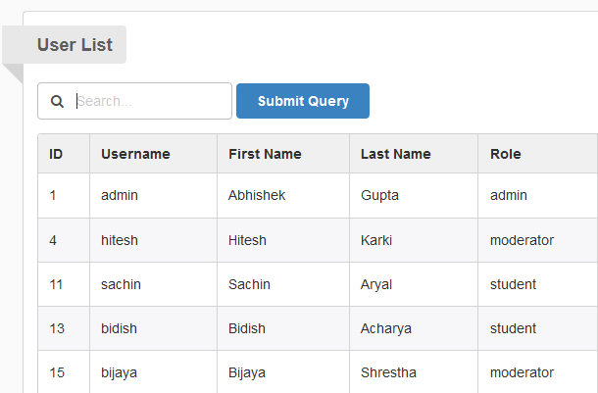
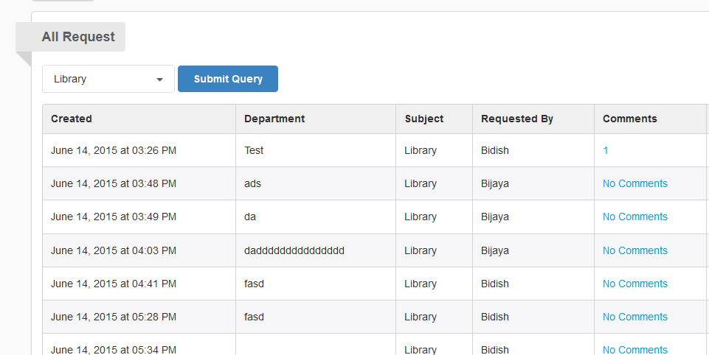
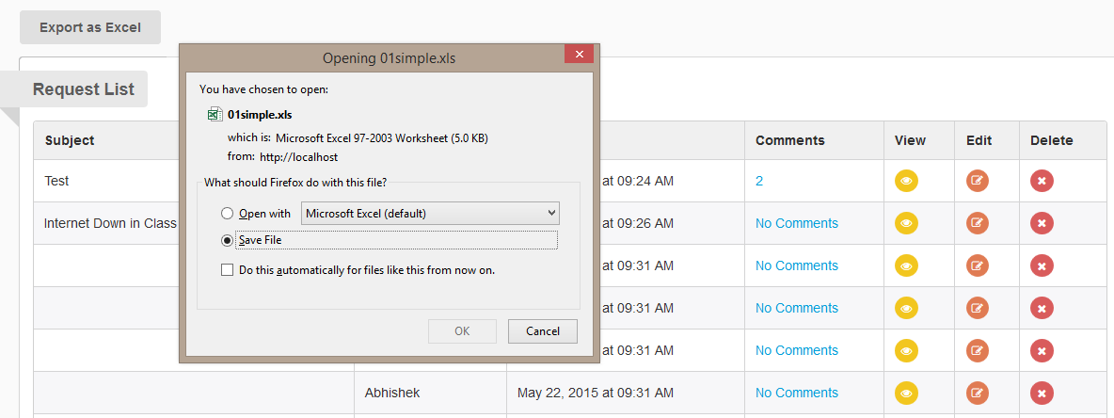
Search/Sort/Export
USERS – Admin,
Moderators,
Students

Slide 14
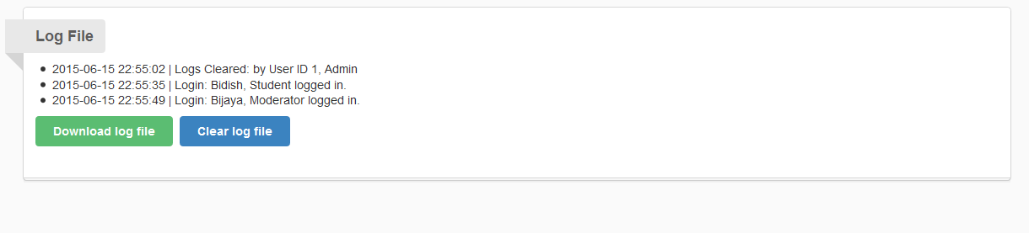
Logs
USER – Admin

Slide 15
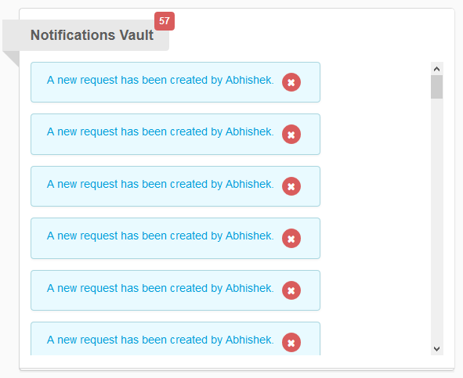
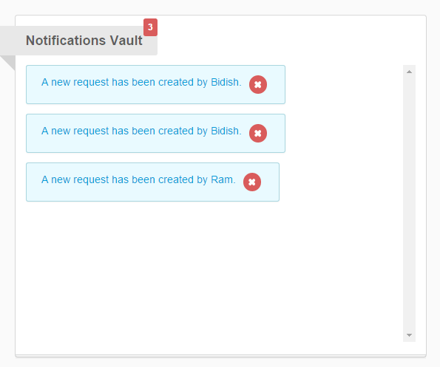
Notification
USERS– Admin, Moderators

Slide 16
Use Case

Slide 17
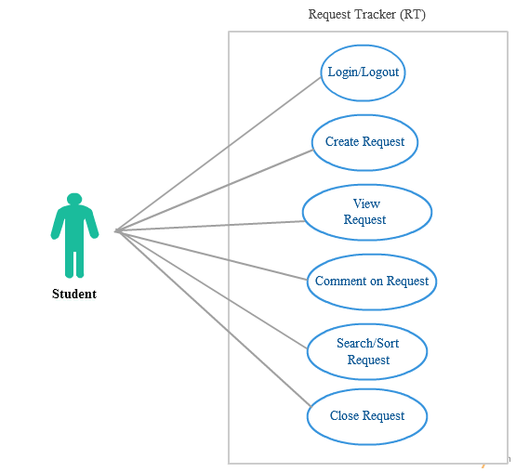
Student

Slide 18
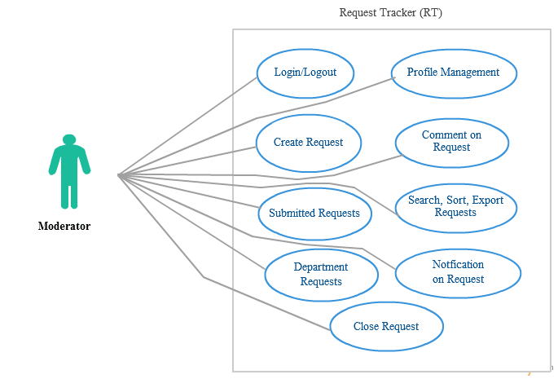
Student

Slide 19
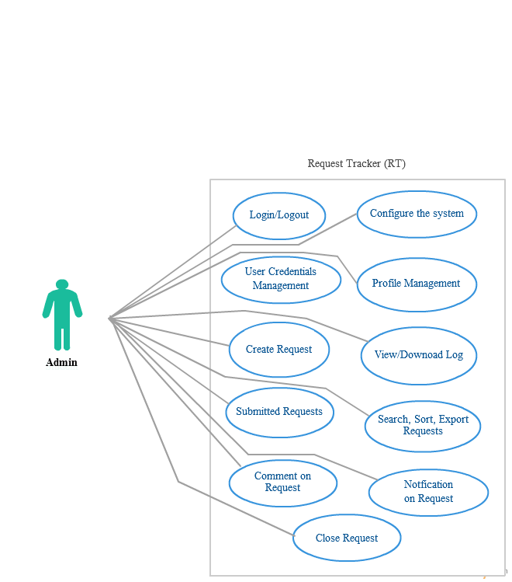
Student

Slide 20
Security
Blowfish - Hashing Function used generate password
Page filtered according to role and department
Input Parameter Sanitized

Slide 21
Thank you!

