Slide 1
Ahamed Alufar
2021506008
B.Tech Information Technology
Madras Institute of Technology
TNSDC - Machine Learning to
Generative AI
Final Project
DATE:04/04/2024

Slide 2
PROJECT TITLE
"Enhancing Educational Outcomes: Analyzing Factors Affecting Student Grades Using Machine Learning
GITHUB LINK:https://github.com/alufar45/PROJECT24/

Slide 3


AGENDA
Problem Statement
Project Overview
Objectives
End Users
Solution and Value Proposition
Model Explanation
Results
Conclusion
3/21/2024 Annual Review

Slide 4

PROBLEM STATEMENT
The challenge is to analyze factors influencing students' grades using a dataset containing information such as student nationality, grade level, attendance, hours studied, and more. The goal is to employ various classifiers and machine learning models to accurately predict which factors significantly impact student performance.

Slide 5

PROJECT OVERVIEW
This project aims to analyze the impact of different factors on student grades by utilizing classifiers and machine learning models on a CSV dataset. Visual aids like graphs and confusion matrices will be employed to present the results effectively.

Slide 6
OBJECTIVES
Explore and preprocess the dataset containing student information and factors potentially affecting grades.
Implement and compare various classifiers and machine learning models to predict the factors influencing student grades accurately.
Create visual aids such as graphs and confusion matrices to visualize and interpret the results effectively.
Evaluate the performance of each model based on metrics like accuracy, precision, recall, and F1-score.

Slide 7

WHO ARE THE END USERS?
Educational institutions, administrators, educators, and policymakers seeking insights into factors impacting student performance and aiming to improve educational outcomes.

Slide 8

YOUR SOLUTION AND ITS VALUE PROPOSITION
By employing classifiers and machine learning models on the dataset, this project offers a data-driven approach to identify factors affecting student grades accurately. Visual aids enhance comprehension and facilitate decision-making for educational stakeholders, ultimately leading to targeted interventions and improved student outcomes.

Slide 9
THE WOW IN SOLUTION
Unraveling the Mysteries of Academic Achievement: Employing Machine Learning to Illuminate the Path to Student Success. Dive into the Depths of Data to Uncover Hidden Insights and Transform Educational Outcomes. Witness the Power of Predictive Analytics as it Unveils the Factors Shaping Student Grades. Experience the Thrill of Discovery as Machine Learning Unlocks the Key to Academic Excellence. Elevate Educational Practices and Empower Students with Data-Driven Strategies for Success

Slide 10
MODELLING
Various classifiers and machine learning models such as logistic regression, decision trees, random forests, support vector machines (SVM), and gradient boosting will be utilized. These models will analyze the dataset to identify patterns and relationships between student attributes and academic performance.

Slide 11
RESULTS
The results showcase the accuracy and effectiveness of each model in predicting factors influencing student grades. Visual aids like graphs and confusion matrices provide insights into model performance and the significance of different factors.

Slide 12
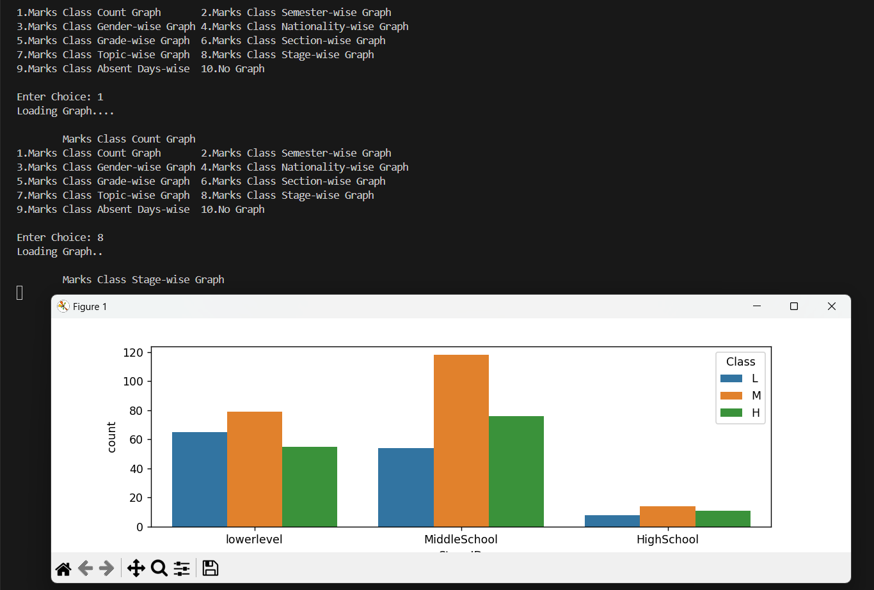
RESULTS

Slide 13
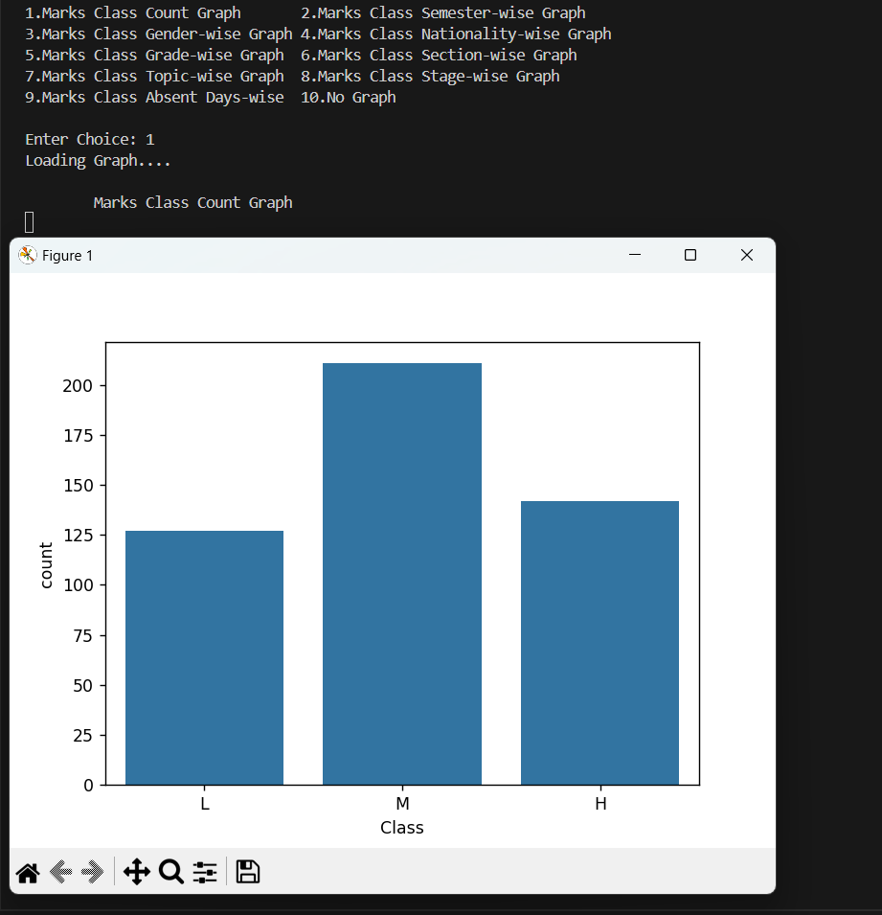
RESULTS

Slide 14
CONCLUSION
Through the application of classifiers and machine learning models on the dataset, this project successfully identifies key factors impacting student grades. The results obtained offer valuable insights for educational stakeholders to make informed decisions and implement targeted interventions to enhance student performance and educational outcomes.
GITHUB LINK:https://github.com/alufar45/PROJECT24/

