Slide 1
ntity Framework Core
Σ
Bassam Alugili
15.10.2017
Stuttgart

Slide 2
Agenda and Terms
Σ
Entity Framework Core
20 Presentation Sheets
25 Live Coding Example
Terms
SmartInspect : Logging Tool
SSM: Sql Server + Profiling
Entity Framework Profiler
OzCode: LINQ Debugging
Not available in EF Core

Slide 3
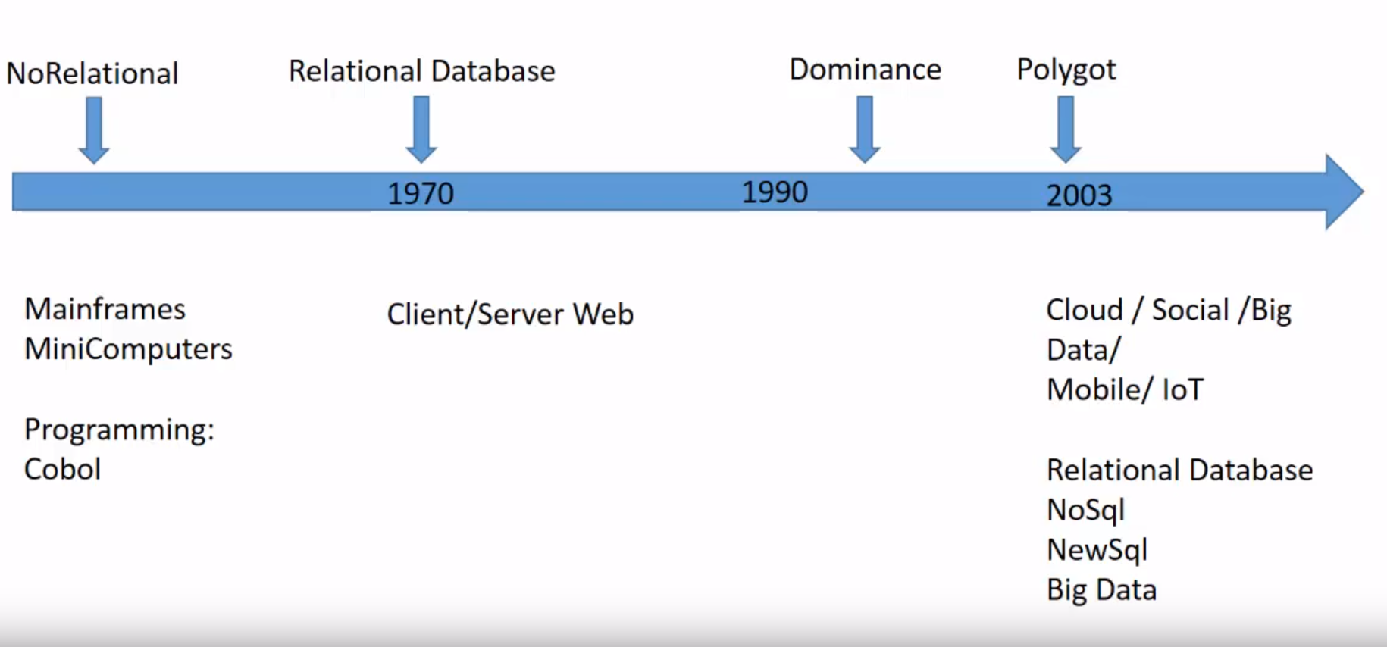
History
Σ

Slide 4
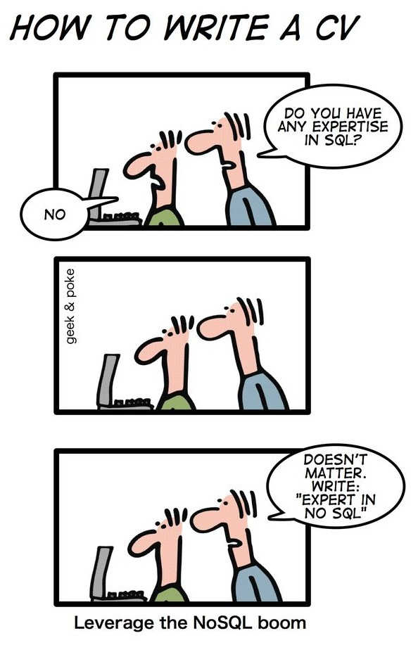
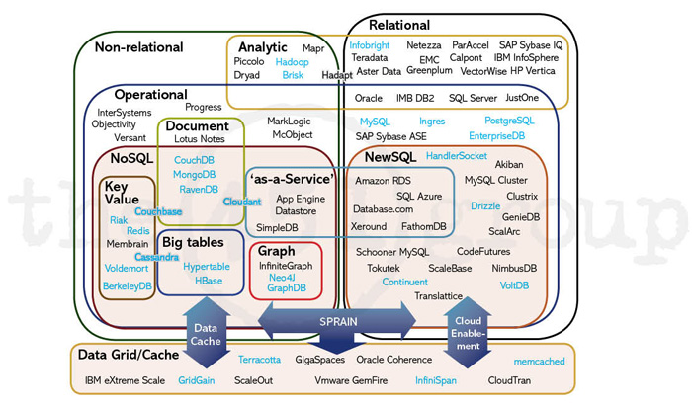
SQL/NoSQL/NewSQL
Σ
Source: https://blogs.the451group.com/information_management/2011/04/15/nosql-newsql-and-beyond/

Slide 5
Intoruction SQL vs. NoSQL vs. NewSQL
Σ
Feature | Old SQL | NoSQL | NewSQL
Relational | Yes | No | Yes
SQL Support | Yes | No | Yes
ACID Transactions | Yes | No | Yes
Horizontal Scalability | No | Yes | Yes
Performance by big volume | No | Yes | Yes
Schema-less | No | Yes | No

Slide 6
Σ
IoT: Machine Learning and Column Store
Simple Example:
The Error 123COP occurs in the last 2 years in the Machines A and B .
What is the covariance between the tow time-series?
(1 / N) * sum (A_{i} –mean(A) )) * (B_{i} –mean(B))
ID | Name | Dept. | Salary
1 | Rami | SW | 6000
2 | Fadi | FM | 7500
3 | Mays | PW | 4000
Physical Row Storage:
1, Rami, SW, 6000
2, Fadi, FM, 7500
3, Mays, PW, 4000
Sum all salaries
Average all salaries
Count
Physical Column Storage:
1,2,3
Rami, Fadi, Mays
SW, FM, PW
6000, 7500, 4000

Slide 7
Entity Framework Core Concept I
Σ
Conceptual
Model
Mapping
Storage
Model
public class User
{
public long Id { get; set;}
public string Name { get; set;}
}
Users
Id | Name
1 | ميس

Slide 8
Entity Framework Core Concept II
Σ
var user = DBContext.Users.FirstOrDefault(u=> u.Name == „صباح“).First();
var user = User {Id = 1, Name =„صباح“}
Object Services
Command Tree:
Query/Predicate:
User->Name == صباح
EntityClient
Command Tree:
Table=Users:
Column = Name
Provider Specific SQL
Users
Id | Name
1 | صباح
Select TOP(1)* From Users Where Name = 'صباح‘

Slide 9
Install
Σ
NuGet Console Manager
Install-Package Microsoft.EntityFrameworkCore.SqlServer
Install-Package Microsoft.EntityFrameworkCore.Tools
Live Coding!

Slide 10
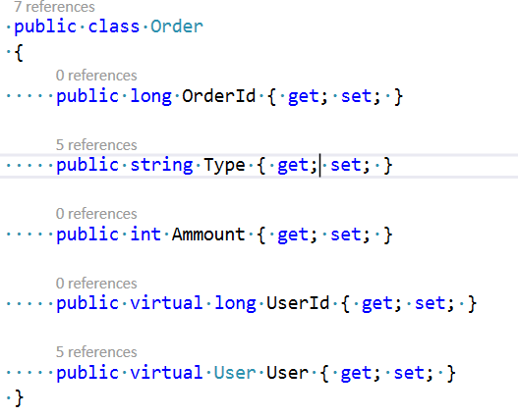
Code First Conventions and Data Annotations
Σ
Conventions: By Default
Data Annotations: Customize by Data Annotations
Fluent API: Customize by Fluent Api
Convention for PK: Id or Class name + Id
Relationship Convention: <navigation property Name>_<primary key property>
Dependent entity : Child of the relationship
Principal entity: Parent of the relationship
Foreign key
Principal key
Navigation properties

Slide 11
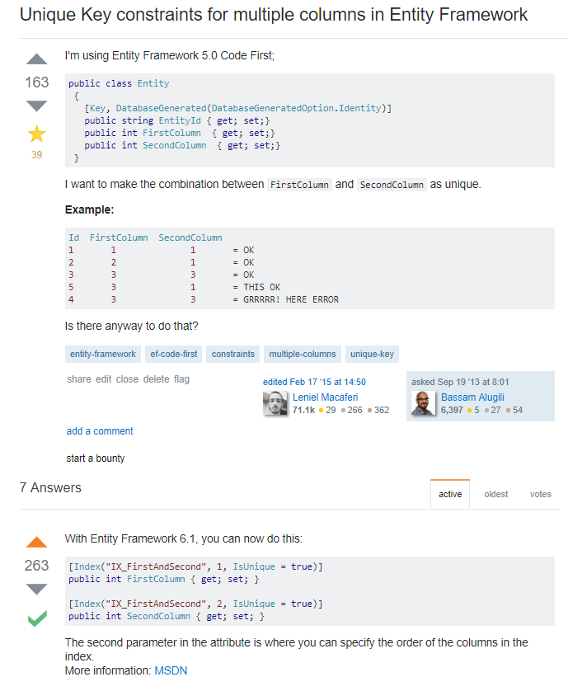
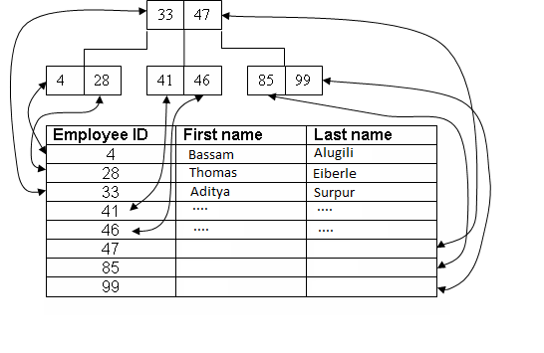
Indexes and Alternate Keys (Unique Constraints)
Σ

Slide 12
Relationship Patterns
Σ
One-To-One
One-To-Many
Many-To-Many

Slide 13
One-To-One
Σ
Relational Database
Users
UserId | Name | Timestamp
1 | Test | 10:00
2 | Test 2 | 11:00
Orders
OrderId | Type | Amount
1 | Car | 3
2 | Sweet | 4
1
1
OOP
class User
{
int UserId = 1;
string Name = „Test“;
Order Order;
}
class Order
{
int OrderId = 1;
int Amount = 3;
string Type= „Sweet“;
}
class User
{
int UserId = 1;
string Name = „Test“;
Order Order;
}
class Order
{
int OrderId =2;
int Amount = 4;
string Type= „Sweet“;
}

Slide 14
One-To-Many
Σ
Relational Database
Users
UserId | Name | Timestamp
1 | ميس | 10:00
2 | Basam | 11:00
Orders
OrderId | Type | Amount | UserId
1 | Car | 3 | 1
2 | Sweet | 4 | 1
3 | Test | 4 | 2
1
1…N
class Order
{
int OrderId = 1;
int Amount = 3;
string Type= „Sweet“;
}
OOP
class User
{
int UserId = 1;
string Name = „ميس“;
Collection<Order>;
}
class Order
{
int OrderId = 2;
int Amount = 4;
string Type= „Sweet“;
}

Slide 15
Many-To-Many
Σ
Relational Database
Users
UserId | Name | Timestamp
1 | Test | 10:00
2 | Test 2 | 11:00
Orders
OrderId | Type | Amount | UserId
1 | Car | 3 | 1
2 | Sweet | 4 | 1
3 | Test | 4 | 2
1
UsersOrders
UserId | OrderId
1 | 1
1 | 2
2 | 1
1
1…N
1…N
OOP
class User
{
int UserId = 1;
string Name = „Test“;
Collection<Order>;
}
class Order
{
int OrderId = 2;
int Amount = 4;
string Type= „Sweet“;
Collection<User>;
}
class User
{
int UserId = 2;
string Name = „Test“;
Collection<Order>;
}
class Order
{
int OrderId = 1;
int Amount = 3;
string Type= „Sweet“;
Collection<User>;
}

Slide 16
Loading Related Data
Σ
Eager loading means that the related data is loaded from the database as part of the initial query.
Explicit loading means that the related data is explicitly loaded from the database at a later time.
Lazy loading means that the related data is transparently loaded from the database when the navigation property is accessed. Lazy loading is not yet possible with EF Core.

Slide 17
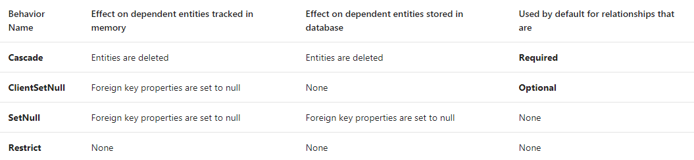
Delete behaviors
Σ
Soruce: https://docs.microsoft.com/en-us/ef/core/saving/transactions

Slide 18
Inheritance
Σ
Table per Hierarchy (TPH)
Table per Type (TPT)
Table per Concrete Type (TPC)

Slide 19
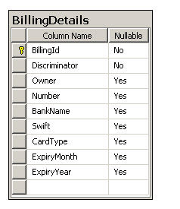
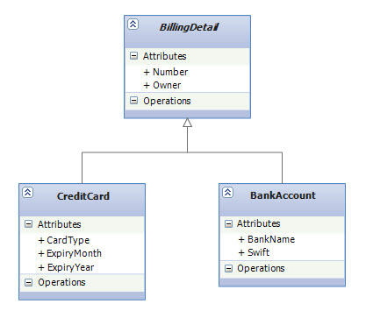
Table per Hierarchy (TPH)
Σ
Source: https://weblogs.asp.net/manavi/inheritance-mapping-strategies-with-entity-framework-code-first-ctp5-part-1-table-per-hierarchy-tph

Slide 20
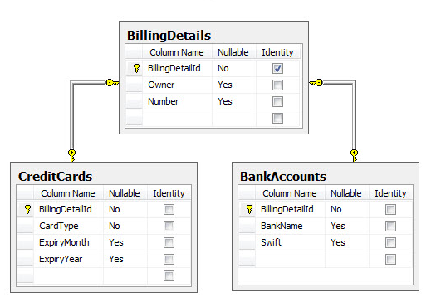
Table per Type (TPT)
Σ
Source: https://weblogs.asp.net/manavi/inheritance-mapping-strategies-with-entity-framework-code-first-ctp5-part-1-table-per-hierarchy-tph

Slide 21
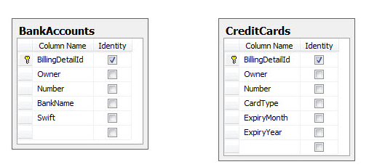
Table per Concrete Type (TPC)
Σ
Source: https://weblogs.asp.net/manavi/inheritance-mapping-strategies-with-entity-framework-code-first-ctp5-part-1-table-per-hierarchy-tph

Slide 22
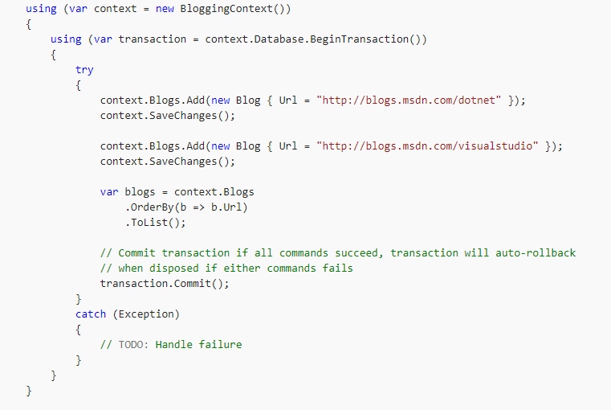
Transaction
Σ
Default transaction behavior all or nothing
Soruce: https://docs.microsoft.com/en-us/ef/core/saving/transactions

Slide 23
Data Seeding
Σ
Live Coding Example!

Slide 24
Migrations
Σ
Migrations to create a database
- Scaffold a migration
- Apply the new migration to the database
Live Coding Example!

Slide 25
Useful Links
Σ
https://docs.microsoft.com/en-us/ef/
http://ef.readthedocs.io/en/latest/
https://github.com/aspnet/EntityFramework
http://www.entityframeworktutorial.net/

Slide 26
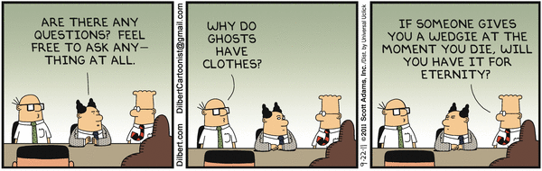
Any Questions
Σ

