Slide 1


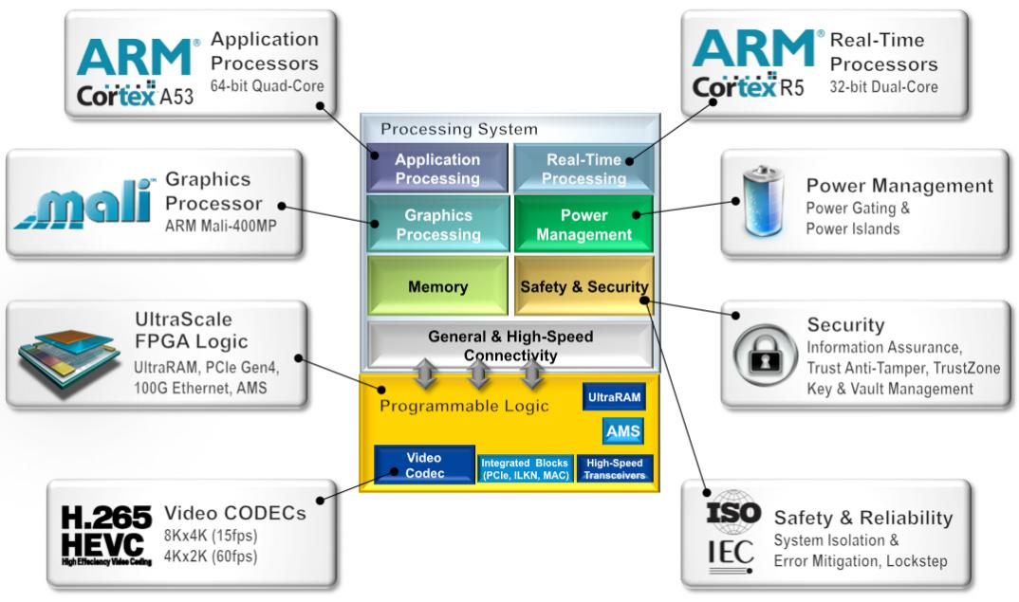
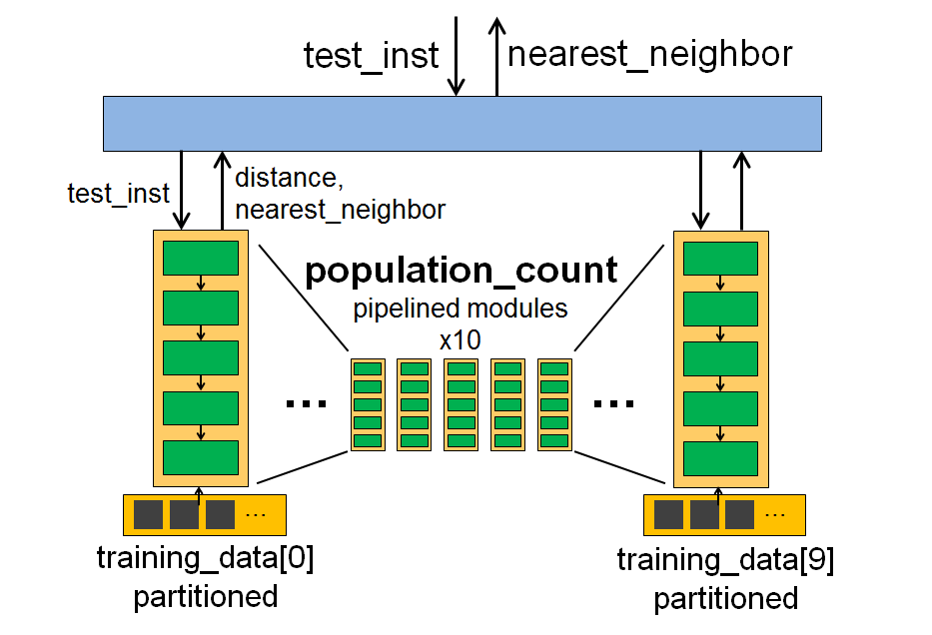
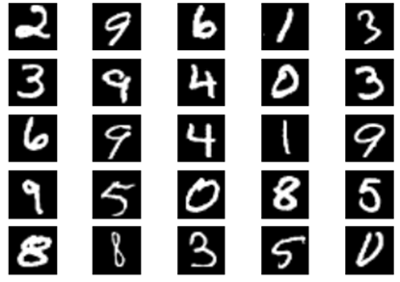
Rosetta: A Realistic Benchmark Suite for Software Programmable FPGAs
Udit Gupta, Steve Dai, Zhiru Zhang
Computer Systems Laboratory, Electrical and Computer Engineering, Cornell University, Ithaca, NY
Overview
Modern FPGAs and HLS Tools
Realistic benchmarks are important for the development of sophisticated yet scalable high-level synthesis (HLS) tools that allow FPGAs to be programmed in software while achieving high-performance designs.
We propose a suite of realistic software applications with enforceable system-level hardware constraints to model hardware accelerators targeting heterogeneous FPGAs.
We present a C and OpenCL based design and verification flow that accommodates both the sequential and parallel programming models commonly supported by HLS.
Hardware
Design
Software
Programming
Manual
RTL
Programming
FPGAs?
Performance
Our Research
~2-3X
Efficiency
gap
C-to-gates
~5-10X
Productivity gap
CPU/GPU
Programming
Image courtesy of Xilinx, 2015
Productivity
The Three R’s of Rosetta
Modern FPGAs are heterogeneous SoCs composed of multi-core processors, hardened IPs, and reconfigurable fabric.
Calls for an unprecedented amount of software programmability as FPGA emerges from a logic to computing device.
Insufficient QoR compared to hand-written RTL and significant productivity gap from pure software programming.
Needs significant amount of manual code transformations and lacks automatic compiler and synthesis optimizations for performance.
Realistic: Representative application domains with large applications and user enforceable design constraints.
Reducible: Users can profile applications and sub-kernels for effectively benchmarking QoR.
Retargetable: Supports various HLS tools which target multiple substrates and FPGA devices.
Existing HLS Benchmark Suites
Span a limit ed subset of computing domains that FPGAs target and consist of small kernels (less than 1000 lines) which lack the complexity representative of common HLS designs.
Provide no support for multiple programming models and require significant user overhead in adding HLS-specific optimization directives.
Do not allow convenient parameterization of designs by user.
K-Nearest Neighbor Digit Recognition
Source Code
for digit in range (0, 10):
for training_inst in training_data[digit]:
diff = training_inst xor test_inst
distance = population_count(diff)
if (distance < min):
nearest_neighbor = training_inst
min = distance
return nearest_neighbor
Rosetta Development Flow and Application Architecture
Realistic Design Constraints
Baseline Software Design
Development Flow
C-based application-specific kernels can easily be added to the generic harnesses.
Synthesis results are used to optimize designs given design constraints.
FPGA Implementation
Host Application - Responsible for controlling the system and accelerator
Kernels - Consist of the compute intensive portions of the applications to be accelerated.
Rosetta Harness
OpenCL Harness
C/C++ Harness
Synthesized System Architecture
Source Data
OpenCL Kernels
C/C++ Kernels
Software Simulation
HLS Optimizations
HLS
Host Processing System
Reconfigurable Fabric
Efficient hardware for population count kernel.
Parallel execution (by loop unrolling) across digits 0-9.
Pipelined execution over training instances.
Partitioned training data increases memory bandwidth.
Hardware/Software Co-Simulation
Host Application
Synthesized Hardware Accelerator
Retargetable FPGA Implementation
Proposed Initial Benchmarks for Rosetta
Application | Domain | Constraints | Kernels/Algorithms
Voice Removal and Pitch Shifting | Audio Processing | Latency (Real-Time) | FFT, Inverse FFT, DSP Filters
DNA and Protein Sequencing | Bioinformatics | Throughput | Smith Waterman
Advanced Encryption Standard | Cryptography | Throughput | Matrix Substitutions and Permutations
Monte Carlo Option-Pricing | Financial Analysis | Throughput / Latency | Black Scholes, Mersenne Twister, Box Muller
Digit Recognition | Machine Learning | Throughput | Population-Count, K-NN, K-Means
Convolutional Neural Networks | Machine Learning | Throughput | Convolution, Soft Max and Max Pool Layers
Face Detection | Video Processing | Throughput | Viola Jones Algorithm
Lane Detection | Video Processing | Latency (Real-Time) | Edge Detection

