Slide 1

Team METALORN
Teamwork Project Java Basics Course @ SoftUni

Slide 2
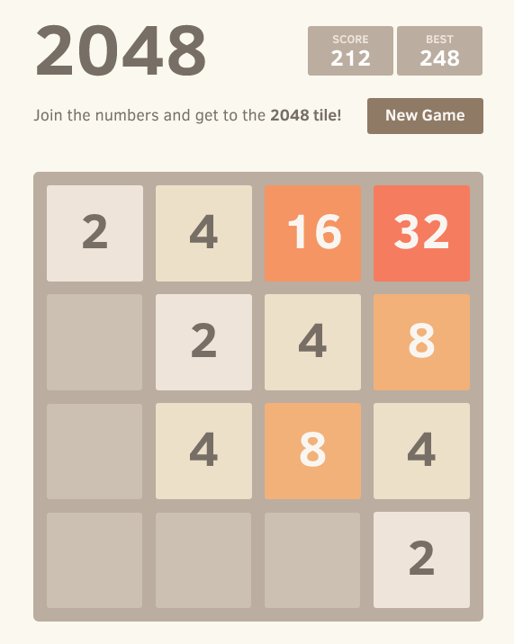
Console version of 2048
The aim of the game is to reach the amount
of 2048.
How does it work?
The digit 2 is generated randomly on the playfield. By moving it left, right, up and down we have to reach another digit. This will combine and sum them up. To win the game we need to reach the desired amount of 2048.

Slide 3
Through this project we exercised the usage of methods, for loops, enhanced for loops, switch-case, arrays and some standard classes in Java."

Slide 4
Team members
aramle (aramle)
Ivaylo Kostadinov (IvayloK)
Kostadin Kostov (kostadin)
Lyubomir Stoyanov (lyubogb)
Maria Mastrafchieva (maria.iankova)
Polina Petrova (Aluin)

