Slide 1
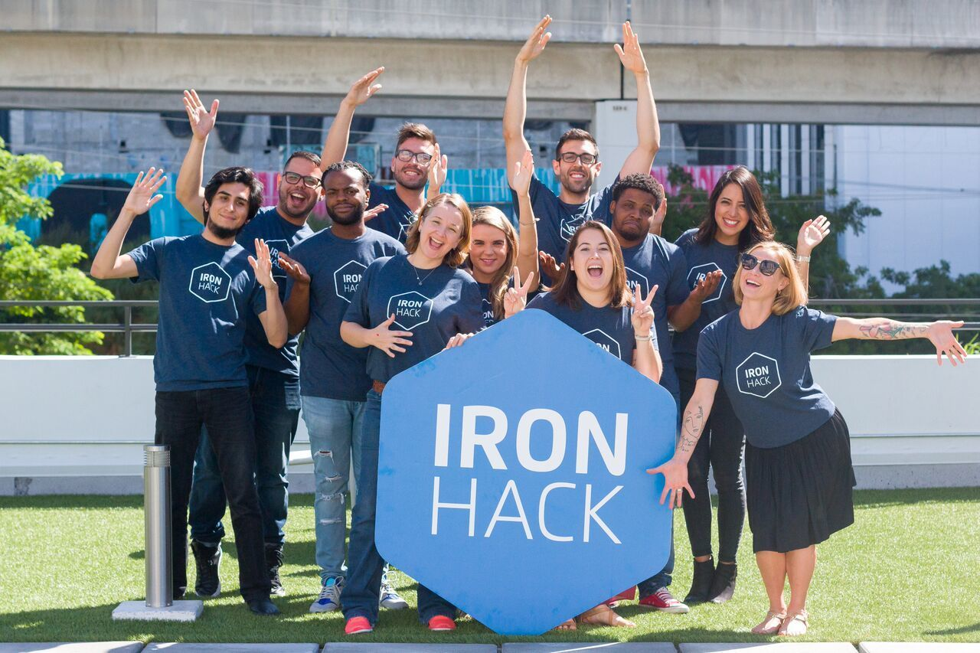
Ironhack is Losing Clients!
Sound the Alarm
Analysis and Strategic Solutions by Elora, Hilena, Imtiaz and Luísa
Notes:
Today, we are here to address a critical issue that threatens the very foundation of our institution: which is Ironhack is at risk of losing its credibility and clients.

Slide 2





Our process
Find a source with client reviews
Web Scrapping
Data Analysis
Notes:
And you may ask why and how we found this?
To understand the severity of the problem, we turned to SwitchUp, which is a trusted source for client reviews and rankings.
And By extracting and analyzing this data, we aimed to uncover where Ironhack is falling short and why clients are turning away.

Slide 3
Ranking requirements
Have at least one U.S campus or be U.S.-based if it’s an online-only program
At least 10 verified reviews since 2019
Average reviews at least 4.5/5
Notes:
Basically, SwitchUp ranks educational institutions based on some criteria. To be considered among the best, a school must have at least one U.S. campus or be U.S.-based if it offers online-only programs.
Additionally, it must have at least 10 verified reviews since 2019 and maintain an average review rating of at least 4.5 out of 5.

Slide 4

Ironhack Ranking
Data Analytics
Web
Design
Cyber
Security
Coding
4th
17th
3rd
Notes:
Our analysis reveals troubling insights into Ironhack's current standings. While we rank 4th in Data Analytics and 3rd in Web Design, our coding program is alarmingly ranked at 17th.
Most concerning is our absence from the cybersecurity rankings, a critical issue that poses a significant threat to our reputation and future success because Cybersecurity is the future, with a growing number of people seeking these courses.
As you may know, Potential students heavily rely on reviews when choosing a school, and if Ironhack is not ranked in this vital field, they will likely choose a competitor.

Slide 5
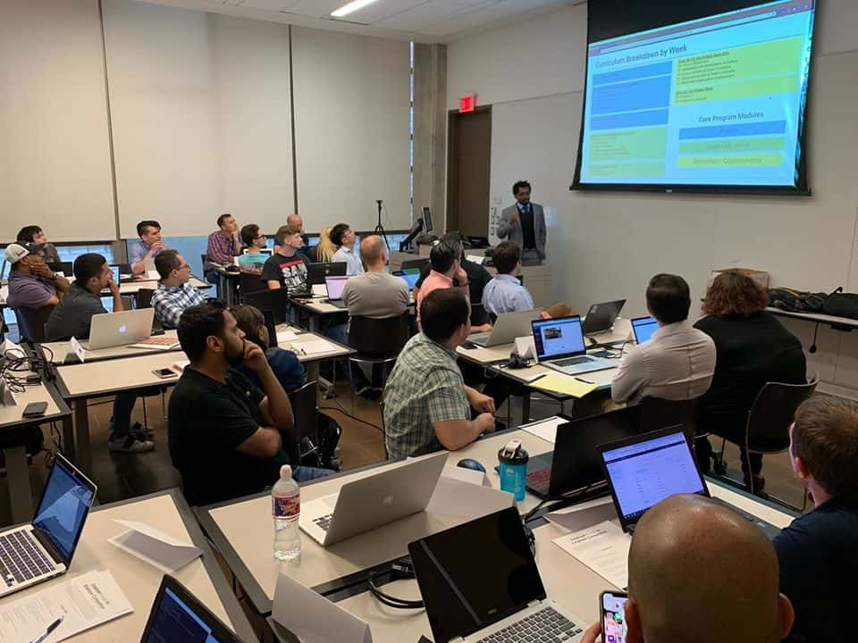
Who are our competitors?
Cyber Security
ranking | bootcamp_name | bootcamp_id
1 | Evolve Security Academy | 10743
2 | Syntax Technologies | 11797
3 | Level Effect | 11282
4 | Clarusway | 11539
5 | Simplilearn | 11016
6 | Springboard | 11035
7 | Edureka | 11739
8 | Colorado State University Pueblo Extended Studies | 11296
Notes:
And these competitors are excelling in cybersecurity education. Schools like evolve security academy, syntax Technologies and level Effect have established themselves as leaders in this field.
To break into this competitive market and secure a place among these top institutions, Ironhack must develop a strong cybersecurity program.

Slide 6

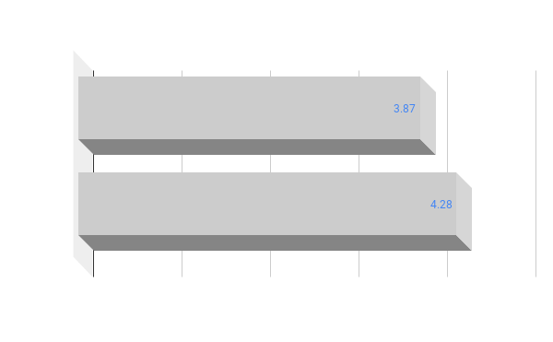
Reviews comparisons
Cyber Security
Requirement
Average reviews at least 4.5/5
school | overallScore
ironhack | 4.14
colorado-state-university-pueblo-extended-studies | 4.38
edureka | 4.48
simplilearn | 4.56
springboard | 4.63
evolve-security-academy | 4.82
clarusway | 4.98
syntax-technologies | 5.00
Ironhack
3.87
4.28
Notes:
Imtiaz

Slide 7

What could influence the overall score?
Notes:
Imtiaz

Slide 8
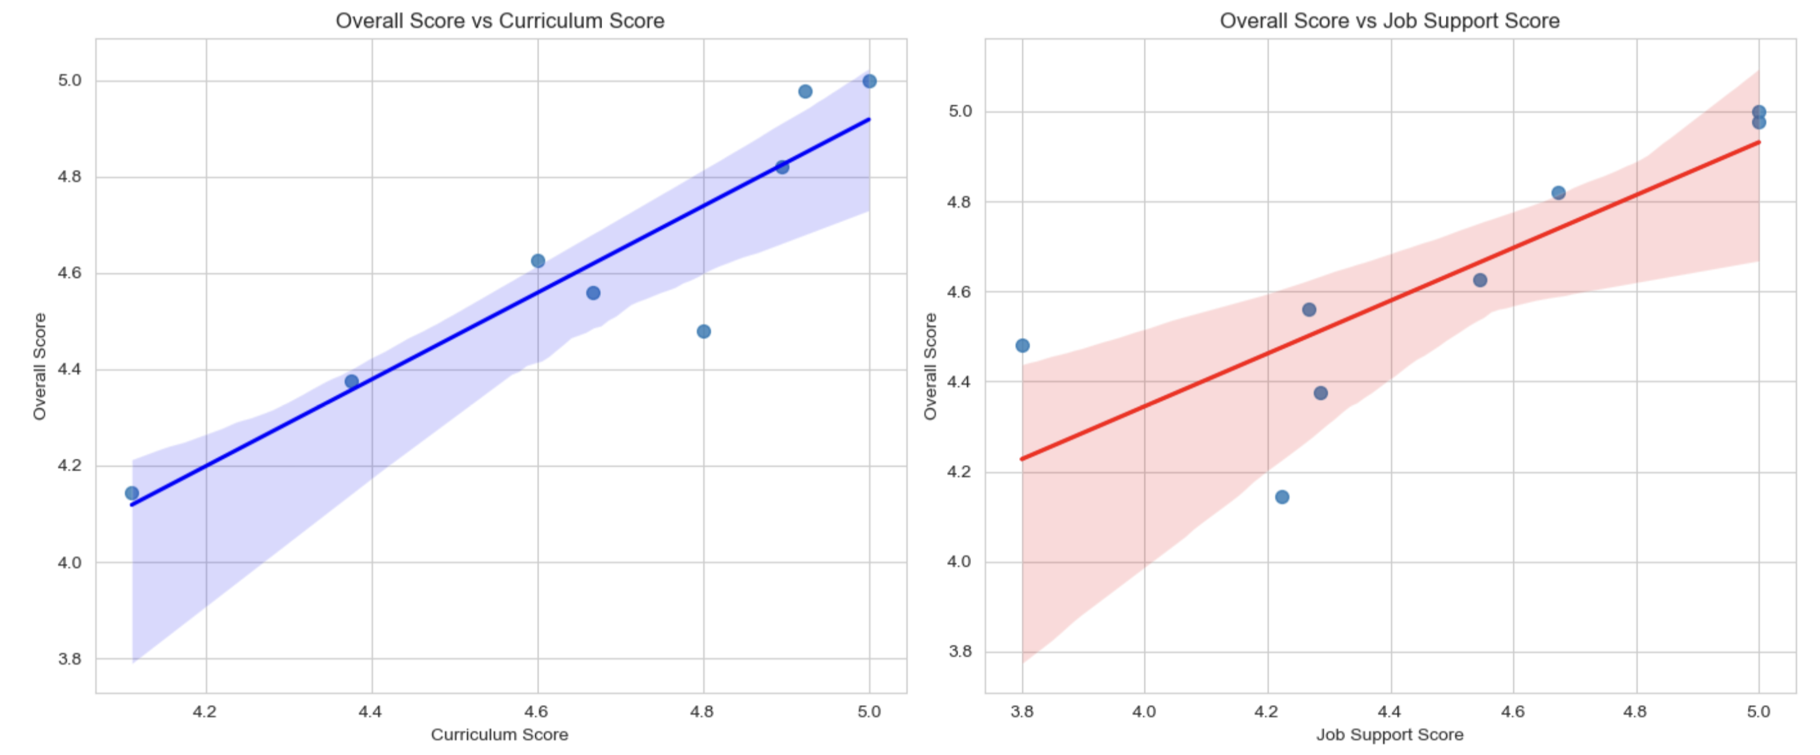
Job support and curriculum
Cyber Security
Notes:
Imtiaz

Slide 9
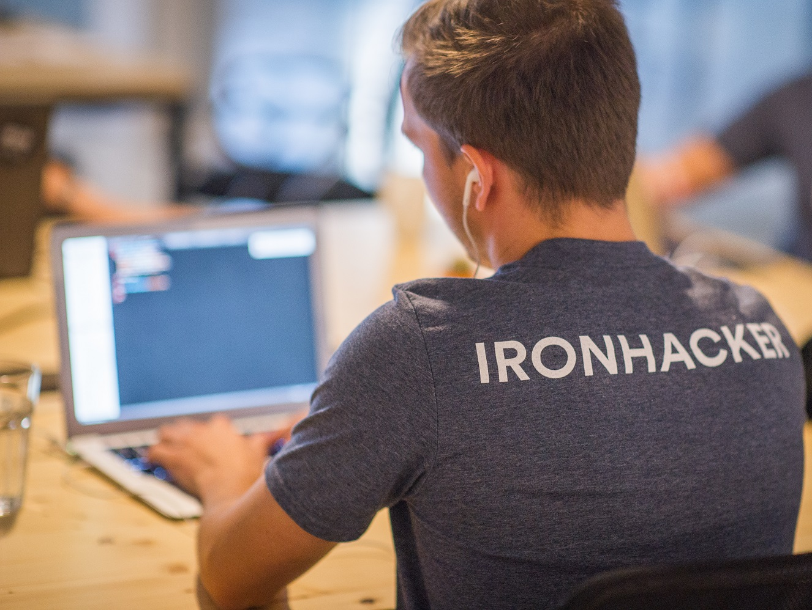
Job support and curriculum
Cyber Security
school | overallScore | curriculum | jobSupport
clarusway | 4.98 | 4.92 | 5.00
colorado-state-university-pueblo-extended-studies | 4.38 | 4.38 | 4.29
edureka | 4.48 | 4.80 | 3.80
evolve-security-academy | 4.82 | 4.89 | 4.67
ironhack | 4.14 | 4.11 | 4.22
simplilearn | 4.56 | 4.67 | 4.27
springboard | 4.63 | 4.60 | 4.55
syntax-technologies | 5.00 | 5.00 | 5.00
Notes:
Imtiaz

Slide 10
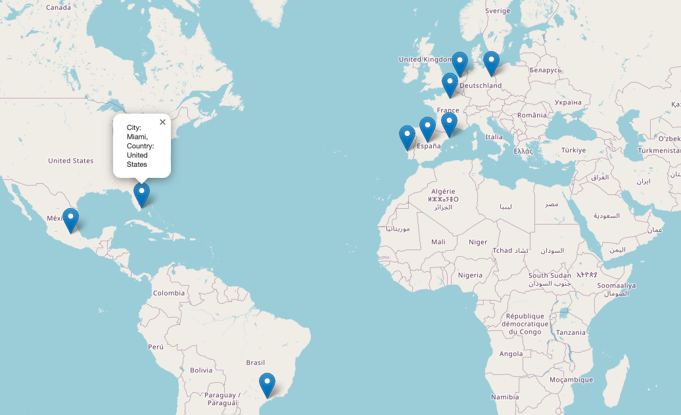
Ironhack Locations
Cyber Security
On-site
United States
Mexico
Brazil
Portugal
Spain
France
Germany
Netherlands
Online
Requirement
Have at least one U.S campus or be U.S.-based if it’s an online-only program
Notes:
Hilena

Slide 11
ironhack Miami
Cyber Security
Data Analytics
Web Development
UX/UI Design
Requirement
Have at least one U.S campus or be U.S.-based if it’s an online-only program
Notes:
Hilena

Slide 12
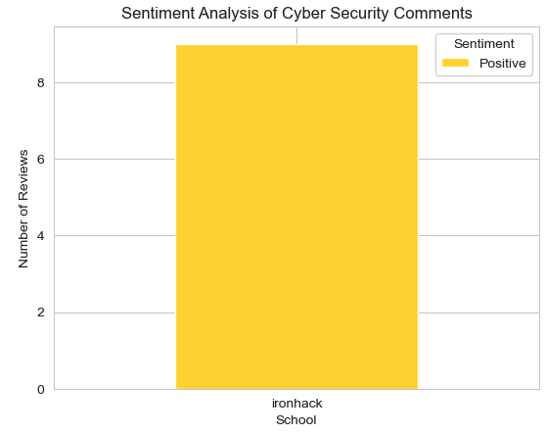

Ironhack reviews
Cyber Security
Total reviews after 2019
9
Verified reviews after 2019
5
Requirement
At 10 verified reviews since 2019
Notes:
Hilena

Slide 13

Ironhack cons
Cyber Security
You lose the job guarantee if you don't finish in time
CONS Tuition is a bit pricey at about $11,340 for 6 months. The Labs sometimes crash and force you to have to restart from the beginning.
The lead instructor when I left taught nothing and relied on the assistant instructors to teach.
I believe the cohort is incredibly overpriced for what you get.
Email support can take time to reach back out sometimes
the breadth and pace of the contente.
It's a lot of LinkedIn Learning vídeos.
There were times where I felt it went by really fast, and where I personally thought I might not succeed and I thought I was the only one that felt this way- but when I did study sessions outside of class time with other students, they felt the same way.
Not being able to get feedback right away and the technical difficulties sometimes.
Curriculum was mainly LinkedIn learning videos, some were 4-5 hours long. Was tedious at times....
Notes:
Elora

Slide 14
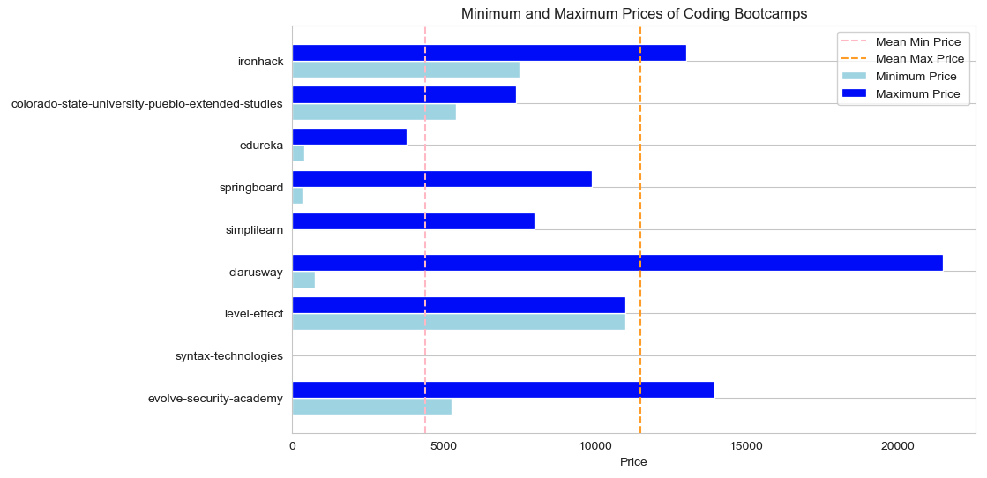

prices
Cyber Security
Notes:
Elora

Slide 15
Other analysis

Slide 16
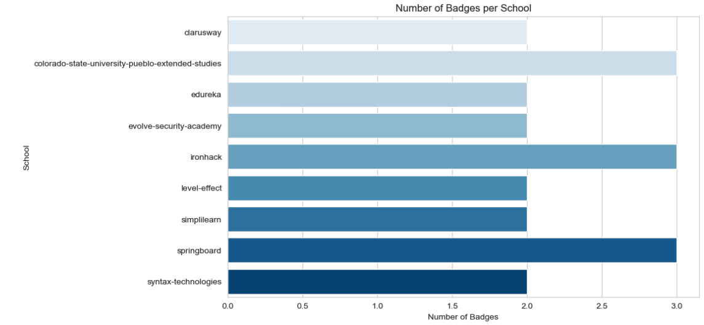
badges
Cyber Security
Ironhack Badges
Available Online
Verified Outcomes
Flexible Classes
Missing Badges
Accepts GI Bill*
Job Guarantee
* It provides educational assistance to servicemembers, veterans, and their dependents
Notes:
Elora

Slide 17
Recomendations
Cyber Security
Increase student reviews
encouranging feedbacks
simplify review process
Improve the curriculum support
recruiting new teachers
Improve job support
building a strong network with hiring companies
providing career coach
engaging multiple plataforms
inviting experts in the Cyber Security field
organizing recruitment events
Open a bootcamp in US
since there's a school in Miami, we would suggest to open an on-site cyber security bootcamp there
encourage to put the name student in the review
Notes:
Elora

Slide 18

Conclusion
Ironhack excels in Data Analysis, Web Development, and UX/UI Design courses, but they must strengthen their cybersecurity program to remain competitive.
Prospective students heavily consider reviews before choosing a school.
Neglecting cybersecurity could harm Ironhack's reputation and lead to fewer students. Ironhack should act quickly to improve its cybersecurity courses and avoid losing students.
Notes:
Elora

Slide 19
Thank You!

