Slide 1
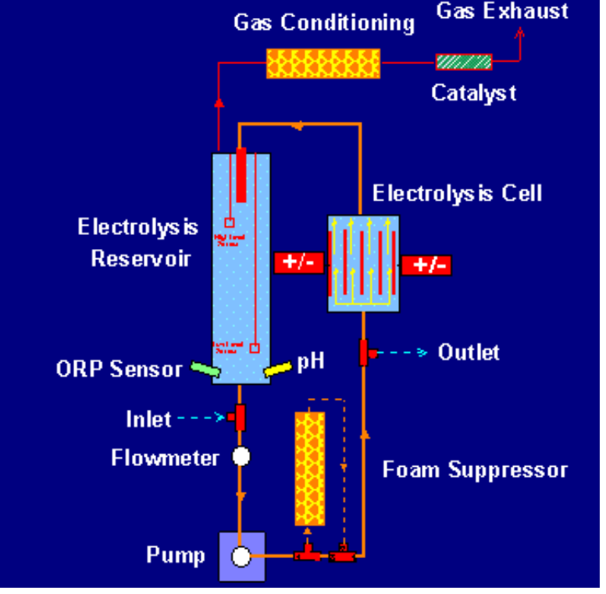
Electrochemical Water Recovery
Umpqua Research Company
Myrtle Creek, OR
Innovation
Electrochemical water recovery (ECWR) process for the recovery
of portable water from urine and other composite waste water.
Accomplishments
Successful integration of electrolysis, electrodialysis, and catalytic
oxidation to produce potable water directly from composite waste water.
Application of a regenerable soap sorbent to control foam formation.
Developed products; ECWR and Regenerable Foam Suppresser.
Contact with Boeing, KRUG,
Station life Support Systems is ongoing.
Commercialization
Funding for life support related to long-term manned space
habitation will dictate the rate of commercialization.
NASA represents the immediate market.
Support for ECWR is anticipated through NASA Contractors
Private funding is being sought for ECWR treatment of marine vessel and other biological waste water discharges.
Private funding is being sought for Regenerable Foam Suppresser use in laundry, carwash and other foam intensive applications
Electrochemical Water Recovery
Government/Science Applications
Space Station requirement for composite waste water
remediation.
Long duration space flights requiring Regenerative Life
Support Systems.
Johnson Space Center
August 12, 1999
SS # 9-019
Points of Contact:
- Jane I Fox, 281-483-4815
- Umpqua, umpqua.hq@fpioneer-net.com
1989 SBIR Phase II; NAS 9-18528 SS # 09-18

