Slide 1
Interagency Biomedical Research Meeting
National Institutes of Health
December 8, 2006
Neal R. Pellis, Ph.D.
Associate Director, Science Management
Space Life Science Directorate
NASA Johnson Space Center
Houston, TX 77058
281-483-2357
neal.r.pellis@nasa.gov

Slide 2
Overview
Communicate the goals of NASA’s current biomedical research portfolio
Understand the near-term challenges faced by NASA’s Human Research Program
Identify potential synergies between NASA and other Federal Agencies for collaborative research efforts

Slide 3
New Direction
The Vision for Space Exploration
Complete ISS assembly and retire Shuttle
Build new human spacecraft (CEV) for transport beyond LEO
Return to the Moon with people and robots to explore and prepare for voyages beyond
Human missions to Mars and other destinations
  "It is time for America to take the next steps.
  Today I announce a new plan to explore space and extend a human presence across our solar system. We will begin the effort quickly, using existing programs and personnel. We'll make steady progress –one mission, one voyage, one landing at a time.
  President George W. Bush -January 14, 2004

Slide 4

Vision for Space Exploration…. to Mars and Beyond
The human element is the most complex element of the mission design
Mars missions will pose significant physiological and psychological challenges to crew members
Human engineering, human robotic/machine interface, and life support issues are critical
Bioastronautics Research Roadmap identifies risks to human health in space and in planetary environments
The ISS and the Moon must be used to investigate exploration risks to the “Go/No Go” decision
Ground-based and flight research will provide the knowledge and technology to mitigate the risks to human health during and after space exploration

Slide 5


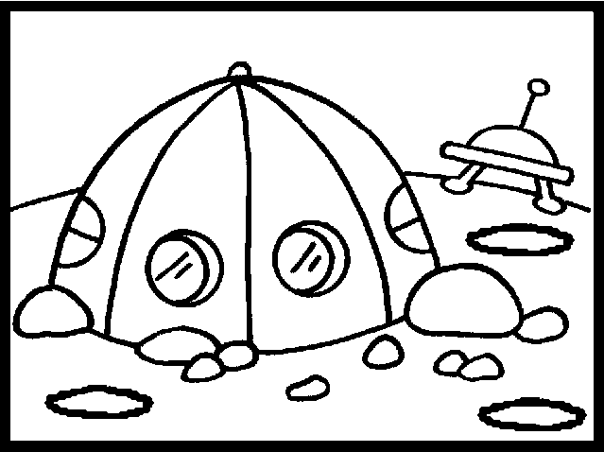
Schedule for Exploration
Biomedical Requirements
2012-14
Lunar Sortie
2018-20
Lunar Outpost
2030-35
Mars
Medical support
Monitoring
Specimen collection
Minimal analytical
capabilities
Radiation protection
Medical support
Monitoring
Exercise
countermeasures
Specimen collection
Expanded health care
capabilities
Diagnostics
Expanded life support
systems
Radiation protection and monitoring
Autonomous operation
  Medical support
  Monitoring
  Specimen collection
  Health care capabilities
  Diagnostics
Life support systems
Food production?
Closed loop systems
Bioregeneration
Waste Management
Exercise and pharmaceutical
countermeasures
Radiation protection,
monitoring, and exposure
countermeasures

Slide 6
Schedule for Exploration
In situ Research
2012-14
Lunar Sortie
2018-20
Lunar Outpost
2030-35
Mars
Human Physiology
Microbiology
Dust toxicology
Radiation
Behavior and performance
Changes unique to
human physiology in an
‘outpost’ scenario
Terrestrial life in 1/6 G
Human performance in
surface exploration
Effects of radiation
Habitation and
environment
In situ resource utilization
Changes unique to
human physiology in an‘
outpost’ scenario
Terrestrial life in 3/8 G
Human performance in
surface exploration
Effects of radiation
Habitation and
environment
In situ resource utilization
Potential for permanent
occupation

Slide 7





Human Mars Mission Scenario
Mars Departure
Jan. 24, 2022
Flight Profile
Transit out: 161 days
Mars surface stay: 573 days
Return: 154 days
3
1
Earth Departure
Jan. 20, 2020
Mars Arrival
June 30, 2020
2
4
Earth Arrival
June 26, 2022
Earth Orbit
Mars Orbit
Piloted Trajectories
Stay on Mars Surface

Slide 8
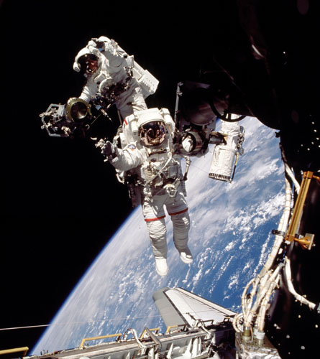
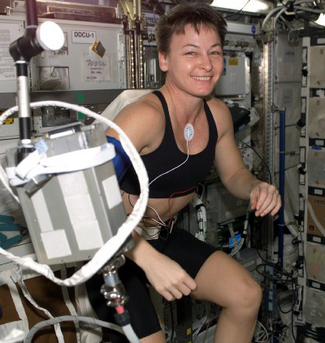
Human Research Program Goals
Reduce spaceflight risks to humans, focused on the highest risks to crew health and performance during exploration missions
Enable development of human spaceflight medical and human factors standards
Development and validation of technologies that serve to reduce medical risks associated with human spaceflight.

Slide 9
Research Portfolio Overview
Main investment areas
  Space Radiation
  Exploration Medical Capability
  Human Health Countermeasures
  Behavioral Health & Performance
  Space Human Factors & Environmental Standards
  ISS Research Capability
Multi-center program with 20% of procurement and 25% of civil service workforce at other centers
  Ames Research Center (space human factors, lunar dust toxicity)
  Glenn Research Center (exercise physiological modeling)
  Langley Research Center (radiation modeling)
  Marshall Space Flight Center (radiation transport codes)
Collaboration with international partners and external organizations are important for maximizing return on investment
  Brookhaven, National Institutes of Health, National Space Biomedical Research Institute (NSBRI) Network, University of Texas Medical Branch (UTMB)
  European Space Agency (ESA), Russia, Japanese Aerospace Exploration Agency (JAXA), Canadian Space Agency (CSA)

Slide 10
Effects of Space Travel
Radiation exposure
  Galactic cosmic radiation
  Solar proton events
  Planetary surface radiation
Bone density decrements
  1% per month in microgravity
  Unknown effects in fractional G
  Calcium excretion (renal stone risk)
Muscle deconditioning
  Dysuse atrophy
  Difficulty upon return to Earth gravity

Slide 11
Effects of Space Travel
Neurovestibular disturbances
  Balance and perception problems
  Space sickness
Behavioral and performance
  Small group dynamics
  Estrangement
  Depression
  Cognition
  Sleep disturbances

Slide 12
Effects of Space Travel
Cardiovascular deconditioning
  Cephalad fluid shift
  Change in hemodynamics
  Decrease in total red blood cell population
  Potential decrease in cardiac muscle performance
Nutrition
  Decreased appetite
  Changes in GI performance

Slide 13
Effects of Space Travel
Potential effect on immune performance
  Decreased response to:
    Recall antigens
    Polyclonal activators
  No evidence of opportunistic infection to date
Gastrointestinal changes
  Increased transit time
Orthostatic intolerance upon return to gravity

Slide 14
CRL/TRL Definitions
TRL Definition | TRL/CRL Score | CRL Definition | CRL Category
Basic principles observed | 1 | Phenomenon observed and reported. Problem defined. | Basic Research
Technology concept and/or application formulated | 2 | Hypothesis formed, preliminary studies to define parameters. Demonstrate feasibility.
Analytical and experimental critical function/proof-of-concept | 3 | Validated hypothesis. Understanding of scientific processes underlying problem. |  | Research to Prove Feasibility
Component and/or breadboard validation in lab | 4 | Formulation of counter-measures concept based on understanding of phenomenon. | Counter-measure Development
Component and/or breadboard in relevant environment | 5 | Proof of concept testing and initial demonstration of feasibility and efficacy.
System/subsystem model or prototype demonstration in relevant environment | 6 | Laboratory/clinical testing of potential countermeasure in subjects to demonstrate efficacy of concept.
Subsystem prototype in a space environment | 7 | Evaluation with human subjects in controlled laboratory simulating operational space flight environment. |  | Countermeasure Demonstration
System completed and flight qualified through demonstration | 8 | Validation with human subjects in actual operational space flight to demonstrate efficacy and operational feasibility.
System flight proven through mission operations | 9 | Countermeasure fully flight-tested and ready for implementation. | Countermeasure Operations

Slide 15
Human Research Program Investment Approach
Integrated Research & Technology Plan
Further develop validated standards & monitor
  Standard A
  Standard B
  Standard C
  …
Reduce highest risks for exploration
  Risk 1
  Risk 2
  Risk 3
  …
Medical Standards defined by OCHMO
Program Resources
Budget
Flight Resources
Ground Facilities
Schedule
Program Risk
Updates
Risk
Assessment
Gap Analysis
FY
+…
Biomedical Risks
FY
+3
FY
+2
FY
+1
Annual Research
Plan
FY 0
Reduced or mitigated risks
Missions & Architectures
Research Program
Behavioral Health
Human Health CM
Exploration Medical Care
Space Radiation
Updated & reduced requirements
Advanced Food
Environmental Standards
Space Human Factors

Slide 16
Managing Human Health Risks
Bioastronautics Roadmap
  Lists 45 major risks to human health in space exploration
  >450 associated “Research & Technology Questions” (R&TQs)
  Reviewed and approved by the Institute of Medicine (IOM)
Standards to deliverables approach
  Establish 8 standards for human health
  Use the standards to prioritize risks, focus research, and set deliverables aligned with the exploration schedules
Risk Management Analysis Tool
  The Risk Mitigation Analysis Tool (RMAT) has been proposed as an analytical and communication tool to be used to compare standards and requirements against known mission architectures and resources.
  The RMAT collects the appropriate standard, program requirements, and research and technology requirements that result in deliverables per architecture to mitigate the highest priority human risks for each architecture.
  Since each mission has different duration, distance from Earth, capabilities etc. the mitigation strategy and hence deliverables vary by mission.

Slide 17
Bioastronautics Roadmap
The Bioastronautics Roadmap is the framework for identifying, assessing, and reducing the risks of crew exposure to the hazardous environments of space.
The Roadmap provides information for making informed decisions about determining research priorities.
The Roadmap defines processes for accommodating new information and technology development as it becomes known, and guides the prioritized research and technology development that, coupled with operational space medicine, will inform:
  Development of medical standards
  Requirements for the human system
  Implementation of medical operations

Slide 18
‘Standards to Deliverables’
NASA has defined a “standards to deliverables” risk mitigation approach for exploration.
Crew health and performance standards will be defined by the NASA Chief Health and Medical Officer to set acceptable risk for exploration missions.
These standards will define the need for deliverables that allow crew health to be maintained within acceptable limits based on the levels of care required for the mission scenario.
The role of the HRP is to conduct research and develop technology that underlies standards development as well as enables deliverables which ensure that standards can be met.

Slide 19
Risk Management Analysis Tool
 | Architectures
 | CEV (CEV to ISS) | ISS (6 Months) | ISS (1 Year) | Moon (<14 days) | Moon (Lunar Habitat) | Mars
Has the Risk Factor been verified? (Y/N)
Probability of the Adverse Outcome
Uncertainty Associated with the Outcome
Impact of the Adverse Outcome
Mitigation, Current and/or Proposed
Cost/Benefit Trades (including risks of mitigation)
Current Work
Future Work
Test Bed Required

Slide 20
Research Venues
Solicited- Grants
Directed- Contracts, Intramural, Extramural
Unsolicited- Offerings from academic institutions, industry, and private individuals
Partnerships
  Interagency
  Space Act and Cooperative Agreements

Slide 21
Interagency Opportunities
Common needs
Common goals
Partnerships that take advantages of complementary talents and resources
Partnerships that share excitement in exploration

Slide 22








