Slide 1

UE21CS390A – Capstone Project Phase I
SEMESTER - VI
END SEMESTER ASSESSMENT
Project Title : Multi-Event Anomaly Detection for Enhanced Video Surveillance
Project ID : PW24_RS_02
Project Guide : Dr Ramamoorthy Srinath
Project Team : Amara Sai Prasad (CS001), Nidhi PG (CS380), Nikita Suresh (CS386), Ria R Kulkarni (CS487)

Slide 2
Outline
Multi-Event Anomaly Detection for Enhanced Video Surveillance
Problem Statement
Abstract and Scope
Literature Survey
Design Approach
Design Constraints, Assumptions & Dependencies
Proposed Methodology / Approach
Architecture
Design Description
Technologies Used
Project Progress
References

Slide 3
Problem Statement
Multi-Event Anomaly Detection for Enhanced Video Surveillance
Our project aims to develop a multi-event anomaly detection framework for video surveillance systems, using visual language models (VLMs) and computer vision techniques.
This framework will help in the simultaneous detection of various security threats and anomalies in a single frame.
Applying the integration of LLM-based semantic understanding with robust computer vision algorithms, the framework seeks to enhance the interpretability and accuracy of anomaly detection, hence improving the overall safety and security of public spaces.

Slide 4
Abstract
Multi-Event Anomaly Detection for Enhanced Video Surveillance
Our project aims to develop a multi-event anomaly detection framework for video surveillance systems, leveraging visual language models (VLMs) and computer vision techniques. This framework will enable the simultaneous detection of various security threats and anomalies, including abandoned objects, unnecessary object placement, vandalism, disguise detection, tailing behavior, and crowd monitoring. By integrating LLM-based semantic understanding with computer vision algorithms, the framework seeks to enhance the interpretability and accuracy of anomaly detection, thereby improving the overall safety and security of public spaces and critical infrastructure.

Slide 5
Scope
Multi-Event Anomaly Detection for Enhanced Video Surveillance
The core focus will be on detecting diverse anomalies like:
a) abandoned or unidentified objects
b) objects in situations where there is no necessity
c) vandalism
d) individuals in disguise or unusual clothing
e) one person following another for a longer duration of time (tailing)
f) crowd monitoring

Slide 6
Literature Survey
Anomaly Detection in Surveillance Videos using Transformer-based Attention Model

Slide 7
Paper-1
Algorithm/model: Videoswin utilizes transformer architecture to capture long range dependencies in sequential data & incorporates attention layer to focus on relevant frames and enhance feature extraction.
Robust Temporal Feature Magnitude Learning to recognize positive instances (abnormal snippets) in videos.
Dataset: ShanghaiTech Campus - 13 scenes with complex light conditions and camera angles. It contains 130 abnormal events and over 270, 000 training frames.

Slide 8
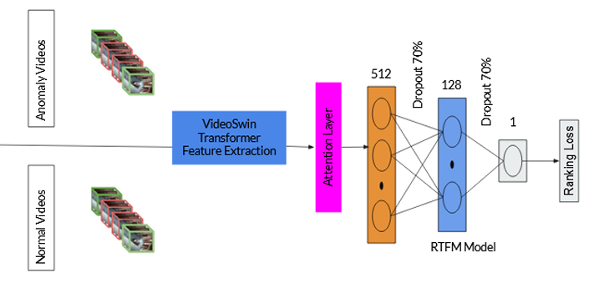
Paper-1

Slide 9
Paper-1
Attention layer:
Global temporal Context M:
M = conv1D(conv1D(F) || conv1D(conv1D(conv1D(F)))) + F
Short-term temporal dependencies K: K = conv1D(F)
Attention feature map F’: F' = concat(M, K) + F
Anomaly detection:
1. Anomaly Score (score(X+, X-)):
score(X+, X-) = max(0, m + mean(topK(X+)) - mean(topK(X-)))

Slide 10
Paper-1
2. Binary Cross-Entropy Loss (loss):
loss = y * log(x) + (1 - y) * log(1 - x)
3. Temporal Smoothness: Smoothness = f(vi) - f(vi+1)^2
4. Sparsity: Sparsity = f(vi)
5. Final Loss:
Final_loss = λ1 * Eq1 + λ2 * Eq2 + λ3 * Eq3 + λ4 * Eq4
λ1, λ2, λ3, and λ4 - learning rates

Slide 11
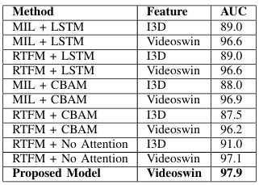
Paper-1
Results & Metrics:

Slide 12
Paper-1
Future work:
localize anomalous segments within videos, rather than just identifying video-level anomalies.
minimize the noise present in the positive bag
real - time deployment
Relevance: Since our research aims to use ViT for anomaly detection, this paper proposes an approach using ViT that outperforms other latest transformer-based approach.

Slide 13
Literature Survey
Vision Transformer-Based Tailing Detection in Videos

Slide 14
Paper-2
Title: Vision Transformer-Based Tailing Detection in Video
Abstract: The paper introduces a method for tailing detection in videos using a modified Time-Series Vision Transformer (TSViT). This model effectively identifies abnormal events like tailing in pedestrian movements, showing promise for applications in video surveillance and anomaly detection.

Slide 15
Paper-2
Algorithm/model: Time-Series Vision Transformer (TSViT). A modified transformer model specifically designed to analyze temporal dependencies in video frames and detect anomalies in pedestrian walking patterns.
Dataset: Sogang Tailing Detection Dataset (STD dataset)

Slide 16
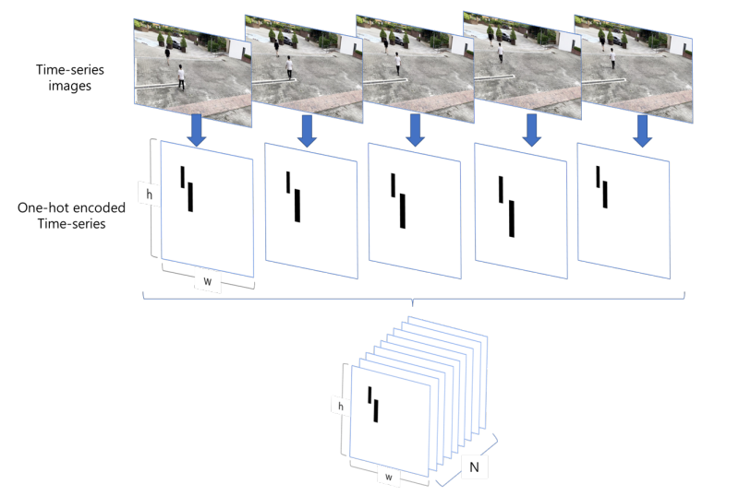
Paper-2

Slide 17


Paper-2
Trajectory similarity used to track moving object locations, using Frechet distance as below:
Cosine similarity used to compare walking direction of pedestrians as below:

Slide 18
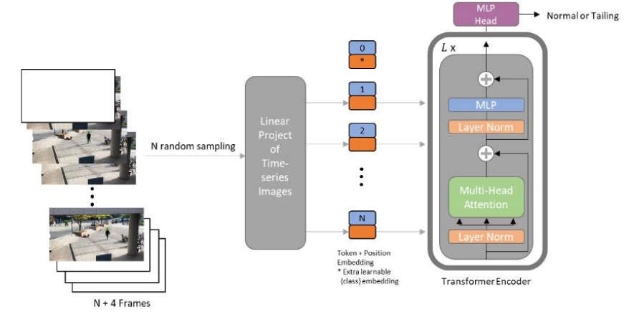
Paper-2

Slide 19

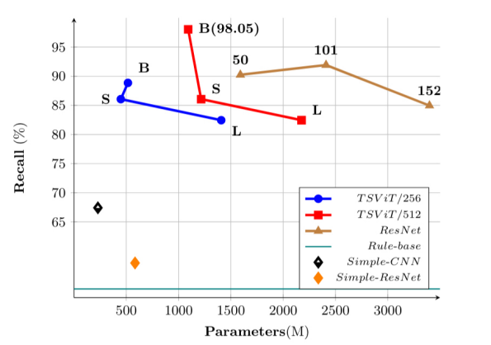
Paper-2

Slide 20
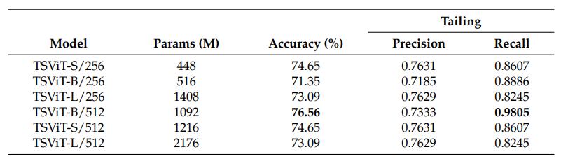
Paper-2
Results & metrics:
Proposed TSViT model outperforms all CNN architectures.

Slide 21
Paper-2
Future work:
leveraging auto-augmentation techniques to mitigate data scarcity and boost model performance
imposing additional constraints on visual cues to improve the identification of tailing events
Relevance: As one of our anomalies is “tailing” and we are employing a vision transformer model, this is a very relevant paper to our research.

Slide 22
Literature Survey
V3Trans-Crowd: A Video-based Visual Transformer for Crowd Management Monitoring

Slide 23
Paper-3
Title: V3Trans-Crowd: A Video-based Visual Transformer for Crowd Management Monitoring
Abstract: The V3Trans-Crowd framework, a transformer-based approach, effectively categorizes crowd behavior using video data. Inspired by 3D visual transformers, it outperforms existing methods in accuracy on the Crowd-11 dataset, enhancing crowd management safety and efficiency.

Slide 24
Paper-3
Algorithm/model: The paper uses the V3Trans-Crowd model which is a 3D visual transformer which integrates both spatial and temporal features.
Dataset: The model is pre-trained on the Imagenet(14 million images and 100k synsets) dataset and Crowd-11(6k video sequences of 100 frames and 11 label classes) as the test dataset.

Slide 25
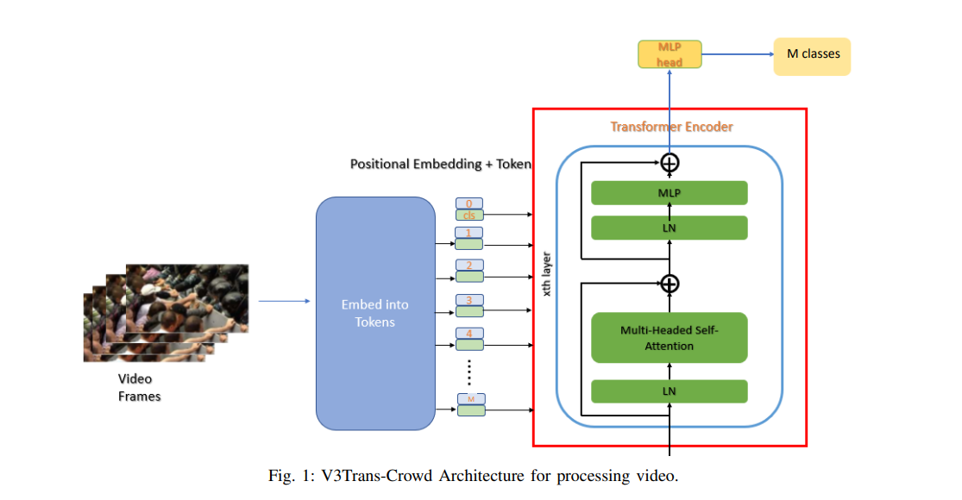
Paper-3

Slide 26



Paper-3
Given video input V with dimensions T×H×W×C spatial-temporal tube dimensions
Linear Projection :
Query, Key and Value computations:

Slide 27


Paper-3
Attention computation:
Concatenation and normalization:

Slide 28
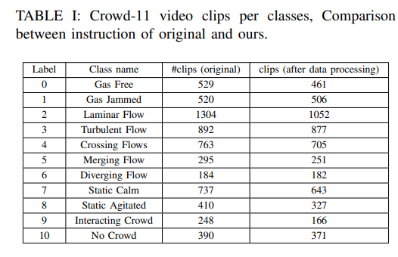
Paper-3

Slide 29
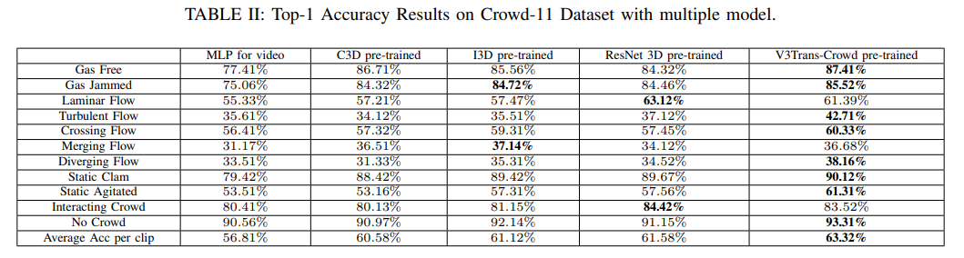
Paper-3
Results & metrics:

Slide 30
Paper-3
Future work: A more generalized system or a more robust semantic hierarchy can be constructed to better track crowds and sub groups that gave similar spatiotemporal features.
Relevance: This solution gives us insight on using transformers with video input and also an interesting approach to building a semantic hierarchy in surveillance footage.

Slide 31
Literature Survey
SwinAnomaly: Real-Time Video Anomaly Detection Using Video Swin Transformer and SORT

Slide 32
Paper-4
Title: SwinAnomaly: Real-Time Video Anomaly Detection Using Video Swin Transformer and SORT
Abstract: The paper proposes a novel architecture, named SwinAnomaly, a video anomaly detection approach based on Swin Transformers. This approach encodes spatiotemporal features from a sequence of video frames using a 3D encoder and upsamples them to predict a future frame using a 2D decoder. It uses YOLOv7 as its object detection model and SORT (Simple Online and Real-TIme Tracking) algorithm for real time identification and tracking of anomalies.The overall method is a reconstruction based method.

Slide 33
Paper-4
Algorithm/model: The model is a GAN which uses Swin Transformer based encoder and decoder.Uses SORT algorithm for real time object detection and tracking
Dataset: UCSD pedestrian, CUHK Avenue, and ShanghaiTech
CHUK Avenue -> 16 training video clips and 21 testing video clips ( include anomalous situations)
UCSD pedestrian -> Divided into 2 subsets Ped1 (34 training and 36 testing) and Ped2(16 training and 12 testing)
ShanghaiTech -> 330 training videos and 107 test videos, capturing 13 different scenes with various camera angles.

Slide 34
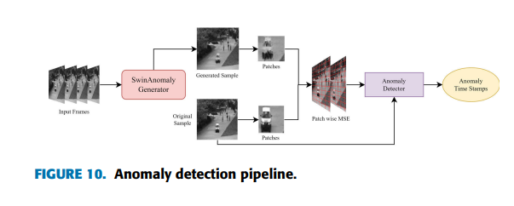
Paper-4

Slide 35



Paper-4
The patch-wise mean squared error on non-overlapping patches of the predicted frame and ground truth frame.
Query, Key and Value computations:
The IOU score is calculated by :

Slide 36

Paper-4
During training, The loss is calculated using the min max loss, defined by:

Slide 37
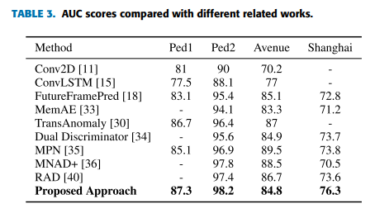
Paper-4
Results & metrics: AUC (Area Under the Curve) is used as the metric to evaluate the model.

Slide 38
Paper-4
Future work:Make the model responsive to outlier anomalies.Swin Transformers are sensitive to lighting conditions, so building a model to overcome this disadvantage.
Relevance: This paper proposes real time object anomaly detection, which is our primary focus as well. Gives an insight of Using Swin transformers and its variant for anomaly detection.

Slide 39
Literature Survey
Enhancing Video Transformers for Action Understanding with VLM-aided Training

Slide 40
Paper-5
Title: Enhancing Video Transformers for Action Understanding with VLM-aided Training
Abstract: Introduces the FTP framework, which combines ViTs and VLMs to improve video action understanding. The framework includes four feature that during training are used to enrich visual embeddings, leading to enhanced generalization across domains and datasets.

Slide 41
Paper-5
Algorithm/model: Four-tier Prompt Network (FTP) for integration of ViTs and VLMs
Dataset: Kinetics-400, UCF-101, SSV2, HMDB51, AVA V2.2 mostly used for video action recognition

Slide 42
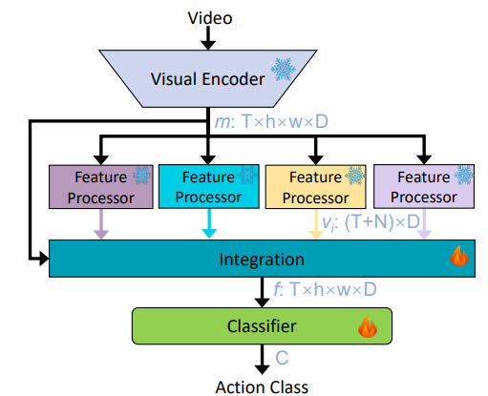
Paper-5

Slide 43
Paper-5
Result:
Achieved remarkable top-1 accuracy of 93.8% on Kinetics-400 and 83.4% on SSV2, surpassing VideoMAEv2 by 2.8% and 2.6%, respectively.
Consistently demonstrated state-of-the-art performance on datasets such as Kinetics-400/600, Something-Something V2, HMDB51, UCF-101, and AVA V2.2, with lower computation costs compared to recent methods

Slide 44
Paper-5
Relevance:
The paper highlights the success of the FTP framework in enhancing video action understanding which is very useful for the task at hand which would enable us to extract textual embeddings and gain more semantic understanding from video sequences

Slide 45
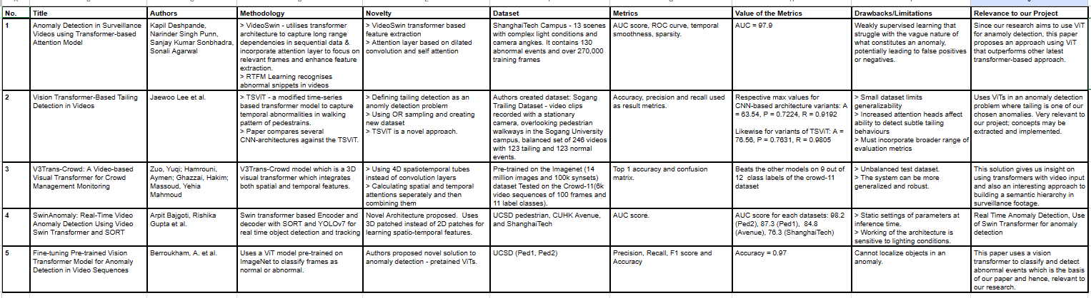
Comparative Summary of all the Papers Studied

Slide 46
Summary of Literature Survey
Multi-Event Anomaly Detection for Enhanced Video Surveillance
The main conclusions drawn from these papers highlight the effectiveness of transformer models in capturing complex spatiotemporal patterns within videos, enabling accurate anomaly detection.
By utilizing attention mechanisms and transformer architectures, these models demonstrate superior performance in identifying abnormal events or behaviors within surveillance footage.

Slide 47
Conclusions of Literature Survey
Multi-Event Anomaly Detection for Enhanced Video Surveillance
Main similarities noticed between all the papers studied are the common transformer architectures and attention mechanisms which have proven to be effective with different parameters in different scenarios.
There are slight differences in model architectures (pre-processing, analysis). Different kinds of anomalies are handled in different papers and results are measured using different evaluation metrics.

Slide 48
Design Constraints, Assumptions & Dependencies
Multi-Event Anomaly Detection for Enhanced Video Surveillance
1) Availability of Pre-trained LLMs and VLMs
2) Availability of Labeled Video Data
3) Transferability of Semantic Understanding
4) Interpretability of Learned Representations

Slide 49
Design Approach
Multi-Event Anomaly Detection for Enhanced Video Surveillance
Modular Approach: The system is designed with a modular architecture that allows for the independent development, testing, deployment, and scaling of distinct and reusable components.
Advanced ML-based Analysis: The system leverages state-of-the-art DL models (ViTs and VLMs) for spatial and temporal analysis of video data, extracting meaningful features, patterns, and insights to detect anomalies, classify events, and generate alerts.

Slide 50
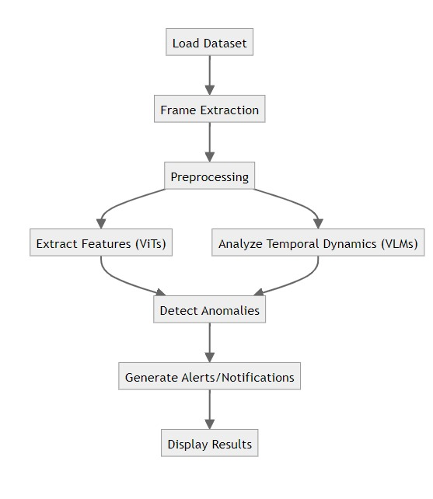
Proposed Methodology
Multi-Event Anomaly Detection for Enhanced Video Surveillance
Diagram depicts the potential high-level design of our proposed workflow.

Slide 51
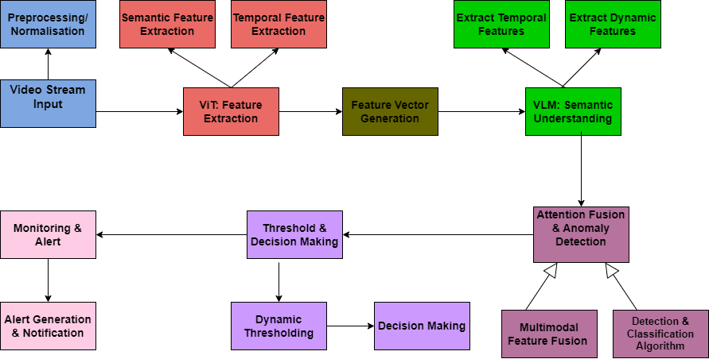
Architecture
Multi-Event Anomaly Detection for Enhanced Video Surveillance

Slide 52
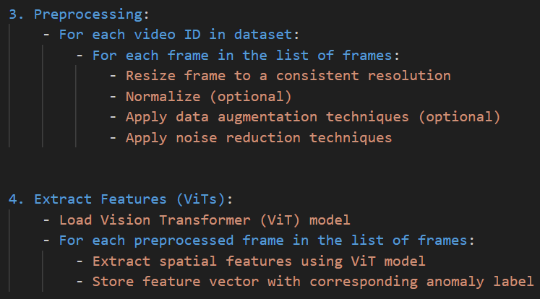
Pseudocode Sample
Multi-Event Anomaly Detection for Enhanced Video Surveillance
https://drive.google.com/file/d/1K62RdJasHKJBLqO-GHT-NRiWiFUeWCq1/view?usp=drive_link
Notes:
open pseudocode.txt for further explanation, if required

Slide 53
Datasets
Multi-Event Anomaly Detection for Enhanced Video Surveillance
Violent-Flows: Real-world, video footage of crowd violence that contains 246 videos downloaded from YouTube.
CUHK Avenue Dataset: Contains 16 training and 21 testing video clips with 30652 frames in total. The training videos are normal situations while testing videos contain both standard and abnormal events.
UCSD Pedestrian Dataset: Contains videos with pedestrians, includes groups of people walking towards, away, and parallel to the camera.
Notes:
open pseudocode.txt for further explanation, if required

Slide 54
Datasets
Multi-Event Anomaly Detection for Enhanced Video Surveillance
4) ShanghaiTech Campus: 13 scenes with complex lighting and camera angles, contains 130 abnormal events and over 270,000 annotated ground truth training frames.
5) UCF-Crime Dataset: Consists of 1900 real-world footage with 13 realistic anomalies including abuse, arson, assault, accidents, etc.
6) XD-Violence Dataset: Contains audio signals, leveraging multimodal information, multi violent labels (1 ≤ #labels ≤ 3) to each violent video owing to the co-occurrence of violent events.
Notes:
open pseudocode.txt for further explanation, if required

Slide 55

Datasets Snapshots
Multi-Event Anomaly Detection for Enhanced Video Surveillance

Slide 56
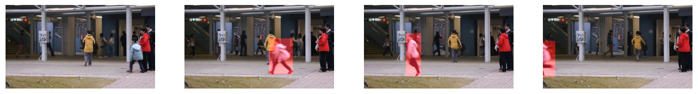
Implementation
Multi-Event Anomaly Detection for Enhanced Video Surveillance
0: #O A man Y walks around the park
1: #O The man X runs towards a gate
2: #O man Y walks out of the store
3: #O man Y walks out of the building
4: #O The man B walks towards the building
5: #O a person H walks in the area
6: #O A man T walks on a sidewalk
7: #C C walks on the pavement
8: #O A man W walks on the pavement
9: #C C walks down the street
Stills from the input sent to the VLM LaViLa and the description generated by the model.

Slide 57
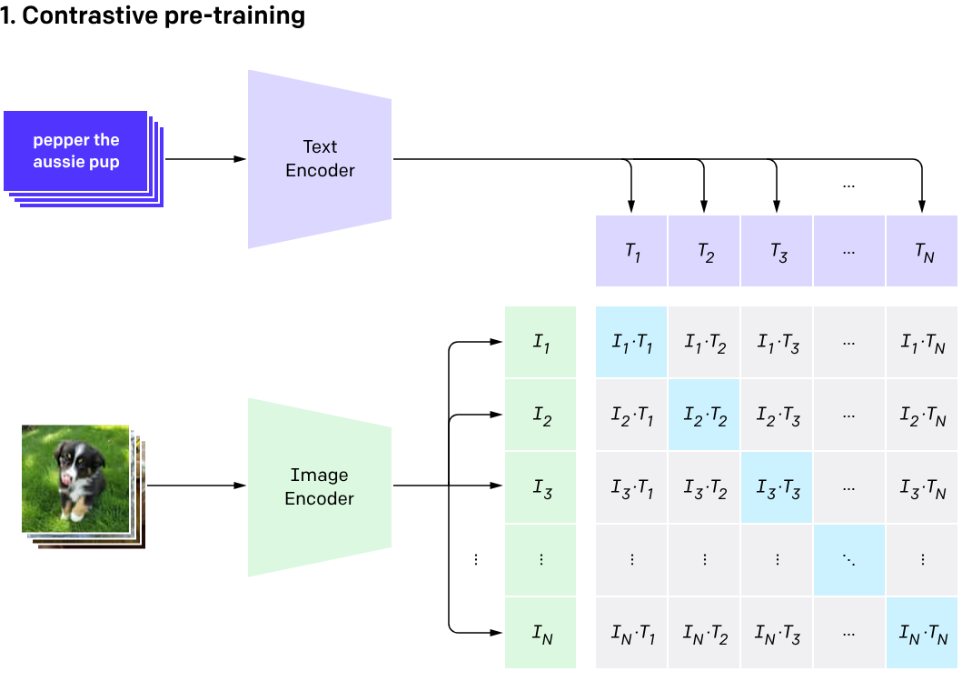
CLIP (Contrastive Language-Image Pre-Training)
Multi-Event Anomaly Detection for Enhanced Video Surveillance
> A multi-modal vision and language model used for image-text similarity and zero-shot image classification
> Uses a ViT-like model to get visual features and a causal language model to get text features
> Both are then projected to a latent space with identical dimension
> Dot product between the projected image and text features is used as similarity score

Slide 58
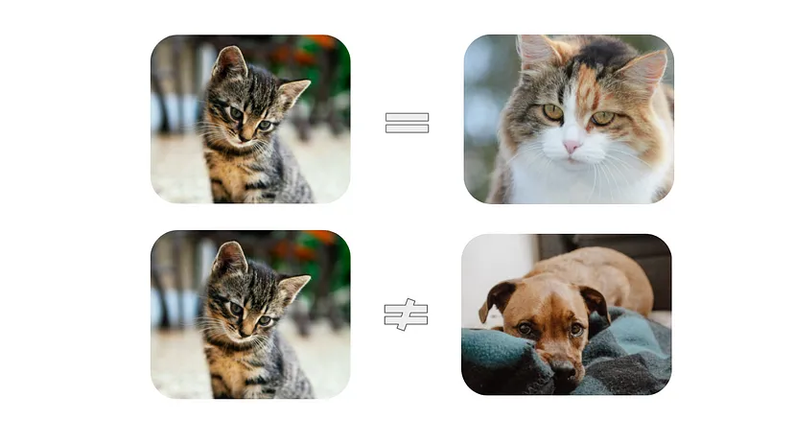
Contrastive Learning
Multi-Event Anomaly Detection for Enhanced Video Surveillance
The LaVila video description model is builds upon OpenAI’s breakthrough CLIP model. Both of these models use the concept of Contrastive Learning.
Contrastive learning is a machine learning technique used to learn the general features of a dataset without labels by teaching the model which data points are similar or different.

Slide 59
Technologies Used
Multi-Event Anomaly Detection for Enhanced Video Surveillance
Programming Languages: Python
Machine Learning Libraries/Frameworks: PyTorch, Transformers
Computer Vision Libraries: OpenCV
Infrastructure: GPUs for accelerated processing, Memory Storage devices
Front-end: Streamlit UI for dashboard development.

Slide 60
Project Progress
Multi-Event Anomaly Detection for Enhanced Video Surveillance
Progress:
1) Extensive literature survey conducted.
2) Previous implementations researched and applied.
3) Potential proposed methodology designed.
4) Datasets finalized.
5) Started on initial bit of implementation.
Percentage completion: 30%

Slide 61
Summary of Work Done in Capstone Phase-I
Multi-Event Anomaly Detection for Enhanced Video Surveillance
In phase 1, through extensive research and studies, we were able to lay the foundational groundwork for further development stages.
Summarily,
> definition of project objectives
> in-depth understanding of problem domain through extensive literature survey
> identification of system requirements
> clear high-level system design
> resources and frameworks identified for implementation

Slide 62
Project Plan for Capstone Phase-II
Multi-Event Anomaly Detection for Enhanced Video Surveillance
As depicted by the Gantt chart, our plan for Phase-II includes:
Implementation
Unit Testing and Integration
Model Deployment
End-to-End Testing and Validation
Documentation
Research Paper Writing

Slide 63
References
Multi-Event Anomaly Detection for Enhanced Video Surveillance
Zuo, Y., Hamrouni, A., Ghazzai, H., & Massoud, Y. (May 2023). V3Trans-Crowd: A Videobased Visual Transformer for Crowd Management Monitoring. 2023 IEEE International Conference on Smart Mobility (SM), pp. 154-159. doi: 10.1109/SM57895.2023.10112514.
Zhao, Y. et al. (2024). Learning Video Representations from Large Language Models.
Lee, J., Lee, S., Cho, W., Siddiqui, Z.A., & Park, U. (December 2021). Vision Transformer-Based Tailing Detection in Videos. Appl. Sci., 11, 11591. https://doi.org/10.3390/app112411591

Slide 64
References
Multi-Event Anomaly Detection for Enhanced Video Surveillance
Deshpande, K., Sonbhadra, S. K., Punn, N. S., & Agarwal, S. (June 2022). Anomaly detection in surveillance videos using transformer-based attention model.
Bajgoti, A., Gupta, R., & Balaji, P. (October 2023). SwinAnomaly: Real-Time Video Anomaly Detection Using Video Swin Transformer and SORT. IEEE Access, 111093-111105. DOI: 10.1109/ACCESS.2023.3321801
Lu, H. et al. (2024). Enhancing Video Transformers for Action Understanding with VLM-aided Training. arXiv:2403.09876.
And several others.

Slide 65
Thank you!

