Slide 1
ScholarTrack
PROJECT PRESENTATION
Finding every open scholarship in one place, ordered by what closes first
3
58
157
live portals
open scholarships
automated tests
Notes:
ScholarTrack aggregates open scholarships for Indian students from three live portals into one list ordered by the nearest deadline, stores the details students retype on every form, and tracks each application. Everything shown today runs against the real portals.

Slide 2
Scholarships are scattered, and applying repeats itself
Two separate problems, both costing students awards they qualify for
1
Discovery is fragmented
2
Applying is repetitive
Central schemes sit on NSP, private ones on Buddy4Study, corporate CSR funds on Vidyasaarathi. No portal shows another’s listings, and none orders by urgency — so the scholarship closing in three days is not shown before the one closing in three months.
Every form asks for the same name, date of birth, category, income, marks, bank details and document list. Eight applications means retyping it eight times, and one mistyped IFSC or income figure can invalidate the application.
Deadlines are missed not because students are unaware of scholarships, but because the information is scattered and the effort of applying repeats.
Notes:
Worth stressing: this is not an awareness problem. Students know scholarships exist. The cost is in finding which are open right now, and in the repetition of applying. ScholarTrack attacks both.

Slide 3
One dashboard, ordered by what closes first
Four capabilities, each answering one part of the problem
1
Aggregate and rank
Three portals merged into one list, nearest deadline first, expired hidden. Refreshed automatically every day.
2
Deep-link to the scholarship
Apply opens that scholarship’s own page — never a portal home page. A record with no specific page is discarded, not published with a misleading link.
3
Reusable portfolio
Personal, academic, family, bank, document and CV details stored once, with a copy button beside every field.
4
Track every application
Saved → Applied → Under review → Awarded or Rejected. Pressing Apply records the scholarship automatically.
Notes:
The deep-link rule is the one to dwell on. A naive aggregator links to the portal and leaves the student to search again, which destroys most of the value of aggregating. We enforce it centrally rather than trusting each scraper.

Slide 4
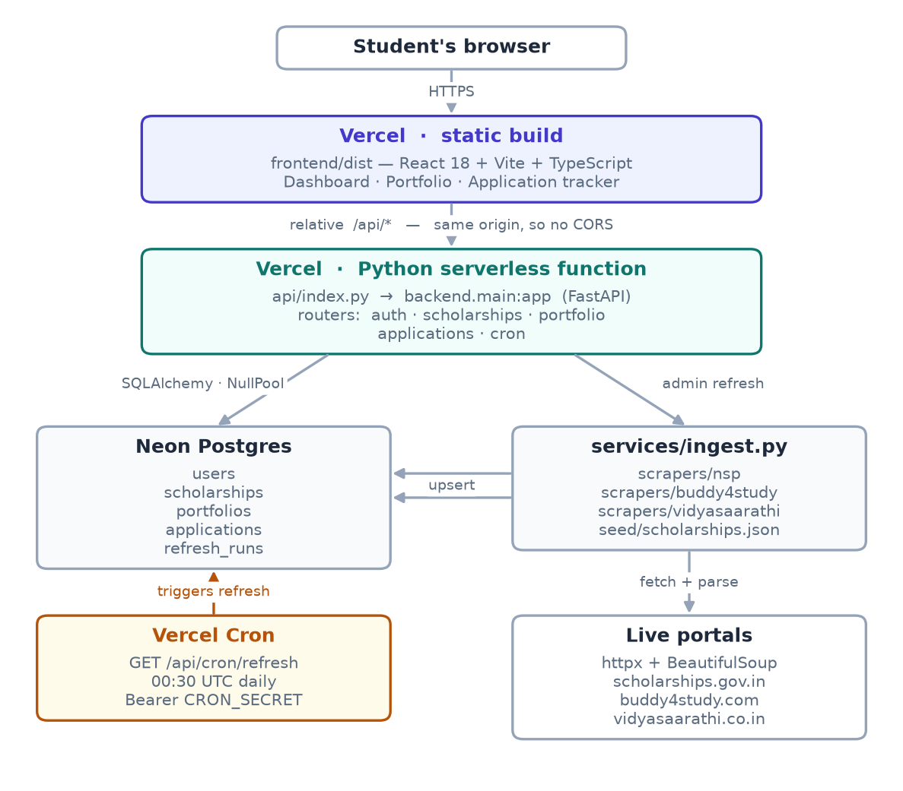
How it is built
React front end, FastAPI on a serverless function, managed Postgres, daily scheduled refresh
Same-origin API
The browser calls relative /api paths, so production needs no CORS configuration at all.
No pooled connections
Serverless functions freeze between calls, so a held pool leaks connections. We use a null pool and let the database’s own pooler do the work.
No headless browser
Scraping uses an HTTP client and an HTML parser only, so the refresh fits inside a serverless function.
Notes:
Three constraints shaped this: same-origin removes CORS, null pooling is forced by serverless execution, and ruling out a headless browser is what made data acquisition the hard part of the project.

Slide 5
Three portals, three different problems
None publishes an API. Two actively mislead a direct reading of the page
NSP
Buddy4Study
Vidyasaarathi
31 schemes
12 scholarships
15 schemes
THE PROBLEM
THE PROBLEM
THE PROBLEM
Four dates per scheme, only one actionable. Labels contain doubled spaces, so a literal match finds nothing. Missing documents render as the text “null”.
Listing rendered entirely in the browser. The delivered HTML holds no scholarships, and the embedded state carries only translation strings.
“Currently No Schemes are Available” appears even when 15 are open — it is a branch inside the page’s own script. Served as ISO-8859-1.
HOW IT WAS SOLVED
HOW IT WAS SOLVED
HOW IT WAS SOLVED
Match the student deadline specifically, after collapsing whitespace.
Its sitemap lists 1,350 scholarship pages, and each one is server-rendered with full data for search engines.
Read the embedded data array; test for emptiness only after stripping scripts.
Neither solution executes JavaScript: both read what the site already publishes for other purposes.
Notes:
This is the slide to spend time on — it is where the real engineering was. Buddy4Study: the sitemap is declared in robots.txt, and individual pages are server-rendered because the site wants them indexed. Vidyasaarathi: the empty-state string is the else-branch of its own renderer, which is why a naive scraper reports zero schemes while fifteen are open.

Slide 6
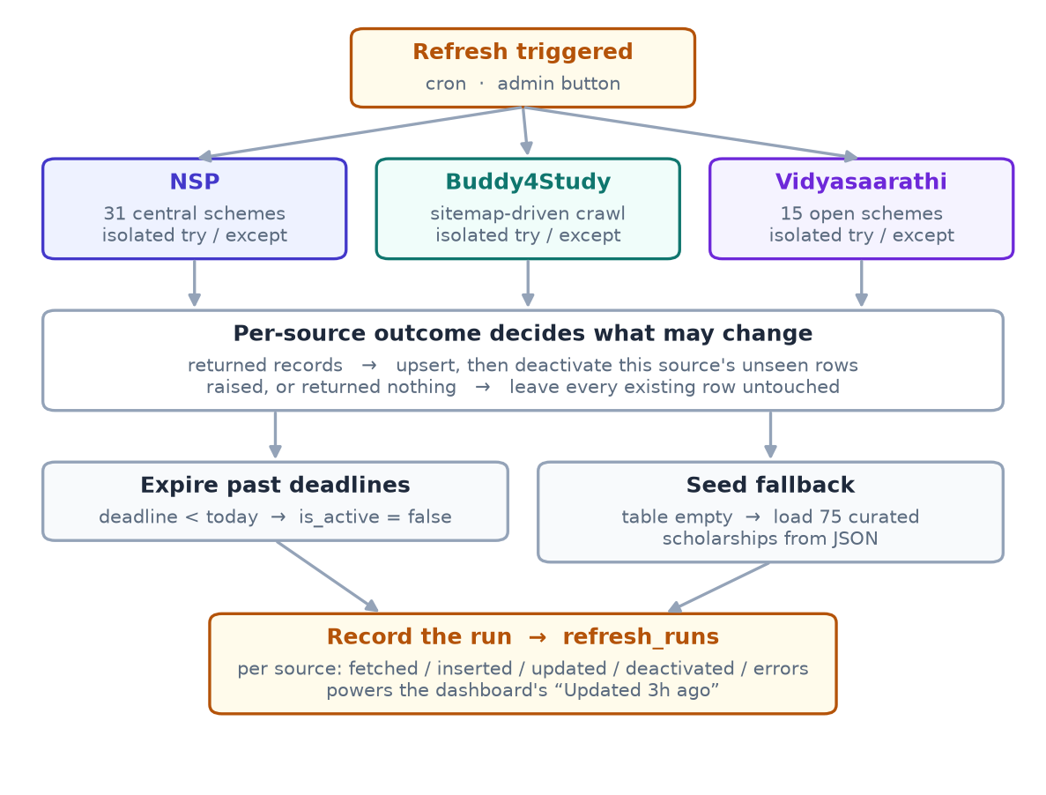
What happens when a portal goes down
Scraping breaks. The design assumes it, so a failure degrades nothing
Failure is not absence
The obvious implementation — mark anything not seen as closed — deletes a whole catalogue the first time a site is unreachable.
Only a source that returned data may retire its own rows
A scraper that raises, or returns nothing, changes nothing.
A verified fallback of 75 scholarships
With all three portals failing, the dashboard still lists real scholarships in deadline order.
Notes:
Demonstrated, not argued: with all three scrapers forced to fail against an empty database, the run is correctly reported as failed, each source is named in the summary, and the dashboard still shows 75 scholarships in deadline order.

Slide 7
What the system delivers
Measured against the live portals on 17 October 2026
58
3
75
157
open scholarships
in one refresh
live portals
aggregated
verified fallback
records
automated tests,
all passing
Objectives met
Nearest deadline first, expired hidden — verified by test and by inspection
Every Apply opens a scholarship-specific page; two portals with no public page show the scheme name to select
A failing portal leaves its own records untouched; all three failing still yields a working dashboard
No Aadhaar number, no full account number, no plaintext password — enforced at the schema level
Notes:
The one objective not fully closed is deployment: the hosting configuration is written and the build verified, but the live deployment was still being brought up at the time of writing. Everything else is demonstrable.

Slide 8
HONEST LIMITS AND WHAT COMES NEXT
Where it stops, and where it goes
Limitations
Future scope
Buddy4Study coverage is partial — the crawl is bounded to fit the function time limit
NSP and Vidyasaarathi publish no per-scheme page, so Apply opens the correct entry point plus the scheme name
The fallback file stores real deadlines and must be regenerated as they pass
Level and tag classification is heuristic; it aids filtering, it is not authoritative
State portals such as MahaDBT, through the same scraper interface
Eligibility matching — the portfolio already holds category, income, level and marks
Deadline notifications, using the countdown already computed
Alerting when a portal’s markup changes, so a parser is repaired before a refresh returns nothing
ScholarTrack
Thank you — questions welcome
Notes:
Closing on limitations deliberately: every one of these is a consequence of a constraint we chose knowingly, and each has a stated route forward. Happy to take questions on any of the three scrapers.

