Slide 1

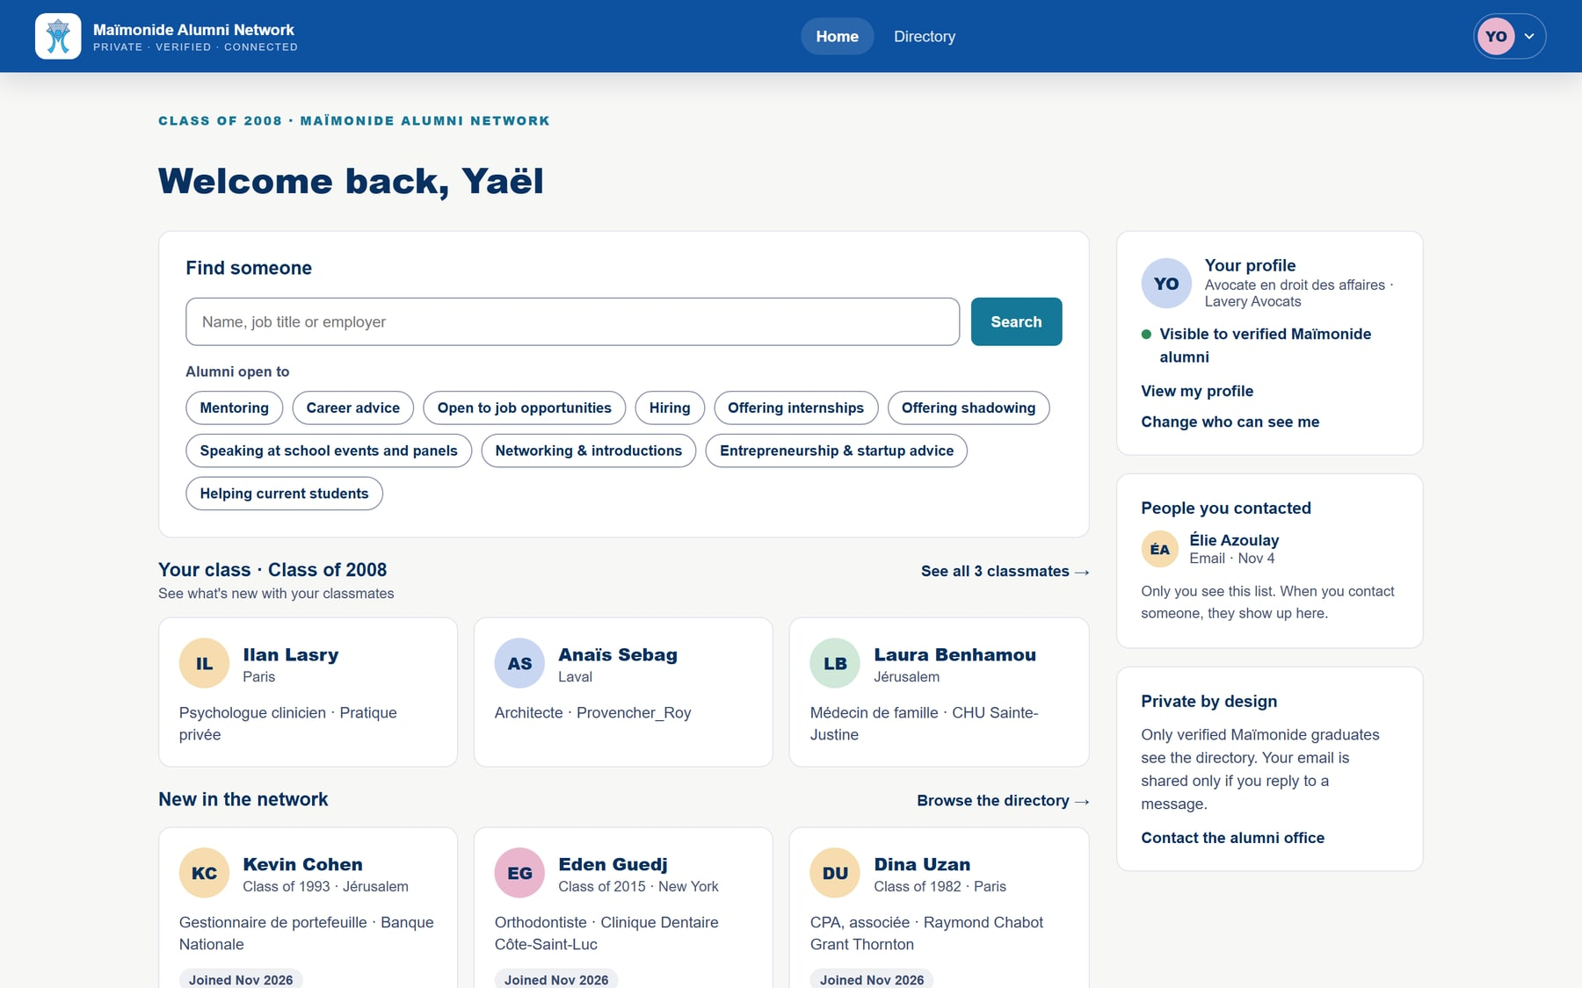
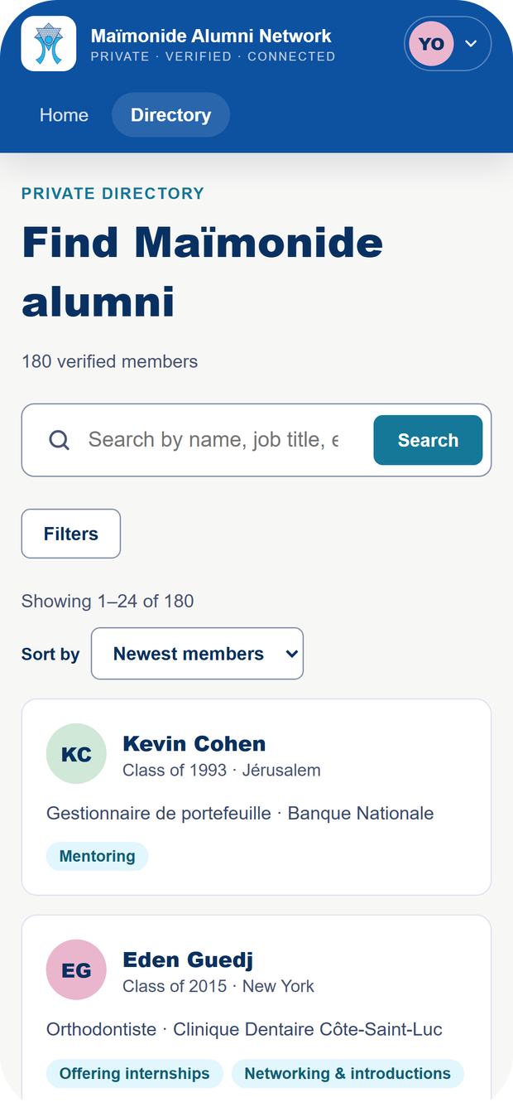
Every class.
One network.
THE MAÏMONIDE ALUMNI NETWORK
The private platform that keeps your graduates connected to the school, and to each other.
Presentation to École Maïmonide · November 5, 2026
Notes:
Hello and thank you for having us. We are building a platform for schools: a private network where alumni find each other, help each other and stay connected to their school. Everything you will see is already in Maïmonide’s colours; the people shown are fictional. First the why, then a graduate’s journey, the school’s side, and a live demo to finish.

Slide 2




On graduation day, the connection starts to fade.
THE PROBLEM
Scattered
Out of reach
Too public
Untapped
Montreal, Paris, Tel Aviv, New York: the school loses track of its alumni.
Old emails, names changed after marriage: alumni lists go stale.
LinkedIn can’t show you “Maïmonide alumni who want to help”.
Many alumni want to help, but nobody knows whom to ask.
Notes:
The problem is simple. After graduation, alumni scatter and lists go stale fast: emails change, and many women change their name after marriage. LinkedIn is public and impersonal: you can’t search for Maïmonide alumni who want to help. Yet many alumni would love to give back to the school and to younger graduates. What’s missing is a place for it.

Slide 3
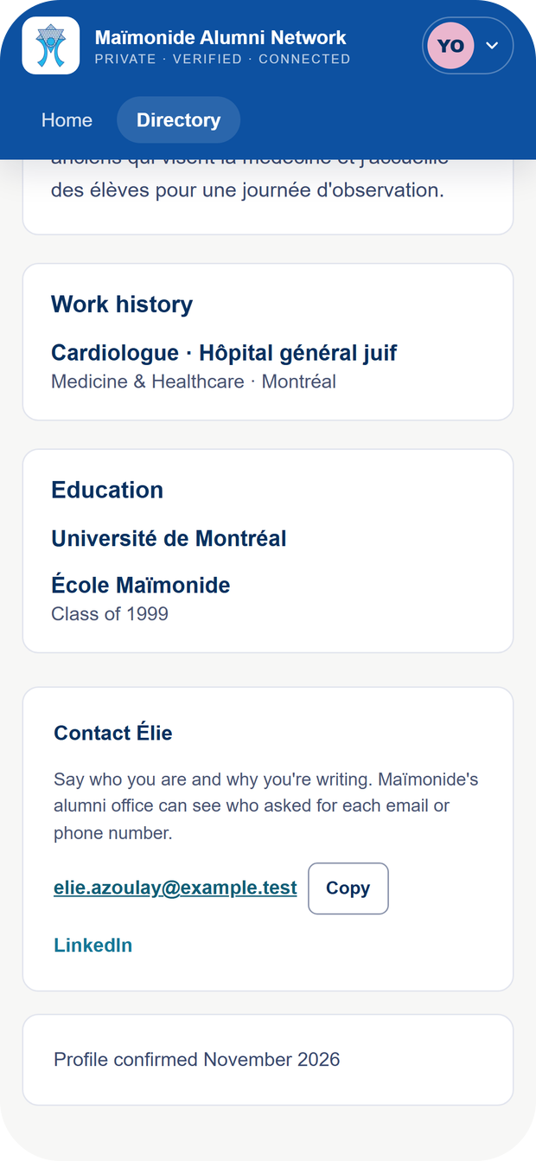



A private network, verified, in your colours.
OUR ANSWER
Private
Only approved alumni see the directory.
Verified
The school approves every sign-up.
Your brand
Your address, your logo, your colours.
maimonide.alumninetwork.ca
Notes:
Our answer: a private professional network for Maïmonide graduates only, at its own address. Private, because only approved alumni see the directory. Verified, because the school approves every sign-up. In your colours: your logo, your colours, and French as the default language. And it works just as well on a phone.

Slide 4



A stronger community, for everyone.
WHO BENEFITS
For alumni
For the school
For students
Reconnect with classmates
Find a mentor, an internship, a job
Give back and stay close to the school
An alumni list the alumni keep up to date
Know where your graduates are and what they do
A community to rally: events, speakers, philanthropy
Alumni who talk about their careers
Job shadowing days and internships
Every alum says how they can help
Notes:
For alumni: reconnecting with classmates, getting career help, and offering theirs. For the school: a living alumni list that the alumni keep up to date themselves, and a community to rally. For students: every alum can say whether they will talk about their job, host a student for a day or offer an internship. Direct student access doesn’t exist yet; it’s an idea for later.

Slide 5






Trust, by design.
PRIVACY
Alumni decide
Controlled contact
Schools kept apart
What they show, and whether they appear at all.
Email and phone shown on request, and logged.
Maïmonide’s data stays with Maïmonide.
Audit log
Hosted in Canada
Our access, limited
Every decision is recorded and can’t be altered.
Montreal region, which eases Law 25 compliance.
A stated reason, 8 hours at most, shown in your log.
Notes:
For a school, privacy is not negotiable, so we put it at the centre. Each alum decides what they show and can hide at any time. Contact details appear only on request, one person at a time, and that is logged. Each school is isolated from the others: the database itself enforces it. The data is hosted in Canada, in the Montreal region. And if our team needs to step in for support, it needs a stated reason, access lasts 8 hours at most, and it shows up in your audit log.

Slide 6
A graduate’s journey
01
From sign-up to the first introduction
1
2
3
4
5
Create an account
Request access
School approval
Build a profile
Find and connect
Notes:
A graduate’s journey in five steps: they create an account, introduce themselves to the school, the school approves them, they build a profile, then they find and contact other alumni.

Slide 7
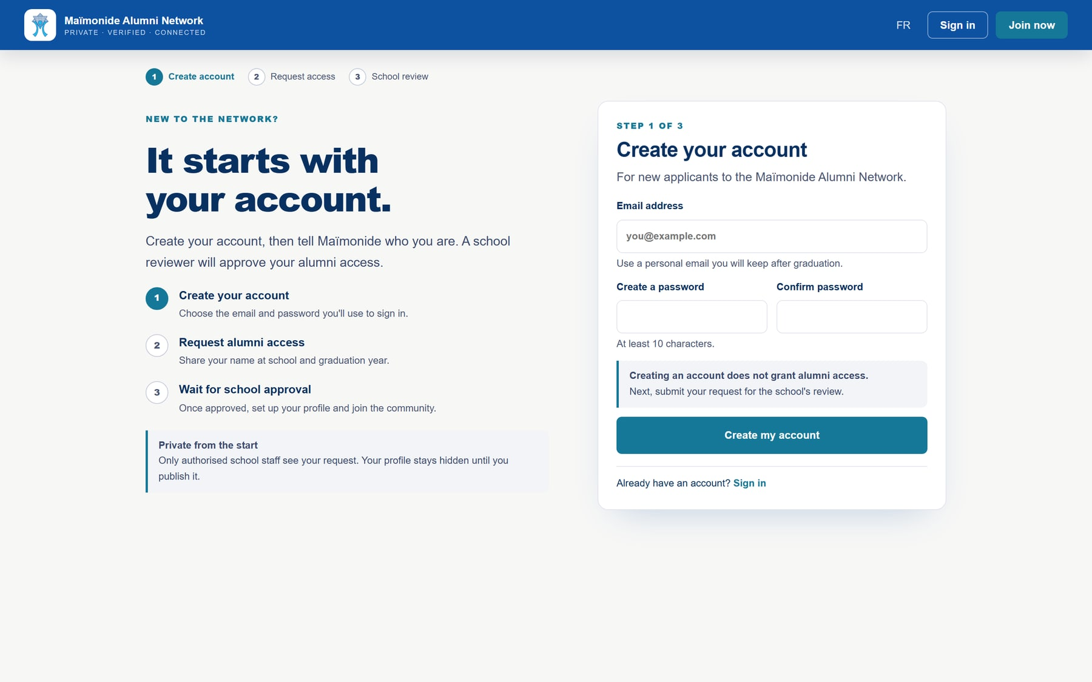

Join in a minute.
STEP 1 · ALUMNI
One link, shared by the school in its newsletter or on social media.
Confirmed email
Every account verifies its address.
Nothing unlocked
An account alone grants no access.
French or English
On every page.
Notes:
The school shares a single link. The graduate creates an account with an email and password, then confirms the address. An account alone grants nothing: the school decides who gets in.

Slide 8
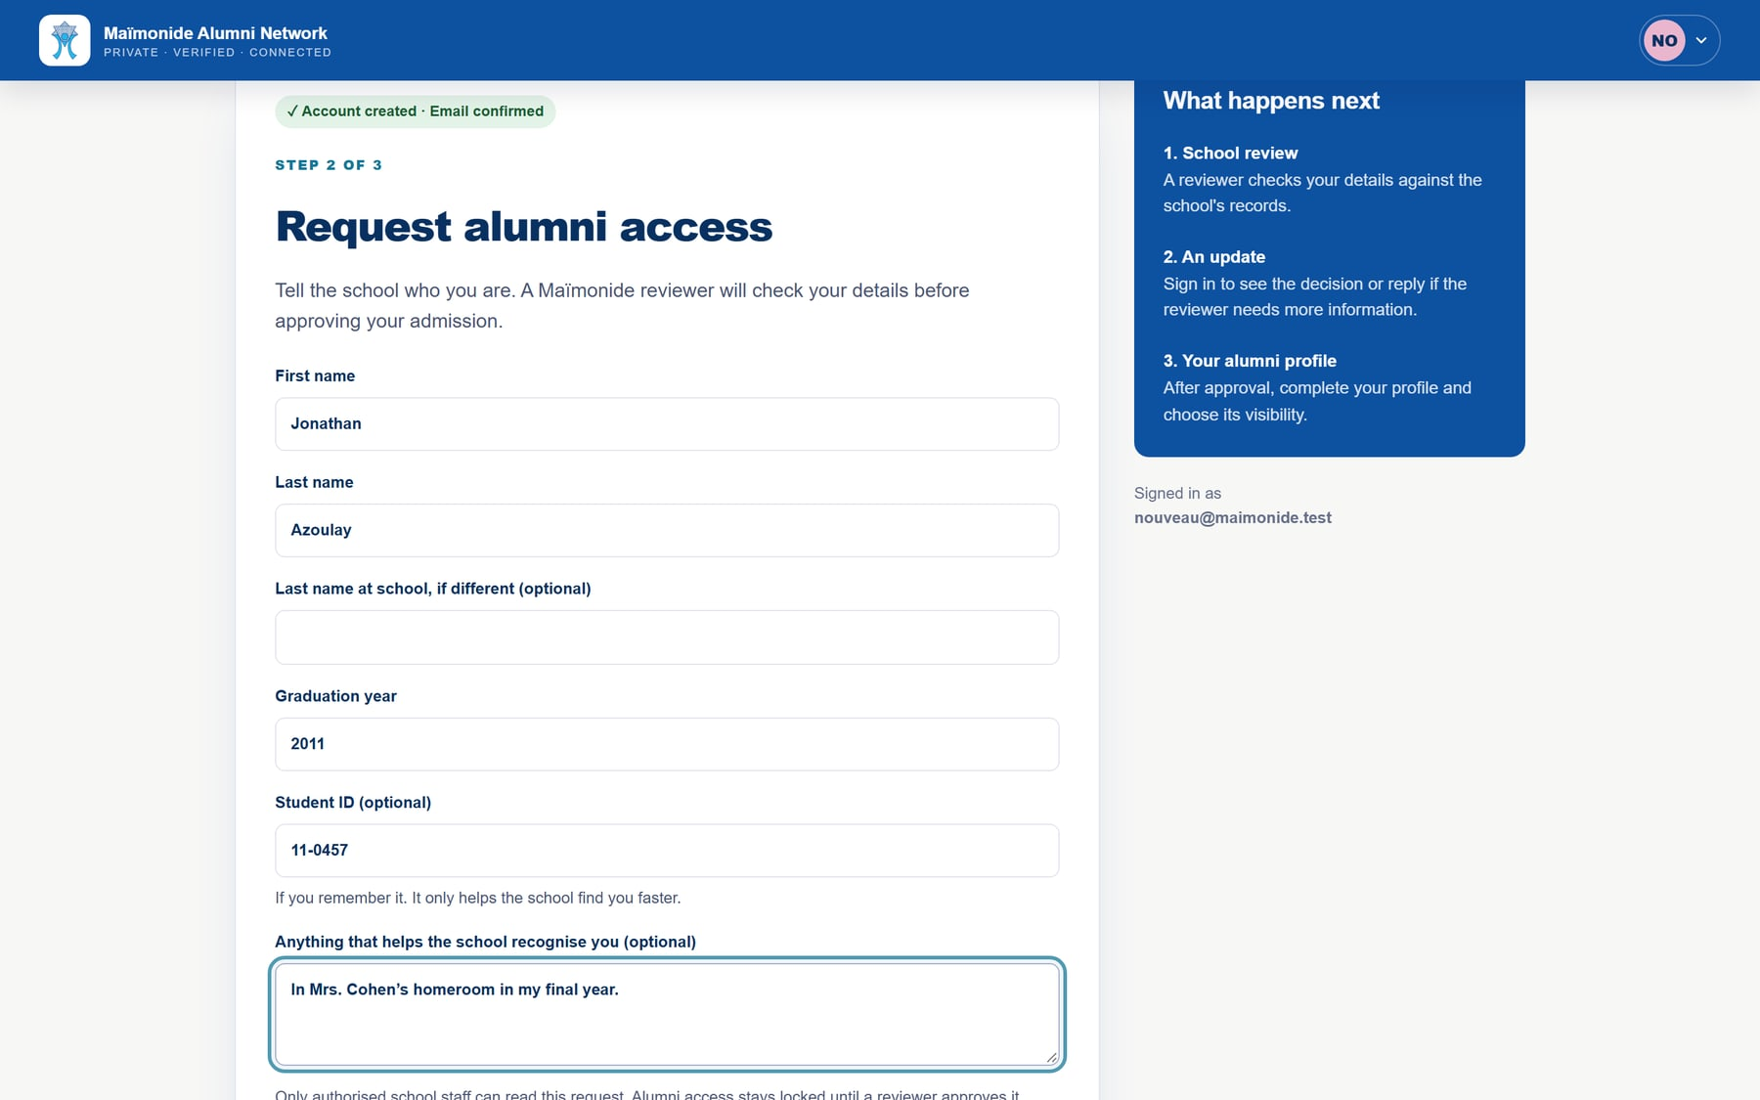

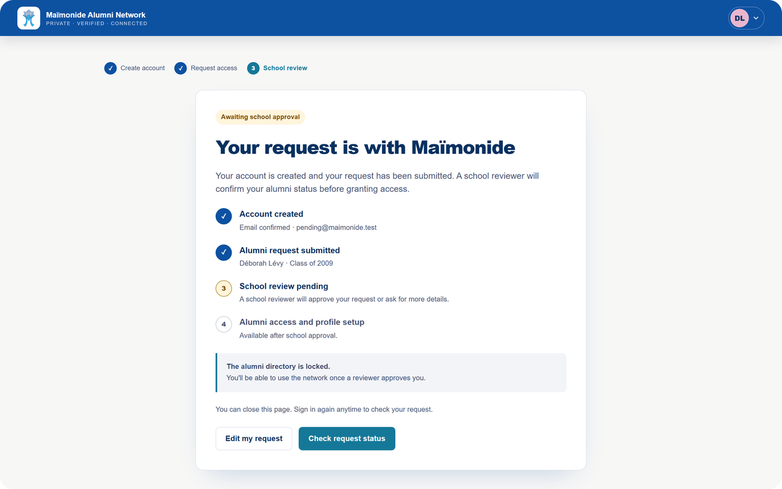
Introduce yourself to the school.
STEP 2 · ALUMNI
Name, name at school, class year and a short note.
Optional student ID
If they remember it, the school finds their record faster.
New: student ID
Maiden name
To recognise graduates who changed their name.
Directory locked
Until the school approves.
Notes:
The graduate introduces themselves: name, name at school if it changed, class year and a note. New in the next version: they can give their student ID if they remember it. It is only a hint: the reviewer sees whether it matches a record, and a person still approves every request. While they wait, the directory stays locked.

Slide 9
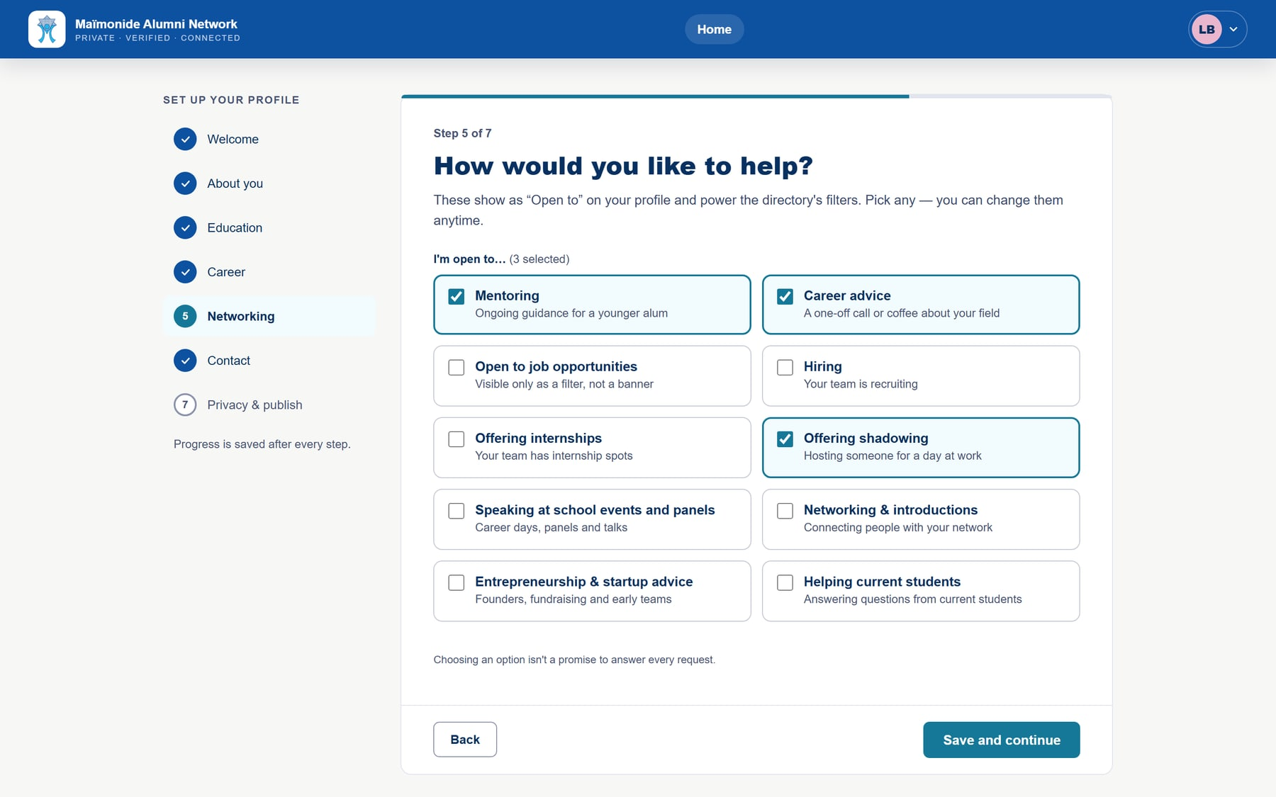
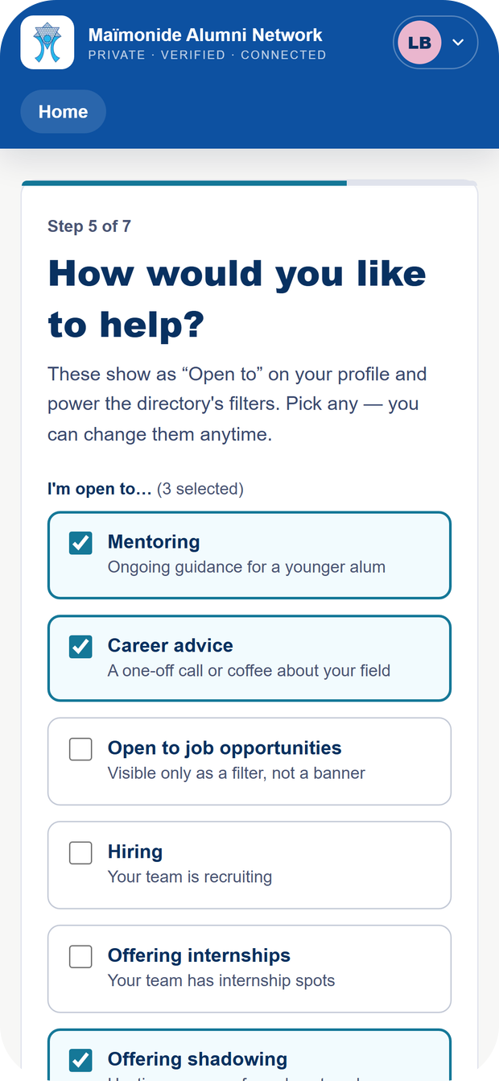


A profile that says how to help.
STEP 3 · ALUMNI
Seven short steps, saved as you go.
Mentoring, internships, shadowing
Alumni choose how they want to help.
Hidden by default
Nothing is published without consent.
Clear consent
They accept the policy before publishing.
Notes:
Once approved, the graduate builds a profile in seven short steps. The key one: “How would you like to help?” Mentoring, career advice, internships, job shadowing, talks, helping students. That is what turns a directory into a network of mutual help. At the end, they choose for themselves whether to appear in the directory.

Slide 10
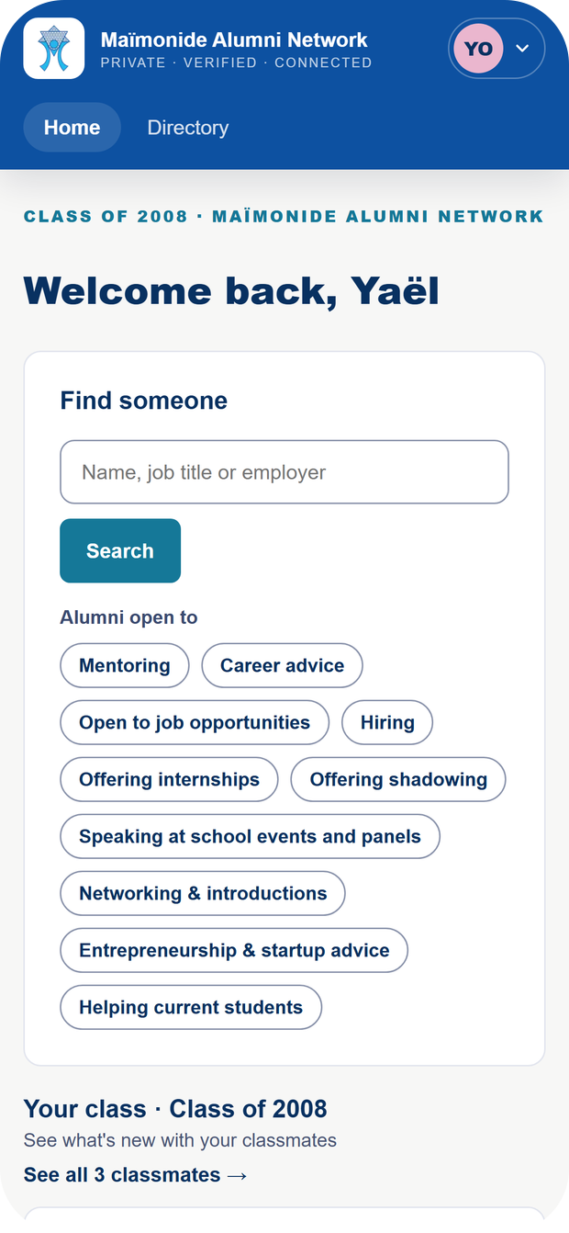


A home page that invites reconnection.
STEP 4 · ALUMNI
Their class, new members, and who is offering help.
Search
By name, job title or employer.
Their class
What classmates are up to.
On mobile
Works on every screen.
Notes:
This is Yaël’s home page, class of 2008. She sees her classmates and new members, searches by name, job title or employer, or clicks “Mentoring” to see who is available.

Slide 11
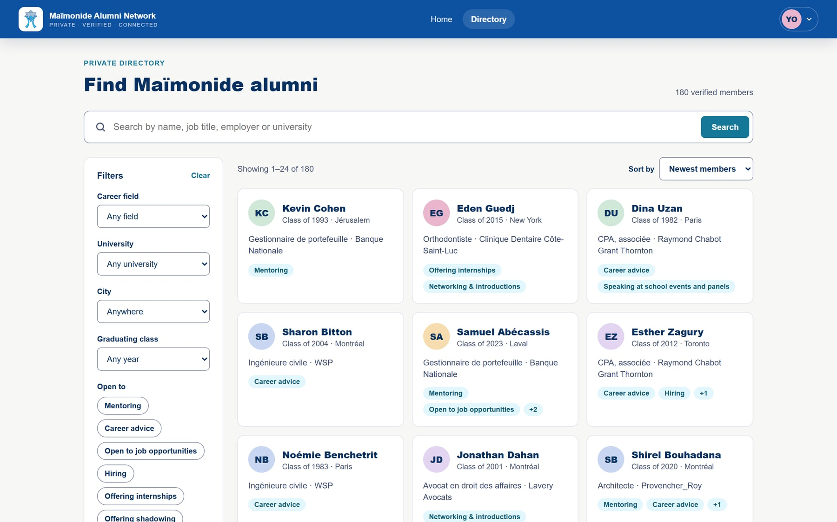


Find the right person in two clicks.
STEP 5 · ALUMNI
A private directory by field, city, university and class.
“Open to”
Mentoring, hiring, internships, shadowing…
Published profiles only
Alumni choose to appear.
Worldwide
Montreal, Paris, Tel Aviv, New York…
Notes:
The directory combines criteria: for example, alumni in medicine in Montreal who offer mentoring. Only alumni who chose to publish their profile appear.

Slide 12


Reach out, with confidence.
STEP 6 · ALUMNI
Career, education, and how each person wants to help.
Email on request
One profile at a time.
Logged
The alumni office knows who asked for what.
Their channels
LinkedIn, email, phone: they choose.
Notes:
A profile shows the person’s career and how they want to help. To write, you click “Show email”: the address appears, and that is logged. It discourages address harvesting and reassures those who share their details.

Slide 13
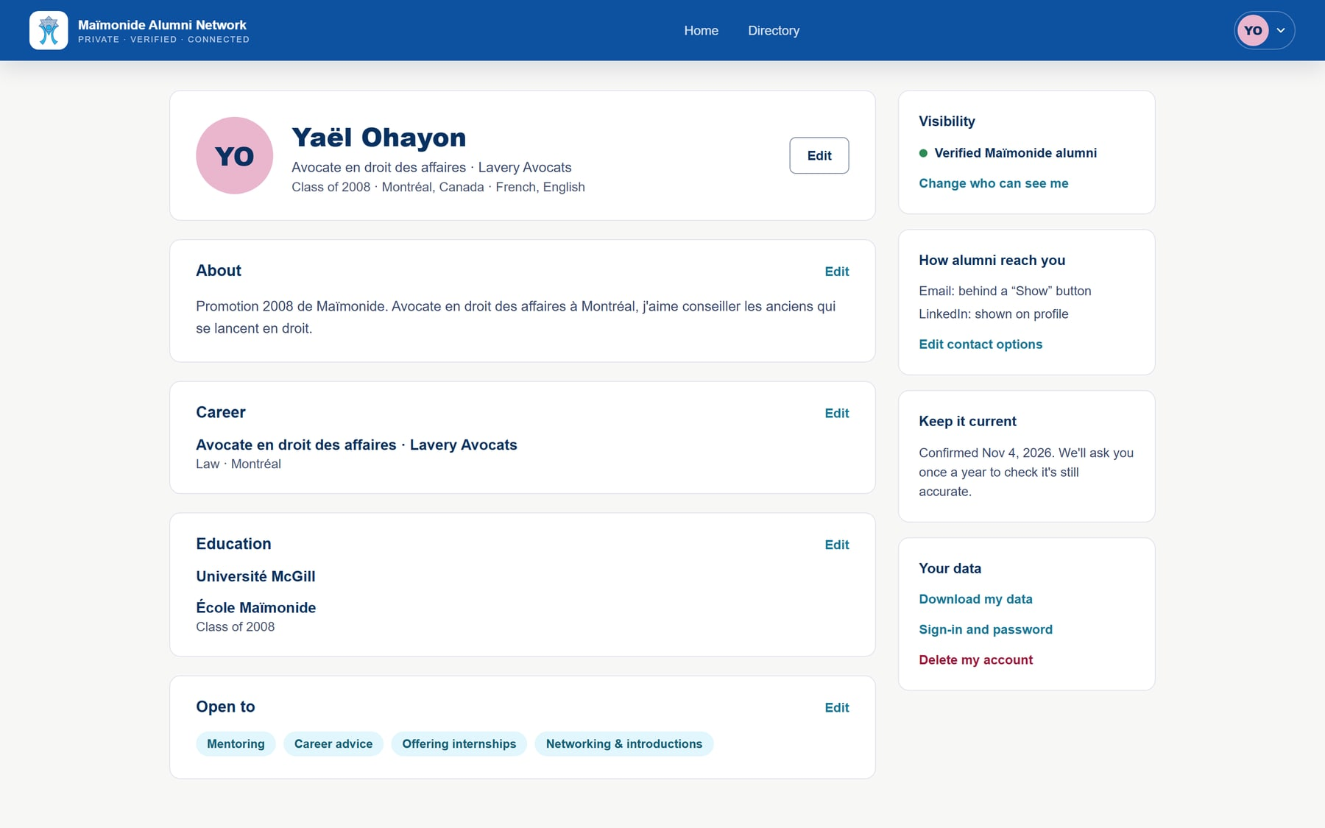

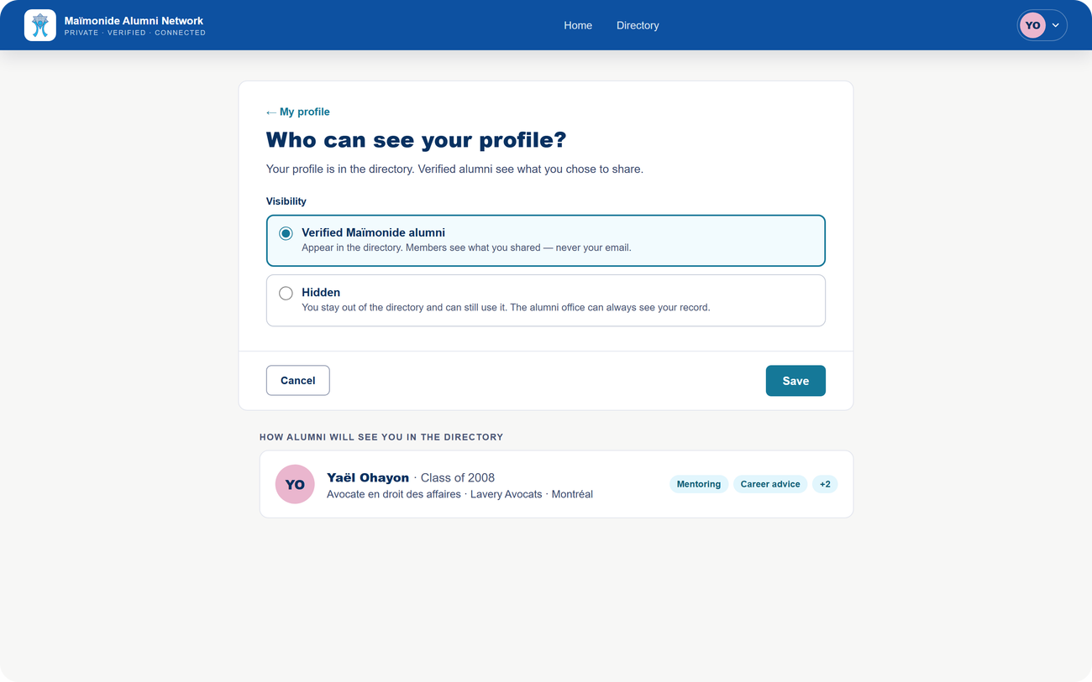

My profile, my rules.
ANY TIME · ALUMNI
Alumni stay in control of their information.
Edit anything
Every section, any time.
Go hidden
In one click.
Their data
Download it, or delete the account.
Notes:
In “My profile”, alumni edit any section whenever they like, change their visibility in one click and choose which contact details to share. They can also download their data or delete their account. That control is what makes people comfortable signing up.

Slide 14

The school’s side
02
Two roles for your team
School admin
Reviewer
Everything: approvals, records, staff, email templates and settings.
Decides on sign-ups and reads records and the audit log.
Notes:
On the school’s side, two roles: the admin, who can do everything, and the reviewer, for example an assistant or a long-time teacher, who recognises alumni and decides on sign-ups.

Slide 15
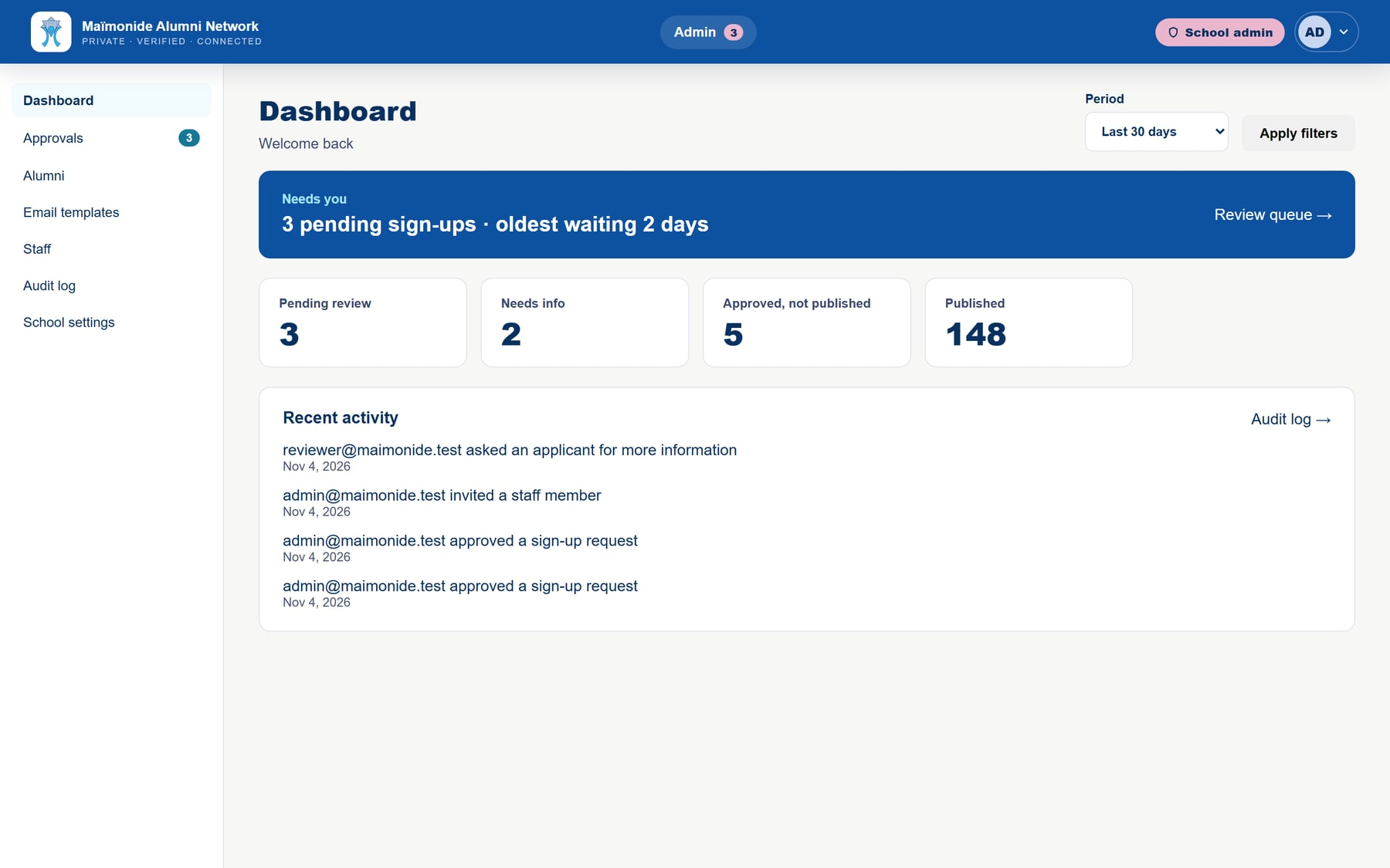



Everything at a glance.
SCHOOL · DASHBOARD
What needs a decision, and what the team is doing.
Waiting
Sign-ups, and for how long.
Key numbers
Info requested, approved, published.
Recent activity
The team’s latest actions.
Notes:
The dashboard shows straight away what needs your attention: here, sign-ups are waiting, the oldest for two days. You also see how many alumni published their profile and what the team did recently.

Slide 16
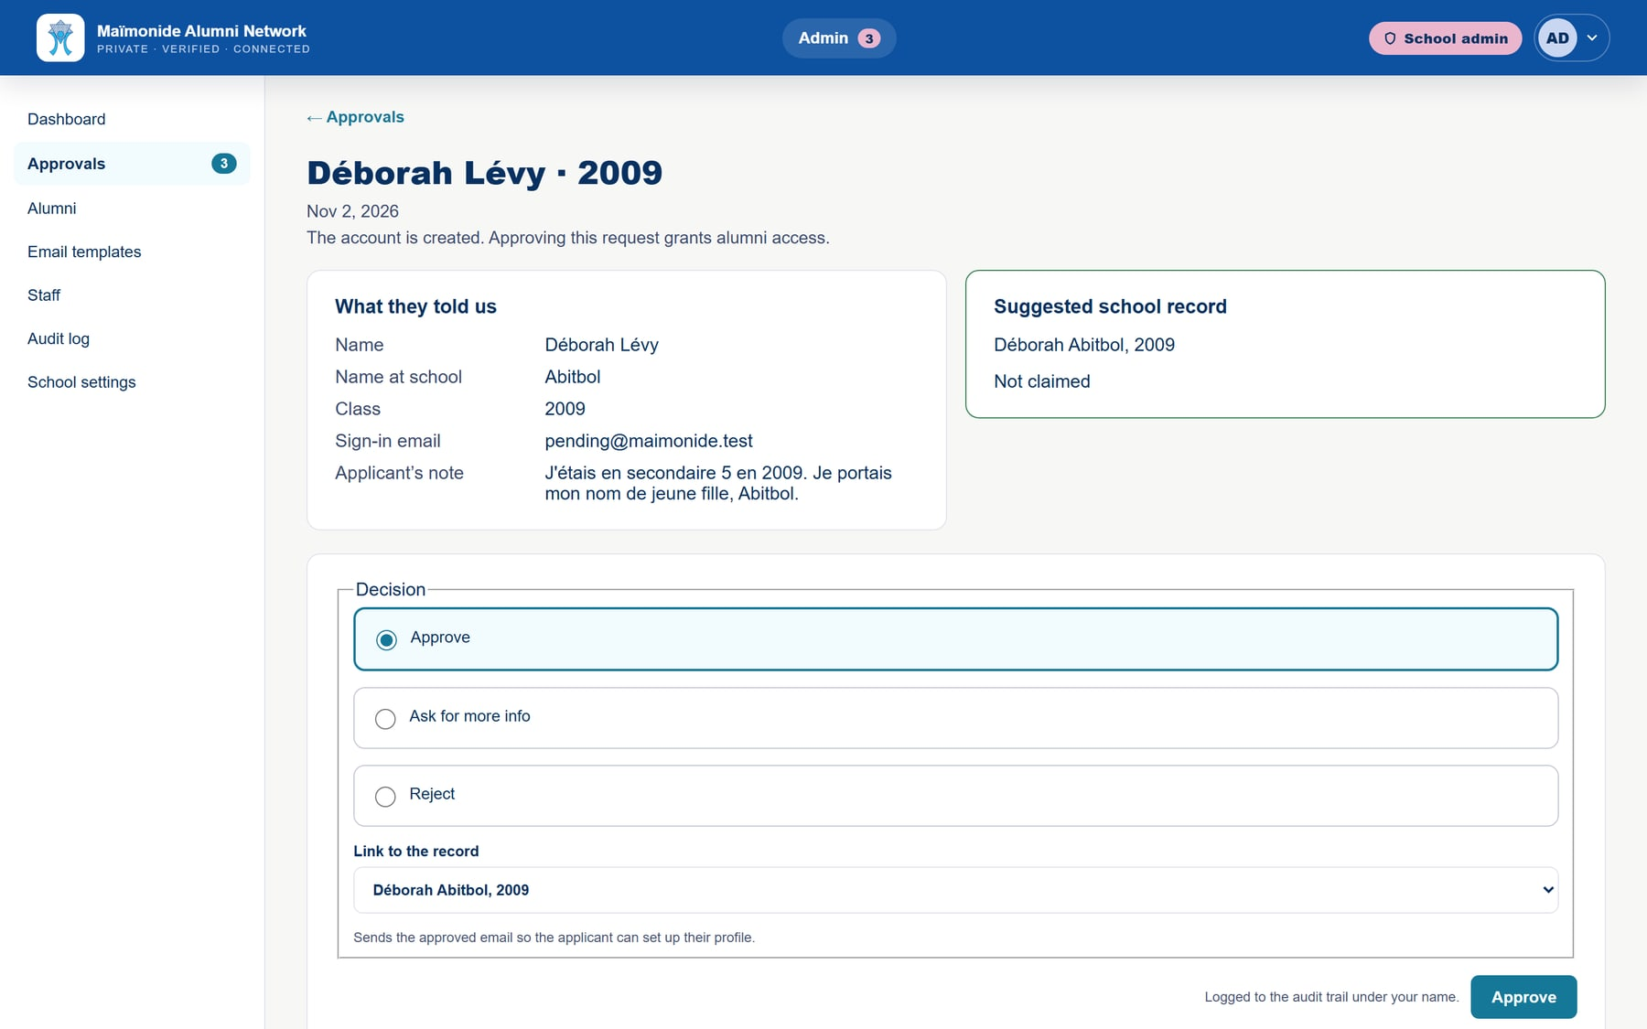

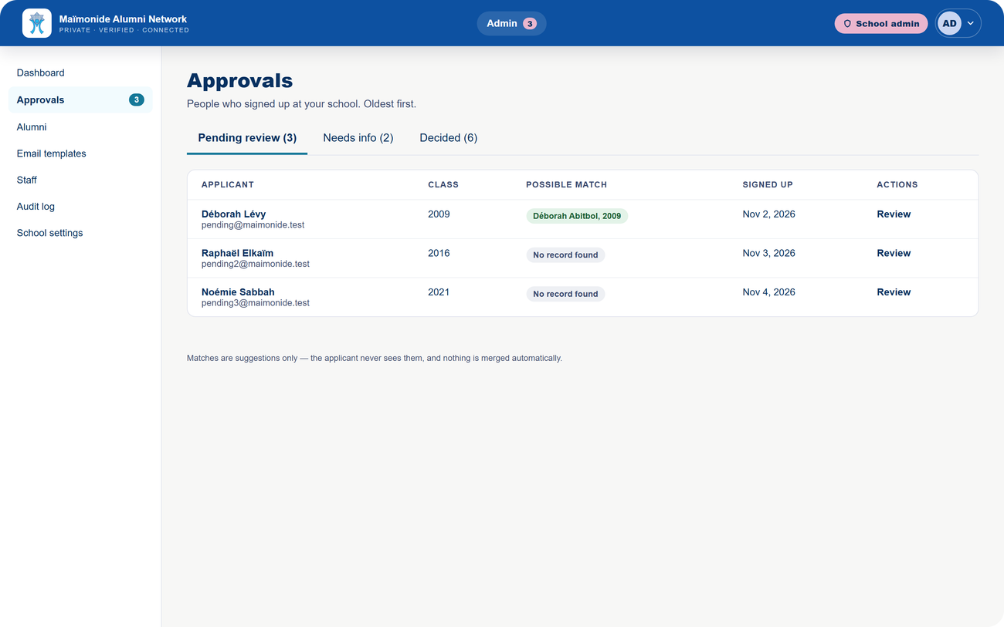

Every member, approved by you.
SCHOOL · APPROVALS
A person at the school reviews every request.
Suggested record
Even under a maiden name.
Three decisions
Approve, ask for details, decline.
Signed
Every decision carries its author’s name.
Notes:
This is the queue. For Déborah Lévy, the platform suggests an existing record: Déborah Abitbol, class of 2009, her maiden name. The reviewer approves and links the record, asks for more information, or declines. Suggestions never merge anything automatically.

Slide 17
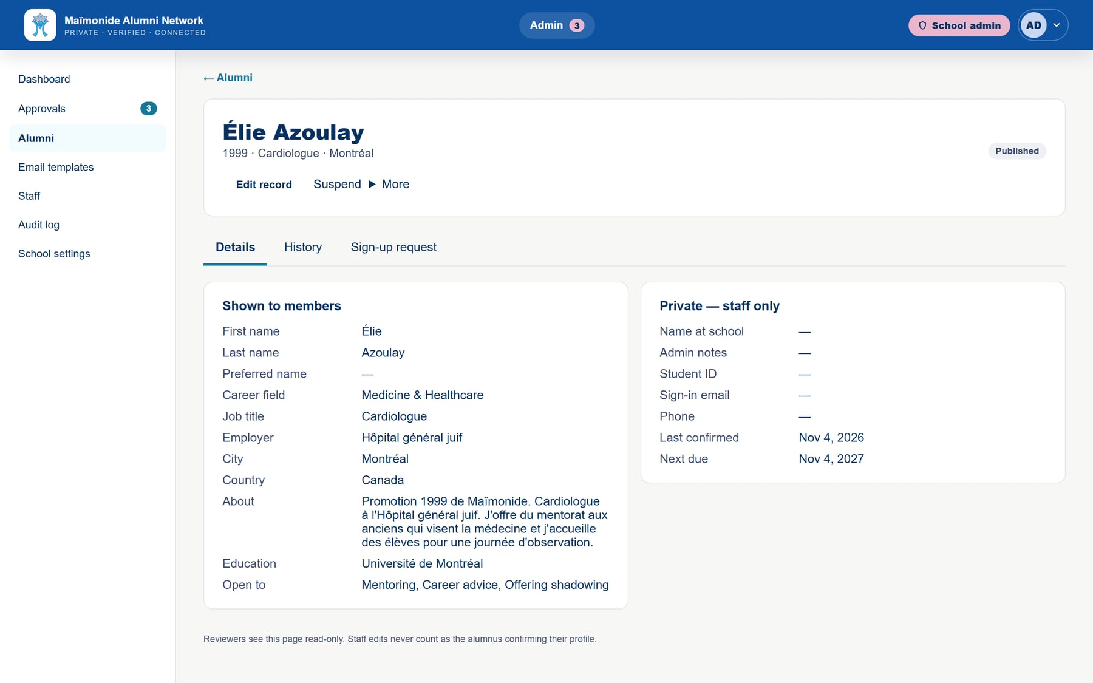
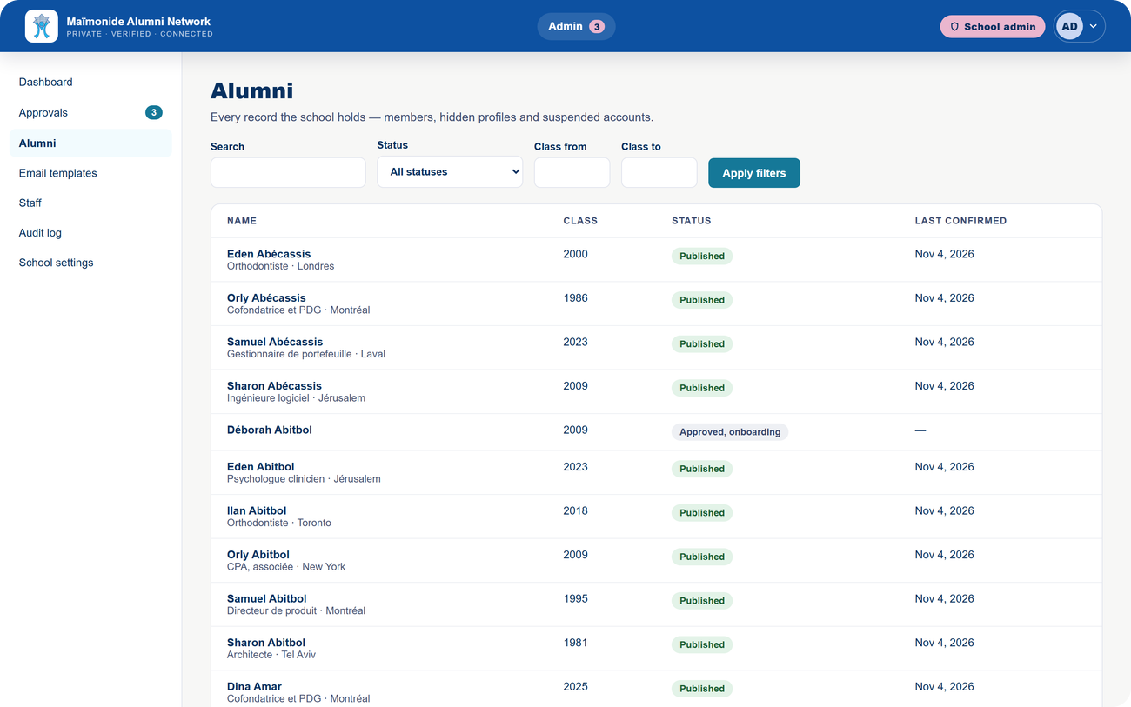
All your alumni, in one place.
SCHOOL · ALUMNI
The full roster: published, hidden, suspended.
Search
By name, status and class year.
Staff only
Notes and name at school stay private.
History
Everything that happened to the record.
Notes:
The roster holds every record. Each record separates what members see from what stays with staff, and the History tab shows everything that happened. Admins can suspend, archive or mark someone as deceased.

Slide 18
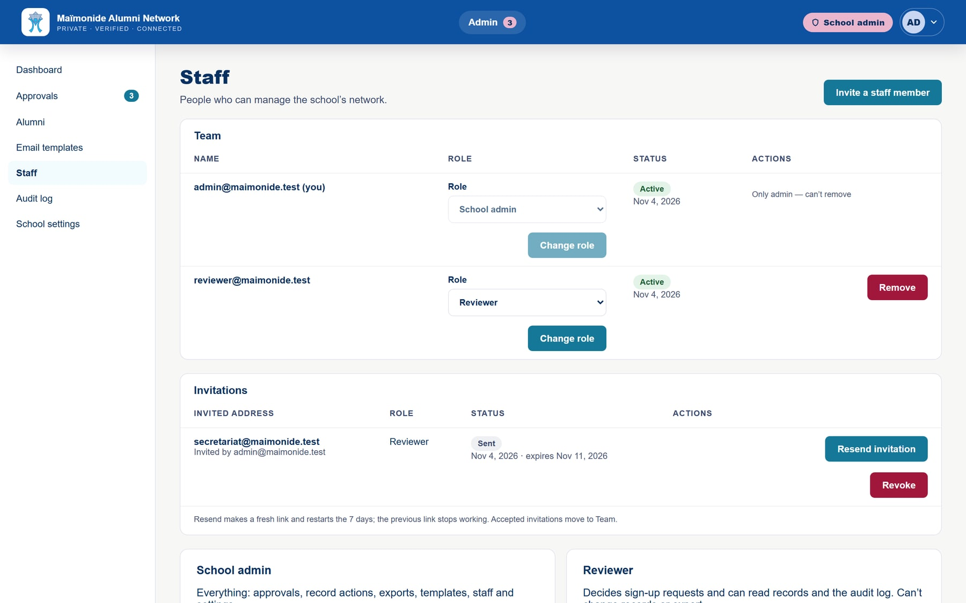
Your team, two roles.
SCHOOL · STAFF
What each role can do | School admin | Reviewer
Approve sign-ups | ✓ | ✓
Read records and the audit log | ✓ | ✓
Edit or suspend a record | ✓ | —
Manage staff | ✓ | —
Emails and settings | ✓ | —
Notes:
The admin invites the team and picks each person’s role. The invitee gets a single-use link valid for 7 days. Reviewers see only what they need. Today the invitation link is copied and sent by hand; automatic sending is coming soon.

Slide 19
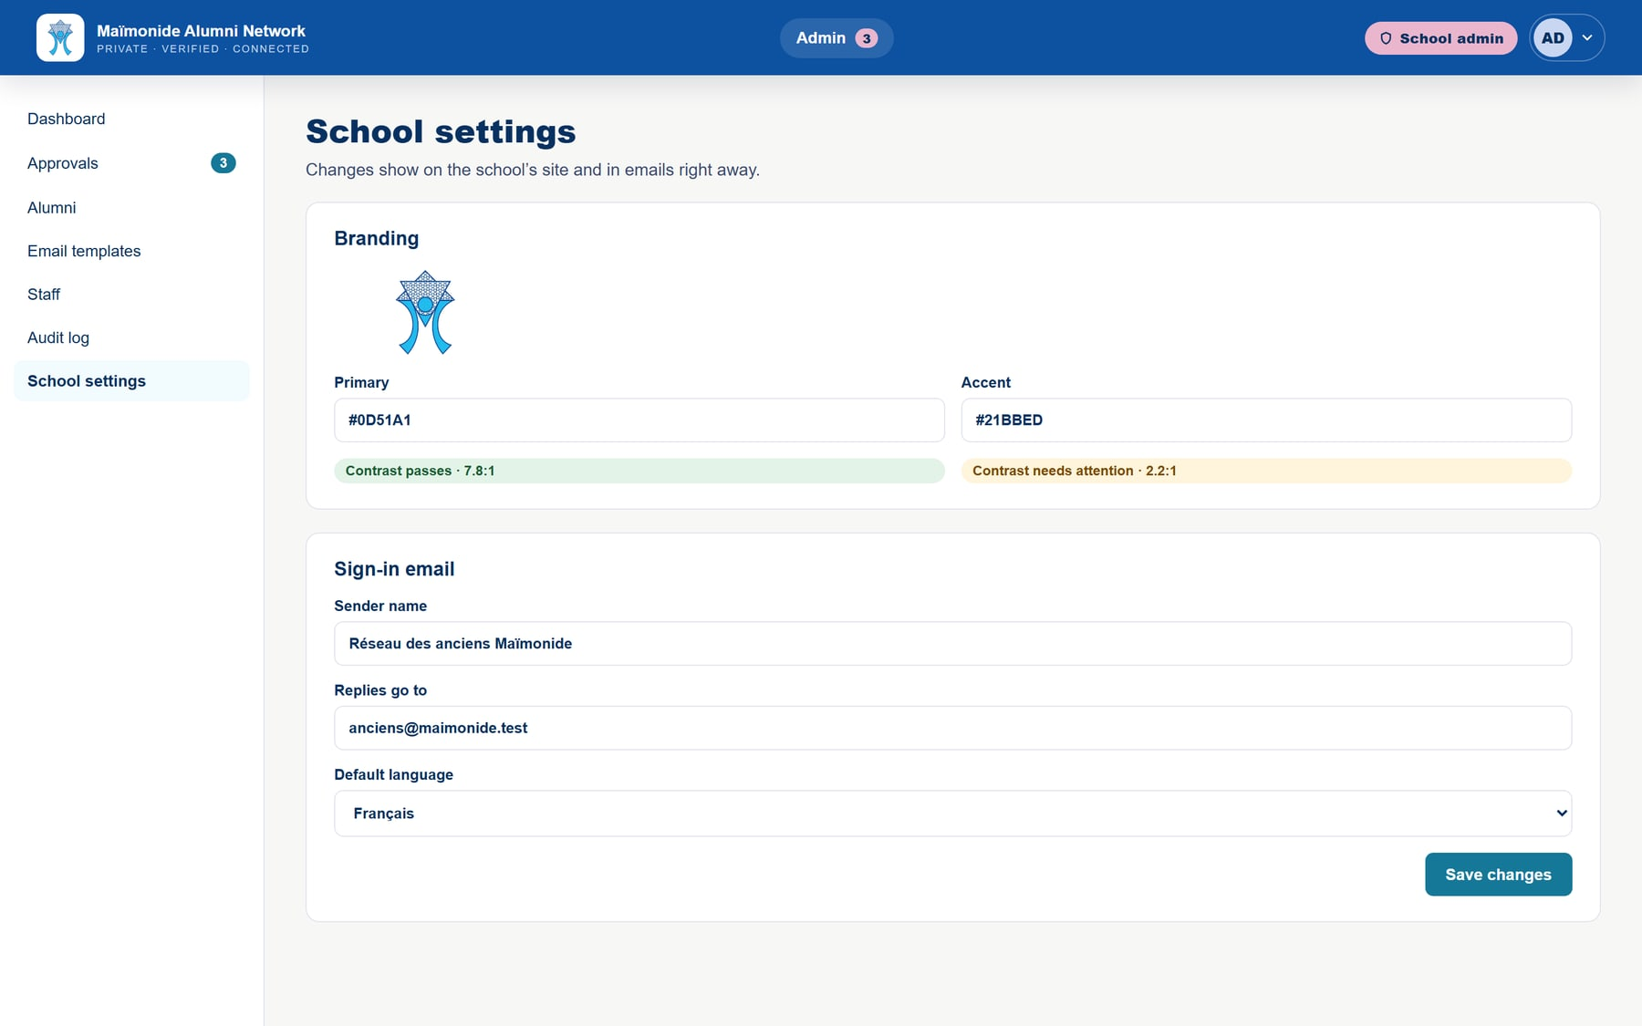

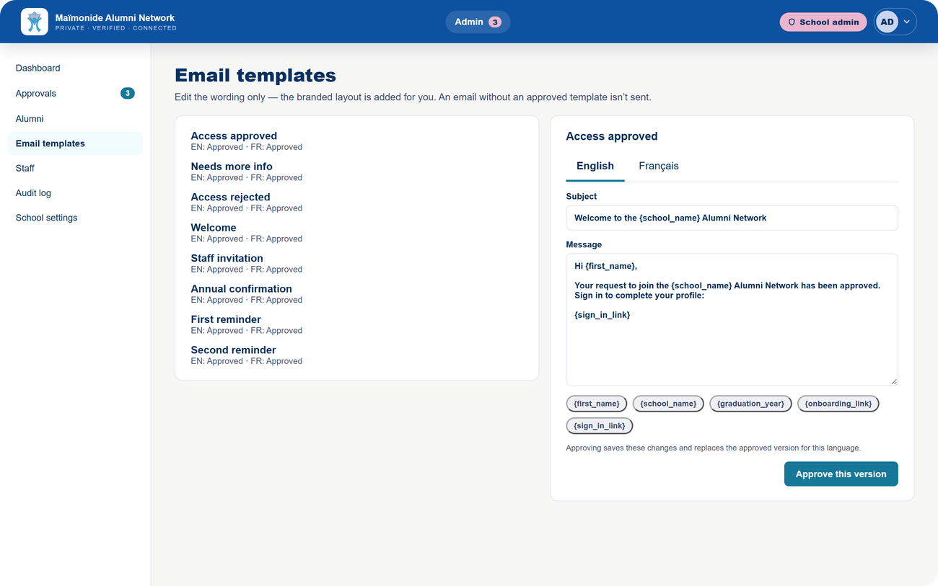
Your brand, everywhere.
SCHOOL · SETTINGS
Logo, colours, language and emails: the school stays in charge.
Your colours
Adjusted automatically to stay readable.
French by default
Anyone can switch to English.
Email templates
In French and English, approved by the school.
Notes:
In the settings: your logo and your two colours. The sky blue is very light, so the platform darkens it automatically wherever text sits on it; that is the contrast warning you see. Email templates, in French and English, are edited by the school, and no email goes out without an approved template. Automatic sending is being connected.

Slide 20
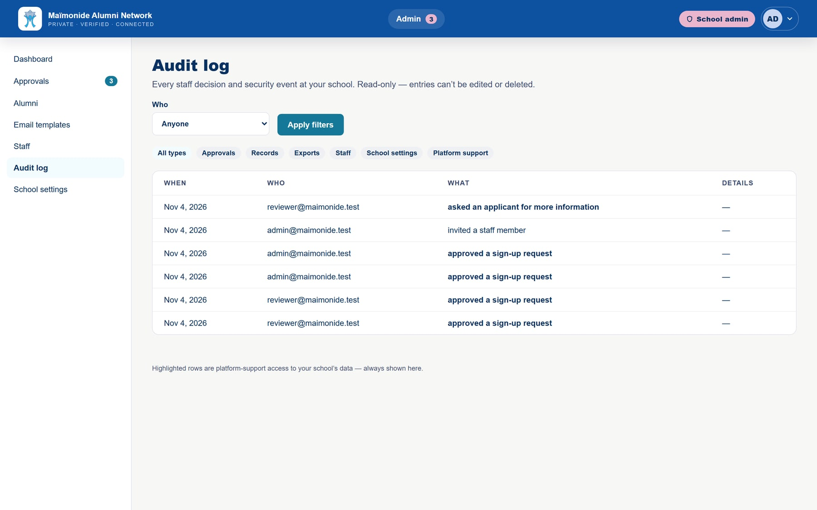

A record of every decision.
SCHOOL · AUDIT LOG
Who did what, and when.
Filters
Approvals, records, staff, settings.
Tamper-proof
No entry can be edited or deleted.
Support is visible
Our support access is highlighted there.
Notes:
The audit log records every staff decision. Nobody, not even us, can edit or delete an entry. If our team accesses your data to help you, it shows up here, highlighted.

Slide 21


Ready today, and what’s next.
WHERE WE ARE
Available today
Coming next
Sign-up, access request and approval
Optional student ID at sign-up
7-step profile, directory and filters
Automatic emails
Controlled, logged contact
Yearly profile confirmation
Dashboard, roster, staff, audit log
Data export for the school
French, English, school logo and colours
Two-factor sign-in for staff
A first Montreal school starts its pilot in December 2026.
Notes:
Let’s be transparent. Everything on the left works today. On the right, what’s coming: the optional student ID at sign-up in the next version, then automatic emails, yearly profile confirmation, data export and two-factor sign-in for staff. A first Montreal school starts its pilot in December.

Slide 22
What’s next?
NEXT STEPS
A few possible next steps, to decide together.
1
2
3
4
Live demo
Your feedback
Your team
A focused launch
Walk through the platform together, alumni side and school side.
What you like, what’s missing, what should change for Maïmonide.
Choose one admin and one or two reviewers who know the alumni well.
Start with a few class years, then open it to every graduate.
Notes:
Next, we suggest doing the live demo right away, then hearing your feedback. If you like the idea, all it takes is naming an admin and one or two reviewers, and starting with a few class years before opening it up.

Slide 23

We’re building this with you.
The platform is still in development.
Criticism, suggestions, recommendations: all welcome. We’re very flexible and want to shape it around Maïmonide’s needs.
What you like
What’s missing
What should change
Thank you! Now, the live demo.
Notes:
To wrap up: the platform is still in development, and now is the right time to tell us what you think. Criticism, suggestions, recommendations: it all helps. Now the live demo: a graduate’s journey, then an admin’s and a reviewer’s.

