Slide 1

SAP Predictive Summit, 13th September 2018 Introducing the Python Client API for SAP HANA In-Database Predictive and Machine Learning Nanda Kaushik, DDM / SAP HANA Christoph Morgen, Product Management SAP HANA

Slide 2
Disclaimer
The information in this presentation is confidential and proprietary to SAP and may not be disclosed without the permission of SAP. Except for your obligation to protect confidential information, this presentation is not subject to your license agreement or any other service or subscription agreement with SAP. SAP has no obligation to pursue any course of business outlined in this presentation or any related document, or to develop or release any functionality mentioned therein.
This presentation, or any related document and SAP's strategy and possible future developments, products and or platforms directions and functionality are all subject to change and may be changed by SAP at any time for any reason without notice. The information in this presentation is not a commitment, promise or legal obligation to deliver any material, code or functionality. This presentation is provided without a warranty of any kind, either express or implied, including but not limited to, the implied warranties of merchantability, fitness for a particular purpose, or non-infringement. This presentation is for informational purposes and may not be incorporated into a contract. SAP assumes no responsibility for errors or omissions in this presentation, except if such damages were caused by SAP’s intentional or gross negligence.
All forward-looking statements are subject to various risks and uncertainties that could cause actual results to differ materially from expectations. Readers are cautioned not to place undue reliance on these forward-looking statements, which speak only as of their dates, and they should not be relied upon in making purchasing decisions.

Slide 3

Agenda
SAP HANA Predictive and Machine Learning Overview
Python integration with SAP HANA
Python Client API for SAP HANA Machine Learning
Demo
Plans and Roadmap

Slide 4
Agenda
SAP HANA Predictive and Machine Learning Overview
Python integration with SAP HANA
Python Client API for SAP HANA Machine Learning
Demo
Plans and Roadmap

Slide 5








SAP HANA – The Data Platform for the Intelligent Enterprise Comprehensive advanced analytics data processing capabilities
SAP HANA Platform
Advanced analytical processing
Application development
Data integration & quality
Spatial
Graph
Predictive & ML
Search
Text analytics
Streaming analytics
Series data
Business functions
Database management
Run applications with dramatically different datatype characteristics in the same system
Optimize graph, planning, and rules applications on the same data
Empower your business with competitive advantage of multimodal applications by mixing in-database predictive with spatial, search, graph as well as external machine learning

Slide 6

SAP HANA ML – Data Platform embedded ML for the Intelligent Enterprise In-database predictive and machine learning capabilities
Predictive & ML
SAP HANA Platform
in-database capabilities
database-level integration
Predictive Analysis Library
Automated Predictive Library
Domain specific Libraries
Custom C++ algorithms
R Integration
TensorFlow Integration
Predictive Analysis Library (PAL)
Automated Predictive Library (APL)
SAP application specific libraries
Application Function Library (AFL) SDK
R Script
EMLAFL
Accelerated predictive analysis with >90 native in-database algorithms for cluster analysis, outlier detection, classification and regression analysis, association analysis and link prediction, recommendation analysis.
The predictive analysis capabilities of SAP Predictive Analytics automated analytics engine (formerly KXEN) in SAP HANA
e.g. the Unified Demand Forecasting (UDF) library as an embedded component of the SAP Customer Activity Repository, or the Optimization Function Library (OFL) includes linear optimization functions leveraged in SAP supply chain solutions.
Application Function Library SDK (AFL) allows SAP partners and customers to leverage their custom C++ functions within SAP HANA
Execution of R scripts via high-performing parallelized vector based connection; R scripts execution calls embedded as part of overall query plan
TensorFlow DeepLearning prediction integration. TensorFlow models for image classification and other scenarios can be called from SAP HANA via the EMAFL.
SAP
Custom
Open Source

Slide 7









SAP HANA ML – Predictive Analysis Library (PAL) Native In-Database Machine Learning
SAP HANA embeds multiple machine learning libraries, designed and optimized for massive parallel in-memory processing.
Predictive Analysis Library (PAL)
Addresses key scenarios like Classification, Regression or Time Series Forecasting (and more)
Over 90+ classic and trending ensemble algorithms
High performance parallel mass prediction, real-time transactional speed prediction
Segmented Modeling, like segmented Forecasting
Automated cross validation and hyper parameter selection
Easy to develop and simple to embed with applications
Supports both expert data scientists and developer personas
Simple SQL interface and Python client
SAP HANA Platform
Predictive Analysis Library (PAL)
Classification
Association analysis
Regression
Outlier detection
Time series forecasting
Recommender System
Cluster analysis
Link prediction
Notes:
Predictive Analysis Library
The SAP HANA core of numerous powerful, native predictive algorithms for in-database and in-memory processing that fully exploit the power and speed of SAP HANA, resulting in quicker insight and faster implementations
Content and Usage
The library includes common as well as specialized algorithms targeting various data mining and machine learning areas
Leveraged and embedded in native SAP applications and usage from within SAP HANA development tools as well as SAP Predictive Analytics
Scenarios and Use Cases
Various LoB/industry scenarios making use of association analysis, time series forecasting, link prediction, predictive modeling, etc

Slide 8
SAP HANA Predictive Analysis Library (PAL) – Typical Scenarios addressed Enabling Data Scientists to build In-Database Machine Learning scenarios
Typical example scenarios
Predicting customer behavior like churn, fraud or buying behavior (classification)
Forecasting future sales, demand, cost, etc. based on historic time related data (time series forecasting)
Predicting car prices, based on model characteristics and market trends (regression)
Analyzing shopping baskets to suggest product placements or additional purchases to a customer (association analysis)
Enabling marketers to develop targeted marketing programs by grouping customers (clustering)
Detecting anomalies in financial transactions for fraud analysis, or in machine sensor data for predictive maintenance (outlier detection)
Provide personalized product recommendations by analyzing product associations, individual purchase history and external factors (recommender system)
In a given social network, you seek to infer which new interactions among its members are likely to occur in the near future (link analysis / prediction)
Notes:
In summary, we allow developers and data scientists to move away from batch ML and embrace real-time ML on data that has complete context. SAP HANA is paving the quickest way to enrich business processes with machine learning – eliminating “regret windows” – by reducing the number of actions taken during the ML lifecycle to deliver the most accurate and best-performing model.
Alliander is a great example. They now get 97% faster and more accurate peak-load forecasts. This is possible because SAP HANA allows them to perform predictive analysis on granular data – which leads to greater accuracy – and run forecasts more often, as it takes less time to analyze data.
With SAP HANA, Alliander has avoided wasting millions of dollars that would have been spent on building power plants and acquiring unnecessary energy supply, improving business outcomes and reducing CO2 footprint.

Slide 9
SAP HANA Predictive Analysis Library (PAL) – Functional Overview Algorithm overview by category
Classification Analysis
CART, C4.5 and CHAID Decision Tree Analysis
K Nearest Neighbor
Logistic Regression Elastic Net
Back-Propagation (Neural Network)
Naïve Bayes
Support Vector Machine
Random Decision Trees
Gradient Boosting Decision Tree (GBDT)*
Linear Discriminant Analysis (LDA)*
Confusion Matrix
Area Under Curve (AUC)
Parameter Selection/Model Evaluation
Regression
Multiple Linear Regression Elastic Net
Polynomial, Exponential, Bi-Variate Geometric, Bi-Variate Logarithmic Regression
Generalized Linear Model (GLM)*
Cox Proportional Hazards Model*
Random Decision Trees
Gradient Boosting Decision Tree (GBDT)*
Cluster Analysis
ABC Classification
DBSCAN, K-Means/Accelerated K-Means**, K-Medoid Clustering, K-Medians
Kohonen Self Organized Maps
Agglomerate Hierarchical
Affinity Propagation
Latent Dirichlet Allocation (LDA)
Gaussian Mixture Model (GMM)
Cluster Assignment
Time Series Analysis
Single/Double/ Brown/Triple Exp. Smoothing
Forecast Smoothing
Auto – ARIMA/Seasonal ARIMA
Croston Method
Forecast Accuracy Measure
Linear Regression with Damped Trend and Seasonal Adjust
Test for White Noise, Trend, Seasonality
Fast Fourier Transform (FFT)*
Hierarchical Forecasting ****
Association Analysis
Apriori, Apriori Lite
FP-Growth
KORD – Top K Rule Discovery
Sequential Pattern Mining*
Probability Distribution
Distribution Fit/ Weibull analysis
Cumulative Distribution Function
Quantile Function
Kaplan-Meier Survival Analysis
Outlier Detection
Inter-Quartile Range Test (Tukey’s Test)
Variance Test
Anomaly Detection
Grubbs Outlier Test
Recommender Systems
Factorized Polynomial Regression Models**
Alternating least squares****
Field-aware Factorization Machines (FFM) ****
Link Prediction
Common Neighbors, Jaccard’s Coefficient, Adamic/Adar, Katzβ PageRank ****
Statistical Functions
Mean, Median, Variance, Standard Deviation, Kurtosis, Skewness
Covariance Matrix
Pearson Correlations Matrix
Chi-squared Tests: Quality of Fit, Test of Independence
F-test (variance equal test)
Data Summary*
Correlation Function*
ANOVA**
One-sample Median Test**
T Test**
Wilcox Signed Rank Test**
Data Preparation
Sampling, Binning, Scaling, Partitioning
Principal Component Analysis (PCA)/PCA Projection
Factor Analysis***
Multi dimensional scaling***
Other
Weighted Scores Table
Substitute Missing Values
* New in HANA 2 SPS 00 | ** New in HANA 2 SPS 01 |
*** New in HANA 2 SPS 02 | **** New in HANA 2 SPS 03

Slide 10
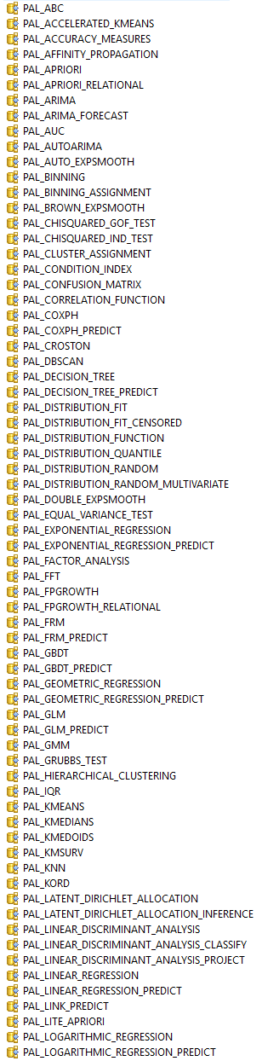
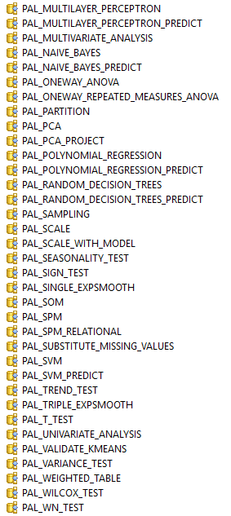
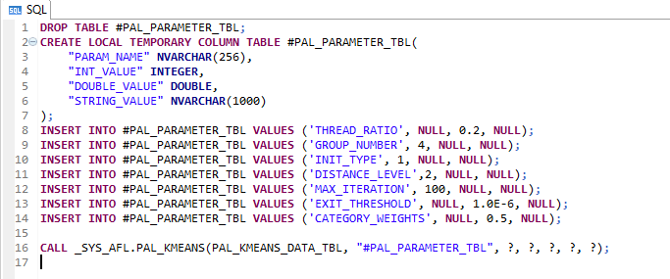
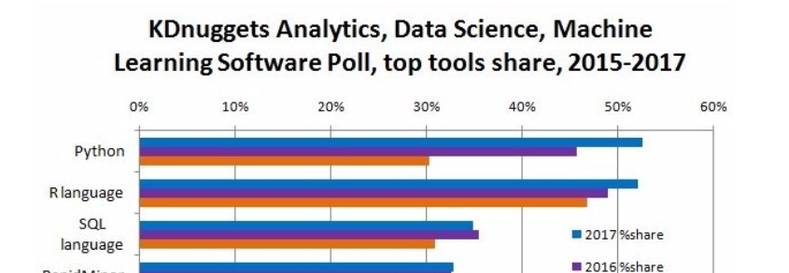
SAP HANA In-Database Advanced Analytics Function Libraries In-database machine learning made easy using SQL
Simple SQL interface to Predictive Analysis Library procedures
Completely re-designed and simplified to allow a far more agile use for developers and data scientists working directly on SAP HANA
Released with SAP HANA 2 SPS02
New generic use-procedures provided out of the box within the _SYS_AFL schema
Dynamic procedure interface
SQL is the #3 most popular language for machine learning
Source: Kdnuggest.com

Slide 11
Agenda
SAP HANA Predictive and Machine Learning Overview
Python integration with SAP HANA
Python Client API for SAP HANA Machine Learning
Demo
Plans and Roadmap

Slide 12
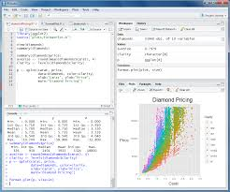
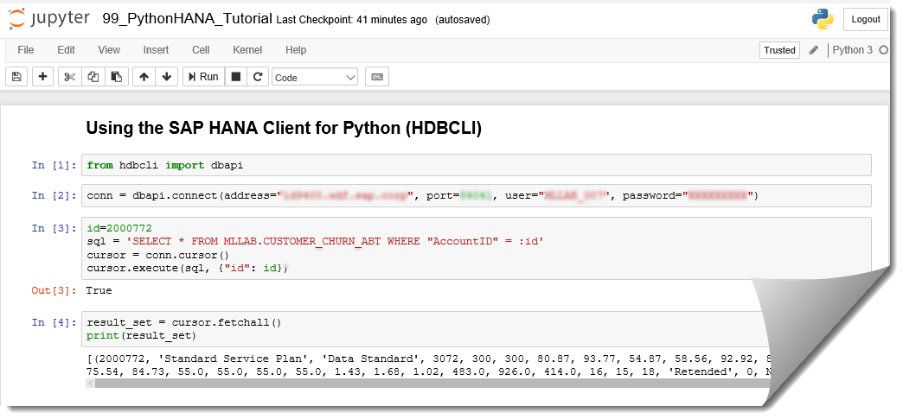




SAP HANA ML – External Machine Learning Integration Leverage open source machine learning with SAP HANA
External Machine Learning integration covers
R Integration with SAP HANA
Connect and interoperate with the SAP HANA database from R Studio
R script-code to be processed as part of the overall query execution plan from SAP HANA
Python driver for SAP HANA
Full support for the SAP HANA network protocol
Leverage SAP HANA predictive & machine learning capabilities from Python development environment
TensorFlow Integration with SAP HANA
Easily extend deep learning from SAP HANA
Retain the familiar database development environment
Python Notebook
ODBC
data
SAP HANA Platform
External Machine Learning Integration
R Integration
TensorFlow Integration
data + R-script
result
EML call
prediction result
R-Serve Server
Active Model(s)
R-Processing
Notes:
Graphic should add SAP tools

Slide 13
SAP HANA External Predictive and Machine Learning Integration Python driver for SAP HANA
Python Driver for SAP HANA (HDBCLI)
Provide the benefits of SAP HANA to the Python community
Fully supported driver for Python 2.7.n and Python 3.4+
Full support for the SAP HANA network protocol
including new features like network compression, encrypted client-side userstore, LDAP authentication, client-side encryption, Uninterrupted connections during server failover, prepared statement caching, etc.
Database capabilities supported include
Executing SQL statements, binding parameters for SQL statements (Question mark and named parameter binding), querying data and handling result sets, calling stored procedures, streaming data
Leverage SAP HANA’s In-Database Predictive and Machine Learning capabilities
Calling Predictive Analysis Library-SQL Procedures
ODBC
data
SAP HANA Platform
Predictive Analysis Library
Automated Predictive Library
https://blogs.sap.com/2017/07/26/sap-hana-2.0-sps02-new-feature-updated-python-driver/
Client libraries downloadable publicly under the SAP Developer License http://tools.hana.ondemand.com Note: PyHDB (on github) is not officially supported, the HANA Python client is the official python client interface.
In Memory Data
Notes:
Executing SQL statements
Binding parameters for SQL statements
Question mark parameter binding
Named parameter binding
Querying data and handling result sets
Calling stored procedures
Streaming data
https://tereshenkov.wordpress.com/2018/02/08/adding-ipython-sql-magic-to-jupyter-notebook/

Slide 14
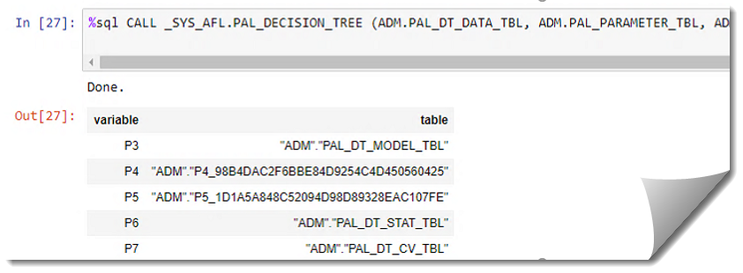
SAP HANA External Predictive and Machine Learning Integration Python driver for SAP HANA
Enhanced SQL capabilities in Python
Leveraging the HANA Python Client API with popular Python SQL packages
ipython-sql magic allows to prefix your SQL statement with a simple %sql and get the results!
Using ipython-sql magic implies the use SQLAlchemy, a great Python SQL Toolkit and Object Relational Mapper module
SQLAlchemy dialect and magic for SAP HANA
The SQLAlchemy Dialect for SAP HANA which is part of the open-source SAP repository on Git. https://github.com/SAP/sqlalchemy-hana
ODBC
data
SAP HANA Platform
Predictive Analysis Library
Automated Predictive Library
In Memory Data
https://blogs.sap.com/2018/03/27/machine-learning-in-a-box-week-7-jupyter-notebook/
https://www.sap.com/canada/developer/tutorials/hxe-python-sqlalchemy-users.html
SAP HANA Client interface documentation – SQL Alchemy dialect for SAP HANA [link]
Notes:
https://tereshenkov.wordpress.com/2018/02/08/adding-ipython-sql-magic-to-jupyter-notebook
https://www.sap.com/canada/developer/tutorials/hxe-python-sqlalchemy-users.html
http://docs.sqlalchemy.org/en/latest/orm/tutorial.html
http://docs.sqlalchemy.org/en/latest/core/tutorial.html#connecting
In addition, we are providing community-supported adapters for popular object-relational-mappers: you now get an improved HANA dialect included, and for python users a SQL Alchemy provider is available from GitHub.
General Enhancement ~ SAP HANA 2 SPS03

Slide 15
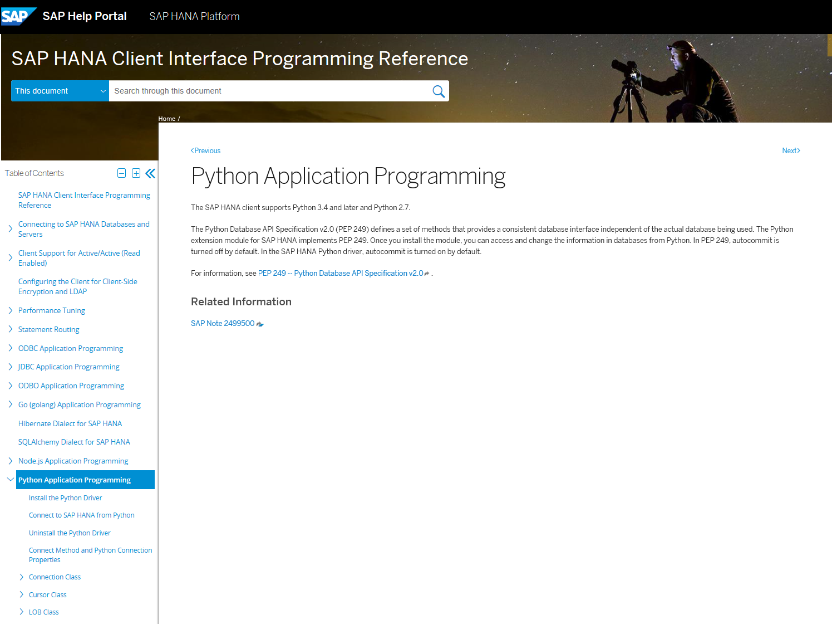
SAP HANA External Predictive and Machine Learning Integration Python Driver for SAP HANA 2 SPS03
https://help.sap.com/viewer/0eec0d68141541d1b07893a39944924e/2.0.03/en-US/f3b8fabf34324302b123297cdbe710f0.html
Notes:
In addition, we are providing community-supported adapters for popular object-relational-mappers: when you get Hibernate you now get an improved HANA dialect included, and for python users a SQL Alchemy provider is available from GitHub.
Python Driver: The python driver inherits a number of general SPS03 client improvements:
Client-side encryption
Prepared statement caching
Uninterrupted connection during server failover
LDAP authentication

Slide 16
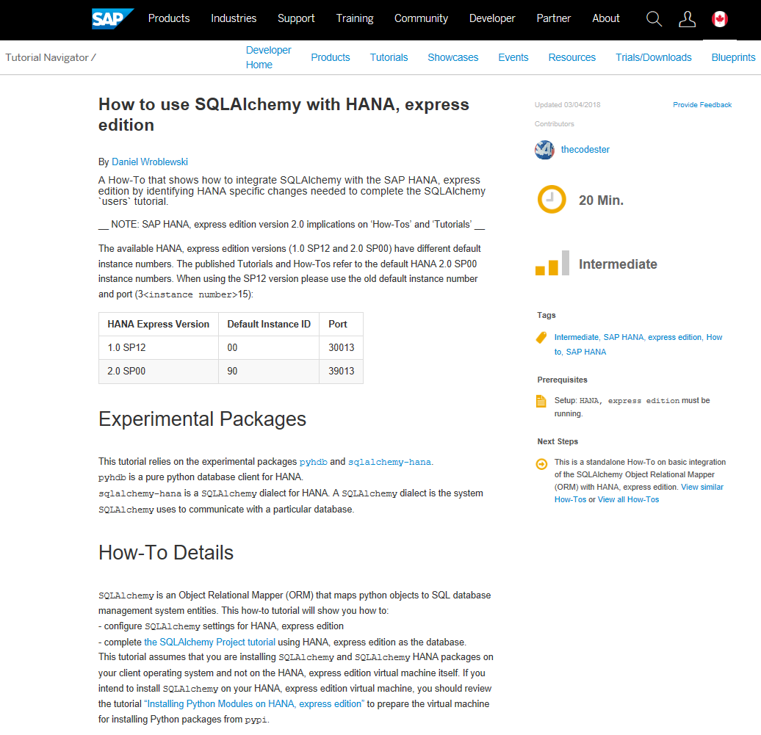
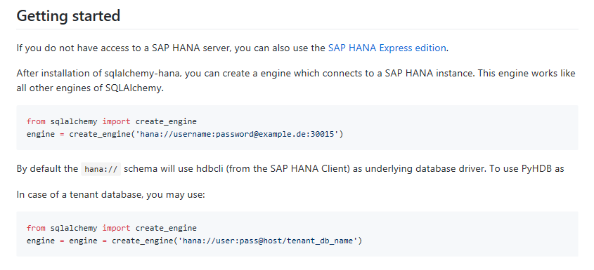
General Enhancement ~ SAP HANA 2 SPS03 SQLAlchemy for SAP HANA
https://www.sap.com/canada/developer/tutorials/hxe-python-sqlalchemy-users.html
http://docs.sqlalchemy.org/en/latest/orm/tutorial.html
http://docs.sqlalchemy.org/en/latest/core/tutorial.html#connecting
Notes:
In addition, we are providing community-supported adapters for popular object-relational-mappers: when you get Hibernate you now get an improved HANA dialect included, and for python users a SQL Alchemy provider is available from GitHub.
Python Driver: The python driver inherits a number of general SPS03 client improvements:
Client-side encryption
Prepared statement caching
Uninterrupted connection during server failover
LDAP authentication

Slide 17
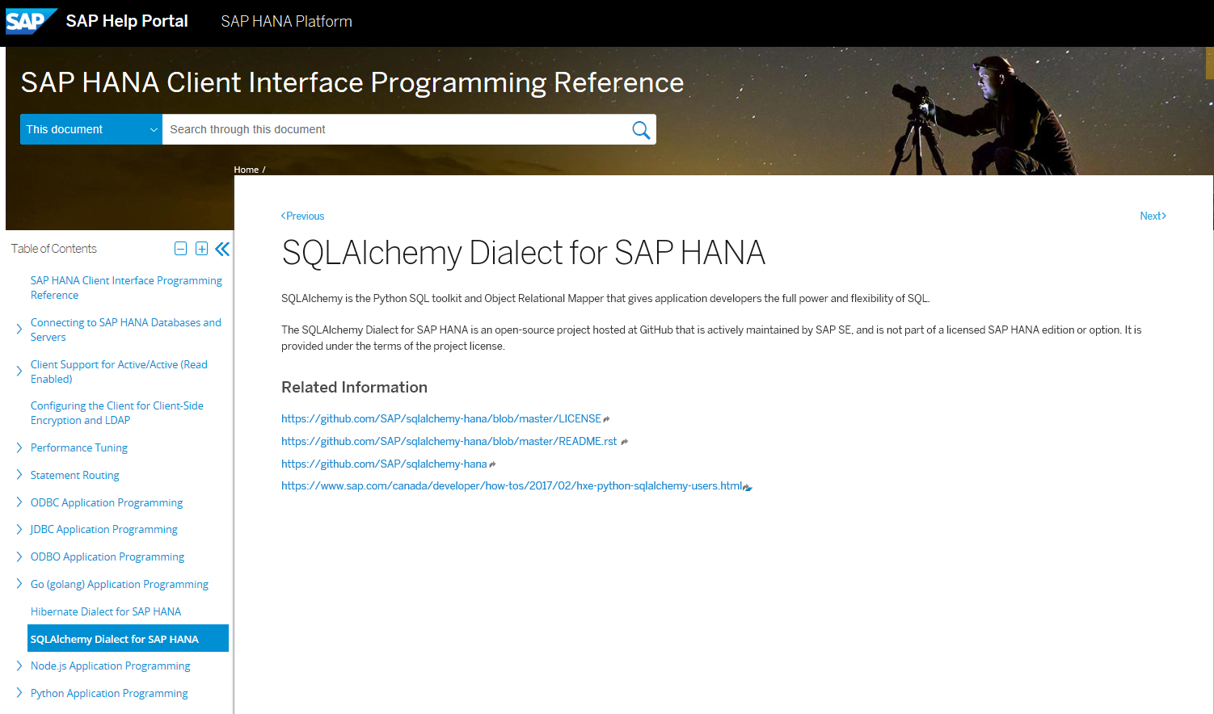
General Enhancement ~ SAP HANA 2 SPS03 SQLAlchemy for SAP HANA
https://help.sap.com/viewer/0eec0d68141541d1b07893a39944924e/2.0.03/en-US/01e93e584e524747b570cd9083b08d2b.html
Notes:
In addition, we are providing community-supported adapters for popular object-relational-mappers: when you get Hibernate you now get an improved HANA dialect included, and for python users a SQL Alchemy provider is available from GitHub.
Python Driver: The python driver inherits a number of general SPS03 client improvements:
Client-side encryption
Prepared statement caching
Uninterrupted connection during server failover
LDAP authentication

Slide 18
Agenda
SAP HANA Predictive and Machine Learning Overview
Python integration with SAP HANA
Python Client API for SAP HANA Machine Learning
Demo
Plans and Roadmap

Slide 19
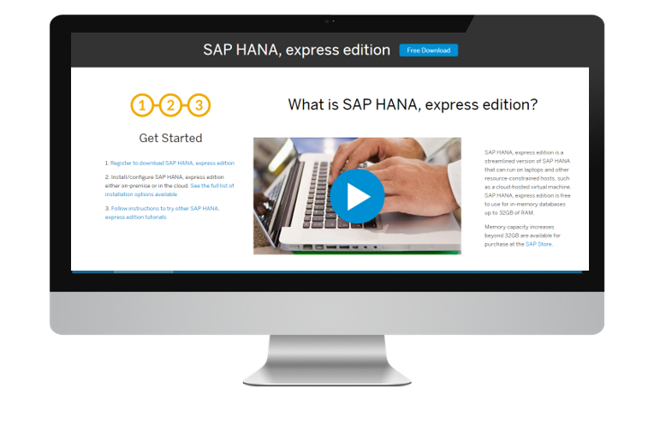

SAP HANA, Express Edition Getting Started with SAP HANA In-Database Predictive and Machine Learning
Business benefits
Streamlined version of the SAP HANA platform that jumpstarts development in the cloud, on a personal computer or a smaller server
Build and deploy applications that use up to 32GB memory without incurring any license fees
SAP HANA, express edition
Inherits SAP HANA 2 SPS 03 enhancements
Now listed on the AWS Marketplace
Docker container for Kubernetes enhanced with SAP HANA development and administration tooling
Proactive notifications suggest how to improve performance based on real-world operations
SAP HANA Predictive and Machine Learning tutorials
https://blogs.sap.com/2016/10/17/getting-started-predictive-sap-hana-express-edition/
https://www.sap.com/developer/tutorials/mlb-hxe-setup-r.html
https://www.sap.com/uk/developer/tutorials/hxe-ua-eml-vm.html
https://blogs.sap.com/2018/01/11/installing-the-automated-predictive-library-apl-on-sap-hana-express-2.0/
Allows for both development and production use cases to rapidly prototype and deploy applications

Slide 20
SAP HANA, Express Edition – New Capability* Python Client API for SAP HANA Machine Learning
Python packages to leverage In-Database Machine Learning
The Python Client API enables Data Scientists to
Easily leverage data in SAP HANA and in-memory performance
Script in Python while process data remotely in SAP HANA
Leverage SAP HANA ML algorithm libraries as easily as any other Python ML packages
Data Scientist using Python
SAP HANA DataFrame
Stores only references to data in SAP HANA
No data transferred to the python process except when explicitly requested
Hides SQL statements
Remote, in-database computation in SAP HANA
Useful for data analysis and exploration
Used as implicit input structure to the Core ML API
SAP HANA Core ML API
Python Wrapper for PAL
Typical Python ML like interface
Works with dataframes
Python Program
DataFrame
ML API
hdbcli
HANA
*Delivered with SAP HANA, express edition 2.0 SPS 03 Revision 33

Slide 21
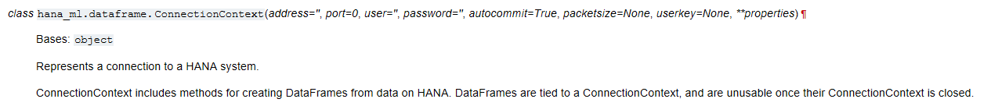
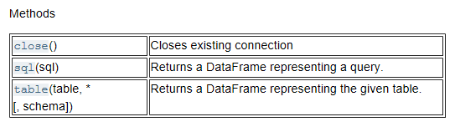
Python Client API for HANA ML – Dataframe module
This module is mainly to represent a database query as a dataframe. Most operations are designed so data is not brought back from the database unless explicitly asked for.

Slide 22
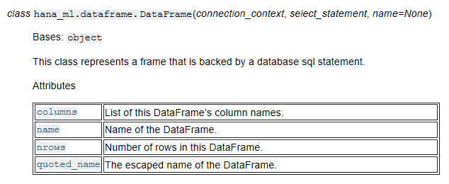
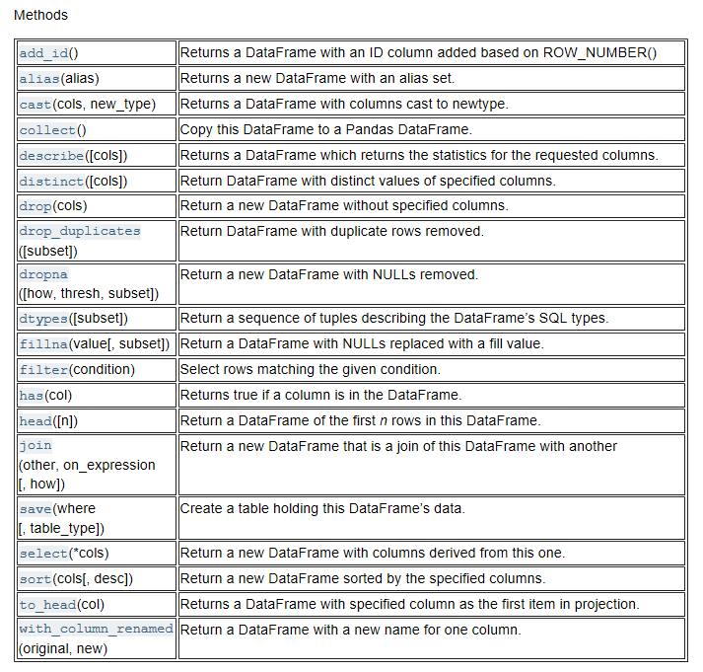
Python Client API for HANA ML – Dataframe module
This module is mainly to represent a database query as a dataframe. Most operations are designed so data is not brought back from the database unless explicitly asked for.

Slide 23
Python Client API for HANA ML – Algorithm modules
Clustering module
This module contains PAL wrapper and helper functions for all clustering algorithms
Classification module
This module contains PAL wrappers for classification algorithms. It includes classification algorithm Logistic Regression (with Elastic Net Regularization).
SVM module
This module contains PAL wrapper and helper functions for Support Vector Machine algorithms including Support Vector Classification(SVC), Support Vector Regression(SVR), Support Vector Ranking(SVRanking) and One Class SVM(OneClassSVM).
Trees module
This module contains RandomForest algorithms including RandomForestClassifier and RandomForestRegressor. Both of them are wrapped around PAL functions PAL_RANDOM_DECISION_TREES and PAL_RANDOM_DECISION_TREES_PREDICT

Slide 24

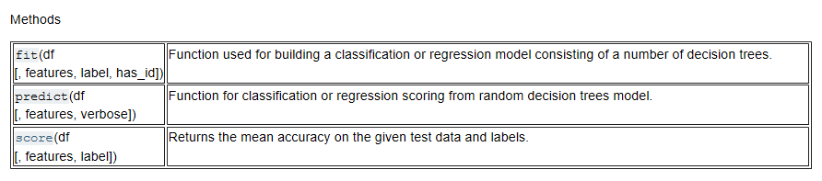
Python Client API for HANA ML – Algorithm modules
Trees module
This module contains RandomForest algorithms including RandomForestClassifier and RandomForestRegressor.
class hana_ml.algorithms.trees.RandomForestClassifier(conn_context, n_estimators=100, max_features=None, max_depth=None, min_samples_leaf=1, min_impurity_split=None, oob_score=True, random_state=None, thread_ratio=None, allow_missing_label=True, categorical_variable=None, sample_fraction=None, strata=None, priors=None)¶

Slide 25
Python Client API for HANA ML – User Perspective
PAL (HANA 2 SP02)
HANA ML Python API
Scikit Learn
Truncate table; #PAL_PARMTBL
INSERT INTO #PAL_PARMTBL VALUES ('CLASS_MAP0', null, null, 'no');
INSERT INTO #PAL_PARMTBL VALUES ('CLASS_MAP1', null, null, 'yes');
INSERT INTO #PAL_PARMTBL VALUES ('METHOD', 0, null, null);
INSERT INTO #PAL_PARMTBL VALUES ('EXIT_THRESHOLD',null,0.000001,null);
INSERT INTO #PAL_PARMTBL VALUES ('THREAD_RATIO',null,0.9,null);
INSERT INTO #PAL_PARMTBL VALUES ('MAX_ITERATION',10000,null,null);
INSERT INTO #PAL_PARMTBL VALUES ('STAT_INF', 1, null, null);
INSERT INTO #PAL_PARMTBL VALUES ('PMML_EXPORT', 2, null, null);
INSERT INTO #PAL_PARMTBL VALUES ('HAS_ID', 0, null, null);
INSERT INTO #PAL_PARMTBL VALUES (‘ENET_LAMBDA', null, 0.01, null);
INSERT INTO #PAL_PARMTBL VALUES (‘ENET_ALPHA', null, 0.1, null);
CALL _SYS_AFL.PAL_LOGISTIC_REGRESSION (
DBM2_TRAINING_TBL,
"#PAL_PARMTBL",
DBM2_LOGISTICR_RESULT_TBL,
DBM2_LOGISTICR_PMMLMODEL_TBL,?,?)
WITH OVERVIEW;
Truncate table; #PAL_PARMTBL
INSERT INTO #PAL_PARMTBL VALUES ('THREAD_RATIO',null,0.1,null);
Truncate table DBM_SCORED_TBL;
CALL _SYS_AFL.PAL_LOGISTIC_REGRESSION_PREDICT(
DBM2_VALIDATION_TBL,
DBM2_LOGISTICR_PMMLMODEL_TBL,
"#PAL_PARMTBL",
DBM_SCORED_TBL) with overview;
ctxt = DataFrame.ConnectionContext(<connect details>)
select_statement = 'select * from "DEVUSER"."DBM2_TRAINING_TBL“’
training_set = DataFrame.DataFrame(ctxt, select_statement)
validation_set=ctxt.table(‘DBM2_VALIDATION_TBL’, schema=’MySchema’)
features = ['AGE','JOB',…,'NREMPLOYED']
label = "LABEL"
enet_lambda = 0.01
enet_alpha = 0.1
bank_data = pd.read_csv('/home/i850316/tests/scikit/bank-additional/bank-additional-full.csv', delimiter=';')
X = bank_data[bank_data.columns.values]
X.drop('y', axis=1, inplace=True)
y = bank_data[['y']].values.ravel()
for col in ('job', 'marital', 'education', 'default', 'housing', 'loan', 'contact', 'month', 'day_of_week', 'poutcome'):
categorize(X, col)
X_train_and_validate, X_test, y_train_and_validate, y_test = model_selection.train_test_split(X, y, test_size=0.2, random_state=0)
lr_model = linear_model.LogisticRegression()
lr_model.fit(X_train_and_validate, y_train_and_validate)
mylr = hana_ml.LogisticRegression(connection_context, solver='Cyclical', tol=0.000001, max_iter=10000, stat_inf=1,pmml_export=2, has_id=1, lamb=enet_lambda, alpha=enet_alpha)
mylr.fit(training_set, features, label, "no","yes")
accuracy_val = mylr.score(validation_set, features, label)
Usability
Reduce complexity
Move computation close to data
Handle large amounts of data

Slide 26

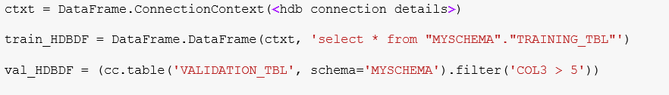
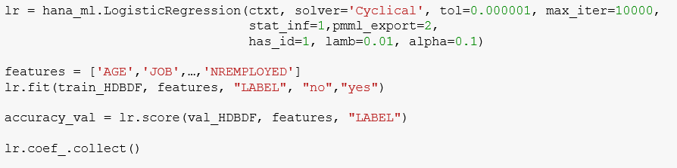

SAP HANA, Express Edition – New Capability* Python Client API for SAP HANA Machine Learning - Example
Import packages
Create dataframes
Create an instance, invoke fit and score method
Use trained model for prediction
*Delivered with SAP HANA, express edition 2.0 SPS 03 Revision 33

Slide 27
Agenda
SAP HANA Predictive and Machine Learning Overview
Python integration with SAP HANA
Python Client API for SAP HANA Machine Learning
Demo
Plans and Roadmap

Slide 28

Python Client API for HANA ML – DataFrame
Data Scientist using Python
HANA DataFrame
Stores only references to data (select statement)
No data brought into the library except when explicitly requested
Hides SQL. SQL statements are built in the library
Push computation to HANA
Useful for data analysis
Used as parameters to APIs in PAL wrapper
Python Program
DataFrame
ML API
DEMO
hdbcli
HANA
Core ML API
Python Wrapper for PAL
Scikit-learn like interface
Works with dataframes

Slide 29
Python Client API for HANA ML – Core ML API
Data Scientist using Python
HANA DataFrame
Stores only references to data (select statement)
No data brought into the library except when explicitly requested
Hides SQL. SQL statements are built in the library
Push computation to HANA
Useful for data analysis
Used as parameters to APIs in PAL wrapper
Python Program
DataFrame
ML API
DEMO
hdbcli
HANA
Core ML API
Python Wrapper for PAL
Scikit-learn like interface
Works with dataframes

Slide 30
Agenda
SAP HANA Predictive and Machine Learning Overview
Python integration with SAP HANA
Python Client API for SAP HANA Machine Learning
Demo
Plans and Roadmap

Slide 31
SAP HANA, Express Edition – New Capability* Python Client API for SAP HANA Machine Learning
Python packages to leverage In-Database Machine Learning
What’s delivered with SAP HANA, express edition 2.0 SPS 03 Revision 33
Dataframe
ML functions (https://wiki.wdf.sap.corp/wiki/display/ESP/Quarterly+Plan )
Rigorous API documentation
Some notebooks
In the works
but coming later the R Client API for SAP HANA ML
*Delivered with SAP HANA, express edition 2.0 SPS 03 Revision 33

Slide 32
SAP HANA, Express Edition – New Capability* Python Client API for SAP HANA Machine Learning – Roadmap and Plans
Python packages to leverage In-Database Machine Learning
Key planned capabilities for the API
Enhance dataframes – Joins, Unions, Group By, Pivot
Complete for all PAL functions
PAL performance functions and hyperparameter tuning functions
Document mapping of API parameters to PAL parameters
Dynamically create anonymous blocks, views, or temporary tables
Modularization to wrap other libraries (e.g. APL)
Smart explorative data visualizations
Model development and model visualization
Result visualization
..
R Client API for SAP HANA ML
*Delivered with SAP HANA, express edition 2.0 SPS 03 Revision 33
Notes:
Exploration Visualization
Visualization for different data types (e.g. time vs. categorical vs. numerical) => Gain more insight as they become data type specific
Common smoothing operations – scaling,… => More insight by removing large variations
Model development
Balanced data sets => better models
Result Visualization
- Metrics => Easily see whether a model is good, determine thresholds, …
For different metrics what are the visualization techniques
Models => Evaluate whether the weights and model parameters pass the smell test.
For different models (clustering, classification decision tree, neural nets)
Comparisons => Easily be able to compare models

Slide 33
SAP HANA, Express Edition – New Capability* Python Client API for SAP HANA Machine Learning
Python packages to leverage In-Database Machine Learning
Available with HXE Rev 33 (Slated for Oct. 2 at this time).
Documentation when HXE Rev 33 is released should be at https://help.sap.com/http.svc/rc/3f0dbe754b194c42a6bf3405697b711f/2.0.03/en-US/html/index.html.
Documentation prior to release of HXE Rev 33 is at https://help.sap.com/http.svc/rc/DRAFT/3f0dbe754b194c42a6bf3405697b711f/2.0.03/en-US/html/index.html.
For more information contact
christoph.morgen@sap.com, ashok.swaminathan@sap.com, or nanda.kaushik@sap.com.
*Delivered with SAP HANA, express edition 2.0 SPS 03 Revision 33
Notes:
Exploration Visualization
Visualization for different data types (e.g. time vs. categorical vs. numerical) => Gain more insight as they become data type specific
Common smoothing operations – scaling,… => More insight by removing large variations
Model development
Balanced data sets => better models
Result Visualization
- Metrics => Easily see whether a model is good, determine thresholds, …
For different metrics what are the visualization techniques
Models => Evaluate whether the weights and model parameters pass the smell test.
For different models (clustering, classification decision tree, neural nets)
Comparisons => Easily be able to compare models

Slide 34
Thank you

