Slide 1
This text is hard to read

Slide 2
This text is easy to read
This text is easy to read
This text is easy to read
This text is easy to read

Slide 3
This text is hard to read

Slide 4
This text is hard to read

Slide 5
This text is hard to read

Slide 6
This text is easy to read
This text is easy to read

Slide 7
This text is hard to read

Slide 8
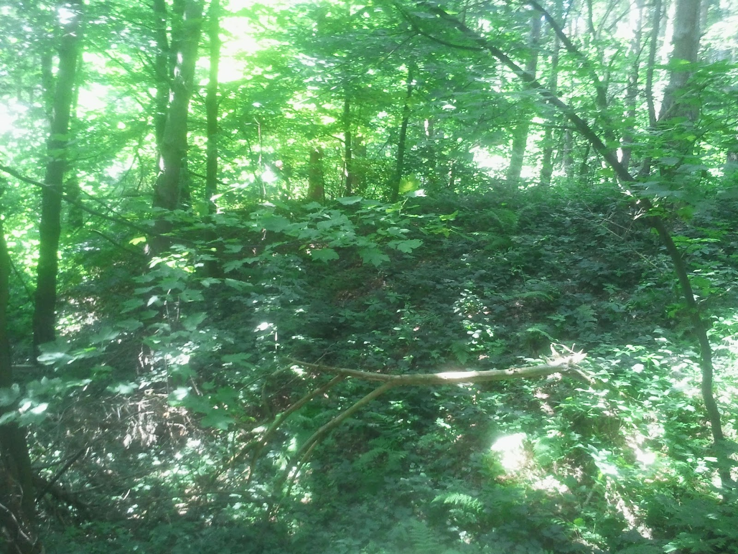
This text is hard to read

Slide 9
This text is easy to read

Slide 10
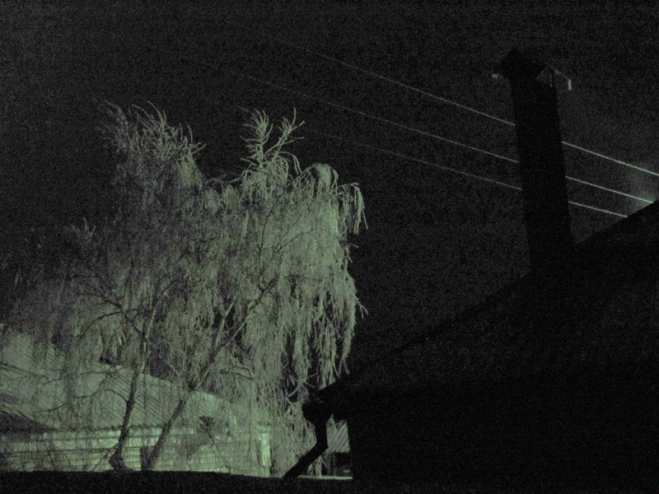
This text is hard to read

Slide 11
This text is easy to read

