Slide 1
Tutorial 1: Google Charts
04.02.2016
Dr. Chris Phethean
Data Visualisation (COMP6234)

Slide 2
COMP6234 Tutorial Series
Provide introductions to a range of tools for creating visualisations
There are many tools out there, we can’t cover them all
Opportunity for hands-on experience creating visualisations
Opportunity to put in to practice the approaches discussed in lectures

Slide 3
Tutorial Schedule
Week 19 (today): Google Charts
Week 21: Tableau (2 hours)
Week 22: Seminar – critiquing visualisations
Week 23: Tableau / CW catchup
Week 24: CartoDB
Week 25: Graph visualisations

Slide 4
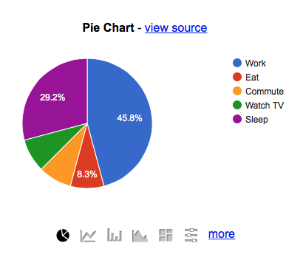
Today: Google Charts

Slide 5
Technologies for Visualisation
Low Level
High Level
WebGL
Canvas
SVG
D3.js
NVD3 (re-usable D3 charts)
Dimple.js (D3 for business analytics)
Rickshaw (D3 for time series)
RAW (Web app, paste data)
Chartio (paid)
Plotly
CartoDB
Tableau
More Complex,
Programmable so more customisable,
More Powerful,
Less Complex,
Mostly automated so more confined to templates,
Less Powerful,

Slide 6
Technologies for Visualisation
Low Level
High Level
WebGL
Canvas
SVG
D3.js
NVD3 (re-usable D3 charts)
Dimple.js (D3 for business analytics)
Rickshaw (D3 for time series)
RAW (Web app, paste data)
Chartio (paid)
Plotly
CartoDB
Tableau
Google Charts
More Complex,
Programmable so more customisable,
More Powerful,
Less Complex,
Mostly automated so more confined to templates,
Less Powerful,

Slide 7
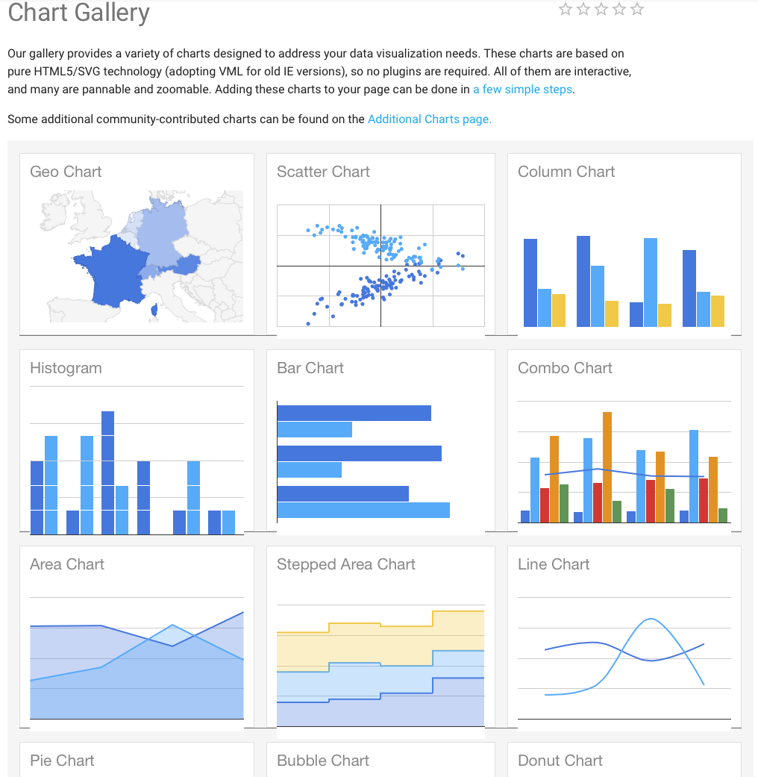

Slide 8
Google Charts
Pre-set chart types
Cross-platform
Will display on a web browser on any device
HTML and Javascript based
Built on a ‘Data Table’ which can be swapped between types of chart to quickly experiment with different graphs

Slide 9
Code
Code is all placed in an HTML file (.html)
If you’re not familiar with Web standards and technologies, I would advise spending some time early in the course to read about them.
For the tutorial, you will need to create a blank .html file in a text editor such as Notepad or TextEdit (make sure it doesn’t save as .txt), and add the code to that.

Slide 10
Tutorials
The tutorials are there as a guide to introduce you to the tool
Feel free to experiment further and see what you can create
Think about what type of data you’re visualising and how this affects the type of visualisation that is most suitable.
Discuss with your peers!

