Slide 1
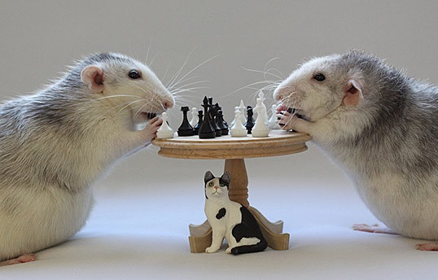
Evolutionary Game Theory
Simon Tudge

Slide 2
Overview
What is Game theory?
What can game theory do for Biology?
Stability and Dynamics.
Are living things rational?
Why do living things cooperate?
Are Genes Selfish?

Slide 3
What is a Game?
Invented 1944 by John von Neumann and Oskar Morgenstern to understand economic behaviour.
Key aspects are “players” who have a choice of different strategies.
Outcome of the game depends upon the strategies employed by each player.
Players prefer different outcomes to others.
Utility can quantify preferences.

Slide 4
Examples of Games
Whenever the best thing to do depends upon the action of others.
Everyday examples: chess, poker, Monopoly, rock-paper-scissors.
Economics: rival petrol station owners deciding what to charge per litre.
Biology: a young male chimpanzee deciding whether to challenge the alpha male for access to females.
One representation uses a payoff matrix:
Him
 | £1/litre | £2/litre
£1/litre | £0.50 | £1
£2/litre | £0 | £1
Entries in table are utility, might be happiness, money or biological fitness.
You

Slide 5
Why does Evolutionary Biology Need Game Theory?
In simple models of evolution different characteristics have different fitnesses.
However, often the fitness of a certain behaviour depends upon what others are doing.
Typical examples involve: fighting, mating, cooperation, reciprocal grooming, parent offspring conflict, sex-ratio “decisions” by mothers.
Game theory was invented to handle this type of situation (though in economics, not biology).

Slide 6
Criminal Penguins
https://www.youtube.com/watch?v=MlbxRBfGAr0
Penguins can collect their own stones, or steal them from others.
There is a benefit to having stones (in terms of reproductive output).
There is an energetic cost to collecting stones.
 | Collect | Steal
Collect | b-c | b/2-c
Steal | b | 0
b>2c and b,c>0

Slide 7
Nash Equilibrium
The Nash Equilibrium (NE) is the situation in which neither player has an incentive to change their strategy.
NE found by finding the mixed strategy that makes ones opponent indifferent about which strategy to play.
Steal Pebbles with probability p.
Payoff to collector = (1-p)(b-c)+p(b/2-c)
Payoff to thief = b(1-p)+p*0
Set Equal and solve for p
p=2c/b
Say b = 1 and c = 0.1, then p = 0.2, i.e. steal 20% of the time.

Slide 8
Agent Based Method
Are penguins really clever enough to do game theory?
Let’s simulate and see.
Genetic strategy either to steal or to collect.
Each individual is paired with a random individual, and gets a payoff.
Next generation is generated via fitness proportionate selection.

Slide 9
b
b/2-c
b-c
b-c
0
0
1. Initial Population
2.Population randomly paired
b-c
b-c
b
b/2-c
0
0
3. Fittest Individuals form next generation

Slide 10
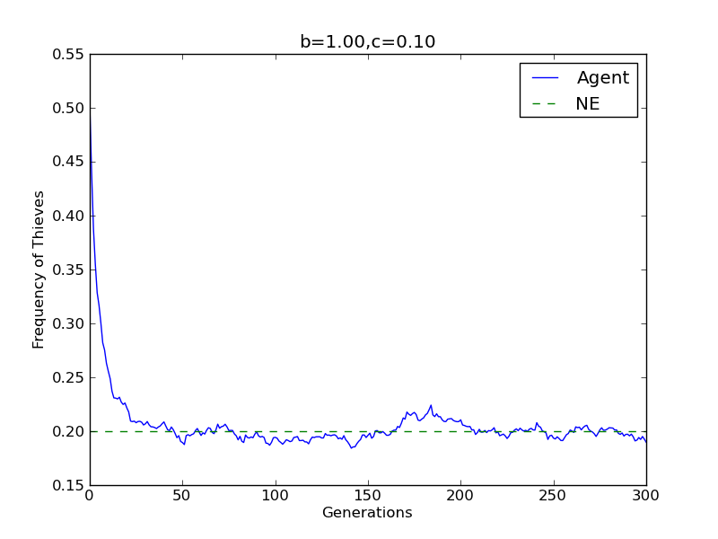
Simulation Results

Slide 11
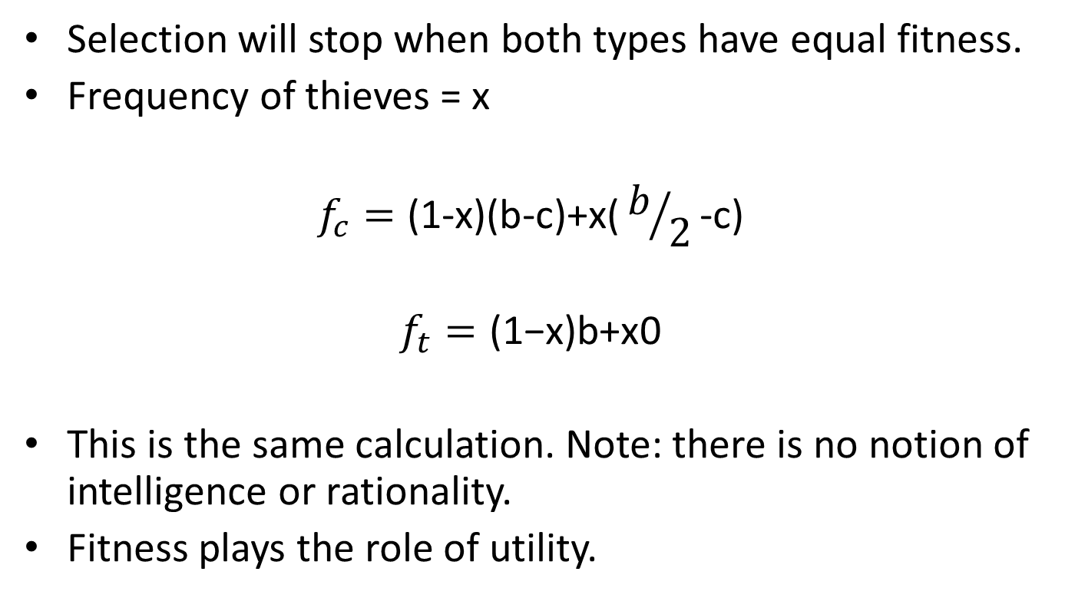
Why do Penguins Play Nash?
Selection will stop when both types have equal fitness.
Frequency of thieves = x
$$f_{c}=\text{(1−}\text{x}\text{)(}\text{b}\text{−}\text{c}\text{)+}\text{x}\text{(}b/2\text{−}\text{c}\text{)}$$
$$f_{t}=\text{(1−}\text{x}\text{)}\text{b}\text{+}\text{x}\text{0}$$
This is the same calculation. Note: there is no notion of intelligence or rationality.
Fitness plays the role of utility.

Slide 12
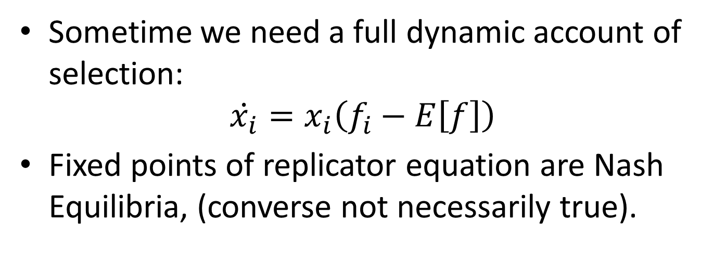
Replicator Equation
Sometime we need a full dynamic account of selection:
$$\dot{x_{i}}=x_{i}\left(f_{i}−E\left[f\right]\right)$$
Fixed points of replicator equation are Nash Equilibria, (converse not necessarily true).

Slide 13
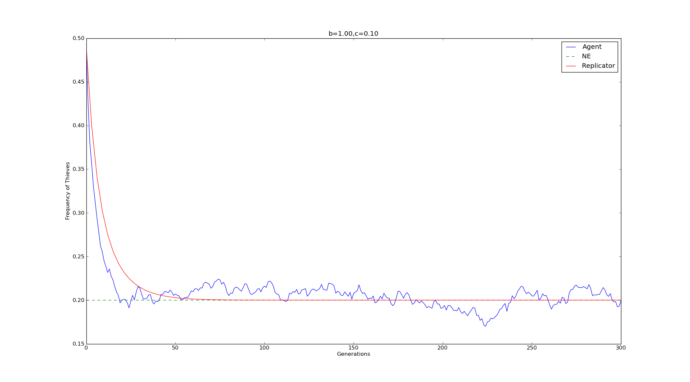
Simulation Results

Slide 14
Benefits of Evolutionary Game Theory
Full dynamic account.
Allows us to think about living things as if they were rational (although they’re not).
Multiple ways of tackling the same problem. (agent based model, NE, replicator equation).

Slide 15
The Evolution of Cooperation
Why do biological individuals cooperate?
Evo-GT helps to frame the question precisely.
Predicts that cooperation should not exist.
Yet it does.
 | C | D
C | b-c | -c
D | b | 0
b>c and b,c>0

Slide 16
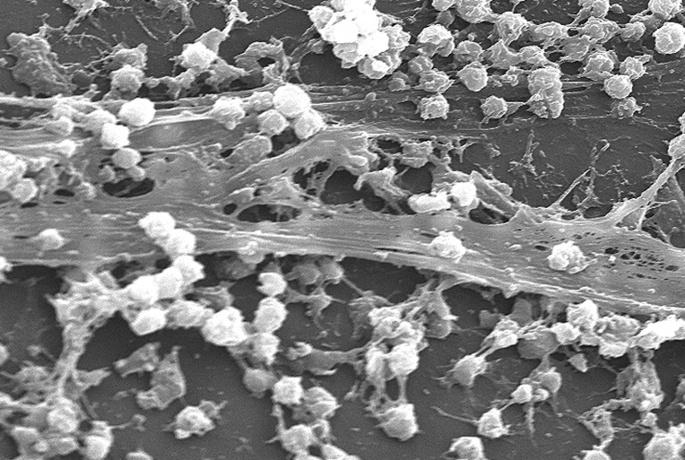
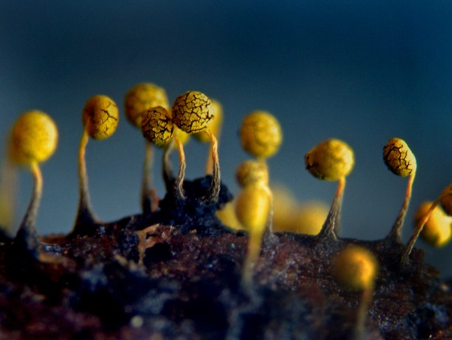
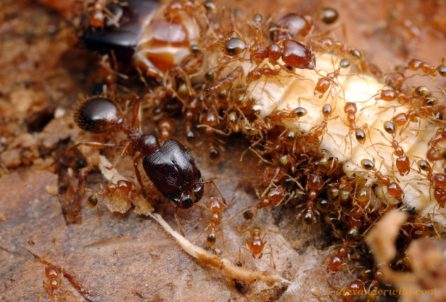
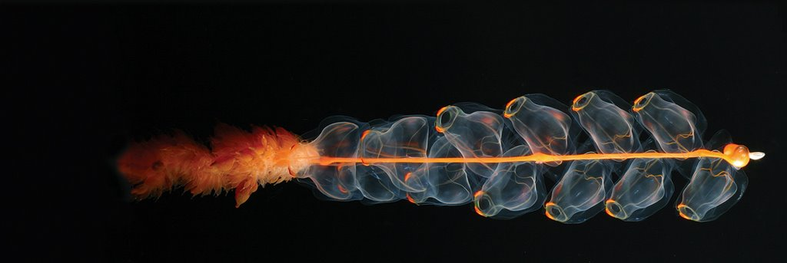

Slide 17
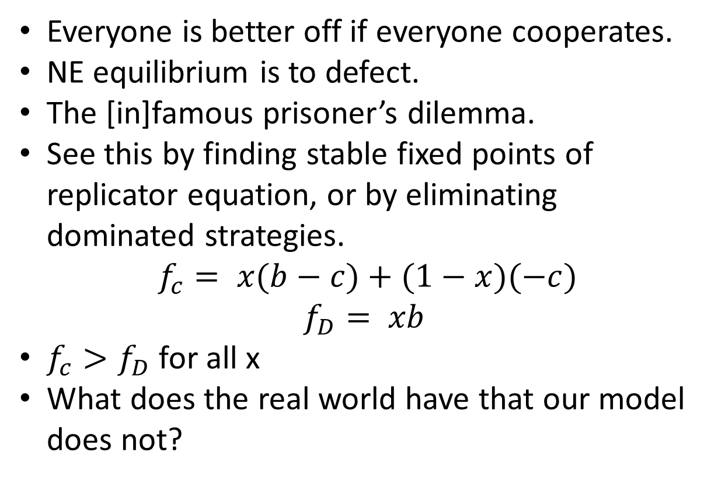
The Evolution of Cooperation
Everyone is better off if everyone cooperates.
NE equilibrium is to defect.
The [in]famous prisoner’s dilemma.
See this by finding stable fixed points of replicator equation, or by eliminating dominated strategies.
$$f_{c}= x(b−c)+(1−x)(−c)$$
$$f_{D}= xb$$
$f_{c}>f_{D}$ for all x
What does the real world have that our model does not?

Slide 18
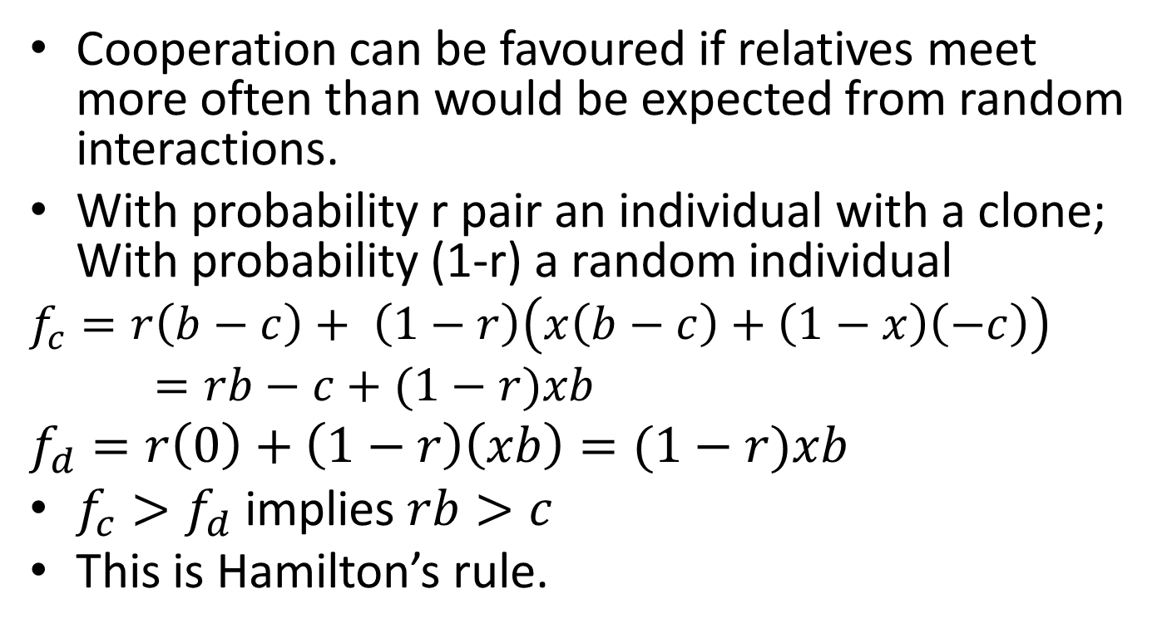
Assortment
Cooperation can be favoured if relatives meet more often than would be expected from random interactions.
With probability r pair an individual with a clone; With probability (1-r) a random individual
$$f_{c}=r\left(b−c\right)+ \left(1−r\right)\left(x\left(b−c\right)+\left(1−x\right)\left(−c\right)\right)=rb−c+(1−r)xb$$
$$f_{d}=r\left(0\right)+\left(1−r\right)\left(xb\right)=(1−r)xb$$
$f_{c}>f_{d}$ implies $rb>c$
This is Hamilton’s rule.

Slide 19
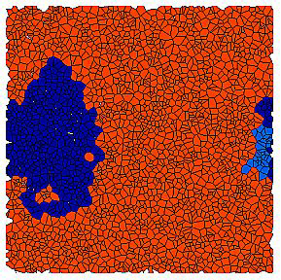
Spatial model
Agents play a prisoner’s dilemma on a network.
If they “beat” their neighbours they reproduce and replace their neighbour.
Cooperation is favoured because individuals meet relatives
Cooperators in red, defectors in blue.
Image from Flache & Hegselmann (2001), JASSS.

Slide 20
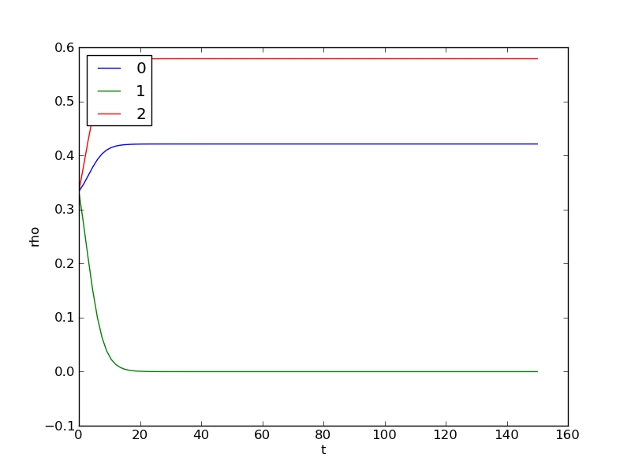
Repeated Game
Individual might play the same game with the same opponent more than once.
The individual’s strategy can be dependent upon the outcome of the previous game(s).
Tit-for-Tat plays the strategy that the opponent played on the previous turn.
 | C | D | TFT
C | b-c | -c | b-c
D | b | 0 | 0
TFT | b-c | 0 | b-c

Slide 21
Are Genes Selfish?
Despite the selfish gene metaphor most genes actually spread by increasing the fitness of the organism.
However, some genes are truly selfish and are able to spread at the expense of the host.
Meiotic drivers are one example in that they are ‘super-Mendelian’.

Slide 22
Fair and Bias Meiosis:
Fair
Un-fair
Germ Cell:
Aa
Aa
Gametes:
A
a
A
a
Frequency:
0.5
0.5
0.5(1+δ)
0.5(1-δ)

Slide 23
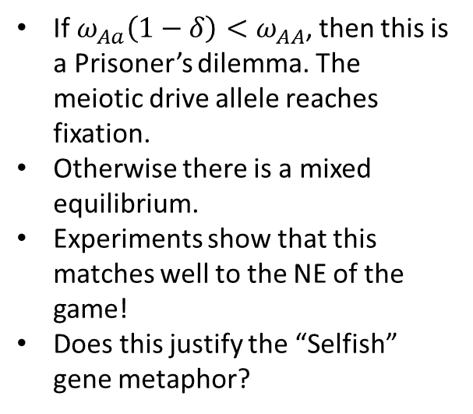
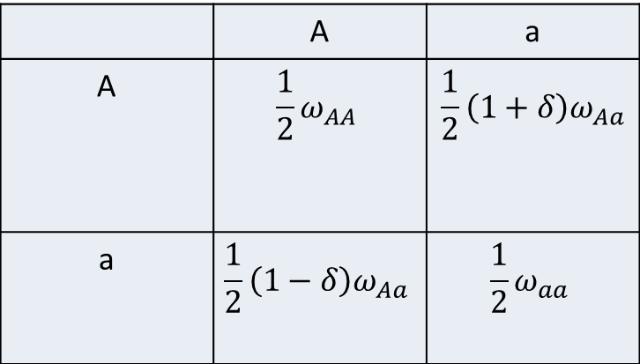
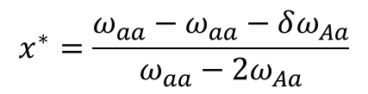
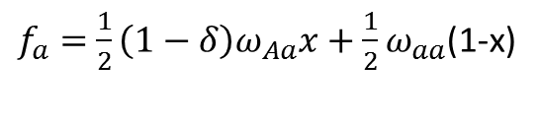

Genes as Agents
 | A | a
A | $${\frac{1}{2}ω}_{AA}$$ | $${\frac{1}{2}\left(1+δ\right)ω}_{Aa}$$
a | $${\frac{1}{2}\left(1−δ\right)ω}_{Aa}$$ | $${\frac{1}{2}ω}_{aa}$$
If$ω_{Aa}\left(1−δ\right)<ω_{AA}$, then this is a Prisoner’s dilemma. The meiotic drive allele reaches fixation.
Otherwise there is a mixed equilibrium.
Experiments show that this matches well to the NE of the game!
Does this justify the “Selfish” gene metaphor?
$f_{A}=$ ${\frac{1}{2}ω}_{AA}x+{\frac{1}{2}\left(1+δ\right)ω}_{Aa}(1−x)$
$f_{a}=$ ${\frac{1}{2}\left(1−δ\right)ω}_{Aa}x+{\frac{1}{2}ω}_{aa}$(1-x)
$$x^{∗}=\frac{ω_{aa}−ω_{aa}−δω_{Aa}}{ω_{aa}−2ω_{Aa}}$$

Slide 24
Summary
Game Theory is used to study strategic interactions.
GT can be used in biology to model frequency dependent selection.
Selection mimics rationality.
Both equilibrium concepts and dynamic descriptions exist.

Slide 25
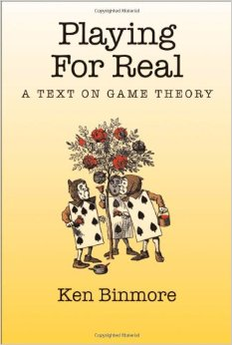
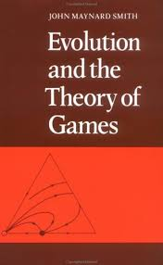
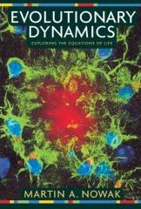
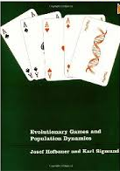
Further Reading

