Slide 1
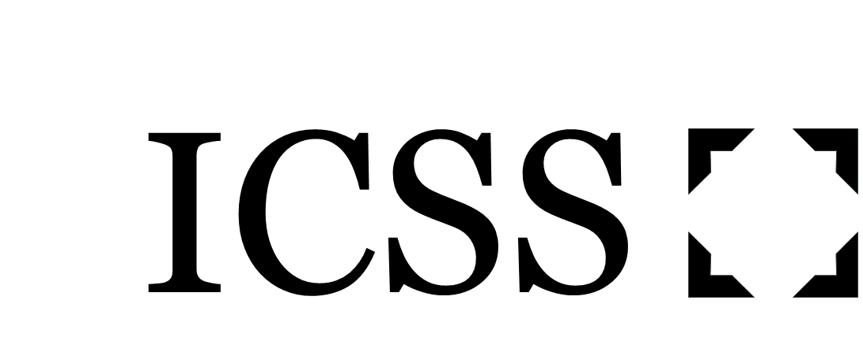
Introduction to Social Evolution
Paul Ryan
paul.ryan@soton.ac.uk

Slide 2
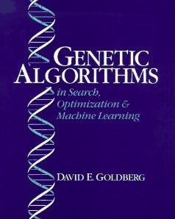
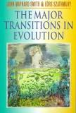
The evolution of complexity
Can evolutionary computation (genetic algorithms etc.) explain it?
Can theoretical biology explain it?

Slide 3
Central message of this talk
Observation: All life is social and collective
Observation: All collective task completion involves a social dilemma
Plausible hypothesis: Such dilemmas can be overcome via adaptations leading to population structures which modify the game being played and so dissolve the dilemma
Speculative hypothesis: Biological complexity has evolved as a side effect of this process

Slide 4
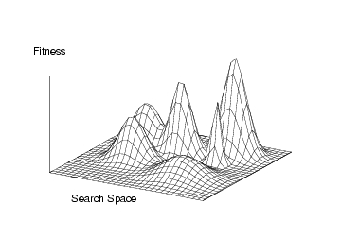
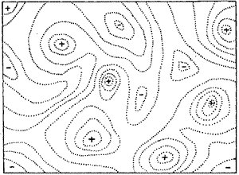
When is the fitness landscape metaphor helpful (and when is it not?)

Slide 5
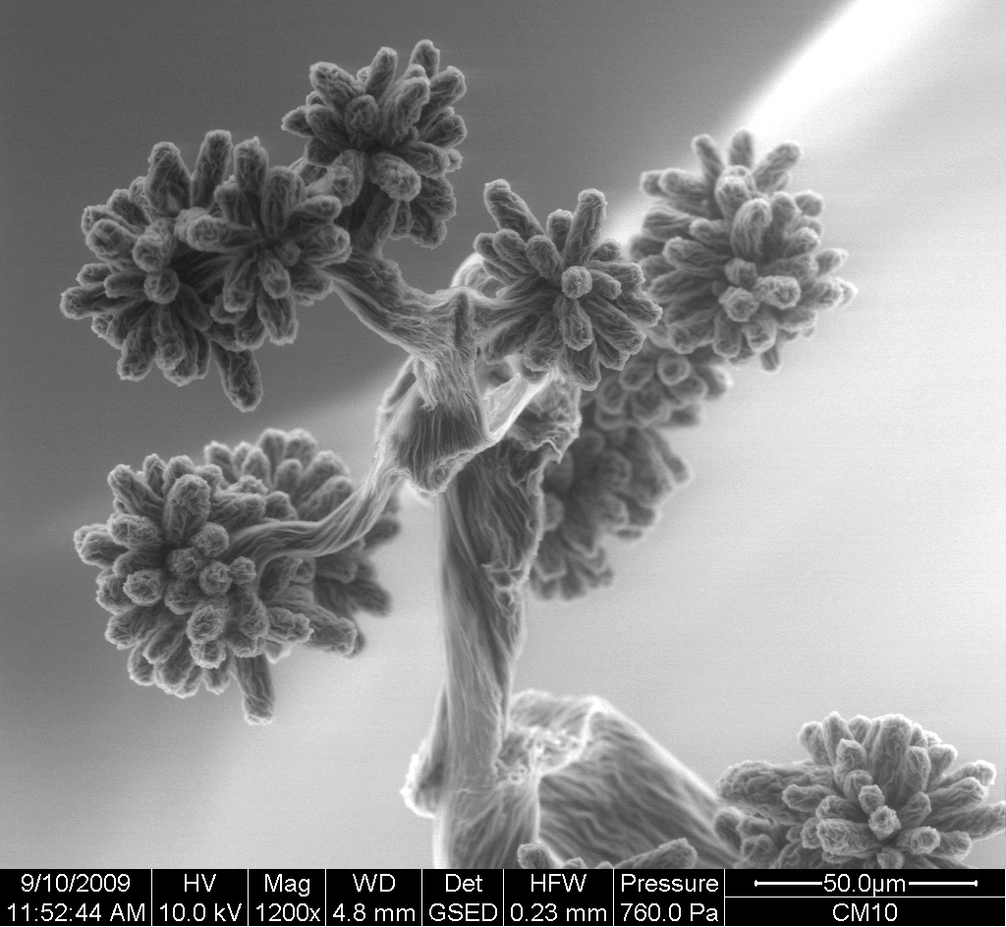
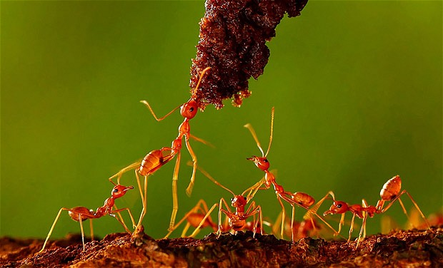
Usually, the best thing to do depends on what everyone else is doing …

Slide 6
A generalized scheme for fitness interactions
Fitness outcomes for a transaction between 2 agents
 | Recipient + | Recipient -
Actor + | Cooperation | Selfishness
Actor - | Altruism | Spite

Slide 7
The classic (non-social) case
 | Recipient + | Recipient -
Actor + | Cooperation | Selfishness
Actor - | Altruism | Spite
And fitness is (usually) relative

Slide 8
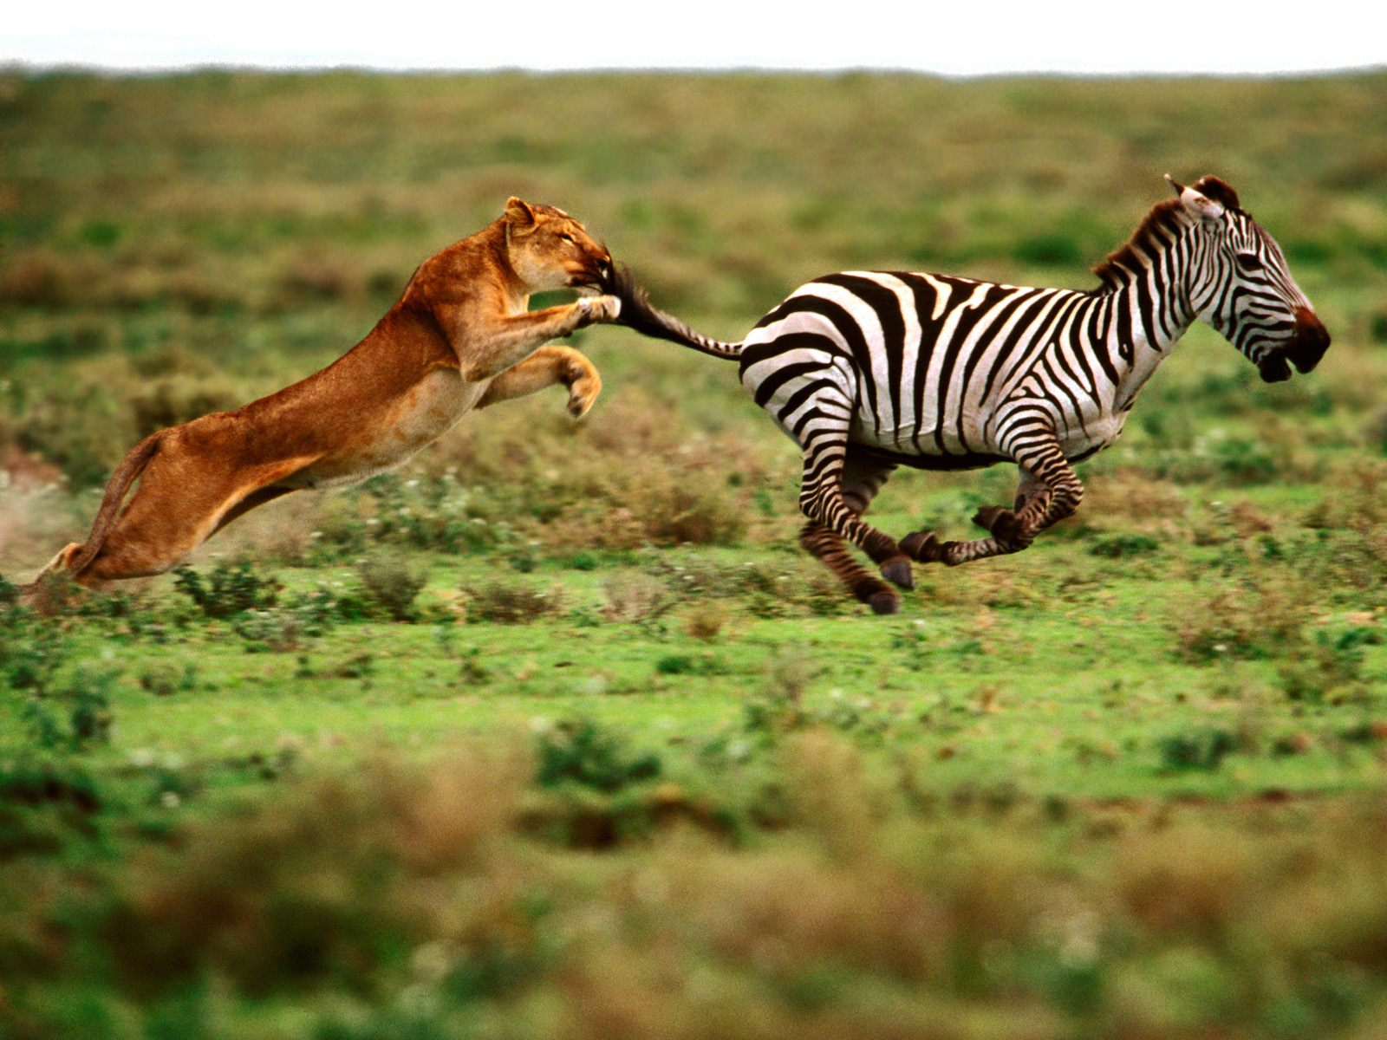

Slide 9
The ‘obvious’ case - selfishness
Nature red in tooth and claw
Agents act to increase their fitness and decrease that of others
Run faster, sharper teeth, hide better, have a longer neck
No dilemma here

Slide 10
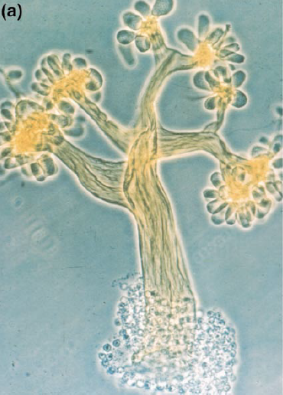
Myxobacteria cooperate and exhibit division of labour and specialisation of parts.
Crespi (2001) The evolution of
social behavior in
Microorganism, TREE, Vol. 16

Slide 11
Cases particular to social evolution
This is where it gets interesting
 | Recipient + | Recipient -
Actor + | Cooperation | Selfishness
Actor - | Altruism | Spite

Slide 12
How can non-intelligent agents be said to ‘cooperate’ ?

Slide 13
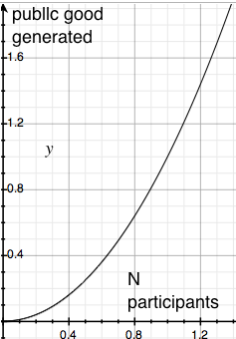
Public goods come from synergy
Sometimes many agents acting together can generate more benefit than each acting in isolation
Benefit(N) > N * Benefit(1)
But the benefit is now a Public Good

Slide 14
The concept of a Public Goods Dilemma
Each agent has a choice between a pro-social ‘cooperative’ and a ‘selfish’ strategy
If all (or most) agents cooperate, all will be better off
But each individual agent will do better still by choosing the selfish strategy
Result: sub-optimal outcome for all
Look up: “Prisoners’ Dilemma”

Slide 15
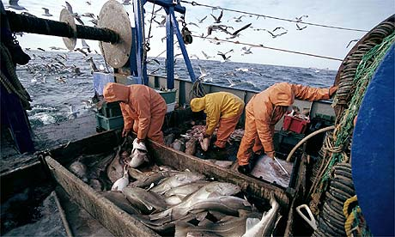
Public goods consumption dilemma: The Tragedy of the Commons

Slide 16
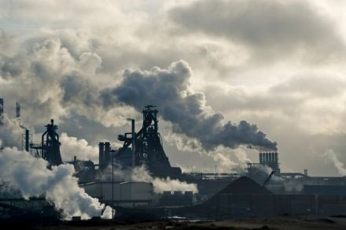
Public goods consumption dilemma: The Tragedy of the Commons

Slide 17
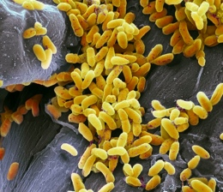
Public goods consumption dilemma: The Tragedy of the Commons
Pseudomonas aeruginosa bacteria generate public goods, ‘siderophores’
Free riders who avail of the good without contributing toward it will increase in frequency in the population

Slide 18
Public goods production dilemma
Myxococcus
Xanthus bacteria

Slide 19
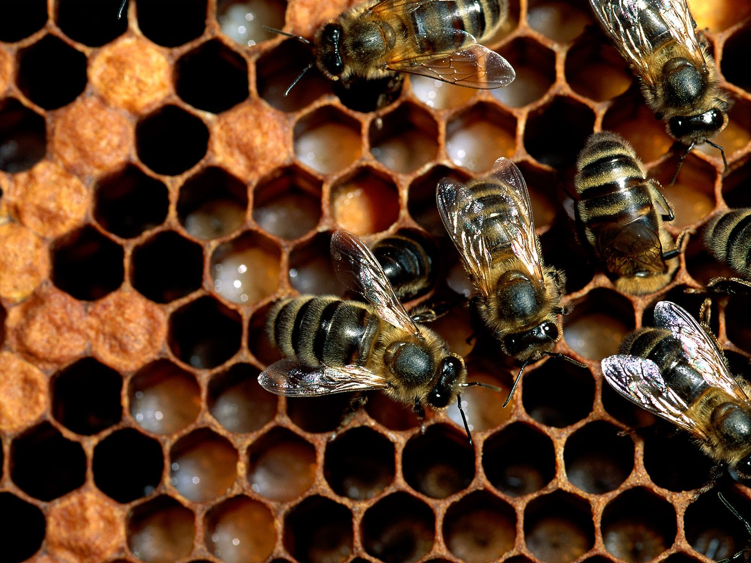
Problem
Theory predicts cooperation will not be stable in public goods dilemmas
BUT we see widespread cooperation in nature
How can we explain this?

Slide 20
Good-of-the-group selection
Naïve suggestion:
Groups with more cooperators do better than groups that don’t
Selection acting at group level can then act to raise levels of cooperation

Slide 21
Darwin (1871) Descent of Man
Proto-group selectionist argument:
“A tribe including many members, who from possessing in a high degree the spirit of patriotism, fidelity, obedience, courage and sympathy, were always ready to aid one another, and to sacrifice themselves for the common good, would be victorious over most other tribes; and this would be natural selection”

Slide 22
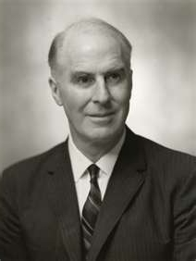
Good-of-the-group selection
Wynne-Edwards

Slide 23
Problem with Good-of-the-group selection
Good-of-the-group selection is not an adequate explanation
It does not explain why, within groups, cooperation does not go extinct due to the relative advantage of selfish ‘free-riders’
Something more is required …

Slide 24
Population structure is a game-changer
The public goods dilemmas as presented above lead inevitably to selfish behaviour
But Population Structure can modify fitness interests in radical ways
Cooperation is evolutionarily stable when the benefits fall preferentially on those likely to pass the behaviour on

Slide 25
Varieties of population structure
Any deviation from random chance interactions between phenotypes, e.g.:
Repeated interaction with same agents
Group structure
Genetic relatedness (kinship)
Shared reproductive fate

Slide 26
e.g. Cooperation can be sustained in group-structured populations
Time t1
Time t2

Slide 27
Examples of population structure
The biological world has a complex hierarchical structure
Genes-chromosomes-cells-organisms-societies
This complexity can be viewed as population structure

Slide 28
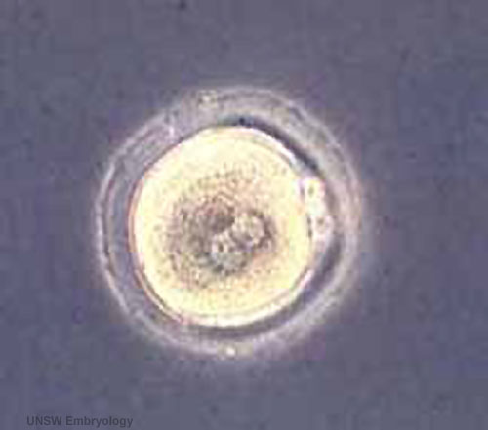
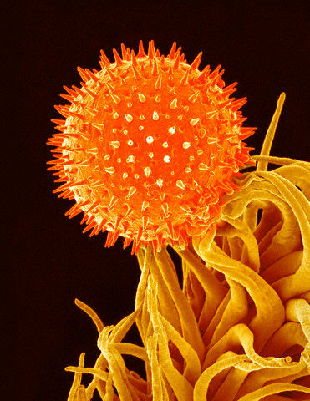
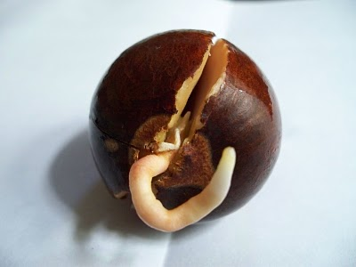

Slide 29
Real population structure example: life-history bottlenecks
Adult multi-cellular organisms contain very many cells
But all start their life as a single cell
Q: Why?
A: This population structure helps defeat a public good dilemma at cell level

Slide 30
History of social evolution 1
Quiet revolution in theoretical biology
Starts as an anomaly for Darwin (1859), his: “one special difficulty” – sterile worker castes in social insects
Anomaly resolved by W.D. Hamilton’s (1964) inclusive fitness theory (which relies on relatedness between actors – a type of population structure)

Slide 31

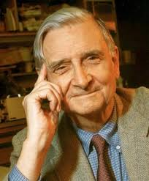
History of social evolution 2 - Sociobology
Inclusive fitness theory resolved the old problem of evolution of cooperation in animals
But cooperation still viewed as a niche area of zoology

Slide 32
History of social evolution 3 – Major Transitions
New, radically increased scope; social evolution seen as key to all stable forms of biological grouping
Genes ‘cooperate’ on chromosomes
Mitochondria and chloroplast ‘cooperate’ in eukaryotic cells
Cells ‘cooperate’ in multicellular organisms
Ants ‘cooperate’ in eusocial colonies

Slide 33
Major Evolutionary Transitions as products of social niche construction
a number of smaller units, originally capable of surviving and reproducing on their own, become aggregated into a single larger unit
thus generating a new level of biological organization and increased complexity
The scope of social evolution theory is now the whole biota

Slide 34
Social Niche Construction
Powers et al. (2011) The Concurrent Evolution of Cooperation
and the Population Structures That Support It, Evolution

Slide 35
Central message of this talk
Observation: All life is social and collective
Observation: All collectives necessarily face public goods dilemmas
Plausible hypothesis: Such dilemmas can be overcome via adaptations leading to population structures which modify the game being played and so dissolve the dilemma
Speculative hypothesis: Biological complexity has evolved as a side effect of this process

Slide 36
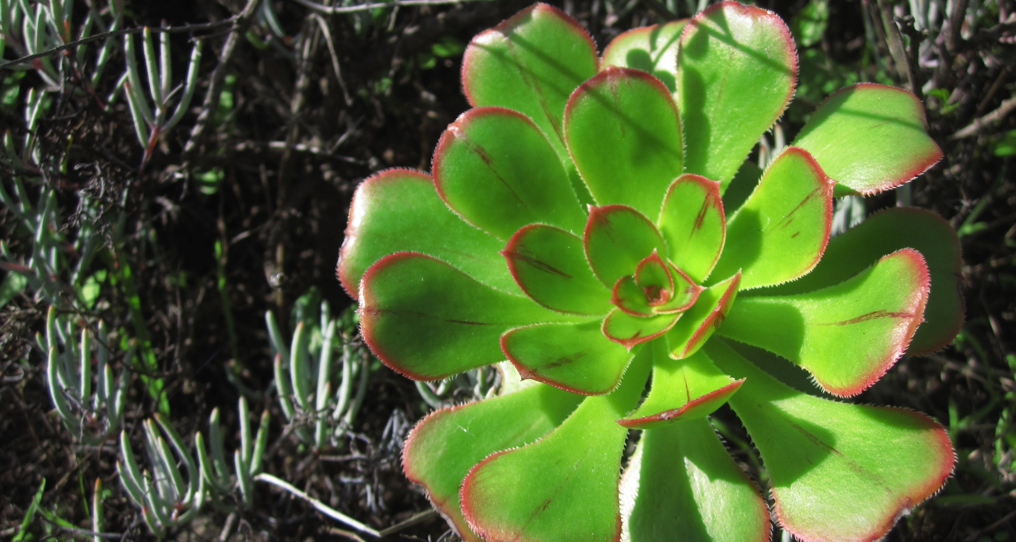
Further reading
A primer on evolutionary game theory and its application to social evolution
http://users.ecs.soton.ac.uk/par1g10/evo_game_theory_primer/
paul.ryan@soton.ac.uk

