Slide 1
CS-503 VISUAL INTELLIGENCE
Progress Report 2
Sensor Structure Shapes
the Format of Cognitive Maps
in Navigation Agents
Léo Bruneau · Weilun Xu · Rim Abkari · Zyad Aoutir
Does visual-input structure shape the format of the cognitive map?

Slide 2



MOTIVATION
Different sensor ecologies, different cognitive maps
Echolocating bat
Blind rodent
Foveated primate
no eyes · sonar map
tactile · path integration
fovea + blurred periphery
→ qualitatively different hippocampal coding strategies, not just different accuracy
Does varying only the visual sensor change the cognitive map's format in deep-RL agents?
CS-503 · Progress Report 2
Motivation · 2 / 9

Slide 3
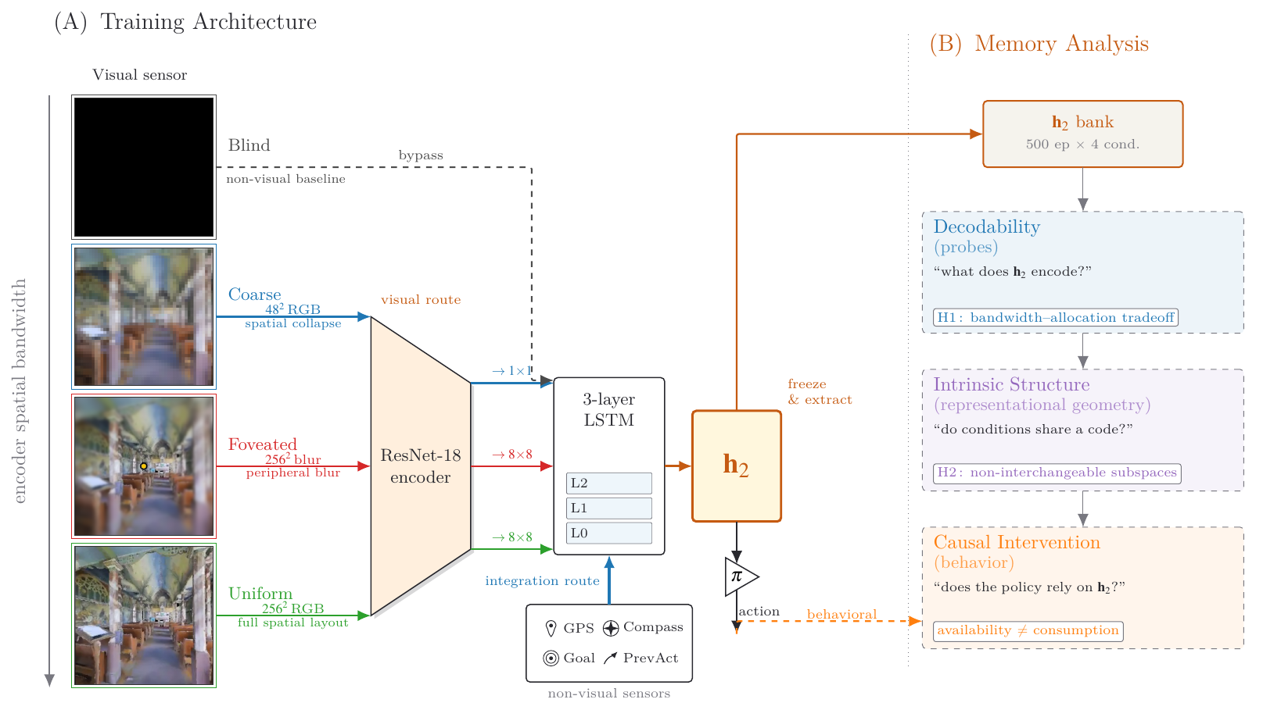
SETUP
5 conditions on one bandwidth axis
Three lenses
on the frozen ℎ₂
Decodability
what does ℎ₂ encode?
Intrinsic structure
do conditions share a code?
Causal intervention
does the policy rely on ℎ₂?
Same architecture, training, sensors. All conditions reach 96–99 % success — no skill gap.
CS-503 · Progress Report 2
Setup · 3 / 9

Slide 4
WHAT CHANGED SINCE THE PROPOSAL
Project rescope: from foveation to encoder bandwidth
H1 reframed
H3 de-scoped
Encoder bandwidth, not foveation.
Cog-neuro toolkit imported instead.
Unified-hyperparameter training removes apparent foveated specialness. Foveated-logpolar (2×2) control lands where the encoder-bandwidth account predicts.
Learned-gaze MLP collapsed under navigation reward. Redirected to Skaggs · SR predictive horizon · Procrustes · subspace divergence · excursion-forgetting.
CS-503 · Progress Report 2
Rescope · 4 / 9

Slide 5
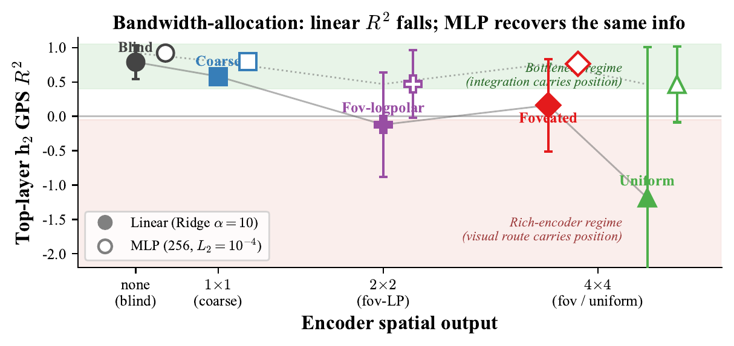
FINDING 1 / 3 · MAGNITUDE AXIS
Encoder bandwidth shapes the linear axis
Linear GPS R² falls monotonically with encoder bandwidth — yet MLP recovers GPS in every condition.
Position is retained, just not as the linearly-readable axis. Format differs.
CS-503 · Progress Report 2
Magnitude · 5 / 9

Slide 6
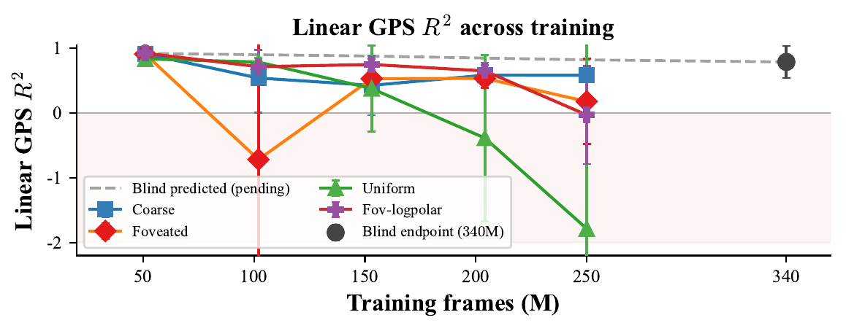
FINDING 2 / 3 · TRAINING-TIME PROCESS
Allocation emerges across training
All conditions start with a high linear GPS code; rich-encoder ones decay as the visual route consolidates.
Decay rate ordered by encoder informativeness — capacity allocation is a training-time process.
CS-503 · Progress Report 2
Training-time · 6 / 9

Slide 7
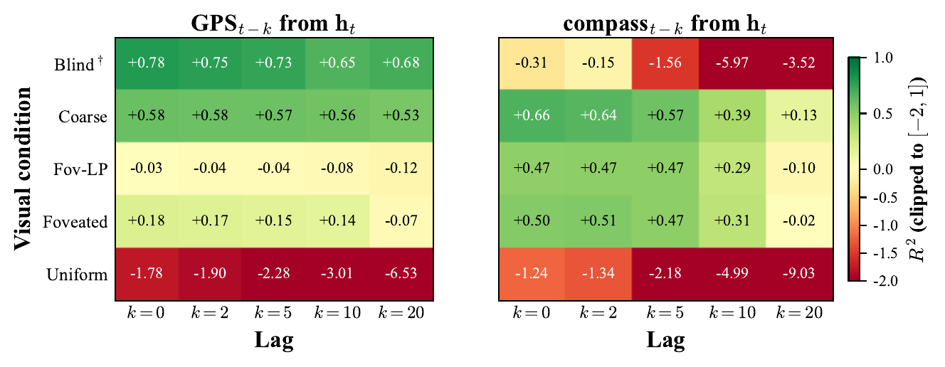
FINDING 3 / 3 · FORMAT GENERALISES
Bottleneck integrates; rich encoder reacts
Bottleneck stable past-position decoding across lags; rich-encoder degrades — generalises GPS → compass.
It is about format, not GPS specifically.
CS-503 · Progress Report 2
Format generalises · 7 / 9

Slide 8
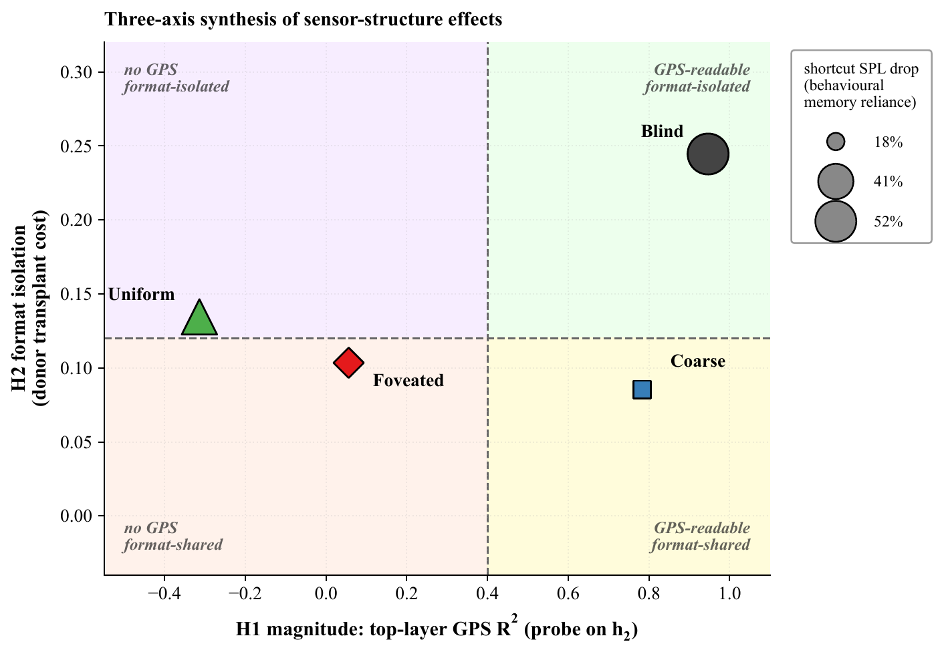
SYNTHESIS
Three regimes of cognitive-map format
Three regimes
Bottleneck
Linear GPS code · format-shared
Rich-encoder
No linear code · format-isolated
No-vision
Linear code · format-isolated
Long-term scientific bet
Does the bandwidth principle predict how real hippocampal circuits differ across species' sensor ecologies?
CS-503 · Progress Report 2
Synthesis · 8 / 9

Slide 9

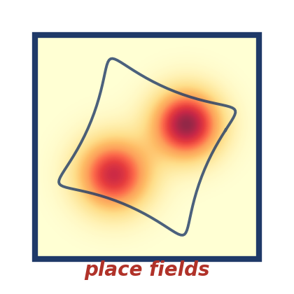
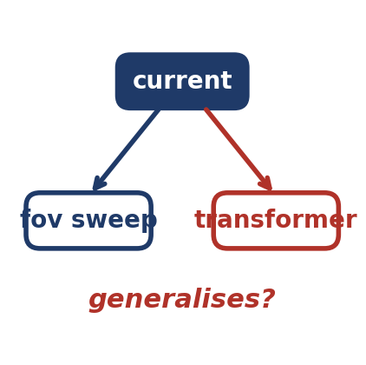
WHAT'S NEXT · WHAT IT MEANS
Open issues · Implications
Toward the final report
Implications
Three batches of pending work.
If the principle survives the remaining tests …
Bandwidth refinements
Encoder bandwidth as design lever
blind cross-training · coarse transplant · two-seed validation
restricting the encoder may recruit integration-style memory
Cog-neuro on ℎ₂
Architecture-agnostic in principle
occupancy decoder · MINE-PH · SR eigenbasis · Sussillo–Barak fixed-points
VLMs on rich foundation encoders may show the same crowd-out
Methodology porting
Scope tests
linear / lag-k / place-cell lens → cog-neuro tools for deep RL
foveation strength sweep · transformer falsification
CS-503 · Progress Report 2
Open issues · Implications · 9 / 9

