Slide 1
Deploying app to AWS
This presentation describe how to deploy
classic 3-tier app in
scalable and highly available and self-healing manner to AWS
in fully automated way.

Slide 2
Infrastructure design
VPC is created in multiple Availability zones (multiple regions are not considered in this example).
All servers are hidden in Private subnets to minimize attack surface.
The only internet facing instance is the Bastion host (for troubleshooting access, part of the app).
Only ssh access and only from specified IP is allowed to the Bastion host.
The Bastion host is behind AutoScaling group to enable self-healing.
AWS managed services like RDS, EFS, S3, CloudWatch are used to reduce maintenance.
To handle extra load and self-heal Webservers are behind AutoScaling group.
Webservers can deliver static objects like pictures from S3 bucket.
For accidental deletion protection Versioning is enabled on the S3 bucket.
To handle extra load and self-heal Appservers are behind AutoScaling group.
Appservers deliver shared files like php or configuration and other mutable storage from EFS filesystem.
Memcached is used to cache frequently used files and improve performance.
For backing up EFS files there is another EFS and a Lambda function that sync files periodically.
The RDS database is deployed in multiple AvailabilityZones for availability.
Database read replicas can be used to improve database throughput.
Database backups are done by AWS snapshots.
AWS native monitoring solution CloudWatch is used to collect metrics.
Logs from instances are sent to CloudWatchLogs.
P.S. I apologize for lousy picture on the next slide.

Slide 3
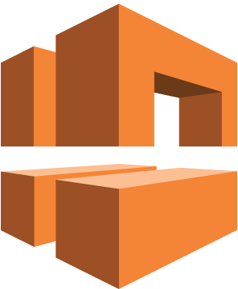


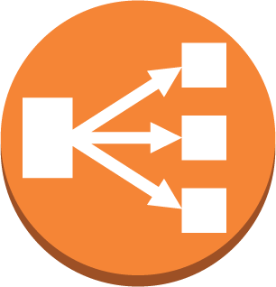









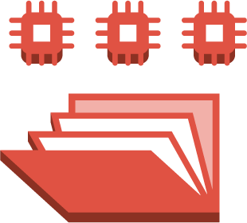



VPC
Internet gateway
Public subnet
Az1
Auto Scaling
Az2
Elastic IP address
elastic network interface
Load Balancer
VPC NAT gateway
Bastion instance
VPC NAT gateway
Private subnet
Auto Scaling
Amazon CloudWatch
bucket with static objects
Webserver instances
Webserver instances
Lambda function
Load Balancer
Appserver instances
Memcached multiAZ
Auto Scaling
Appserver instances
Backup Elastic file system
Elastic file system
Database subnet
RDS DB
instance read replica
RDS DB
instance standby (multi-AZ)
RDS DB instance

Slide 4
ToDo
In order to save time and effort for doing this example, I reused some old application code I found lying around where Webserver and Appserver is one machine. So in the example there is a 2-tier application.
S3 bucket for static objects is introduced in the infrastructure, but the application code is not yet modified to actually use it.
EFS filesystem is introduced in the infrastructure and mounted on servers, but the application code is not yet modified to actually use it.
Backup EFS filesystem and Lamda function for backing up mutable storage is not done.
RDS Read Replica is introduced in the infrastructure, but the application code is not yet modified to actually use it.
Route53 and ContentDeliveryNetwork is not described in this example.

