Slide 1
Module 4 Project: Property Values
Liz Alvarez

Slide 2
Important
Factors
Modest amount of capital
Multiple properties to manage risk
Maximum growth in the medium term
Minimal risk in the medium term
Minimal ethical concerns for low-income families

Slide 3


Analysis
DATA
Affordable?
Past Growth?
Potential?
Risky?

Slide 4
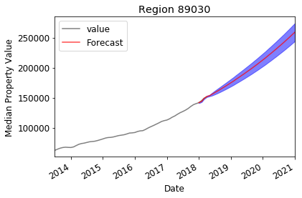
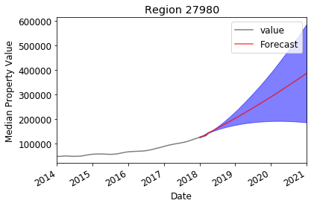
Results
North Las Vegas, NV
Hertford, NC

Slide 5
Results
Zip Code | Location | Growth | Confidence
89030 | North Las Vegas, NV | +117,641 (83%) | High
27980 | Hertford, NC | +259,999 (205%) | Low
33615 | Town ‘n’ Country, FL | +36,924 (19%) | Medium
33713 | St Petersburg, FL | +55,922 (32%) | Medium
33755 | Clearwater, FL | +52,104 (29%) | Medium
Notes:
89030 North Las Vegas, NV: $141,600.00 --> $259,241.10 for an increase of $117,641.10. Growth rate: 83.1%
27980 Hertford, NC: $126,600.00 --> $386,599.06 for an increase of $259,999.06. Growth rate: 205.4%
33615 Town 'n' Country, FL: $191,800.00 --> $228,724.62 for an increase of $36,924.62. Growth rate: 19.3%
33713 St. Petersburg, FL: $173,500.00 --> $229,422.40 for an increase of $55,922.40. Growth rate: 32.2%
33755 Clearwater, FL: $180,100.00 --> $232,203.91 for an increase of $52,103.91. Growth rate: 28.9%

Slide 6
Future
Work
Determine what % of capital to invest in each of the zip codes
Focus on metro areas instead of zip codes
As company grows, invest in:
more expensive properties
affordable housing in low-income areas

Slide 7
Thank you!

