Slide 1
Credit Card Fraud Detection
Liz Alvarez
Notes:
Welcome. Today, I’ll be speaking about detecting credit card fraud.

Slide 2
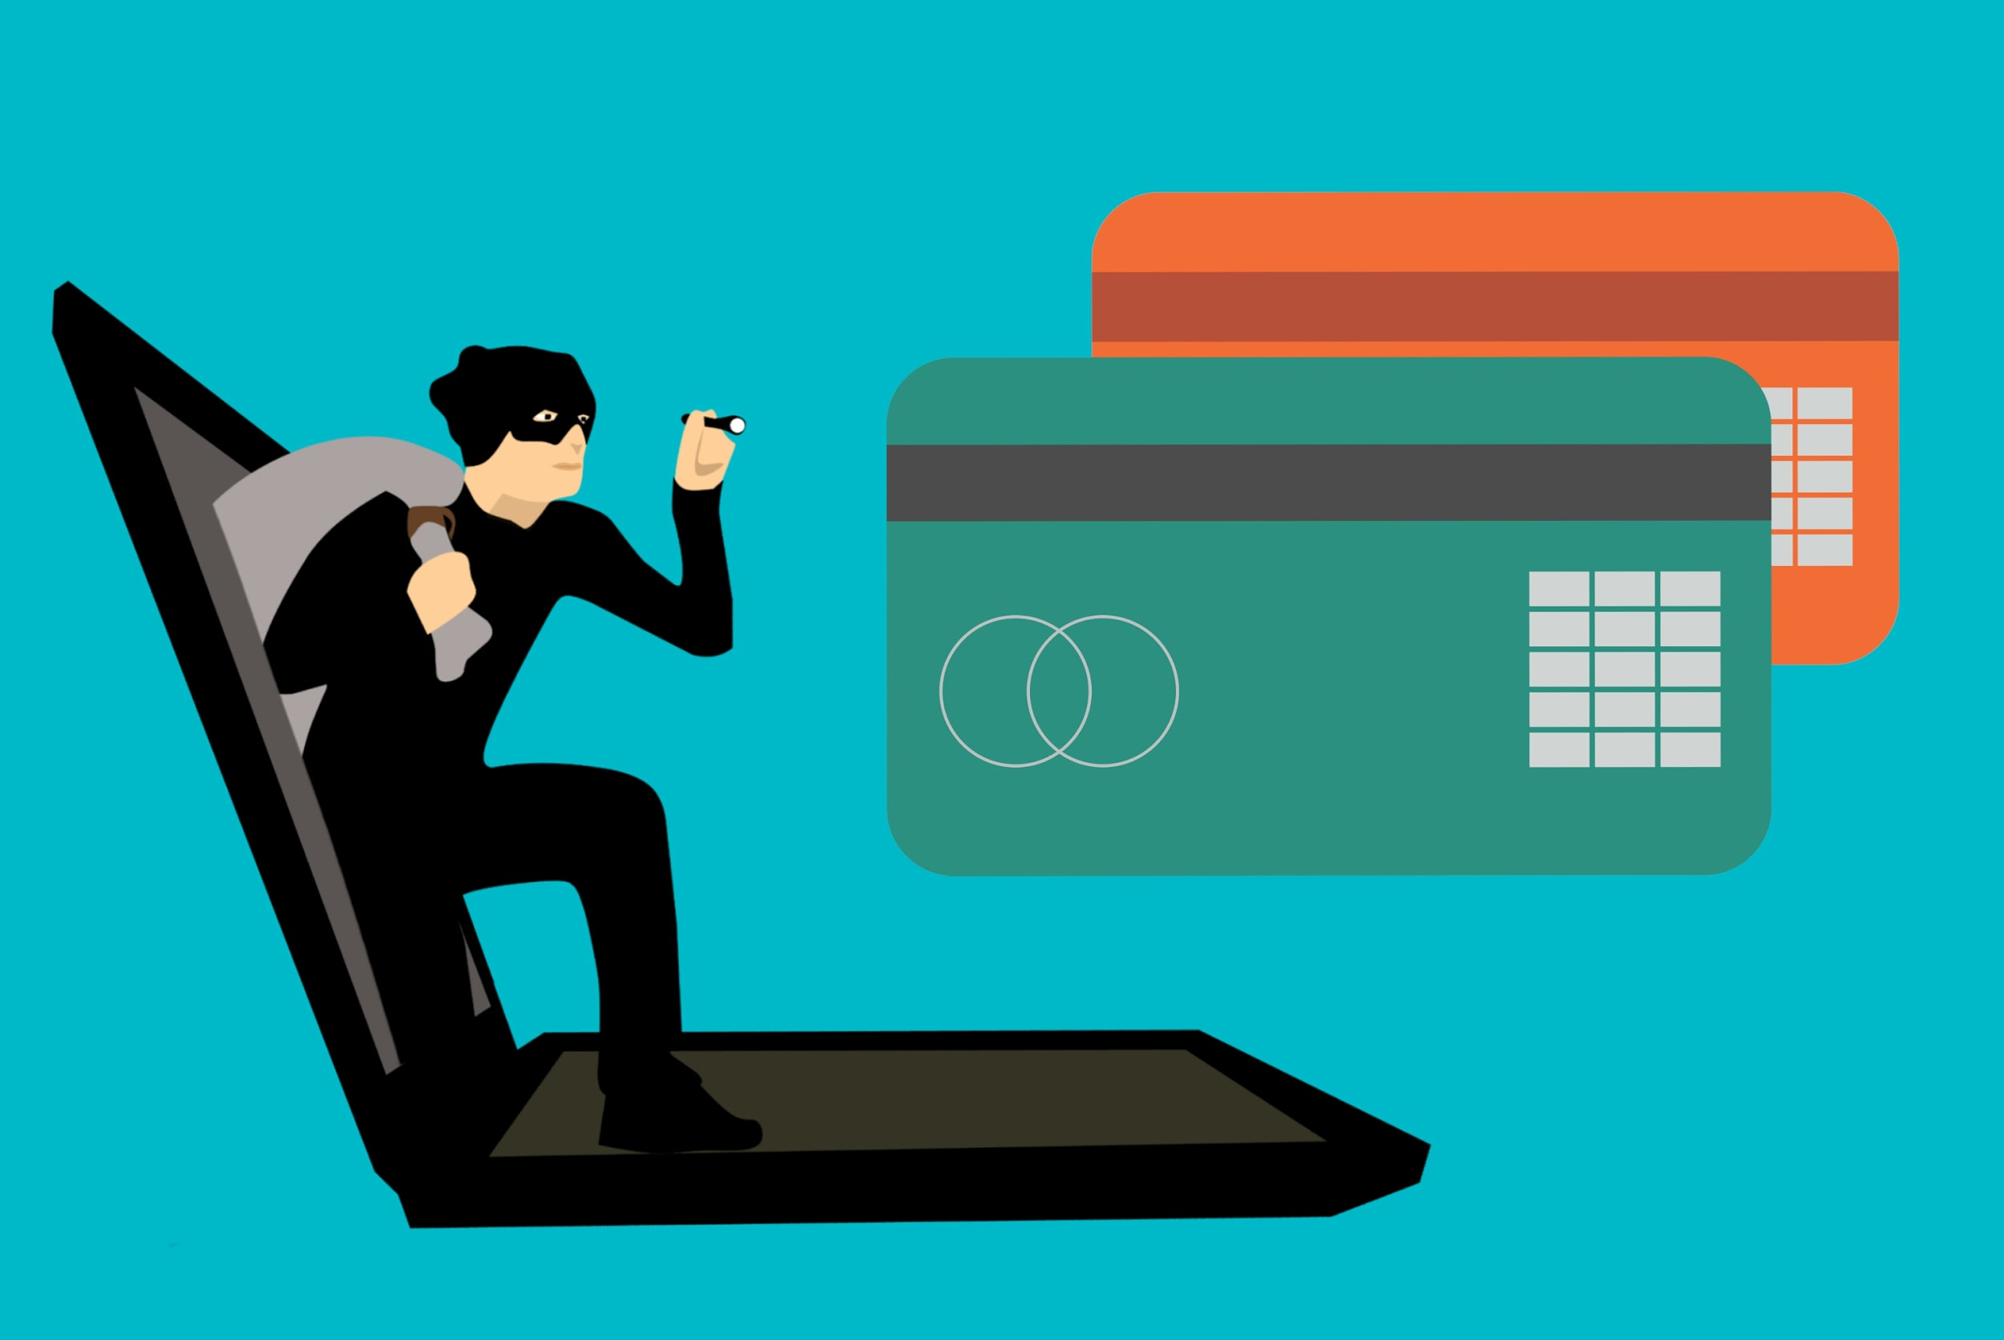
Problem Statement
Determine if transactions are genuine or fraudulent
Notes:
The challenge is to determine which transactions are real and which ones are fraudulent. This can be a huge challenge because there are a lot of transactions and fraudulent transactions may not look very different than genuine transactions.

Slide 3
Business Value
Detecting fraud quickly...
Stops Transactions
Saves
Money
Retains Customers
Notes:
Detecting these fraudulent transactions quickly and accurately obviously has many benefits. If we realize a transaction is fraudulent, then it can be stopped quickly, maybe even before any money changes hands. The faster we can detect fraud, the more money (and effort) it saves both for the credit card company and for the consumer. Which, of course, makes the consumers happy, too and leads to the company retaining those customers. Customers will see the company as being trustworthy and safe, which could potentially even lead to new customers for the company.

Slide 4

Methodology
Protect Privacy
Look for Trends
Create Basic Models
Choose Best Model
Tune
Best Model
Interpret Results
Notes:
To detect fraud, I went through several steps. The customers’ personal information was protected and removed from the dataset first. Then, I looked for trends and patterns in the data. I tested several basic models and chose the top performing model to further refine. I fine-tuned the model and then interpreted the results.

Slide 5



Business Recommendation
Predicted
 | Genuine | Fraud
Genuine
Fraud
When in doubt,
be suspicious.
Actual
Notes:
One of the major pieces of advice is that it’s better to err on the side of caution. In this case, if a transaction looks weird, it’s better to flag it for further investigation instead of assuming it’s probably fine. As you can see in the chart, if a transaction is genuine and the system realizes it’s genuine, then everyone is happy. Instead, if that genuine transaction is flagged as fraud, the customer might get a little stressed out but a quick phone call can clear everything up. On the other hand, if a transaction is fraudulent and recognized as fraud, then everyone is happy (with the situation, not with the fraud). But if that fraud is marked as a genuine transaction..Oh boy, we will have a lot of problems to deal with when someone finally realizes what happened. In the end, it’s better to be overly cautious than not cautious enough.

Slide 6
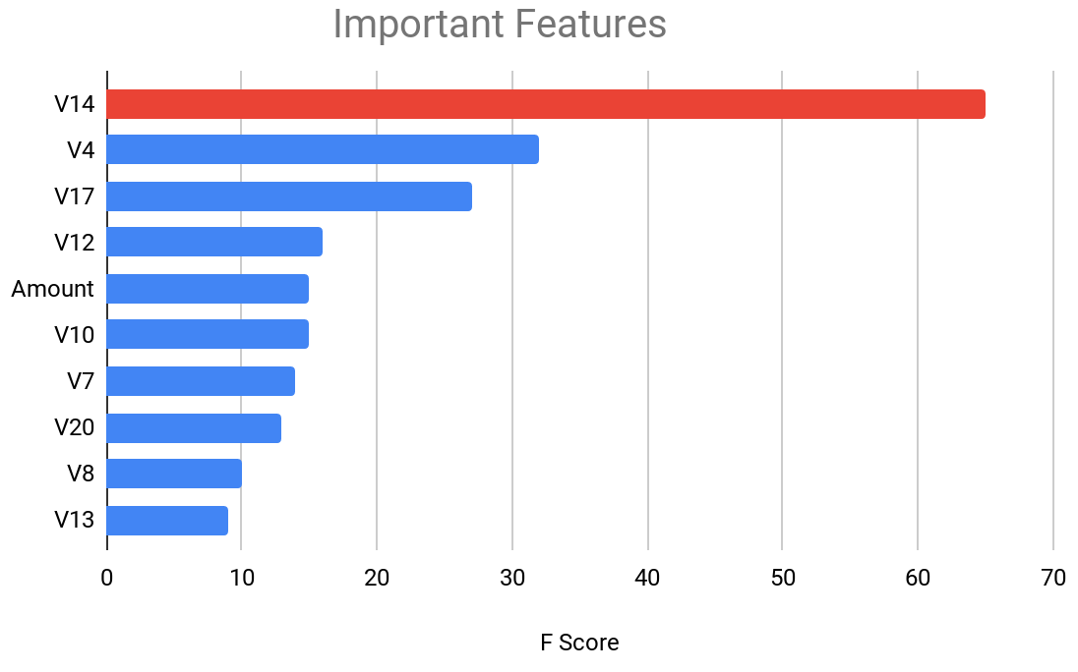
Business Recommendation
Use Feature V14 as the first defense.
Notes:
Feature V14 is the biggest predictor of whether a transaction is fraudulent. (The data categories were obscured to protect consumer privacy but your data team will be able to clarify what V14 means.) V14 is more than twice as important as the next feature. If feature V14 is less than or equal to 4, the transaction should be flagged for further investigation. This provides a quick way to determine which transactions are suspicious and that will save on time and computational power without compromising on accuracy.

Slide 7
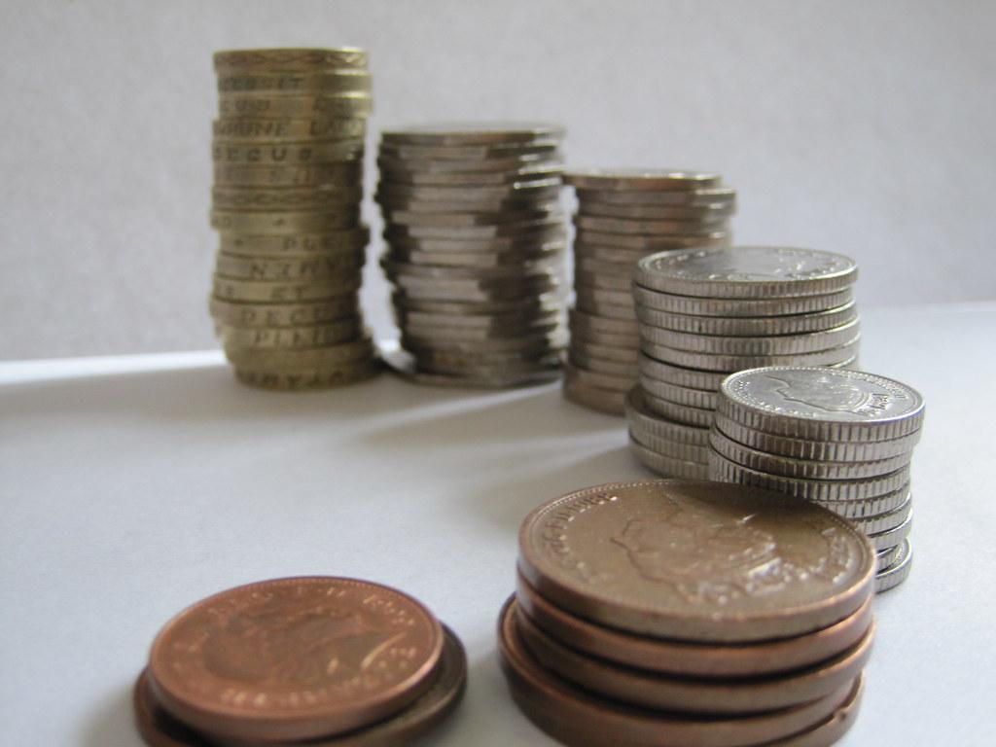
Business Recommendation
Larger transactions are not more suspicious.
Notes:
Fraudulent transactions tend to be for a lower amount than genuine transactions. Because of this, blanket policies (such as freezing transactions over a certain dollar amount) are not particularly effective. As we also saw on the last slide, the transaction amount is not a great predictor of fraud by itself.

Slide 8
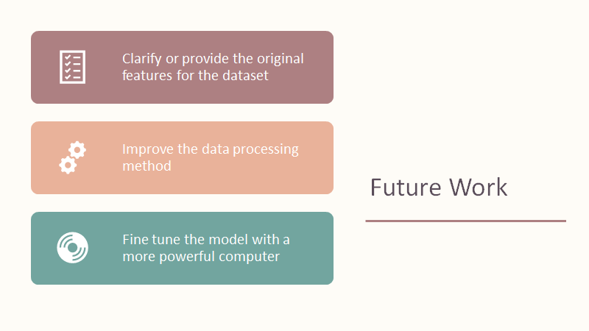
Notes:
To improve our ability to predict fraud, it would be useful to have a better understanding of the original features for the dataset. It’s important to protect consumer privacy but it’s possible to do it while still being transparent about the features of the dataset. Being more transparent would allow for better, more specific business recommendations.
Another suggestion is to improve the data processing method. Right now, the model looks like it’s doing really well but the model is cheating a little bit because of how the data was processed before it was handed over to me. The problem is that I don’t know how much the model is cheating. So, I would suggest a more robust processing method and I would be happy to discuss that with your data processing team in more detail.
Finally, in the future, I would like to fine tune the model even more by using a more powerful computing system.

Slide 9
Thank you!
Notes:
Thank you for your time!

