Slide 1
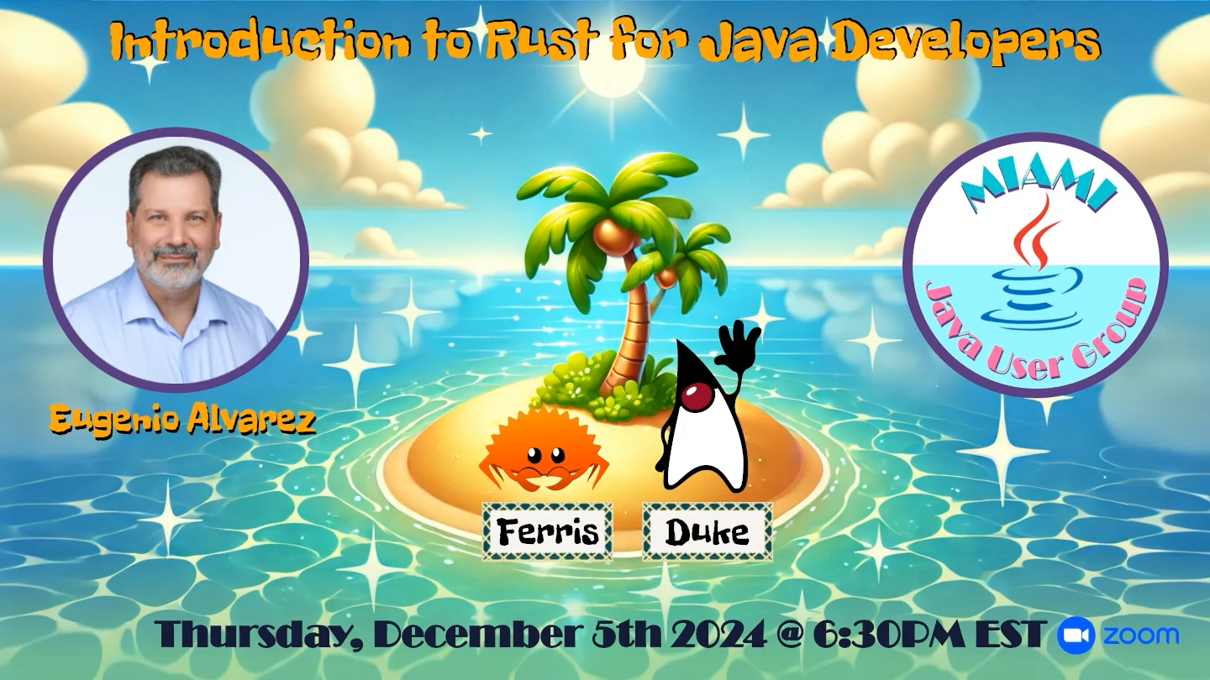
Miami JVM Group (MJUG)
https://www.meetup.com/miami-java-user-group/
Notes:
Introduction to the Rust programming language for Java Developers
A presentation for the Miami Java (JVM) User Group.
Thursday, December 5, 2024

Slide 2

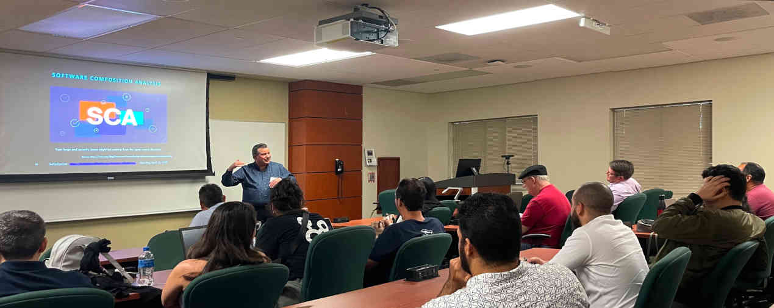








Eugenio Alvarez
Eugenio Alvarez
A South Florida software engineering professional. Experienced in organizational design, software design, construction, and deployment. Extensive knowledge of Java. Proponent of Unit testing. An advocate for Agile Software Engineering methods using Kanban and Scrum.
www.linkedin.com/in/ealvarez
Miami JVM Group https://www.meetup.com/miami-java-user-group/ Thursday, December 5, 2024
Notes:
Organizer of Miami JVM Group (Miami Java User Group)

Slide 3


What IS this Video ABOUT
The Rust programming language has consistently topped Stack Overflow's annual Developer Survey as the "most-admired programming language." We will discuss why Rust is so admired, compare it to Java, and investigate Rust use cases to understand how they relate.
The 2024 Stack Overflow Survey Results show that Rust is the most admired programming language, making it the most loved language since 2016.
Source: 2024 Stack Overflow Developer Survey: https://survey.stackoverflow.co/2024/technology#admired-and-desired
Miami JVM Group https://www.meetup.com/miami-java-user-group/ Thursday, December 5, 2024
Notes:
Rust logo based on bicycle chainring

Slide 4
BRIEF Rust HISTORY
Miami JVM Group https://www.meetup.com/miami-java-user-group/ Thursday, December 5, 2024

Slide 5



Where did RuST Come From?
Created by Graydon Hoare as a personal project while working at Mozilla Research
Hoare has stated that Rust was named for the group of fungi that are "over-engineered for survival”^{[1]}
Source: [1]: https://www.technologyreview.com/2023/02/14/1067869/rust-worlds-fastest-growing-programming-language/
Miami JVM Group https://www.meetup.com/miami-java-user-group/ Thursday, December 5, 2024
Notes:
Trivia: Mozilla is a portmanteau of "Mosaic and Godzilla”
Additional Trivia: Godzilla is a portmanteau of the Japanese words
gorira (ゴリラ, "gorilla") and kujira (鯨クジラ, "whale"), pronounced in Japanese as Gojira.
Rust Fungus image: https://www.flickr.com/photos/scotnelson/8715618508/in/photostream/

Slide 6

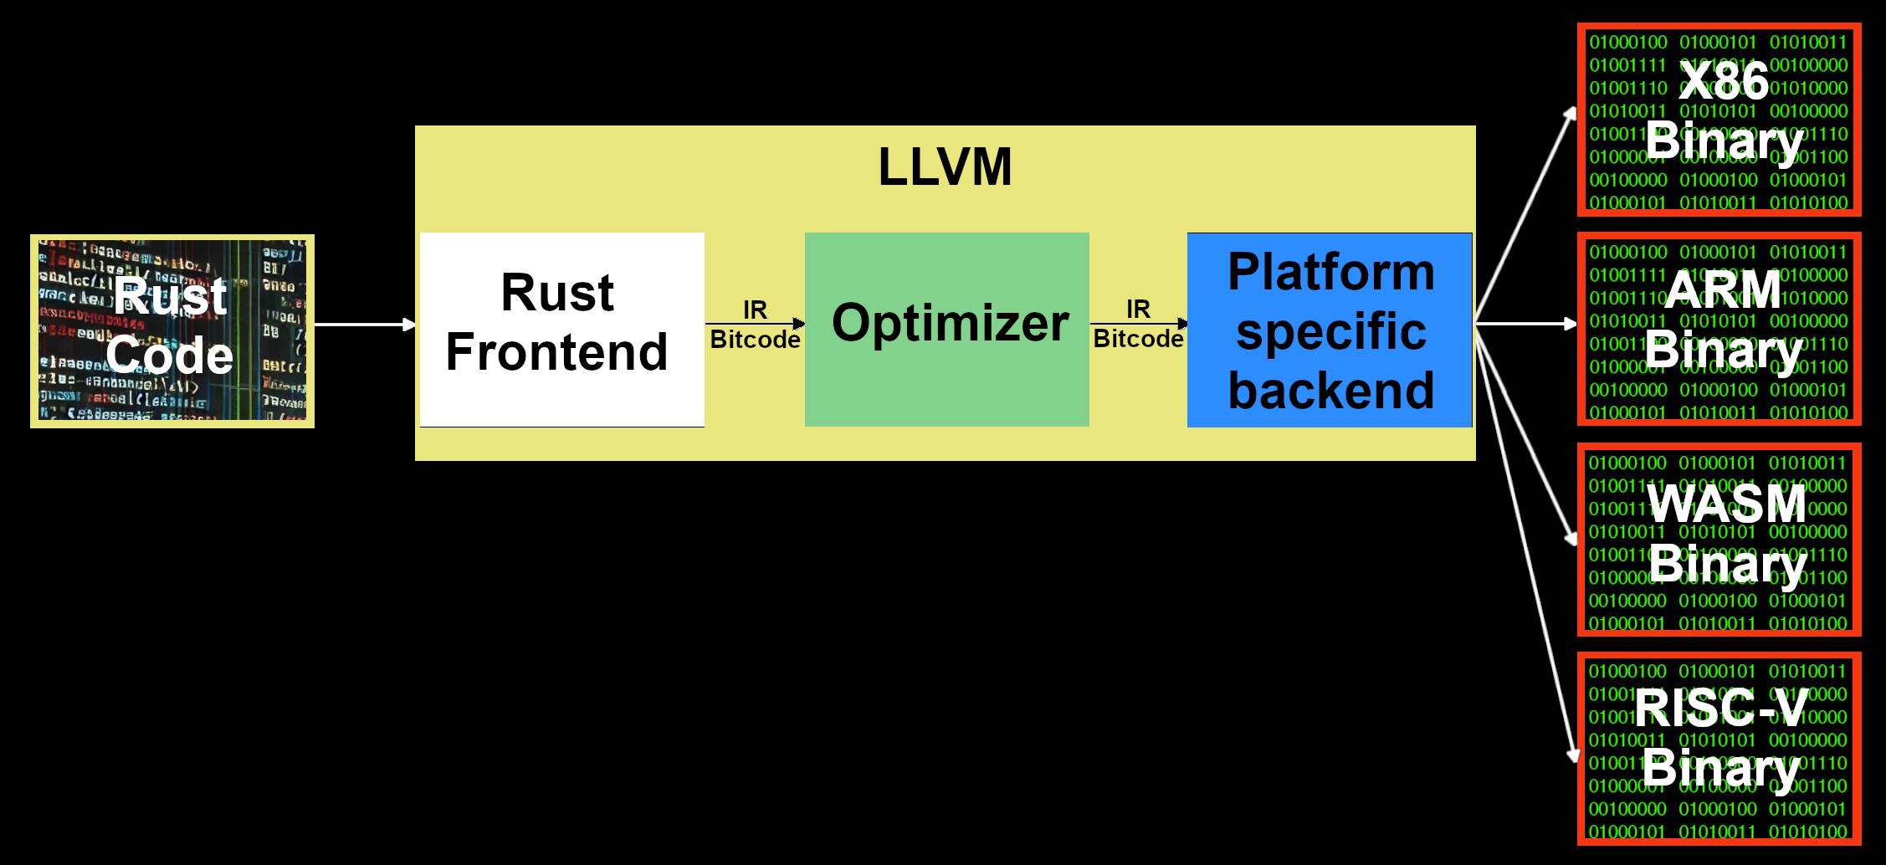
Rust Compiler Infrastructure
Source: LLVM Compiler Infrastructure : https://llvm.org/
Source: Rustc Platform Support: https://doc.rust-lang.org/rustc/platform-support.html
Miami JVM Group https://www.meetup.com/miami-java-user-group/ Thursday, December 5, 2024
Notes:
ISA = Instruction Set Architecture (x86/ARM/RISC-V)
ARM = Advanced RISC Machine / Acorn RISC Machine from Acorn Computer
IR = Intermediate Representation (strongly typed RISC instruction set)

Slide 7

Why is Rust so Admired?
Miami JVM Group https://www.meetup.com/miami-java-user-group/ Thursday, December 5, 2024

Slide 8
Why all the LOVE
Rust is generally considered the first widely adopted language to achieve memory safety without relying on a garbage collector with comparable performance and memory usage to C and C++.
How is memory safety achieved without garbage collection?
Rust’s ownership system and borrow checker
Checks at compile time: “If it compiles, it works!”
Source: 2024 Stack Overflow Developer Survey: https://survey.stackoverflow.co/2024/technology#admired-and-desired
Miami JVM Group https://www.meetup.com/miami-java-user-group/ Thursday, December 5, 2024

Slide 9
Why all the LOVE (partie deux)
High-performance concurrency, aka “Concurrency without fear” is achieved with the ownership model and borrow checker at compile time.
Zero-cost abstraction language features enable high-level code without incurring runtime overhead.
Developer centered design like compiler error messages
Source: 2024 Stack Overflow Developer Survey: https://survey.stackoverflow.co/2024/technology#admired-and-desired
Miami JVM Group https://www.meetup.com/miami-java-user-group/ Thursday, December 5, 2024
Notes:
Zero-cost abstraction like C++

Slide 10

Cloud providers Love Rust
A 2017 study of Rust-based code found Rust uses half as much electricity as a similar program written in Java.
“Rust is the fastest growing language at . It's had such an impact that we've actually rewritten a lot of our critical code in Rust” Chris Betz, AWS CISO June 2024.
Source: Energy Efficiency Across Programming Languages: https://sites.google.com/view/energy-efficiency-languages/
Source: AWS re:Inforce 2024 - Keynote with Chris Betz: https://www.youtube.com/watch?v=skH3Q90llss
Miami JVM Group https://www.meetup.com/miami-java-user-group/ Thursday, December 5, 2024

Slide 11


Operating System Vendors Love Rust
Microsoft is rewriting parts of the Windows 11 kernel using the memory-safe programming language Rust (May 2023)
Linux kernel version 6.1 (2022) introduced initial support for Rust
Source: First Rust Code in the Windows 11 Kernel: https://www.thurrott.com/windows/windows-11/282995/first-rust-code-shows-up-in-the-windows-11-kernel
Source: Rust for Linux: https://en.wikipedia.org/wiki/Rust_for_Linux
Miami JVM Group https://www.meetup.com/miami-java-user-group/ Thursday, December 5, 2024
Notes:
There is a drama with Linux kernel developers slow adoption of Rust.

Slide 12

The United States GOVERNMENT Loves Rust
and Java Too
Darpa’s TRACTOR Project (Translating C to Rust)
The Case for Memory Safe Roadmaps (CISA, NSA, FBI etc.)
C#
Go
Java
Python
Rust
Swift
Source: In Rust we trust? White House Office urges memory safety:
https://stackoverflow.blog/2024/03/04/in-rust-we-trust-white-house-office-urges-memory-safety/
Source: The Case for Memory Safe Roadmaps:
https://media.defense.gov/2023/Dec/06/2003352724/-1/-1/0/The-Case-for-Memory-Safe-Roadmaps-TLP-clear.pdf
Miami JVM Group https://www.meetup.com/miami-java-user-group/ Thursday, December 5, 2024

Slide 13

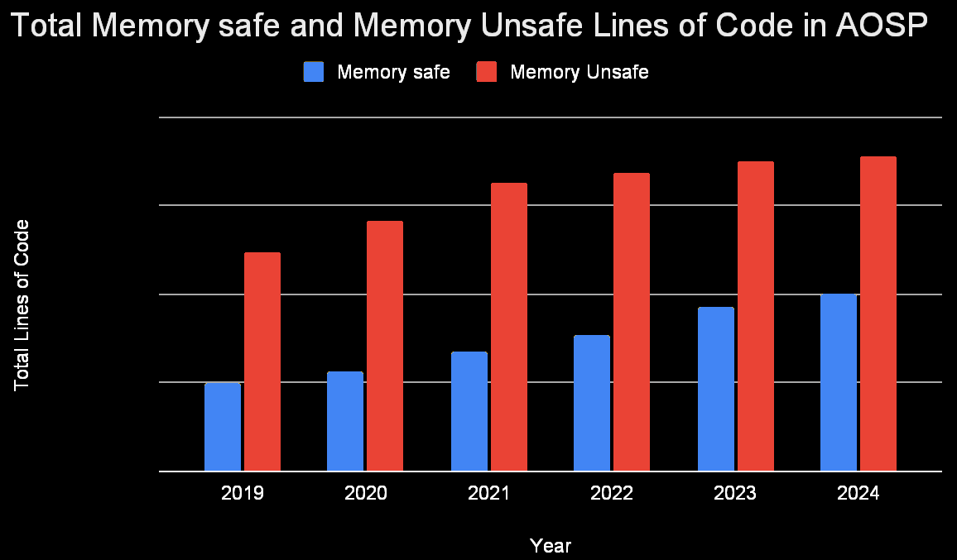
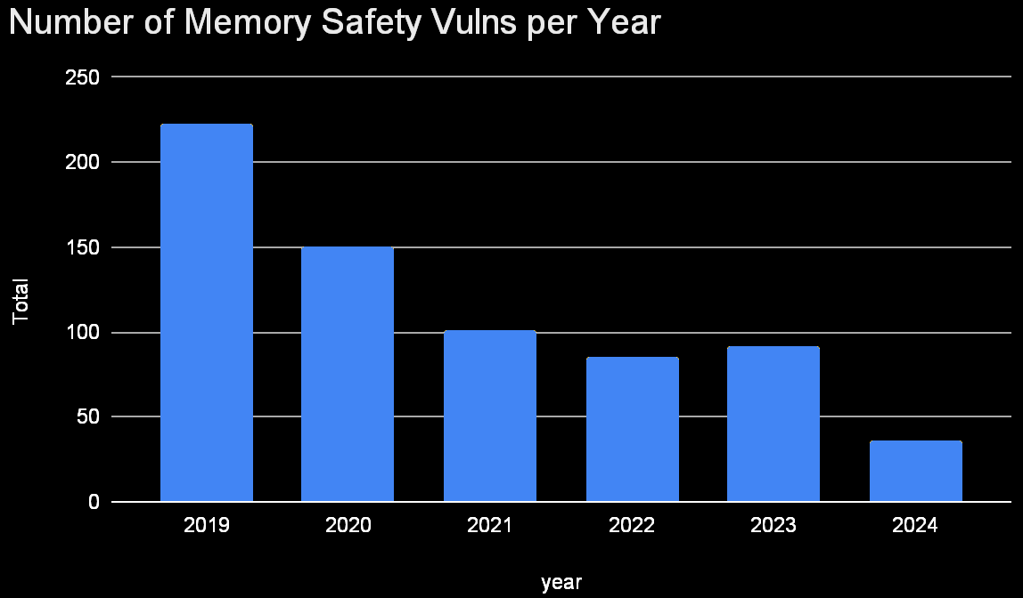
Operating System Vendors Love Rust
“The percentage of memory safety vulnerabilities in Android dropped from 76% to 24% over 6 years as development shifted to memory safe languages” (September 2024)
Source: Eliminating Memory Safety Vulnerabilities at the Source
https://security.googleblog.com/2024/09/eliminating-memory-safety-vulnerabilities-Android.html
Miami JVM Group https://www.meetup.com/miami-java-user-group/ Thursday, December 5, 2024
Notes:
Rust is not the majority. Other memory safe languages like Kotlin are being used.

Slide 14


C/C++ Reaction to Rust
Safe C++ proposal
https://safecpp.org/draft.html
Fil-C
https://github.com/pizlonator/llvm-project-deluge/blob/deluge/Manifesto.md
TrapC
https://vimeo.com/1028578347
Enabling hardened libc++ / listedc++
https://security.googleblog.com/2024/11/retrofitting-spatial-safety-to-hundreds.html
Miami JVM Group https://www.meetup.com/miami-java-user-group/ Thursday, December 5, 2024
Notes:
Safe C++ : Currently proposal with no implementation
Fil-C : Available for use, only works on Linux, 1.5 to 5 times slower than C
TrapC : A memory safe fork of C, includes C++ constructors

Slide 15

Rust / Java Ecosystems
Miami JVM Group https://www.meetup.com/miami-java-user-group/ Thursday, December 5, 2024

Slide 16

Rust Ecosystem
rustup (install/update)
Clippy: linting tool (700 rules)
Rustfmt: code formatter / checker
Cargo: build / package manager
Miami JVM Group https://www.meetup.com/miami-java-user-group/ Thursday, December 5, 2024
Notes:
As of 2024, 700 rules in Clippy

Slide 17
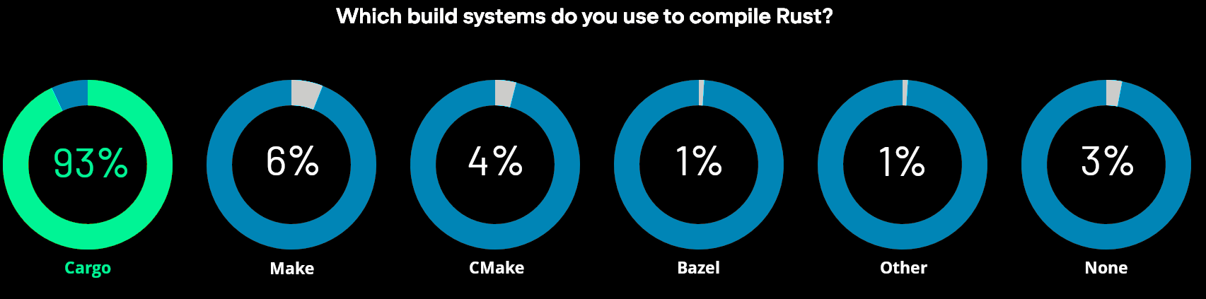
BUILDING RUST Applications
Cargo ● Make ● CMake ● Bazel
Source: JetBrains State of Developer Ecosystem 2023 : https://www.jetbrains.com/lp/devecosystem-2023/rust/
Miami JVM Group https://www.meetup.com/miami-java-user-group/ Thursday, December 5, 2024

Slide 18
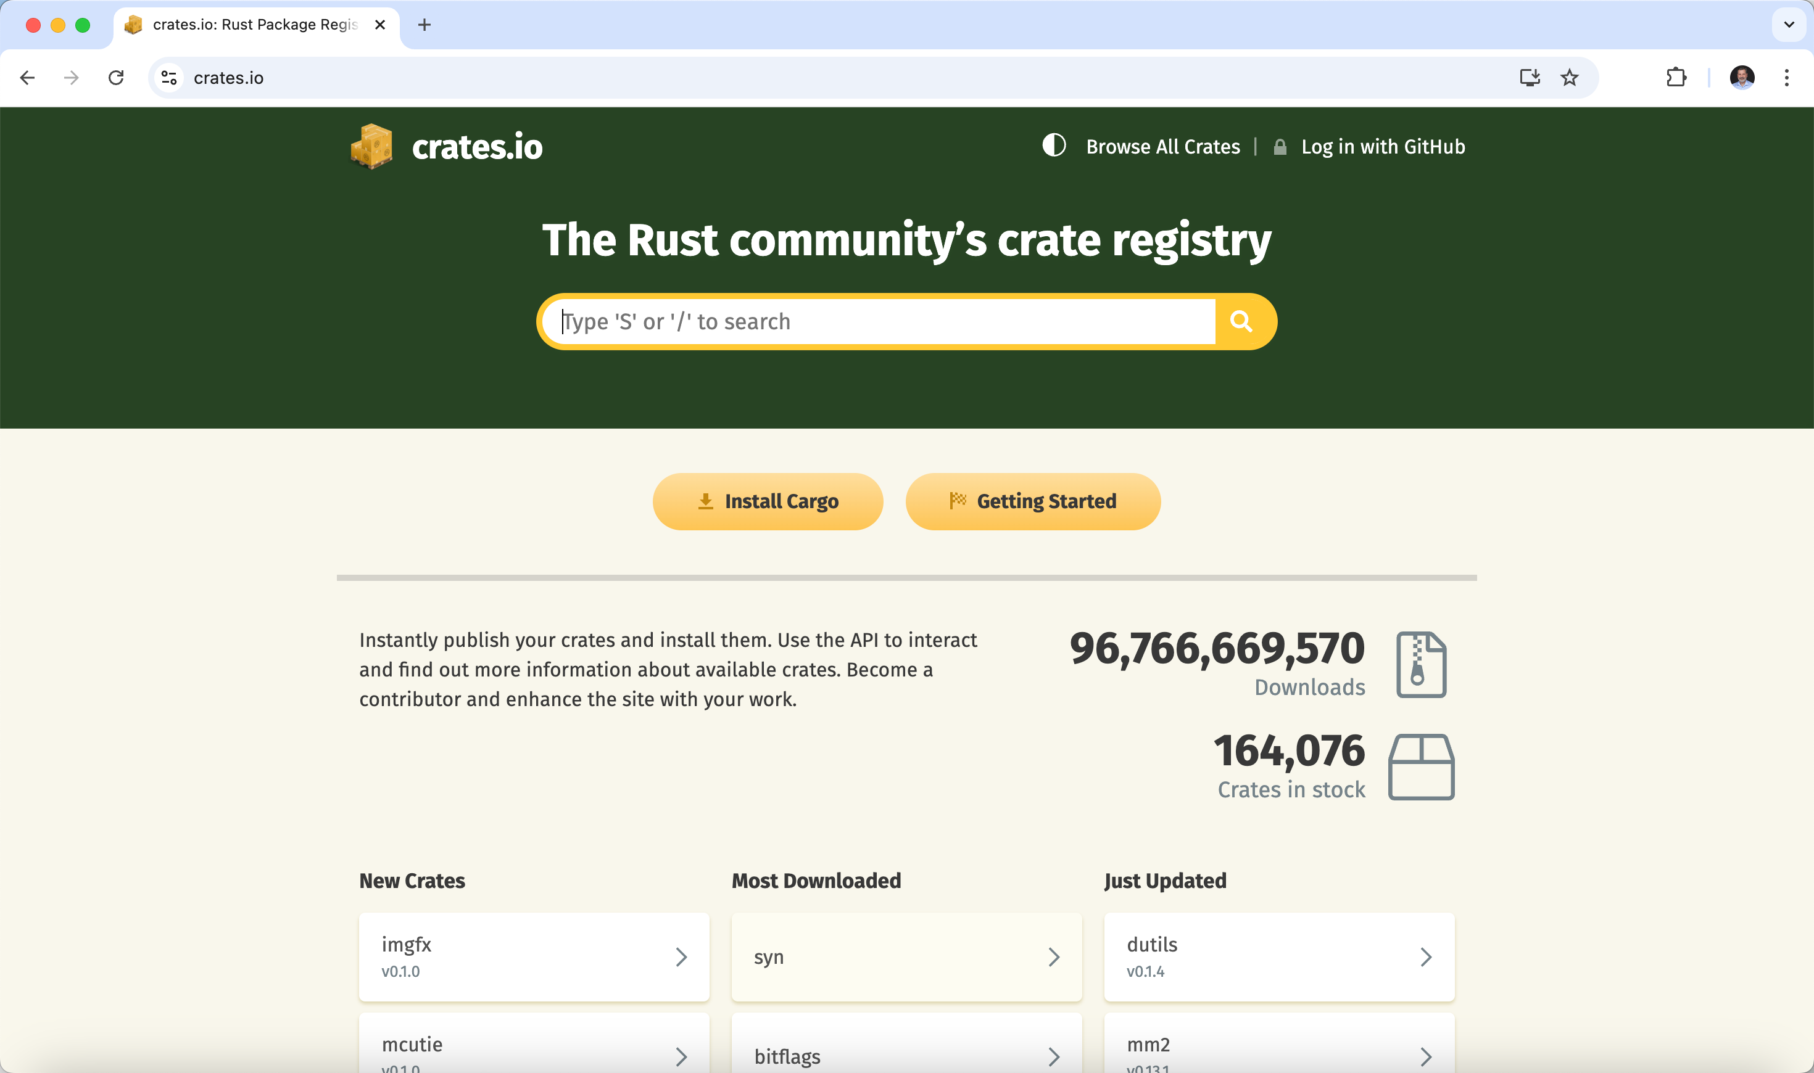
RUST Crates
Source: The Rust community’s crate registry : https://crates.io/
Miami JVM Group https://www.meetup.com/miami-java-user-group/ Thursday, December 5, 2024
Notes:
Rust crates are in source code
Compared to Java’s Maven central jar files

Slide 19
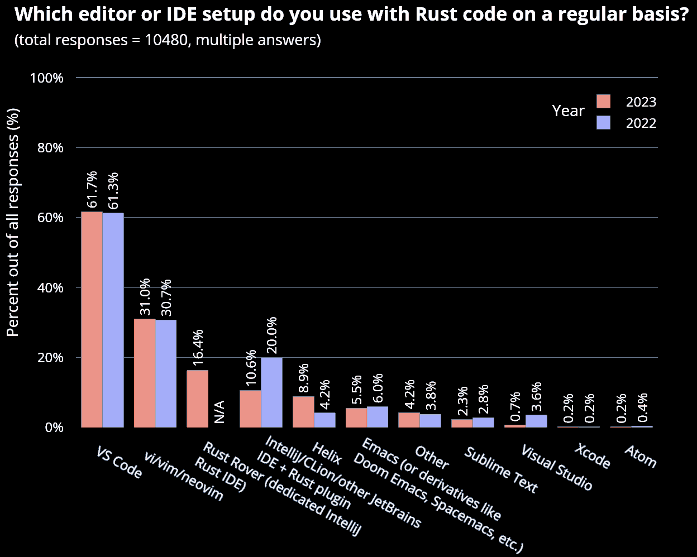
RUST IDE
Source: 2023 Annual Rust Survey Results : https://blog.rust-lang.org/2024/02/19/2023-Rust-Annual-Survey-2023-results.html
Miami JVM Group https://www.meetup.com/miami-java-user-group/ Thursday, December 5, 2024

Slide 20


Rust / Java Language Features
Miami JVM Group https://www.meetup.com/miami-java-user-group/ Thursday, December 5, 2024

Slide 21

JAVA Features Not Rust
Garbage Collector
Inheritance
Exceptions
Reflection
Null references
Miami JVM Group https://www.meetup.com/miami-java-user-group/ Thursday, December 5, 2024

Slide 22
A String IN RUST Compared to Java
Strings are encoded in UTF-8
String when you need an owned, mutable string.
&str for borrowing or when working with literals.
CString for C interoperability.
OsString and OsStr for platform-specific needs.
Cow<str> for efficient shared and owned string scenarios.
Miami JVM Group https://www.meetup.com/miami-java-user-group/ Thursday, December 5, 2024
Notes:
1. String (Heap-allocated, growable string)
Description:
A growable, mutable string type stored on the heap.
Often used when the string content might change or its size is not known at compile time.
Key Features:
Owned, meaning it manages its own memory and ensures it gets freed when it goes out of scope.
Can grow or shrink as needed.
Commonly used when creating or processing strings dynamically.
2. &str (String slice)
Description:
A borrowed, immutable view of a string, usually a portion of a String or a string literal.
Often referred to as a "string slice."
Key Features:
Not owned; does not manage its own memory.
Used for references to string data, avoiding unnecessary allocations.
3. String Literals
Description:
A statically allocated string with the type &'static str.
Used for hard-coded strings in a program.
Key Features:
Lives for the entire duration of the program ('static lifetime).
Efficient for fixed strings as they don't require dynamic memory allocation.
4. CString (C-compatible string)
Description:
A heap-allocated, null-terminated string compatible with C-style strings.
Useful when interacting with C libraries or FFI (Foreign Function Interface).
Key Features:
Null-terminated to match C conventions.
Cannot contain internal null bytes.
5. OsString and OsStr (Operating system strings)
Description:
Designed for strings that interact with the operating system (e.g., file paths).
Works seamlessly with platform-specific encoding.
Key Features:
OsString: Owned, growable, heap-allocated string.
OsStr: Borrowed, immutable slice.
6. Cow<'a, str> (Clone-on-write string)
Description:
A string type that can act as either borrowed or owned, optimizing for cases where ownership isn't always necessary.
Key Features:
Borrowed when no modification is needed.
Cloned into an owned String only if modification is required.

Slide 23
RUST Traits / Java INTERFACE
trait Animal {
fn speak(&self);
}
struct Dog;
impl Animal for Dog{
fn speak(&self) {
println!(“Woof!");
}
}
interface Animal {
void speak();
}
class Dog implements Animal{
public void speak() {
System.out.println(“Woof!”);
}
}
Miami JVM Group https://www.meetup.com/miami-java-user-group/ Thursday, December 5, 2024
Notes:
1. String (Heap-allocated, growable string)
Description:
A growable, mutable string type stored on the heap.
Often used when the string content might change or its size is not known at compile time.
Key Features:
Owned, meaning it manages its own memory and ensures it gets freed when it goes out of scope.
Can grow or shrink as needed.
Commonly used when creating or processing strings dynamically.
2. &str (String slice)
Description:
A borrowed, immutable view of a string, usually a portion of a String or a string literal.
Often referred to as a "string slice."
Key Features:
Not owned; does not manage its own memory.
Used for references to string data, avoiding unnecessary allocations.
3. String Literals
Description:
A statically allocated string with the type &'static str.
Used for hard-coded strings in a program.
Key Features:
Lives for the entire duration of the program ('static lifetime).
Efficient for fixed strings as they don't require dynamic memory allocation.
4. CString (C-compatible string)
Description:
A heap-allocated, null-terminated string compatible with C-style strings.
Useful when interacting with C libraries or FFI (Foreign Function Interface).
Key Features:
Null-terminated to match C conventions.
Cannot contain internal null bytes.
5. OsString and OsStr (Operating system strings)
Description:
Designed for strings that interact with the operating system (e.g., file paths).
Works seamlessly with platform-specific encoding.
Key Features:
OsString: Owned, growable, heap-allocated string.
OsStr: Borrowed, immutable slice.
6. Cow<'a, str> (Clone-on-write string)
Description:
A string type that can act as either borrowed or owned, optimizing for cases where ownership isn't always necessary.
Key Features:
Borrowed when no modification is needed.
Cloned into an owned String only if modification is required.

Slide 24
RUST Ownership
Example
fn main() {
let s1 = String::from("Hello, Rust!"); // ‘s1' owns the string.
let s2 = s1; // Ownership is moved to 's2'.
// println!("{}", s1); // ERROR: `s1` is no longer valid after the move.
println!("{}", s2); // Only 's2' can be used now.
}
Miami JVM Group https://www.meetup.com/miami-java-user-group/ Thursday, December 5, 2024

Slide 25
Testing IN RUST
pub fn add(a: i32, b: i32) -> i32 {
a + b
}
#[cfg(test)]
mod tests {
use super::*; // Import from the parent module
#[test]
fn test_add() {
assert_eq!(add(2, 3), 5); // Check if 2 + 3 equals 5
}
}
Command line: cargo test
Miami JVM Group https://www.meetup.com/miami-java-user-group/ Thursday, December 5, 2024

Slide 26
A Few data points
Feature | Java | Rust
Usage | Web/E-Commerce/Banking/Medical | Systems/Web/IoT/BlockChain
Deployment | Bytecode/ Native (GraalVM) | Native/WASM
Memory | GC | Ownership Model
Paradigm | OOP/Functional/Generic/Declarative | Functional/Generic/Declarative
Miami JVM Group https://www.meetup.com/miami-java-user-group/ Thursday, December 5, 2024

Slide 27
Rust Use Cases
Miami JVM Group https://www.meetup.com/miami-java-user-group/ Thursday, December 5, 2024

Slide 28
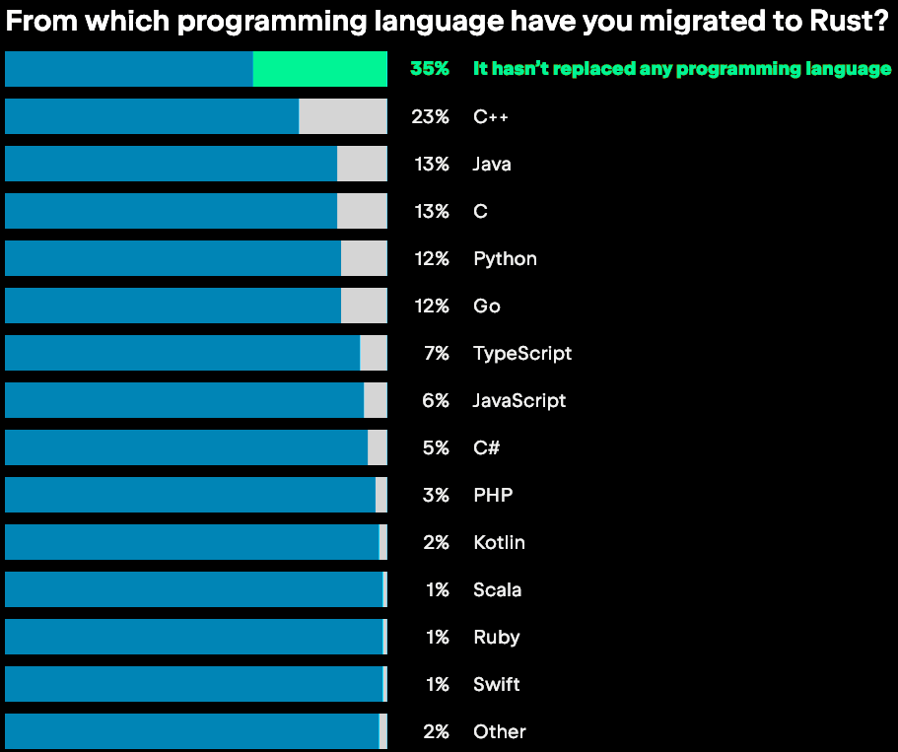
RUST Migration
Source: JetBrains State of Developer Ecosystem 2023 : https://www.jetbrains.com/lp/devecosystem-2023/rust/
Miami JVM Group https://www.meetup.com/miami-java-user-group/ Thursday, December 5, 2024

Slide 29
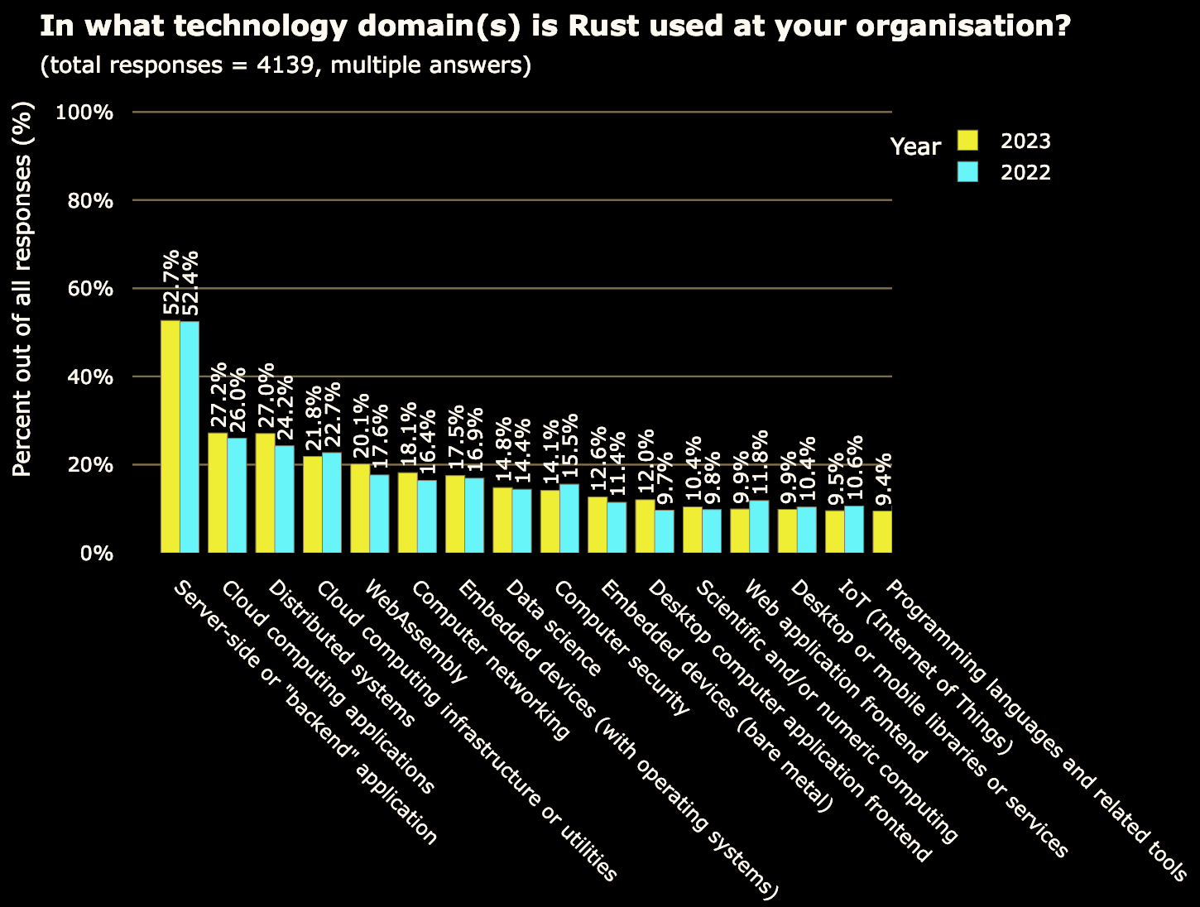
In What Domains is RUST Being Used
Source: 2023 Annual Rust Survey Results : https://blog.rust-lang.org/2024/02/19/2023-Rust-Annual-Survey-2023-results.html
Miami JVM Group https://www.meetup.com/miami-java-user-group/ Thursday, December 5, 2024

Slide 30
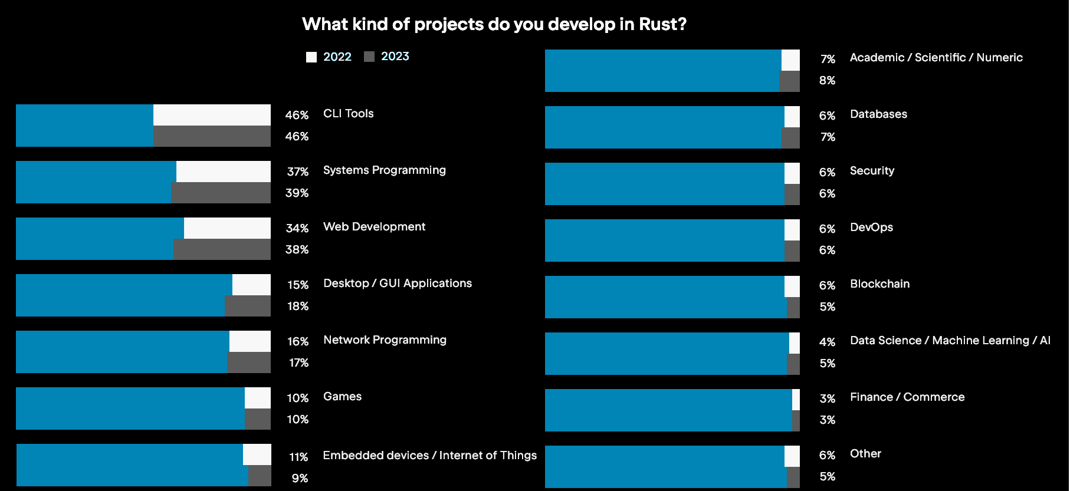
What are DEVELOPERS making with RUST?
Source: JetBrains State of Developer Ecosystem 2023 : https://www.jetbrains.com/lp/devecosystem-2023/rust/
Miami JVM Group https://www.meetup.com/miami-java-user-group/ Thursday, December 5, 2024

Slide 31
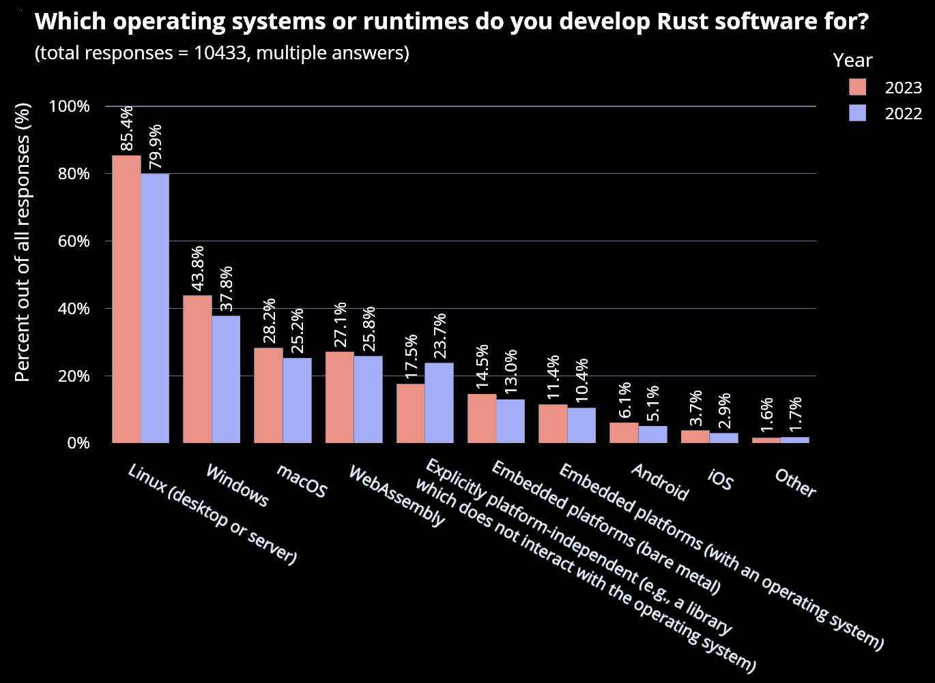
RUST Target OS/Runtimes
Source: 2023 Annual Rust Survey Results : https://blog.rust-lang.org/2024/02/19/2023-Rust-Annual-Survey-2023-results.html
Miami JVM Group https://www.meetup.com/miami-java-user-group/ Thursday, December 5, 2024

Slide 32

WebAssembly (WASM)
Goal: Enable high-performance applications on web browsers.
A binary instruction format for a stack-based virtual machine. Multiple languages can be used to create WASM, including Rust.
Supported by all major web browsers, including mobile web browsers for iOS and Android.
Miami JVM Group https://www.meetup.com/miami-java-user-group/ Thursday, December 5, 2024
Notes:
https://en.wikipedia.org/wiki/Asm.js

Slide 33
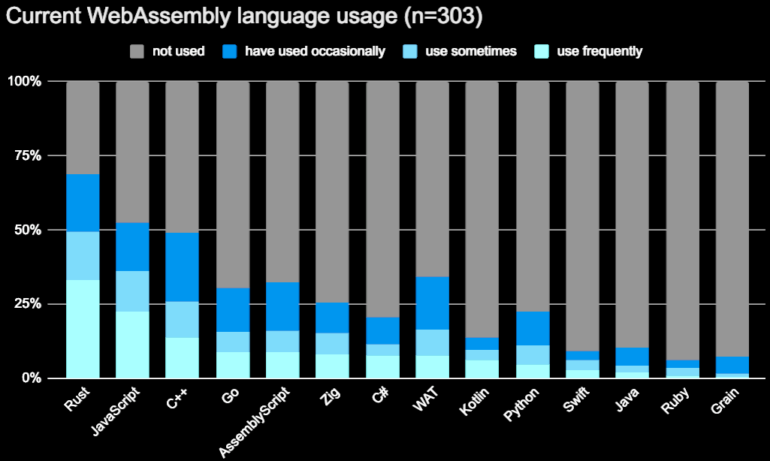
RUST and WebAssembly (WASM)
Source: The State of WebAssembly 2023: https://blog.scottlogic.com/2023/10/18/the-state-of-webassembly-2023.html
Miami JVM Group https://www.meetup.com/miami-java-user-group/ Thursday, December 5, 2024

Slide 34
WebAssembly Beyond the Browser
The evolution of WebAssembly from browser-based to non-browser contexts.
Mirrors evolution of JavaScript to Node.js
Similarities to Java Virtual Machine.
WasmGC is supported in Chrome and Firefox but is still pending in Safari.
Kotlin can compile to WASM using WasmGC.
Miami JVM Group https://www.meetup.com/miami-java-user-group/ Thursday, December 5, 2024

Slide 35
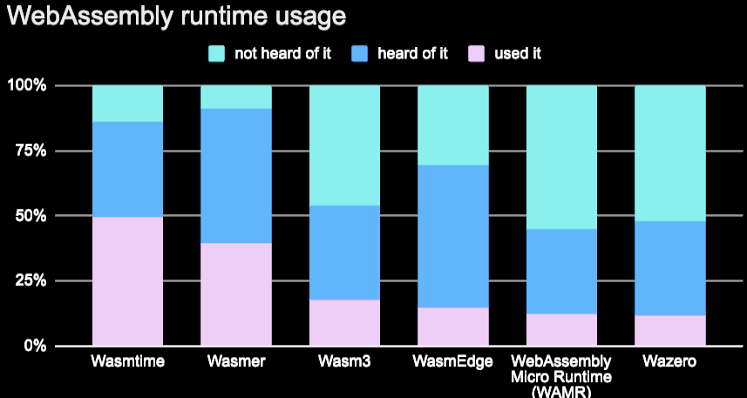
WebAssembly Runtimes
Source: The State of WebAssembly 2023: https://blog.scottlogic.com/2023/10/18/the-state-of-webassembly-2023.html
Miami JVM Group https://www.meetup.com/miami-java-user-group/ Thursday, December 5, 2024

Slide 36

Learning More About Rust
Miami JVM Group https://www.meetup.com/miami-java-user-group/ Thursday, December 5, 2024
Notes:
Learning more about Rust

Slide 37
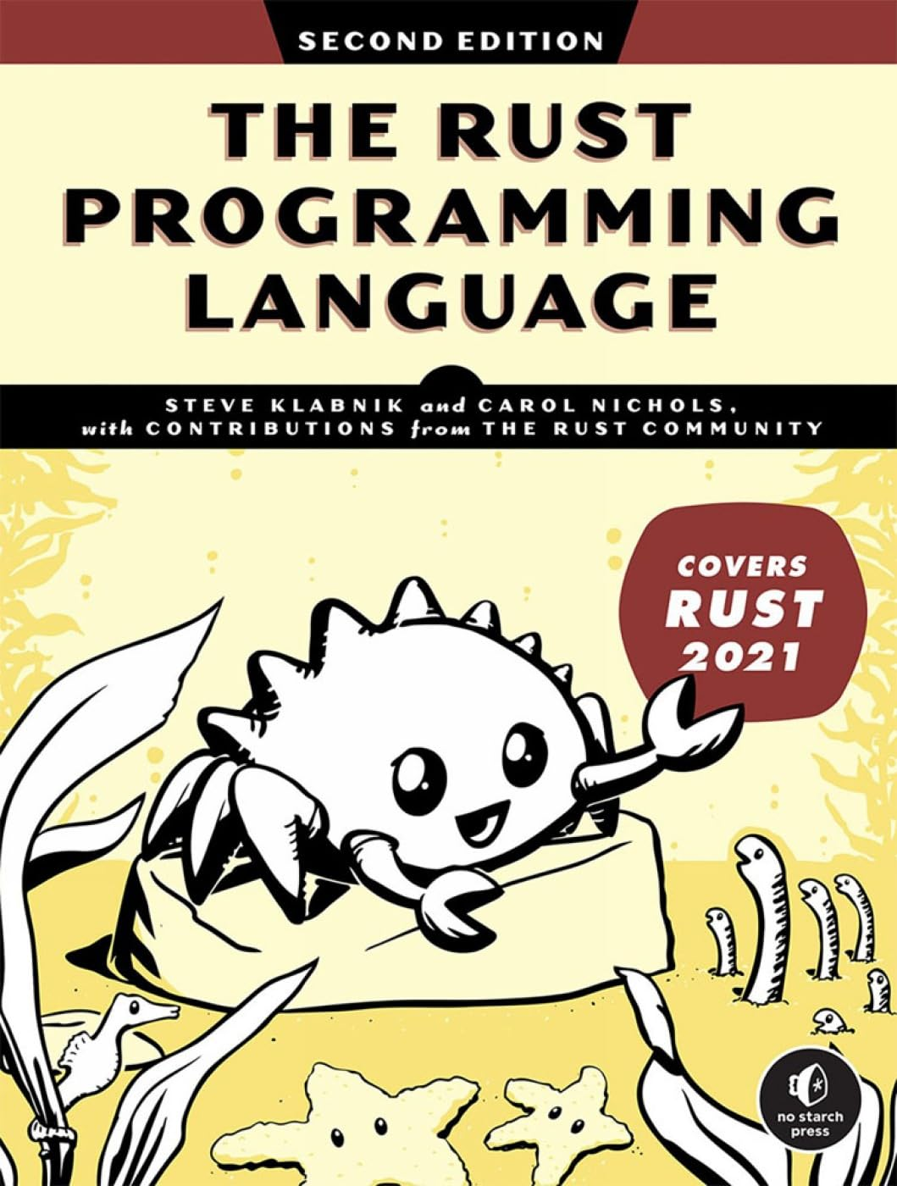
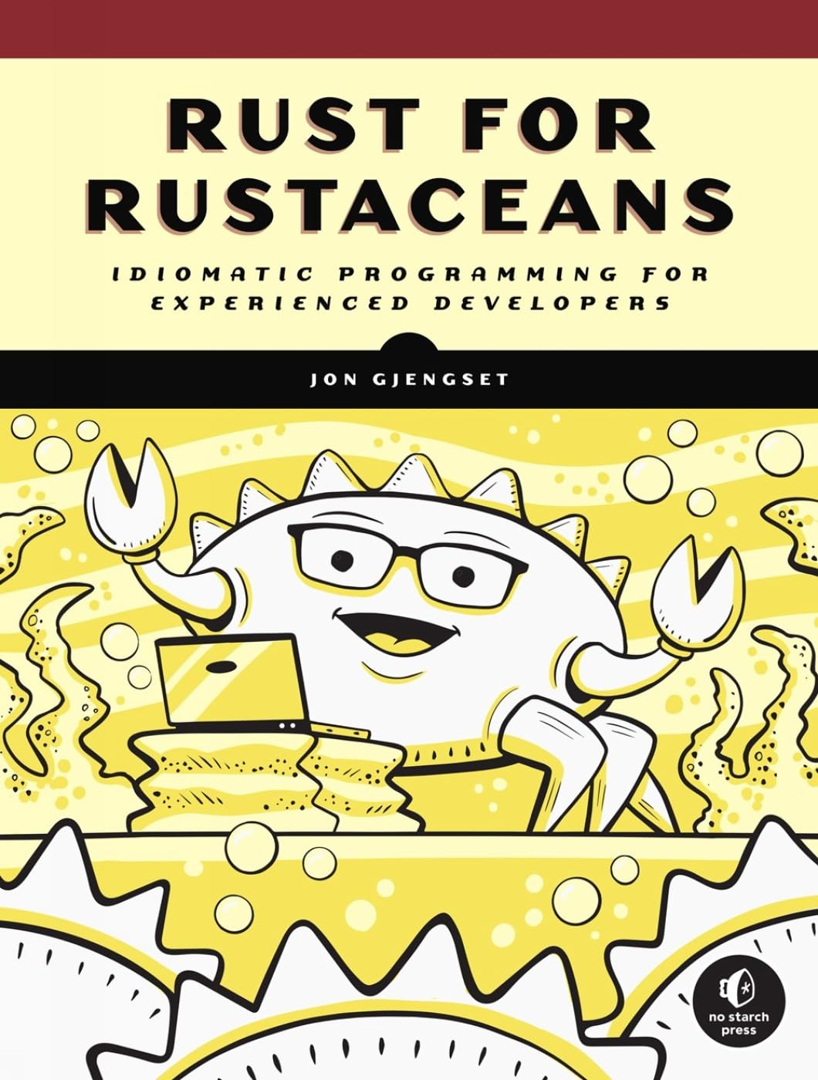
Learning more about RUST
“The Book” The Rust Programming Language
https://doc.rust-lang.org/book/
https://www.amazon.com/Rust-Programming-Language-2nd/dp/1718503105/
Let’s Get Rusty (“The Book” in videos)
https://www.youtube.com/playlist?list=PLai5B987bZ9CoVR-QEIN9foz4QCJ0H2Y8
Rust by Example
https://doc.rust-lang.org/rust-by-example/
Rust Playground (Interactive Rust)
https://play.rust-lang.org/
Rust for Rustaceans
https://www.amazon.com/Rust-for-Rustaceans/dp/1718501854/
Miami JVM Group https://www.meetup.com/miami-java-user-group/ Thursday, December 5, 2024

Slide 38

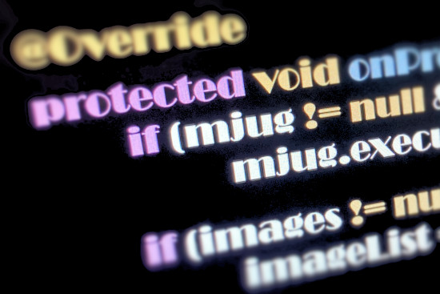


Thank You
Miami JVM Group (MJUG)
https://www.meetup.com/miami-java-user-group/
www.linkedin.com/in/ealvarez
Miami JVM Group https://www.meetup.com/miami-java-user-group/ Thursday, December 5, 2024
Notes:
Thank You

Slide 39

REFERENCES
2024 Stack Overflow Developer Survey
https://survey.stackoverflow.co/2024/technology#admired-and-desired
How Rust went from a side project to the world’s most-loved programming language
https://www.technologyreview.com/2023/02/14/1067869/rust-worlds-fastest-growing-programming-language/
LLVM Compiler Infrastructure
https://llvm.org/
Rustc Platform Support
https://doc.rust-lang.org/rustc/platform-support.html
Energy Efficiency Across Programming Languages
https://sites.google.com/view/energy-efficiency-languages/
AWS re:Inforce 2024 - Keynote with Chris Betz
https://www.youtube.com/watch?v=skH3Q90llss
Miami JVM Group https://www.meetup.com/miami-java-user-group/ Thursday, December 5, 2024
Notes:
References

Slide 40
REFERENCES
First Rust Code in the Windows 11 Kernel
https://www.thurrott.com/windows/windows-11/282995/first-rust-code-shows-up-in-the-windows-11-kernel
Rust for Linux
https://en.wikipedia.org/wiki/Rust_for_Linux
In Rust we trust? White House Office urges memory safety
https://stackoverflow.blog/2024/03/04/in-rust-we-trust-white-house-office-urges-memory-safety/
The Case for Memory Safe Roadmaps
https://media.defense.gov/2023/Dec/06/2003352724/-1/-1/0/The-Case-for-Memory-Safe-Roadmaps-TLP-clear.pdf
Eliminating Memory Safety Vulnerabilities at the Source
https://security.googleblog.com/2024/09/eliminating-memory-safety-vulnerabilities-Android.html
Miami JVM Group https://www.meetup.com/miami-java-user-group/ Thursday, December 5, 2024
Notes:
References

Slide 41
REFERENCES
Safe C++ proposal
https://safecpp.org/draft.html
Fil-C
https://github.com/pizlonator/llvm-project-deluge/blob/deluge/Manifesto.md
TrapC
https://vimeo.com/1028578347
Enabling hardened libc++ / listedc++
https://security.googleblog.com/2024/11/retrofitting-spatial-safety-to-hundreds.html
Miami JVM Group https://www.meetup.com/miami-java-user-group/ Thursday, December 5, 2024
Notes:
References

Slide 42

REFERENCES
2023 JetBrains State of Developer Ecosystem
https://www.jetbrains.com/lp/devecosystem-2023/rust/
The Rust community’s crate registry
https://crates.io/
2023 Annual Rust Survey Results
https://blog.rust-lang.org/2024/02/19/2023-Rust-Annual-Survey-2023-results.html
The State of WebAssembly 2023
https://blog.scottlogic.com/2023/10/18/the-state-of-webassembly-2023.html
Miami JVM Group https://www.meetup.com/miami-java-user-group/ Thursday, December 5, 2024
Notes:
References

Slide 43
REFERENCES
The Rust Programming Language “The Book”
https://doc.rust-lang.org/book/
Let’s Get Rusty (Videos)
https://www.youtube.com/playlist?list=PLai5B987bZ9CoVR-QEIN9foz4QCJ0H2Y8
Rust by Example
https://doc.rust-lang.org/rust-by-example/
Rust Playground
https://play.rust-lang.org/
Rust for Rustaceans
https://www.amazon.com/Rust-Rustaceans-Programming-Experienced-Developers/dp/1718501854/
Miami JVM Group https://www.meetup.com/miami-java-user-group/ Thursday, December 5, 2024
Notes:
References

Slide 44

Et cetera
Miami JVM Group https://www.meetup.com/miami-java-user-group/ Thursday, December 5, 2024

Slide 45
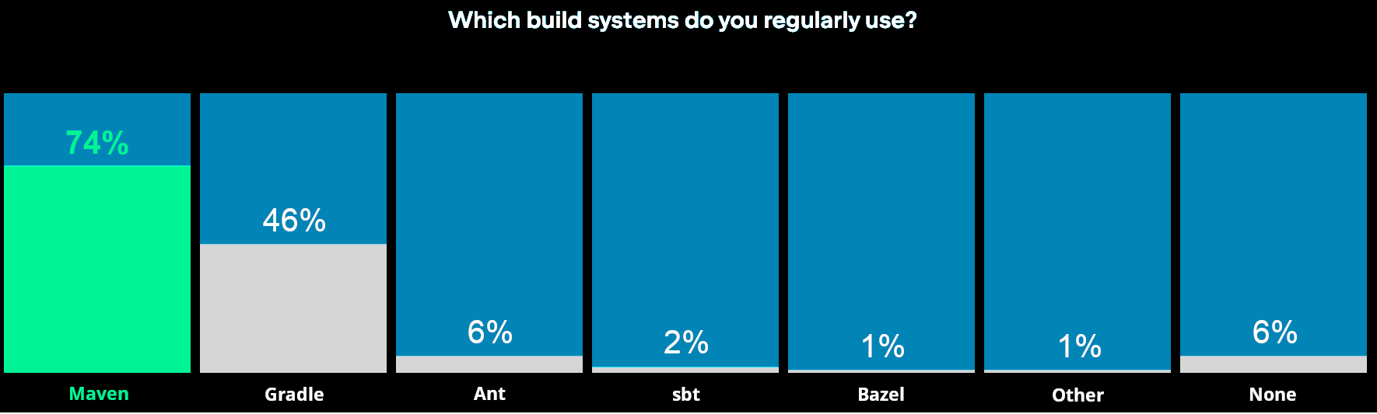
Building Java Applications
Maven ● Gradle ● Ant ● sbt ● Bazel
Source: JetBrains State of Developer Ecosystem 2023 : https://www.jetbrains.com/lp/devecosystem-2023/java/
Miami JVM Group https://www.meetup.com/miami-java-user-group/ Thursday, December 5, 2024

Slide 46
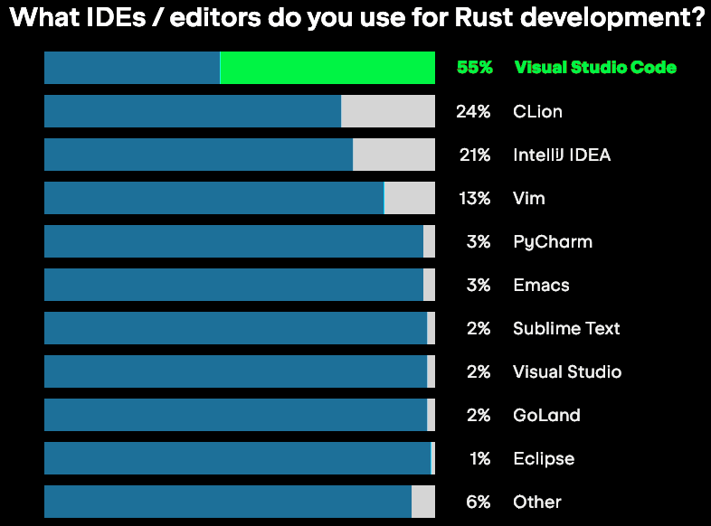
RUST IDE
Source: JetBrains State of Developer Ecosystem 2023 : https://www.jetbrains.com/lp/devecosystem-2023/rust/
Miami JVM Group https://www.meetup.com/miami-java-user-group/ Thursday, December 5, 2024
Notes:
JetBrains released a new IDE for Rust named, RustRover, released May 21, 2024 that is not reflected in this survey data.

Slide 47

MICROSOFT Blazor
C#-Based Web Development: Enables building interactive web applications using C# and .NET instead of JavaScript.
Component-Based Architecture: Allows developers to create reusable UI components using Razor syntax (HTML + C#).
WebAssembly and Server-Side Models: Supports both Blazor WebAssembly for client-side execution and Blazor Server for server-side execution via SignalR.
Seamless Integration: Works seamlessly with the .NET ecosystem, offering robust support for libraries, tools, and frameworks.
Unified Full-Stack Development: Allows developers to use a single programming language (C#) for both client-side and server-side logic.
Source: Blazor: https://en.wikipedia.org/wiki/Blazor
Miami JVM Group https://www.meetup.com/miami-java-user-group/ Thursday, December 5, 2024
Notes:
Trivia: Blazor is a portmanteau of Browser and Razor
(In .NET, the view generator engine is typically called "Razor")

