Slide 1


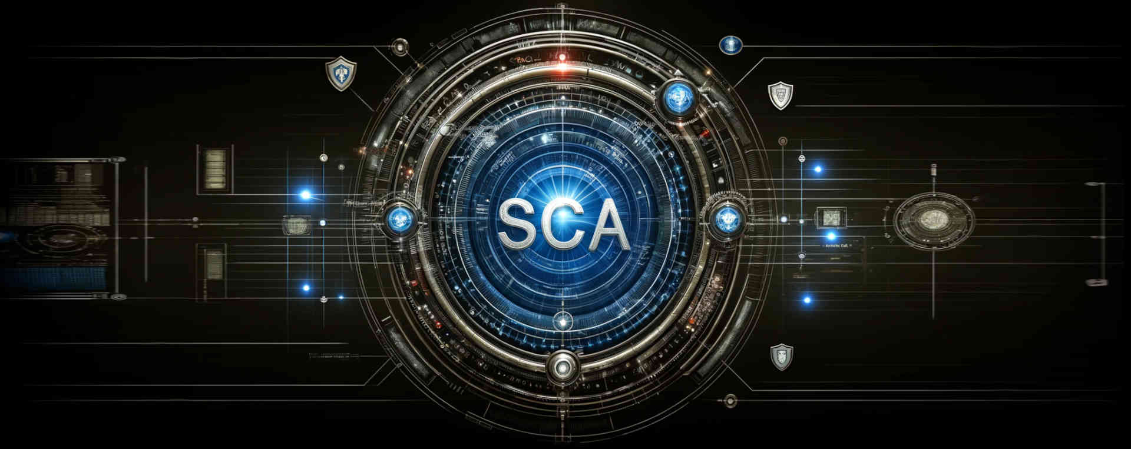
· SOFLO DEVCON 2024
Software Composition Analysis
Notes:
Software Composition Analysis (SCA)
This presentation is based on SCA presentations given at:
South Florida Developer Conference SoFlo DevCon 2024, May 4th, 2024
Miami JVM Group (Miami Java User Group), May 8th, 2024
American Express DevCon, May 20th, 2024

Slide 2
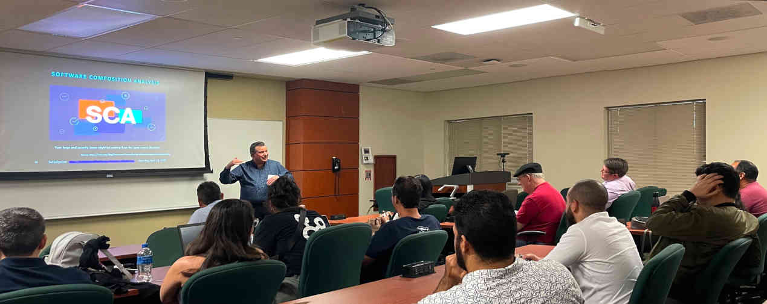
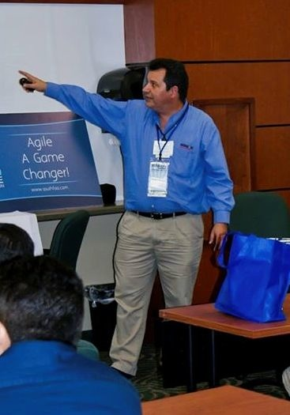








Eugenio Alvarez
A South Florida software engineering professional. Experienced in organizational design, software design, construction, and deployment. Extensive knowledge of Java. Proponent of Unit testing. An advocate for Agile Software Engineering methods using Kanban and Scrum.
www.linkedin.com/in/ealvarez
Software Composition Analysis · www.linkedin.com/in/ealvarez · Wednesday, May 22, 2024
Notes:
Organizer of Miami JVM Group (Miami Java User Group)

Slide 3
INTRODUCTION
Market forces are driving companies to accelerate the development of secure software to gain a competitive advantage and avoid costly security breaches.
The software development community has found that Software Component Analysis tooling can improve the competitive need for increased security and speed.
Software Composition Analysis tooling provides an efficient way to reduce security threats from open-source software components.
Software Composition Analysis · www.linkedin.com/in/ealvarez · Wednesday, May 22, 2024

Slide 4
We Will DISCUSS
The need for SCA to manage open source.
How do CVEs and SBOMs relate to SCA?
SCA tooling as part of a secure coding practice.
The Cybersecurity landscape that is requiring SCA.
The need for software license management with SCA.
Third-party risk management (TPRM) and SCA.
Software Composition Analysis · www.linkedin.com/in/ealvarez · Wednesday, May 22, 2024

Slide 5
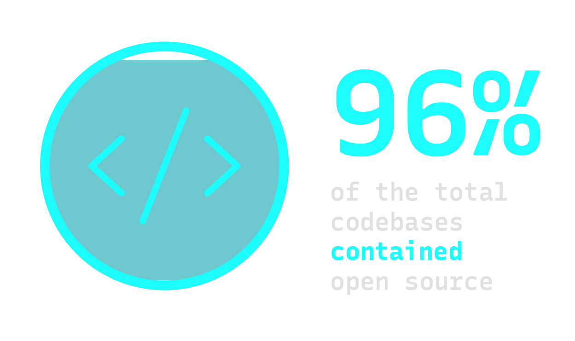
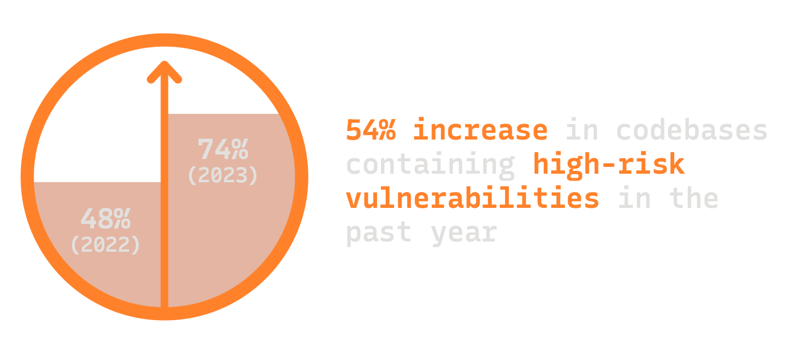
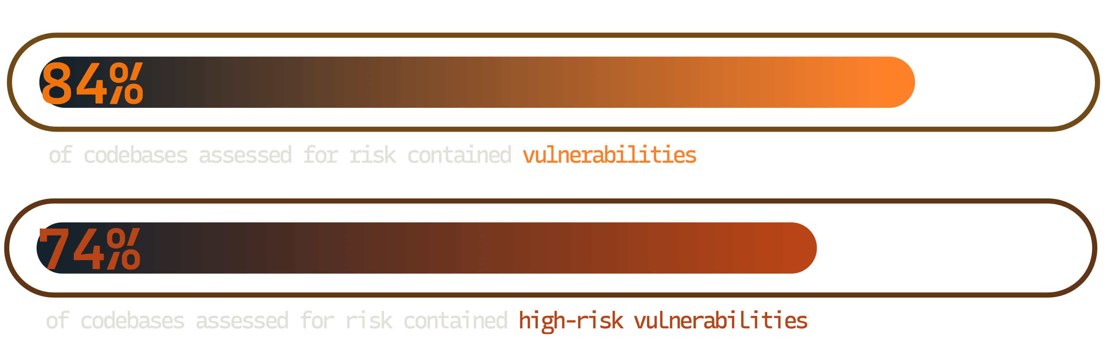
Open SourcE Exposure
Source: Synopsys Open Source Security and Risk Report 2024
Software Composition Analysis · www.linkedin.com/in/ealvarez · Wednesday, May 22, 2024
Notes:
OSSRA analyzed 1000+ codebases
96% contained open source, 84% contained vulnerabilities
74% contained high-risk vulnerabilities, up from 48% in 2022

Slide 6
Open Source COMPONENTS
PER Application (2016-2024)
Source: Meta-analysis from Synopsys BlackDuck Open Source Security and Risk Reports 2016-2024
Software Composition Analysis · www.linkedin.com/in/ealvarez · Wednesday, May 22, 2024
Notes:
So you think you don’t have much open source in your projects?
Meta-Analysis from Synopsys / Blackduck Open Source Security and Risk Reports (OSSRA) 2016-2024
OSSRA analyzed 1000+ codebases in the latest report from February 20, 2024
Sonatype reports average java application has 148 dependencies with around 90% of the 148 being open source

Slide 7
Why so Many Open Source COMPONENTS
AVERAGE OF 526
Source: Synopsys BlackDuck Open Source Security and Risk Reports 2024
Average of 148
for java Applications
(ESt. 90% of that IS Open Source)
Source: Sonatype 9th Annual State of the Software Supply Chain Report, Nov 2023
Median of 683
for javaSCRIPT Applications
(From a median of 10 direct)
Source: GitHub Octoverse Report, Dec 2020
Software Composition Analysis · www.linkedin.com/in/ealvarez · Wednesday, May 22, 2024
Notes:
So you think you don’t have much open source in your projects?
OSSRA analyzed 1000+ codebases in the latest report from February 20, 2024
Sonatype reports average java application has 148 dependencies with around 90% of the 148 being open source

Slide 8

Transitive Dependencies
“Do you realize how many dependencies?”
App
A
B
C
AA
AB
BC
CA
CB
CC
BCA
BCB
Software Composition Analysis · www.linkedin.com/in/ealvarez · Wednesday, May 22, 2024
Notes:
2020 Github Octoverse Report
Median direct dependencies: JavaScript 10, Java: 8, .NET: 6, Python: 6, Ruby: 9

Slide 9

“Thus, what is of supreme importance in war is to attack the enemy’s strategy.”
Tzu, Sun. The Art of WAr
孫子
“Invincibility lies in the defence”
Tzu, Sun. The Art of War
Software Composition Analysis · www.linkedin.com/in/ealvarez · Wednesday, May 22, 2024
Notes:
Sun Tzu was a Chinese military general, strategist who lived in China around 500 BCE.

Slide 10
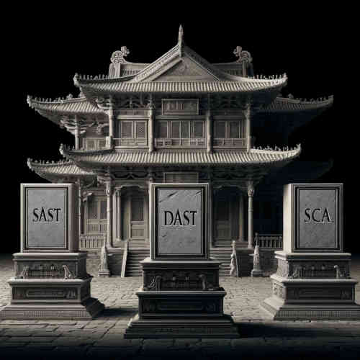
secure Coding DOJO
SAST: Static Application Security Testing
DAST: Dynamic Application Security Testing
SCA: Software Composition Analysis
Software Composition Analysis · www.linkedin.com/in/ealvarez · Wednesday, May 22, 2024

Slide 11
SCA Tools in Action
Identify open-source components
Identify security issues in open-source components
Identify license issues in open-source components
Notify and mitigate open-source issues
Manage open-source quality
Software Composition Analysis · www.linkedin.com/in/ealvarez · Wednesday, May 22, 2024

Slide 12

Software COmposition Analysis
combined with
Static Application Scan
Some SCA tools use SAST to confirm that code is vulnerable
Be careful with false negatives
Dynamic code can only be detected with runtime analysis
Software Composition Analysis · www.linkedin.com/in/ealvarez · Wednesday, May 22, 2024

Slide 13

JUST a Simple UpdatE?
H2 database
JUnit4 vs JUnit5
Spring Framework
Angular JS
Apache Struts
MAYBE or MAYBE NOT
Software Composition Analysis · www.linkedin.com/in/ealvarez · Wednesday, May 22, 2024

Slide 14
CVE
(Common Vulnerabilities and Exposures)
Publicly released list of known cybersecurity vulnerabilities
Issued by vendors and researchers
Each CVE has an identification number “identifier”
A CVE does not include technical data
Databases of public disclosed CVEs (multiple)
NVD (National Vulnerabilities Database) USA
Source: https://www.cve.org/
Software Composition Analysis · www.linkedin.com/in/ealvarez · Wednesday, May 22, 2024

Slide 15
SBOM Formats
(Software Bill of Materials)
CycloneDX
Open source machine-readable by OWASP
SPDX® (Software Package Data Exchange)
Open standard ISO/IEC 5692:2021 by Linux Foundation
Source: https://cyclonedx.org/
Source: https://spdx.dev/
Software Composition Analysis · www.linkedin.com/in/ealvarez · Wednesday, May 22, 2024

Slide 16
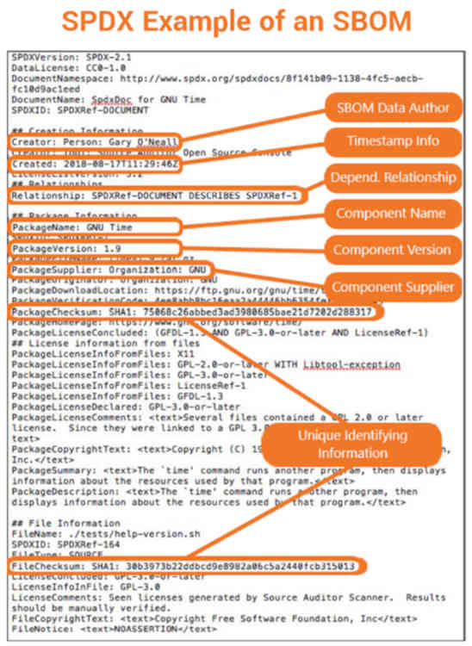

Example SBOM?
Source: https://www.thesslstore.com/blog/sbom-an-up-close-look-at-a-software-bill-of-materials/
Software Composition Analysis · www.linkedin.com/in/ealvarez · Wednesday, May 22, 2024
Notes:
SPDX supports various formats: YAML, JSON, XML, RDF/XML, XLSX, and tag-value.
CyloneDX supports: JSON and XML.

Slide 17
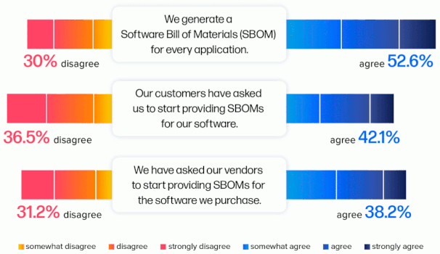
SBOM USAGE
Survey Says
Source: Sonatype 9th Annual State of the Software Supply Chain Report, Nov 2023
Software Composition Analysis · www.linkedin.com/in/ealvarez · Wednesday, May 22, 2024
Notes:
SBOM usage is growing, but there is still a ways to go.

Slide 18
SBOM Adoption DRIVERs
Presidential Executive order 14028 (Cybersecurity)
An SBOM as part of Secure Development
Regulatory Compliance
Risk management via CI/CD supply chain monitoring
Customer Assurance
Source: https://www.whitehouse.gov/briefing-room/presidential-actions/2021/05/12/executive-order-on-improving-the-nations-cybersecurity/
Software Composition Analysis · www.linkedin.com/in/ealvarez · Wednesday, May 22, 2024
Notes:
SBOM adoption drivers.

Slide 19


Where is SCA in Build PIPELINE
Application Security Pipeline
Plan
Code
Build
Test
Pre-
release
Deploy
Operate
& monitor
IDE Integration
Static analysis and SCA
SAST and SCA
SCA Container scan
Source: https://vulcan.io/blog/ci-cd-security-5-best-practices/
Software Composition Analysis · www.linkedin.com/in/ealvarez · Wednesday, May 22, 2024

Slide 20

Open Source LICENSE IDENTIFICATION and Management
MIT License
Apache License 2.0
BSD License variants
Mozilla Public License 2.0
Public Domain
GNU Lesser (As long as the code is unmodified)
GNU GPL (License conflict)
Source: https://www.gnu.org/licenses/gpl-3.0.en.html
Software Composition Analysis · www.linkedin.com/in/ealvarez · Wednesday, May 22, 2024
Notes:
What happens with GPL license conflict.
Vendor or customer scan. Not acceptable.
Example with transitive dependency with different license. Main license Apache, subcomponent with GPL.

Slide 21
Why GPL causes a conflict
Copyleft Requirement: Any derivative work created from a GPL licensed code must be distributed under the GPL which includes the source code of the entire derivative work.
Examples:
Linksys/Cisco WRT54G
Samsung Smart TVs
Source: https://www.fsf.org/news/2008-12-cisco-suit
Software Composition Analysis · www.linkedin.com/in/ealvarez · Wednesday, May 22, 2024

Slide 22
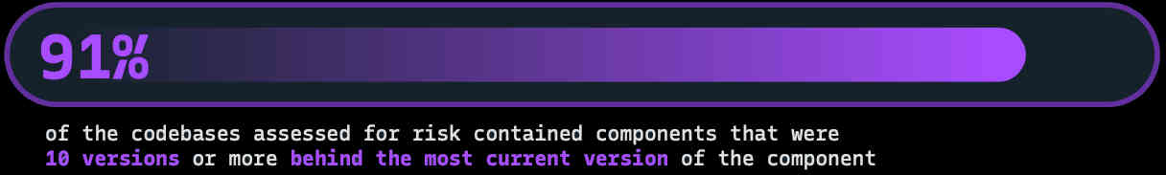
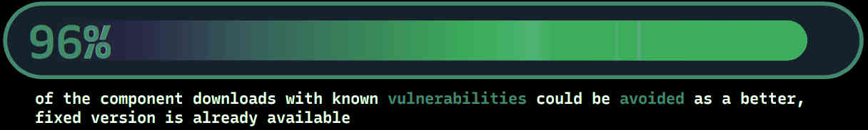
OPEN SOURCE Version management
Source: Synopsys Open Source Security and Risk Report, Feb 2024
Source: Sonatype 9th Annual State of the Software Supply Chain Report, Nov 2023
SCA Tools recommend the latest version
Software Composition Analysis · www.linkedin.com/in/ealvarez · Wednesday, May 22, 2024
Notes:
Better updating of open-source components is needed.
No updates or constant security updates are both a problem.

Slide 23
OPEN SOURCE QUality management
“The fact that 18.6% of [open source] projects stopped being maintained in the last year
highlights the need to not only choose good dependencies, but monitor those
dependencies for changes in their quality.” *
Source: Sonatype 9th Annual State of the Software Supply Chain Report, Nov 2023
* maintained as defined by the OpenSSF (Open Source Security Foundation) scorecard
Software Composition Analysis · www.linkedin.com/in/ealvarez · Wednesday, May 22, 2024
Notes:
Better updating of open source components is needed.

Slide 24
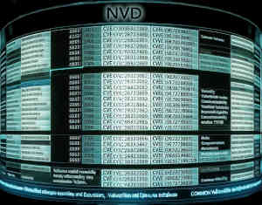






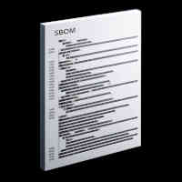


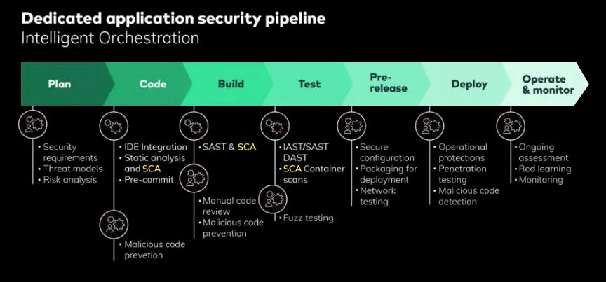


Continuous Monitoring and NOTIFICATION
Email
24/7 Monitoring
Text
NVD et al.
SCA
Service
SBOM
Pipeline
Software Composition Analysis · www.linkedin.com/in/ealvarez · Wednesday, May 22, 2024
Notes:
A SCA Service will monitor 24/7 and send notifications
GitHub Dependabot integration

Slide 25

SCA SCAN for VENDOR SOFTWARE
Source: DALL·E
SBOM for VENDOR SOFTWARE RECOMMENDED
Software Composition Analysis · www.linkedin.com/in/ealvarez · Wednesday, May 22, 2024
Notes:
Black duck scan for vendor installed software without SBOM. Beware of obfuscated code. It is recommended to get an SBOM from the vendor.

Slide 26

THIRD-PARTY RISK MANAGEMENT (TPRM)
“98% of organizations have a relationship with a third party that has been breached.”
Source: SecurityScoreCard Global Third-Party Cybersecurity Breaches Report, Feb 2024
Third-party breaches by industry:
43% Technology & Telecommunications
30% Financial Services
29% Overall cross-industry rate
Source: SecurityScoreCard Global Third-Party Cybersecurity Breaches Report, Feb 2024
Stop depending on a questionnaires for TPRM
Vendor SBOMs can be monitored 24/7 by SCA Tooling
Software Composition Analysis · www.linkedin.com/in/ealvarez · Wednesday, May 22, 2024

Slide 27
SCA TOOLS
Software Composition Analysis · www.linkedin.com/in/ealvarez · Wednesday, May 22, 2024

Slide 28
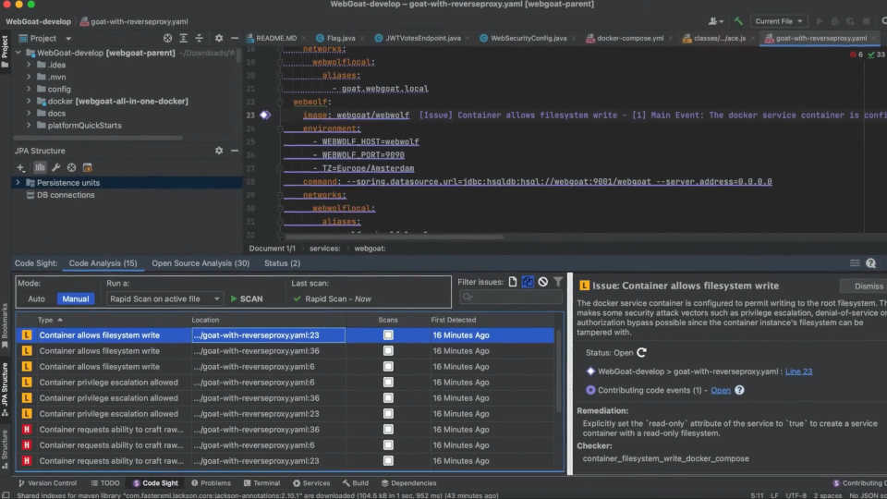
SCA IDE PlugINS
Source: https://youtu.be/6cxi96CJB14
Software Composition Analysis · www.linkedin.com/in/ealvarez · Wednesday, May 22, 2024
Notes:
SCA IDE Plugin: Synopsys Code Sight IDE plugin
Frame from video: Code Sight IDE Plugin for Application Security Testing | Synopsys

Slide 29
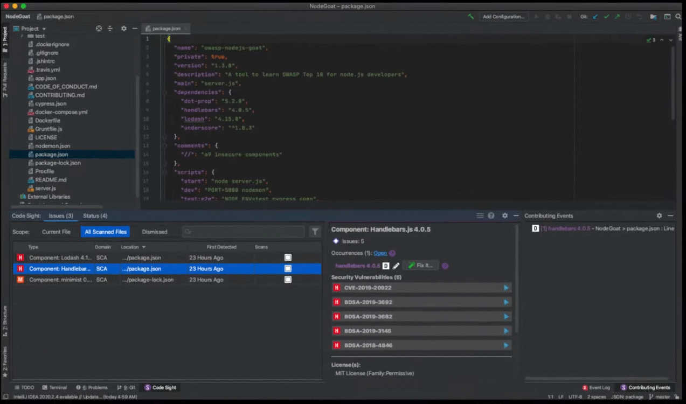
SCA IDE PlugINS
Source: https://youtu.be/W9BHyXYw3vQ
Software Composition Analysis · www.linkedin.com/in/ealvarez · Wednesday, May 22, 2024
Notes:
SCA IDE Plugin: Synopsys/BlackDuck Code Sight IDE plugin
Frame from video: Secure and manage open source risks in applications and contains with Black Duck SCA

Slide 30
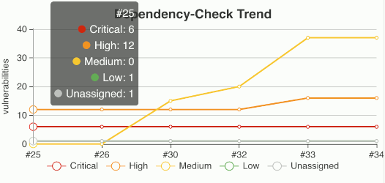
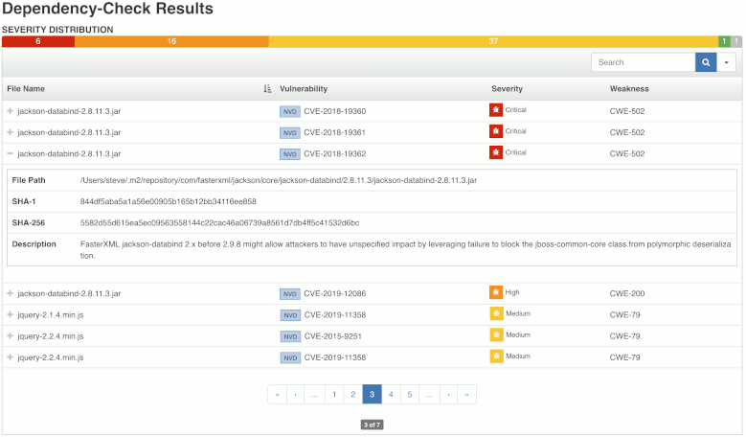
DEPendency CHECK
Source: https://plugins.jenkins.io/dependency-check-jenkins-plugin/
Software Composition Analysis · www.linkedin.com/in/ealvarez · Wednesday, May 22, 2024
Notes:
Dependency Check can be used as part of a Jenkins pipeline build.
Can stop a build if there is a critical vulnerability.

Slide 31
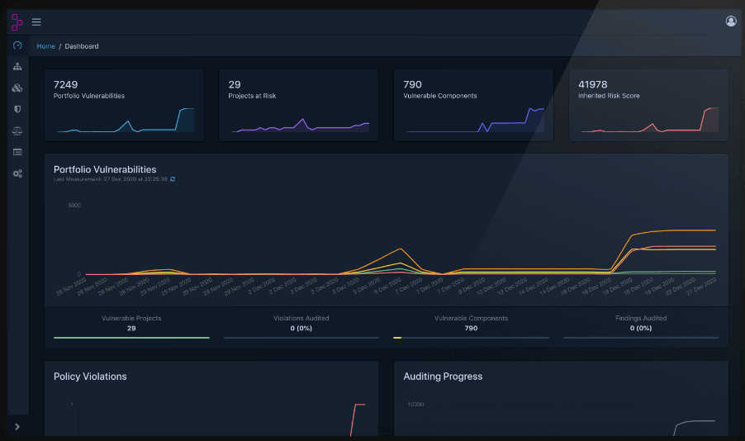
DEPendency TRACK
Source: https://www.dependencytrack.org/
Software Composition Analysis · www.linkedin.com/in/ealvarez · Wednesday, May 22, 2024
Notes:
An SBOM is sent to Dependency Track to monitor for vulnerabilities.

Slide 32

SOFTWARE Composition Analysis
Eugenio Alvarez
Thank You
www.linkedin.com/in/ealvarez
Software Composition Analysis · www.linkedin.com/in/ealvarez · Wednesday, May 22, 2024

Slide 33
REFERENCES
Synopsys 2024 Open Source Security and Risk Analysis Report (OSSRA)
https://www.synopsys.com/content/dam/synopsys/sig-assets/reports/rep-ossra-2024.pdf
Sonatype 2023 9th Annual State of the Software Supply Chain Report
https://www.sonatype.com/hubfs/2023 Sonatype- 9th Annual State of the Software Supply Chain- Update.pdf
GitHub Octoverse Report 2020
https://octoverse.github.com/2020/
The Art of War: Sun Tzu
https://www.amazon.com/Art-War-Sun-Tzu/dp/1599869772
CVE (Common Vulnerabilities and Exposures)
https://www.cve.org
OWASP CycloneDX Software Bill of Materials (SBOM) Standard
https://cyclonedx.org/
Software Composition Analysis · www.linkedin.com/in/ealvarez · Wednesday, May 22, 2024

Slide 34
REFERENCES
System Package Data Exchange (SPDX®) (SBOM) Standard
https://spdx.dev/
SBOM: An Up-Close Look at a Software Bill of Materials
https://www.thesslstore.com/blog/sbom-an-up-close-look-at-a-software-bill-of-materials/
Executive order 14028 (Cybersecurity)
https://www.whitehouse.gov/briefing-room/presidential-actions/2021/05/12/executive-order-on-improving-the-nations-cybersecurity/
CI/CD security - 5 best practices
https://vulcan.io/blog/ci-cd-security-5-best-practices/
GNU General Public License
https://www.gnu.org/licenses/gpl-3.0.en.html
GPL Violation law suit
https://www.fsf.org/news/2008-12-cisco-suit
Software Composition Analysis · www.linkedin.com/in/ealvarez · Wednesday, May 22, 2024

Slide 35
REFERENCES
SecurityScoreCard Global Third-Party Cybersecurity Breaches Report, Feb 2024
https://securityscorecard.com/wp-content/uploads/2024/02/Global-Third-Party-Cybersecurity-Breaches-Final-1.pdf
Code Sight IDE Plugin for Application Security Testing | Synopsys
https://youtu.be/6cxi96CJB14
Secure and manage open source risks in applications and contains with Black Duck SCA
https://youtu.be/W9BHyXYw3vQ
OWASP Dependency Check
https://owasp.org/www-project-dependency-check/
https://plugins.jenkins.io/dependency-check-jenkins-plugin/
OWASP Dependency Track
https://owasp.org/www-project-dependency-track/
https://www.dependencytrack.org/
Software Composition Analysis · www.linkedin.com/in/ealvarez · Wednesday, May 22, 2024

