Slide 1
KanBAn
WHY
かんばん
AN AGILE FRAMEWORK
South Florida Agile Association
http://southfaa.com
November 3, 2015
Notes:
Why Kanban?
A presentation for the South Florida Agile Association at NSU on November 3th 2015

Slide 2
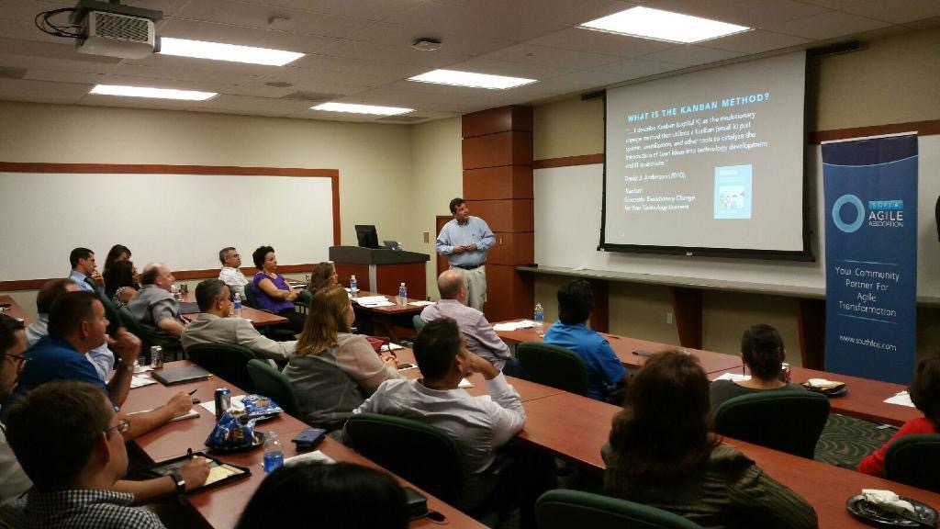
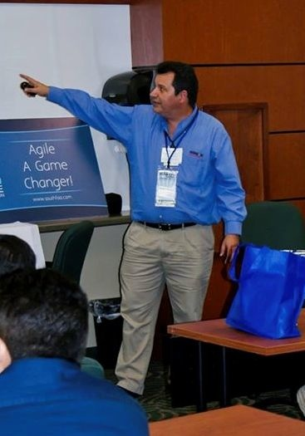





Eugenio Alvarez
A South Florida software development professional with 20 plus years of experience in the design, construction and deployment of software. The bulk of my experience is as a software developer. Unit test infected since 1999. I have been working as a Software Development Director, focusing on agile development methods since 2013.
www.linkedin.com/in/ealvarez
Notes:
My name is Eugenio Alvarez. I am a South Florida software development professional focusing on agile software development since 2013.

Slide 3
INTRODUCTION
Economic forces are driving companies to develop software faster to gain competitive advantage.
The software development community has found that agile software development can address the competitive need for speed.
The Lean Kanban Method adds an agility framework for software development that is simple, efficient with the capacity to improve quality.

Slide 4
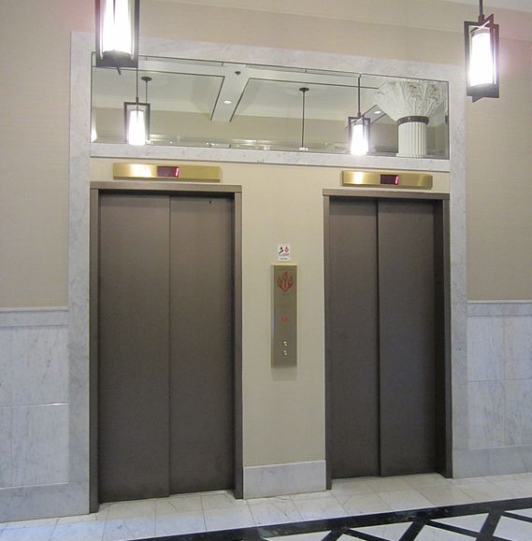
KANBAN’S ElEVATOR PITCH
Source: https://commons.wikimedia.org/wiki/File:Dekum_Building,_Portland,_Oregon_(2012)_-_11.JPG

Slide 5
KANBAN’S ElEVATOR PITCH
“For companies with software development teams
who are dissatisfied with speed/quality of software development.
The Lean Kanban Method is a new option to improve responsiveness.
Unlike Scrum it does not require hiring new roles.
It is an inexpensive method to improve business value.”

Slide 6
questions?
Why Kanban?
Challenges in moving to Kanban?
How can Kanban transform a team?
How were obstacles tackled?
What were the benefits realized?
Recommendations

Slide 7
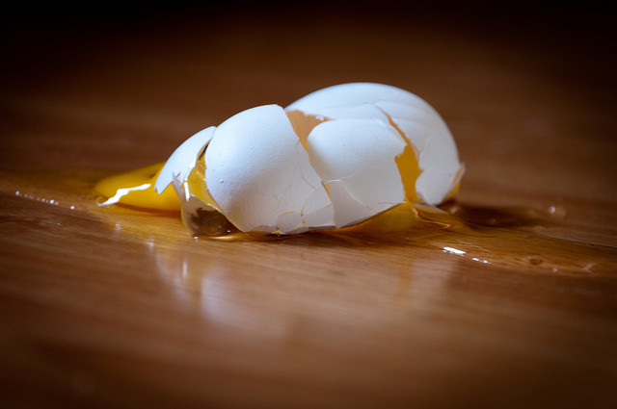
WHY KANBAN?
Source: https://www.flickr.com/photos/8047705@N02/5816198695/
Notes:
Working at a rapidly growing company created a need to organize the development team’s productivity.
Necessity is the mother of invention

Slide 8
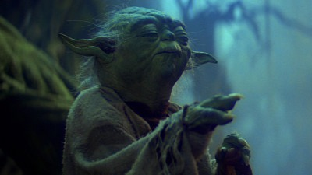
“Do. Or do not. There is no try.”
Source: http://www.starwars.com/news/the-starwars-com-10-best-yoda-quotes
Notes:
Yoda quote

Slide 9
2013: What Agile approach is Your
Organization USING (Select all that Apply)?
15%
9
Source: The State of Scrum Report, ScrumAlliance, June 2013
Notes:
The State of Scrum / Nearly 500 participants
Release: June 2013

Slide 10
2015: What Agile approach is Your
Organization USING (Select all that Apply)?
43%
10
Source: The State of Scrum Report, ScrumAlliance, July 2015
Notes:
The 2015 State of Scrum Report / 4,452 took survey
Released: July 2015

Slide 11
Many organizations mix and
match approaches and frameworks
Of those using a combination of practices, 63% practice Scrum alongside Waterfall.
43% combine Scrum with Kanban.
21% combine Scrum with Lean.
Source: The State of Scrum Report, ScrumAlliance, July 2015

Slide 12

SCRUMBAN
Combination of Scrum and Kanban
Coined and described by Corey Ladas
Spectrum of combining Scrum and Kanban
Scrum
Kanban
Kanban
Scrum
Source: http://leansoftwareengineering.com/ksse/scrum-ban/
Notes:
Ladas worked with David Anderson.

Slide 13
FRAMEWORK Versus MethoDOLOGY
A software development framework is an incomplete set of practices needed for software construction. Gaps are filled with additional methods and/or tools to make a working methodology.
A software development methodology includes a full set of practices and tools needed for software construction. It is common to omit parts of a full methodology that are not appropriate for a given environment.

Slide 14
AGILE METHODS are becoming MORE ADAPTIVE and LESS PRESCRIPTIVE
Counting method roles, activities and artifacts
Source: Henrik Kniberg & Mattias Skarin (2010), Kanban and Scrum, making the most of both.
Notes:
Source: Henrik Kniberg & Mattias Skarin (2010), Kanban and Scrum, making the most of both.

Slide 15
THE LEAN KANBAN METHOD
かんばん
KanBAn
A software development agility framework
Kanban originates from Japanese [かんばん] where kan means “visual” and ban means “card” or “board”
Influenced by Lean Manufacturing, the Toyota Production System (TPS) and Eliyahu Goldratt’s Theory of Constraints (TOC)
Developed by David J. Anderson

Slide 16
KANBAN HELPS AGILE BE AGILE
Accelerate time to market
More easily manage changing priorities
Better align IT and business objectives
Increase productivity
Enhance software quality
Project visibility

Slide 17
ReaSONS FOR KANBAN Adoption
Other Agile methods didn’t make sense
Evolutionary step for Agile methods
Need ability for daily task reschedule
Organization resistance

Slide 18
IMPORTANT CONCEPTS
Let’s discuss a few terms
Flow
Pull
Kaizen

Slide 19
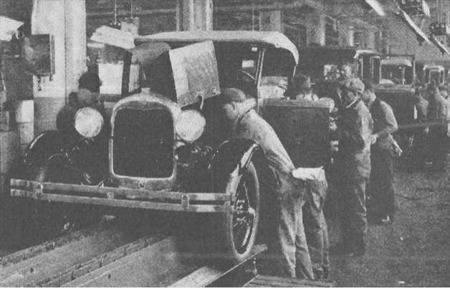
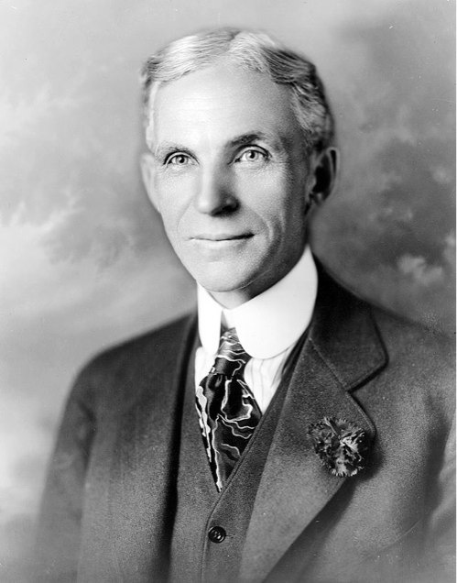
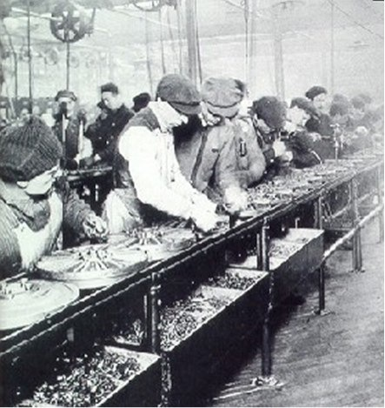
WHAT IS FLOW?
Henry Ford pioneered the assembly line aka “flow lines”
Notes:
Different from “mental state” of flow defined by Mihály Csíkszentmihályi (aka in the Zone).
Pronunciation guide: Me-high Cheek-sent-me-high

Slide 20
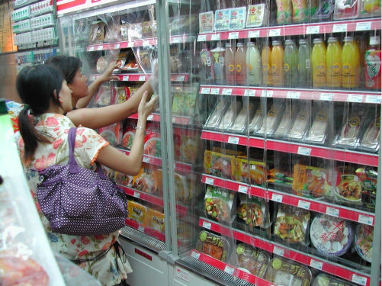
What is Pull?
Grocery store refills items based on customer “pulling” inventory
Source: http://en.wikipedia.org/wiki/File:Frozen_dimsum.JPG

Slide 21
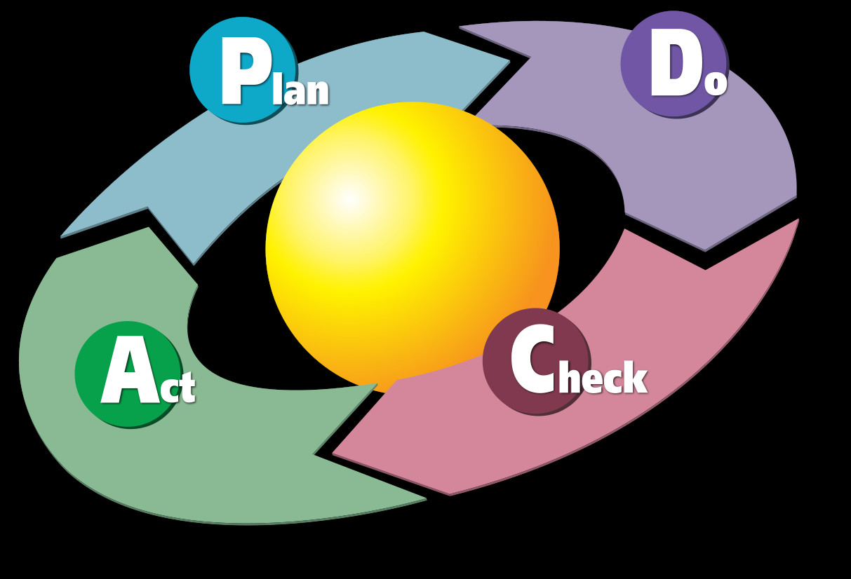
WHAT IS Kaizen?
Kaizen (改善), Chinese and Japanese for "improvement"
Source: Diagram by Karn G. Bulsuk (http://www.bulsuk.com).

Slide 22
CONCEPT Review
Quick review of important concepts
Flow
Pull
Kaizen

Slide 23
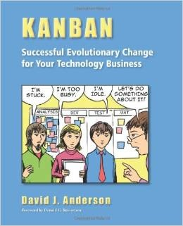
WHAT is the KANBAN METHOD?
“… I describe Kanban (capital K) as the evolutionary change method that utilizes a kanban (small k) pull system, visualization, and other tools to catalyze the introduction of Lean ideas into technology development and IT operations.”
David J. Anderson (2010).
Kanban
Successful Evolutionary Change
for Your Technology Business
Notes:
Mike Burrows. (2014). Kanban from the Inside

Slide 24
THE KANBAN METHOD
かんばん
KanBAn
Guiding Principles
Core Practices
Notes:
Not including Mike Burrows’ 9 values.

Slide 25
Kanban Method principles
Start with what you know
Agree to pursue evolutionary change
Initially, respect roles, responsibilities and job titles
Encourage acts of leadership at all levels
Source: Mike Burrows (2014), Kanban from the Inside.

Slide 26
Kanban Method PRACTICES
Visualize
Limit work-in-progress (WIP)
Manage flow
Make policies explicit
Implement feedback loops
Improve collaboratively, evolve experimentally (using models and the scientific method)
Source: Mike Burrows (2014), Kanban from the Inside.

Slide 27
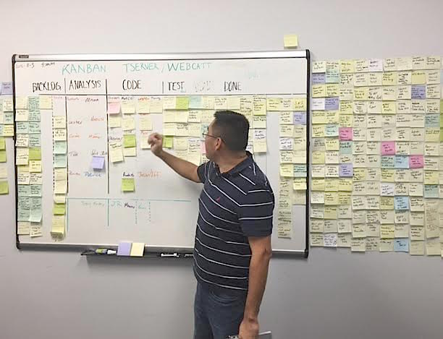
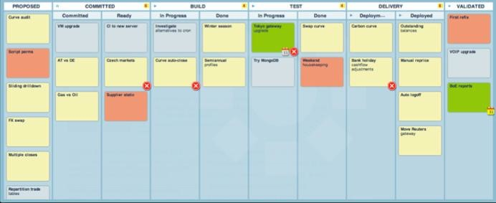
VISUALIZE
Kanban boards
Visual work management

Slide 28

LIMIT WORK IN PROGRESS (WIP)
“Do you realize what impact multi-tasking has on lead time?”
A
B
C
10
10
10
A
B
C
A
B
C
20
20
20
Source: Eliyahu M. Goldratt (1997), Critical Chain
Notes:
Eliyahu M. Goldratt. (1984). The Goal: A Process of Ongoing Improvement

Slide 29
MANAGE FLOW
Cumulative Flow Diagrams (CFD)

Slide 30
Make Policies EXPLICIT
Explicit policies are on the board.
Board rules

Slide 31
IMPLEMENT FEEDBACK LOOPS
Daily standup meetings
Weekly replenishment meetings
Monthly operations review meetings
Notes:
Daily Scrum
Sprint Planning
Scrum Sprint Retrospective

Slide 32
IMPROVE, EVOLVE
Improve collaboratively, evolve experimentally (using models and the scientific method).
Notes:
Finishing Kanban principles and practices.

Slide 33
SCRUM, KANBAN OR SCRUMBAN?
Do you have separate teams for new development and maintenance?
Do you have a enough people for a cross-functional Scrum team?
Can your team focus for 2-4 weeks with minimal interruption?
Is the company culture against Agile?

Slide 34
Top TEN SIGNS YOUR KANBAN IS not Working
かんばん
KanBAn
1. Where is Kaizen?
2. Violating WIP limits.
3. Lacking Agile Engineering practices.
4. Not knowing what to do (explicit rules).
5. No visual workflow.
6. Tasks are not flowing.
7. Not updating the board.
8. Not showing actual work on the board.
9. Missing work on the board.
10. We can’t start till we get everything right.

Slide 35
Conclusion
かんばん
KanBAn
Kanban provides an agile framework that works along with other software development methods or by itself.
Kanban’s ease of implementation allows for its deployment in a wide variety of environments.
Kanban is a method that can be incorporated into all aspects of IT include portfolio management, software development and operations.

Slide 36
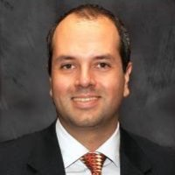


Kanban Training/MEnTORING
Rodrigo de Toledo provided training and mentoring for me and my team.
Thank you Rodrigo.
www.linkedin.com/in/rodrigodetoledo
edu.leankanban.com/users/rodrigo-de-toledo

Slide 37









South Florida KANBAN
You Are Not Alone

Slide 38


South Florida KANBAN
THANK YOU MEETING SPONSORS

Slide 39
WHY KANBAN
かんばん
THANK YOU MEETING SPONSORS
KanBAn
Thank You
www.linkedin.com/in/ealvarez

Slide 40
REFERENCES
ScrumAlliance, (June 2013). The State of Scrum Report
https://www.scrumalliance.org/why-scrum/state-of-scrum-report
ScrumAlliance, (July 2015). The State of Scrum Report
https://www.scrumalliance.org/why-scrum/state-of-scrum-report
Henrik Kniberg & Mattias Skarin. (2010). Kanban and Scrum, making the most of both.
http://www.infoq.com/minibooks/kanban-scrum-minibook
Corey Ladas. (2008). Scrum-ban
http://leansoftwareengineering.com/ksse/scrum-ban/

Slide 41
REFERENCES
Henry Ford. (1922). My Life and Work
http://www.amazon.com/My-Life-Work-Autobiography-Henry/dp/149428300X/
David J. Anderson. (2010). Kanban Successful Evolutionary Change
http://www.djaa.com/kanban-successful-evolutionary-change-your-technology-business-0
Mike Burrows. (2014). Kanban from the Inside
http://www.djaa.com/kanban-inside
Eliyahu M. Goldratt. (1984). The Goal: A Process of Ongoing Improvement
http://www.amazon.com/Goal-Process-Ongoing-Improvement/dp/0884271951/
Eliyahu M. Goldratt. (1997). Critical Chain
http://www.amazon.com/Critical-Chain-Eliyahu-M-Goldratt/dp/0884271536/

