Slide 1
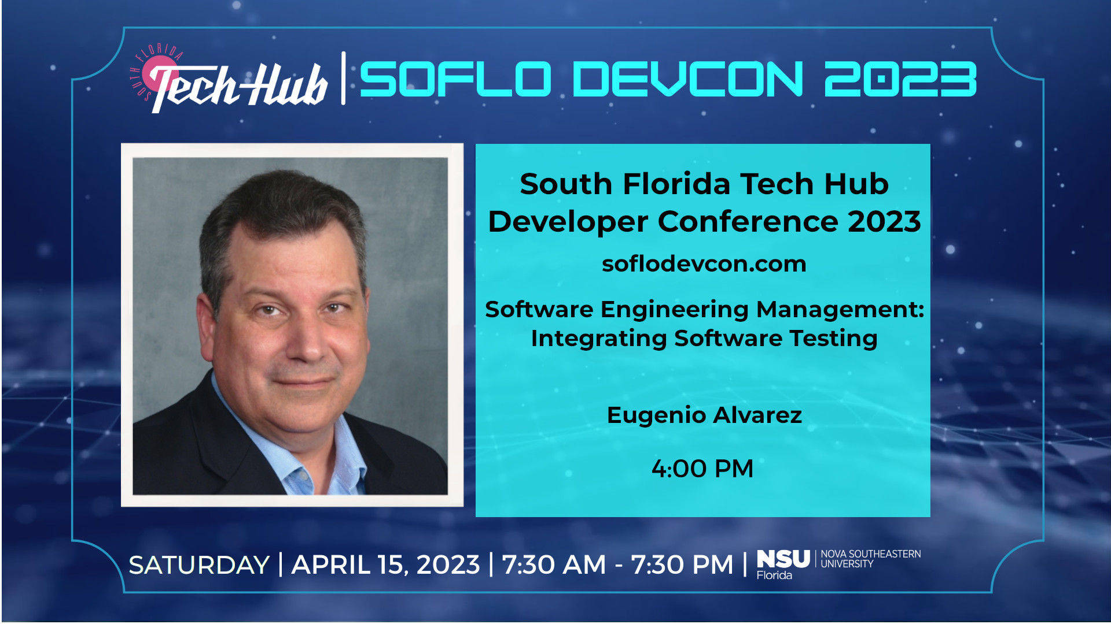
Notes:
Software Engineering Management: Integrating Software Testing
A presentation for the South Florida Developer Conference (SoFloDevCon) 2023. Saturday, April 15, 2023

Slide 2
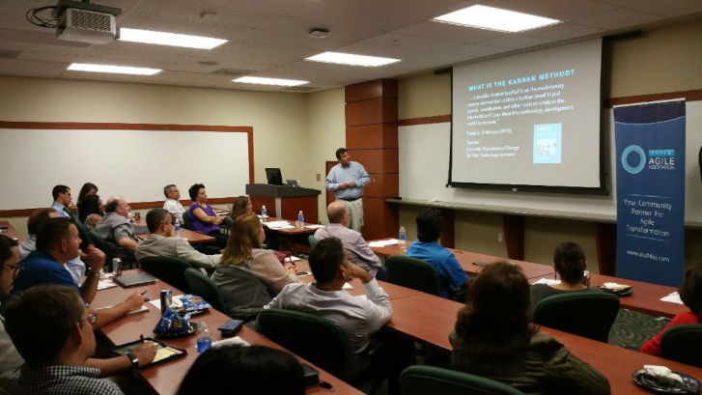
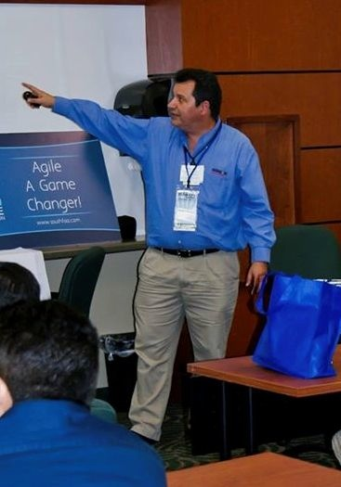


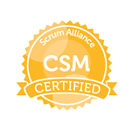

Eugenio Alvarez
A South Florida software engineering professional. Experienced in organizational design, software design, construction, and deployment. Started working with Java in 1996. Unit test infected since 1999. An advocate for Agile Software Engineering methods using Kanban and Scrum.
www.linkedin.com/in/ealvarez
SoFloDevCon https://techhubsouthflorida.org/meetups/soflodevcon/ Saturday, April 15, 2023
Notes:
New organizer of Miami JVM Group

Slide 3
INTRODUCTION
Business Context for Software Testing
Tools to avoid bugs
Testing levels
Unit testing
Integration testings
System testing
Production testing
Other kinds of Testing
Testing Anti-patterns
SoFloDevCon https://techhubsouthflorida.org/meetups/soflodevcon/ Saturday, April 15, 2023

Slide 4
BUSINESS CONTEXT FOR SOFTWARE TESTING
Considerations include:
IT Spend by Industry
Corporate Lifecycle
Product Lifecycle
Corporate organization
Software architecture
SoFloDevCon https://techhubsouthflorida.org/meetups/soflodevcon/ Saturday, April 15, 2023
Notes:
Software testing considerations

Slide 5
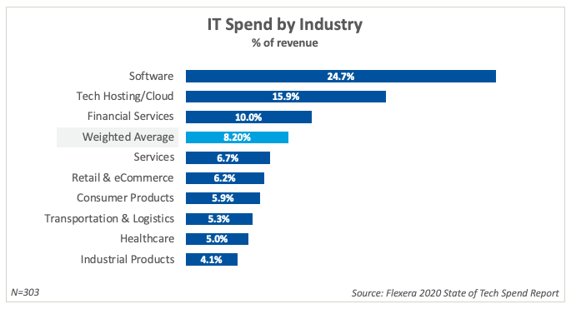
SOFTWARE TESTING AS PART OF IT SPEnd by Industry
SoFloDevCon https://techhubsouthflorida.org/meetups/soflodevcon/ Saturday, April 15, 2023
Notes:
All budgets are not the same.

Slide 6
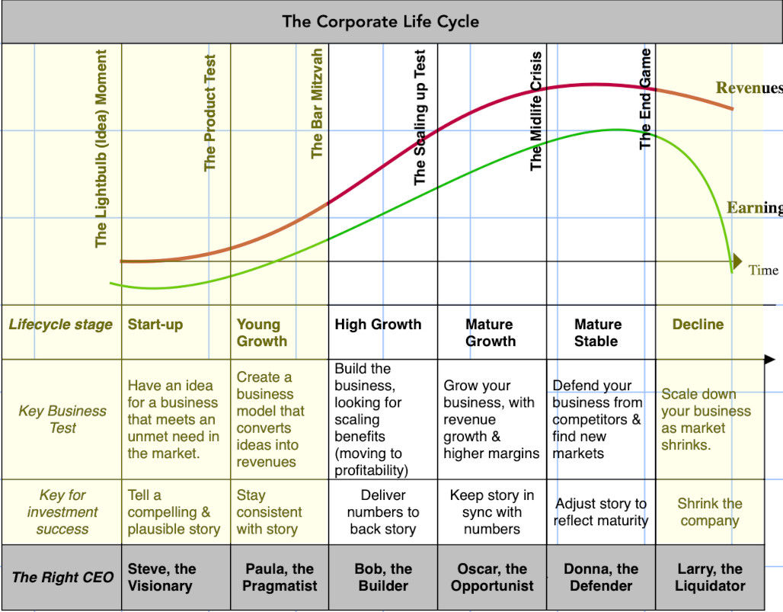
SOFTWARE TESTING
CORPORATE lifecycle
Source: https://aswathdamodaran.blogspot.com/2021/12/managing-across-corporate-life-cycle.html
SoFloDevCon https://techhubsouthflorida.org/meetups/soflodevcon/ Saturday, April 15, 2023
Notes:
Corporate Lifecycle

Slide 7
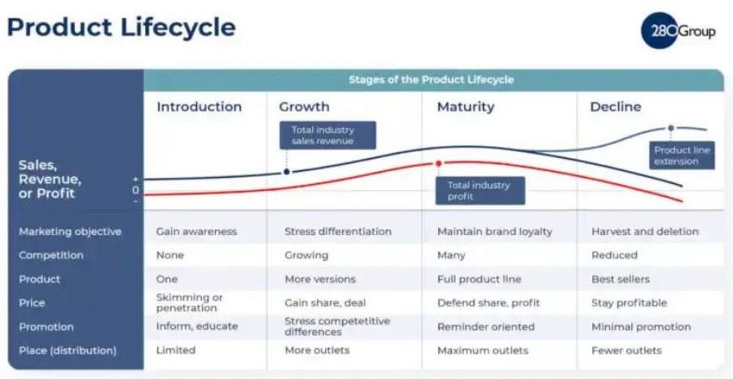
SOFTWARE TESTING
PRODUCT LIFECYCLE
Source: 280 Group https://280group.com/product-management-blog/the-power-of-the-product-lifecycle-a-look-at-the-4-key-stages-of-the-plc/
SoFloDevCon https://techhubsouthflorida.org/meetups/soflodevcon/ Saturday, April 15, 2023
Notes:
Product Lifecycle

Slide 8
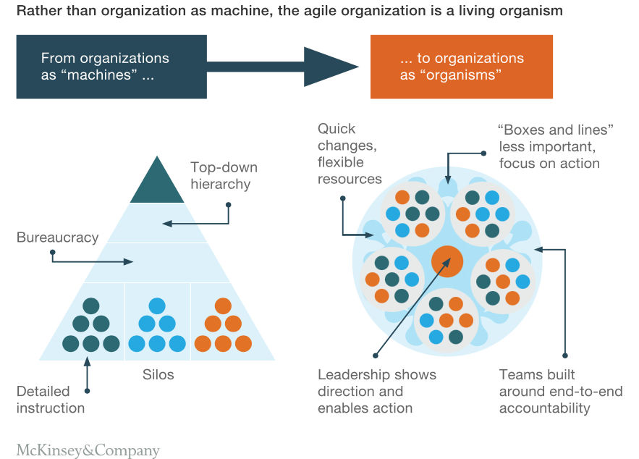
SOFTWARE TESTING
IT ORGANIZATIONAL DESIGN
Source: McKinsey & Company
SoFloDevCon https://techhubsouthflorida.org/meetups/soflodevcon/ Saturday, April 15, 2023
Notes:
Organizational design’s influence on improved outcomes

Slide 9



SOFTWARE TESTING
Methodology / PrOCESS DESIGN
Requirements
Design
Code
Test
Rather than doing all of one thing at a time..
…Teams do a little of everything all the time
Source: “The New New Product Development Game” by Takeuchi and Nonaka. Harvard Business Review, January 1986
Graphics from: “Mike Cohn’s Scrum Presentation” Mountain Goat Software, LLC
SoFloDevCon https://techhubsouthflorida.org/meetups/soflodevcon/ Saturday, April 15, 2023
Notes:
All budgets are not the same.

Slide 10
SOFTWARE TESTING
Methodology / PrOCESS DESIGN
Source: “The New New Product Development Game” by Takeuchi and Nonaka. Harvard Business Review, January 1986
SoFloDevCon https://techhubsouthflorida.org/meetups/soflodevcon/ Saturday, April 15, 2023
Notes:
All budgets are not the same.

Slide 11
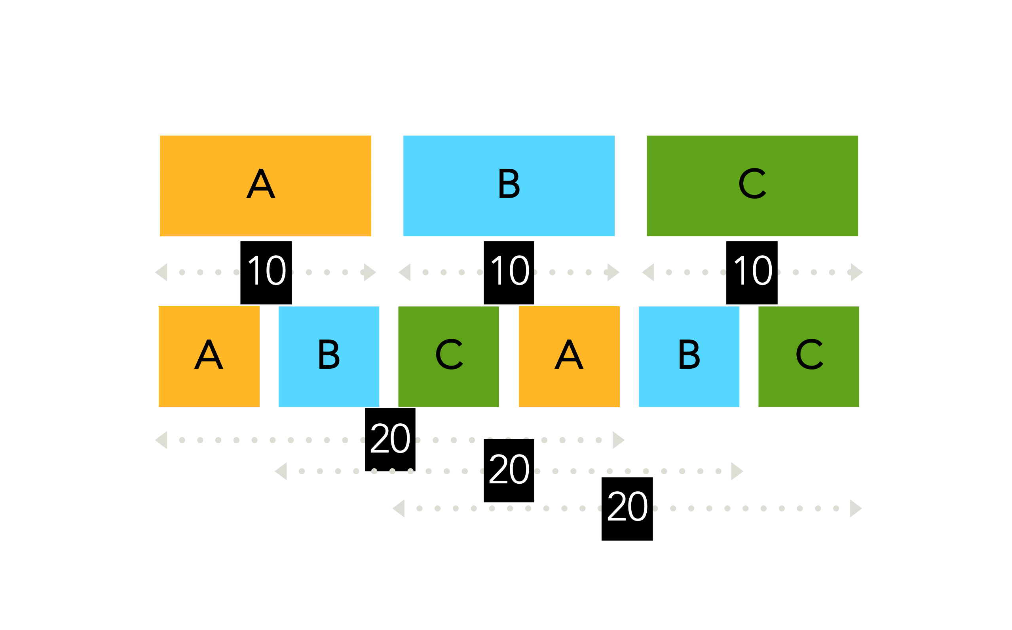
BUT doesn’t that take longer
SoFloDevCon https://techhubsouthflorida.org/meetups/soflodevcon/ Saturday, April 15, 2023
Notes:
Each slice is an iteration with feedback. You end up with what you reality want.

Slide 12
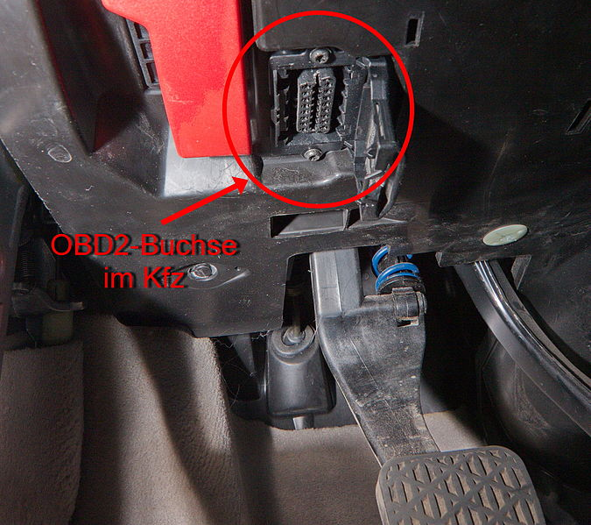
TestABLE Software DESIGNS PRODUCE BETTER Software ARCHITECTURE
Monolithic Software is Like MAKING a CAR Without A DiagnoStic Port
OBD2 diagnostic port
modular design
Inversion of Control Design Pattern
Source: https://en.wikipedia.org/wiki/Inversion_of_control
Source: https://commons.wikimedia.org/wiki/File:OBD2-Buchse_am_Mercedes-Benz_IMG_1701.jpg
SoFloDevCon https://techhubsouthflorida.org/meetups/soflodevcon/ Saturday, April 15, 2023
Notes:
Modular design and design software with testability in mind.

Slide 13

SOFTWARE TESTING NEWS
No matter the Industry Trends, Corporate Lifecycle, Product Lifecycle, Company Culture or Software Architecture
There is always room for improving Software Testing
Source: https://commons.wikimedia.org/wiki/File:Good_news_is_coming_%28Unsplash%29.jpg
SoFloDevCon https://techhubsouthflorida.org/meetups/soflodevcon/ Saturday, April 15, 2023

Slide 14
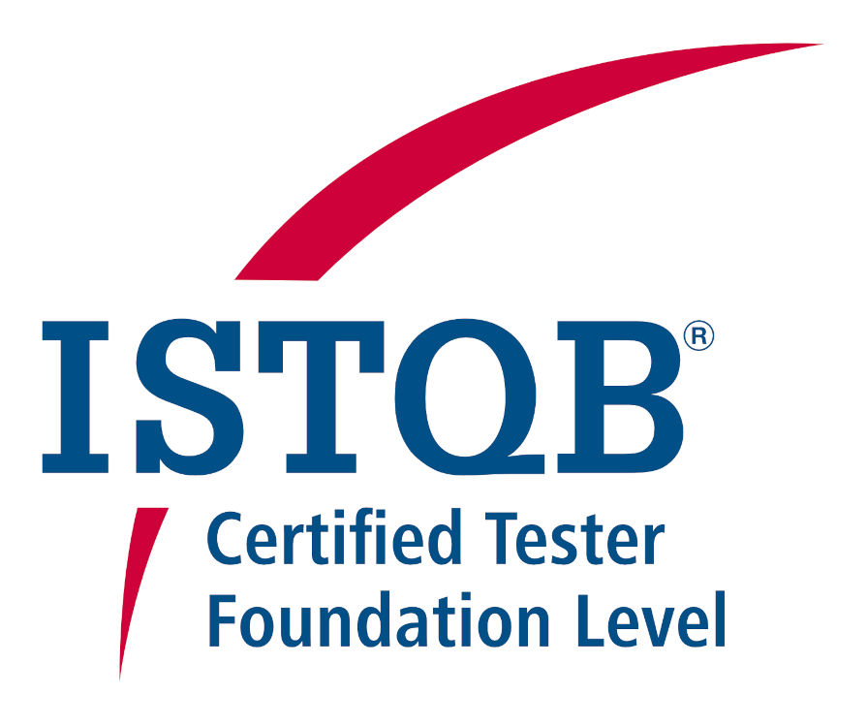
Start WiTH Training for TEsting
Source: https://www.istqb.org/certifications/certification-list/
SoFloDevCon https://techhubsouthflorida.org/meetups/soflodevcon/ Saturday, April 15, 2023
Notes:
The journey from default path to ideal is unique to each organization.

Slide 15
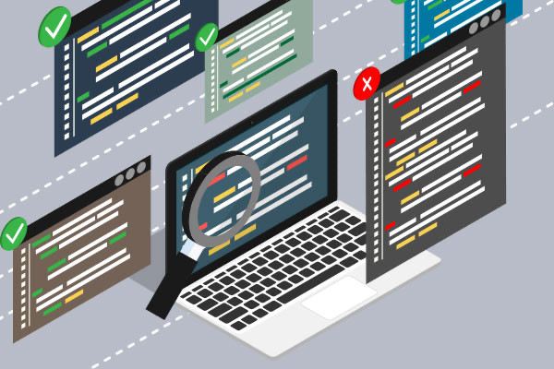
STATIC CODE ANalysis
Finding bugs and security issues before testing
Source: https://www.perforce.com/blog/sca/what-static-analysis
SoFloDevCon https://techhubsouthflorida.org/meetups/soflodevcon/ Saturday, April 15, 2023
Notes:
Static analysis helps to find bug before testing

Slide 16

Software Composition analysis
Your bugs and security issues might be coming from the open source libraries
Source: https://fossa.com/blog/framework-for-evaluating-software-composition-analysis-tools/
SoFloDevCon https://techhubsouthflorida.org/meetups/soflodevcon/ Saturday, April 15, 2023
Notes:
Software Composition Analysis (SCA) finds bug and security issue from open source libraries

Slide 17
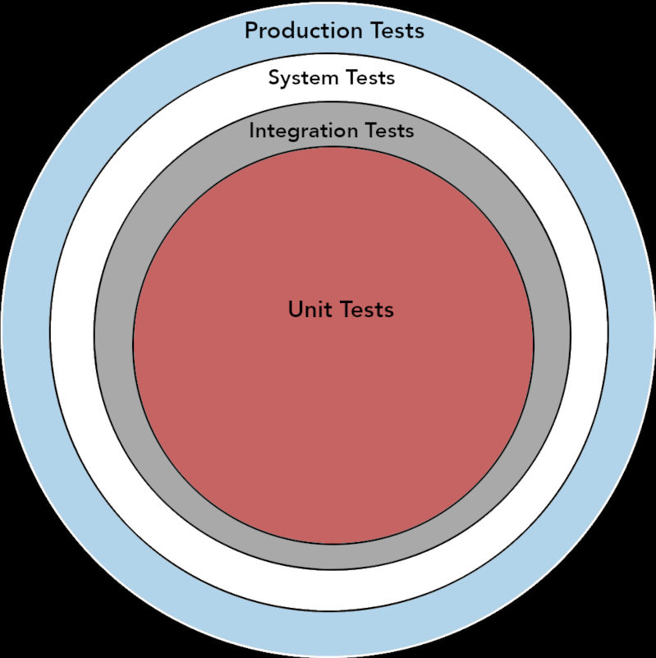
Test Levels
SoFloDevCon https://techhubsouthflorida.org/meetups/soflodevcon/ Saturday, April 15, 2023
Notes:
Test levels

Slide 18
OThER Kinds of TestING
Blackbox Testing
Whitebox Testing
Acceptance Testing
Performance Testing
Installation Testing
SoFloDevCon https://techhubsouthflorida.org/meetups/soflodevcon/ Saturday, April 15, 2023
Notes:
Test levels

Slide 19
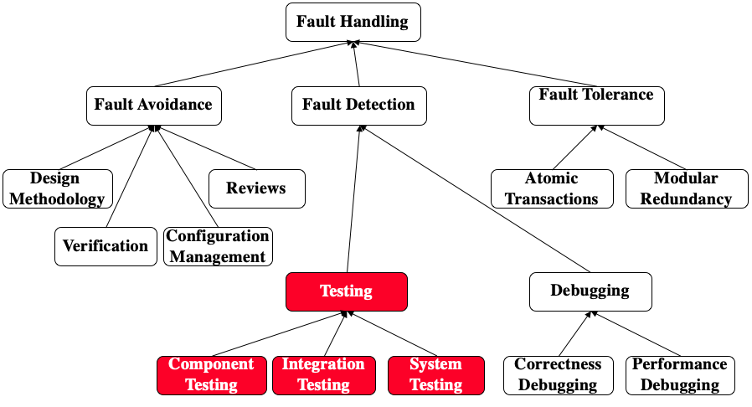
Where does TestING FIT in?
QUality Assurance encompasses testing
Source: Object-Oriented Software Engineering: Conquering Complex and Changing Systems (Bernd Bruegge & Allen H. Dutoit)
SoFloDevCon https://techhubsouthflorida.org/meetups/soflodevcon/ Saturday, April 15, 2023
Notes:
Test levels

Slide 20
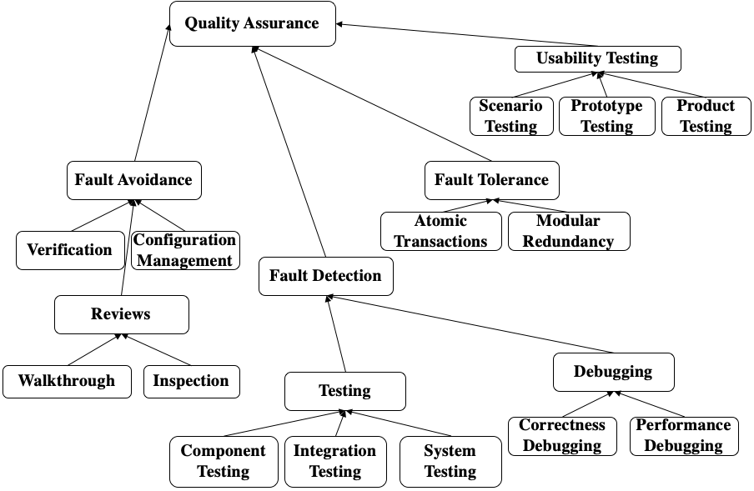
OThER Kinds of TestING
Fault handling techniques
Source: Object-Oriented Software Engineering: Conquering Complex and Changing Systems (Bernd Bruegge & Allen H. Dutoit)
SoFloDevCon https://techhubsouthflorida.org/meetups/soflodevcon/ Saturday, April 15, 2023
Notes:
Test levels

Slide 21
Unit TestS
Designed to test individual components
Cover boundary conditions
Cover edge cases and error conditions
Are small and designed to execute quickly
Many unit test are execute together to create a suite
Are usually created by developers
Coverage Reports are typically used to review them
SoFloDevCon https://techhubsouthflorida.org/meetups/soflodevcon/ Saturday, April 15, 2023
Notes:
Software unit testing is a type of testing in which individual units or components of a software application are tested in isolation from the rest of the application. The purpose of unit testing is to verify that each unit of the software is working as expected and that it meets its functional and non-functional requirements.
During unit testing, each unit is tested using a set of test cases that exercise the code and check its behavior against expected results. The test cases are typically designed to cover a range of scenarios, including typical inputs, edge cases, and error conditions.
Unit testing is usually performed by developers as part of the software development process, and it is often automated using testing frameworks and tools. The benefits of unit testing include the early detection and prevention of defects, improved code quality, and reduced development and maintenance costs.

Slide 22
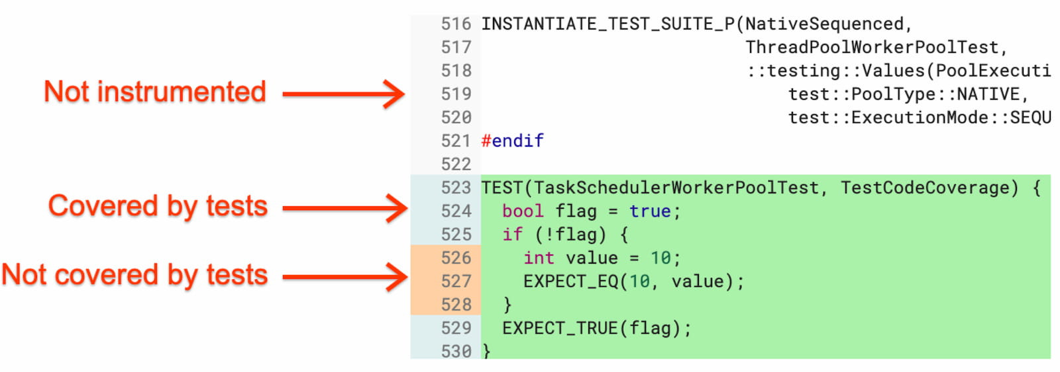
Code COverage Reporting
Source: https://developer.chrome.com/blog/chromium-chronicle-3/
SoFloDevCon https://techhubsouthflorida.org/meetups/soflodevcon/ Saturday, April 15, 2023
Notes:
Code coverage measures how much of the code is used during testing

Slide 23
INTEGRATION TestS
Designed to test multiple components
Can discover compatibility issues between components
Cover edge cases and error conditions
Larger test that can take longer to execute
Created by developers and testing team
Coverage Reports can also be used to review them
Since Unit tests run fast they are run before integration tests
SoFloDevCon https://techhubsouthflorida.org/meetups/soflodevcon/ Saturday, April 15, 2023
Notes:
Software integration testing is a type of testing in which multiple components or modules of a software system are tested together to verify that they work as expected when integrated. The purpose of integration testing is to identify any issues or defects that arise from the interaction between different parts of the software.
During integration testing, the individual components are combined and tested as a group to ensure that they work together seamlessly and that there are no compatibility issues. The testing may be performed using different approaches such as top-down, bottom-up, or a combination of both, depending on the software architecture and the testing objectives.
Integration testing is usually performed after unit testing and before system testing, and it is typically conducted by a separate team of testers. The benefits of integration testing include early detection of defects, improved reliability and quality of the software, and reduced risk of failures in the production environment.

Slide 24
SYSTEM TestS (E2E)
Entired application is tested
Covers functional and non-functional requirements
End-to-end testing to find component interoperability
Usually after integration testing
Takes the longest amount of time to complete
Usually created by Testing team
SoFloDevCon https://techhubsouthflorida.org/meetups/soflodevcon/ Saturday, April 15, 2023
Notes:
Software system testing is a type of testing in which the entire software application is tested as a whole to ensure that it meets the specified requirements and functions as intended in the intended environment. The purpose of system testing is to validate the software application against the defined functional and non-functional requirements, including performance, reliability, security, and usability.
During system testing, the software application is tested from end-to-end to ensure that all the components work together correctly and meet the desired quality standards. This testing typically involves functional testing, non-functional testing, and user acceptance testing (UAT) to ensure that the software meets the expectations of the end-users.
System testing is usually performed after integration testing and before user acceptance testing (UAT) and it may be conducted by a separate team of testers or by the same team that performed the integration testing. The benefits of system testing include the identification of defects and issues that could impact the software's functionality, reliability, and performance, and the verification that the software application meets the specified requirements and quality standards.

Slide 25
Production TestS
Testing in production environment
Feature toggle used enable/disable new feature
Usually subset of users or environments are tested
Any issues identified disable new feature
Reduces risk and need to rollback
Designed by developers as part of the feature
SoFloDevCon https://techhubsouthflorida.org/meetups/soflodevcon/ Saturday, April 15, 2023
Notes:
Software production testing with feature toggles is a testing approach that enables the release of new or modified software features to a subset of users or environments for testing and evaluation, while keeping the existing functionality intact. Feature toggles are a mechanism that allows developers to selectively enable or disable specific features of a software application at runtime, without modifying the code or requiring a full deployment.
During production testing with feature toggles, the new or modified features are released to a limited number of users or environments where they can be tested and evaluated in real-world scenarios. This enables developers to gather feedback, identify and fix any issues, and refine the features before they are released to the wider audience.
The feature toggles are used to control the access to the new or modified features, and they may be configured based on various criteria such as user roles, geographic locations, or user preferences. This enables developers to test and evaluate the features in different scenarios and environments, and to collect feedback from a diverse group of users.
The benefits of production testing with feature toggles include reduced risk and cost associated with software releases, faster feedback and validation of new or modified features, and improved quality and reliability of the software application.

Slide 26
SOFTWARE Feature Toggle
Typically used for production testing
SoFloDevCon https://techhubsouthflorida.org/meetups/soflodevcon/ Saturday, April 15, 2023
Notes:
Feature toggles used for production testing.

Slide 27
SOFTWARE TESTING ANTI-PATTERNS
Ideal Testing Pyramid
Hourglass Anti-Pattern
Hexagonal Anti-Pattern
Ice Cream Cone Anti-Pattern
Reference: https://en.wikipedia.org/wiki/Anti-pattern
SoFloDevCon https://techhubsouthflorida.org/meetups/soflodevcon/ Saturday, April 15, 2023
Notes:
What is an anti-pattern

Slide 28
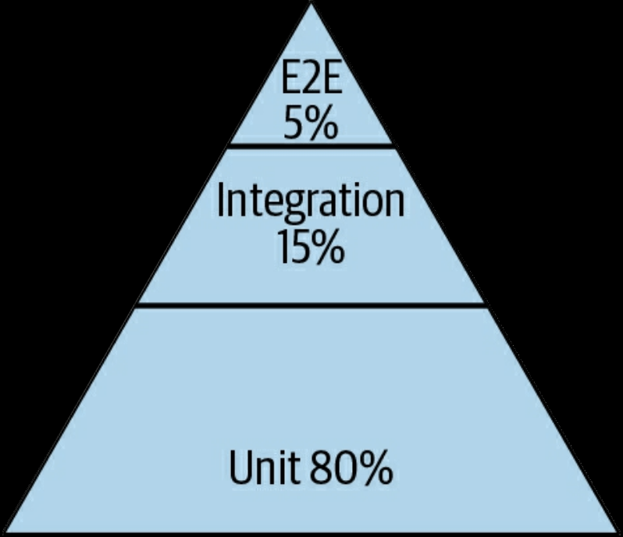
IDEAL Software TESTING PYRAMID
Source: Winters, Titus; Manshreck, Tom; Wright, Hyrum. Software Engineering at Google. O'Reilly Media, 2020
Source: Mike Cohn, Succeeding with Agile: Software Development Using Scrum (New York: Addison-Wesley Professional, 2009
SoFloDevCon https://techhubsouthflorida.org/meetups/soflodevcon/ Saturday, April 15, 2023
Notes:
Testing pyramid from Google which is based on Mike Cohn’s

Slide 29
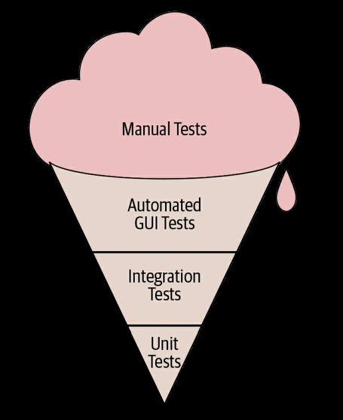
Software Testing
“Ice Cream Cone” Anti-Pattern
Source: Winters, Titus; Manshreck, Tom; Wright, Hyrum. Software Engineering at Google. O'Reilly Media, 2020
SoFloDevCon https://techhubsouthflorida.org/meetups/soflodevcon/ Saturday, April 15, 2023
Notes:
Ice cream cone testing anti-pattern
Often appears on project that were prototyped quickly and rushed to production never stopping to address testing technical debt.

Slide 30
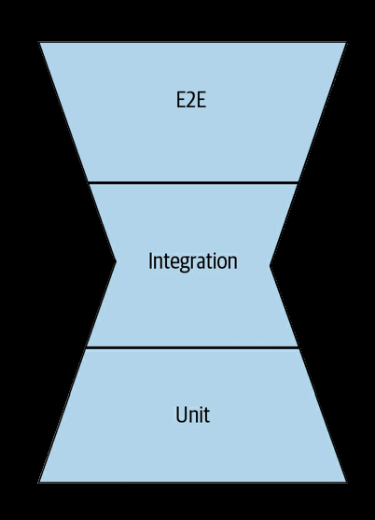
Software Testing
“Hourglass” Anti-Pattern
Source: Winters, Titus; Manshreck, Tom; Wright, Hyrum. Software Engineering at Google. O'Reilly Media, 2020
SoFloDevCon https://techhubsouthflorida.org/meetups/soflodevcon/ Saturday, April 15, 2023
Notes:
Hourglass testing anti-pattern
Better than ice cream cone, but dependance on E2E tests creates more failures that would be identified with integration tests.

Slide 31
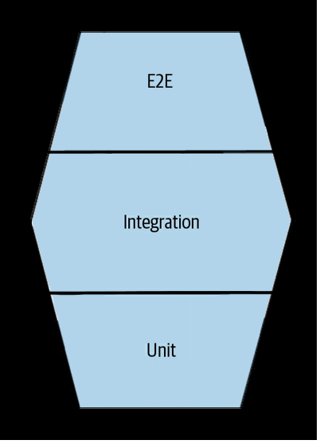
Software Testing
“HEXagonAL” Anti-Pattern
Source: Eugenio Alvarez, Software Engineering: Integrating Software Testing, SoFloDevCon 2023
SoFloDevCon https://techhubsouthflorida.org/meetups/soflodevcon/ Saturday, April 15, 2023
Notes:
Hexagonal testing anti-pattern
Initial project rushed to production without testing.
An integration test harness was provided to developers causing them to choose the easy path. Very little refactor for unit tests. Longer time executing tests.

Slide 32
UNIT TESTING
My friend works at a large social media company says that they do not write unit test
Large social media company is less concerned about errors in production
Feature toggles used extensively in production
Multiple deploys for per day to allow for quick fixes
SoFloDevCon https://techhubsouthflorida.org/meetups/soflodevcon/ Saturday, April 15, 2023
Notes:
The journey from default path to ideal is unique to each organization.

Slide 33

IF it ain’t broke don’t fix it
THIS is HOW WE WOULD GET AROUND if we followed the SAYING
Source: https://commons.wikimedia.org/wiki/File:Horse_(Cleveland_Bay)_Drawn_Clarence_(Brougham)_Carriage_%26_Victoria_Memorial,_Buckingham_Palace,_Westminster,_London_(3795290693).jpg
SoFloDevCon https://techhubsouthflorida.org/meetups/soflodevcon/ Saturday, April 15, 2023
Notes:
It has always been done this way.

Slide 34

Technology Hatchling IMPRINTING
I have worked at enterprise CompanIes and They all do it This way
WE have Always DONE it
This way
NO ONE ACTUALLY DOES UNIT TESTING
NOBODY DOES Testing this way
SoFloDevCon https://techhubsouthflorida.org/meetups/soflodevcon/ Saturday, April 15, 2023
Notes:
It has always been done this way.

Slide 35


Default Desire PATH
THE Beaten PATH IS EASIER
https://en.wikipedia.org/wiki/Desire_path
SoFloDevCon https://techhubsouthflorida.org/meetups/soflodevcon/ Saturday, April 15, 2023
Notes:
A desire path (often referred to as a desire line in transportation planning), also known as a game trail, social trail, fishermen trail, herd path, cow path, elephant path, goat track, pig trail, use trail and bootleg trail, is an unplanned small trail created as a consequence of mechanical erosion caused by human or animal traffic. The path usually represents the shortest or the most easily navigated route between an origin and destination, and the width and severity of its surface erosion are often indicators of the traffic level it receives.

Slide 36
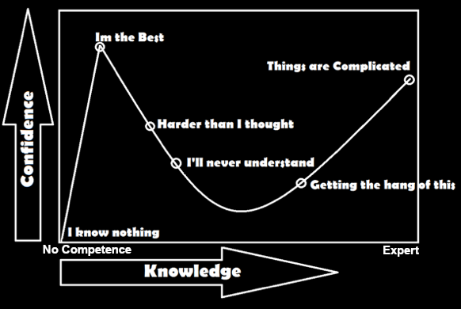
Dunning-kruger Effect
Reference: https://en.wikipedia.org/wiki/Dunning%E2%80%93Kruger_effect
SoFloDevCon https://techhubsouthflorida.org/meetups/soflodevcon/ Saturday, April 15, 2023
Notes:
Dunning-Krugger effect.

Slide 37
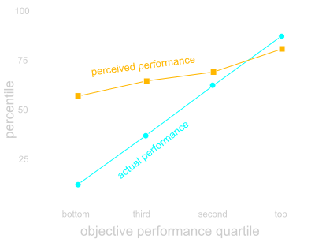
Dunning-kruger Effect
Source: https://commons.wikimedia.org/wiki/File:Dunning-kruger_effect_-_percentile.svg
SoFloDevCon https://techhubsouthflorida.org/meetups/soflodevcon/ Saturday, April 15, 2023
Notes:
Dunning-Krugger effect.

Slide 38
UNIT TEST USAGE VARIES BY LANGUAGE
Source: JetBrain’s State of Developer Ecosystem Report 2022
SoFloDevCon https://techhubsouthflorida.org/meetups/soflodevcon/ Saturday, April 15, 2023
Notes:
JetBrain’s The State of Developer Ecosystem 2022.
Report was created based on the responses of 29,269 developers from around the world who participated in May–July 2022.

Slide 39
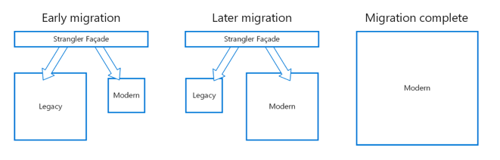
How to get to a best STATe of TESTING
StranglER MIGRATION PATTERN
https://learn.microsoft.com/en-us/azure/architecture/patterns/strangler-fig
SoFloDevCon https://techhubsouthflorida.org/meetups/soflodevcon/ Saturday, April 15, 2023
Notes:
The journey from default path to ideal is unique to each organization.

Slide 40
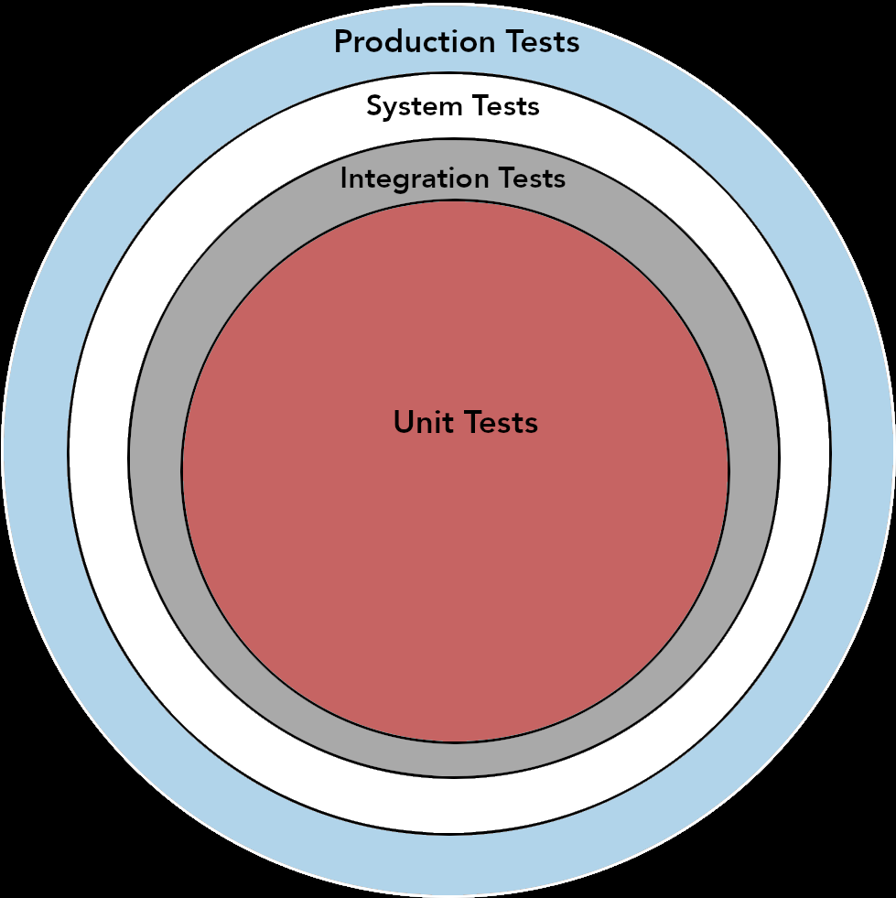
USING Test Levels AND THE Strangler Pattern
SoFloDevCon https://techhubsouthflorida.org/meetups/soflodevcon/ Saturday, April 15, 2023
Notes:
Test levels

Slide 41
2022 SURVEY Tests Performed
Source: JetBrain’s State of Developer Ecosystem Report 2022
SoFloDevCon https://techhubsouthflorida.org/meetups/soflodevcon/ Saturday, April 15, 2023
Notes:
JetBrain’s The State of Developer Ecosystem 2022.
Report was created based on the responses of 29,269 developers from around the world who participated in May–July 2022.

Slide 42
Inexperienced UNIT Testing
Hire Interns to do our unit testing
Have a separate development team do unit tests
Do unit test in separate sprint/cycle
Unit test generate tons of output to log
Example: Hello from Unit test so and so.
Running unit test with full debug enabled
SoFloDevCon https://techhubsouthflorida.org/meetups/soflodevcon/ Saturday, April 15, 2023
Notes:
The journey from default path to ideal is unique to each organization.

Slide 43
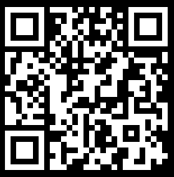
SOFTWARE ENGINEERING Management:
Integrating SOFTWARE TESTING
South Florida Developer Conference
https://techhubsouthflorida.org/meetups/soflodevcon/
Thank You
www.linkedin.com/in/ealvarez
SoFloDevCon https://techhubsouthflorida.org/meetups/soflodevcon/ Saturday, April 15, 2023

Slide 44
REFERENCES
Software Engineering at Google: Lessons Learned from Programming Over TIme (2020)
https://www.amazon.com/Software-Engineering-Google-Lessons-Programming/dp/1492082791
The five trademarks of agile organizations (McKinsey & Company)
https://www.mckinsey.com/capabilities/people-and-organizational-performance/our-insights/the-five-trademarks-of-agile-organizations
The New New Product Development Game. Harvard Business Review Hirotaka Takeuchi & Ikujiro Nonaka. (1986)
http://hbr.org/1986/01/the-new-new-product-development-game/
Critical Chain Eliyahu M. Goldratt. (1997)
http://www.amazon.com/Critical-Chain-Eliyahu-M-Goldratt/dp/0884271536/
Object-Oriented Software Engineering: Conquering Complex and Changing Systems (Bernd Bruegge & Allen H. Dutoit)
https://www.amazon.com/Object-Oriented-Software-Engineering-Conquering-Changing/dp/0134897250
Flexera State of Tech Spend Report
https://info.flexera.com/FLX1-REPORT-State-of-Tech-Spend
SoFloDevCon https://techhubsouthflorida.org/meetups/soflodevcon/ Saturday, April 15, 2023

Slide 45
REFERENCES
The “Right” CEO: A Corporate Life Cycle Perspective (Aswath Damodaran)
https://aswathdamodaran.blogspot.com/2021/12/managing-across-corporate-life-cycle.html
Product Life Cycle by the 280 Group
https://280group.com/product-management-blog/the-power-of-the-product-lifecycle-a-look-at-the-4-key-stages-of-the-plc/
Inversion of control software design pattern
https://en.wikipedia.org/wiki/Inversion_of_control
ISTQB Software Testing Certification
https://www.istqb.org/certifications/certification-list/
Software Static Analysis
https://www.perforce.com/blog/sca/what-static-analysis
Software Composition Analysis
https://fossa.com/blog/framework-for-evaluating-software-composition-analysis-tools/
SoFloDevCon https://techhubsouthflorida.org/meetups/soflodevcon/ Saturday, April 15, 2023

