Slide 1




· SOFLO DEVCON 2024
Saturday · May 4, 2024 · DAVIE, FL · 8:00AM - 8:00PM
SCA
Software Composition Analysis
3:40PM - 4:40PM
Notes:
Software Composition Analysis (SCA)
A presentation for the South Florida Developer Conference (SoFloDevCon) 2024.
Saturday, May 4, 2024

Slide 2
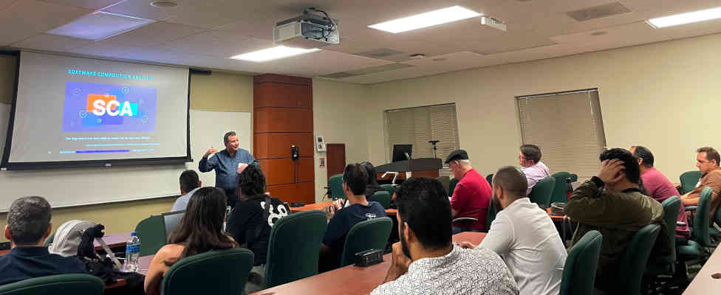
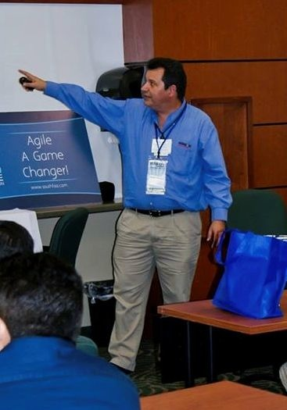








Eugenio Alvarez
A South Florida software engineering professional. Experienced in organizational design, software design, construction, and deployment. Extensive knowledge of Java. Proponent of Unit testing. An advocate for Agile Software Engineering methods using Kanban and Scrum.
www.linkedin.com/in/ealvarez
South Florida Developer Conference (SoFlo Dev Con 2024) Saturday, May 4, 2024
Notes:
Organizer of Miami JVM Group (Miami Java User Group)

Slide 3
INTRODUCTION
Market forces are driving companies to develop secure software faster to gain a competitive advantage.
The software development community has found that Software Component Analysis tooling can improve the competitive need for increased security and speed.
Software Composition Analysis tooling provides an efficient way to reduce security threats from open-source software components.
South Florida Developer Conference (SoFlo Dev Con 2024) Saturday, May 4, 2024

Slide 4
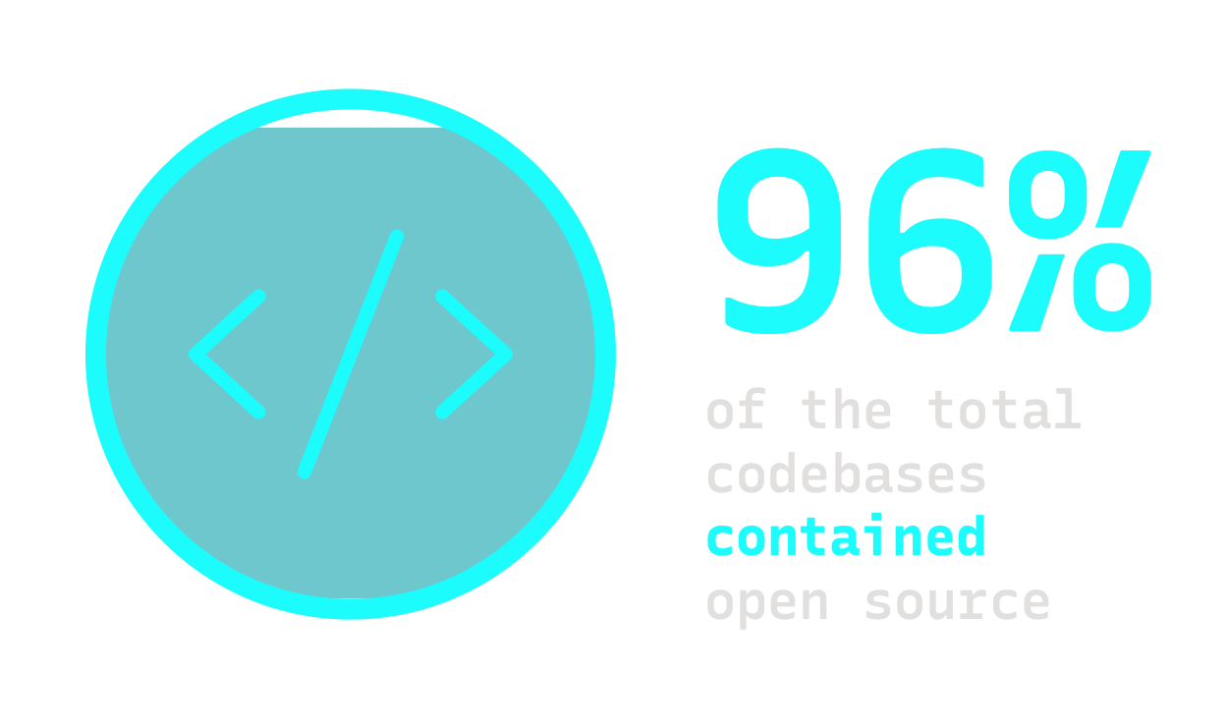
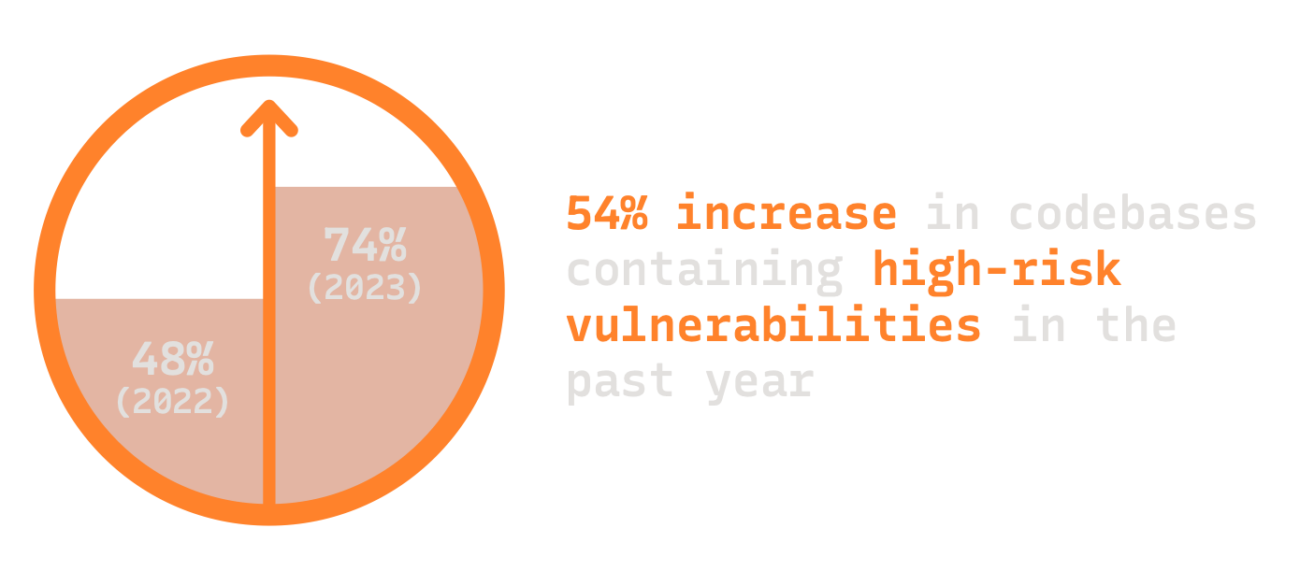
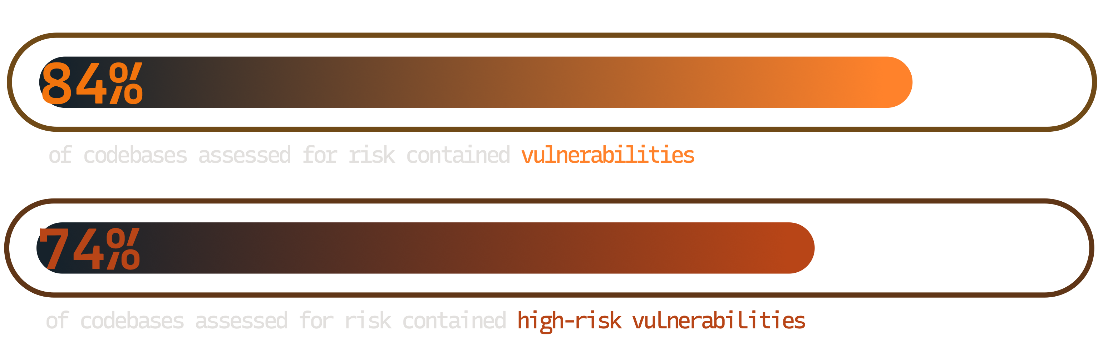
Open SourcE Exposure
Source: Synopsys Open Source Security and Risk Report 2024
South Florida Developer Conference (SoFlo Dev Con 2024) Saturday, May 4, 2024
Notes:
OSSRA analyzed 1000+ codebases
96% contained open source, 84% contained vulnerabilities
74% contained high-risk vulnerabilities, up from 48% in 2022

Slide 5
Open Source COMPONENTS
PER Application (2016-2024)
Source: Meta-analysis from Synopsys BlackDuck Open Source Security and Risk Reports 2016-2024
South Florida Developer Conference (SoFlo Dev Con 2024) Saturday, May 4, 2024
Notes:
So you think you don’t have much open source in your projects?
Meta-Analysis from Synopsys / Blackduck Open Source Security and Risk Reports (OSSRA) 2016-2024
OSSRA analyzed 1000+ codebases in the latest report from February 20, 2024
Sonatype reports average java application has 148 dependencies with around 90% of the 148 being open source

Slide 6
Why so Many Open Source COMPONENTS
AVERAGE OF 526
Source: Synopsys BlackDuck Open Source Security and Risk Reports 2024
Average of 148
for java Applications
(ESt. 90% of that IS Open Source)
Source: Sonatype 9th Annual State of the Software Supply Chain Report, Nov 2023
Median of 683
for javaSCRIPT Applications
(From a median of 10 direct)
Source: GitHub Octoverse Report, Dec 2020
South Florida Developer Conference (SoFlo Dev Con 2024) Saturday, May 4, 2024
Notes:
So you think you don’t have much open source in your projects?
OSSRA analyzed 1000+ codebases in the latest report from February 20, 2024
Sonatype reports average java application has 148 dependencies with around 90% of the 148 being open source

Slide 7

Transitive Dependencies
“Do you realize how many dependencies?”
App
A
B
C
AA
AB
BC
CA
CB
CC
BCA
BCB
South Florida Developer Conference (SoFlo Dev Con 2024) Saturday, May 4, 2024

Slide 8

“A Jedi uses the Force for knowledge and defense, never for attack.”
Source: https://www.starwars.com/news/the-starwars-com-10-best-yoda-quotes
https://www.starwars.com/databank/the-force
South Florida Developer Conference (SoFlo Dev Con 2024) Saturday, May 4, 2024

Slide 9
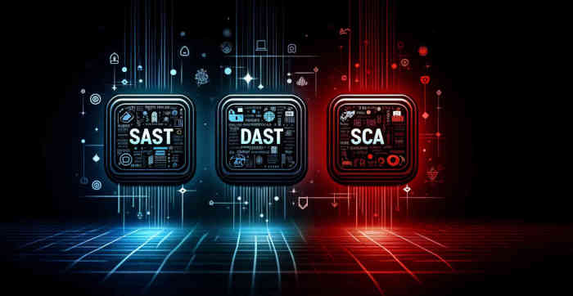
secure Coding TOol Chest
SAST: Static Application Security Testing
DAST: Dynamic Application Security Testing
SCA: Software Composition Analysis
South Florida Developer Conference (SoFlo Dev Con 2024) Saturday, May 4, 2024

Slide 10
SCA USE-CASES
Identify open source components
Identify security issues in open source components
Identify license issues in open source components
Mitigate open-source issues
Manage open-source quality
Audits for M&A (Mergers and Acquisitions)
Monitor vendor software
South Florida Developer Conference (SoFlo Dev Con 2024) Saturday, May 4, 2024

Slide 11

Software COmposition Analysis
combined with
Static Application Scan
Some SCA tools use SAST to confirm that code is vulnerable
Be careful with false negatives
Dynamic code can only be confirmed with runtime analysis
South Florida Developer Conference (SoFlo Dev Con 2024) Saturday, May 4, 2024

Slide 12

JUST a Simple UpdatE?
H2 database
JUnit4 vs JUnit5
Spring Framework
Angular JS
Apache Struts
MAYBE or MAYBE NOT
South Florida Developer Conference (SoFlo Dev Con 2024) Saturday, May 4, 2024

Slide 13
CVE
(Common Vulnerabilities and Exposures)
Publicly released list of known cybersecurity vulnerabilities
Issued by vendors and researchers
Each CVE has an identification number “identifier”
A CVE does not include technical data
Databases of public disclosed CVEs (multiple)
NVD (National Vulnerabilities Database) USA
Source: https://www.cve.org/
South Florida Developer Conference (SoFlo Dev Con 2024) Saturday, May 4, 2024

Slide 14
SBOM Formats
(Software Bill of Materials)
CycloneDX
Open source machine-readable by OWASP
SPDX® (Software Package Data Exchange)
Open standard ISO/IEC 5692:2021 by Linux Foundation
Source: https://cyclonedx.org/
Source: https://spdx.dev/
South Florida Developer Conference (SoFlo Dev Con 2024) Saturday, May 4, 2024

Slide 15
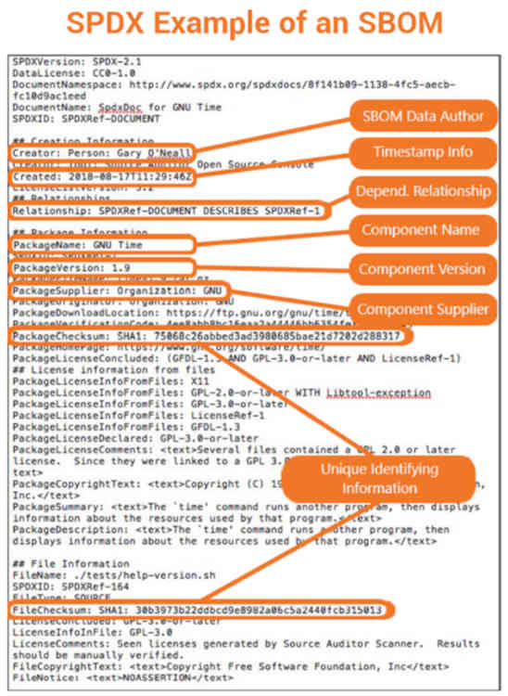
Example SBOM?
Source: https://www.thesslstore.com/blog/sbom-an-up-close-look-at-a-software-bill-of-materials/
South Florida Developer Conference (SoFlo Dev Con 2024) Saturday, May 4, 2024

Slide 16
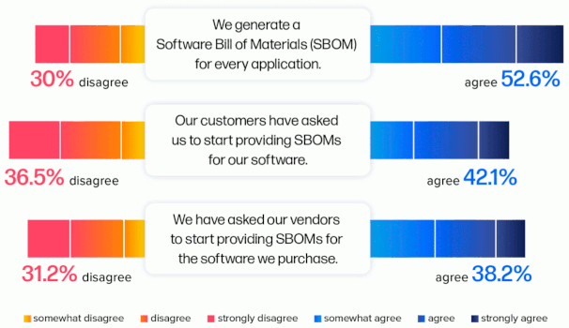
SBOM USAGE
Survey Says
Source: Sonatype 9th Annual State of the Software Supply Chain Report, Nov 2023
South Florida Developer Conference (SoFlo Dev Con 2024) Saturday, May 4, 2024
Notes:
SBOM usage is growing, but there is still a ways to go.

Slide 17
SBOM Adoption DRIVERs
Presidential Executive order 14028 (Cybersecurity)
An SBOM as part of Secure Development
Regulatory Compliance
Risk management via CI/CD supply chain monitoring
Customer Assurance
Source: https://www.whitehouse.gov/briefing-room/presidential-actions/2021/05/12/executive-order-on-improving-the-nations-cybersecurity/
South Florida Developer Conference (SoFlo Dev Con 2024) Saturday, May 4, 2024
Notes:
SBOM usage drivers

Slide 18


Where is SCA in Build PIPELINE
Application Security Pipeline
Plan
Code
Build
Test
Pre-
release
Deploy
Operate
& monitor
· IDE Integration
· Static analysis
and SCA
· SAST and SCA
· SCA Container
scan
Source: https://vulcan.io/blog/ci-cd-security-5-best-practices/
South Florida Developer Conference (SoFlo Dev Con 2024) Saturday, May 4, 2024

Slide 19
Open Source LICENSE IDENTIFICATION and Management
GNU GPL (License conflict)
MIT License
Apache License 2.0
BSD License variants
Mozilla Public License 2.0
Public Domain
GNU Lesser (As long as the code is unmodified)
Source: https://www.gnu.org/licenses/gpl-3.0.en.html
South Florida Developer Conference (SoFlo Dev Con 2024) Saturday, May 4, 2024
Notes:
What happens with GPL license conflict.
Vendor or customer scan. Not acceptable.
Example with transitive dependency with different license. Main license Apache, subcomponent with GPL.

Slide 20
Why GPL causes a conflict
Copyleft Requirement: Any derivative work created from a GPL licensed cost must be distributed under the GPL which includes the source code of the entire derivative work.
Examples:
Linksys/Cisco WRT54G
Samsung Smart TVs
Source: https://www.fsf.org/news/2008-12-cisco-suit
South Florida Developer Conference (SoFlo Dev Con 2024) Saturday, May 4, 2024

Slide 21
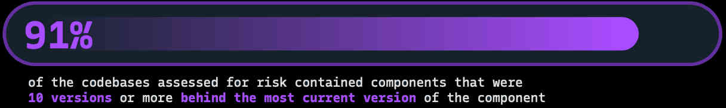
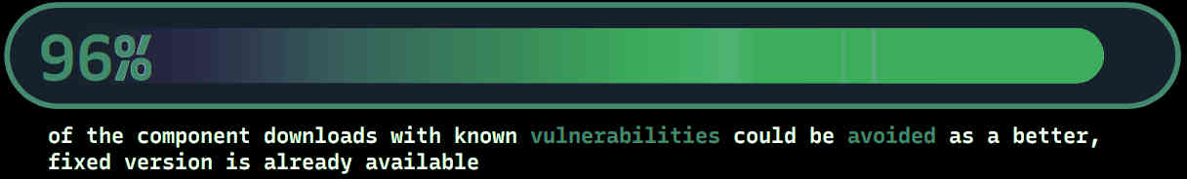
OPEN SOURCE Version management
Source: Synopsys Open Source Security and Risk Report, Feb 2024
Source: Sonatype 9th Annual State of the Software Supply Chain Report, Nov 2023
SCA Tools recommend the latest version
South Florida Developer Conference (SoFlo Dev Con 2024) Saturday, May 4, 2024
Notes:
Better updating of open-source components is needed.
No updates or constant security updates are both a problem.

Slide 22
OPEN SOURCE QUality management
“The fact that 18.6% of [open source] projects stopped being maintained in the last year
highlights the need to not only choose good dependencies, but monitor those
dependencies for changes in their quality.” *
Source: Sonatype 9th Annual State of the Software Supply Chain Report, Nov 2023
* maintained as defined by the OpenSSF (Open Source Security Foundation) scorecard
South Florida Developer Conference (SoFlo Dev Con 2024) Saturday, May 4, 2024
Notes:
Better updating of open source components is needed.

Slide 23
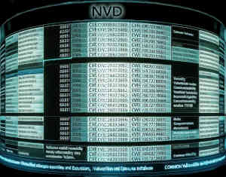






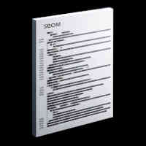


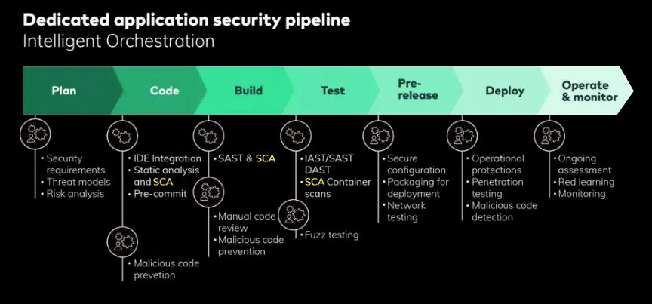


Continuous Monitoring and NOTIFICATION
Email
24/7 Monitoring
Text
NVD et al.
SCA
Service
SBOM
Pipeline
South Florida Developer Conference (SoFlo Dev Con 2024) Saturday, May 4, 2024
Notes:
A SCA Service will monitor 24/7 and send notifications
GitHub Dependabot integration

Slide 24

SCA SCAN for VENDOR SOFTWARE
Source: DALL·E
SBOM for VENDOR SOFTWARE RECOMMENDED
South Florida Developer Conference (SoFlo Dev Con 2024) Saturday, May 4, 2024
Notes:
Black duck scan for vendor installed software without SBOM. Beware of obfuscated code. It is recommended to get an SBOM from the vendor.

Slide 25
THIRD-PARTY RISK MANAGEMENT (TPRM)
“98% of organizations have a relationship with a third party that has been breached.”
Source: SecurityScoreCard Global Third-Party Cybersecurity Breaches Report, Feb 2024
Third-party breaches by industry:
43% Technology & Telecommunications
30% Financial Services
29% Overall cross-industry rate
Source: SecurityScoreCard Global Third-Party Cybersecurity Breaches Report, Feb 2024
Stop depending on a questionnaires for TPRM
Vendor SBOMs can be monitored 24/7 by SCA Tooling
South Florida Developer Conference (SoFlo Dev Con 2024) Saturday, May 4, 2024

Slide 26
M&A Use-case
Searching for code vulnerabilities
Searching for licensing conflicts
Experience
Scan and correct before initial engagement
Third-party software will be used to audit
Do not expect to explain any risk assessment
South Florida Developer Conference (SoFlo Dev Con 2024) Saturday, May 4, 2024
Notes:
Private Equity uses SCA to make sure that any potential investment is sound.

Slide 27
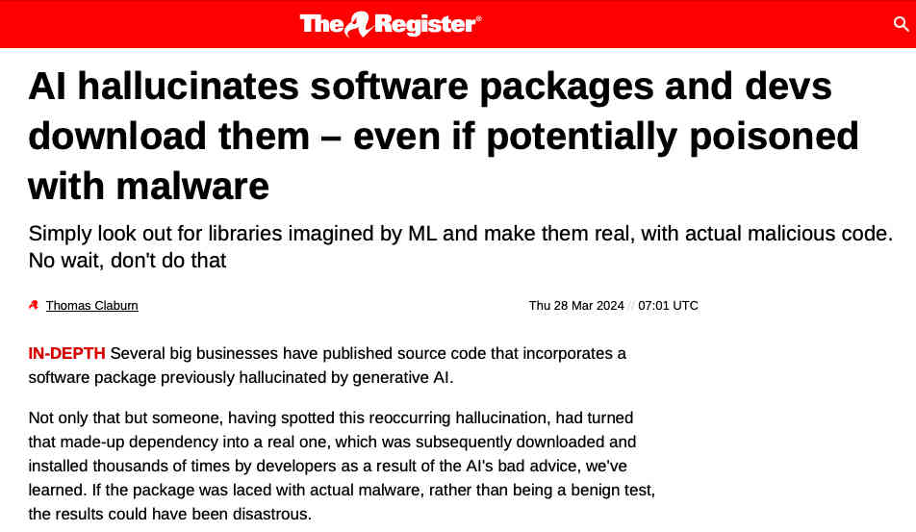
AI Hallucinations
Source: https://www.theregister.com/2024/03/28/ai_bots_hallucinate_software_packages/
South Florida Developer Conference (SoFlo Dev Con 2024) Saturday, May 4, 2024

Slide 28
SCA TOOLS
South Florida Developer Conference (SoFlo Dev Con 2024) Saturday, May 4, 2024

Slide 29
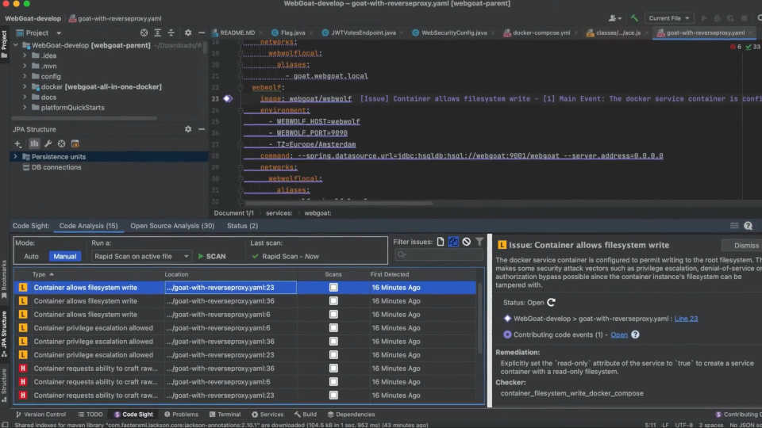
SCA IDE PlugINS
Source: https://youtu.be/6cxi96CJB14
South Florida Developer Conference (SoFlo Dev Con 2024) Saturday, May 4, 2024
Notes:
SCA IDE Plugin: Synopsys Code Sight IDE plugin
Frame from video: Code Sight IDE Plugin for Application Security Testing | Synopsys

Slide 30
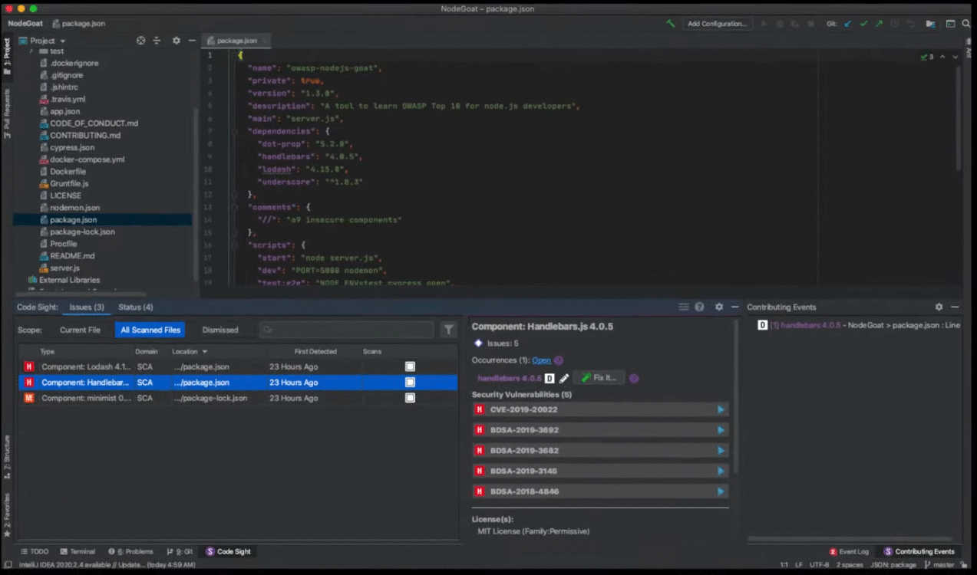
SCA IDE PlugINS
Source: https://youtu.be/W9BHyXYw3vQ
South Florida Developer Conference (SoFlo Dev Con 2024) Saturday, May 4, 2024
Notes:
SCA IDE Plugin: Synopsys/BlackDuck Code Sight IDE plugin
Frame from video: Secure and manage open source risks in applications and contains with Black Duck SCA

Slide 31
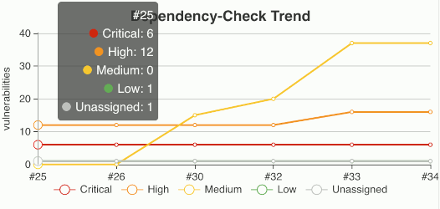
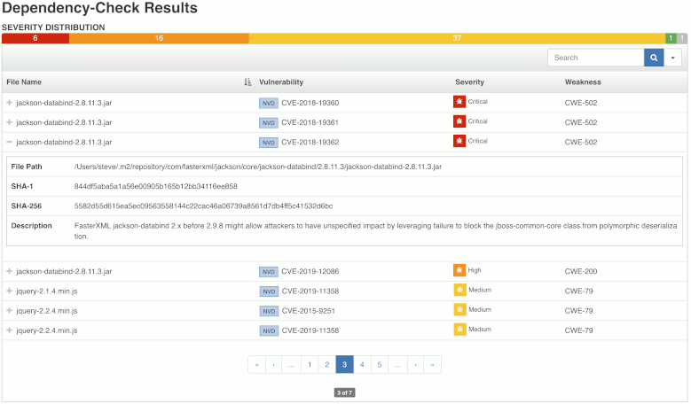
DEPendency CHECK
Source: https://plugins.jenkins.io/dependency-check-jenkins-plugin/
South Florida Developer Conference (SoFlo Dev Con 2024) Saturday, May 4, 2024
Notes:
Dependency Check can be used as part of a Jenkins pipeline build.
Can stop a build if there are critical.

Slide 32

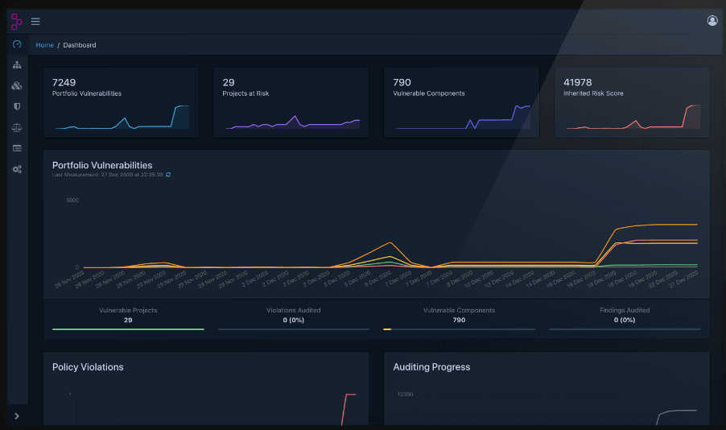
DEPendency TRACK
Source: https://www.dependencytrack.org/
South Florida Developer Conference (SoFlo Dev Con 2024) Saturday, May 4, 2024
Notes:
SBOM is sent to Dependency Track to monitor for vulnerabilities.

Slide 33
DEPendency TRACK DEMO OVERVIEW
Step 1: Download application code from GitHub
Step 2: Create SBOM from project
Step 3: Upload SBOM to Dependency Track
Step 4: Observe project’s CVEs in Dependence Track
South Florida Developer Conference (SoFlo Dev Con 2024) Saturday, May 4, 2024
Notes:
Get Dependency Track up and running.
Create an SBOM from a project
Upload the SBOM to Dependency Track.
Observer identified CVEs in Dependency Track UI.

Slide 34
Running DEPendency TRACK
Step 1: Requirements
Windows/Mac/Linux with
Memory: Recommend 16 gigabytes
Step 2: Download/install Docker
Step 3: Download/install Dependency Track Docker image
curl -LO https://dependencytrack.org/docker-compose.yml
docker-compose up -d
Step 4: Download/install git
Step 5: Download/install npm
Step 6: Download/install cdxgen
npm install -g @cyclonedx/cdxgen
South Florida Developer Conference (SoFlo Dev Con 2024) Saturday, May 4, 2024

Slide 35
WhAT HAPPENS When DEPendency TRACK
is STARTED the First TIME
Downloading the Docker compose file
curl -LO https://dependencytrack.org/docker-compose.yml
Starts Docker container
docker-compose up -d
An embedded H2 database is the default
Options: PostgreSQL or Microsoft SQL Server
Initial startup downloads CVE database
Database download takes at least 30 mins.
South Florida Developer Conference (SoFlo Dev Con 2024) Saturday, May 4, 2024

Slide 36
DEPendency TRACK API SETUP
Step 1: Login with user/password: admin/admin
http://localhost:8080/
Default: admin/admin
Step 2: Dependency Track needs time to download DB (min. 30 mins)
Step 3: Change admin password
Step 4: Retrieve API key
Home / Administration / Access Management / Teams / Automation
Note: UI: localhost:8080 / API: localhost:8081
South Florida Developer Conference (SoFlo Dev Con 2024) Saturday, May 4, 2024

Slide 37
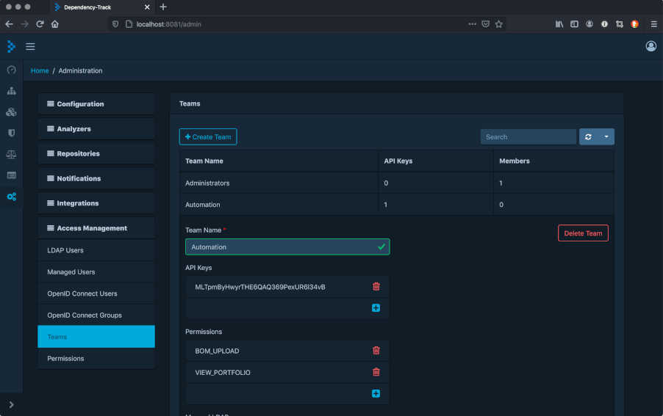
DEPendency TRACK API Retrieve API KEY
Note: Add “PROJECT_CREATION_UPLOAD” permission
South Florida Developer Conference (SoFlo Dev Con 2024) Saturday, May 4, 2024

Slide 38
CrEATING THE SBOM
Why use cdxgen?
Multi-language support:
Python, C/C++, Java, JavaScript, Go, Ruby, Rest and more..
Command line:
cdxgen -o bom.json
Maven plugin (Java maven based projects):
mvn cyclonedx:makeAggregateBom
Chose random Java application
git clone https://github.com/neo-nico-neiman/fullstack-booking.git
South Florida Developer Conference (SoFlo Dev Con 2024) Saturday, May 4, 2024

Slide 39
Sending SBOM via CURL
curl -X "POST" "http://localhost:8081/api/v1/bom" ^
-H "Content-Type: multipart/form-data" ^
-H "X-Api-Key: odt_mt3zaRUX48bKPt82IBlQyhzluk7YRknG" ^
-F "autoCreate=true" ^
-F "projectName=fullstack-booking-cdxgen" ^
-F "projectVersion=2.9" ^
-F "bom=@bom.json"
* Window batch file example
South Florida Developer Conference (SoFlo Dev Con 2024) Saturday, May 4, 2024

Slide 40
DEPendency TRACK
DeMO TIME!
South Florida Developer Conference (SoFlo Dev Con 2024) Saturday, May 4, 2024
Notes:
Get Dependency Track up and running.
Create an SBOM from a project
Upload the SBOM to Dependency Track.
Observer CVE identified

Slide 41

SOFTWARE Composition Analysis
South Florida Developer Conference (SoFlo Dev Con)
Thank You
www.linkedin.com/in/ealvarez
South Florida Developer Conference (SoFlo Dev Con 2024) Saturday, May 4, 2024

Slide 42
REFERENCES
Synopsys 2024 Open Source Security and Risk Analysis Report (OSSRA)
https://www.synopsys.com/content/dam/synopsys/sig-assets/reports/rep-ossra-2024.pdf
Sonatype 2023 9th Annual State of the Software Supply Chain Report
https://www.sonatype.com/hubfs/2023 Sonatype- 9th Annual State of the Software Supply Chain- Update.pdf
GitHub Octoverse Report 2020
https://octoverse.github.com/2020/
The StarWars.com 10: Best Yoda Quotes
https://www.starwars.com/news/the-starwars-com-10-best-yoda-quotes
CVE (Common Vulnerabilities and Exposures)
https://www.cve.org
OWASP CycloneDX Software Bill of Materials (SBOM) Standard
https://cyclonedx.org/
South Florida Developer Conference (SoFlo Dev Con 2024) Saturday, May 4, 2024

Slide 43
REFERENCES
System Package Data Exchange (SPDX®) (SBOM) Standard
https://spdx.dev/
SBOM: An Up-Close Look at a Software Bill of Materials
https://www.thesslstore.com/blog/sbom-an-up-close-look-at-a-software-bill-of-materials/
Executive order 14028 (Cybersecurity)
https://www.whitehouse.gov/briefing-room/presidential-actions/2021/05/12/executive-order-on-improving-the-nations-cybersecurity/
CI/CD security - 5 best practices
https://vulcan.io/blog/ci-cd-security-5-best-practices/
GNU General Public License
https://www.gnu.org/licenses/gpl-3.0.en.html
GPL Violation law suit
https://www.fsf.org/news/2008-12-cisco-suit
South Florida Developer Conference (SoFlo Dev Con 2024) Saturday, May 4, 2024

Slide 44
REFERENCES
The Register: AI hallucinates software packages
https://www.theregister.com/2024/03/28/ai_bots_hallucinate_software_packages/
SecurityScoreCard Global Third-Party Cybersecurity Breaches Report, Feb 2024
https://securityscorecard.com/wp-content/uploads/2024/02/Global-Third-Party-Cybersecurity-Breaches-Final-1.pdf
Code Sight IDE Plugin for Application Security Testing | Synopsys
https://youtu.be/6cxi96CJB14
Secure and manage open source risks in applications and contains with Black Duck SCA
https://youtu.be/W9BHyXYw3vQ
OWASP Dependency Check
https://owasp.org/www-project-dependency-check/
https://plugins.jenkins.io/dependency-check-jenkins-plugin/
OWASP Dependency Track
https://owasp.org/www-project-dependency-track/
https://www.dependencytrack.org/
CycloneDX: A multi-language tool that can create SBOM (Bill of Materials) in CycloneDX format.
https://cyclonedx.github.io/cdxgen/
South Florida Developer Conference (SoFlo Dev Con 2024) Saturday, May 4, 2024

