Slide 1
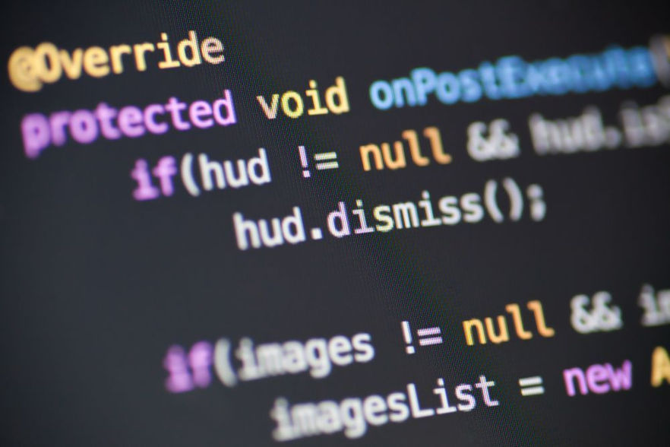
Review Java ECOSYSTEM TRENDS 2023
Miami JVM Group
https://www.meetup.com/miami-java-user-group/
Wednesday, March 29, 2023
Notes:
Review Java Ecosystem Trends 2023
A presentation for the Miami JVM Group. Wednesday, March 29, 2023

Slide 2

Thanks Marcelo
Marcelo Olivas was the organizer of the Miami JVM User Group aka (Miami Java User Group) from Jan 2011 to Feb 2023. We appreciate the work that he put into this group.
https://www.linkedin.com/in/marceloolivas/
Notes:
Thanks to Marcelo for keeping the JVM Group alive for years.

Slide 3
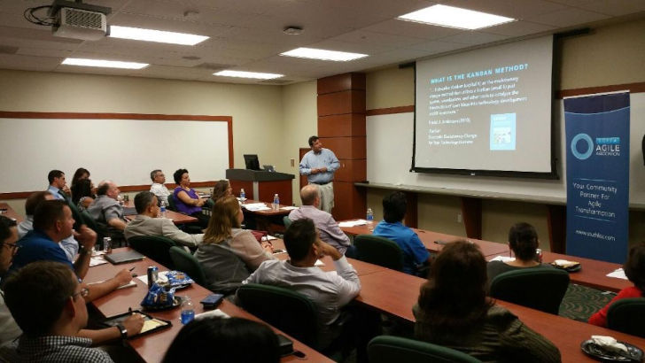
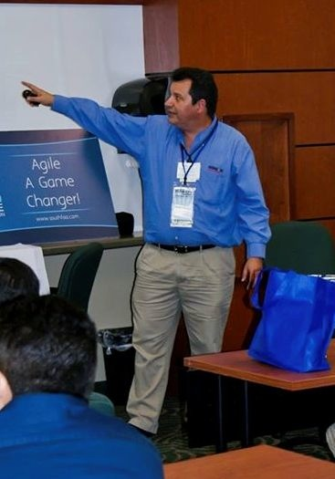





Eugenio Alvarez
A South Florida Software Engineering Management professional with 25 plus years of experience in the design, construction and deployment of software. Started working with Java in 1997. Unit test infected since 1999. An advocate for Agile Software Engineering methods using Kanban and Scrum.
www.linkedin.com/in/ealvarez
Notes:
New organizer of Miami JVM Group

Slide 4
We WILL DISCUSS
Java versions
Java distributions
Java web frameworks
Java build systems
Other languages commonly used with Java
Miami JVM Group https://www.meetup.com/miami-java-user-group/ Wednesday, March 29, 2023

Slide 5
Java Versions
Version | Release date | End of Free Updates | Extended Support
Java SE 8 (LTS) | 18th March 2014 | (OpenJDK currently maintained by Red Hat)^{[19]} March 2022 for Oracle (commercial) December 2030 for Oracle (non-commercial) December 2030 for Azul^{[12]} May 2026 for IBM Semeru^{[14]} At least May 2026 for Eclipse Adoptium^{[10]} At least May 2026 for Amazon Corretto^{[11]} | December 2030 for Oracle^{[9]} November 2026 for Red Hat^{[13]}
Java SE 11 (LTS) | 25th September 2018 | (OpenJDK currently maintained by Red Hat)^{[20]} September 2026 for Azul^{[12]} October 2024 for IBM Semeru^{[14]} At least October 2024 for Eclipse Adoptium^{[10]} At least September 2027 for Amazon Corretto^{[11]} At least October 2024 for Microsoft^{[21][15]} | September 2026 for Oracle^{[9]} September 2026 for Azul^{[12]} October 2024 for Red Hat^{[13]}
Java SE 17 (LTS) | 14th September 2021 | (OpenJDK currently maintained by SAP)^{[24]} September 2029 for Azul^{[12]} October 2027 for IBM Semeru^{[14]} At least September 2027 for Microsoft^{[15]} At least September 2027 for Eclipse Adoptium ^{[10]} | September 2029 or later for Oracle^{[9]} September 2029 for Azul^{[12]} October 2027 for Red Hat^{[13]}
Java SE 20 | 21st March 2023 | September 2023 for OpenJDK | —
Java SE 21 (LTS) | September 2023 | September 2028 | September 2031 for Oracle^{[9]}
Source: https://en.wikipedia.org/wiki/Java_version_history
Notes:
New long-term support (LTS) version coming September 2023.

Slide 6
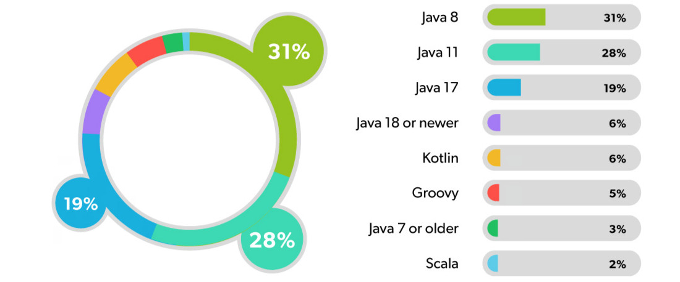
Which JDK is Your Main APPLIcation?
Which JDK Programming Languages Are You Using in Your Main Application?
When looking at responses based on company size, Java 8 usage was slightly higher among companies with under 100 employees, while they continued to show elevated usage of Java versions 11 and newer. Meanwhile, companies with over 100 employees showed nearly equal usage of Java 11 and Java 8.
www.jrebel.com JRebel by Perforce © Perforce Software, Inc. All trademarks and registered trademarks are the property of their respective owners. (0320TKP23)
March 24, 2023 (411) Source: https://www.jrebel.com/resources/java-developer-productivity-report-2023
Notes:
This is a smaller survey with 411 participants

Slide 7
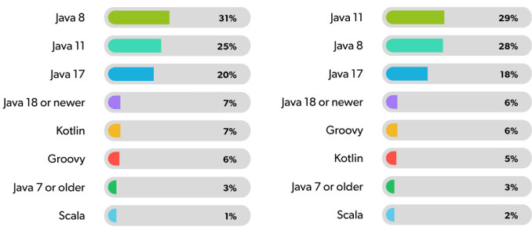
Under 100 Employees
OVER 100 Employees
March 24, 2023 (411) Source: https://www.jrebel.com/resources/java-developer-productivity-report-2023
Notes:
Java version usage changes relative to larger or smaller company.

Slide 8
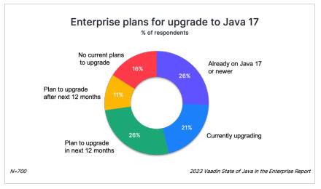
Upgrading to Java 17
Feb 15, 2023 (879) Source: https://vaadin.com/java-report-2023

Slide 9
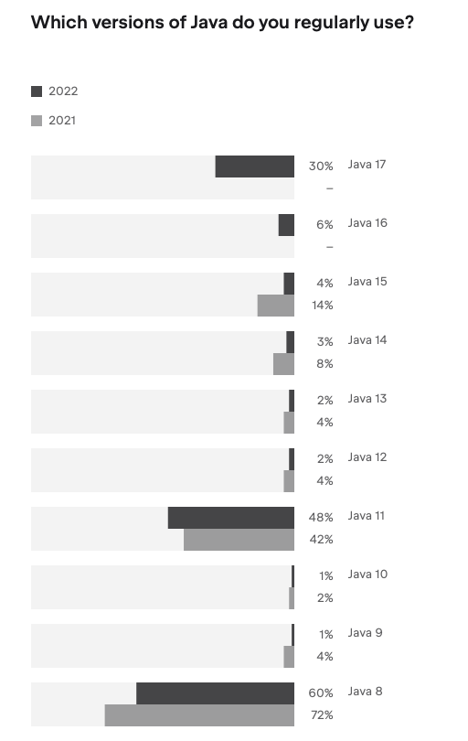
WhiCH VERSION of JAVA?
July 2022 (29k) Source: https://www.jetbrains.com/lp/devecosystem-2022/java/

Slide 10
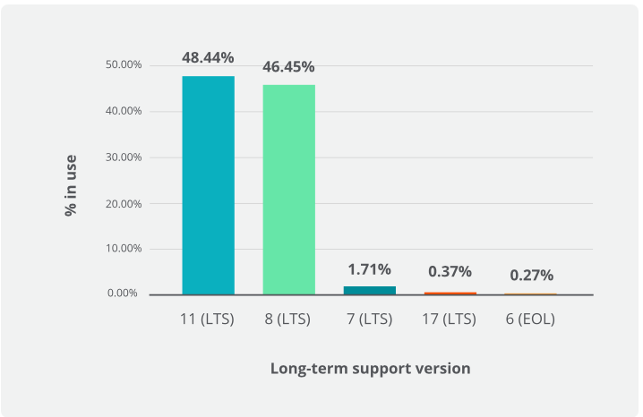
Java 11 is the NEW Standard
Usage data from monitoring production systems
April 2022 Source: https://newrelic.com/resources/report/2022-state-of-java-ecosystem

Slide 11
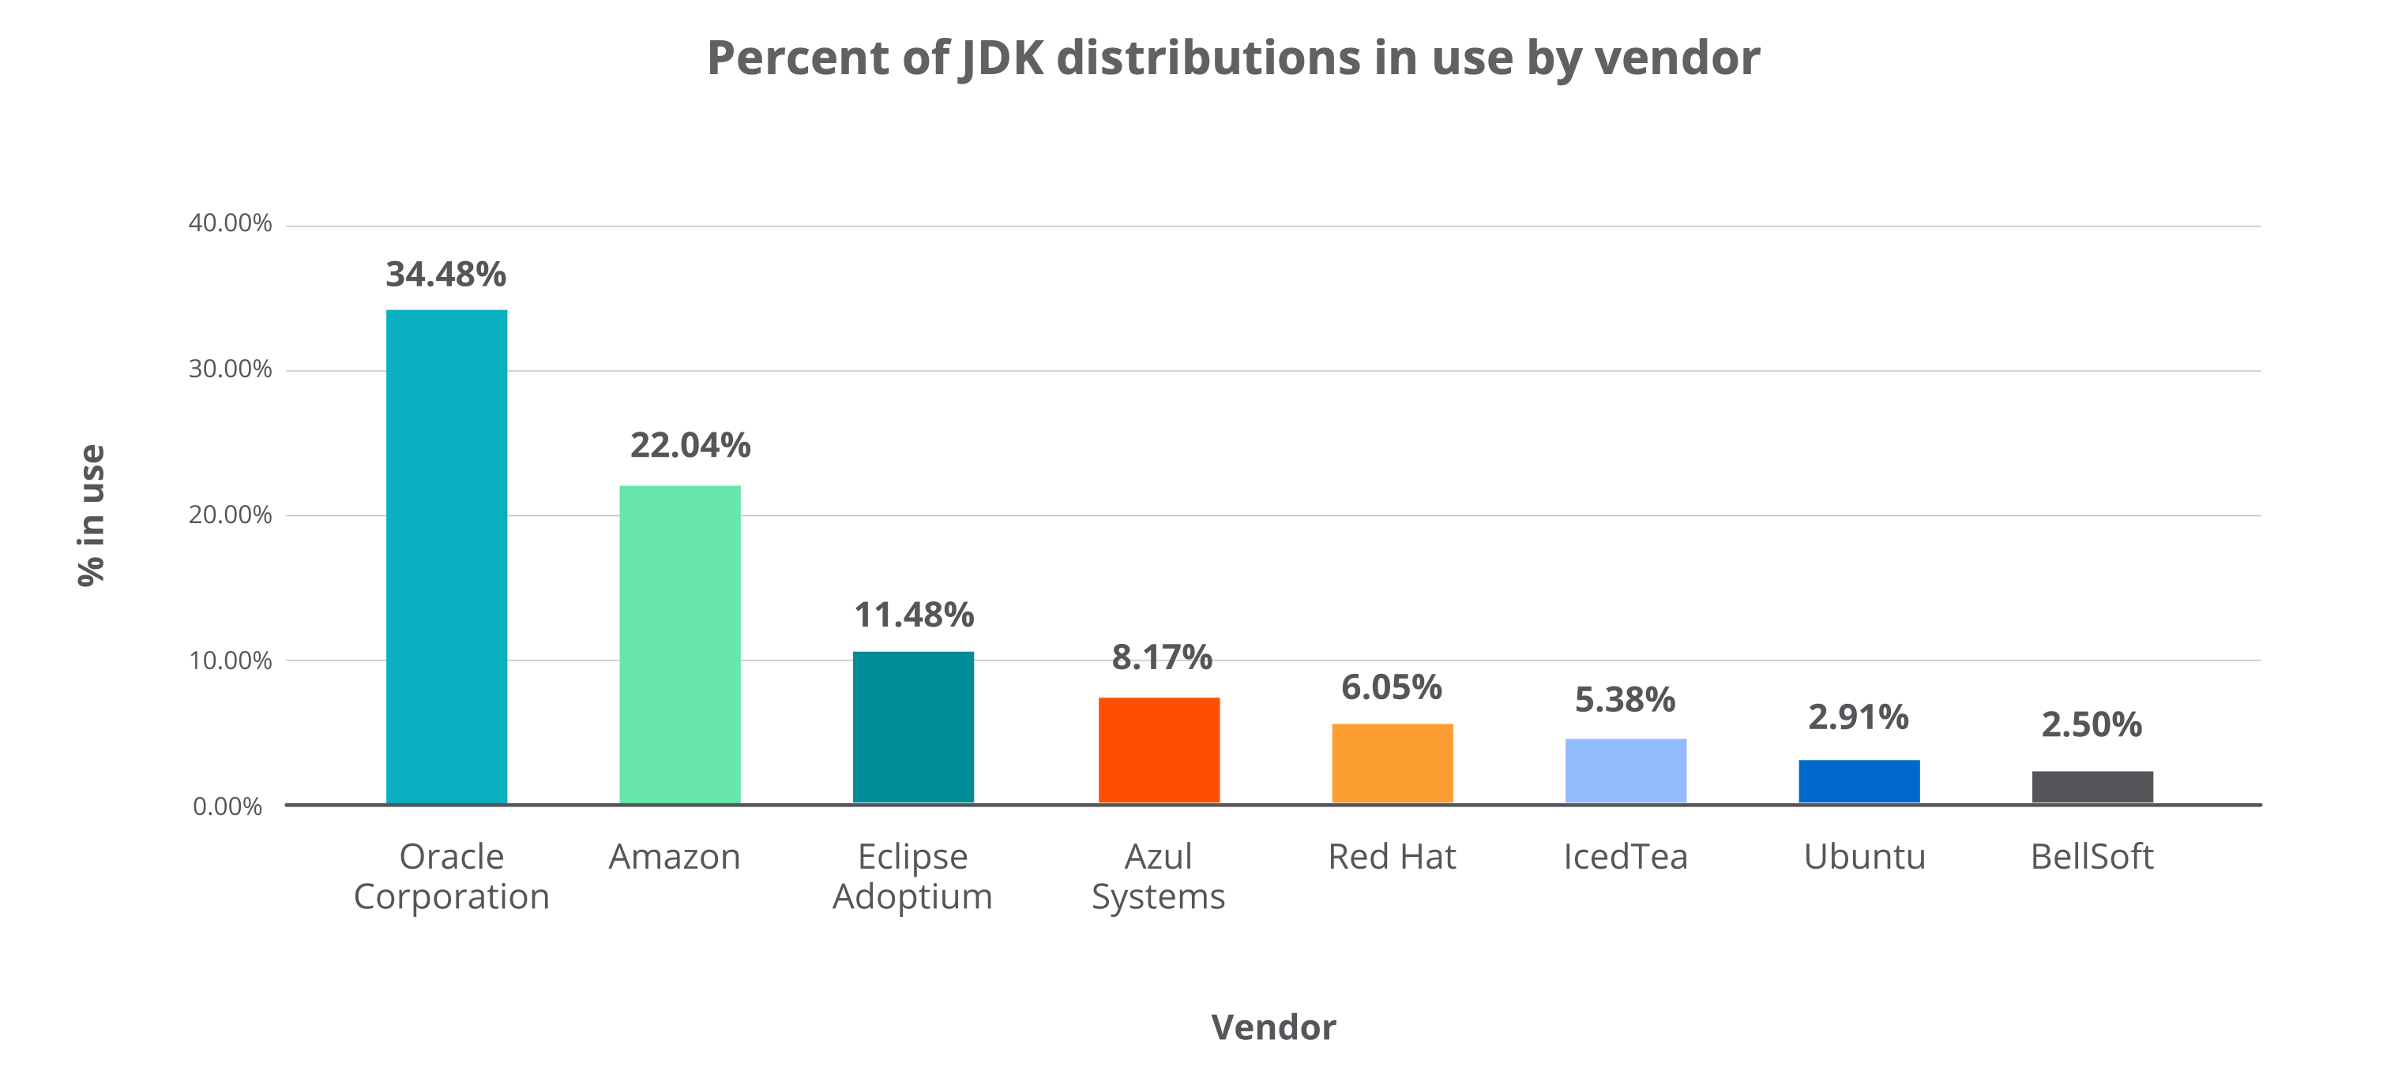
Java DIStributions
Oracle popularity shrinking
April 2022 Source: https://newrelic.com/resources/report/2022-state-of-java-ecosystem

Slide 12
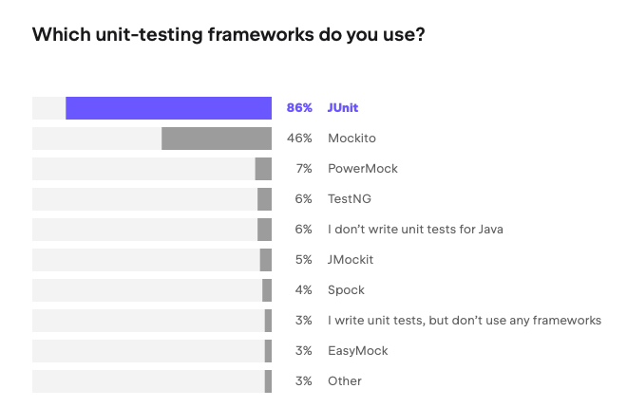
Java TESTING FRAMEWORK USAGE
July 2022 (29k) Source: https://www.jetbrains.com/lp/devecosystem-2022/java/

Slide 13
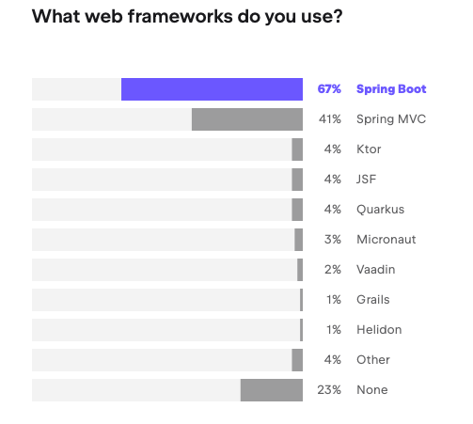
Java WEB FRAMEWORKS USAGE
July 2022 (29k) Source: https://www.jetbrains.com/lp/devecosystem-2022/java/

Slide 14
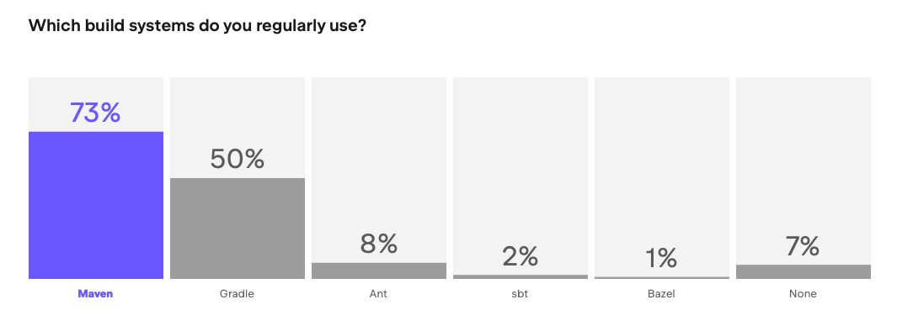
Java BUILD SYSTEMS USAGE
July 2022 (29k) Source: https://www.jetbrains.com/lp/devecosystem-2022/java/

Slide 15
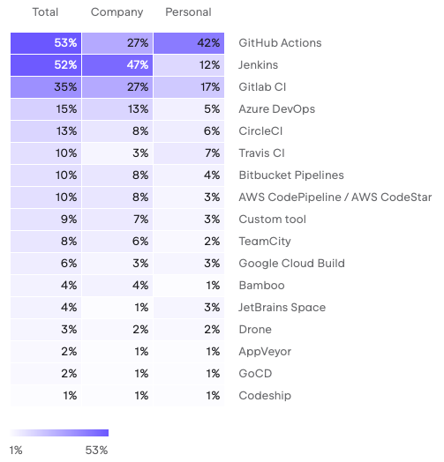
Which Continuous Integration (CI) systems do you regularly use?
GitHub Actions remains the most common choice for personal use, while companies tend to prefer Jenkins.
July 2022 (29k) Source: https://www.jetbrains.com/lp/devecosystem-2022/team-tools/

Slide 16
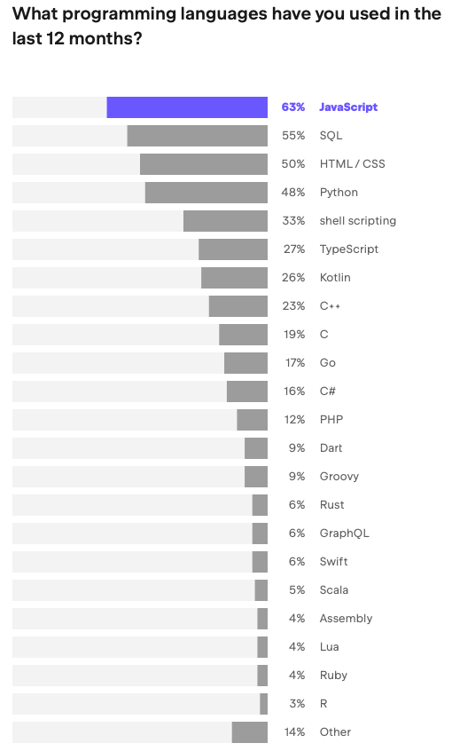
OTHER Languages Commonly USED with Java
July 2022 (29k) Source: https://www.jetbrains.com/lp/devecosystem-2022/java/

Slide 17

SOFTWARE TESTING
IN-PERSON PRESENTATION in TWO WEEKS
THANK YOU MEETING SPONSORS
SEE YOU AT SOFLO DEVCon 2023

Slide 18
Java ECOSYSTEM Review
THANK YOU MEETING SPONSORS
Thank You
Miami JVM Group
https://www.meetup.com/miami-java-user-group/
www.linkedin.com/in/ealvarez

Slide 19
REFERENCES
Mar 24, 2023 (411)
https://www.jrebel.com/resources/java-developer-productivity-report-2023
Feb 23, 2023
https://hired.com/state-of-software-engineers/2023/
Feb 15, 2023 (879)
https://vaadin.com/java-report-2023
Jan 14, 2023
https://www.infoworld.com/article/3685672/javascript-java-and-python-skills-top-demand.html
Jan 10, 2023
https://www.codingame.com/work/codingame-and-coderpad-tech-hiring-survey-2023/
Dec 9, 2022
https://thenewstack.io/java-usage-keeps-climbing-according-to-new-survey/

Slide 20
REFERENCES
Nov 7, 2022
https://www.hackerrank.com/research/developer-skills/2023
Nov 7, 2022 (26k) SlashData Developer Nation State of the Developer Nation
https://slashdata-website-cms.s3.amazonaws.com/sample_reports/dsIe6JlZge_KsHWt.pdf
July 2022 (29k)
https://www.jetbrains.com/lp/devecosystem-2022/java/
June 22, 2022 (71.4k)
https://survey.stackoverflow.co/2022/
May 15, 2022
https://www.continuum.be/en/blog/the-java-ecosystem-2022-survey-results/
April 14, 2022
https://newrelic.com/resources/report/2022-state-of-java-ecosystem

